Slide 1
Introduction to git
Marcus Sherman
January 2018

Slide 2
GSI Office Hours
Monday, Tuesday, Wednesday, and Fridays
3:00-4:00
Palmer Commons Room 2055

Slide 3
Review
Overview
Background
Installation
Tutorial
Best Practices
git vs GitHub
Conclusion
Quick Review

Slide 4
Review
Overview
Background
Installation
Tutorial
Best Practices
git vs GitHub
Conclusion
What is the best way to start a coding project?
Prove it
Sleep on it
Write test code
Pseudocode

Slide 5
Review
Overview
Background
Installation
Tutorial
Best Practices
git vs GitHub
Conclusion
When, if at all, should you optimize your code?
First
Last
If you’re not first, you’re last
During

Slide 6
Review
Overview
Background
Installation
Tutorial
Best Practices
git vs GitHub
Conclusion
What would the command ls –la do in the terminal?
Make linux try to sing
Show last command typed
List all files in long form
Limit types of files shown in directory

Slide 7
Review
Overview
Background
Installation
Tutorial
Best Practices
git vs GitHub
Conclusion
Given the path /users/mdsherm/projects/W18/ and the command cd ~/, what would be my new path?
/users/
/users/mdsherm/projects/
Stay the same
/users/mdsherm/

Slide 8
Review
Overview
Background
Installation
Tutorial
Best Practices
git vs GitHub
Conclusion
Jeff and I are in a different group than everyone else. Jeff made the final exam and wants none of the students to see it yet, but asked me to add a couple questions to it, what should the permissions be set to?
-rwx r-x ---
-r-x r-- ---
-rwx rw- ---
Both A and C

Slide 9
Review
Overview
Background
Installation
Tutorial
Best Practices
git vs GitHub
Conclusion
Overview
What is git?
How to install
Tutorial:
git init
git commit –m
git checkout
git clone
git status
…
Best practices
git vs GitHub
Conclusion

Slide 10

Review
Overview
Background
Installation
Tutorial
Best Practices
git vs GitHub
Conclusion
What is git?
Most popular version control system
Written by the creator of Linux—Linus Torvalds
Distributed Version Control System (DVCS)
The de facto standard in industry
https://www.scm-manager.com/wp-content/uploads/2013/04/git-logo.png
Notes:
3. Meaning your local copy of code is a complete version control repository. Changes are made locally, then committed to the main repository

Slide 11
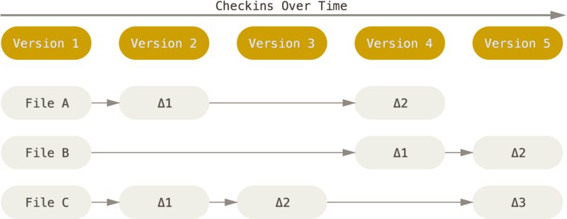
Review
Overview
Background
Installation
Tutorial
Best Practices
git vs GitHub
Conclusion
How is git different?
(Others) Delta-based version control
https://git-scm.com/book/en/v2/Getting-Started-Git-Basics
Notes:
Most other version control systems use a delta-based VC. They save the initial file, then save the series of changes (or diffs) to the file over time.

Slide 12
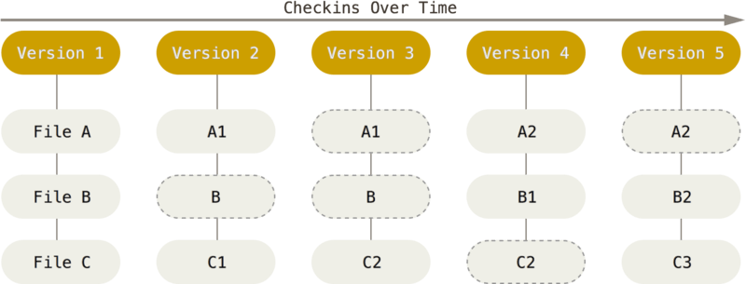
Review
Overview
Background
Installation
Tutorial
Best Practices
git vs GitHub
Conclusion
How is git different?
(git) Stream of snapshots version control
https://git-scm.com/book/en/v2/Getting-Started-Git-Basics
Notes:
Git takes a snapshot of the file or complete directory that is submitted. If a file hasn’t changed, it just uses a reference to the unchanged file instead of storing a new snapshot

Slide 13

Review
Overview
Background
Installation
Tutorial
Best Practices
git vs GitHub
Conclusion
Why does git matter?
Each commit is linked to the previous
Allows for comparison between commits
Creates a graph history of development
Enables ‘undo’ of bugs and failed features
https://www.visualstudio.com/learn/what-is-git/

Slide 14
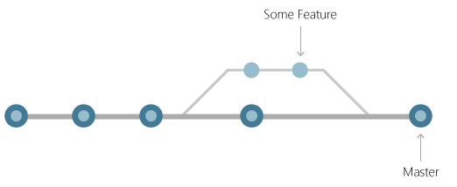
Review
Overview
Background
Installation
Tutorial
Best Practices
git vs GitHub
Conclusion
Branching
Users can work (branch) off of the working code base in parallel without compromising it during development
https://www.visualstudio.com/learn/what-is-git/

Slide 15
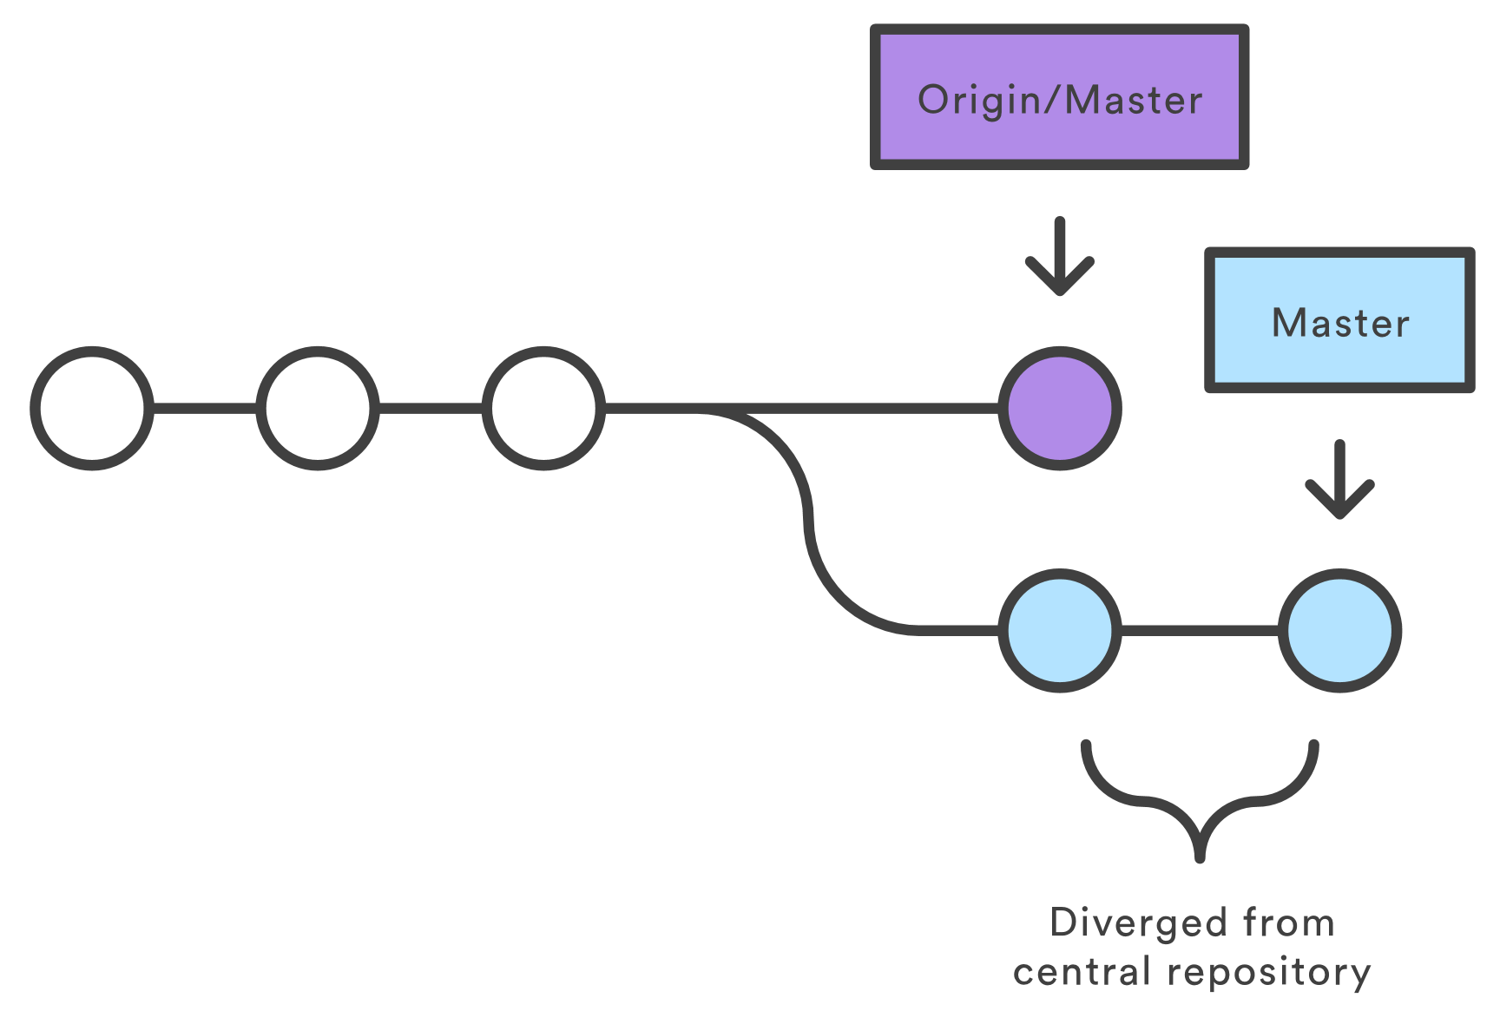
Review
Overview
Background
Installation
Tutorial
Best Practices
git vs GitHub
Conclusion
Conflict management
Detects conflicts to ‘Master’ when submissions don’t match current code base
https://www.atlassian.com/git/tutorials/comparing-workflows

Slide 16
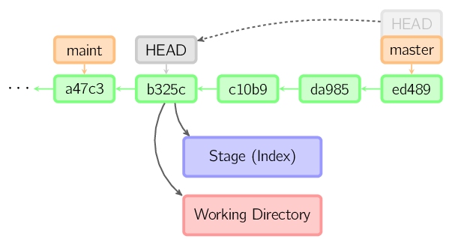
Review
Overview
Background
Installation
Tutorial
Best Practices
git vs GitHub
Conclusion
Hash tracking
Each commit is given a unique SHA-1 checksum
Checksum ensure integrity of files
Allows unique tracking of each commit
Difficult to change the contents of any file or directory without detection
http://marklodato.github.io/visual-git-guide/checkout-detached.svg.png

Slide 17
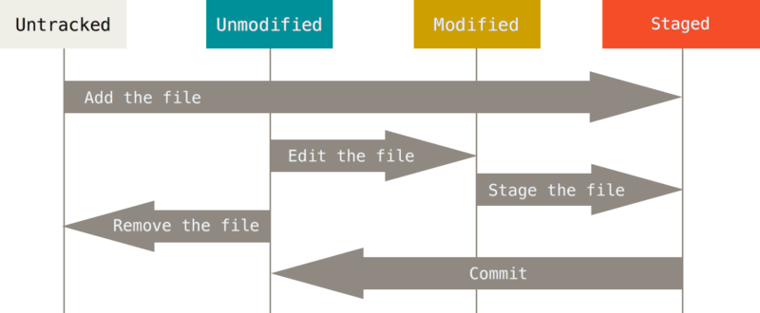
Review
Overview
Background
Installation
Tutorial
Best Practices
git vs GitHub
Conclusion
3 Git states
Untracked is a initial or pseudostate
https://git-scm.com/book/en/v2/book/02-git-basics/images/lifecycle.png

Slide 18
Review
Overview
Background
Installation
Tutorial
Best Practices
git vs GitHub
Conclusion
Installation
Anaconda (recommended):
conda install git
Windows:
https://git-scm.com/download/win
Mac:
https://git-scm.com/download/mac
Linux:
(sudo) apt-get install git
Or
https://git-scm.com/download/linux

Slide 19
Review
Overview
Background
Installation
Tutorial
Best Practices
git vs GitHub
Conclusion
Tutorial
Please, feel free to follow along!
Notebook can be found at https://goo.gl/u1zssZ
Cheat sheet can be found at https://goo.gl/2488Fb

Slide 20
Review
Overview
Background
Installation
Tutorial
Best Practices
git vs GitHub
Conclusion
git init <directory>
Initializes the given or current directory as the path to an empty git repository
Helpful Commands:
git config --global user.name "[name]“
git config --global user.email "[email address]“
git config --global color.ui auto
git config --global core.editor "vim"

Slide 21
Review
Overview
Background
Installation
Tutorial
Best Practices
git vs GitHub
Conclusion
git clone <URL>
Creates a copy of a remote git repository in the current directory
Notes:
https://github.com/jupyter/jupyter.git

Slide 22
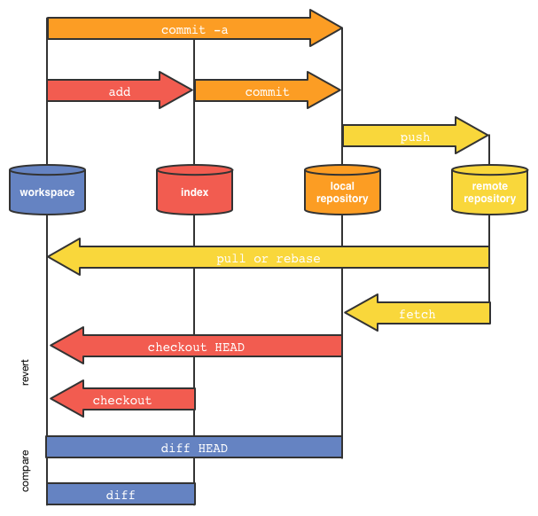
Review
Overview
Background
Installation
Tutorial
Best Practices
git vs GitHub
Conclusion
git workflow
Next is a live demo of the git workflow and commands. This image will be kept up as a reference throughout the demo
http://www.brianadvent.com/wp-content/uploads/2016/04/GitDiagram.png

Slide 23
Review
Overview
Background
Installation
Tutorial
Best Practices
git vs GitHub
Conclusion
git add <file/dir>
Stage a file or directory to be added to a git repository
git status
Lists all new or modified files to be committed
git diff
Shows file differences not yet staged

Slide 24
Review
Overview
Background
Installation
Tutorial
Best Practices
git vs GitHub
Conclusion
git branch <name>
Creates a branch from current commit
git log
Lists version history for the current branch
git reset <commit/tag>
Sets the HEAD to specific point in history

Slide 25
Review
Overview
Background
Installation
Tutorial
Best Practices
git vs GitHub
Conclusion
git commit -m “<message>”
Records file snapshots permanently in version history
git checkout <branch>
Moves HEAD to <branch>
git merge <branch>
Combines the specified branch’s history into the current branch

Slide 26
Review
Overview
Background
Installation
Tutorial
Best Practices
git vs GitHub
Conclusion
Remote Repos
If you haven’t already, sign up for a free GitHub account.
Note: use https://education.github.com/pack to set up a student developer pack that give you 5 free private repos and tons of extra stuff.

Slide 27
Review
Overview
Background
Installation
Tutorial
Best Practices
git vs GitHub
Conclusion
git remote add <name> <URL>
Adds access to remote repo
git pull <name> <branch>
Download remote repo changes to local branch
git push <name> <branch>
Commits current branch contents to remote repo

Slide 28
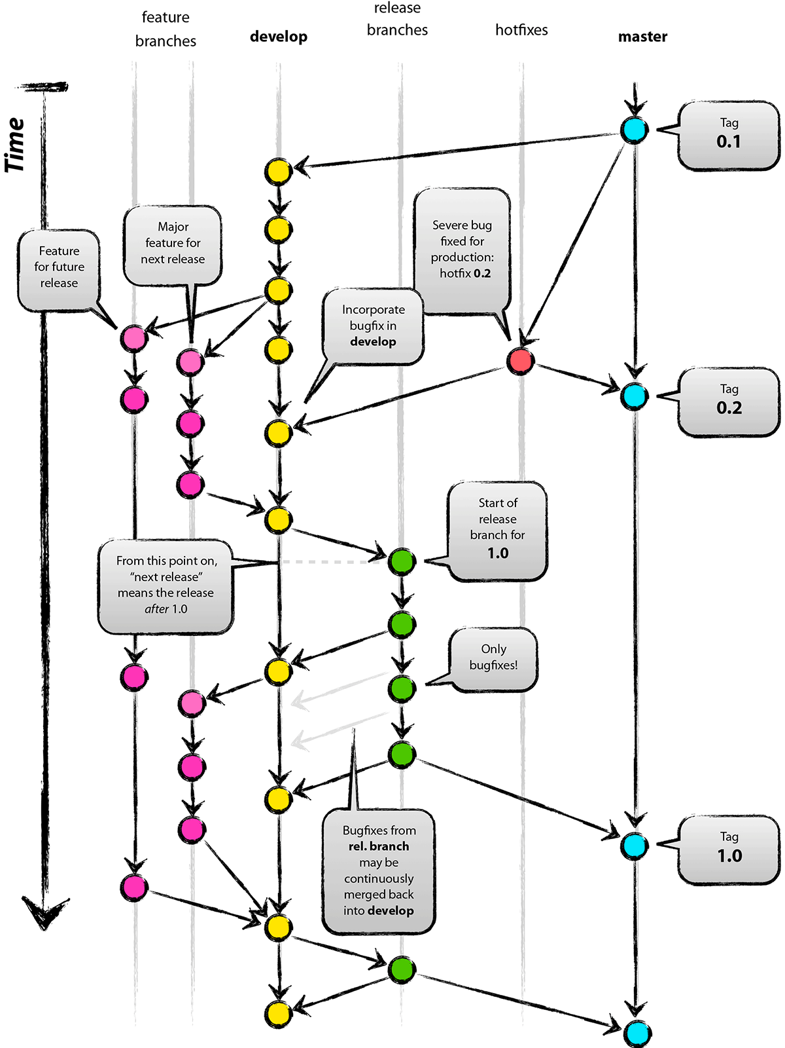
Review
Overview
Background
Installation
Tutorial
Best Practices
git vs GitHub
Conclusion
Git-flow
Best practices for git branching as found in this blog:
Alter the ‘master’ branch as little as possible
‘Hotfixes; are used to quickly fix bugs that are then immediately merged into master
‘Develop’ is where most work is done
As ‘develop’ becomes stable and/or actionable, it is merged into ‘releases’
‘Features’ are separate from develop, as many are higher risk. When complete, they are merged into ‘develop’
Lastly, as ‘releases’ are stable or updated, they are merged into ‘master’

Slide 29


Review
Overview
Background
Installation
Tutorial
Best Practices
git vs GitHub
Conclusion
vs
Online database to store git repos remotely, share code to users and developers, and a community within the industry devoted to open source projects
Series of command line tools used to create, track, and modify a version control of a working project. No internet access required

Slide 30

Review
Overview
Background
Installation
Tutorial
Best Practices
git vs GitHub
Conclusion
Git is the ultimate undo function that allows users to see when something changed, what was changed, and who changed it (called ‘blame casting’). It also enables easy sharing of open source and reproducible code. Lastly, it prevents folders from being cluttered with different versions of the same file—all with uninformative names.

