Slide 1
ENS: Fast and Full-Fidelity Edge Network Simulator
Li, Qinyong
2023/9/13

Slide 2
Background
1) Continuous-time simulation
Queuing theory, network calculus, …
Advantages:
Easy extension
Drawbacks:
Coarse-grain: ignore packet-level events
Low fidelity
2) AI-assisted simulation
RouteNet[SOSR’ 19], MimicNet[SIGCOMM’21], DeepQueueNet[SIGCOMM’22]
Advantages:
Fast
Drawbacks:
GPU-based
Poor extension
Inherent errors

Slide 3

Background
What is a discrete event simulator(DES)?
Timeline
A
B
Dequeue
Enqueue
…
Dequeue
Dequeue
Enqueue
A continuous transmission process
A serial of discrete events in chronological sequence
Widely-used DES simulator
NS3 | Serial Execution Object-Oriented Design Logic-Progress-based Parallelism | Advantages: Simple, easy-extension, fidelity Drawbacks: Poor multi-core and cache efficiency Poor memory efficiency
OMNeT++
Notes:
1)串行执行 2）面向对象设计 3）划分子网，每个逻辑进程模拟一个子网

Slide 4
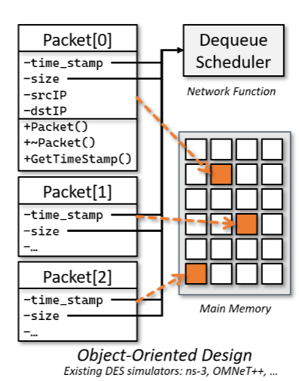
Motivation
1. Poor multi-core and cache efficiency
Event Queue
CPU
C1
C2
C3
…
Submit
L1
L2
DES Simulator Implementation
L3
Load memory blocks in batch
Single Progress
Single Thread
Bind
Scattered Objects
Only pieces of information in object is useful
C1
C2
C3
C4
C5
C6
Significantly increase cache miss ratio
Available but unused Cores
C7
C8
C9
CPU
Notes:
1）DES simulator采用单进程单线程的实现，这意味着他只能调度到一个CPU核上
2）面向对象的设计降低了cache的命中率，两方面原因，一方面同类型的数据分散存储在内存中，另一方面在封装的内存的只有部分信息是有用的

Slide 5
Motivation
2. Poor memory efficiency and ineffective parallelism mechanism
Simulation Configurations
LP1
LP2
LP3
Network topology
Routing tables
Node attributes
Configuration duplicates
Configuration duplicates
Configuration duplicates
Load by All LPs
Sub-Graph 1
Sub-Graph 2
Sub-Graph 3
Timestamp Synchronization
Memory Synchronization
MPI Interface
Redundant duplicates are unfriendly to memory-constrained devices
Cross-progress synchronization causes expensive computing overhead
Notes:
1）每个LP都有整个网络的数据拷贝
2）大量开销用于LP之间的时间同步和数据同步

Slide 6
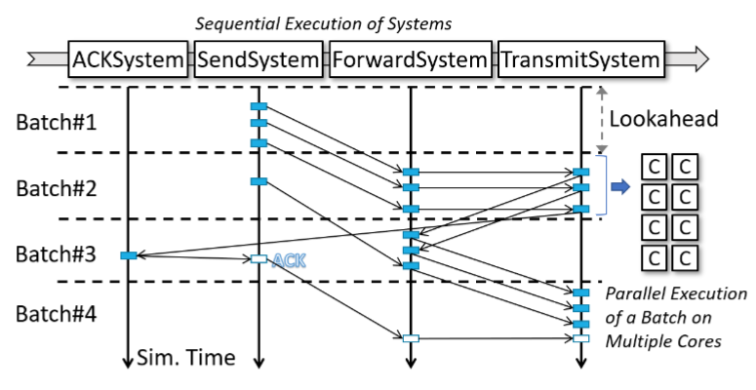
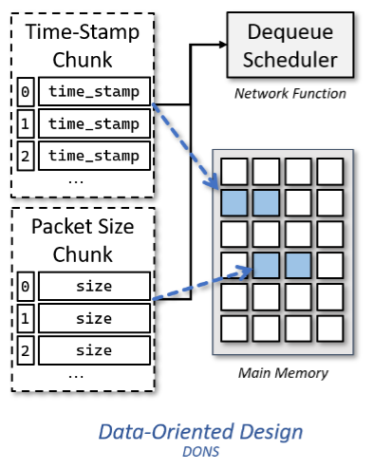
Related work
DONS[SIGCOMM’23]
1) Data-Orient Design
2) Thread-pool-based Simulation Engine
Decompose coupled operations into discrete events
Divide events into independent sets
Create thread pool for each set
Place the data of the same type together
Notes:
1）面向数据流的设计，核心观点是将同类型的数据放在一起
2）基于线程池的并行，根据网络行为将离散事件分为4类，然后将每类事件分割为可并行的独立集，独立集内部可并行执行

Slide 7
Analysis
Advantages
Drawbacks
Efficient memory sharing mechanism
Strikingly improve multi-core efficiency
Downgrade cache miss ratio
Functionality:
Lack supports on channel, mobility and protocol model
Lack real-time simulator implementation
Cannot transfer packets from physical machines
Performance:
Competition between threads may bring about fake sharing
Ignore GPU
Core 1
Core 2
L1
Y
X
L2
Y
X
L3
X
Y
Frequent L1/2 cache refresh
Notes:
1)确实解决了效率问题
2）功能性缺失：信道、移动模型、协议栈、simulator实现、物理机交互
3）性能方面：线程竞争导致伪共享问题，忽略了GPU的存在

Slide 8
Solution
Channel, mobility, and protocol model | Divide independent sets
Real-time simulator implementation | Double timelines
Interact with physical machine | TAP/TUN device
Fake sharing | Re-design data structure, disperse mutable variables and gather stable variables together
GPU | GPU-assisted architecture
GPU vs CPU
Single instruction multiple data
Computation-intensive tasks
Simple-logic tasks
Programable cache
High parallel-dimension
Expensive overhead on I/O
Universal Computing device
Complicated-logic tasks
Low parallel-dimension
Powerful single-core ability
Un-programable cache

Slide 9
Design
Design Principles
Simulator Engine Overview
Batch-based parallelism
Decouple logical control from computing
Disperse mutable variables into different cache lines
Reduce condition branches of kernel functions
Simple kernel functions, try not to invoke third-party cpu-based libraries
Avoid frequent data exchange between GPU and host
GPU execute tasks in offline
Packet Generation
Protocol System
Send System
Transmission System
Receive System
Mobility System
Repetitive Tasks
Simulation plan
Formulate
Systems
GPU Controller
Main Progress
SM
…
SM
SM
Deploy
Thread pool
Schedule
Agent 1
Agent 2
GPU
…
Notes:
1)分离控制逻辑和计算分离，将计算任务卸载到GPU；
2)阶段性卸载任务到GPU，然后GPU离线执行任务；
3）kernel函数减少分支，GPU对于不执行的分支的处理是空转等待
4）性能优化：缓存优化（解决伪共享问题）、数据交换、少用第三方库

