Slide 1
General Purpose Data Acquisition System Using STM32 and FreeRTOS Qinyuan Liu 20137095 Dr. Ian Grout
LM118: BEng in Electronic and Computer Engineering
Autumn semester 2024 Interim Presentation

Slide 2
Presentation Overview
Project introduction and objectives
Hardware System design.
Software System design
Gantt chart
Conclusions and next steps

Slide 3
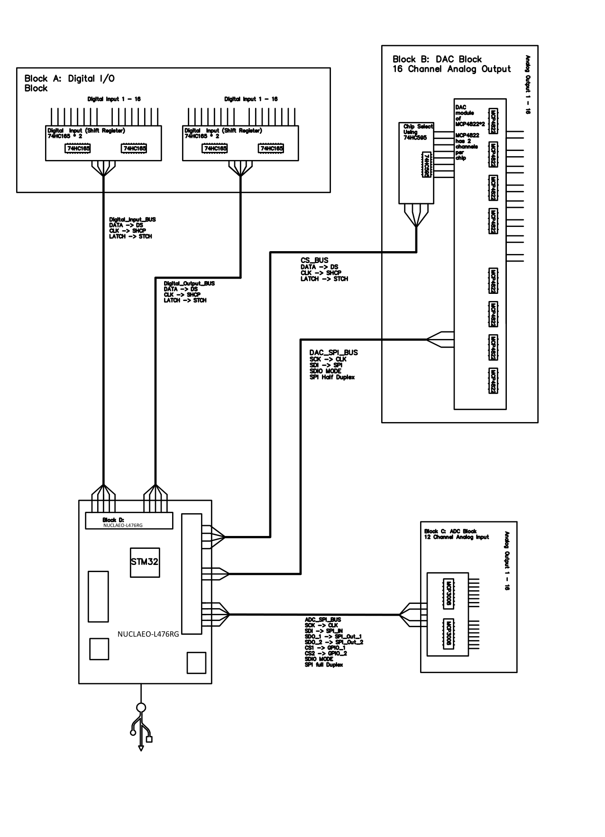
Project Overview – Hardware
The project consists of four custom-designed modules to achieve 16 × 16 analog I/O and 16 × 16 digital I/O.
1. DAC module (MCP3008 * 2)
2. ADC module (MCP4822 * 8 and 74HC595 as CS)
3. Digital Input (74HC165 * 2)
4. Digital Output (74HC595 * 2)
Connected by header, planning on making 3 PCB bord, A shield board, an analog board and a digital board, connected via a Flexible flat cable （FFC）

Slide 4
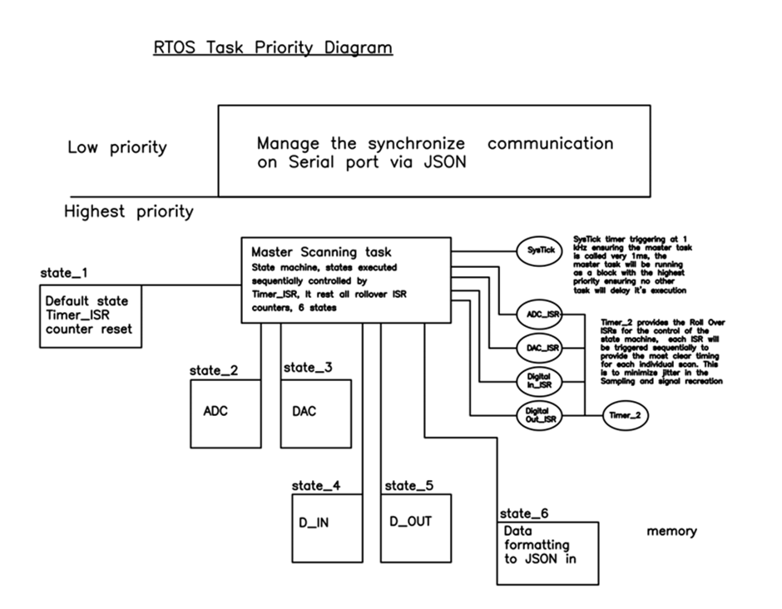
Project Overview Software
In our application, a 2-level priority is defined: the highest priority Master Scanning task, and the low priority data management and Serial communication task.
Purpose of Configuring the Master Scanning Task as an FSM controlled by ISR

Slide 5
Project Gantt chart

Slide 6
Conclusions
Project summary:
Prototype schematics done, the nest step will of implementing the prototype will exciting yet challenging, I am expecting imperfection and improvement in the current schematics, as well as challenges in implementing the relatively complexed RTOS code architecture, after prototype, we will be focused on dishing the custom PCB.
Work completed to-date:
Significant progress has been made in understanding and developing the foundations of the project, a schematic has been made while the breadboard testing prototype is under development.
Next steps:
Hard ware: Finish the porotype on a bread board.
Soft ware: Finish the prototype some ware that will be the foundation in next step.

Slide 7
Thank you. Any questions?

