Slide 1


Thinkings on LLM
QIONG FANG (Joanne)
June 2023

Slide 2
Model Selection
Hardware and Software Constraints
Limited GPU resources
Can only choose LLMs with up to several billion parameters.
Smaller #paras ≠ less powerful
Support of software platform
Ideally, most of the models can be run on the Kubeflow platform.
Choose some eligible pretrained LLMs
Fine-tune the base models using publicly available datasets
Learn LLMs and Test the Kubeflow platform

Slide 3
Model Selection (II)
We expect more ….
An LLM as AI Custom Service Assistant
LLaMA, BLOOM, …
Fine-tune the models using VMware KB data
An LLM as Coding Assistant
StarCoder, CodeGen, …
Finetune the models using private coding data
Used in protected area
Open-source LLMs

Slide 4
Fine-Tune LLMs
Preprocess the data
Azure: How to prepare your data for fine-tuning
Code data preparation
Design evaluation metrics
Resource consumption
Training time
GPU cost
Performance
Question answering
Code Generation
Multilinguistic understanding
Fine-Tune the pretrained base model

Slide 5
Fine-Tune LLMs (II)
What if the fine-tuned model does not achieve desired effects?
The base model may not be good enough
Optimization techniques;
Number of parameters;
Pre-training data size, quality, and diversity;
Context length; …….
Adjust the hyper-paras during fine-tuning
Introduce RLHF (ChatGPT, GPT-4…)
StackLLaMA: A hands-on guide to train LLaMA with RLHF (Hugging Face)
Prompt engineering
Few-shot Learning

Slide 6
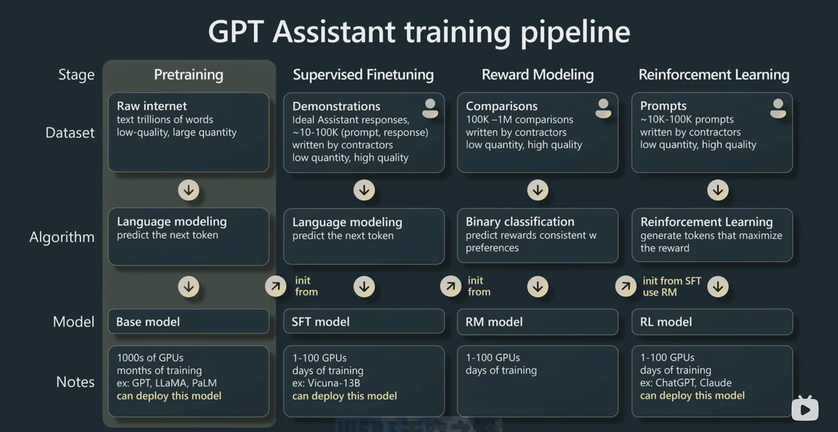
Training Process of GPT-4

Slide 7
Few-Shot Learning
Few-shot learning
Provide a base prompt that describes the task.
Give a few high-quality examples ("shots") that illustrate the desired input-output pattern.
Use the model to generate outputs based on the provided examples and instructions.
The model achieved by providing a few hundred high-quality examples (“few shots”) performs better than a base model using well-designed prompts (“zero shot”).

Slide 8
Few-Shot Learning (II)
A recent study by Google Brain & Stanford
With k = 6 exemplars per class

Slide 9
Prompt Engineering
Improve prompt writing skills
Prompt Engineering Techniques, Microsoft.
ChatGPT Prompt Engineering for Developers, Isa Fulford and Andrew Ng.
Principles
Write clear and specific instructions
Use delimiters to indicate different parts of the inputs
Ask for structural output
Ask models to check assumptions required to do the task
Few-shot prompting
Give the model time to think
Specify the steps to complete a task

Slide 10
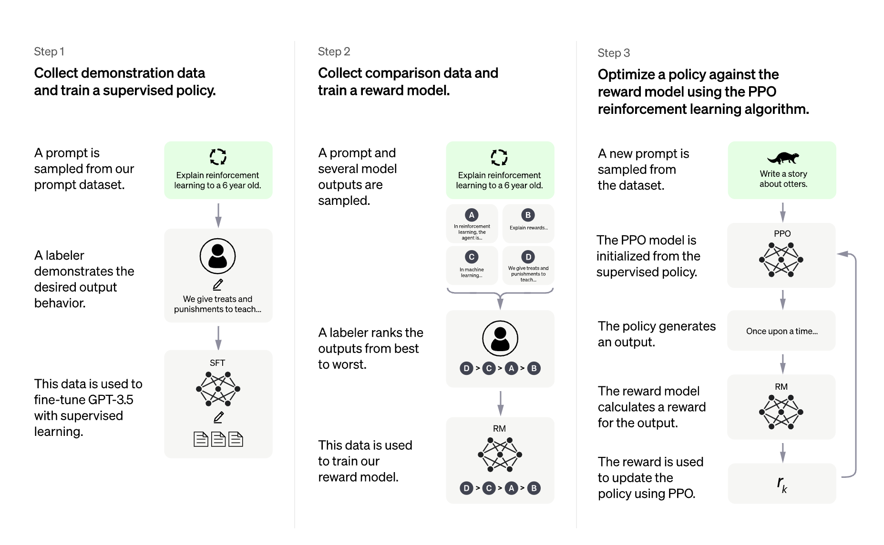
Supervised Fine-Tuning of GPT-3.5
Overview of ChatGPT's training protocol, from the data collection to the RL part. Source: OpenAI's ChatGPT blogpost
PPO RL Algorithm: https://github.com/openai/baselines
Notes:
Proximal Policy Optimization
https://openai.com/research/openai-baselines-ppo

Slide 11
References
Hugo Touvron et al. LLaMA: Open and Efficient Foundation Language Models, arXiv, Feb 2023.
Andrej Karparthy. “State of GPT” in Microsoft Build, May 23, 2023. https://www.bilibili.com/video/BV1ts4y1T7UH/?spm_id_from=444.42.list.card_archive.click
Raymond Li et al. StarCoder: May the Source be With You! arXiv, May 2023.
Jerry Wei et al. Larger Language Models Do In-Context Learning Differently. arXiv, Mar 2023.
Hugo Tuvron et al. LLaMA: Open and Efficient Foundation Language Models. arXiv, Feb 2023.
Teven Le Scao et al. BLOOM: A 176B-Parameter Open-Access Multilingual Language Model. arXiv, March 2023.

