Slide 1
Garbage Collection

Slide 2
Will This Program Crash?
let a = [];
let sum = 0;
for (let i = 0; i < 1000000; ++i) {
a = Array.create(1000, 1);
sum += a[0];
}
console.log(sum);
Why would you even expect this program to crash?
How many objects are created?
How much memory is consumed?
Does this tell us something about what's happening under the hood?

Slide 3
Mental model of JS: Main principles
The values of JavaScript are numbers, booleans, strings, references to objects, references to arrays, and closures
Every variable stores a value
An assignment x = y creates a copy of the value in y and stores it in x
Every field in an object stores a value
A closure in an object with two fields: (1) the code of a function and (2) a dictionary that contains the values of variables that were in scope when the function was defined.
Notes:
Note: the dictionary is known as the “environment”

Slide 4
What does "★ = ▲" mean?
Take the value of ▲. What is the "value" of ▲?
Make a copy of the value.
Store the copy as the value of ★. What is the "value" of ★? These mean completely different things: x = y obj.x = y
Notes:
Just because ★ includes an object in the expression (e.g. "o.x") does not mean the reference to the object is modified.

Slide 5
Which box is modified?
Before line 3 (b = 0):
let a = { x: 1 };
let b = a;
b = 0;
Values
a = ☐
b = ☐
Memory
{ x: ☐ }
Notes:
I suggest drawing this on the board
Which one is it? a or b
Write a test that will pass if (a) is true
Write a test that will pass if (b) is true

Slide 6
Which box is modified?
Before line 3 (b.x = 0):
let a = { x: 1 };
let b = a;
b.x = 0;
Values
a = ☐
b = ☐
Memory
{ x: ☐ }
Notes:
I suggest drawing this on the board
Which one is it? a or b
Write a test that will pass if (a) is true
Write a test that will pass if (b) is true

Slide 7
What is the value map and memory layout?
let a = { x: 0, y: 1 };
let b = { z: 2 };
a.y = b;
b = 1;
After line 2?
After line 4?

Slide 8
What is the value map and memory layout?
let a = { x: 0, y: { z: 1 } };
let b = 3;
b = a.y;
a = 0;
After line 2?
After line 4?
How can you set the value of the "x" field after line 4?

Slide 9
Some observations
Both value map, and memory layout change as the program runs
Not all contents of memory are directly accessible from the value map
As the program runs, some values in memory can never be accessed again
Note: The "value map" is the stack!
The memory layout is "the heap"

Slide 10
What are all the reachable locations in memory?
Start with the values on the stack.
Mark all values as "reachable".
If there are any references, follow each reference one at a time.
Recurse from step 2.

Slide 11
Mark the reachable blocks
let a = { x: 0, y: 1 };
let b = { z: 2 };
a.y = b;
b = 1;
After line 2?
After line 4?

Slide 12
Mark the reachable blocks
let a = { x: 0, y: { z: 1 } };
let b = 3;
b = a.y;
a = 0;
After line 2?
After line 4?

Slide 13
Mark the reachable blocks
let a = { x: 0, y: { z: 1 } };
let b = { x: 2, y: { z: 3 } };
b.y = a.y;
a.y.z = a;
a = 0;
After line 2?
After line 3?
After line 4?
Is the a.x from line 1 still reachable?

Slide 14
The "Mark and Sweep" Algorithm
Mark Phase. Starting from the variables on the stack, mark the objects in memory that are reachable by following references in the object graph.
Sweep Phase. Delete the objects that were not marked.
Unmark the remaining objects.

Slide 15
The "Mark and Sweep" Algorithm
Mark Phase. Starting from the variables on the stack, mark the objects in memory that are reachable by following references in the object graph.
Sweep Phase. Delete the objects that were not marked.
Unmark the remaining objects.
What is the run-time cost, in terms of the number of objects that are reachable (n), and the size of the heap (m)?
Mark: O(n)
Sweep: O(m)
Unmark: O(n)

Slide 16
What is the max. instantaneous memory usage?
let a = { x: 0 };
let sum = 0;
for (let i = 0; i < 1000000; ++i) {
a = Array.create(1000, 1);
sum += a[0];
}
console.log(sum);
Answer in terms of number of objects
If the GC runs after every statement
If the GC runs after four statements

Slide 17
The Fragmentation problem
What is the memory layout:
Before the red lines?
How many elements exist in memory?
After the red lines, but before GC?
After the red lines, after GC?
let x = [5];
let l1 = [x];
let y = [6];
let l2 = [y, l1];
let z = [7];
let l3 = [z, l2];
let w = [8];
let l4 = [w, l2];
l1 = []
l2 = []
l3 = []
l4 = []

Slide 18
Low-Level Details
When should the GC run?
Need list of pointers to free parts of heap
When allocating new objects, search through list of free pointers to find space large enough

Slide 19
Why is memory fragmentation a problem?
The interpreter starts with a small heap size
When a new object is created, it tries to re-use the heap
It must find a place in the heap where the new object will fit.
With fragmented memory, it becomes hard to find places to put new objects, especially for "medium-sized" objects (small objects can fit anywhere, large objects will require growing the heap)
If no free block is found, it may prefer to compact the heap, or grow memory, with different resulting costs: time, vs. memory (remember this, it will haunt us later!)

Slide 20
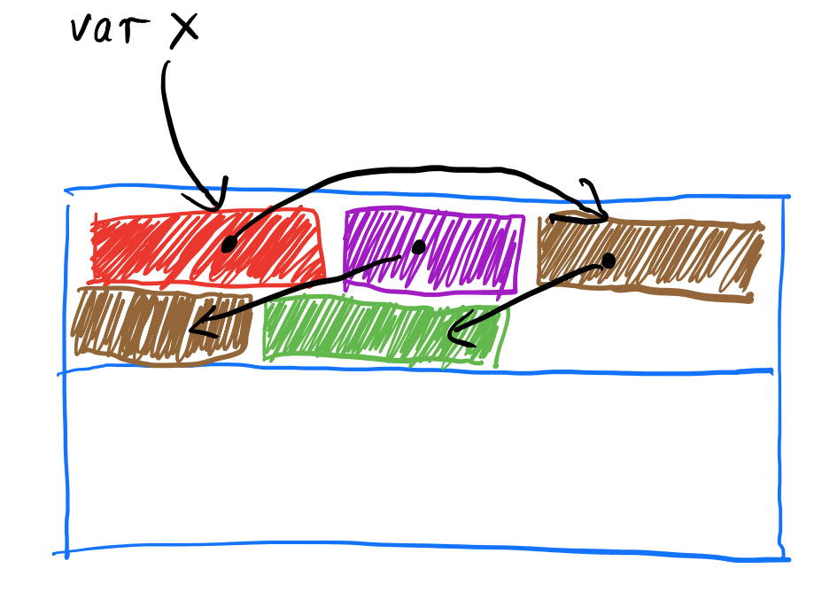
The "Stop and Copy" Algorithm

Slide 21
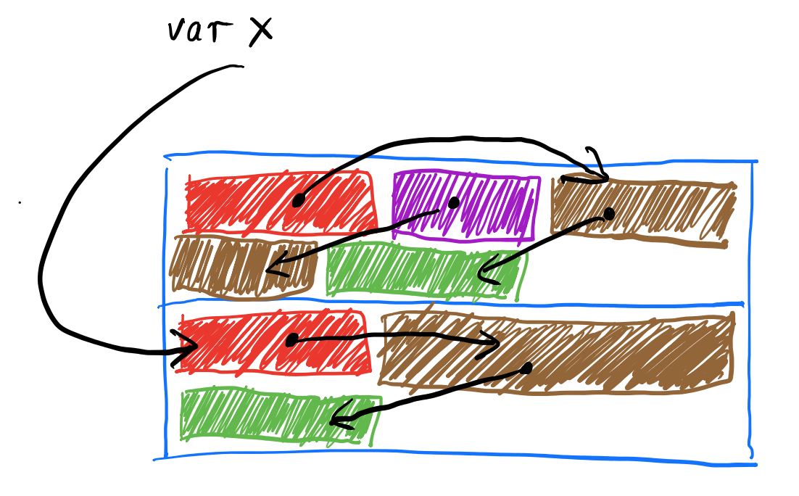
The "Stop and Copy" Algorithm

Slide 22
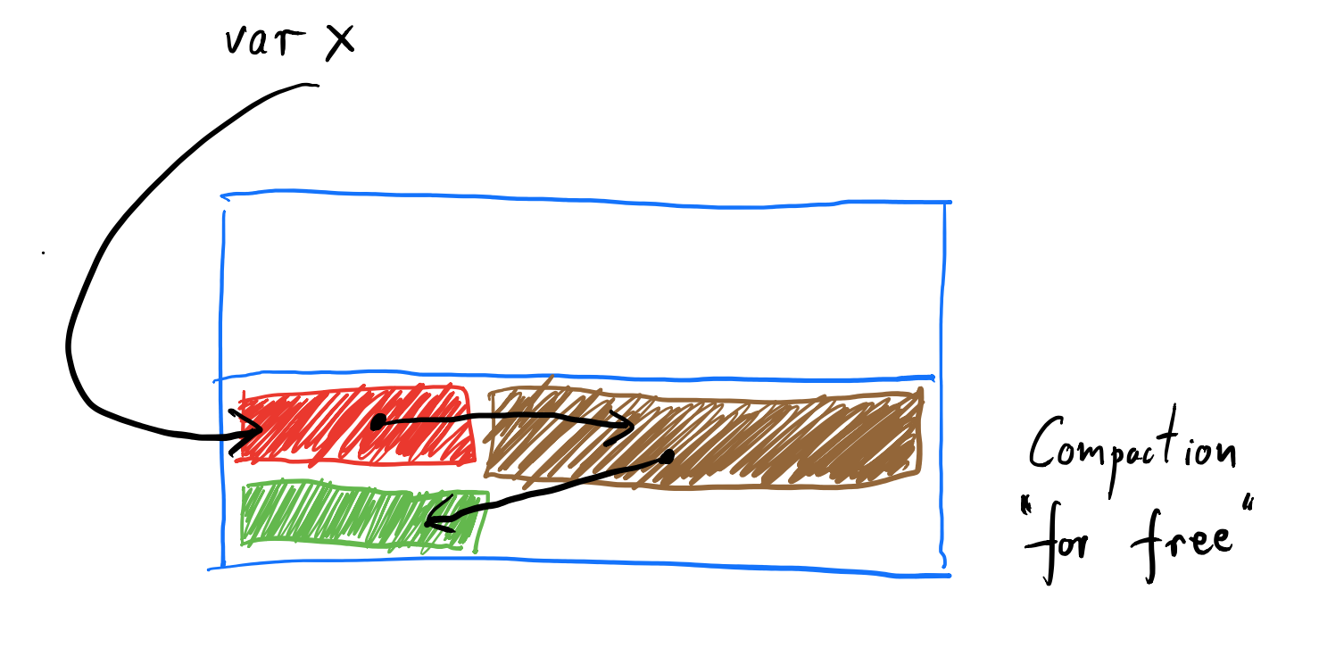
The "Stop and Copy" Algorithm

Slide 23
The "Stop and Copy" Algorithm
Divide the heap into two halves
Allocate objects in one half
When one half is full, copy reachable objects to the other half (Update references to new copies)
Allocate objects in new half
Keep alternating between two halves
No need to keep pointers to free blocks
Half the heap is lost
Copying large objects takes time

Slide 24
Mark and Sweep vs. Stop and Copy
Mark and sweep: Incurs cost for reachable objects, and free memory on heap No need for additional memory Fragmentation a problem
Stop and Copy: Incurs cost for reachable objects Need twice the memory size as allocated objects No fragmentation

Slide 25
What affects fragmentation?
[Example program: large number of small objects allocated together, low turnover]
[Example program: large number of small objects allocated together, high turnover]
[Example program: small number of large objects, high turnover]

Slide 26
Mark and Sweep vs. Stop and Copy
Mark and sweep: Incurs cost for reachable objects, and free memory on heap No need for additional memory Fragmentation a problem Good for large objects, or long-lived objects (low memory overhead, little to no fragmentation)
Stop and Copy: Incurs cost for reachable objects Need twice the memory size as allocated objects No fragmentation Good for small, short-lived objects (high memory overhead, fragmentation resolved)

Slide 27
The "Generational Hypothesis":
New objects die young
Old objects tend to live for a long time

Slide 28
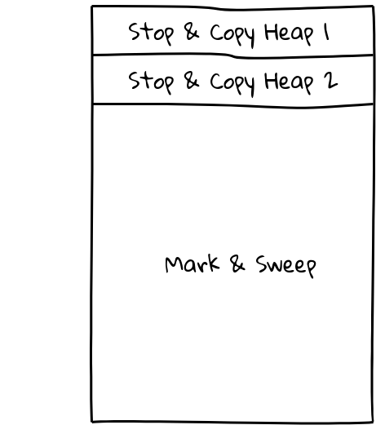
The Generational Garbage Collector
Allocate new small objects in the nursery
If object survives n rounds of stop and copy, promote to old generation
Allocate large objects directly in the old generation
Notes:
http://shaky.github.bushong.net/
+----------------------+
| |
| Stop & Copy Heap 1 |
| |
+----------------------+
| |
| Stop & Copy Heap 2 |
| |
+----------------------+
| |
| |
| |
| |
| |
| |
| |
| |
| |
| |
| |
| |
| Mark & Sweep |
| |
| |
| |
| |
| |
| |
| |
| |
| |
| |
| |
| |
+----------------------+

Slide 29
Why does Garbage Collection work?
No pointer arithmetic Hence, no way to "recover" lost references Hence, once its reference is lost, an object can be deleted by the GC

Slide 30
Recovering References
C++
JavaScript
int* x = new int[2];
x[0] = 0;
x[1] = 1;
printf("x: %d\n", *x);
int* y = &(x[1]);
printf("y: %d\n", *y);
x = y;
printf("x: %d\n", *x);
x = y - 1; // Pointer arithmetic
printf("Recovered x:%d\n", *x);
let x = [[0], [1]];
console.log('x: ' + (x[0]).toString());
let y = x[1];
console.log('y: ' + (y[0]).toString());
x = y;
console.log('x: ' + (x[0]).toString());
// Can't do this!!

Slide 31
Why does Garbage Collection work?
No pointer arithmetic Hence, no way to "recover" lost references Hence, once its reference is lost, an object can be deleted by the GC
No way to directly access memory Hence, the interpreter has full knowledge of what's allocated, of what size, where, and referenced by whom

Slide 32
In a distant, dangerous language, far far away...
struct Point {
double x;
double y;
};
void DangerousMemory() {
void* x = malloc(16); // "Allocate 16 bytes of memory"
Point& p = *reinterpret_cast<Point*>(x);
p.x = 42;
p.y = -42;
printf("%f, %f\n", p.x, p.y);
free(x);
}
// "Treat it as a Point now!"
// Are these bytes? Points? Doubles? Which part of these can be de-allocated? Can't tell.

