Slide 1


jPAD — A Java Toolchain of Computer Programs for Aircraft Design. Software Engineering Best Practices Applied to Aerospace Sciences
SCAD2015 — 5th Symposium on Collaboration in Aircraft Design
12-14 October, Naples, Italy
A. De Marco
Università degli Studi di Napoli Federico II, Dept. Industrial Engineering, Aerospace Div.

Slide 2
jPAD ― Java Programs for Aircraft Design
A software toolchain for aircraft preliminary design and MDO.
A modern, user friendly, modular framework.
Support for simultaneous management/analysis of several aircraft and/or ‘varied’ configurations of the same aircraft.
Conceived for collaborative design activities.
Interoperability with other tools/disciplines (CAD/CFD/FEM analysis).
Started in early 2014. Approx. 120k lines-of-code.
Planning to go open source.

Slide 3
What you can do with jPAD
Define parametric representations of wings, fuselages and nacelles with XML configuration/input files (similar to OpenVSP).
Generate CAD geometries of aircraft assembly and sub-components (Open CASCADE, JNI Technology). Measure lengths, areas, volumes. Export in CAD formats (Brep, STEP, IGES, STL, Collada).
Vary geometric parameters and regenerate internal representation of geometries programmatically.
Import CPACS aircraft configurations files (Tigl Native Interface) and extract relevant properties. (Work in progress)
Perform various types of analysis (L0, L0.5, L1): Aerodynamics, Stability & Control, Performance, Weight, Costs. (Structural TBD)
Exports analysis results in XML (native/CPACS) and Excel formats.

Slide 4
Competency spectrum
Computer Science,
Software Engineering
Aircraft Design Disciplines
We are aerospace engineers ... Should we extend our capabilities?

Slide 5
Software engineering principles
Software design patterns: formalized best practices that the programmer can use to solve common problems when designing an application or system.
Design patterns speed up the development process by providing tested, proven development paradigms.
Examples of patterns:
Builder, Factory, Dependency Injection,
Strategy, Separation-of-Concerns,
Observer (Publish/Subscribe)
Micro patterns (design decisions in code): DRY (Don’t Repeat Yourself), Sampler (Controlled Creation),

Slide 6
Example of Java code
Aircraft aircraft = new Aircraft("Baseline_AC_AGILE.xml");
OperatingPoint op = OperatingPointFactory.getPoint("OP_001.xml");
ACAnalysisManager analysis = new ACAnalysisManager(op, aircraft,
AnalysisTypeEnum.AERODYNAMIC, AnalysisTypeEnum.BALANCE,
AnalysisTypeEnum.WEIGHTS,
AnalysisTypeEnum.PERFORMANCE,
AnalysisTypeEnum.COSTS);
analysis.calculateGeometryAuxiliaryData();
analysis.runAnalysis(AnalysisTypeEnum.AERODYNAMIC, AnalysisTypeEnum.PERFORMANCE);
DataWriter dataWriter = new DataWriter(analysis);
dataWriter.exportToXML("Analysis_Baseline_AGILE_op_001.xml");
dataWriter.exportToXLS("Analysis_Baseline_AGILE_op_001.xlsx");
CADBuilder cadBuilder = new CADBuilder(aircraft);
cadBuilder.build().exportToSTEP("Baseline_AGILE_op_001.stp");
CPACSBuilder cpacsBuilder = new CPACSBuilder(aircraft); // TBD
cpacsBuilder.build().export("Baseline_AGILE_op_001.xml");
WriteUtils.serializeObject(aircraft, aircraft.getName());

Slide 7
Java. Why?
“Compile once. Run it everywhere.” (well, almost)
Widely supported, continuously updated and improved.
Many open source libraries available, especially for I/O tasks and for complex mathematical operations.
Widely supported GUI frameworks (SWT/JFace and JavaFX) and a GUI visual builders.
Object-Oriented paradigm is naturally applied in the abstraction of typical Aircraft Design problems.
Promotes modularity: easier to work with in an ever changing team.

Slide 8
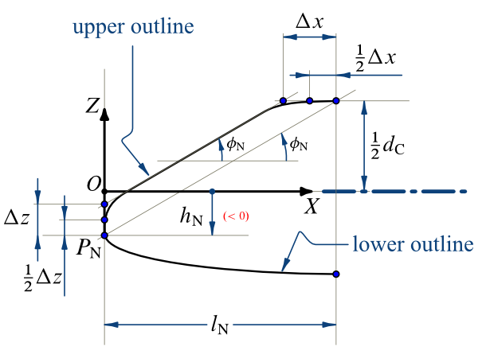
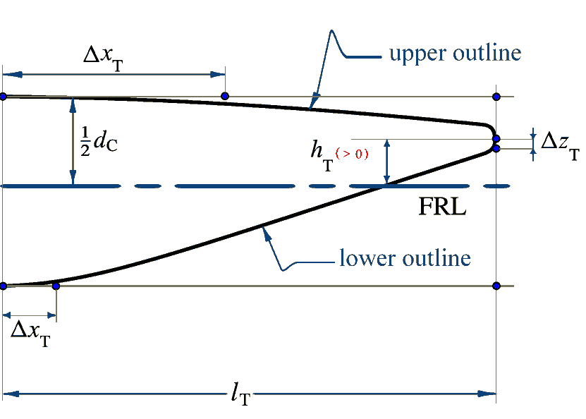
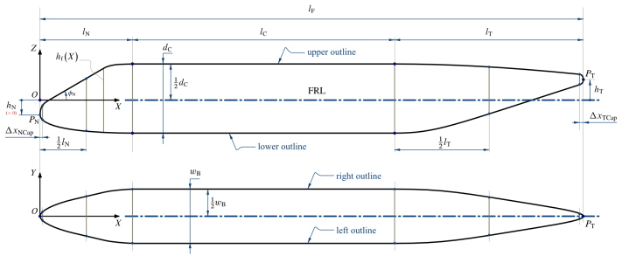
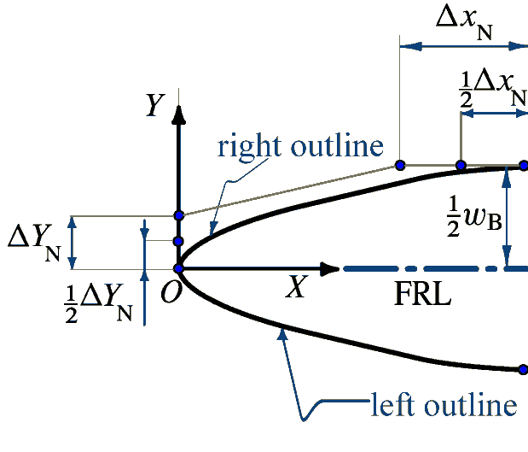
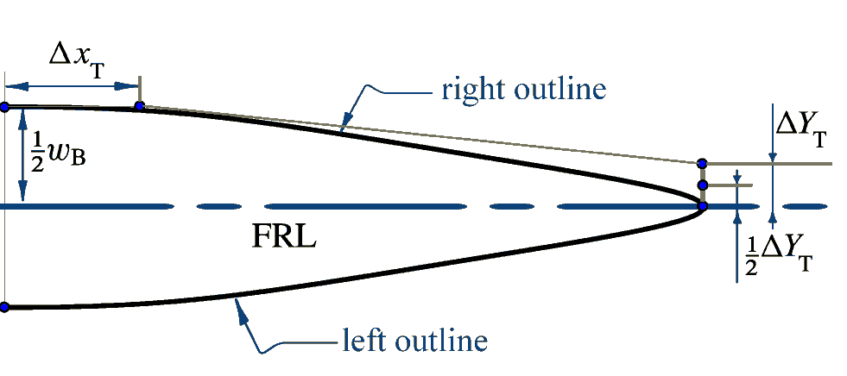
Parametric Fuselage in jPAD

Slide 9
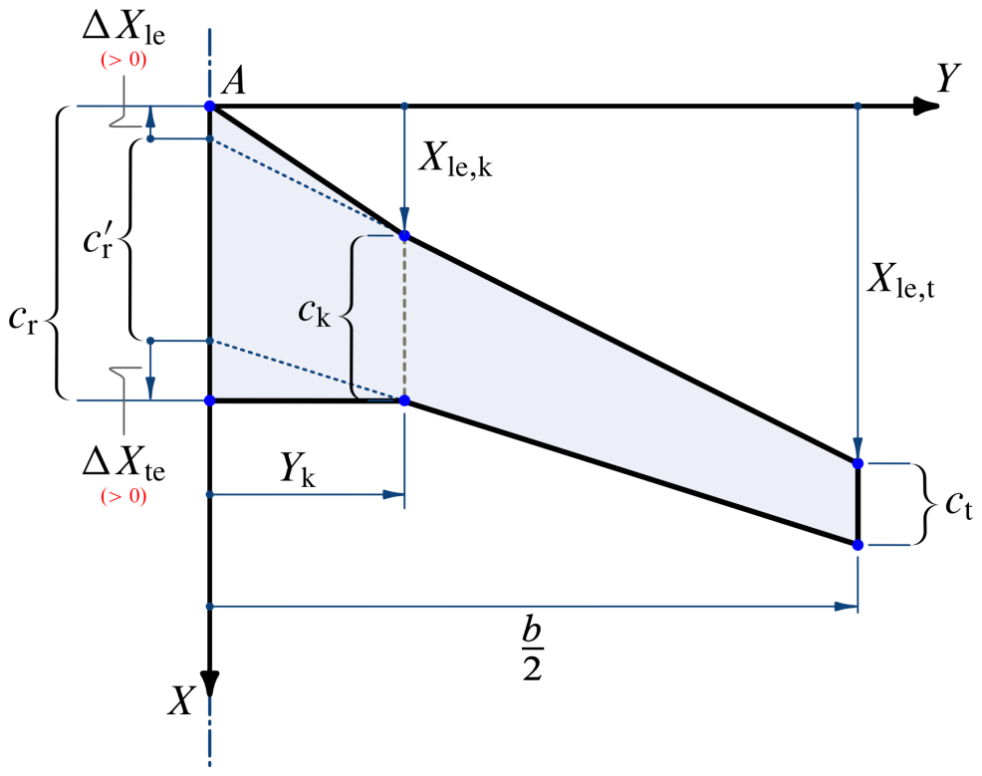
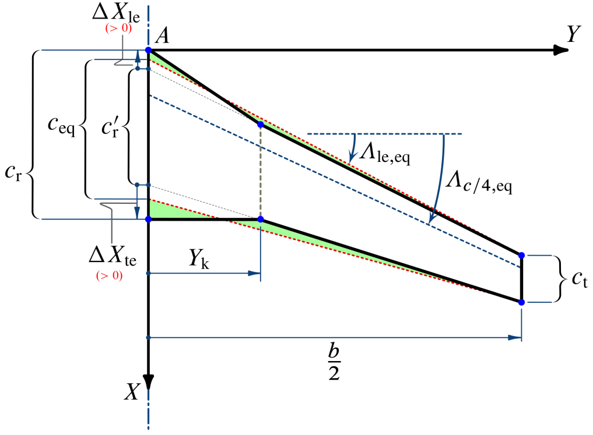
Parametric wing in jPAD

Slide 10
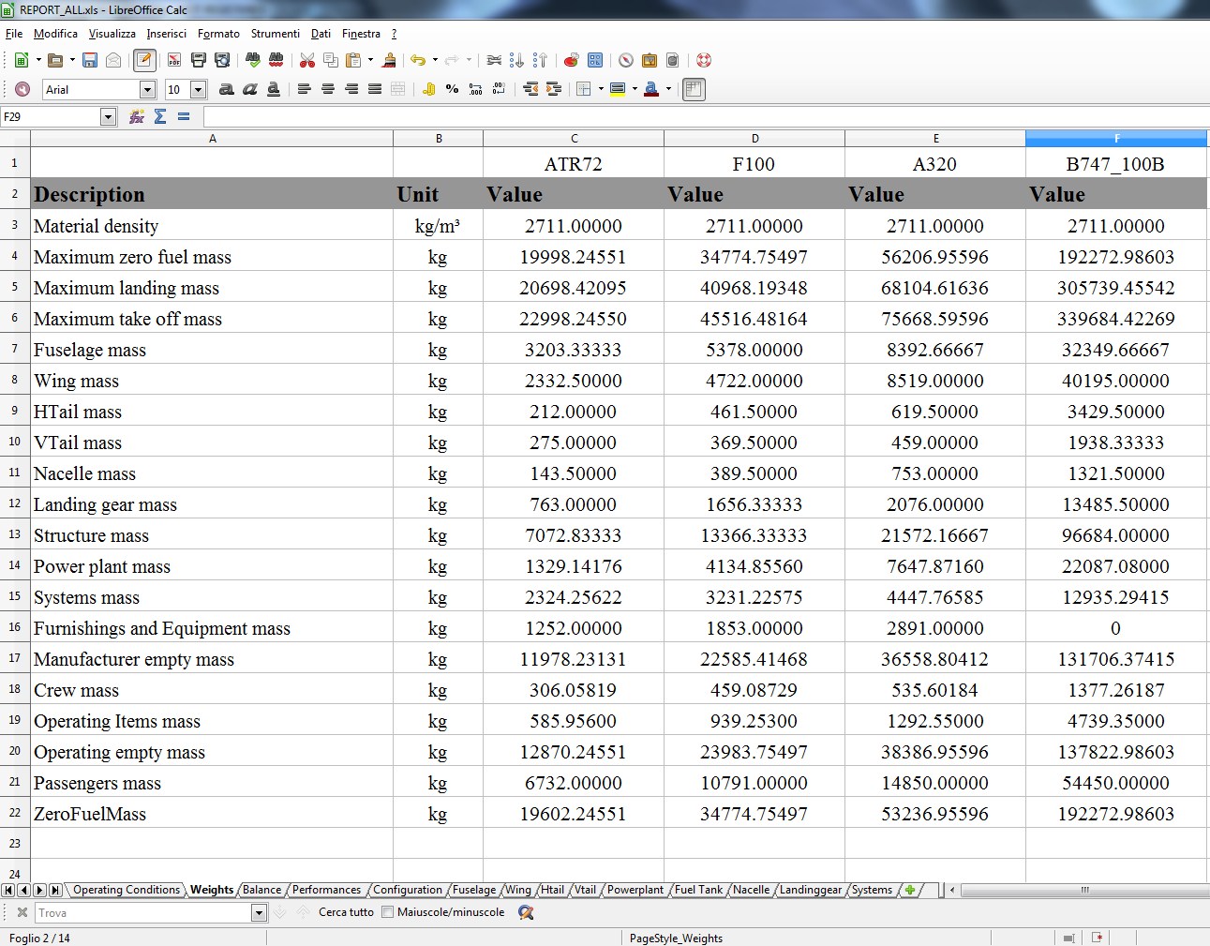
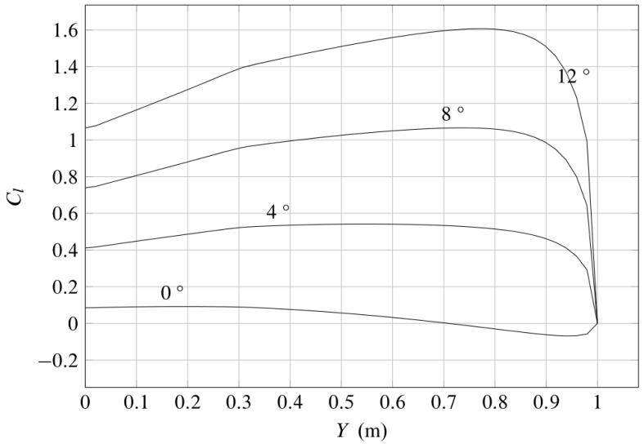
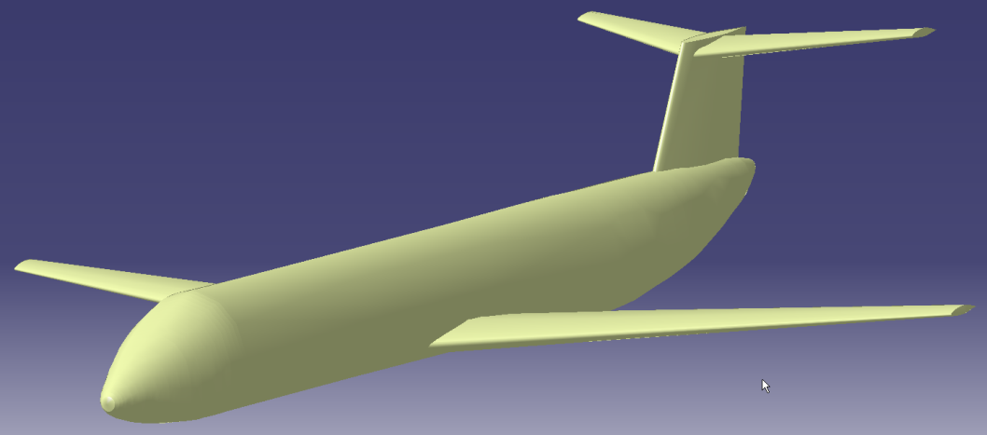
Output files
XML
Microsoft Excel
Charts
CAD model ready to be meshed

Slide 11
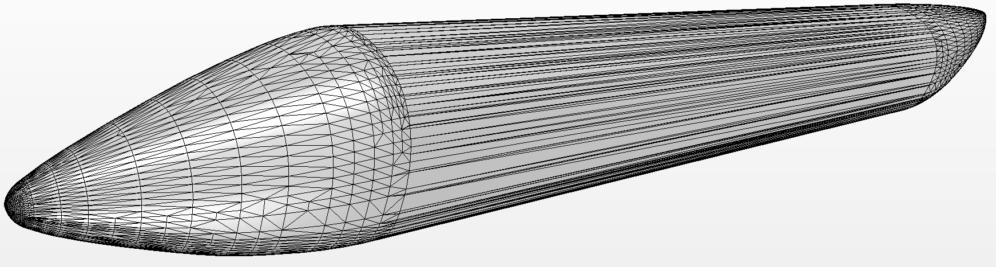
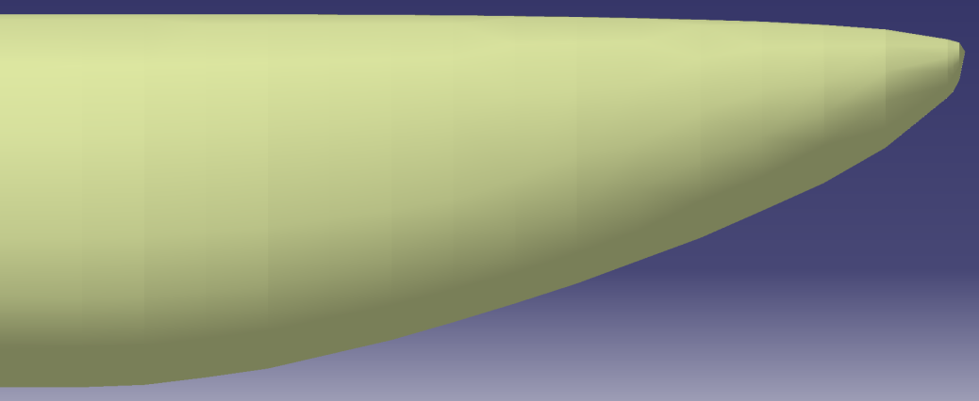
Example of jPAD output
External fuselage shape exported as STEP file

Slide 12
Example of jPAD output
Multiple aircraft analysis result comparisons

Slide 13
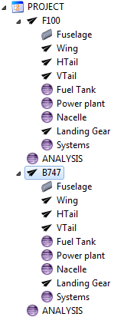
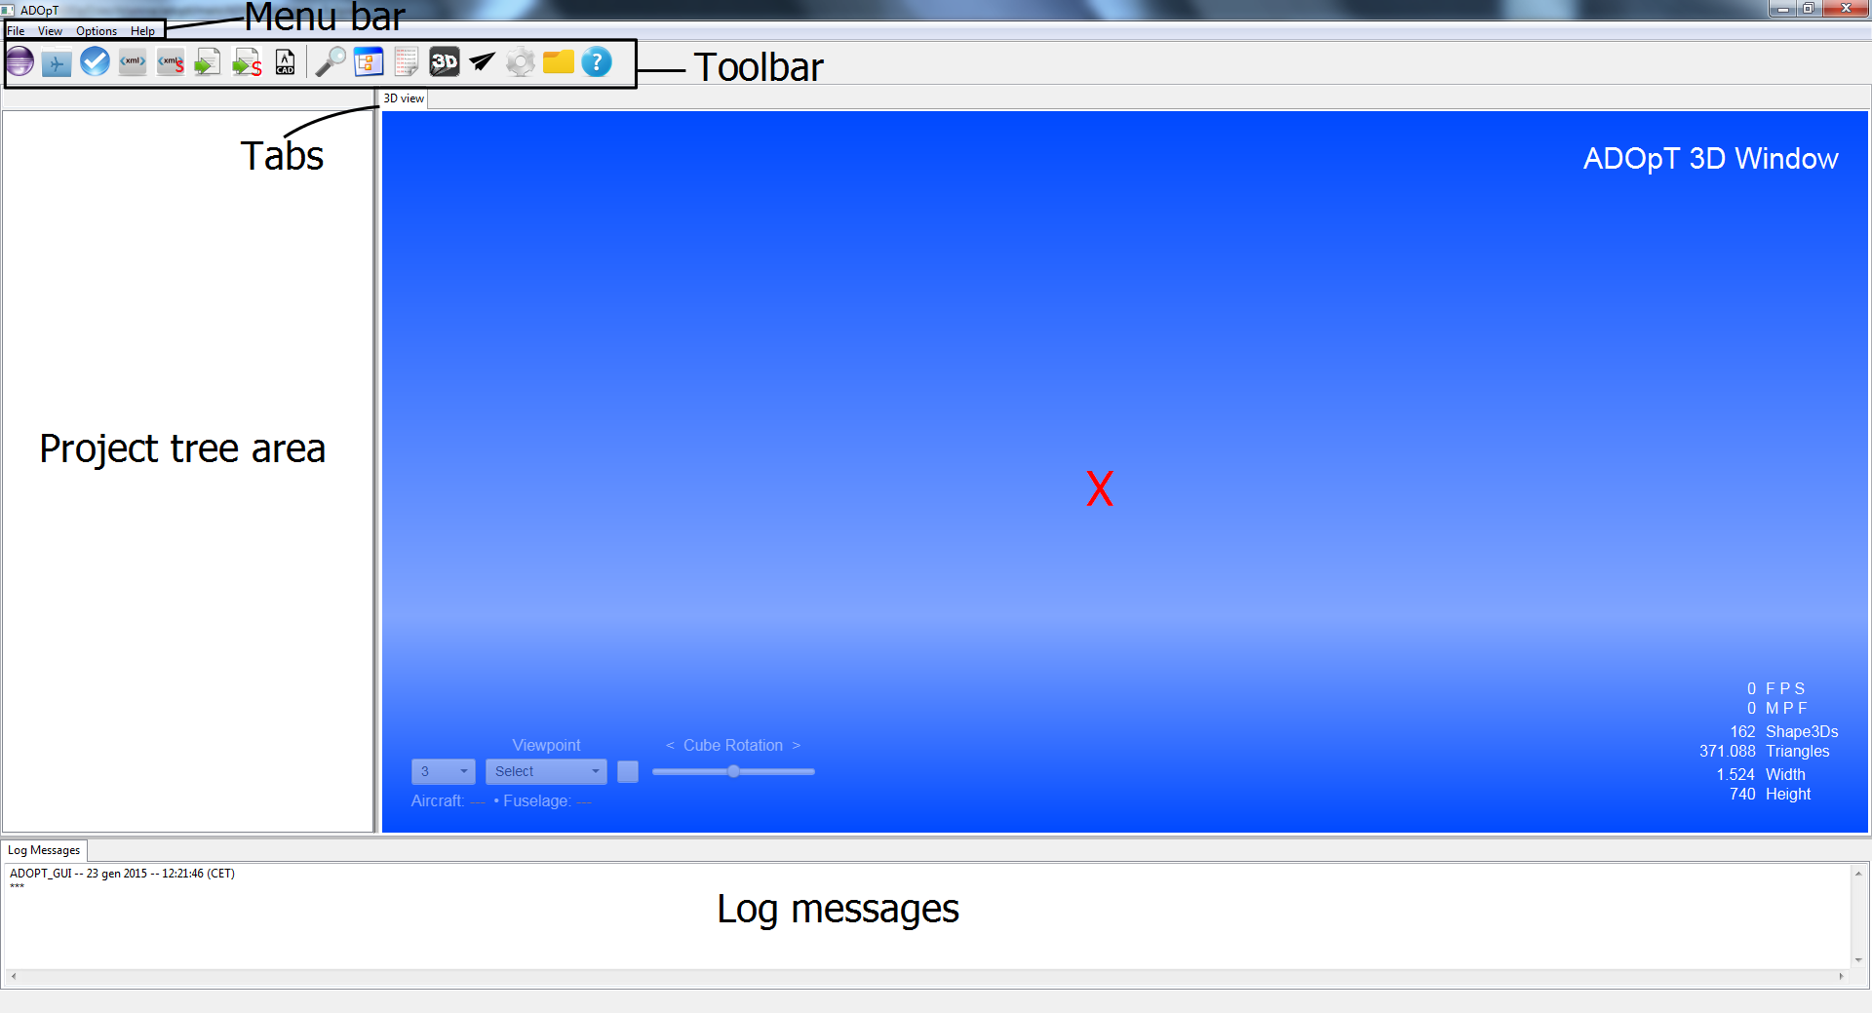
ADOpT: a GUI for jPAD
The GUI – Eclipse SWT/Jface technology, JavaFX for the 3D view
Example of project tree

Slide 14
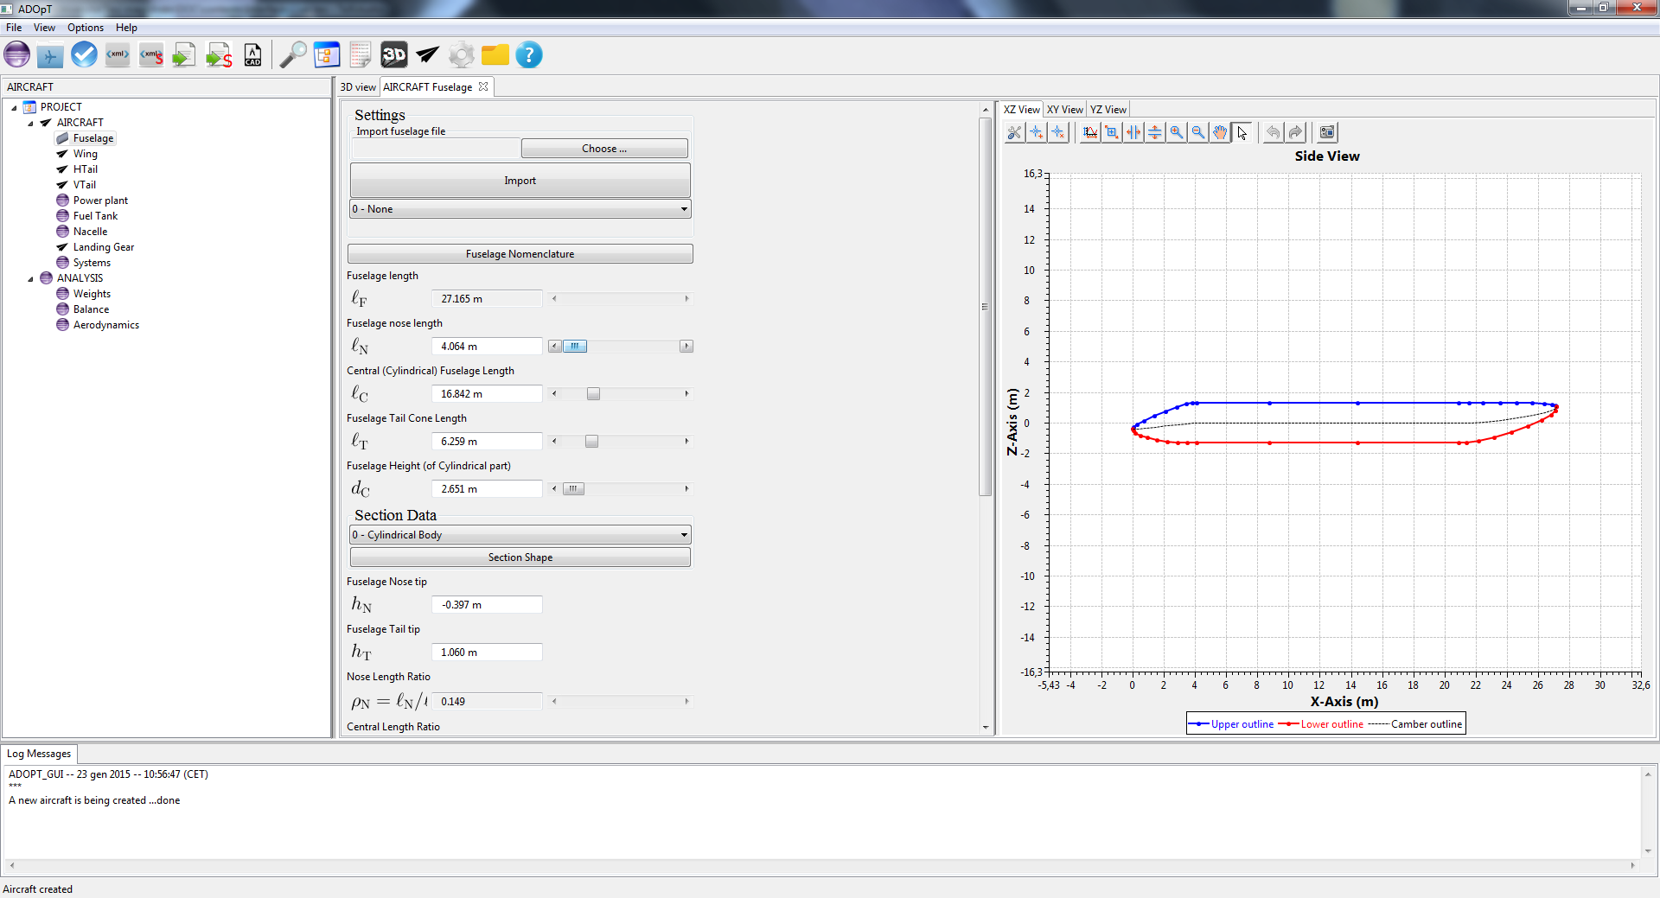
ADOpT: a GUI for jPAD
Varying geometric parameters

Slide 15
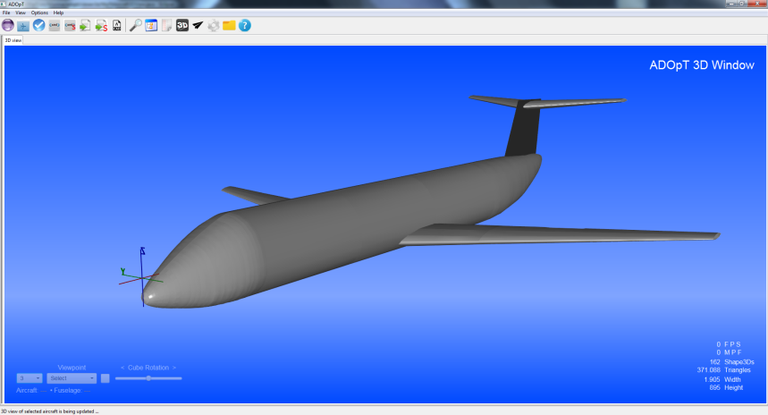
ADOpT: a GUI for jPAD
CAD generated from parametric representation

Slide 16
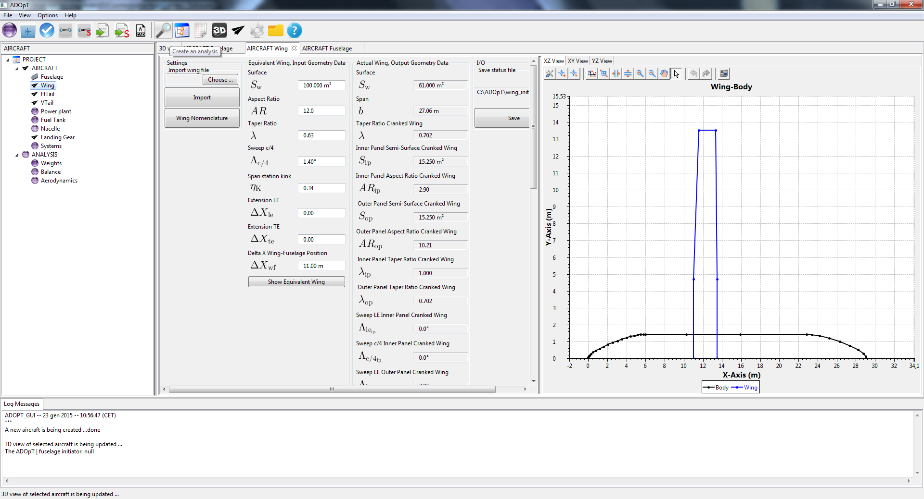
ADOpT: a GUI for jPAD
Configuring the aerodynamic analysis

Slide 17
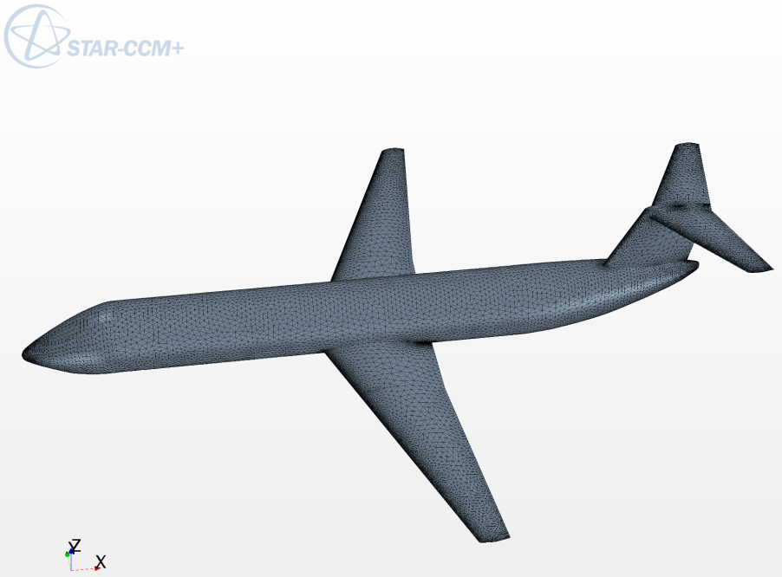
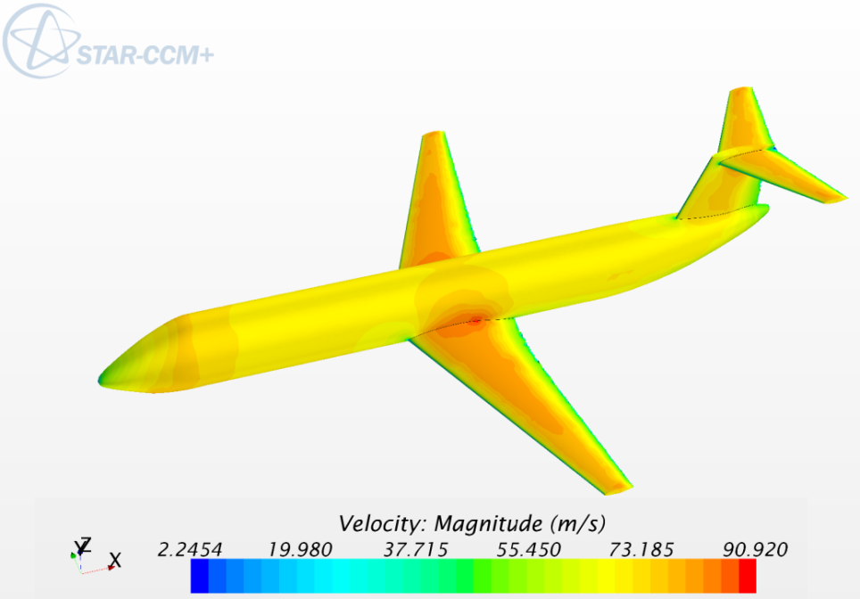
Interface with external CFD tools

Slide 18
Key Points
Java programming language (JDK ≥1.8)
Eclipse IDE
Great effort to make code easily maintainable
In-house solutions for:
Importing/exporting data (including CPACS via Tigl interface)
Array handling
GUI design (SWT/JFace libraries, JavaFX)
Building the CAD model (via Open CASCADE libraries/Java Native Interface JNI)
CAD 3D viewer (JavaFX)
DATCOM-like database for Aerodynamics/Performances/Stability & Control analysis modules (Hierarchical Data Format, HDF)

Slide 19
Conclusions
Main features and general arrangement complete
Work in progress:
Loads
Stability & Control module
Collaborative features:
CPACS
United States Air Force Stability and Control Digital DATCOM
FlightGear simulator input XML file

