Slide 1
WORK-STUDY ATTACHMENT
Guyana Labour Force Survey: Pipeline & Data Cleaning Project
2017, Quarter 4 (Survey Round 174)
Baqir Elcock · August 2026
Notes:
Introduce yourself, the placement, and the two-week window this deck covers.

Slide 2
Guyana Labour Force Survey (2017, Quarter 4, Survey Round 174)
+
+
The Panel uses this attachment to see whether I can take real survey microdata from raw export to an analysis-ready dataset on my own tooling, not a guided exercise.
The brief calls for one command that runs the whole pipeline in the correct order, with every stage logged before and after.
ASSIGNED DATASET
Guyana Labour Force Survey
Two independent tracks: ind (individual, 175 columns) and emig (emigration module, 28 columns) — pushed through identical stages, never merged in this phase.
2017, Quarter 4 — survey round 174
hhid links the two tracks, but each is diagnosed and cleaned on its own.
This phase stops at a written problem inventory — cleaning is a separate, later pass.
+
+
+
+
+
+
13,853
659
3,783
individual records, 175 columns — the ind track
households, 28 columns — the emig emigration module
households in the underlying sample, per the methodological report
+
+
+
+
+
+
+
+
Notes:
Slide 1: The panel wanted to see if I could take messy, raw data from a real survey and clean it. I was given the Guyana Labour Force Survey (2017, Quarter 4) and the data was split into two tracks...ind (individual data with 175 columns) and emig (emigration module data with 28 columns). They were to be cleaned separately and never merged together in this phase. The goal was to write a command that runs all cleaning steps in the correct order automatically and at every stage of the process, recording/logging before and after it runs. This phase would stop once I made a list of problems found in the data (a problem inventory) and actual cleaning would come later.

Slide 3
THE BRIEF
What the attachment asks for
01
02
Core Objective
Pipeline Scope
Take real survey microdata from a raw export to an analysis-ready state using custom tooling rather than a guided, step-by-step exercise.
Build a single command that executes the entire pipeline in the correct order, complete with pre- and post-stage logging and a written problem inventory before any modifications are made.
Notes:
Transition into the pipeline build.

Slide 4
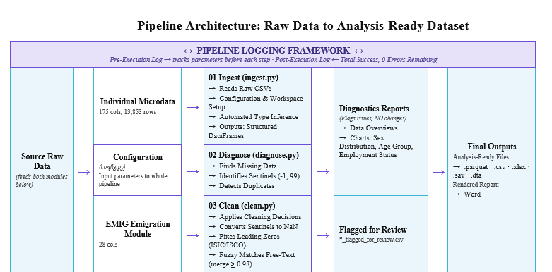
Notes:
I started a code repository on Github and organised my workspace into three clear folders ( Data, Scripts and Outputs). Then I created a config.py to keep all file paths organised in one place and an ingest.py (with Claude) to start loading the data. I successfully recovered from a git history rewrite mistake without losing any work thanks to claude and rebuilt the folder structure cleaner halfway through the week. A breakthrough this week involved my ingest.py successfully figuring out the correct data types automatically, saving me from typing them manually and loading the dataset with zero broken or missing values (NaNs)
I mapped out which columns were missing information and confirmed certain gaps like q1_15/16 were built-in on purpose rather than being mistakes. I searched for duplicate people and checked if age, weight or hours made sense. No duplicate people were found and unusual numbers were just hidden codes for missing data (-1). I took a baseline look at the numbers before touching anything...showing a nearly even sex split (51.1%/48.9%) and noted that employees make up 66.2% of the status. I realised the datasets do not contain real dates, category columns use text instead of numbers and all reports are generated automatically by code rather than typed by hand. The diagnostic script only reports problems and never actually changes any data values.
Slide 4: I used claude to create a script named visualize.py to create these charts directly from the core numbers, ensuring the charts and written reports never disagree or drift. Out of the 13,853 respondents, the data shows a nearly even split. Out of 13,841 respondents, it groups people into age brackets..showing the spread from children (0-14) up to seniors (65+). Out of 4,789 people with a main job, the vast majority (66.2%) are regular employees, while the rest are self employed or unpaid family workers.

Slide 5
WEEK TWO
The Problem Inventory
Before fixing anything, a written and counted account of what's actually wrong — four cleaning issues, cross-referenced against what the cleaning script does about each.
VARIABLE
ISSUE
COUNT
Age
"−1" don't-know sentinel
12 rows
Hours worked
"99" top-code, plus the "−1" sentinel in 8 more columns
88 + ~110 rows
Industry (ISIC)
leading zero stripped on export
206 rows
Occupation (ISCO)
non-4-digit codes, same pattern
12 rows
Notes:
Slide 9: Age: 12 rows use -1 as a hidden code meaning "don't know".
Hours worked: 88 rows use 99 as a maximum limit code, and about 110 rows use the -1 missing code across multiple columns.
Industry (ISIC): 206 rows accidentally lost their starting zero when exported.
Occupation (ISCO): 12 rows have the same code length issue (not 4 digits).
panelid: All 13,853 rows are named like a unique ID, but there are only 18 actual distinct values—so it has been flagged to make sure nobody accidentally uses it to merge datasets together.

Slide 6
WEEK TWO
How I cleaned it
Every inventory item, the correction the pipeline applies, and the measured result — nothing changed without a verified reason and a logged before/after.
ISSUE
FIX
RESULT
Sentinels (99, −1)
Checked every hours and age column before touching anything, then converted the confirmed sentinels to NaN
12 + ~110 rows fixed
Leading-zero bug
Zero-pad every ISIC/ISCO code back to 4 digits before reading its section or major group
0 of 4,789 failed
Free-text job titles
Near-duplicate variants merged into their most common form, but only above a 0.98 similarity threshold
436 variants, 648 rows
Duplicate records
Exact-duplicate removal on the natural person key, run on both tracks independently
0 duplicates found
Uncertain cases
Flagged for review, never auto-changed — q3_05 == 99 and the noisier 0.90–0.97 text matches
All flags logged

Slide 7
Imputation
Scoped to the same five variables as problem_inventory.py: impute only within the real applicable population, preserve structural missingness, and flag every filled value.
VARIABLE
METHOD
RESULT
Age q1_04 / q7_06
Median after checking the distribution was right-skewed (mean ≠ median).
12 ind + 28 emig rows filled; applicable-population missingness = 0.
Main-job hours q3_03 + 7 daily cols
Median, restricted to respondents with a main job.
88 + ~14–15 per daily column filled; no out-of-scope values created.
Other-job actual q3_08
Median, restricted to respondents with a second job.
1 row filled; avoided the naive error of inventing 4,626 values.
Other-job usual q3_04
Left missing after confirming the field is 100% structural.
Structural missingness untouched.
Derived totals q3_05 / q3_09 / q3_10
Re-derived, not imputed, using clean.py recompute_derived_hours().
Totals rebuilt from the now-more-complete component fields.
Industry / occupation isic_code / isco_code
Left missing; exact structural match to the “no main job” population.
No imputation. Sex (q1_03) also needed none: 0 missing.
Auditability
Add a <column>_imputed boolean flag to every imputed field.
10 new flags on ind + 1 on emig; supports the observed-vs-imputed chart.
Verified: post-imputation missingness is 0 within every applicable population; structural counts 13,690 / 9,064 / 9,064 are unchanged. run_pipeline.py passes end-to-end and README is updated. Commit pending; next: Step 8 — data dictionary.

Slide 8
WEEK TWO
6 hours logged
From Diagnosis to Cleaning
Built clean.py with Imran and Nicholas: exact-duplicate removal on the natural person key
Two verified corrections applied automatically: age −1 and hours 99 sentinels → NaN
Wrote problem_inventory.py: a counted list of issues across sex, age, hours, industry and occupation
Cleaned data exported and committed, with every change logged before/after
Verified: zero duplicate rows in either dataset — nothing to drop.
Caught a second sentinel: q3_05 == 99 regardless of q3_03+q3_04 — flagged, not assumed.
Every flag lands in *_flagged_for_review.csv — nothing altered without a check to point to.
Notes:
Slide 5: Moving past just finding problems, week 2 was about actually starting to clean the data safely. With the guidance of Imran and Nicholas, I created a Clean.py to get rid of any exact duplicate people in the dataset. You automatically converted placeholder codes that meant "missing data"..specifically -1 for age and 99 for hours...into proper missing values (NaN). I made a problem_inventory.py to count and tack issues across categories like sex, age, hours, industry and occupation and spotted another weird code (99 in q3_05) and safely flagged it for review instead of guessing how to fix it. Every single change and flag is saved into a review file (*_flagged_for_review.csv) and fully logged before and after, ensuring nothing was altered bliindly.

Slide 9
WEEK TWO
Chasing Sentinel Values
A sentinel is a stand-in number that means "don't know" or "top of scale" — not a real answer. Finding one means checking, not assuming.
+
+
+
+
"99" — THE TOP-CODE
"−1" — DON'T KNOW
88 rows in usual weekly hours read exactly 99, while every other value capped at 98. Checked every other hours column first — none of them ever use 99, confirming it's a sentinel specific to this field.
The usual-hours-mismatch flag count dropped from 6 to 0 the moment this correction landed — it was never an independent arithmetic error.
Verified before correcting: zero occurrences of 99 in any other hours column, despite values as high as 168.
Verified on age (12 rows), then found still live and uncorrected in seven more hours columns nobody had checked against it before this pass.
Verified the same way as age: checked every value, confirmed −1 means exactly one thing everywhere it appears.
Total corrected this pass: 12 age rows plus roughly 110 rows across seven hours columns and q3_08.
+
+
+
+
Notes:
Slide 6: A sentinel is a fake placeholder number (such as a code for "don't know" rather than a real answer. Finding one meant I had to carefully check the data instead of blindly guessing what it means. I found two sentinels. - 88 rows used the number 99 for weekly hours as a maximum limit code. Cleaning this up instantly fixed several hours-mismatch errors in the dataset. - The code -1 was used to mean "don't know" or missing data. This was found and cleaned across age rows (12 rows) and multiple hours columns (about 110 rows total).

Slide 10
WEEK TWO
The Leading-Zero Bug
Industry and occupation codes inconsistently lost a leading zero on export — "0729" stored as "729".
+
+
0 / 4,789
Left alone, it would have silently misclassified every one of those rows into the wrong industry section.
coded rows failed to classify after the fix
Fix: zero-pad every code to 4 digits before reading its section or major group.
+
+
Verified against a known example: isco_code 3131 → 'Technicians and Associate Professionals' — matches the very first sample record this project looked at.
Notes:
Slide 7: When I exported the dataset, some job and industry codes accidentally lost ther leading zero (for example, turning 0729 into 729). If this went unnoticed, it would have secretly assigned those rows to the completely wrong industry categories. So I added a rule to automatically pad every code back out to 4 digits with a zero before reading it. It worked perfectly—0 out of 4,789 rows failed to classify after applying the fix.

Slide 11
WEEK TWO
Free Text, Cleaned Without Guessing
Job titles and descriptions are typed free-hand — "Cashier", "cashier", "Cashier " are probably the same answer, entered inconsistently.
+
+
Near-duplicate values were found automatically, but only merged above a 0.98 similarity threshold.
436 variants
merged into their most common form, across 648 rows
Anything less certain stays flagged for a human to review, not auto-merged.
+
+
The noisier 0.90–0.97 band stayed flag-only — real pairs there were ambiguous enough that auto-merging would have guessed wrong.
Notes:
Slide 8: Because the enumerators typed job descriptions and titles by hand, things were written inconsistently with typos, extra spaces or different capitalisation. Near-duplicates were found automatically, but only merged if they reached a very high 0.98 similarity threshold. Anything in the noisier 0.90 to 0.97 siimilarity range was left unmerged and flagged for myself to review to prevent the computer from guessing incorrectly. A total of 436 variants were successfully cleaned up and merged into their most common form across 648 rows.

Slide 12
COURSE-CORRECTION
Self-Audit: Four Blind Spots
The standard applied to every check: if it reports "no problems," would it have caught one if it existed? Four checks failed that test — all four fixed.
+
+
+
+
+
+
+
+
01
02
03
04
Ordering bug
Tautological check
Sentinel not generalized
Wrong rows inspected
A consistency check ran after its own sentinel correction — it could never see the rows it was meant to flag.
Fixed by: running once, deliberately, on raw data before any correction touches it.
A computed total was compared to itself — true by construction, could never fail. Replaced with direct recomputation.
Fixed by: recompute_derived_hours(), which recalculates the totals from cleaned components instead.
The "−1" fix proven for age was never checked against hours — it was live in seven more columns.
Fixed by: correct_negative_one_hours_sentinel(), generalized across all affected columns.
A skip-logic check required an explicit "No" and missed blank answers — 23 real rows were never even inspected.
Fixed by: treating blank as 'no evidence' and adding q2_06 to the check — 0 unexplained violations remain.
+
+
+
+
+
+
+
+
Notes:
=I tested the error checking system to see if it actually spotted mistakes if they happened. They found four blind spots where the code was failing to catch errors and fixed them. 01. Ordering Bug: A check ran after the data was already fixed, meaning it couldn't see the original error anymore. Fix: They made it run on the raw data first.
02. Tautological Check: A check was comparing a total to itself, which always looks "correct" and can never fail. Fix: They changed it to recalculate the total properly from scratch.
03. Sentinel Not Generalized: A fix for the -1 missing code was only working for age and was accidentally ignored in 7 other hours columns. Fix: They applied the fix across all columns.
04. Wrong Rows Inspected: A check missed blank answers entirely instead of checking them. Fix: They updated the code to inspect those blanks, dropping remaining errors to zero.

Slide 13
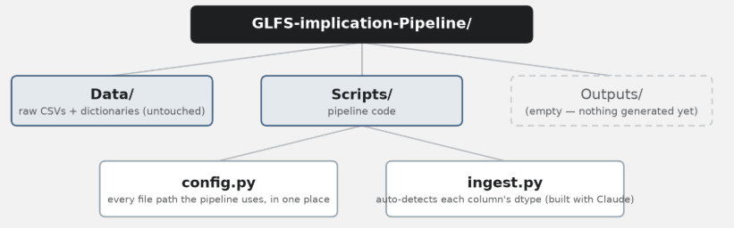
WEEK ONE
Standing Up the Pipeline
+
+
Initialised the GitHub repository with regular commits
Set up the folder skeleton: Data / Scripts / Outputs
Built config.py — every path the pipeline uses, in one place
Built ingest.py, drafted the first README with Claude
Recovered from a git history-rewrite incident — no data lost
Verified: dtype coercion introduced zero new NaNs
Reset to a bare skeleton mid-week, then rebuilt it cleaner
+
+
Fixed markdownlint warnings in the README before merging

Slide 14
WEEK ONE
First Diagnostics
Missingness
Duplicates & range
Distributions
Percent missing per column across both datasets, worst first — the starting map of where attention is needed.
q1_15/16 turned out structurally intended, not a gap.
Checked the natural person key for duplicates, and flagged age, weight and hours values outside a plausible range.
Zero duplicates found; every flag traces to the −1 sentinel.
A first look at sex, age group and employment status, before any value was touched.
Sex splits 51.1% / 48.9%; Employee status leads at 66.2%.
READ ONLY, VERIFIED FIRST
No date-parsing check run — neither public dataset carries a real date field.
Corrected an early assumption: category columns hold resolved label text already, not numeric codes.
Every diagnostic here is regenerated by rerunning ingest → diagnose — never hand-edited.
Ground rule for the whole project: diagnostics only report. They never change a single value.
Notes:
Slide 3: I mapped out which columns were missing information and confirmed certain gaps like q1_15/16 were built-in on purpose rather than being mistakes. I searched for duplicate people and checked if age, weight or hours made sense. No duplicate people were found and unusual numbers were just hidden codes for missing data (-1). I took a baseline look at the numbers before touching anything...showing a nearly even sex split (51.1%/48.9%) and noted that employees make up 66.2% of the status. I realised the datasets do not contain real dates, category columns use text instead of numbers and all reports are generated automatically by code rather than typed by hand. The diagnostic script only reports problems and never actually changes any data values.

Slide 15
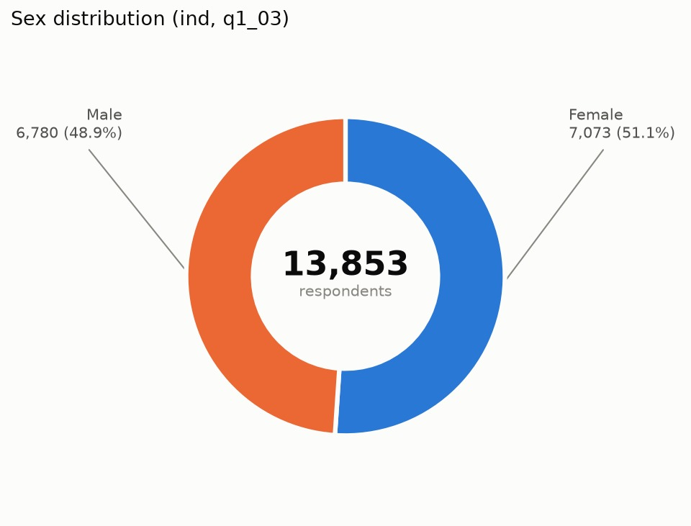
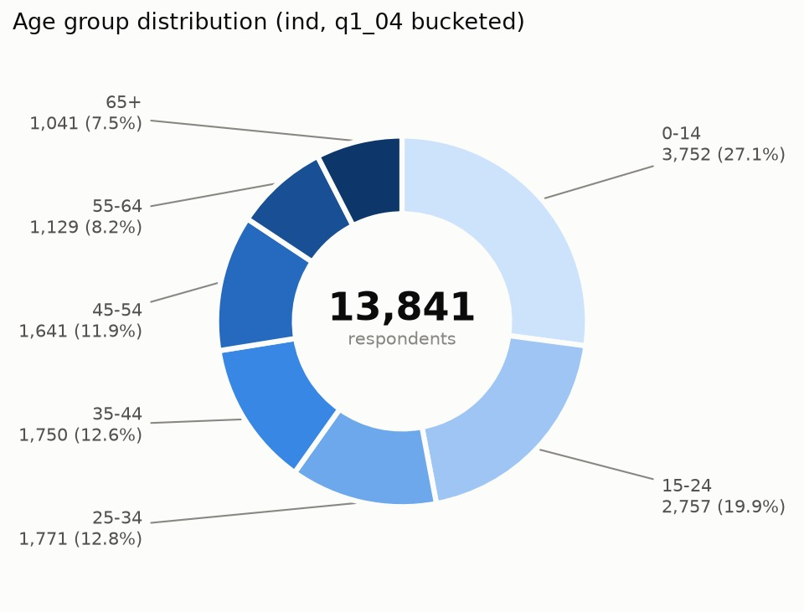
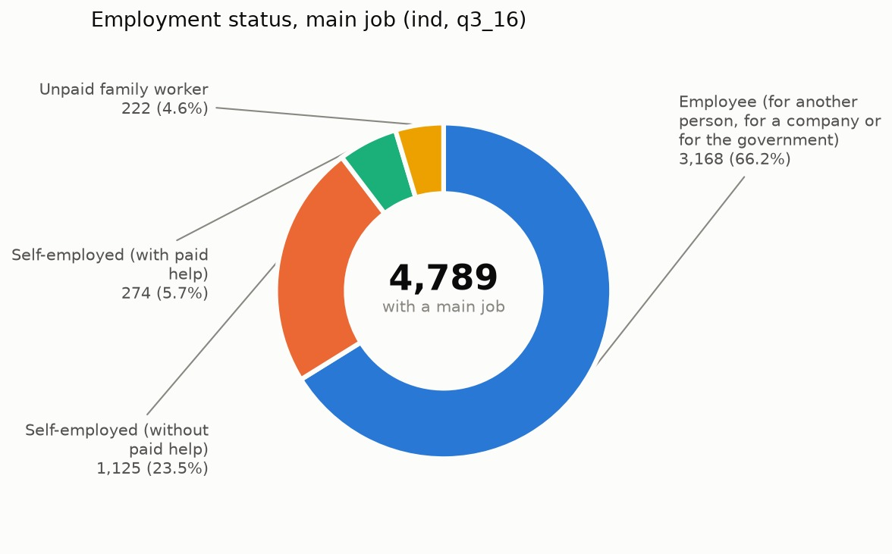
WEEK ONE
Six Charts, One Dataset
+
+
+
+
+
+
+
+
+
+
+
+
visualize.py renders six distributions straight from the diagnostics numbers — no separate recalculation, so the charts and the report can never disagree.

Slide 16
WEEK TWO
The Problem Inventory
Before fixing anything, a written and counted account of what's actually wrong — six variables, cross-referenced against what the cleaning script does about each.
VARIABLE
ISSUE
COUNT
Age
"−1" don't-know sentinel
12 rows
Hours worked
"99" top-code, plus the "−1" sentinel in 8 more columns
88 + ~110 rows
Industry (ISIC)
leading zero stripped on export
206 rows
Occupation (ISCO)
non-4-digit codes, same pattern
12 rows
panelid
named like a unique ID, only 18 distinct values — flagged so it's never used as a join key
13,853 rows
Notes:
Slide 9: Age: 12 rows use -1 as a hidden code meaning "don't know".
Hours worked: 88 rows use 99 as a maximum limit code, and about 110 rows use the -1 missing code across multiple columns.
Industry (ISIC): 206 rows accidentally lost their starting zero when exported.
Occupation (ISCO): 12 rows have the same code length issue (not 4 digits).
panelid: All 13,853 rows are named like a unique ID, but there are only 18 actual distinct values—so it has been flagged to make sure nobody accidentally uses it to merge datasets together.

Slide 17
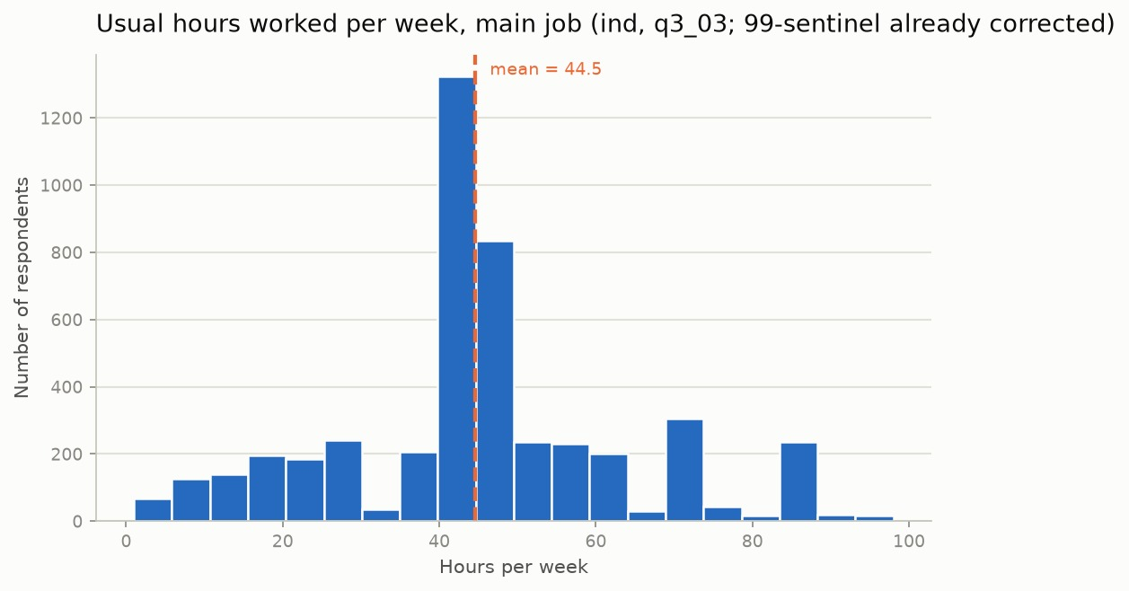
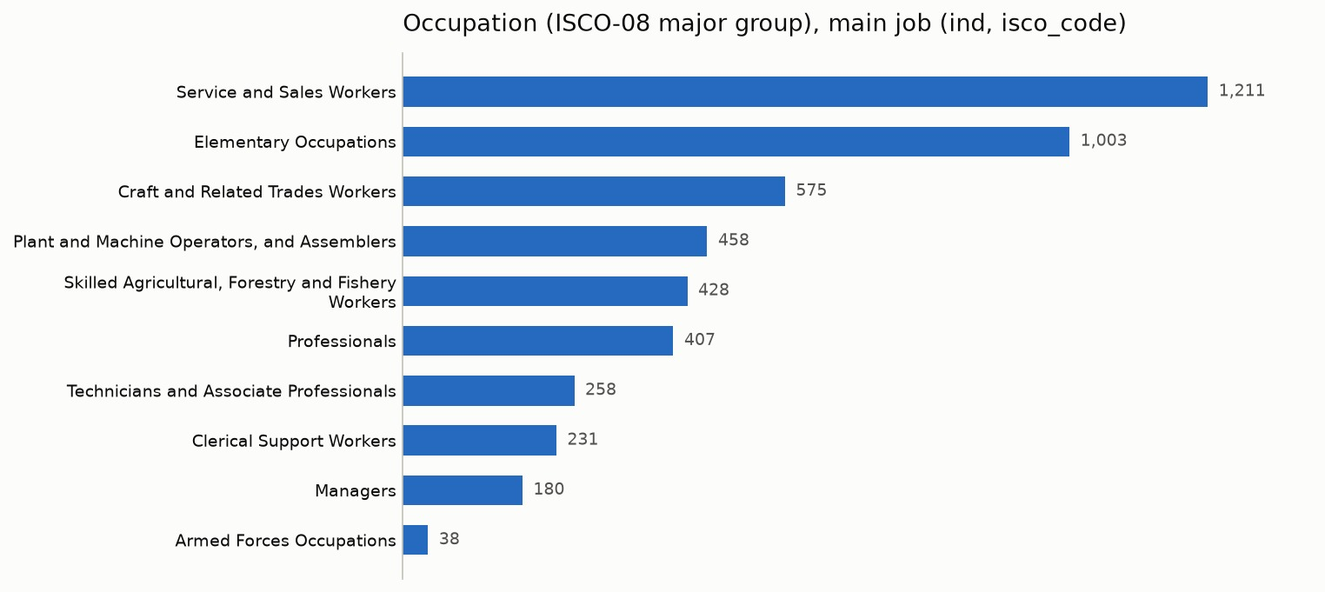
FINDINGS
What the Data Shows
+
+
HOURS WORKED DISTRIBUTION
+
+
OCCUPATION MIX (ISCO MAJOR GROUP)
+
+
Service and sales roles, and elementary occupations, are the two largest groups. The work week centers on 44.5 hours , with a visible spike at the standard 40-hour week.
Occupation and industry codes are fully resolved for every coded row (4,789/4,789) — the leading-zero fix from earlier holds up at scale.
+
+
Notes:
Once everything was completely cleaned and verified, the results revealed two major patterns:
Occupation Mix: The most common jobs in the survey are Service and Sales Workers (1,211 people) and Elementary Occupations (1,003 people), while Armed Forces is the smallest group (38 people).
Hours Worked Distribution: The average work week is 44.5 hours, with a massive spike right at the standard 40-hour work week.
Total Success: Every single one of the 4,789 job and industry codes was successfully classified with zero errors remaining.

Slide 18
CREDIT
Tools & Teammates
+
+
+
+
+
+
Imran & Nic
Claude
Python toolchain
Worked through the cleaning script's logic together — the sentinel corrections and validation rules were built as a team.
Together we built the −1 age-sentinel correction and the flag-only checks for hours, skip-logic and monetary outliers.
Reviewed the free-text consolidation threshold together too — checked by eye before trusting any auto-merge.
Drafted the README, the problem-inventory scaffolding and the free-text consolidation logic — every suggestion checked against real examples before it was trusted.
Also caught two real rendering bugs by looking at the charts, and ran the self-audit that found four checks which could never have caught a real problem.
Co-authored the design spec and plan docs that scoped each phase before any code was written.
pandas for the pipeline, rapidfuzz for near-duplicate detection, one command ( run_pipeline.py) to run it end to end.
Plus openpyxl for the ISCO structure file, and python-docx for these weekly reports.
One command, run_pipeline.py, chains every stage end to end — the brief's core requirement.
+
+
+
+
+
+
Notes:
Credit collaborators and tools explicitly.

Slide 19
LOOKING AHEAD
Next: Imputation
+
+
+
+
THE PLAN
THE OPEN ITEM
Learn and apply imputation methods — mean, median, mode — to the incidental missingness the diagnostics have already separated out from structural skips.
classify_missingness() already separated structural skips (100% explained by 7 documented gates) from incidental gaps — only the incidental share gets imputed.
Mean/median for numeric fields, mode for categorical — chosen per-column, not blanket-applied.
Still waiting on the evaluating office's assigned cleaning-scope variables — not a blocker so far, since the pipeline runs against the full dataset either way.
If scope arrives later, it'll change which columns get flagged for cleaning, not how the pipeline itself runs.
In the meantime, the self-audit habit continues — assume a clean check is broken until proven otherwise.
+
+
+
+

