Slide 1
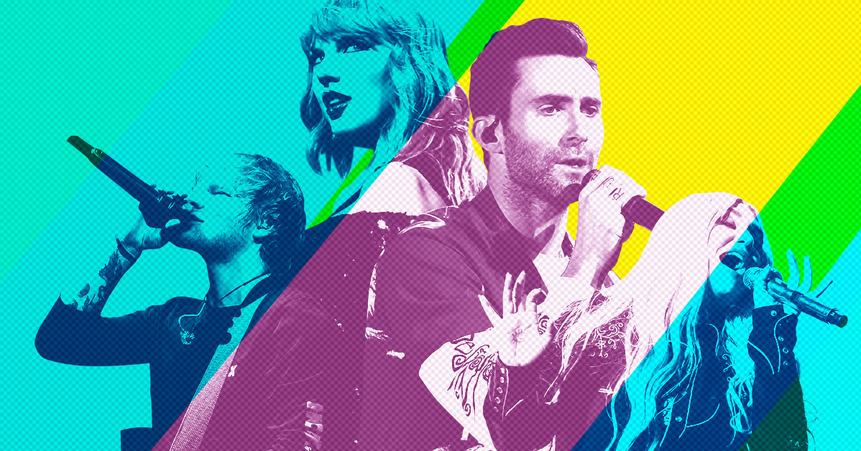
Part 1 Music Genre Classification
Introduction
My work classifies ten classes music genre of a sound sample and uses Pytorch and scikit-learn to recognize the music genre.

Slide 2
GTZAN -- Datasets
The dataset consists of 1000 audio tracks each 30 seconds long. It contains 10 genres, each represented by 100 tracks. The tracks are all 22050Hz Mono 16-bit audio files in .wav format.
Classes: blues, classical, country, disco, hiphop, jazz, metal, pop, reggae, rock

Slide 3
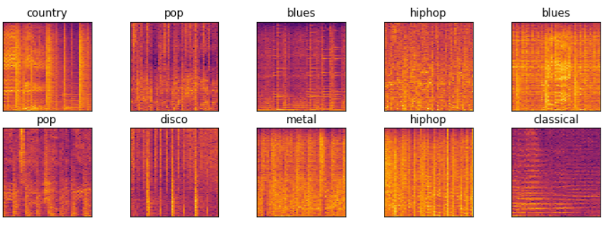
Preprocessing Data
Mel-frequency cepstral coefficients (MFCC)
Spectral Centroid
Zero Crossing Rate
Chroma Frequencies
Spectral Roll-off
Spectrogram images

Slide 4
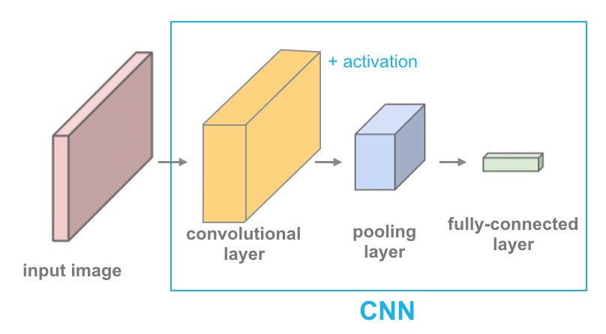
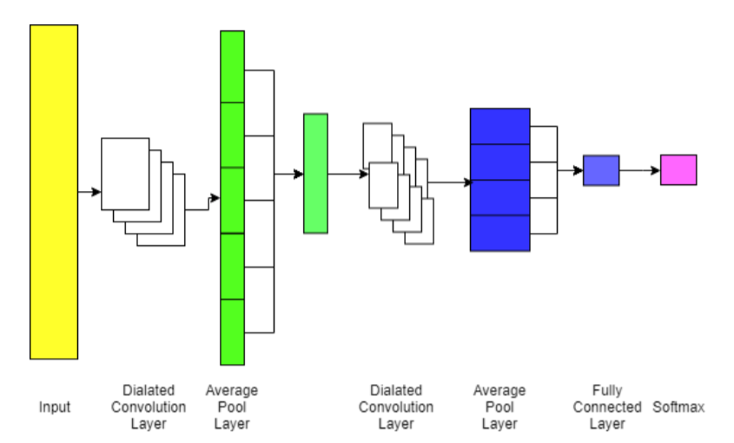
Models
Scikit-learn: SVM, MLP lbfgs(quasi-Newton method), MLP Adam(gradient-based optimizer), Decision Tree
Pytorch: CNN, DCNN, DCNN-RNN

Slide 5
Results
Scikit-learn with MFCC(20), Spectral Centroid, Zero Crossing Rate, Chroma Frequencies, Spectral Roll-off:
SVM: 65.5%
MLP adam: 66%
MLP lbfgs: 65%
Decision Tree: 44%
Pytorch:
DCNN-RNN with MFCC(50): 63%
DCNN with MFCC(50): 60%
CNN with spectrogram images: 43%

Slide 6
Discussion
The results of CNN, DCNN, DCNN-RNN are not the most optimized results. During analyzing the training loss and valid loss, the NN performance can increase by adjusting the learning rate, changing the parameters in the NN model, choosing the different features, and inputting the more substantial data size.
The performance of my NN will surpass the scikit-learn results after optimization.

Slide 7

Part 2 Music Generator
Magenta is a research project exploring the role of machine learning in the process of creating art and music. Magenta was started by some researchers and engineers from the Google Brain team, but many others have contributed significantly to the project. TensorFlow

Slide 8
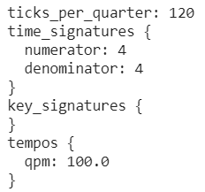
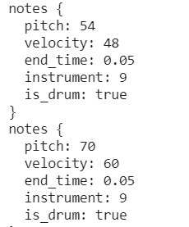
Drums RNN
This model applies language modeling to drum track generation using an LSTM. Modeling a drum track as a single sequence of events by
(a) mapping all of the different MIDI drums onto a smaller number of drum classes
(b) representing each event as a single value representing the set of drum classes that are struck.

Slide 9
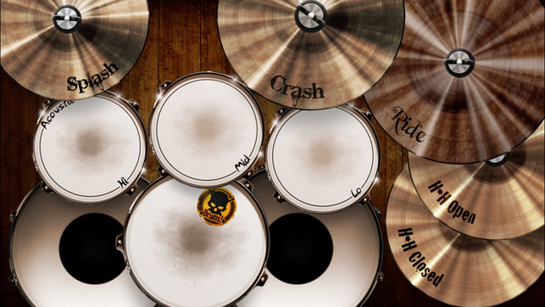
Drum Kit – Pre-trained Model
This configuration maps all drums to a 9-piece drum kit consisting of bass drum, snare drum, closed and open hi-hat, three toms, and crash and ride cymbals. The set of drums is encoded as a length 512 one-hot vector, where each bit of the vector corresponds to one of the 9 drums. The input to the model is also augmented with binary counters.

Slide 10
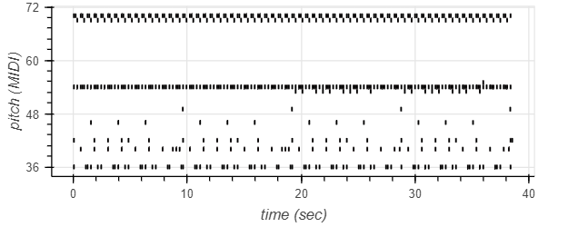
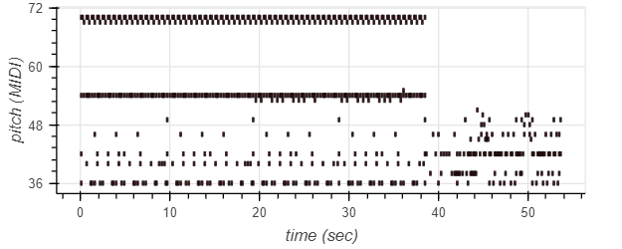
Results

Slide 11
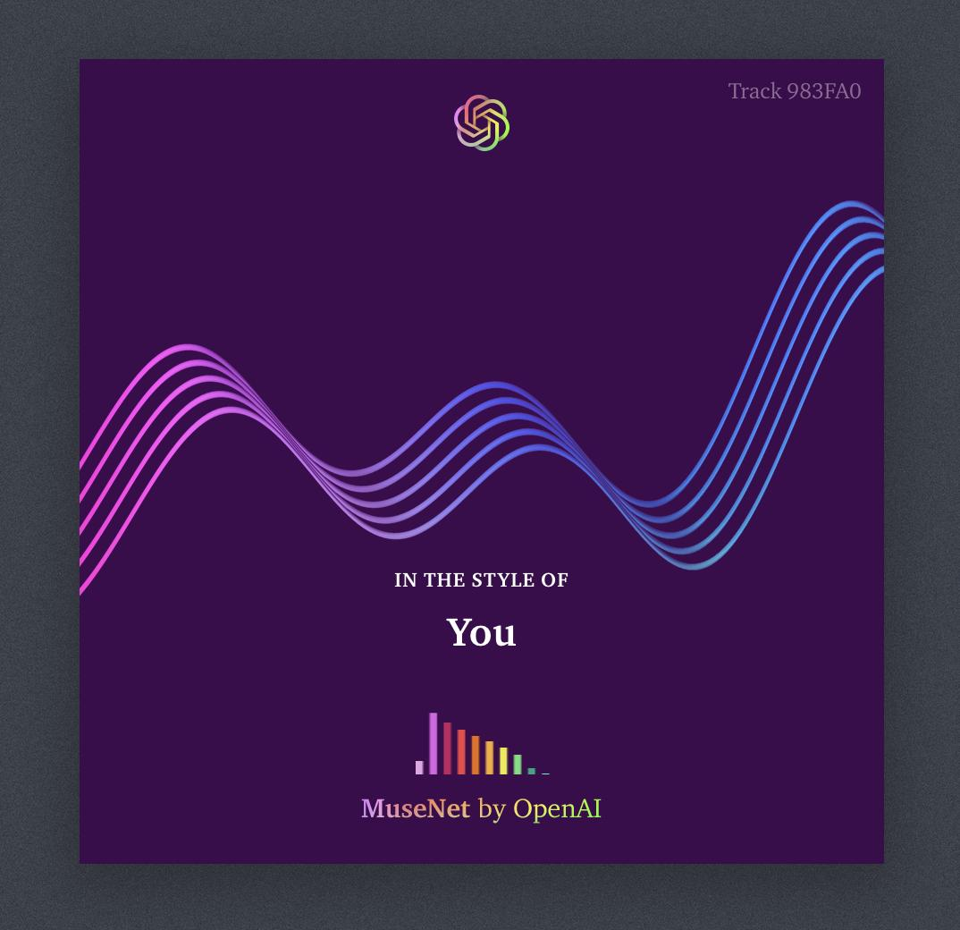
MuseNet
A deep neural network that can generate 4-minute musical compositions with 10 different instruments, and can combine styles from country to Mozart to the Beatles. MuseNet was not explicitly programmed with our understanding of music, but instead discovered patterns of harmony, rhythm, and style by learning to predict the next token in hundreds of thousands of MIDI files. MuseNet uses the same general-purpose unsupervised technology as GPT-2, a large-scale transformer model trained to predict the next token in a sequence, whether audio or text.

