Slide 1
Characters
CS240

Slide 2
ASCII
American Standard Code for Information Interchange
based on the English alphabet
Originally developed for telegraph/teleprinters.
encodes 128 specified characters into 7 bits
Letters, numbers, control characters
8th bit was used by computer vendors to “extend” ASCII by adding their own characters (i.e. line drawing characters)

Slide 3
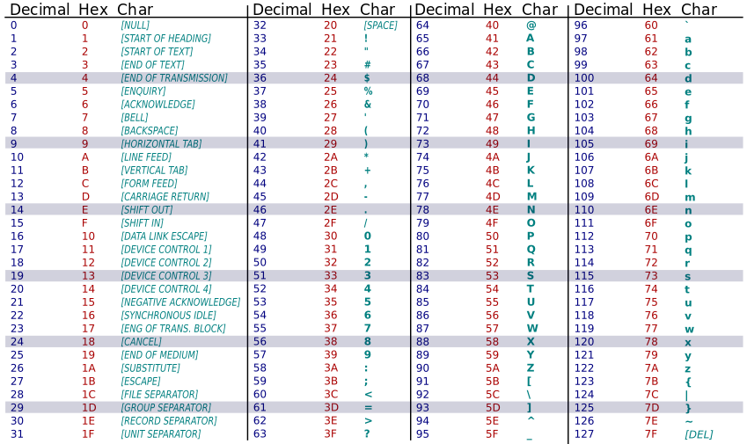
ASCII Table

Slide 4
Unicode
Assigns a number or “code point” to each character.
1,114,112 code points from 0 to 0x10FFFF.
Latest version of Unicode standard contains more than 110,000 characters.
First 128 code points are same as ASCII.
A code point is written as “U+” followed by a hexadecimal number. i.e. A is U+0041

Slide 5
Unicode Encoding
Can be implemented by different character encodings:
UCS-2 – uses 2 bytes. Obsolete. It cannot encode every character in the current Unicode standard.
UTF-8 – uses 1 to 4 bytes. Used by Unix and HTML.
UTF-16 – uses 2 bytes or 4 bytes. Extends UCS-2. Used by Windows XP, Windows Vista, Windows 7

Slide 6
UTF-8
UCS Transformation Format—8-bit
a variable-width encoding
designed for backward compatibility with ASCII
The first 128 characters of Unicode are encoded with the same binary value as ASCII
encodes each of the 1,112,064 code points in the Unicode character set using one to four bytes

Slide 7
UTF-8 used in HTML
<!DOCTYPE html>
<html lang="en" dir="ltr" class="client-nojs">
<head>
<meta charset="UTF-8" />

Slide 8
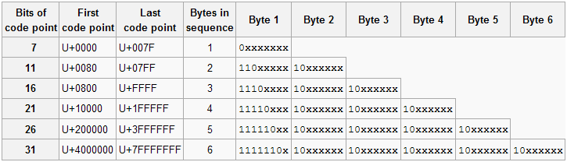
UTF-8 Encoding Scheme
Code Points 0 to 127 - Same value as the ASCII code. It is represented with one byte, with the high order bit set to 0.
Code points 128 and higher are represented by 2 to 6 bytes, with a leading byte and one or more continuation bytes.
The number of high-order 1s in the leading byte of a multi-byte sequence indicates the number of bytes in the sequence.
All continuation bytes contain ‘10’ in the high order bits.
The code point’s binary value is encoded in the remaining bits, with 0’s padded to the left if necessary.

Slide 9
UTF-8 Encoding Scheme
Example:
$ = U+0024
U+0024 is within the range of U+0000 to U+007F, so it is stored in 1 byte.
(24)₁₆ is (36)₁₀ or (100100)₂
According to the specifications, the format for storing into one byte is:
0xxxxxxx where 0 is placed in the highest order bit and the binary is stored into the remaining 7 bits.
100100 is only 6 bits, so we need to pad it with a 0 to make it seven bits:
100100 -> 0100100
The resulting UTF-8 encoded byte will be: 00100100

Slide 10
UTF-8 Encoding Scheme
Example:
¢ = U+00A2
U+00A2 is within the range of U+0080 to U+07FF, so it is stored in 2 bytes.
(A2)₁₆ is (162)₁₀ or (10100010)₂
According to the specifications, the format for storing into two bytes is:
1st byte: 110xxxxx where 110 is placed in the higher order bits, indicating that this is a leading byte of 2 bytes.
2nd byte: 10xxxxxx where 10 is placed in the higher order bits, indicating that this is a continuation byte.
10100010 is only 8 bits, so we need to pad it with a 0 to make it 11 bits:
10100010 -> 00010100010
The resulting UTF-8 encoded bytes will be: 11000010 10100010

Slide 11
Compression
Lossless data compression – allows original data to be reconstructed from compressed data without loss of information.
Lossy data compression – allows for some loss. Reconstructed data is an approximation of original data.

Slide 12
Huffman Encoding
Assigns binary codes to characters to reduce the overall number of bits that would otherwise be needed to store a string of characters.
Uses a binary tree to generate a code table for lossless data compression.
A variable length binary code is assigned to each character
Most frequent characters represented by the smallest binary numbers
Least frequent characters represented by the largest binary numbers

Slide 13
Huffman Encoding
ABRACADABRA
5 distinct characters.
In fixed width encoding, would require 3 bits to represent the 5 distinct characters.
i.e. A = 000 B = 001 R = 010 C = 011 D = 100
If each character is 3 bits, and ABRACADABRA has 11 characters, we would need 33 bits to store that word.

Slide 14
Generate a Huffman Table
List all the characters of the word: ABRACADABRA
List the frequency of each character
A: 5 B: 2 R: 2 C: 1 D: 1

Slide 15
Generate a Huffman Table
A: 5 B: 2 R: 2 C: 1 D: 1
2
C
D

Slide 16
Generate a Huffman Table
A: 5 B: 2 R: 2 2
4
R
2
C
D

Slide 17
Generate a Huffman Table
A: 5 B: 2 4
6
B
4
R
2
C
D

Slide 18
Generate a Huffman Table
A: 5 6
11
A
6
B
4
R
2
C
D

Slide 19
Generate a Huffman Table
Generate Code:
Assign 0 to left branches
Assign 1 to right branches
A = 0
B = 10 R = 110 C = 1110
D = 1111
11
0
1
A
6
0
1
B
4
0
1
R
2
0
1
C
D

Slide 20
Encode data
Using: A = 0
B = 10 R = 110 C = 1110
D = 1111
A | B | R | A | C | A | D | A | B | R | A
0 | 10 | 110 | 0 | 1110 | 0 | 1111 | 0 | 10 | 110 | 0
23 bits to encode ‘ABRACADABRA’ vs 33 bits.

