Slide 1


Slide 2

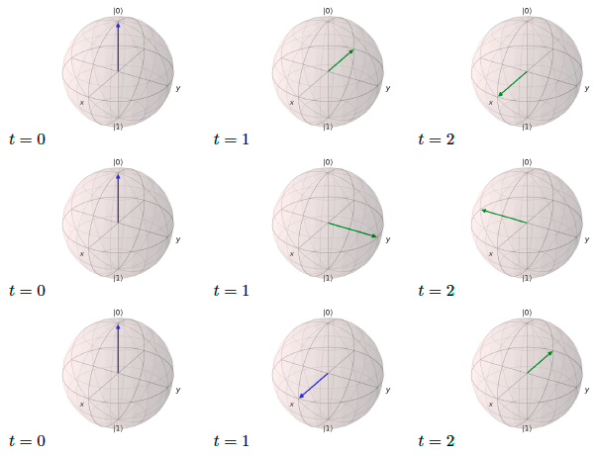
Option 1
Option 2
Option 3
Option 4

Slide 3

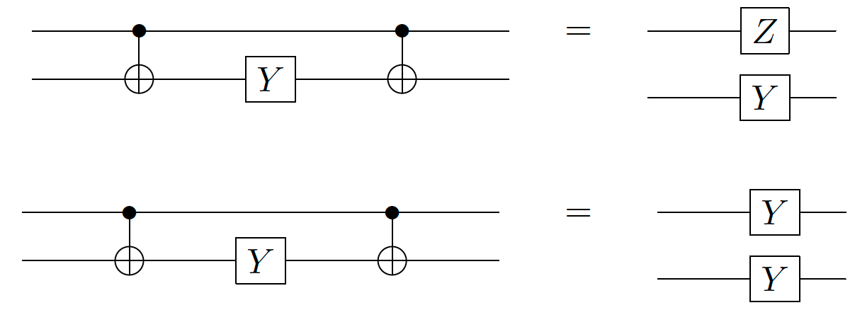
Option 1
Option 2
Option 3

