Slide 1
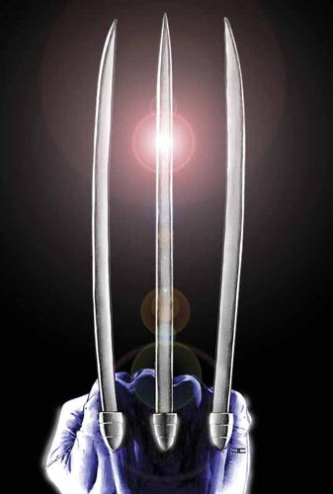
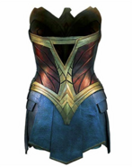

WHAT KIND OF MATERIAL WOULD YOU LIKE TO DESIGN?
Wolverine - Adamantium
Wonder Woman – Amazon suit
Black Panther - Vibranium

Slide 2
Introduction to Linux
Day 1:
YALE PATHWAYS TO SCIENCE SUMMER WORKSHOP 2021
Aakash Kumar
aakash.kumar@yale.edu
DESIGN OF NEW MATERIALS USING SUPERCOMPUTERS

Slide 3
LEARNING GOALS
Different type of Operating Systems (OS)
Introduction to Linux
Commands to change directories, view and edit files

Slide 4
QUIZ: WHICH OS DO YOU CURRENTLY USE?
A) Windows 10
B) MacOS
C) Ubuntu
D) Chrome OS
Personal laptop/desktop generally have Windows or MacOS
Both Ubuntu and Chrome OS are based on Linux
Notes:
Some of you are already using Linux in the form of Chrome OS

Slide 5


LINUX
Linux is the most common OS on large computing resources
Developed by Linus Torvalds in the early 90s
Advantages:
Security
Free (open-source)
Performance
Low specs (memory, storage) required
Tux the penguin
Android is Linux based
Notes:
Some historical figures

Slide 6
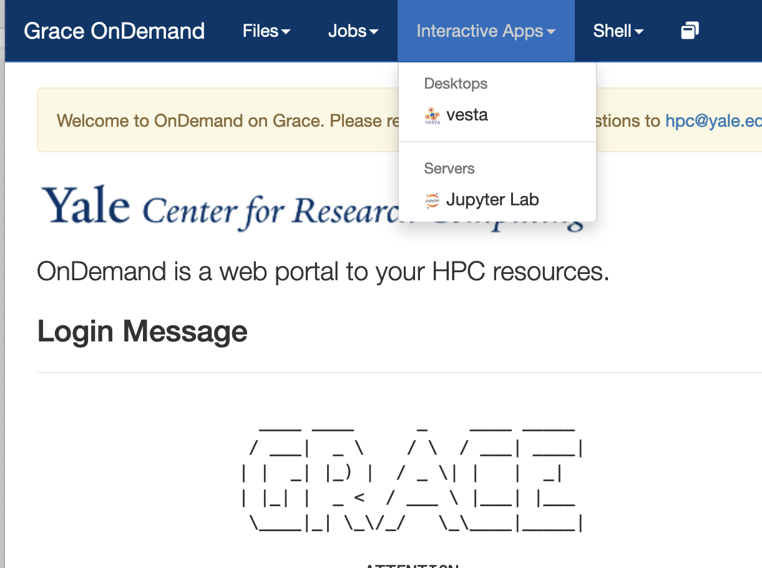
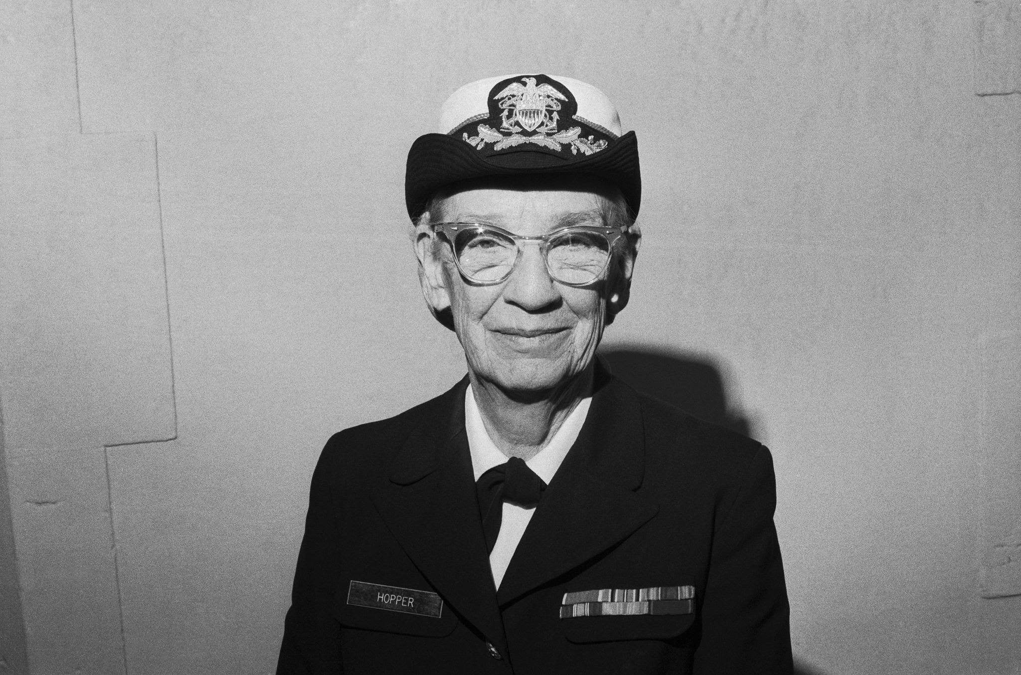
LOGGING ON TO GRACE
Grace Supercomputer on Yale (https://research.computing.yale.edu/)
Named after Grace Hopper, a pioneer of computer programing
Grace has ~ 27000 cores (compare it to a 2-core or a quad-core laptop)
Go to:
https://pathways.ycrc.yale.edu and type in your
netID and password
To use the supercomputer, we will use an
interface called JupyterLab!
Specify number of cores as 6, time as 2 hours
Grace Hopper

Slide 7
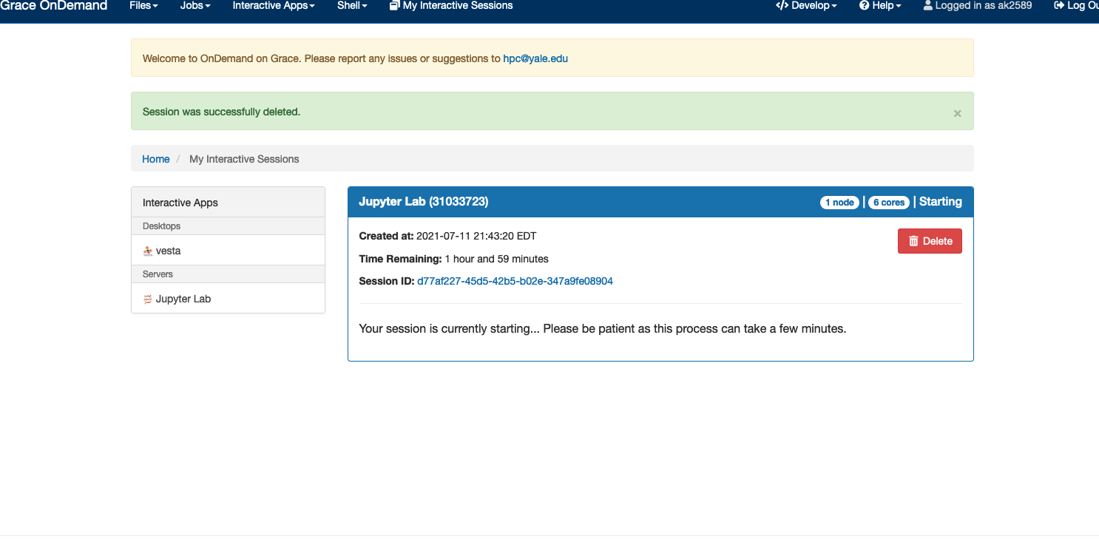
LOGGING ON TO GRACE
Grace Supercomputer on Yale (https://research.computing.yale.edu/)
Named after Grace Hopper, a pioneer of computer programing
Grace has over 25000 cores (compare it to a 2-core or a quad-core laptop)
Go to:
https://pathways.ycrc.yale.edu
To use the supercomputer, we will use an interface called JupyterLab!
Specify number of cores as 6, time as 2 hours
Grace Hopper

Slide 8
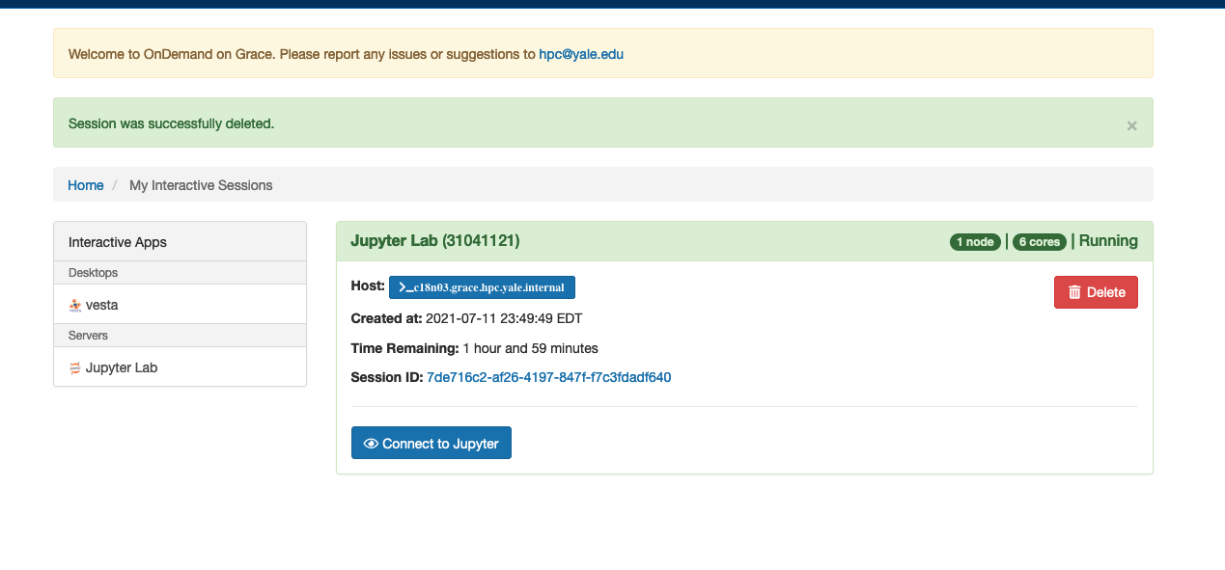
LOGGING ON TO GRACE
Grace Supercomputer on Yale (https://research.computing.yale.edu/)
Named after Grace Hopper, a pioneer of computer programing
Grace has over 25000 cores (compare it to a 2-core or a quad-core laptop)
Go to:
https://pathways.ycrc.yale.edu
To use the supercomputer, we will use an interface called JupyterLab!
Specify number of cores as 6, time as 2 hours
Grace Hopper

Slide 9
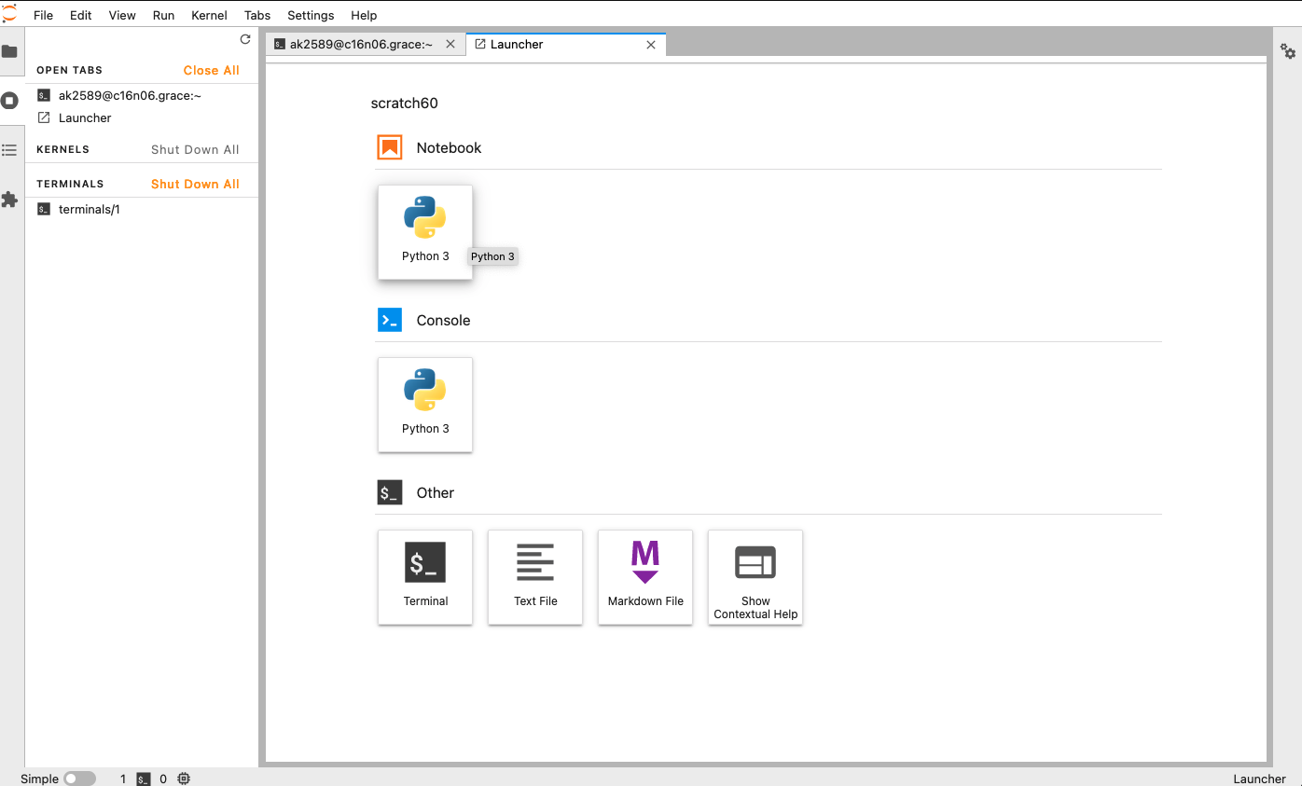
LEARNING GOALS
What is an Operating System?
Some example of supercomputers in action
We interact with the supercomputer using Linux command line by using commands
Notes:
This session is about Linux, which is the medium by which we interact with the supercomputer

Slide 10

LINUX COMMAND LINE
Your netid@computer node
ls (lists the contents of the current directory)
cd <directory> (takes you into <directory>)
cd Commands
cd .. (takes you one folder up)
Activity: type the following command
cd -
What does this do?
Notes:
Some historical figures

Slide 11
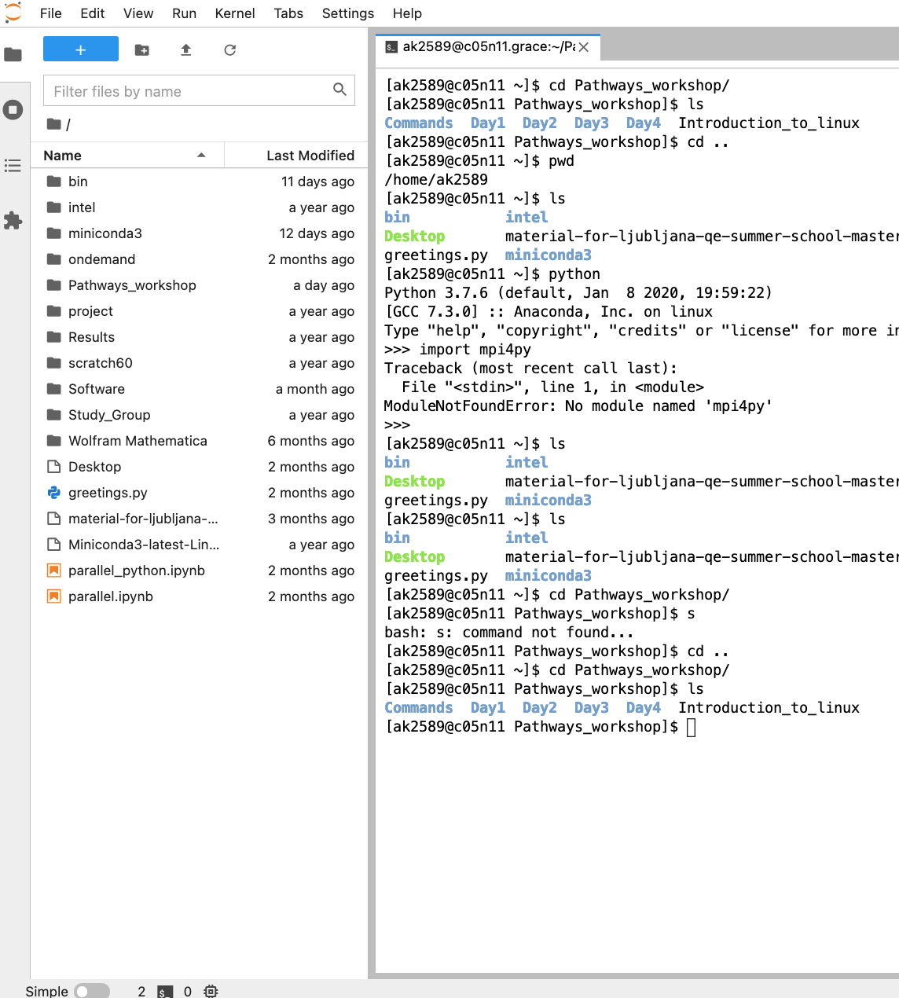
File Navigator on the left side
Go to Pathways_workshop

Slide 12
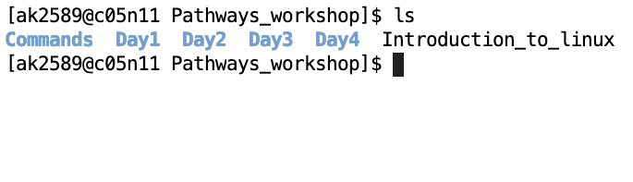
COPYING AND DELETING FILES
cp <filename1> <copy_of_filename1> (make a copy)
cp Introduction_to_linux intro
cp <filename1> <directory> (copy to a directory)
cp intro Day1
cd <directory> (takes you into <directory>)
cd Day1
ls (should show the file intro you just copied)
rm intro (deletes/removes the file)
Notes:
Some historical figures

Slide 13

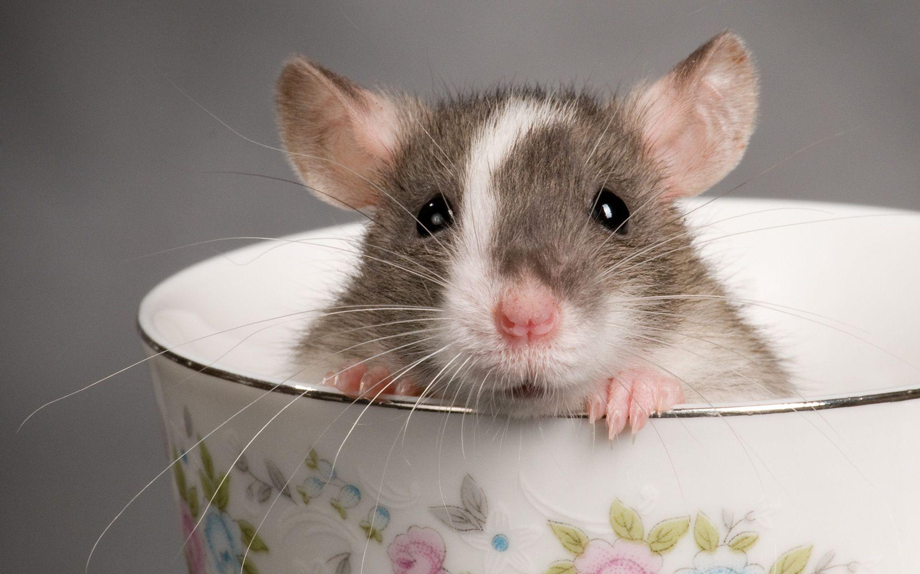
VIEWING AND EDITING FILES
We will use vim as the editor
very powerful and simple text editor
we use commands to view, edit and save files!
vi <filename>
vi command_list
To start typing, press ‘i’ key
bsudgwudghekce
press ‘Esc’ key to exit writing (insert) mode
save by :x and hit enter
Mouse not needed
Notes:
Some historical figures

Slide 14
VIEWING AND EDITING FILES
To ensure, file is not changed accidentally after some typing
type :q! and hit ‘enter’
vi command_list
Activity: Make some changes to the file (Hint: press ‘i’ to begin writing)
dd deletes the current line
What does 5dd do? Try it!
Exit the file saving the new changes (some lines deleted)!
Also, try opening the file from the Navigation pane on the left
Notes:
Some historical figures

Slide 15
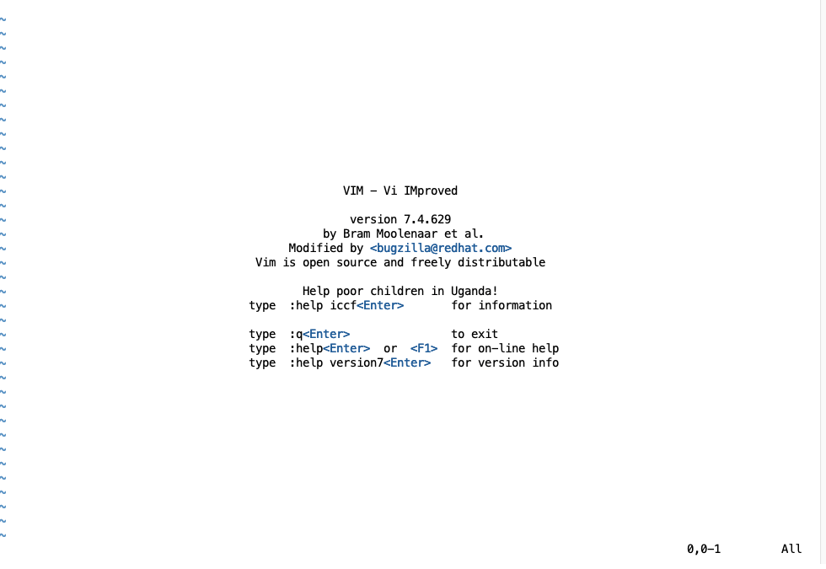
QUIZ
You opened a file using vi and accidentally made changes! What do you type to discard these changes and exit as it was earlier?
:x
5dd
:q!
The damage is done! Don’t cry
if you just type ‘vi’ it shows you all the
info you need about using it
vim is also available for windows and Mac
systems
(Correct Answer)
Notes:
Some historical figures

Slide 16
KEY POINTS
Linux is very powerful, free OS and secure OS.
We can use its command line interface to work with directories and files.
vim editor is a highly configurable text editor to create, edit and save files.

Slide 17
RESOURCES
Google search because linux & vim have a huge number of users
https://www.linux.org/forums/#linux-tutorials.122
https://vimhelp.org/vim_faq.txt.html
https://vim-adventures.com/ (play games and learn vim)
Notes:
Some historical figures

