Slide 1
Introduction to Parallel Computing
Day 2:
YALE PATHWAYS TO SCIENCE SUMMER WORKSHOP 2021
Aakash Kumar
aakash.kumar@yale.edu
DESIGN OF NEW MATERIALS USING SUPERCOMPUTERS

Slide 2
LEARNING GOALS
What is the difference between serial and parallel computing? Why do we need parallel computing?
introduction to programing
How supercomputers apply parallel computing
Message Passing Interface to apply parallel computing
Think of some examples where you benefit/can benefit from parallelization !!

Slide 3
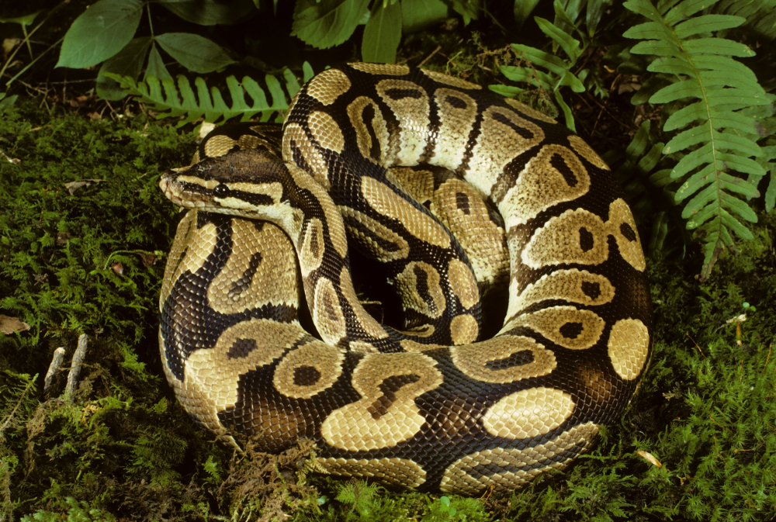
SERIAL PROGRAMING
QUIZ: Which is a programing language?
A) Rattlesnake
B) Garden snake
C) King Cobra
D) Python
Serial computing example next
Notes:
Some historical figures

Slide 4
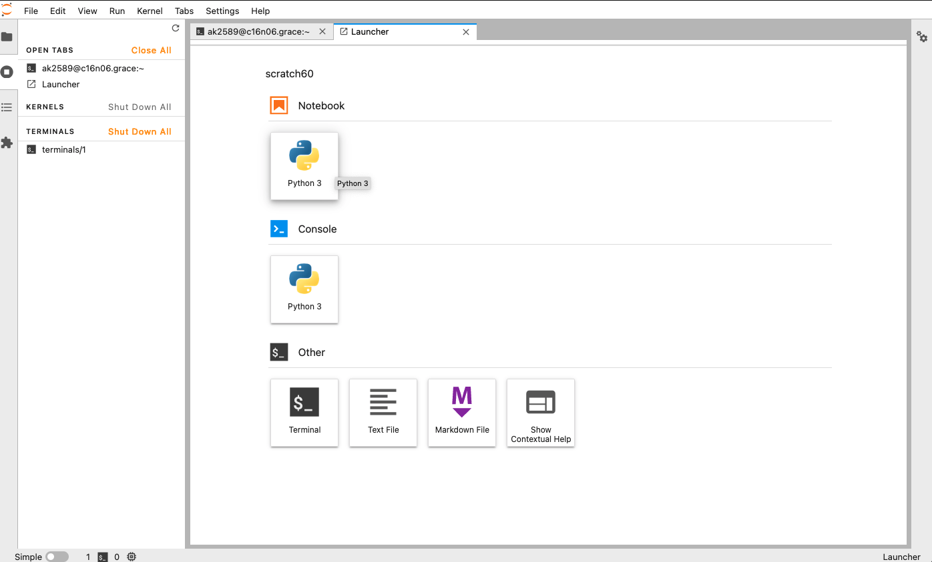
LEARNING GOALS
What is an Operating System?
Some example of supercomputers in action

Slide 5
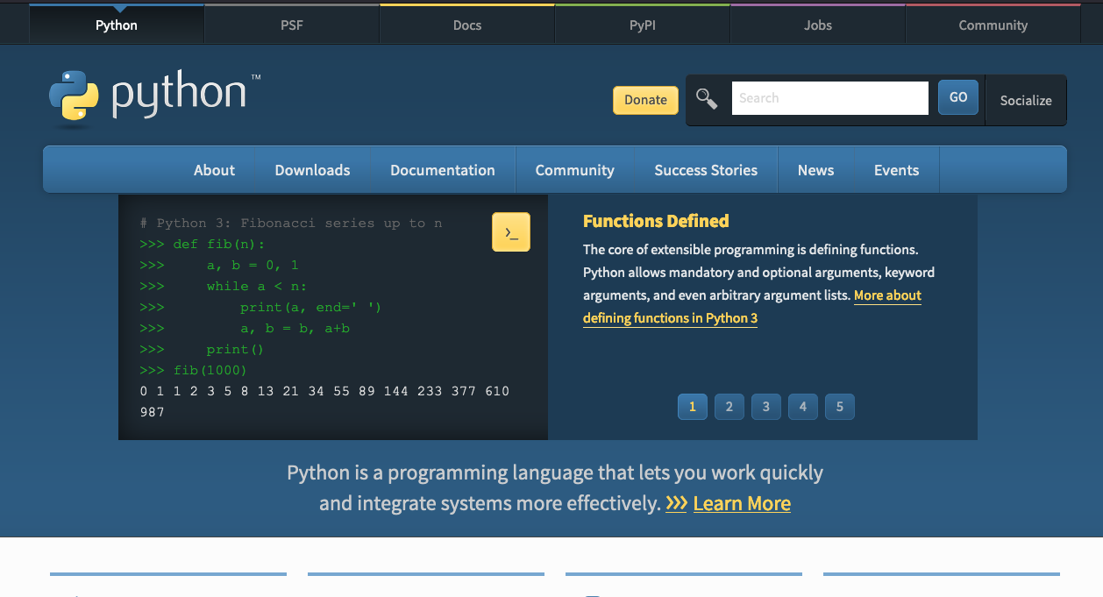
PYTHON
Scripting language
Object-oriented
Easy to read, friendly design
[Terminal] python
>>> a = 2
>>> b = 3
>>> c = a + b
>>> c
5
We can also write the above code in a file sum.py
then run it as
[Terminal] python sum.py
Notes:
Some historical figures

Slide 6
EXAMPLE
Write the code in a file sum.py
a = 2
b = 3
c = a + b
print(c)
print("The sum is", c)
numpy is a useful module in Python for numbers
import numpy as np
np.a = 2
np.b = 3
np.c = np.a + np.b
print(np.c)
Notes:
Some historical figures

Slide 7
EXAMPLE 2
Array is a list of data, represented in [], so a = [1 , 2, 3] is an array of size 3
Its elements are a[0], a[1], a[2]
numpy module can be used to create an array -> numpy provides functions
np.arange(3.0) [0, 1.0, 2.0]
directly define the array
2. np.a = np.array([3, 6, 3])
3. np.b = np.array([5, 5, 4])
Now these two arrays can be summed up
np.c = np.a + np.b
print(np.c)
>>[8, 11, 7]
Notes:
Some historical figures

Slide 8
SERIAL COMPUTING
Uses one process to do all the work
Heavy computations will be slow
What if we could do the work in parallel?
We could save time and money
We could work on more complex problems (climate change, energy, big data)
Start
Do All the work!
Notes:
Some historical figures

Slide 9
DIVIDE AND CONQUER
Divide the problem into smaller pieces - subtasks
Different processors
Activity: Breakout rooms 2 students each (grab a pen and a sheet of paper)
Isn’t Parallel computing fun?
Problem
Subtask1
Subtask2
Subtask3
Notes:
Sometimes some calculations we do can take over a moth on regular serial computing

Slide 10
DIVIDE AND CONQUER
Divide the problem into smaller pieces - subtasks
Different processors
Problem
Subtask1
Subtask2
Subtask3
Subtask4
Subtask5
Subtask6
Notes:
Some historical figures

Slide 11
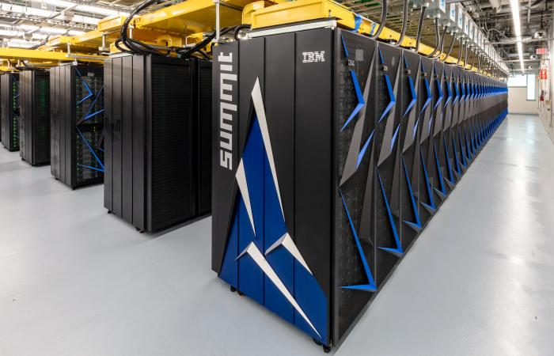
HEAD NODE & COMPUTE NODES
Summit – ORNL, Tennessee
User communicates to the “Head Node”
“Head Node” instructs the ”Compute Nodes”
to carry out the job.
Head Node
Compute node1
Compute node2
Compute node3
Compute node4
Compute node5
compute node6
Notes:
Some historical figures

Slide 12
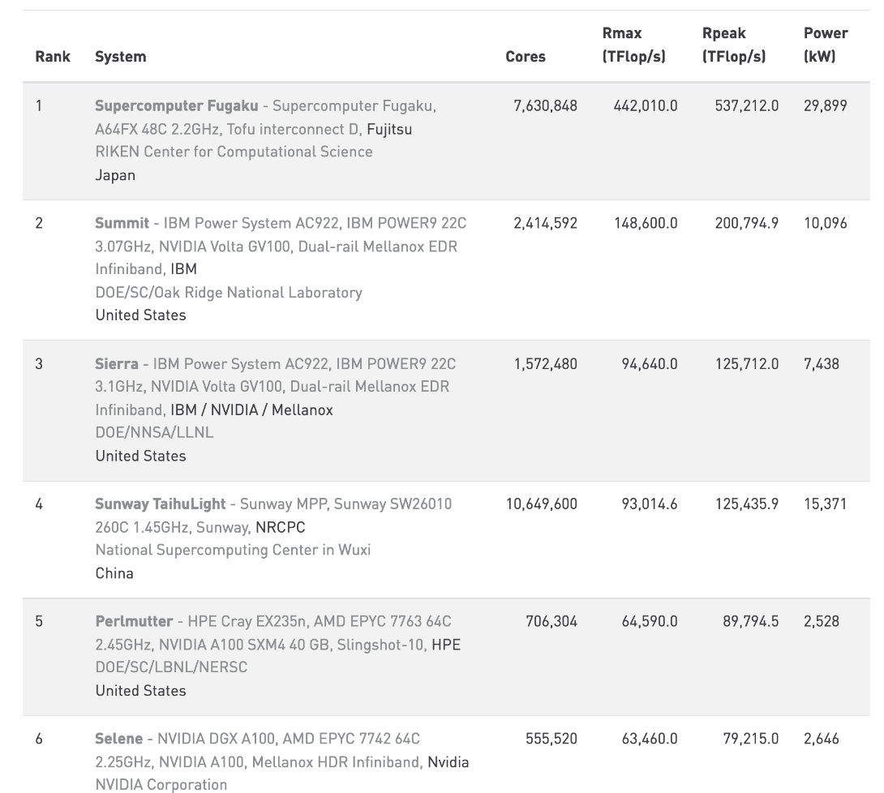
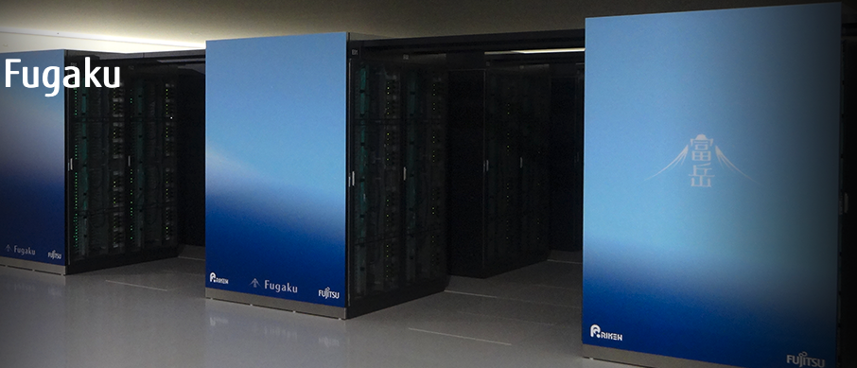
FASTEST SUPERCOMPUTERS
www.top500.org lists the fastest machines
Summit at Oak Ridge national lab
in Tennessee
Fugaku
(https://www.fujitsu.com/global/about/innovation/fugaku/ )
Notes:
Some historical figures

Slide 13
SHARED MEMORY SYSTEMS
CPU
Entire memory shared between all CPUs here
CPUs perform their subtasks individually
Think of 4 members making a dish for a party!
Thanksgiving turkey?
Memory
CPU
CPU
CPU
Notes:
Some historical figures

Slide 14
DISTRIBUTED MEMORY SYSTEMS
CPU
Memory
CPUs have different local memory
CPUs perform their subtasks without any interference
Communication network required to connect
inter-process memory
Example: musicians (from our workshop) performing together
Most modern computing systems use a hybrid shared-distributed
memory
Memory
CPU
Network
Memory CPU
Memory
CPU
Notes:
Some historical figures

Slide 15
HOW TO USE PARALLEL MACHINES
CPU
Memory
Message Passing Interface (MPI) is a commonly used system
Data moved from one part to another using
cooperation between CPUs
For our workshop:
Python programing language
mpi4py python module
How to run in parallel:
serial:
python program.py
On n=6 cores,
mpirun –n 6 python program.py
MPI
MPI
MPI
Memory
CPU
Network
Memory CPU
MPI
Memory
CPU
Notes:
Zoom poll: which is a language

Slide 16
EXAMPLE: PRINT “HELLO”
hello.py
Code snippet:
from mpi4py import MPI
comm = MPI.COMM_WORLD # comm is the MPI object we will use
size = comm.Get_size() # how many processes (1 on each core)
rank = comm.Get_rank() # rank of processor (ID) 0 is head processor
print("Hello world from rank", str(rank), "of", str(size))
mpirun –n 4 python hello.py
Hello world from rank 0 of 4
Hello world from rank 1 of 4
Hello world from rank 2 of 4
Hello world from rank 3 of 4
Notes:
Some historical figures

Slide 17
BROADCAST
broadcast data to all cores
Code snippet:
if rank == 0:
data = np.arange(4.0)
else:
data = None
data = comm.bcast(data, root=0)
if rank == 0:
print('Process {} broadcast data:' .format(rank), data)
else:
print('Process {} received data:' .format(rank), data)
mpirun –n 4 python bcast.py
Process 0 broadcast data: [0. 1. 2. 3.]
Process 2 received data: [0. 1. 2. 3.]
Process 1 received data: [0. 1. 2. 3.]
Process 3 received data: [0. 1. 2. 3.]
Notes:
Some historical figures

Slide 18
ZOOM POLL
Amber alert for thunderstorms is an example of broadcast?
True
False
If hurricane Elsa reaches Miami, FL in the morning and New Haven in the afternoon, should we send same messages by broadcasting to the two states?
We could, but separate alerts might be better -> scatter message to different states
Weather Department
Broadcast
County1
County2
County3
Notes:
Some historical figures

Slide 19
SCATTER
scatter data to various cores
Code snippet:
if rank == 0:
data = np.arange(4.0)
else:
data = None
data = comm.scatter(data, root=0)
if rank == 0:
print('Process {} broadcast data:' .format(rank), data)
else:
print('Process {} received data:' .format(rank), data)
mpirun –n 4 python scatter.py
Process 0 has data: 0.0
Process 1 has data: 1.0
Process 2 has data: 2.0
Process 3 has data: 3.0
Notes:
Some historical figures

Slide 20
GATHER
mpirun –n 4 python scatter_sum.py
Gather data from all cores and do something (SUM it up, etc.)
Code snippet:
do something.
…………
create an array -> data = np.arange(16.0). [0, 1.0, 2.0, ….,15.0]
scatter this data to all cores -> np.array_split(data, size)
…………
partial_sum = comm.gather(partial_sum, root=0)
if rank == 0:
print(Sum is {} from all data:' .format(sum(partial_sum)))
Process 0 has data: [0. 1. 2. 3.]
Process 1 has data: [4. 5. 6. 7.]
Process 2 has data: [ 8. 9. 10. 11.]
Process 3 has data: [12. 13. 14. 15.]
Sum is 120.0 from all data
Notes:
Some historical figures

Slide 21
KEY POINTS
python language is useful for serial and parallel computing
Supercomputers have a hybrid of shared & distributed memory systems
For parallel computing, we use mpi4py module
basic communication techniques
broadcast – send the entire data to all processors
scatter – send different data to different processors
gather – gather the data from all processors and do some operation

Slide 22
RESOURCES
https://hpc.llnl.gov/training/tutorials/introduction-parallel-computing-tutorial
https://towardsdatascience.com/parallel-programming-in-python-with-message-passing-interface-mpi4py-551e3f198053
https://www.kth.se/blogs/pdc/2019/08/parallel-programming-in-python-mpi4py-part-1/
Notes:
Some historical figures

