Slide 1
Introduction to Parallel Computing: Hands-on
Day 2:
YALE PATHWAYS TO SCIENCE SUMMER WORKSHOP 2021
Aakash Kumar
aakash.kumar@yale.edu
DESIGN OF NEW MATERIALS USING SUPERCOMPUTERS

Slide 2
LEARNING GOALS
Run basic python scripts to sum numbers and arrays
Run parallel script to access difference cores
Apply the ideas of broadcasting, scattering and gathering from parallel computing lecture earlier

Slide 3
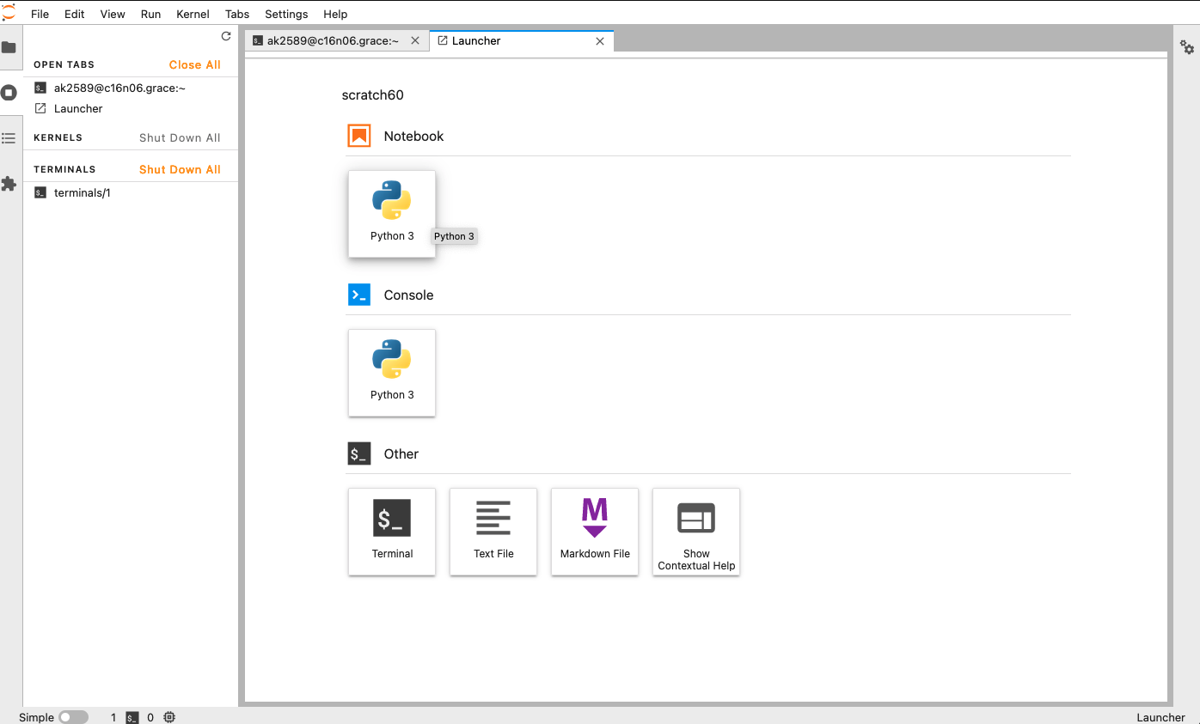
LEARNING GOALS
What is an Operating System?
Some example of supercomputers in action
Open the terminal then type day2 and hit Enter
Notes:
This session is about Linux, which is the medium by which we interact with the supercomputer

Slide 4
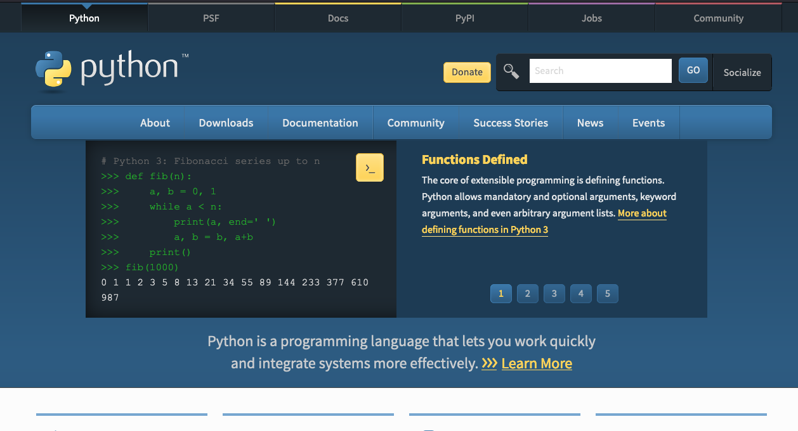
PYTHON
Scripting language
Object-oriented
Easy to read, friendly design
[Terminal] python
>>> a = 2
>>> b = 3
>>> c = a + b
>>> c
5
Exit the python environment (>>>) by pressing Ctrl+D
We can also write the above code in a file sum.py
then run it as
[Terminal] python sum.py
Notes:
Some historical figures

Slide 5
EXERCISE 1a, 1b, 1c
run the code in file 1a_sum.py
a = 2
b = 3
c = a + b
print(c)
print("The sum is", c)
repeat the above with floating point numbers, so 2 is 2.0 (1b_sum_float.py)
Use numpy module of python to define a and b as np.a, np.b and sum (1c_sum_numpy.py)
import numpy as np
np.a = 2
np.b = 3
np.c = np.a + np.b
print(np.c)
Notes:
Some historical figures

Slide 6
EXERCISE 1d, 1e
Array is a list of data, represented in [], so a = [1 , 2, 3] is an array of size 3
Its elements are a[0], a[1], a[2]
numpy module can be used to create an array
np.a = np.array([1, 2, 3])
np.b = np.array([4, 5, 6])
Run the following code in a file 1d_sum_array.py
np.c = np.a + np.b
print(np.c)
print("The sum is", np.c)
Notes:
Some historical figures

Slide 7
EXERCISE 2
Copy the below code snippet to a file called hello.py
from mpi4py import MPI
comm = MPI.COMM_WORLD # comm is the MPI object we will use
size = comm.Get_size() # how many processes (1 on each core)
rank = comm.Get_rank() # rank of processor (ID) 0 is head processor
print("Hello world from rank", str(rank), "of", str(size))
Run the python program greetings.py on 6 cores (format is slightly different than what is shown here, notice the comm.send and comm.recv)
Each core will print its rank and total number of cores
mpirun –n 6 python greetings.py
Notes:
Some historical figures

Slide 8
EXERCISE 3: BROADCAST
broadcast data to all cores
Code snippet:
if rank == 0:
data = np.arange(4.0)
else:
data = None
data = comm.bcast(data, root=0)
if rank == 0:
print('Process {} broadcast data:' .format(rank), data)
else:
print('Process {} received data:' .format(rank), data)
mpirun –n 4 python bcast.py
Process 0 broadcast data: [0. 1. 2. 3.]
Process 2 received data: [0. 1. 2. 3.]
Process 1 received data: [0. 1. 2. 3.]
Process 3 received data: [0. 1. 2. 3.]
Notes:
Some historical figures

Slide 9
EXERCISE 4: SCATTER
scatter different data to various cores
Code snippet:
if rank == 0:
data = np.arange(4.0)
else:
data = None
data = comm.scatter(data, root=0)
if rank == 0:
print('Process {} broadcast data:' .format(rank), data)
else:
print('Process {} received data:' .format(rank), data)
4b_scatter.py scatters arrays of data to all cores.
mpirun –n 4 python 4a_scatter.py
Process 0 has data: 0.0
Process 1 has data: 1.0
Process 2 has data: 2.0
Process 3 has data: 3.0
Notes:
Some historical figures

Slide 10
EXERCISE 5: GATHER
Gather data from all processes/cores and Do something (SUM it up, etc.)
Code snippet:
do something
…………
…………
…………
…………
partial_sum = comm.gather(partial_sum, root=0)
if rank == 0:
print(Sum is {} from all data:' .format(sum(partial_sum)))
mpirun –n 4 python 5_gather.py
Notes:
Some historical figures

Slide 11
EXSERICSE 5:REDUCE
reduce data from all processes/cores and sum it while collecting
Code snippet:
do something
…………
…………
…………
…………
total_sum = comm.reduce(partial_sum, op=MPI.SUM, root=0)
if rank == 0:
print(Sum is {} from all data:' .format(total_sum))
mpirun –n 4 python 5_reduce.py
Notes:
Some historical figures

Slide 12
RESOURCES
https://hpc.llnl.gov/training/tutorials/introduction-parallel-computing-tutorial
https://towardsdatascience.com/parallel-programming-in-python-with-message-passing-interface-mpi4py-551e3f198053
https://www.kth.se/blogs/pdc/2019/08/parallel-programming-in-python-mpi4py-part-1/
Notes:
Some historical figures

