Slide 1
Introduction to Materials Science: Hands-on
Day 3:
YALE PATHWAYS TO SCIENCE SUMMER WORKSHOP 2021
Aakash Kumar
aakash.kumar@yale.edu
DESIGN OF NEW MATERIALS USING SUPERCOMPUTERS

Slide 2
LEARNING GOALS
Use VESTA to load structures of Au, Fe and NaCl
Measure lattice parameters, nearest-neighbor distances
Create new structures files that contain defects (vacancies, interstitials, antisites)

Slide 3
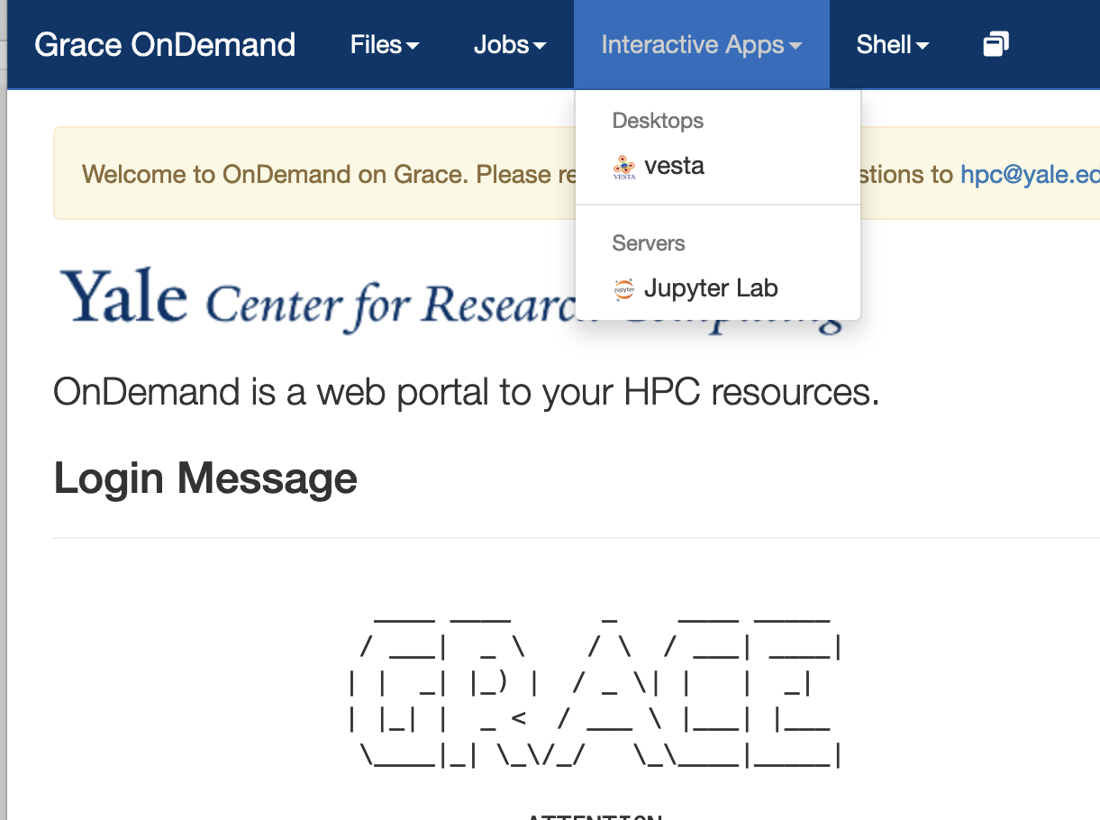
VESTA TO VIEW STRUCTURES
We will use VESTA to visualize the structures!
Go to:
https://pathways.ycrc.yale.edu
Click on vesta under interactive Apps
Go to Day 3 directory inside the
Pathways_workshop directory
Notes:
Some historical figures

Slide 4
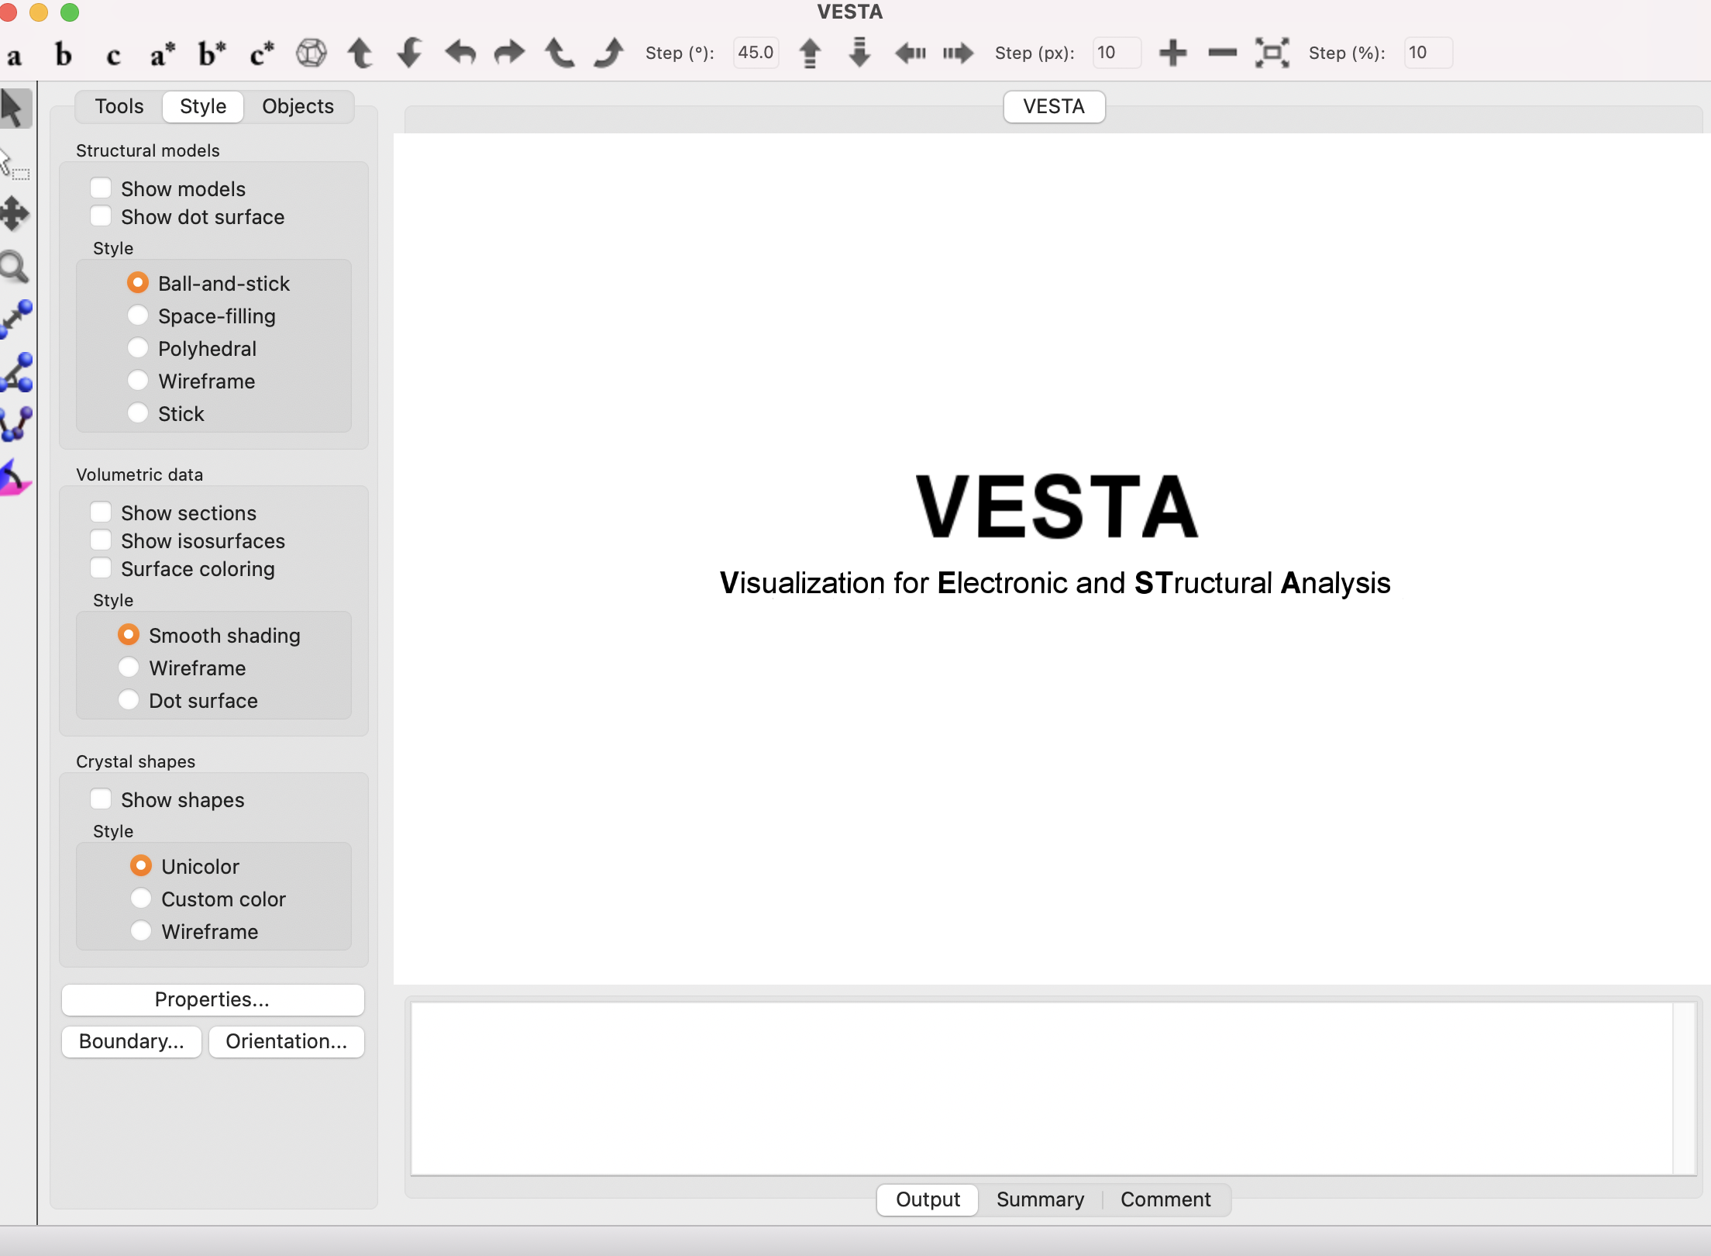
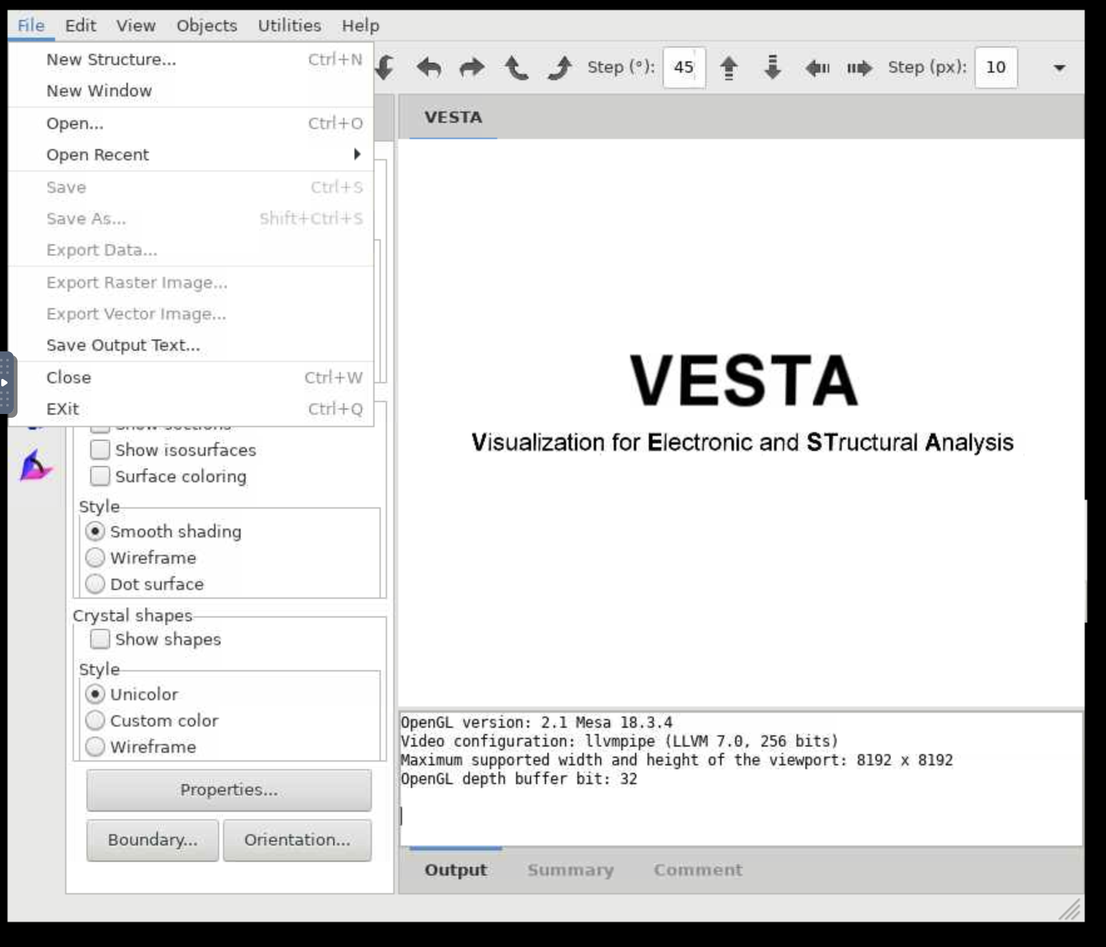
VESTA TO VIEW STRUCTURES
We will use VESTA to visualize the structures!
Go to:
https://pathways.ycrc.yale.edu
Click on vesta under interactive
Go to Day 3 directory inside the
Pathways_workshop directory
Notes:
Some historical figures

Slide 5
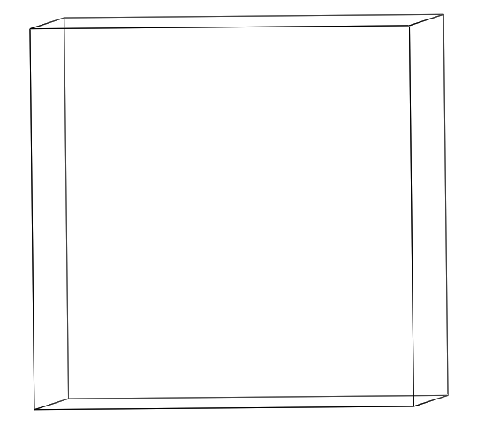
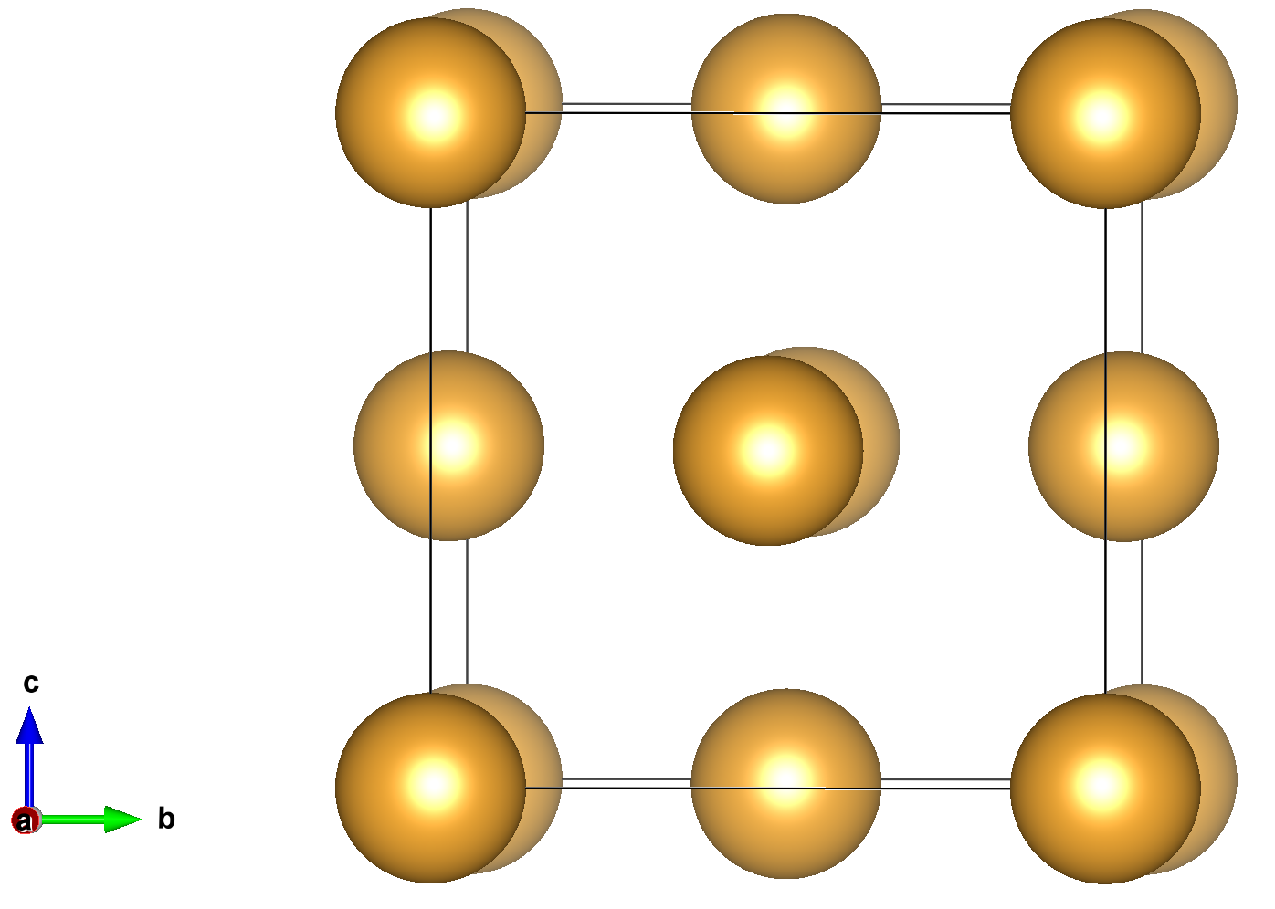
Au CRYSTAL STRUCTURE
Properties of Crystal:
three-dimensional (3D) repeating
ordered arrangement
How do we simplify this large structure?
Unit-cell
-smallest repeating unit which gives us the crystal structure
For gold, the structure is face-centered cubic (fcc)
- Atoms at corners of the cube
- Atoms at face-centers
We will use VESTA to visualize the structures! (Hands-on)
Notes:
Some historical figures

Slide 6
Au CRYSTAL STRUCTURE
Open the POSCAR_Au.vasp in Jupyterlab editor.
POSCAR file contains the structure
Let’s go to zoom whiteboard!
Name
Au
1.0
4.078200 0.00000 0.000000
0.000000 4.07820 0.000000
0.000000 0.00000 4.078200
Au
4
direct
0.000000 0.000000 0.000000 Au
0.500000 0.500000 0.000000 Au
0.000000 0.500000 0.500000 Au
0.500000 0.000000 0.500000 Au
Scaling Factor – leave it as 1
a crystal lattice vector -> x axis
b crystal lattice vector -> y axis
c crystal lattice vector -> z axis
Chemical Symbol(s) in the same order as their count below
Number of atoms of each type
positions with respect to a cell of length 1
x, y and z coordinates of each atom
Notes:
Some historical figures

Slide 7
NaCl Crystal Structure
Open the POSCAR_NaCl.vasp in Jupyterlab editor.
Na4 Cl4
1.0
5.691694 0.000000 0.000000
0.000000 5.691694 0.000000
0.000000 0.000000 5.691694
Na Cl
4 4
direct
0.000000 0.000000 0.000000 Na
0.000000 0.500000 0.500000 Na
0.500000 0.000000 0.500000 Na
0.500000 0.500000 0.000000 Na
0.500000 0.000000 0.000000 Cl
0.500000 0.500000 0.500000 Cl
0.000000 0.000000 0.500000 Cl
0.000000 0.500000 0.000000 Cl
Chemical Symbol(s) in the same order as their count below
Recall the Au FCC
Number of atoms of each type
positions with respect to a cell of length 1
0.000000 0.000000 0.000000 Na
0.000000 0.500000 0.500000 Na
0.500000 0.000000 0.500000 Na
0.500000 0.500000 0.000000 Na
x, y and z coordinates of each atom
Fe BCC
0.500000 0.500000 0.500000 Cl
0.500000 0.000000 0.000000 Cl
0.000000 0.000000 0.500000 Cl
0.000000 0.500000 0.000000 Cl
Cl on each axis
Notes:
Some historical figures

Slide 8
EXERCISE 1
Fill out the following table after measuring the distances in VESTA
Compare with the known value in literature from experiments.
 | Measured lattice parameter a(Å) | Measured d-1NN (Å) | Experimental a(A)*
Au
Fe
NaCl
* Google search lattice parameter of gold/Fe/NaCl and fill in the value
Notes:
Some historical figures

Slide 9
EXERCISE 2
Copy POSCAR_Au.vasp to a new file POSCAR_Au_vacancy.vasp
cp POSCAR_Au.vasp POSCAR_AU_vacancy.vasp
Delete on Au atom and save it
Open it in VESTA. Can you see the vacancy?
Repeat the same for POSCAR_Fe.vasp (copy to POSCAR_Fe_vacancy.vasp)
Delete the Fe atom at 0.5, 0.5, 0.5 and save the file
Open in VESTA. Notice the vacancy!
Copy POSCAR_Fe.vasp to POSCAR_Fe_Au_defect.vasp
Change the atom type of 0.5, 0.5, 0.5 to Au
What kind of defect did we create?
Notes:
Some historical figures

Slide 10
EXERCISE 3
Copy POSCAR_Fe.vasp to POSCAR_Fe_Au_defect.vasp
Change the atom type of 0.5, 0.5, 0.5 to Au
What kind of defect did we create?
Copy POSCAR_Fe.vasp to POSCAR_Fe_intersitital.vasp
Add an additional Fe atom at 0.0, 0.0, 0.5
Can you see the intersititial defect we created?
Notes:
Some historical figures

Slide 11
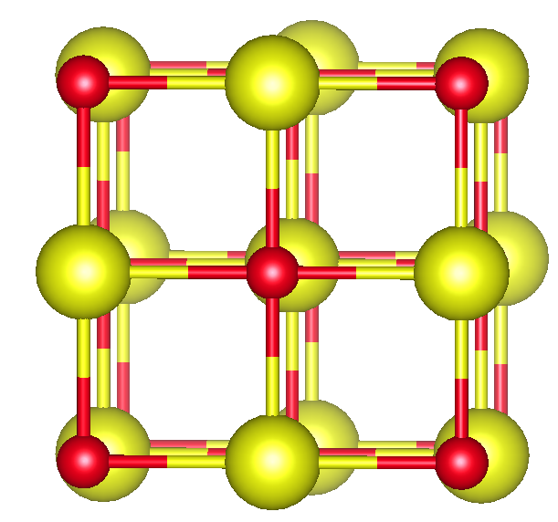
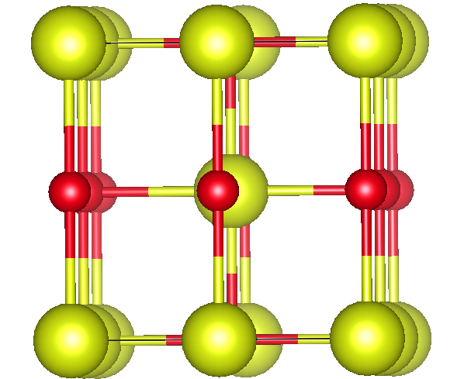
EXERCISE 4
Create an antistite defect in NaCl
Copy POSCAR_NaCl.vasp to POSCAR_NaCl_antisite.vasp
Do you see the Na and Cl atoms swapping positions?
Notes:
Some historical figures

