Slide 1
Computational
Materials Science: Hands-on
Day 3:
YALE PATHWAYS TO SCIENCE SUMMER WORKSHOP 2021
Aakash Kumar
aakash.kumar@yale.edu
DESIGN OF NEW MATERIALS USING SUPERCOMPUTERS

Slide 2
HANDS-ON SESSION
Quantum Espresso – Software to calculate the energies of structures
Finding the lowest-energy structure of Au, Fe and NaCl
Lattice parameters of the lowest-energy structures and comparison with earlier experimental data

Slide 3
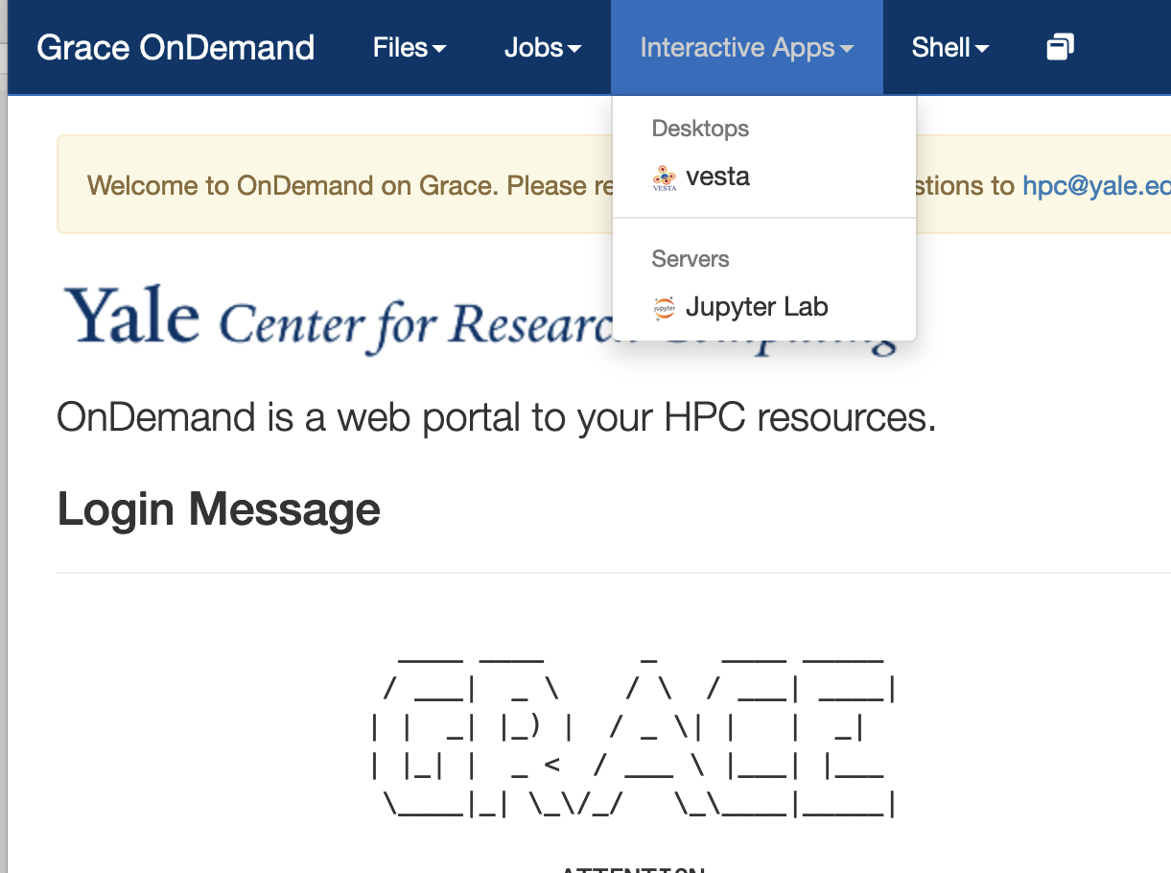
Day 4
We will use Quantum Espresso to do the energy calculations using Density Functional Theory (DFT).
Go to:
https://pathways.ycrc.yale.edu
Click on Jupyter Lab under interactive Apps
Go to Day 4 directory inside the
Pathways_workshop directory
Notes:
Some historical figures

Slide 4
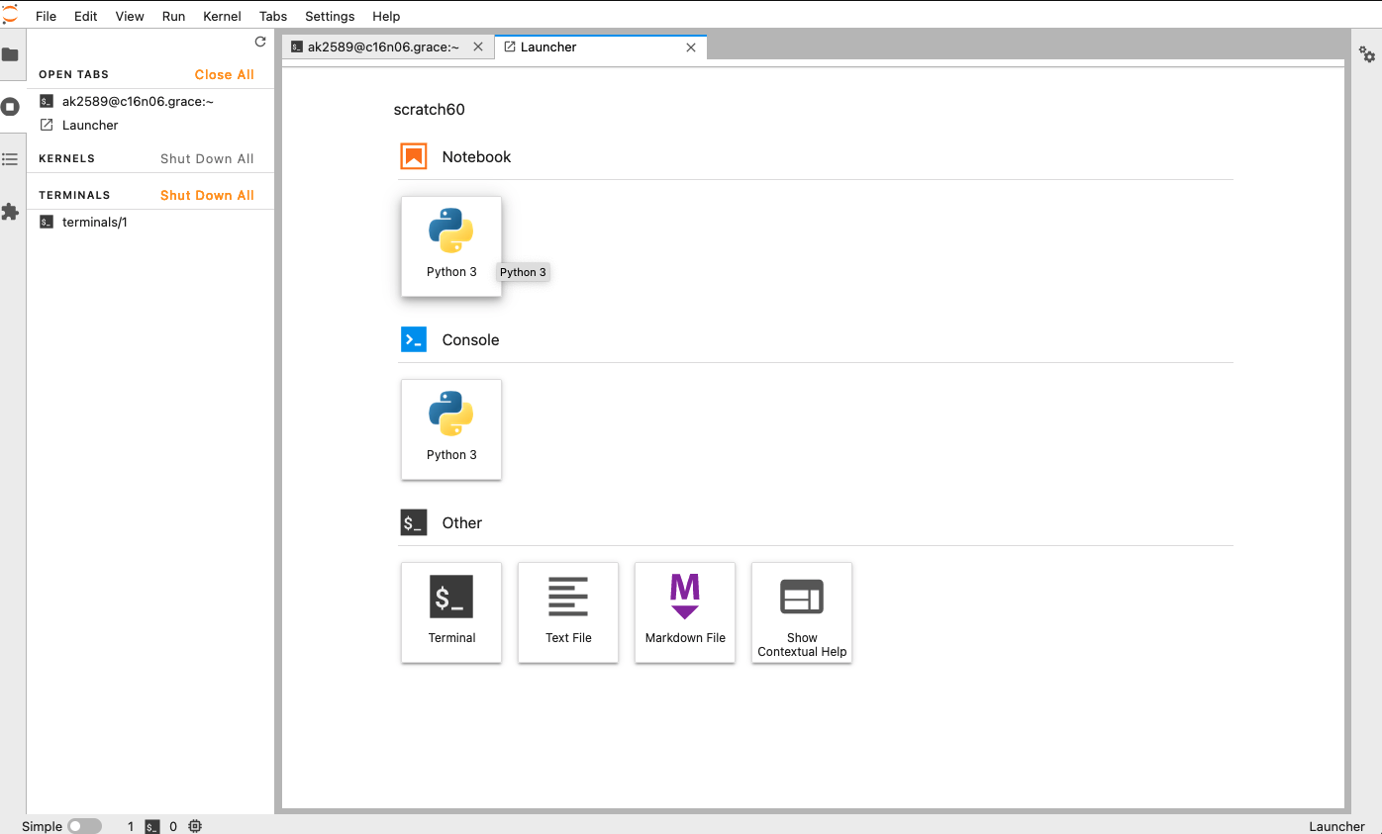
LEARNING GOALS
What is an Operating System?
Some example of supercomputers in action
Open the terminal then type day4 and hit Enter

Slide 5

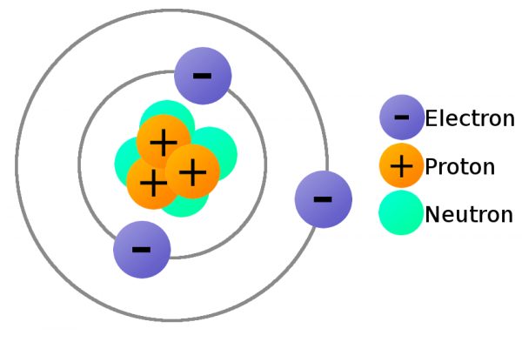
QUANTUM ESPRESSO (QE)
Quantum Espresso is a software to calculate the energies, forces, …. of a structure made of atoms.
open-source (free to use!)
focus on valence electrons of atoms.
https://www.quantum-espresso.org/
Notes:
Some historical figures

Slide 6

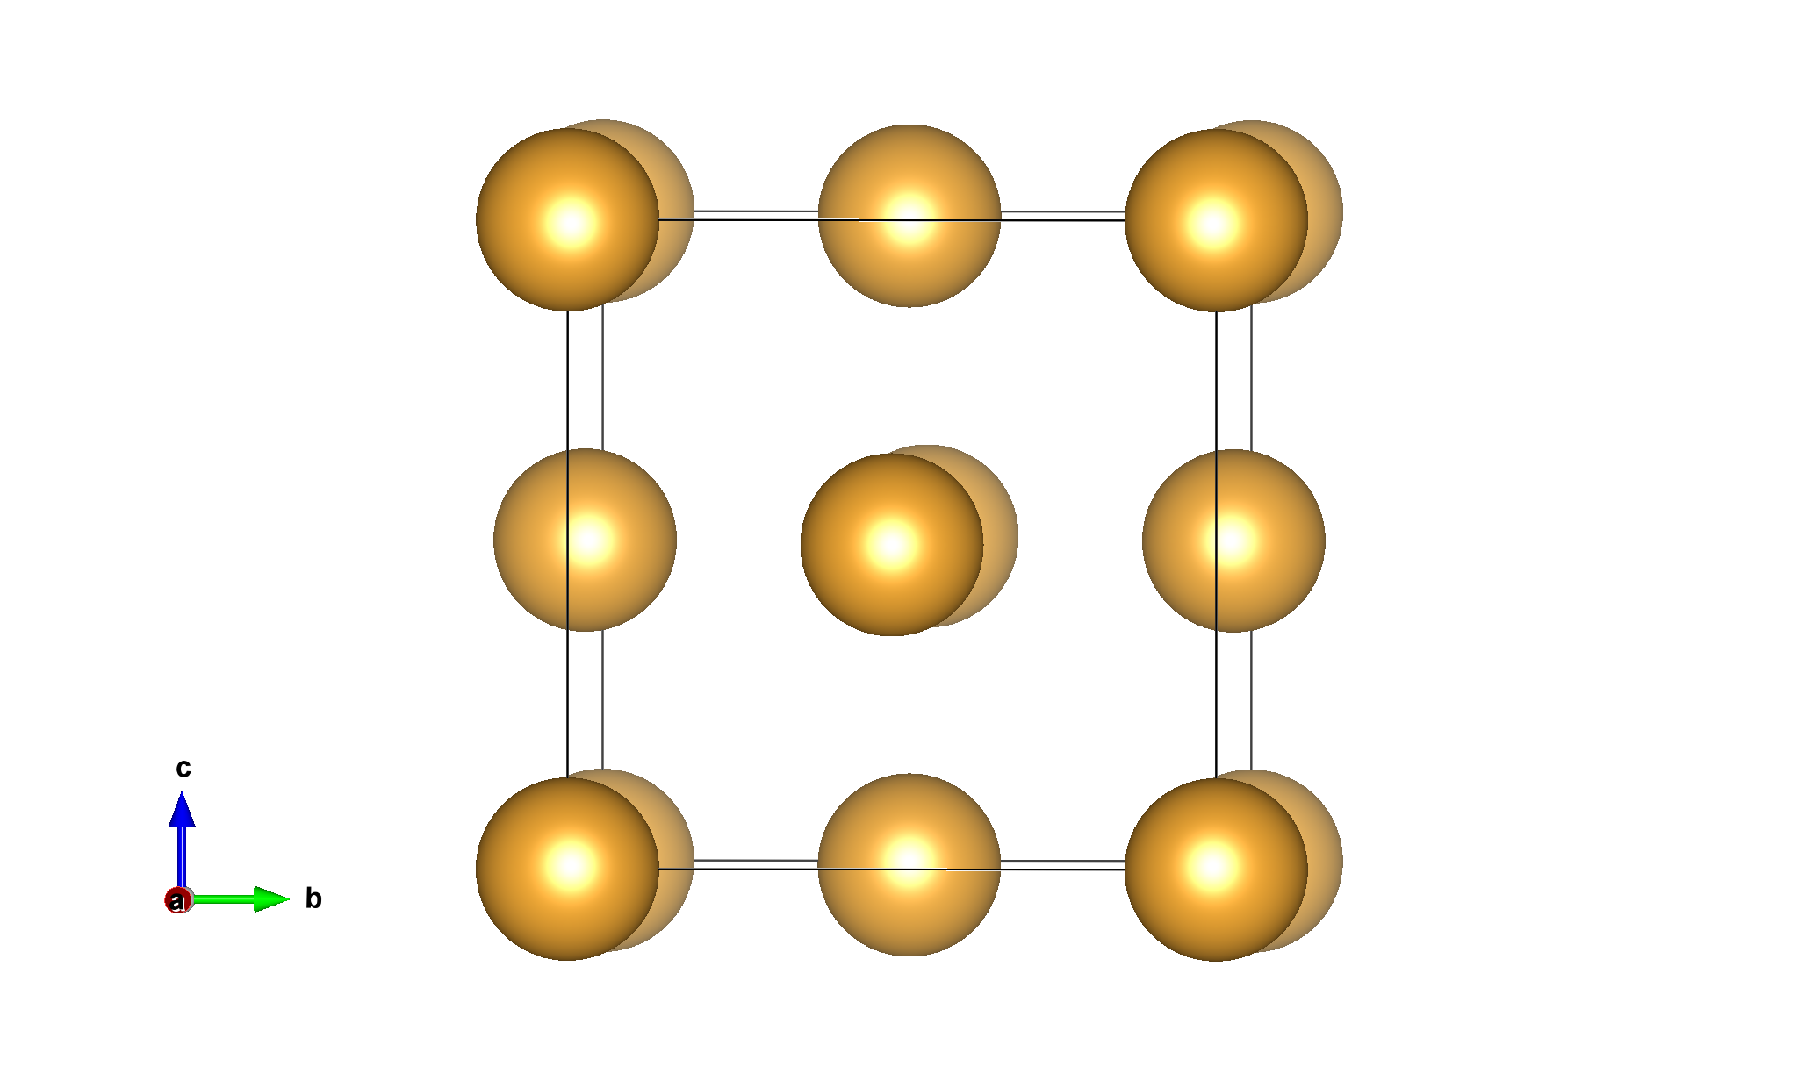
QE BASIC WORKFLOW
Provide the structure to QE
QE calculates the energy of the input structure based on the settings
Move the atoms such that the energy decreases (our goal is to find the minimum energy)
We continue Steps 2 and 3 until convergence is reached (energy and force on atoms don’t change much)
Energy
Input structure
Energies, forces,
lattice parameter
Quantum Espresso (QE)
pw.x
Notes:
Some historical figures

Slide 7
QE INPUT FILE
https://www.quantum-espresso.org/Doc/INPUT_PW.html
Different sections separated by &…. /
&control
prefix = 'gold’ ! prefix for the generated files
calculation = 'relax’ ! type of calculation, relax the atoms
restart_mode = 'from_scratch’! fresh calculation
tstress = .true. ! calculate the stress
tprnfor = .true. ! calculate the forces
pseudo_dir = './’ ! directory containing the potential file
etot_conv_thr = 1.0d-4 ! energy convergence threshold
forc_conv_thr = 1.0d-3 ! force convergence threshold
/
&system
ntype = 1 ! types of atoms
nat = 4 ! number of atoms
ibrav = 0 ! related to crystal structure
ecutwfc = 40 ! convergence parameter
occupations = 'smearing'
smearing = 'gaussian’ ! settings for metals
degauss = 5d-3
/
Notes:
Some historical figures

Slide 8
QE INPUT FILE- STRUCTURE
https://www.quantum-espresso.org/Doc/INPUT_PW.html
Structure data includes lattice parameters and atom positions
Does this look familiar?
Au
1.0
4.078200 0.00000 0.000000
0.000000 4.07820 0.000000
0.000000 0.00000 4.078200
Au
4
direct
0.000000 0.000000 0.000000 Au
0.500000 0.500000 0.000000 Au
0.000000 0.500000 0.500000 Au
0.500000 0.000000 0.500000 Au
CELL_PARAMETERS angstrom
4.100000 0.000000 0.000000
0.000000 4.100000 0.000000
0.000000 0.000000 4.100000
ATOMIC_SPECIES
Au 196.970 Au.potential.UPF (core electrons)
ATOMIC_POSITIONS crystal
Au 0.000000 0.00000 0.000000
Au 0.500000 0.50000 0.000000
Au 0.000000 0.50000 0.500000
Au 0.500000 0.00000 0.500000
our POSCAR file for Au

Slide 9
SOME CONVERGENCE TIPS
https://www.quantum-espresso.org/Doc/INPUT_PW.html
ecutwfc is the energy cut-off of functions that we use to represent atoms
K-points are point on the lattice where we calculate the energies
&system
….
ecutwfc = 40 ! increase this value systematically
….
/
K_POINTS automatic ! points to sample on the lattice
4 4 4 0 0 0 ! increase this systematically

Slide 10
EXERCISE 1- Au
Remember, lattice parameter
a_Au = 4.08 Å
Here, we will change this to different values
4, 4.1, 4.2 and 4.3
We will calculate the energy of Au structure at each
lattice parameter value using QE
a_Au
Notes:
Some historical figures

Slide 11
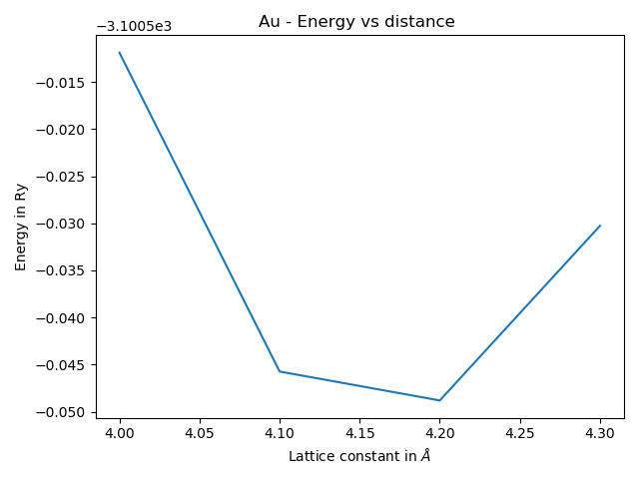
EXERCISE 1- Au
Remember, lattice parameter
a_Au = 4.08 Å
Here, we will change this to different values
4, 4.1, 4.2 and 4.3
We will calculate the energy of Au structure at each
lattice parameter value using QE
The lowest energy structure gives us the lattice parameter
We can plot the energy vs distance to find the energy minimum (plt_energy_dist.py)
lowest energy -> lattice param.
Notes:
Some historical figures

Slide 12
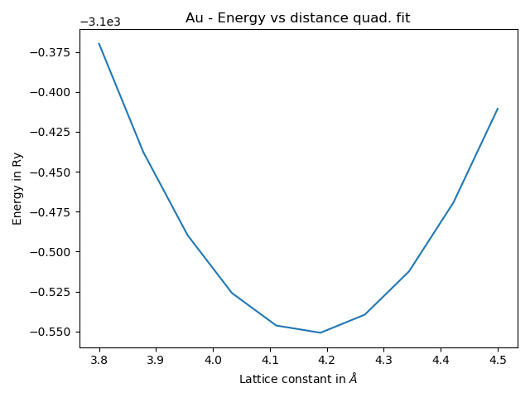
EXERCISE 2- Au
The lowest energy structure gives us the lattice parameter
We can plot the energy vs distance to find the energy mimimum
We will learn how to use the energies to fit a quadratic curve
ax² + bx + c
Then, we will plot the energy vs distance using the values of a, b and c
plt_parabola.py
This is closer to the real energy variation in materials
lowest energy -> lattice param.

Slide 13
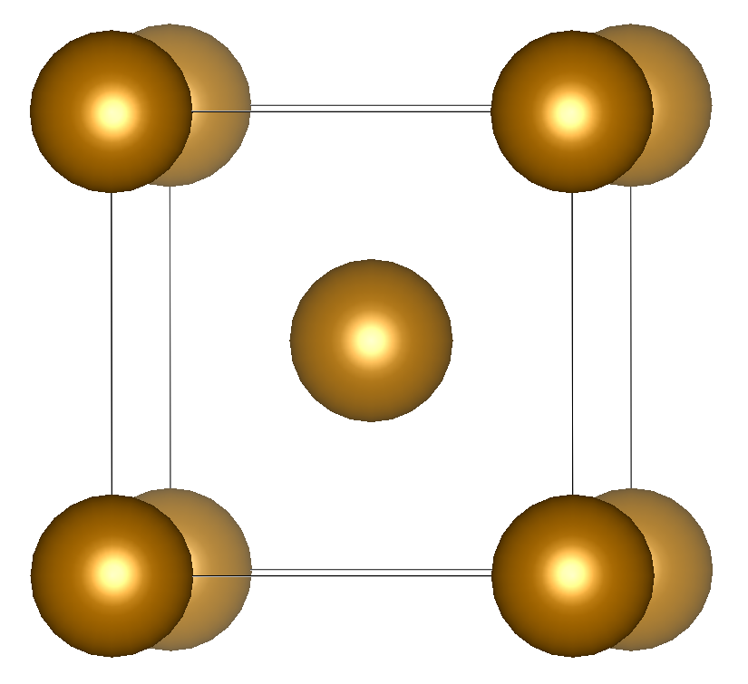
EXERCISE 3- Fe
We will repeat the previous exercises for Fe
Since for Fe, lattice parameter, a_Fe = 2.87 Å
We will change this to different values
2.7, 2.8, 2.9 and 3.0
We will calculate the energy of these structures individually using QE
Next, we plot the energy vs distance curve using both linear and quadratic fits
a_Fe
Notes:
Some historical figures

Slide 14
EXERCISE 4- NaCl
We will repeat the previous exercises for NaCl
For NaCl, lattice parameter, a_NaCl = 5.64 Å
We will change this to different values
5.6, 5.7, 5.8 and 5.9
We will calculate the energy of these structures individually using QE
Next, we plot the energy vs distance curve using both linear and quadratic fits
a_Fe
Notes:
Some historical figures

Slide 15
SUMMARY OF ALL RESULTS
Fill out the following table after measuring the distances in VESTA
Using the results of your DFT parabolic (quadratic) fit, enter the lattice parameter values a (Å)
 | Measured lattice parameter a(Å) | Measured d-1NN (Å) | Experimental a(A)* | DFT calculated lattice parameter a(Å)
Au | 4.08 | 2.88 | 4.08
Fe | 2.87 | 2.48 | 2.87
NaCl | 5.69 | 2.85 | 5.64
* Google search lattice parameter of gold/Fe/NaCl and fill in the value
Notes:
Some historical figures

