Slide 1

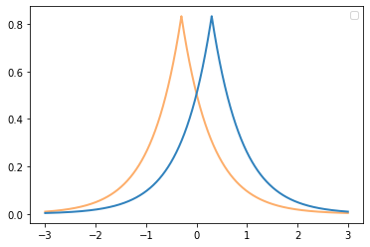
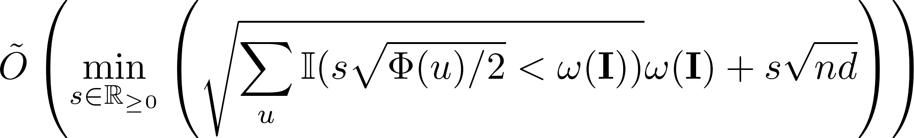
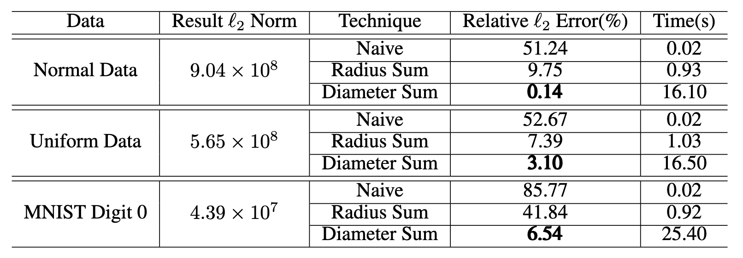
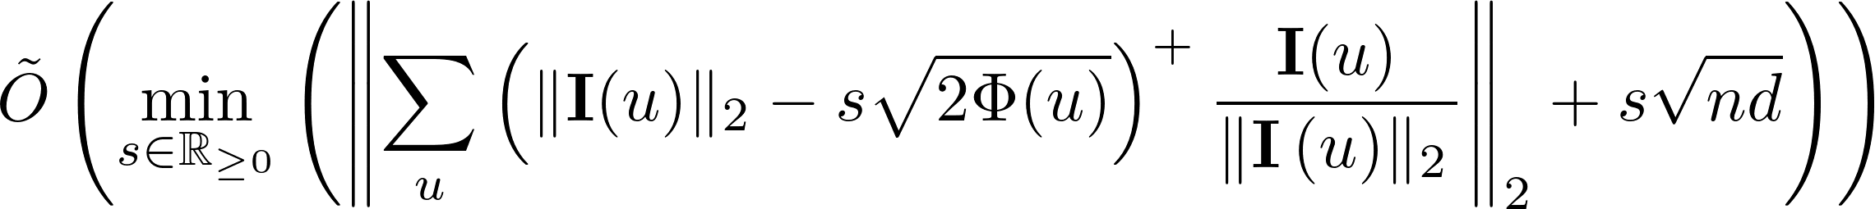
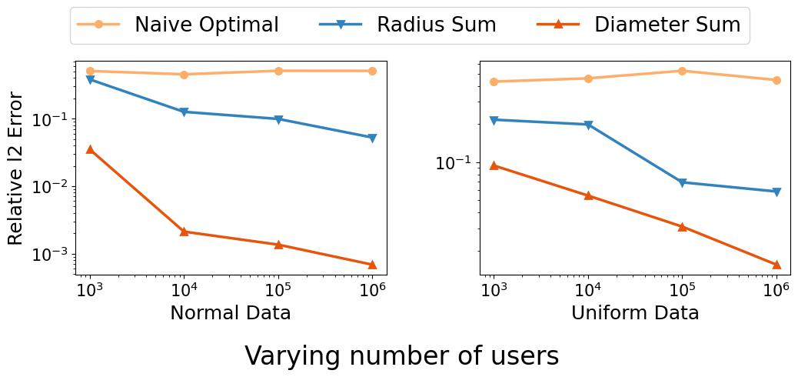
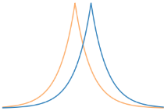
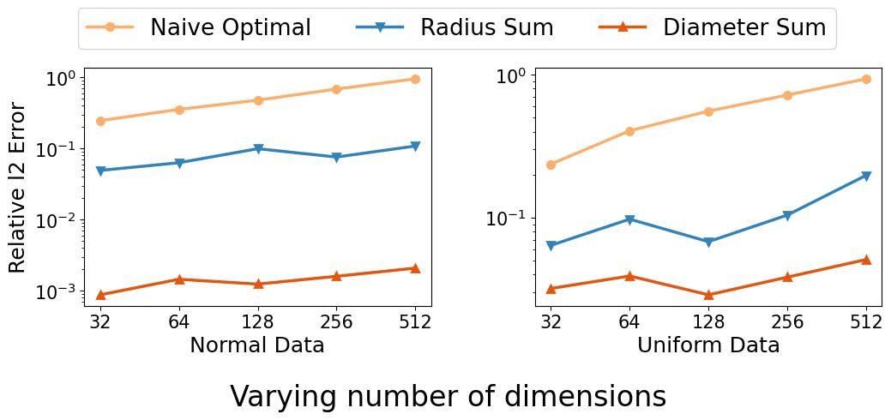



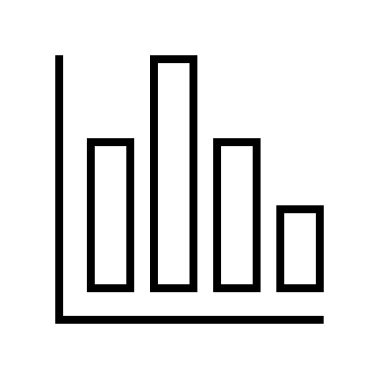
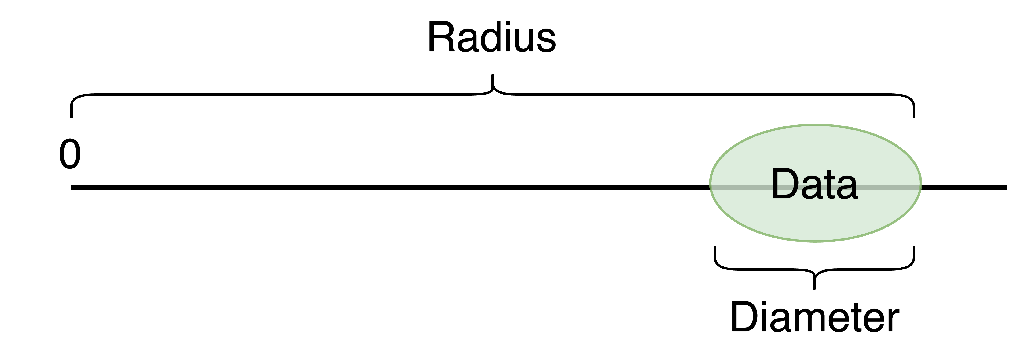

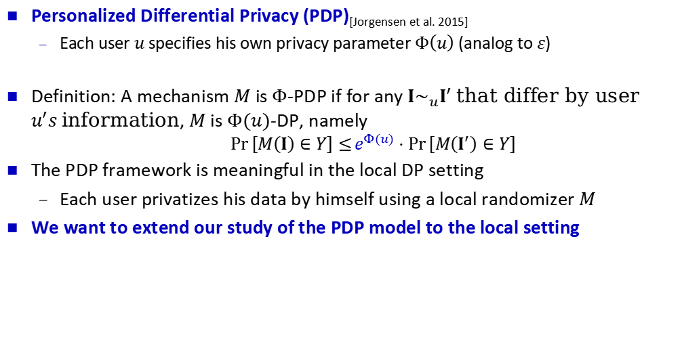
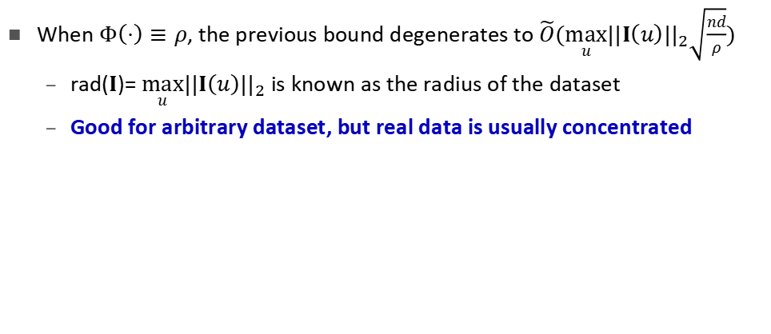
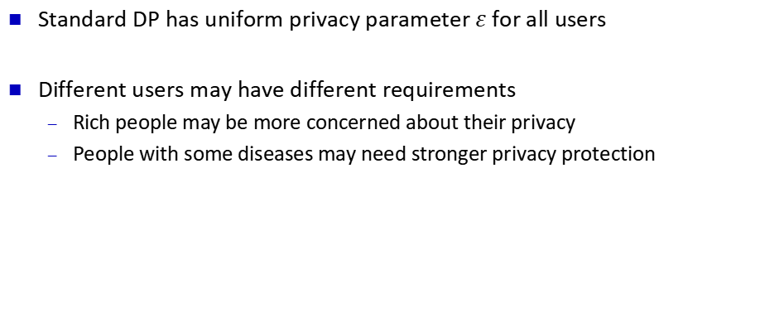
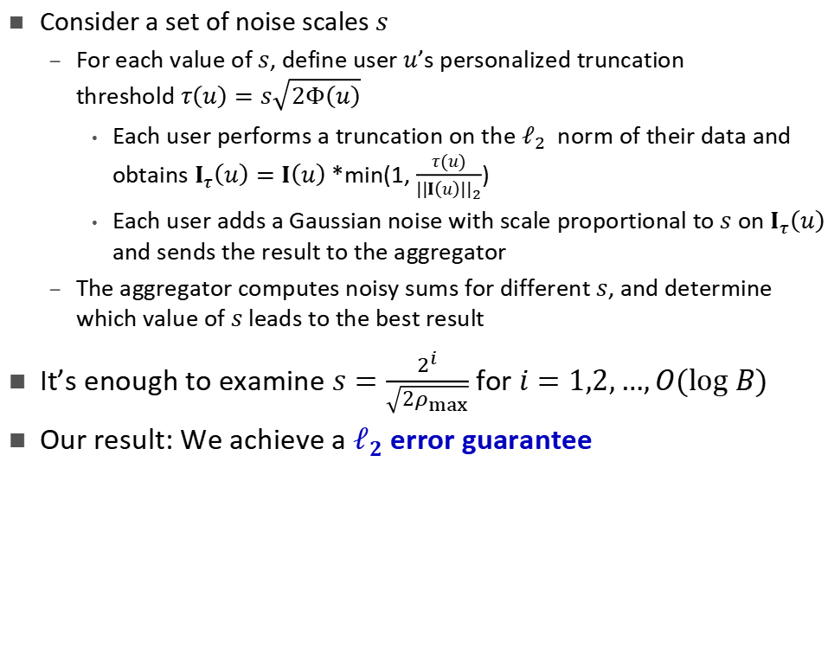
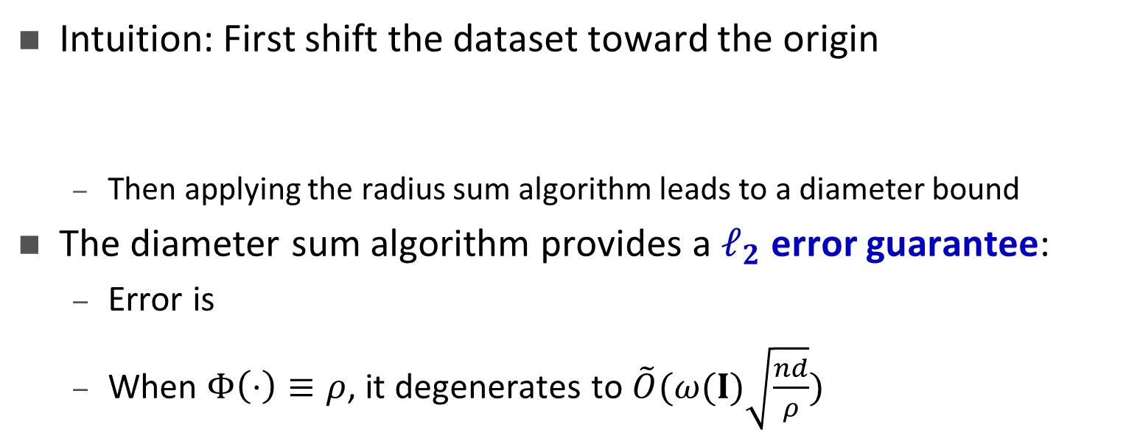


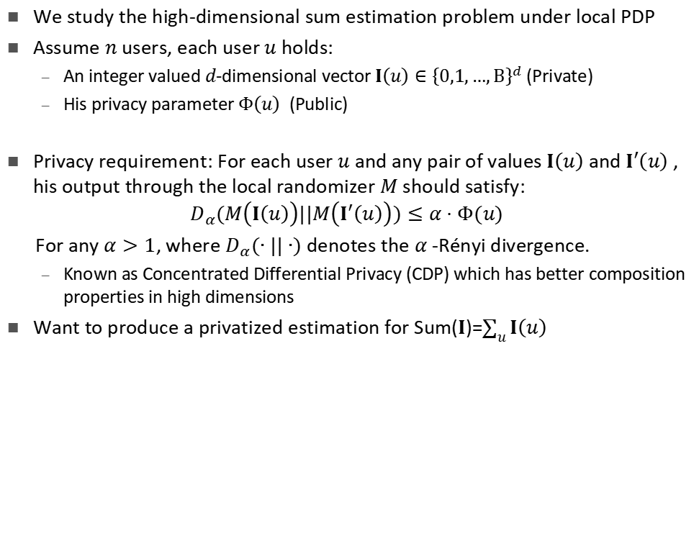
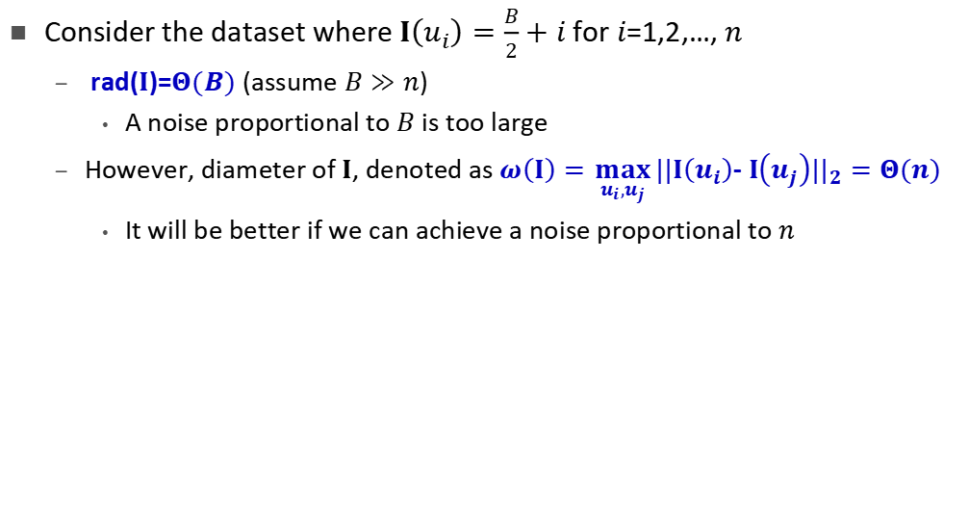

Sum Estimation under Personalized Local Differential Privacy
Dajun Sun, Wei Dong, Yuan Qiu, Ke Yi, Graham Cormode
HKUST, NTU, Southeast University, University of Warwick
Background
Problem Definition
Consider the dataset where $I\left(u_{i}\right)=\frac{B}{2}+i$ for $i$=1,2,…, $n$
rad($I$)=$Θ(B)$ (assume $B≫n$)
A noise proportional to $B$ is too large
However, diameter of $I$, denoted as $ω\left(I\right)=\max_{u_{i},u_{j}} ||I\left(u_{i}\right)$- $I\left(u_{j}\right)||_{2}=Θ(n)$
It will be better if we can achieve a noise proportional to $n$
Differential Privacy
Database instance $I$
For any $I, I′$, they are neighbors ($I∼I′$) if they differ by one individual’s information
For $ε,δ>0$, a mechanism $M$ is $(ε,δ)$-DP if for any $I∼I′$, any subset of outputs $Y$ $\operatorname{Pr}\left[M\left(I\right)∈Y\right]≤e^{ε}⋅Pr\left[M\left(I^{′}\right)∈Y\right]$.
$ε$: controls privacy level
We study the high-dimensional sum estimation problem under local PDP
Assume $n$ users, each user $u$ holds:
An integer valued $d$-dimensional vector $I\left(u\right)∈{\left\{0,1,…,B\right\}}^{d}$ (Private)
His privacy parameter $Φ\left(u\right)$ (Public)
Privacy requirement: For each user $u$ and any pair of values $I\left(u\right)$and $I′\left(u\right)$, his output through the local randomizer $M$ should satisfy:
$$D_{α}(M\left(I\left(u\right)\right)||M\left(I^{′}\left(u\right)\right))≤α⋅Φ(u)$$
For any $α>1$, where $D_{α}(∙||∙)$ denotes the $α$-Rényi divergence.
Known as Concentrated Differential Privacy (CDP) which has better composition properties in high dimensions
Want to produce a privatized estimation for Sum($I$)=$\sum_{u}{I\left(u\right)}$
Diameter Sum
Intuition: First shift the dataset toward the origin
Then applying the radius sum algorithm leads to a diameter bound
The diameter sum algorithm provides a $ℓ_{2}$ error guarantee:
Error is
When $Φ\left(⋅\right)≡ρ$, it degenerates to $\tilde{O}(ω(I)\sqrt{\frac{nd}{ρ}})$
Laplace mechanism
Denote the query as 𝑄
Global sensitivity ($GS$):
$GS=\max_{I}{\max_{I^{′},d\left(I,I^{′}\right)=1}{|Q\left(I\right)−Q(I′)|}}$
$$Q\left(I\right)+Lap(GS/ε)$$
$$Q\left(I′\right)+Lap(GS/ε)$$
Local PDP Sum: First Attempt
Consider a set of noise scales $s$
For each value of $s$, define user $u$’s personalized truncation threshold$τ\left(u\right)=s\sqrt{2Φ\left(u\right)}$
Each user performs a truncation on the $ℓ_{2}$ norm of their data and obtains $I_{τ}\left(u\right)=$ $I\left(u\right)$*min(1, $\frac{τ\left(u\right)}{||I\left(u\right)||_{2}}$)
Each user adds a Gaussian noise with scale proportional to $s$ on $I_{τ}\left(u\right)$ and sends the result to the aggregator
The aggregator computes noisy sums for different $s$, and determine which value of $s$ leads to the best result
It’s enough to examine $s=\frac{2^{i}}{\sqrt{2ρ_{max}}}$ for $i=1,2,…,O(log B)$
Our result: We achieve a $ℓ_{2}$ error guarantee
Standard DP has uniform privacy parameter $ε$ for all users
Different users may have different requirements
Rich people may be more concerned about their privacy
People with some diseases may need stronger privacy protection
Experiments
We need a more flexible DP model
Personalized Differential Privacy (PDP)_{[Jorgensen et al. 2015]}
Each user $u$specifies his own privacy parameter $Φ\left(u\right)$ (analog to $ε$)
Definition: A mechanism $M$ is $Φ$-PDP if for any $I∼_{u}I^{′} \text{that} \text{differ} \text{by} \text{user} u^{′}s \text{information}$, $M$is $Φ(u)$-DP, namely
$$\operatorname{Pr}\left[M\left(I\right)∈Y\right]≤e^{Φ(u)}⋅Pr\left[M\left(I^{′}\right)∈Y\right]$$
The PDP framework is meaningful in the local DP setting
Each user privatizes his data by himself using a local randomizer $M$
We want to extend our study of the PDP model to the local setting
Radius vs Diameter
When $Φ\left(⋅\right)≡ρ$, the previous bound degenerates to $\tilde{O}(\max_{u}||I\left(u\right)||_{2}\sqrt{\frac{nd}{ρ}})$
rad($I$)= $\max_{u}||I\left(u\right)||_{2}$ is known as the radius of the dataset
Good for arbitrary dataset, but real data is usually concentrated
Inject DP noises
Untrusted Aggregator
User
Privatized output

