Slide 1



DP-S4S: Accurate and Scalable Select-Join-Aggregate Query Processing with User-Level Differential Privacy
Yuan Qiu
Southeast University
Xiaokui Xiao
National University of Singapore
Yin Yang
Hamad Bin Khalifa University
Notes:
This is the presentation for our paper DP-Sample for scale: accurate and scalable select-join-aggregate query processing with user-level differential privacy. I am Yuan Qiu from southeast university, and my collaborators are Prof. Xiaokui Xiao from NUS, and Prof. Yin Yang from HBKU.

Slide 2
Differential Privacy (DP)
Dataset
Privacy Notion
Neighboring Dataset
User | Age
Alice | 25
Bob | 45
User | Age
Alice | 25
Bob | 45
Cathy | 60
Record-level DP
Customer | Order
Alice | #1
Alice | #2
Bob | #3
User | Order
Bob | #3
User-level DP w/o self-join
Customer | Order | Supplier
Alice | #1 | Bob
Alice | #2 | Cathy
Bob | #3 | Cathy
User-level DP w/ self-join
Customer | Order | Supplier
Alice | #2 | Cathy
Notes:
Differential Privacy has emerged as the golden standard for privacy protection, it requires the output of a mechanism to be indistinguishable on neighboring datasets.
Depending on the definition of neighboring datasets, several privacy notions have been proposed.
In this work, we adopt the strongest notion of user-level DP with self joins, where multiple users may collaboratively contribute to a record, and neighboring datasets differ by a user and any records involving the user.
This is more general than record-level DP, where each user only holds one record, or user-level DP without self joins, where the users cannot collaborate.

Slide 3
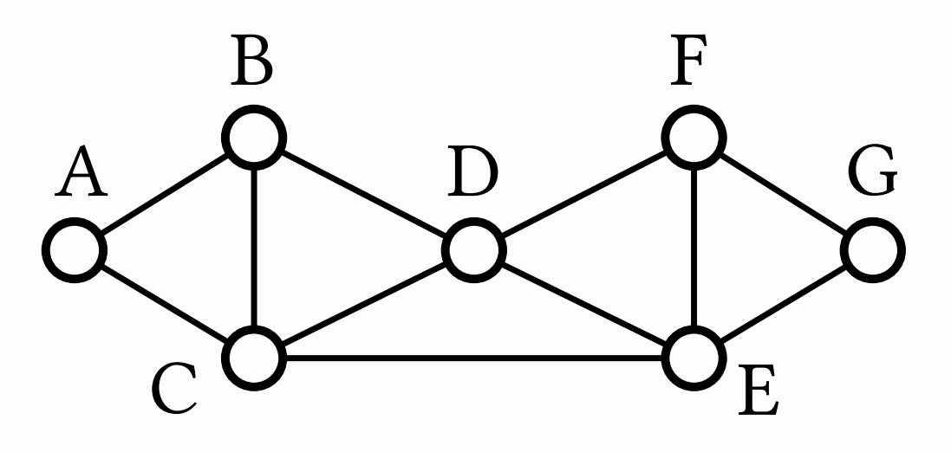

Select-Join-Aggregate (SJA) Queries
SELECT count(*)
FROM edge as e1, edge as e2, edge as e3
WHERE e1.dst = e2.src AND e2.dst = e3.src
AND e3.dst = e1.src AND e1.src < e2.src
AND e2.src < e3.src
$$Q\left(Ι\right)≔f\left(T_{Q}\right)=\sum_{t∈T}{w_{t}}$$
Database Instance
Flat Table of Join Results
Weight of tuple $t$
Notes:
Select join aggregate queries form the backbone of many SQL queries in practice.
A typical example is triangle counting, which can be expressed as self joins on the edge table.
In general, an SJA query we consider is defined as a join combined with a weighting function for each tuple in the join result, and the target is to compute the aggregated sum.

Slide 4



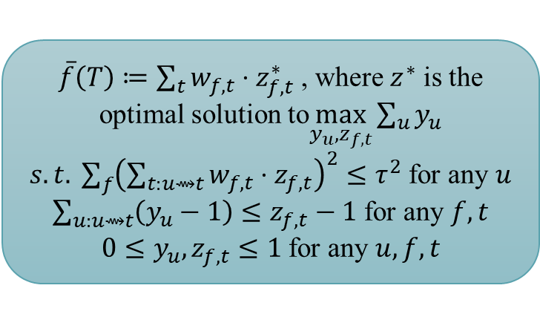

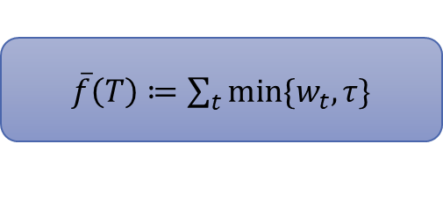
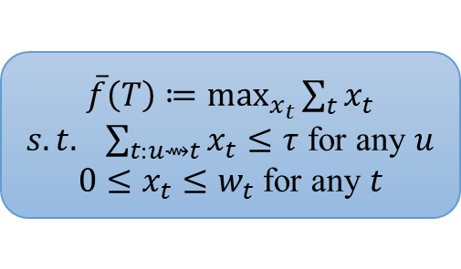



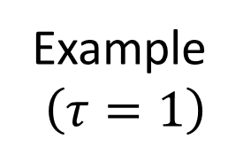

SJA Queries under DP: Truncation
Privacy Notion
Truncated Query
Example
$$\left(τ=1\right)$$
Ref.
Record-level DP
$\overline{f}\left(T\right)≔\sum_{t}{min⁡\{w_{t},τ\}}$
Strawman, e.g.
[ACG+, CCS’16]
[QDY+, KDD’22]
5
1
(truncate 5 to 1)
$\overline{f}\left(T\right)≔\max_{x_{t}}{\sum_{t}{x_{t}}}$
$s.t. \sum_{t:u⇝t}{x_{t}≤τ}$ for any $u$
$0≤x_{t}≤w_{t}$ for any $t$
[KNR+, TCC’13]
[DFY+, SIGMOD’22]
Scalar query
(LP)
1
0
1
(truncate the middle edge)
User-level DP
w/ self-join
$$f_{1}$$
$$f_{2}$$
$\overline{f}\left(T\right)≔\sum_{t}{w_{f,t}⋅z_{f,t}^{∗}}$ , where $z^{∗}$ is the optimal solution to$\max_{y_{u}, z_{f,t}}{\sum_{u}{y_{u}}}$
$s.t. \sum_{f}{{\left(\sum_{t:u⇝t}{w_{f,t}⋅z_{f,t}}\right)}^{2}}≤τ^{2}$ for any $u$
$\sum_{u:u⇝t}{\left(y_{u}−1\right)}≤z_{f,t}−1$ for any $f,t$
$0≤y_{u},z_{f,t}≤1$ for any $u,f,t$
[DSY, SIGMOD’23]
(truncate weights)
Vector query
(QCQP)
$$\frac{1}{\sqrt{2}}$$
$$\frac{1}{\sqrt{2}}$$
$$\frac{1}{\sqrt{2}}$$
Notes:
There has been a line of research on how to privately answer SJA queries with good utility. A central technique here is truncation, namely limiting the contribution of any user to the final result.
Without digging into the details here, a key observation is that under user-level DP with self joins, the state of the art solutions involve either a linear program or a QCQP to decide the truncated query.
While they achieve a nice trade-off between privacy and utility, the algorithms may not be practical enough when also taking efficiency into account.

Slide 5







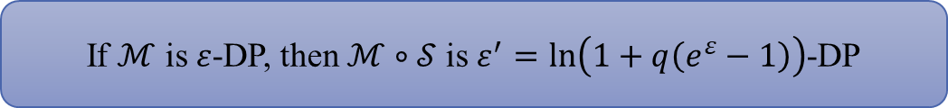

Privacy Amplification by Subsampling
Dataset $D$
Private Output
$ε$-DP Mechanism
Subsampling with Probability $q$
Amplified Privacy Guarantee
$$×\frac{1}{q}$$
Sample $𝒮\left(D\right)$
Private Output on Sample
Unbiased Estimate
Record-level DP
If $ℳ$ is $ε$-DP, then $ℳ∘𝒮$ is $ε^{′}=\ln\left(1+q\left(e^{ε}−1\right)\right)$-DP
[BBG, NeurIPS’18]
$$≈qε$$
Notes:
A natural attempt here is to adopt sampling. Moreover, it is known that subsampling amplifies differential privacy, that is, in order to achieve the same privacy guarantee, it suffices to inject a smaller amount of noise. This has been well-studied under record-level DP. For example, in coin-flip sampling, the amplification scale is roughly q, which cancels out with the rescale required for unbiased estimation.

Slide 6
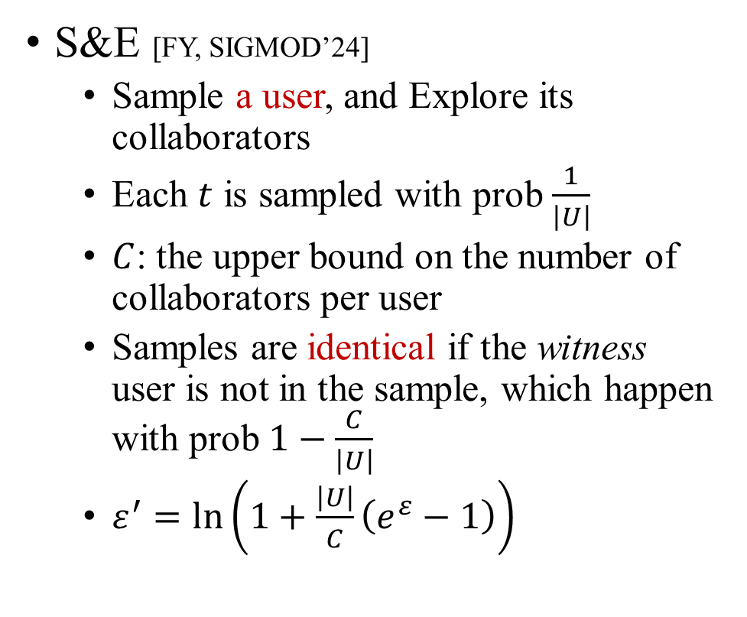
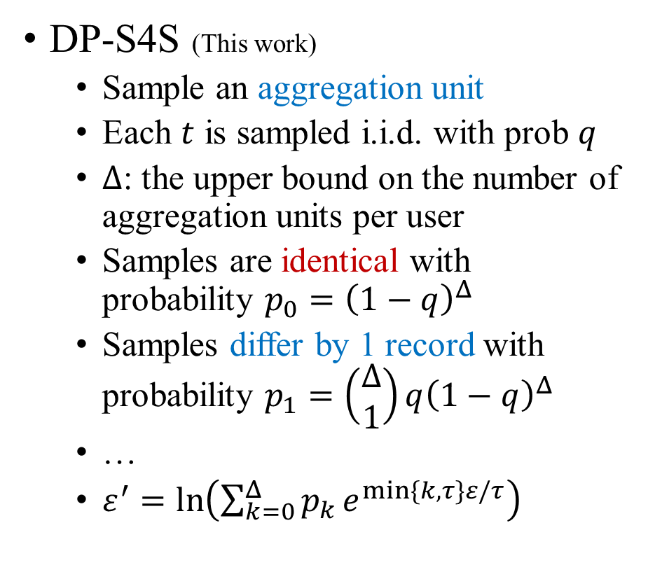
Our Contribution (1): Sample-and-Truncate Amplification
S&E [FY, SIGMOD’24]
Sample a user, and Explore its collaborators
Each $t$ is sampled with prob $\frac{1}{\left|U\right|}$
$C$: the upper bound on the number of collaborators per user
Samples are identical if the witness user is not in the sample, which happen with prob $1−\frac{C}{\left|U\right|}$
$ε^{′}=\ln\left(1+\frac{\left|U\right|}{C}\left(e^{ε}−1\right)\right)$
DP-S4S (This work)
Sample an aggregation unit
Each $t$ is sampled i.i.d. with prob $q$
$Δ$: the upper bound on the number of aggregation units per user
Samples are identical with probability $p_{0}={\left(1−q\right)}^{Δ}$
Samples differ by 1 record with probability $p_{1}=\left(\begin{matrix}Δ \\ 1\end{matrix}\right)q{\left(1−q\right)}^{Δ}$
…
$ε^{′}=\ln\left(\sum_{k=0}^{Δ}{p_{k}}e^{min⁡\{k,τ\}ε/τ}\right)$
Notes:
Our first contribution is a novel way of sampling and its privacy amplification guarantee under user-level DP, which leads to a more efficient execution of DP mechanisms for SJA queries without harming the utility. Compared to the recent work by Fang and Yi who initiated the study, in DP-S4S, sampling is performed on aggregation units instead of users. As our experiments show, this leads to a smaller sampling error. The nontrivial part is the privacy guarantee of such sampling. In all prior work, the main argument that leads to privacy amplification is the fact that samples can be identical on neighboring datasets. For example in S&E, this happens when the witness user do not appear in the sample, meaning she is not the sampled user, nor a collaborator of the sampled user. This happens with probability 1-C/U, where U is the number of users, and C is an upper bound on the number of collaborators that a user might have. Our key observation is that even if the samples are not identical, privacy may still be amplified due to excessive noise injected by the private mechanism. For example, if the two samples only differ by one record, then adding a noise that scales with tau is excessive when tau is large. This is the amplification we prove in the paper, which can be significant when the sample rate q is small or the truncation threshold tau is large.

Slide 7
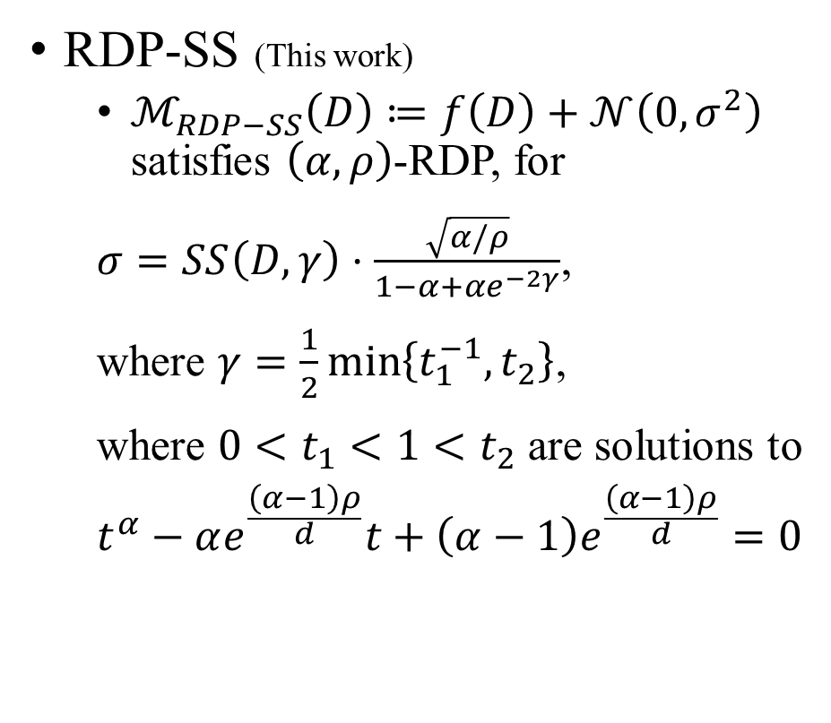
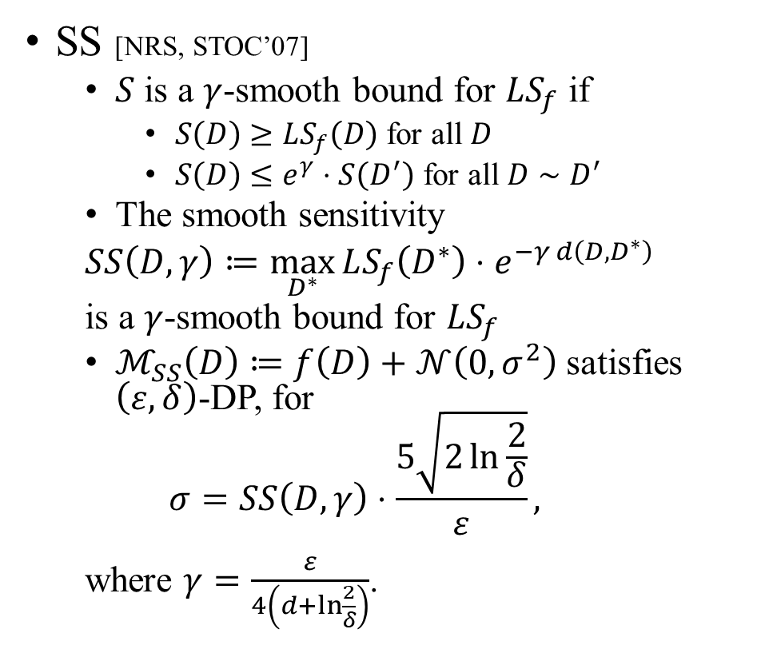
Our Contribution (2): Smooth Sensitivity under Rényi-DP
SS [NRS, STOC’07]
$S$ is a $γ$-smooth bound for $LS_{f}$ if
$S\left(D\right)≥LS_{f}\left(D\right)$ for all $D$
$S\left(D\right)≤e^{γ}⋅S\left(D^{′}\right)$ for all $D∼D^{′}$
The smooth sensitivity
$SS\left(D,γ\right)≔\max_{D^{∗}}{LS_{f}\left(D^{∗}\right)⋅e^{−γ d\left(D,D^{∗}\right)}}$
is a $γ$-smooth bound for $LS_{f}$
$ℳ_{SS}\left(D\right)≔f\left(D\right)+𝒩\left(0, σ^{2}\right)$ satisfies $\left(ε,δ\right)$-DP, for
$$σ=SS\left(D,γ\right)⋅\frac{5\sqrt{2\ln{\frac{2}{δ}}}}{ε},$$
where $γ=\frac{ε}{4\left(d+\ln{\frac{2}{δ}}\right)}$.
RDP-SS (This work)
$ℳ_{RDP−SS}\left(D\right)≔f\left(D\right)+𝒩\left(0, σ^{2}\right)$ satisfies $\left(α,ρ\right)$-RDP, for
$σ=SS\left(D,γ\right)⋅\frac{\sqrt{α/ρ}}{1−α+αe^{−2γ}}$,
where $γ=\frac{1}{2}\min\left\{t_{1}^{−1},t_{2}\right\}$,
where $0<t_{1}<1<t_{2}$ are solutions to
$$t^{α}−αe^{\frac{\left(α−1\right)ρ}{d}}t+\left(α−1\right)e^{\frac{\left(α−1\right)ρ}{d}}=0$$
Notes:
Our second contribution, focused on vector queries, is a fundamental renyi-DP mechanism that utilizes the smooth sensitivity introduced by Nissim, Raskhodnikova(Ras ha ni ka va) and Smith. Due to time constraints, I will not introduce the technical details here. Our work can be seen as filling the gap of smooth sensitivity under renyi DP, in addition to its applications to pure and approximate DP as in the original paper.

Slide 8
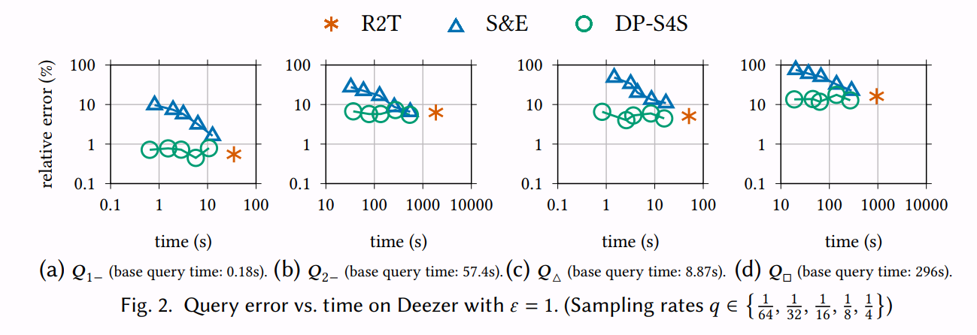
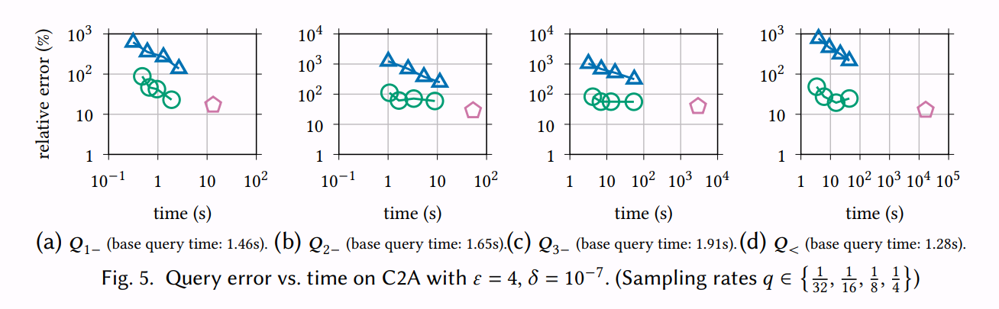
Summary
Notes:
In summary, our dp-s4s mechanism significantly improves the running time of state-of-the-art DP mechanisms for SJA queries at no cost for scalar queries and with a better utility overhead compared to S&E for vector queries. For more details, please refer to the paper.

Slide 9
References
Martin Abadi, Andy Chu, Ian Goodfellow, H. Brendan McMahan, Ilya Mironov, Kunal Talwar, and Li Zhang. 2016. Deep Learning with Differential Privacy. In Proceedings of the 2016 ACM SIGSAC Conference on Computer and Communications Security (CCS '16).
Yuan Qiu, Wei Dong, Ke Yi, Bin Wu, and Feifei Li. 2022. Releasing Private Data for Numerical Queries. In Proceedings of the 28th ACM SIGKDD Conference on Knowledge Discovery and Data Mining (KDD '22).
Shiva Prasad Kasiviswanathan, Kobbi Nissim, Sofya Raskhodnikova, and Adam Smith. 2013. Analyzing graphs with node differential privacy. In Proceedings of the 10th theory of cryptography conference on Theory of Cryptography (TCC'13).
Wei Dong, Juanru Fang, Ke Yi, Yuchao Tao, and Ashwin Machanavajjhala. 2022. R2T: Instance-optimal Truncation for Differentially Private Query Evaluation with Foreign Keys. In Proceedings of the 2022 International Conference on Management of Data (SIGMOD '22).
Wei Dong, Dajun Sun, and Ke Yi. 2023. Better than Composition: How to Answer Multiple Relational Queries under Differential Privacy. Proc. ACM Manag. Data 1, 2, Article 123 (SIGMOD '23), 26 pages.
Borja Balle, Gilles Barthe, and Marco Gaboardi. 2018. Privacy Amplification by Subsampling: Tight Analyses via Couplings and Divergences. In Proceedings of the Conference on Neural Information Processing Systems (NeurIPS '18).
Juanru Fang and Ke Yi. 2024. Privacy Amplification by Sampling under User-level Differential Privacy. Proc. ACM Manag. Data 2, 1, Article 34 (SIGMOD '24), 26 pages.
Kobbi Nissim, Sofya Raskhodnikova, and Adam Smith. 2007. Smooth sensitivity and sampling in private data analysis. In Proceedings of the thirty-ninth annual ACM symposium on Theory of computing (STOC '07).
Notes:
Thank you.

