Slide 1


Weighted Distinct Sampling: Cardinality Estimation for SPJ Queries
Yuan Qiu, Yilei Wang, Ke Yi, Feifei Li, Bin Wu, Chaoqun Zhan
HKUST
Alibaba Group

Slide 2
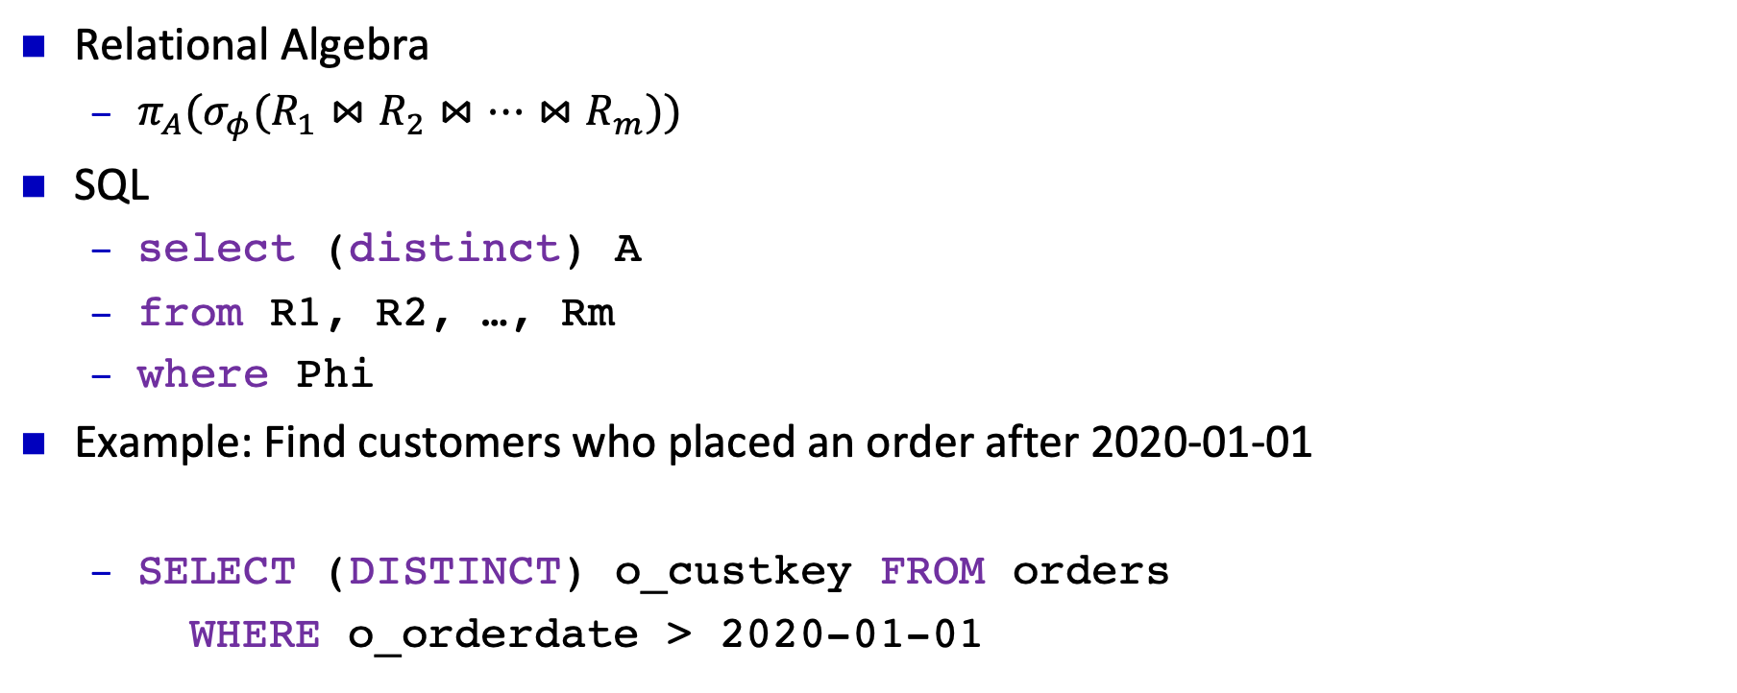
Select-Project-Join Queries
Relational Algebra
${π_{A}(σ}_{φ}(R_{1}⋈R_{2}⋈…⋈R_{m}))$
SQL
select (distinct) A
from R1, R2, …, Rm
where Phi
Example: Find customers who placed an order after 2020-01-01
SELECT (DISTINCT) o_custkey FROM orders
WHERE o_orderdate > 2020-01-01

Slide 3
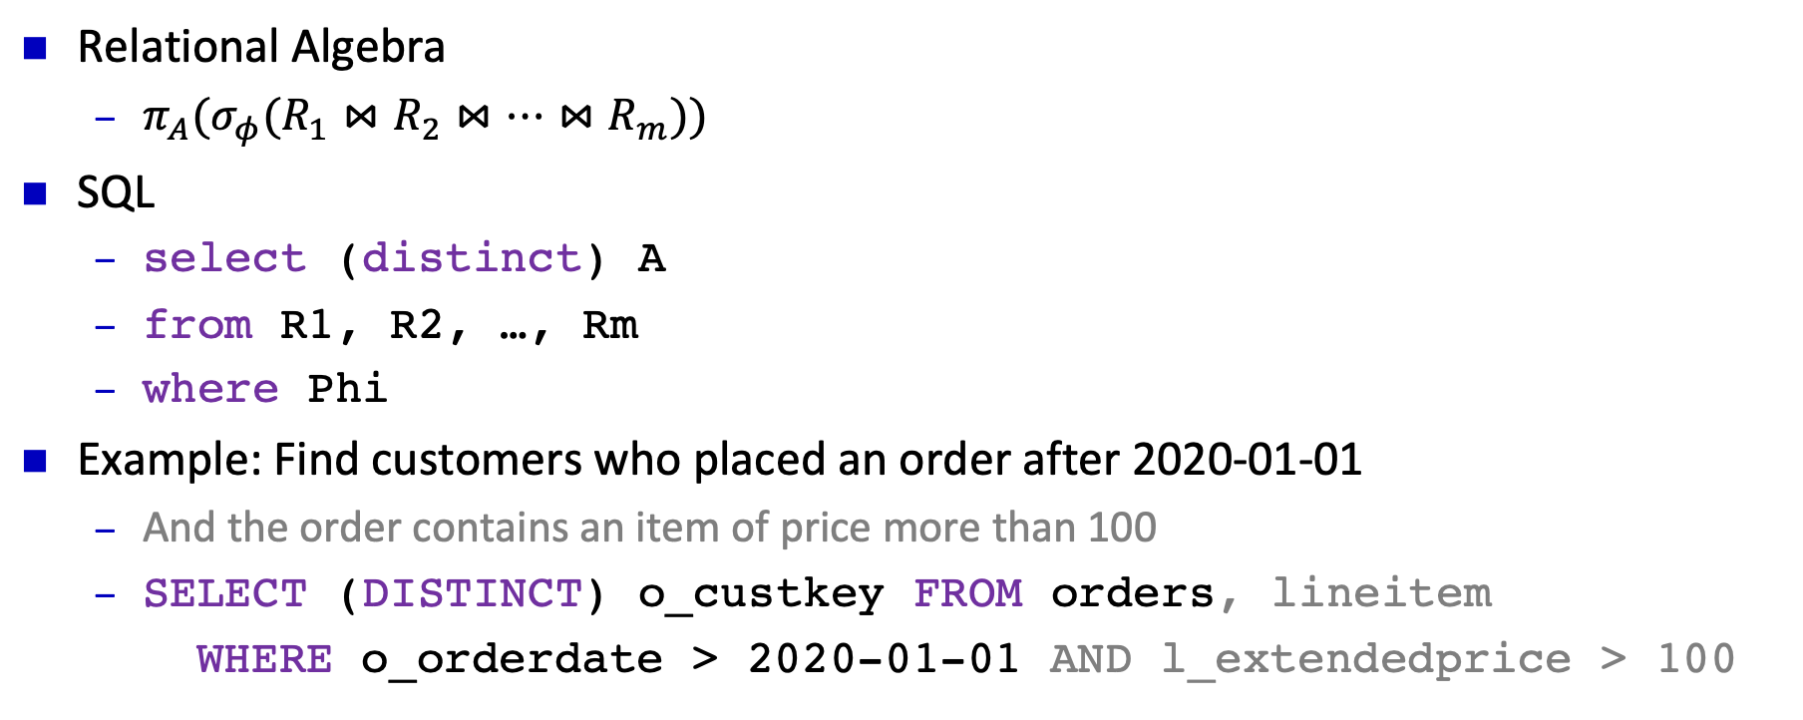
Select-Project-Join Queries
Relational Algebra
${π_{A}(σ}_{φ}(R_{1}⋈R_{2}⋈…⋈R_{m}))$
SQL
select (distinct) A
from R1, R2, …, Rm
where Phi
Example: Find customers who placed an order after 2020-01-01
And the order contains an item of price more than 100
SELECT (DISTINCT) o_custkey FROM orders, lineitem
WHERE o_orderdate > 2020-01-01 AND l_extendedprice > 100

Slide 4
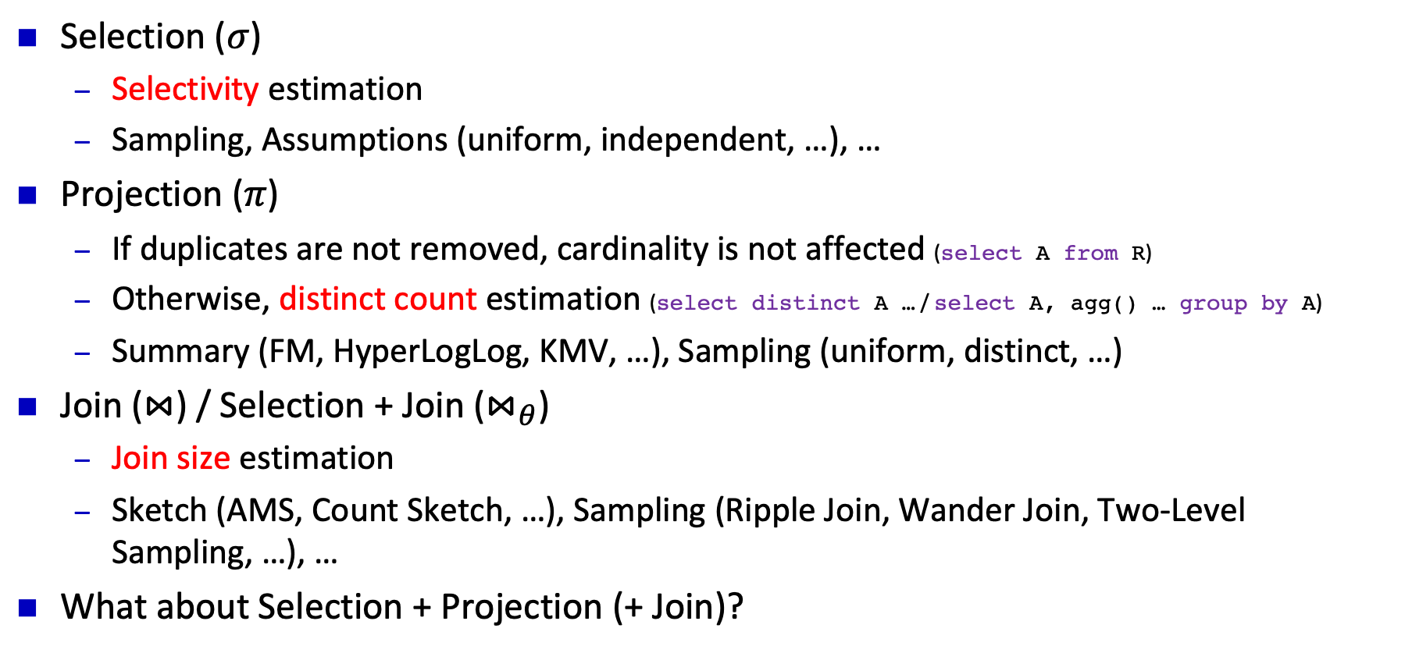
Cardinality Estimation for S / P / J Queries
Selection ($σ$)
Selectivity estimation
Sampling, Assumptions (uniform, independent, …), …
Projection ($π$)
If duplicates are not removed, cardinality is not affected (select A from R)
Otherwise, distinct count estimation (select distinct A … / select A, agg() … group by A)
Summary (FM, HyperLogLog, KMV, …), Sampling (uniform, distinct, …)
Join ($⋈$) / Selection + Join ($⋈_{θ}$)
Join size estimation
Sketch (AMS, Count Sketch, …), Sampling (Ripple Join, Wander Join, Two-Level Sampling, …), …
What about Selection + Projection (+ Join)?

Slide 5
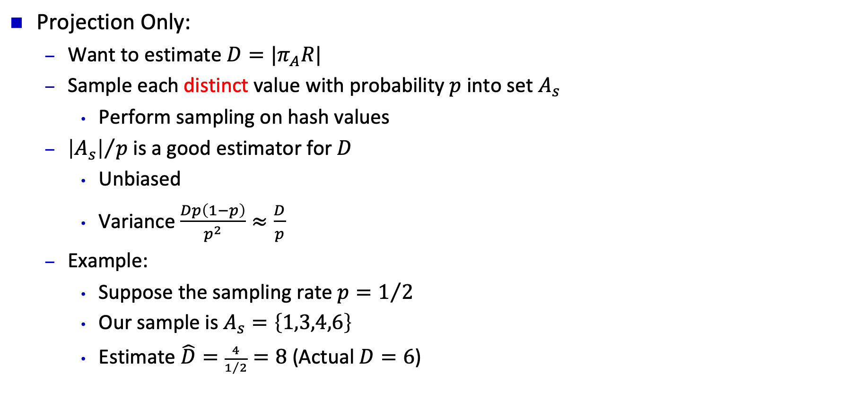
Review: Distinct Sampling
A
1
1
2
2
2
3
4
5
5
6
6
6
6
Projection Only:
Want to estimate $D=|π_{A}R|$
Sample each distinct value with probability $p$ into set $A_{s}$
Perform sampling on hash values
${\left|A_{s}\right|}/p$ is a good estimator for $D$
Unbiased
Variance $\frac{Dp\left(1−p\right)}{p^{2}}≈\frac{D}{p}$
Example:
Suppose the sampling rate $p=1/2$
Our sample is $A_{s}=\left\{1,3,4,6\right\}$
Estimate $\hat{D}=\frac{4}{1/2}=8$ (Actual $D=6$)
h(a) | Sampled?
v1 | ✔
v2
v3 | ✔
v4 | ✔
v5
v6 | ✔

Slide 6
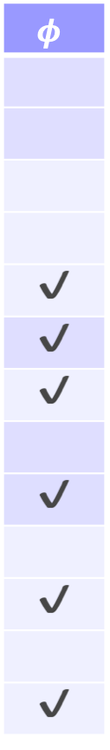
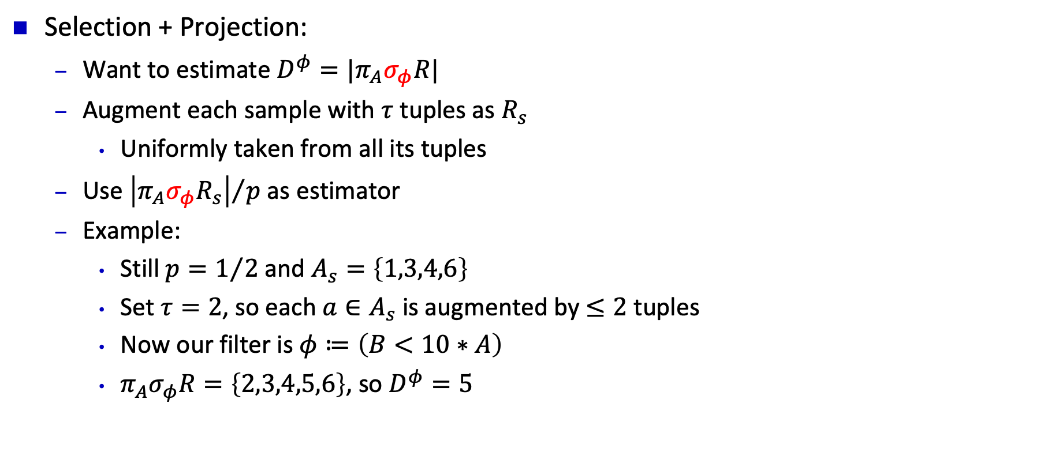
Review: Distinct Sampling
A | B | sampled?
1 | 10 | ✔
1 | 20 | ✔
2 | 30
2 | 20
2 | 10
3 | 10 | ✔
4 | 20 | ✔
5 | 60
5 | 10
6 | 80 | ✔
6 | 20
6 | 60 | ✔
6 | 30
$$φ$$
✔
✔
✔
✔
✔
✔
Selection + Projection:
Want to estimate $D^{φ}=|π_{A}σ_{φ}R|$
Augment each sample with $τ$ tuples as $R_{s}$
Uniformly taken from all its tuples
Use ${\left|π_{A}σ_{φ}R_{s}\right|}/p$ as estimator
Example:
Still $p=1/2$ and $A_{s}=\left\{1,3,4,6\right\}$
Set $τ=2$, so each $a∈A_{s}$ is augmented by $≤2$ tuples
Now our filter is $φ≔\left(B<10∗A\right)$
$π_{A}σ_{φ}R=\left\{2,3,4,5,6\right\}$, so $D^{φ}=5$

Slide 7
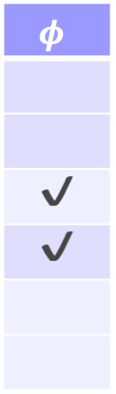
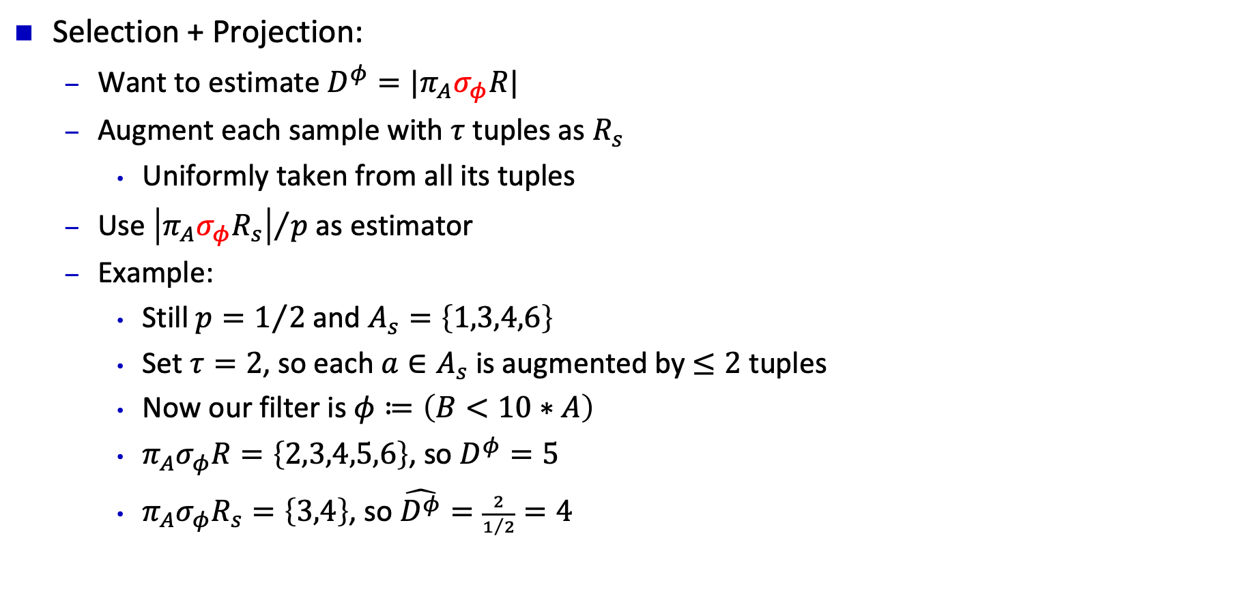
Review: Distinct Sampling
A | B | sampled?
1 | 10 | ✔
1 | 20 | ✔
3 | 10 | ✔
4 | 20 | ✔
6 | 80 | ✔
6 | 60 | ✔
$$φ$$
✔
✔
Selection + Projection:
Want to estimate $D^{φ}=|π_{A}σ_{φ}R|$
Augment each sample with $τ$ tuples as $R_{s}$
Uniformly taken from all its tuples
Use ${\left|π_{A}σ_{φ}R_{s}\right|}/p$ as estimator
Example:
Still $p=1/2$ and $A_{s}=\left\{1,3,4,6\right\}$
Set $τ=2$, so each $a∈A_{s}$ is augmented by $≤2$ tuples
Now our filter is $φ≔\left(B<10∗A\right)$
$π_{A}σ_{φ}R=\left\{2,3,4,5,6\right\}$, so $D^{φ}=5$
$π_{A}σ_{φ}R_{s}=\left\{3,4\right\}$, so $\hat{D^{φ}}=\frac{2}{1/2}=4$

Slide 8
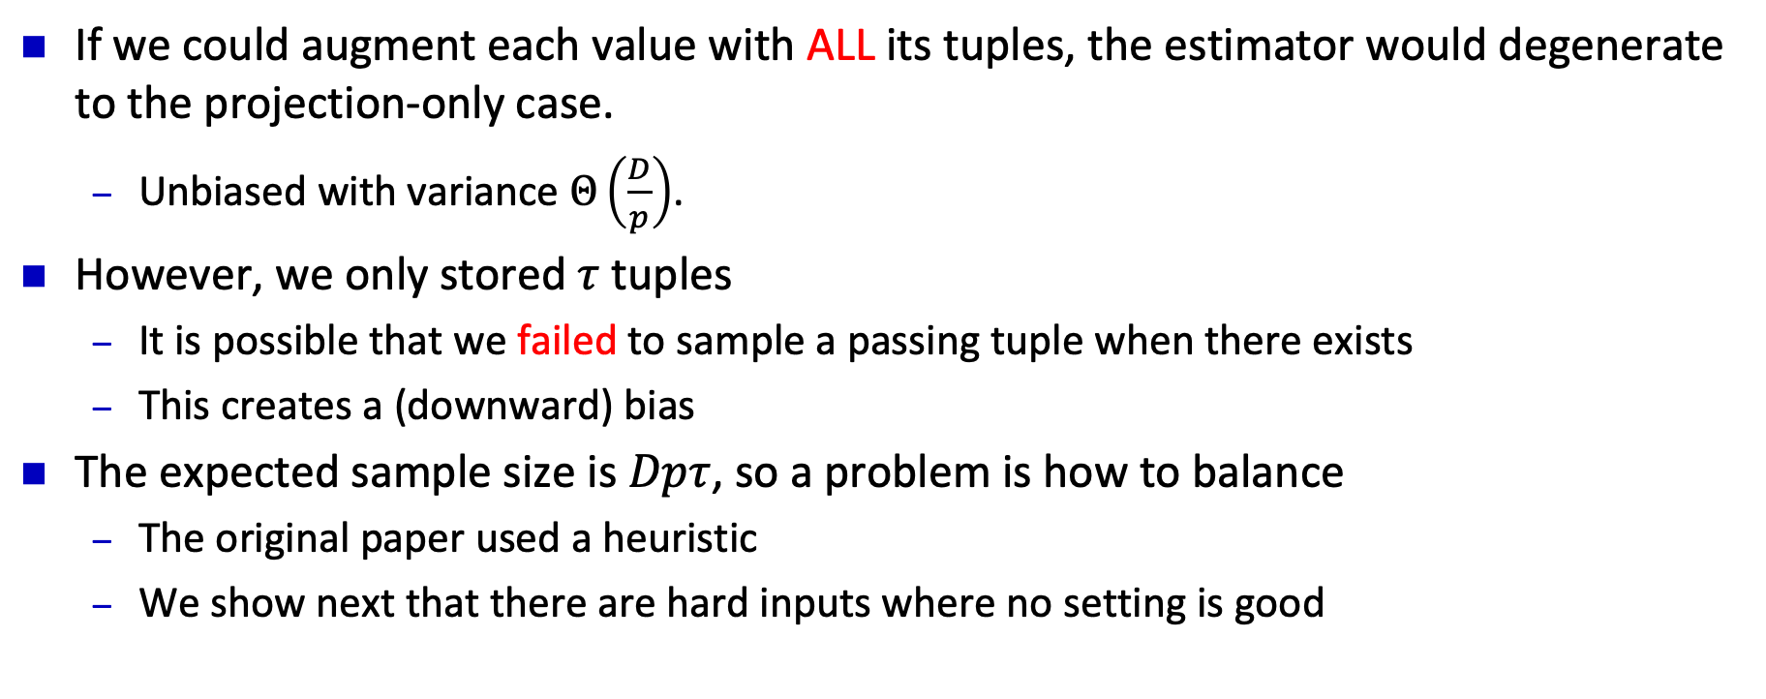
Uniform Distinct Sampling: Problems
If we could augment each value with ALL its tuples, the estimator would degenerate to the projection-only case.
Unbiased with variance $Θ\left(\frac{D}{p}\right)$.
However, we only stored $τ$ tuples
It is possible that we failed to sample a passing tuple when there exists
This creates a (downward) bias
The expected sample size is $Dpτ$, so a problem is how to balance
The original paper used a heuristic
We show next that there are hard inputs where no setting is good

Slide 9

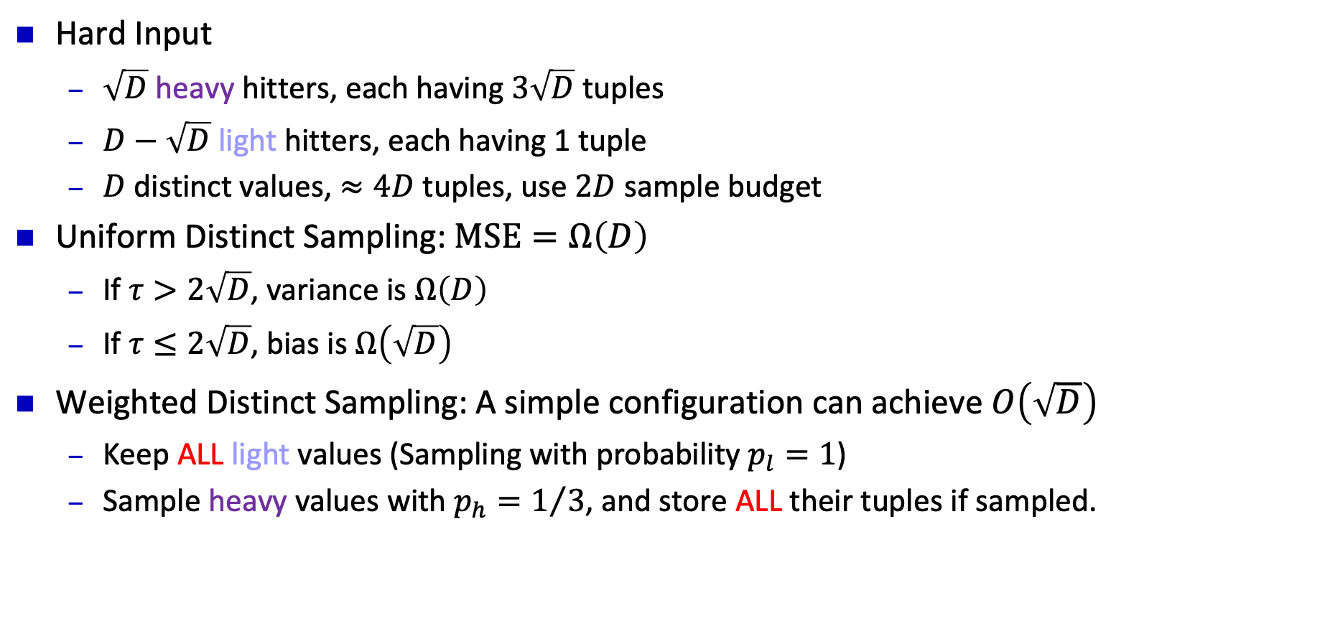



Uniform vs. Weighted Distinct Sampling
$$3\sqrt{D}$$
Hard Input
$\sqrt{D}$ heavy hitters, each having $3\sqrt{D}$ tuples
$D−\sqrt{D}$ light hitters, each having 1 tuple
$D$ distinct values, $≈4D$ tuples, use $2D$ sample budget
Uniform Distinct Sampling: $\text{MSE}=Ω\left(D\right)$
If $τ>2\sqrt{D}$, variance is $Ω\left(D\right)$
If $τ≤2\sqrt{D}$, bias is $Ω\left(\sqrt{D}\right)$
Weighted Distinct Sampling: A simple configuration can achieve $O\left(\sqrt{D}\right)$
Keep ALL light values (Sampling with probability $p_{l}=1$)
Sample heavy values with $p_{h}=1/3$, and store ALL their tuples if sampled.
$$1$$
$$\sqrt{D}$$
$$D−\sqrt{D}$$

Slide 10

Why Use Weighted Distinct Sampling?
In distinct count estimation, heavy hitters are not more important.
Any distinct value can only contribute 1 to the distinct count post filter $D^{φ}$.
However, heavy hitters are harder to estimate.
For light hitters, we may store all its tuples to remove the bias.
This is not possible for heavy hitters.

Slide 11
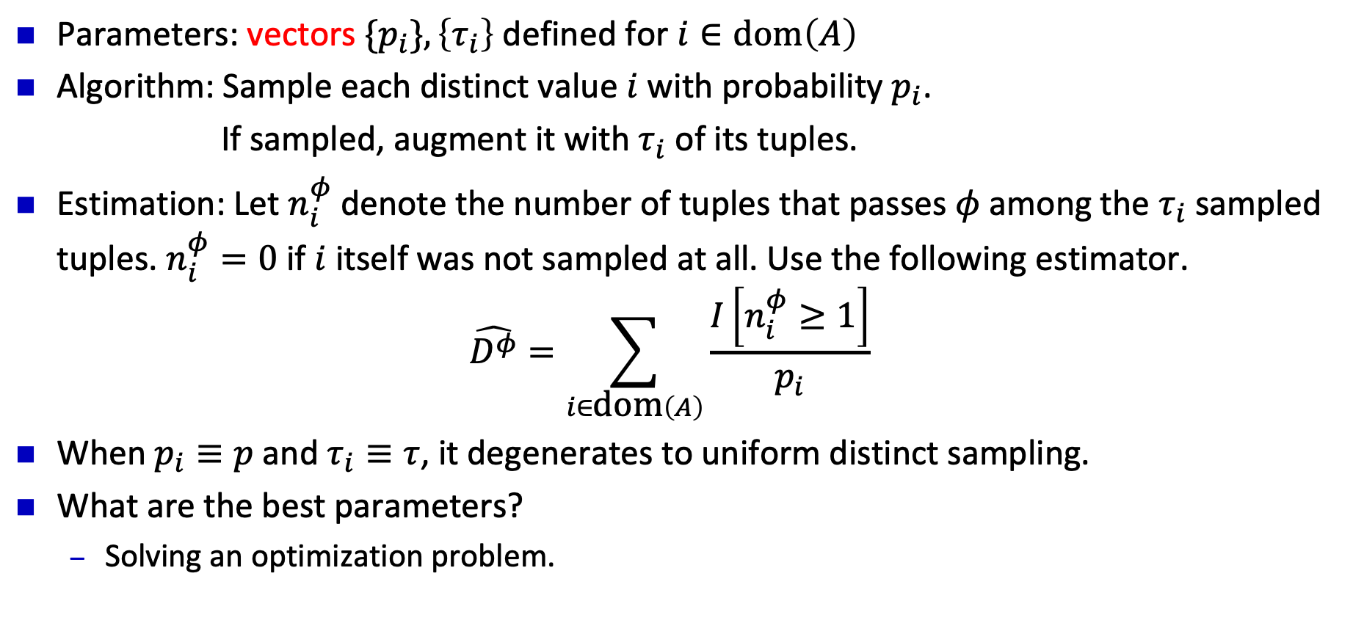
Weighted Distinct Sampling: Algorithm
Parameters: vectors $\{p_{i}\}, \left\{τ_{i}\right\}$ defined for $i∈\text{dom}\left(A\right)$
Algorithm: Sample each distinct value $i$ with probability $p_{i}$.
If sampled, augment it with $τ_{i}$ of its tuples.
Estimation: Let $n_{i}^{φ}$ denote the number of tuples that passes $φ$ among the $τ_{i}$ sampled tuples. $n_{i}^{φ}=0$ if $i$ itself was not sampled at all. Use the following estimator.
$$\hat{D^{φ}}=\sum_{i∈\text{dom}\left(A\right)}{\frac{I\left[n_{i}^{φ}≥1\right]}{p_{i}}}$$
When $p_{i}≡p$ and $τ_{i}≡τ$, it degenerates to uniform distinct sampling.
What are the best parameters?
Solving an optimization problem.

Slide 12
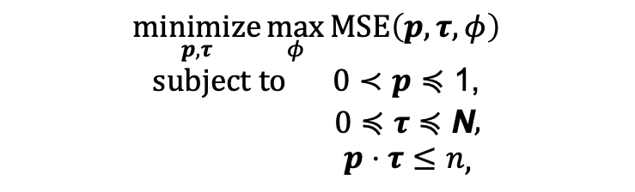
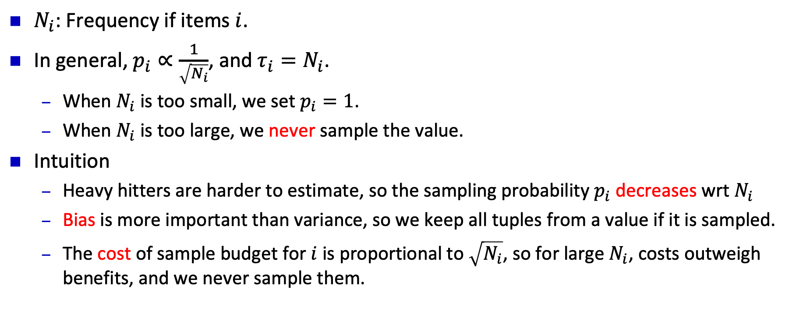
Near Optimal Solution
$N_{i}$: Frequency if items $i$.
In general, $p_{i}∝\frac{1}{\sqrt{N_{i}}}$, and $τ_{i}=N_{i}$.
When $N_{i}$ is too small, we set $p_{i}=1$.
When $N_{i}$ is too large, we never sample the value.
Intuition
Heavy hitters are harder to estimate, so the sampling probability $p_{i}$ decreases wrt $N_{i}$
Bias is more important than variance, so we keep all tuples from a value if it is sampled.
The cost of sample budget for $i$ is proportional to $\sqrt{N_{i}}$, so for large $N_{i}$, costs outweigh benefits, and we never sample them.
$$\underset{p,τ}{\text{min}\text{imize}}{\max_{φ}{\text{MSE}\left(p,τ,φ\right)}}$$
$$\begin{matrix}\text{s}\text{ubject} \text{to} & 0≺p≼\text{1}\text{,}\end{matrix}$$
$$\begin{matrix} & 0≼τ≼\text{N}\end{matrix},$$
$$\begin{matrix} & p⋅τ≤n\end{matrix},$$

Slide 13
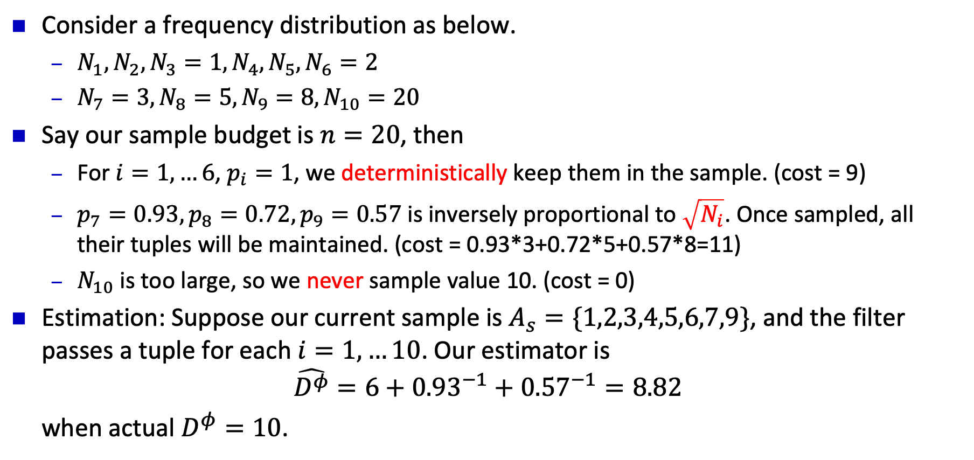
Weighted Distinct Sampling: Example
20
8
Consider a frequency distribution as below.
$N_{1},N_{2},N_{3}=1, N_{4},N_{5},N_{6}=2$
$N_{7}=3, N_{8}=5, N_{9}=8, N_{10}=20$
Say our sample budget is $n=20$, then
For $i=1,…6$, $p_{i}=1$, we deterministically keep them in the sample. (cost = 9)
$p_{7}=0.93, p_{8}=0.72, p_{9}=0.57$ is inversely proportional to $\sqrt{N_{i}}$. Once sampled, all their tuples will be maintained. (cost = 0.93*3+0.72*5+0.57*8=11)
$N_{10}$ is too large, so we never sample value 10. (cost = 0)
Estimation: Suppose our current sample is $A_{s}=\{1,2,3,4,5,6,7,9\}$, and the filter passes a tuple for each $i=1,…10$. Our estimator is
$$\hat{D^{φ}}=6+{0.93}^{−1}+{0.57}^{−1}=8.82$$
when actual $D^{φ}=10$.
5
3
2
1
1
4
7
10

Slide 14
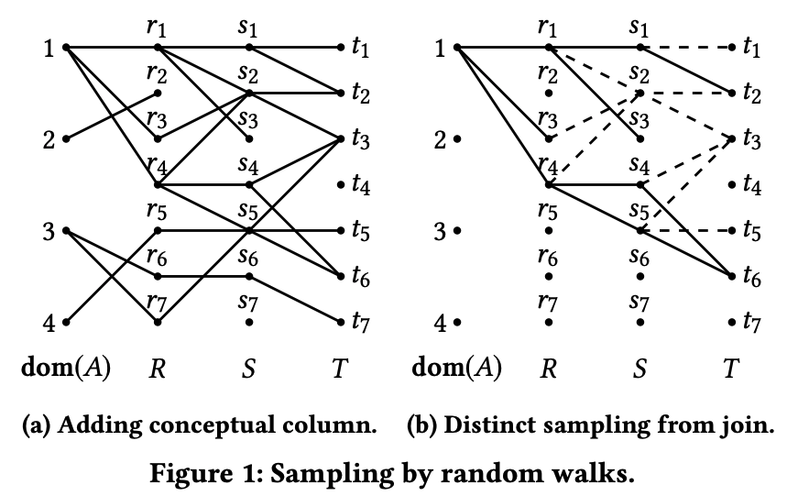
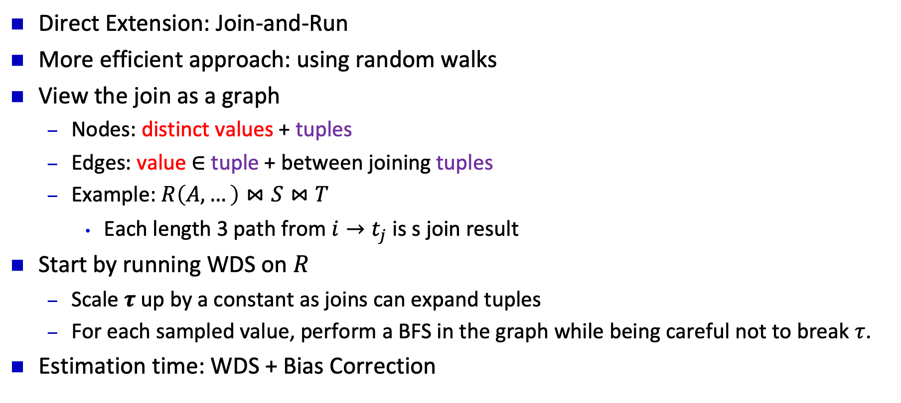
Weighted Distinct Sampling for SPJ queries
Direct Extension: Join-and-Run
More efficient approach: using random walks
View the join as a graph
Nodes: distinct values + tuples
Edges: value $∈$ tuple + between joining tuples
Example: $R\left(A,…\right)⋈S⋈T$
Each length 3 path from $i→t_{j}$ is s join result
Start by running WDS on $R$
Scale $τ$ up by a constant as joins can expand tuples
For each sampled value, perform a BFS in the graph while being careful not to break $τ$.
Estimation time: WDS + Bias Correction

Slide 15
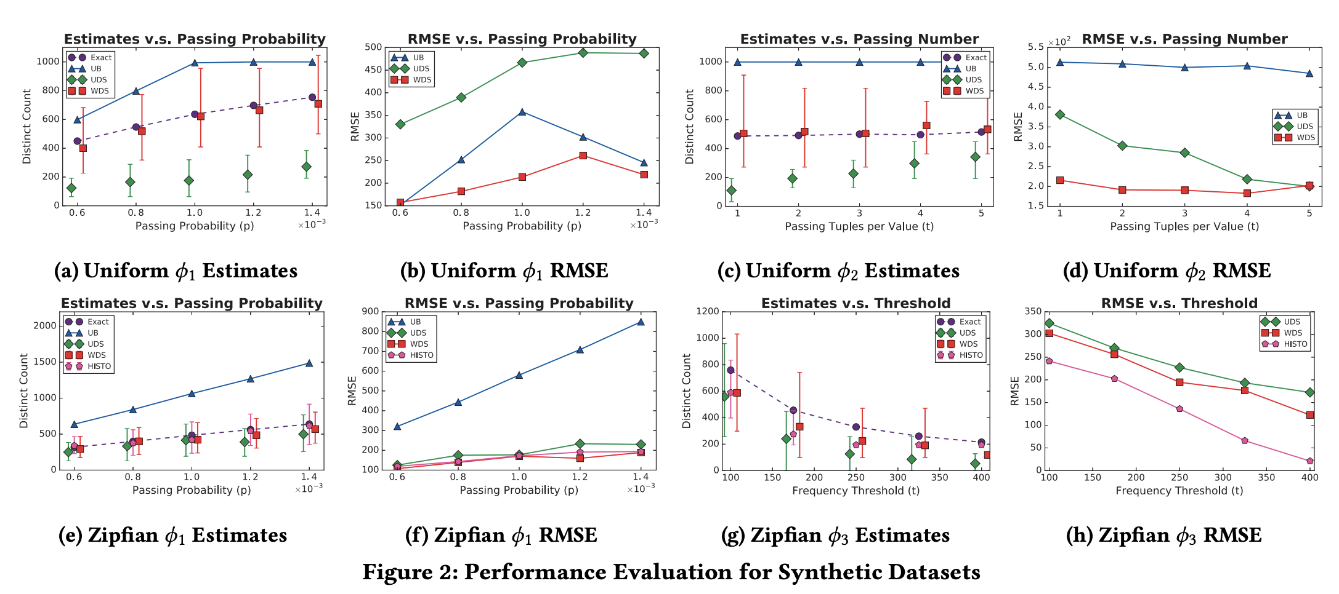
Experiment Results (SP, Synthetic)

Slide 16
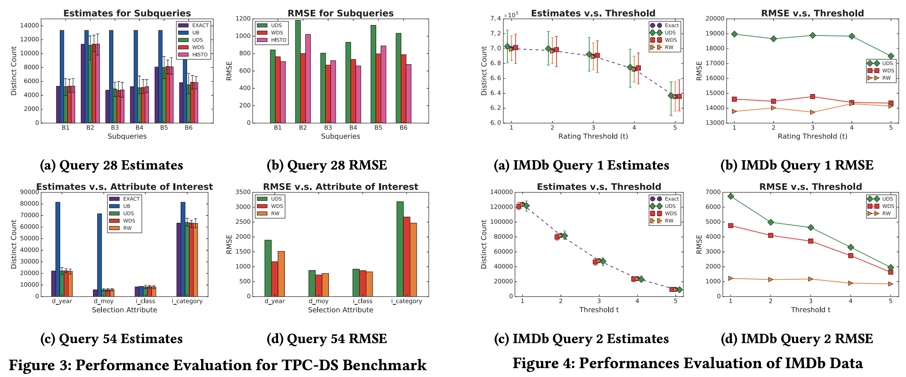
Experiment Results (SPJ, Benchmark & Real)

Slide 17
Conclusions and Future Directions
We introduced Weighed Distinct Sampling for cardinality estimation of SP(J) queries.
Implemented in AnalyticDB, product of Alibaba Cloud
Future Directions
Dynamic Maintenance
Special Predicates (e.g. ranges)

Slide 18
Thank you!

Slide 19
Back-up slides

Slide 20
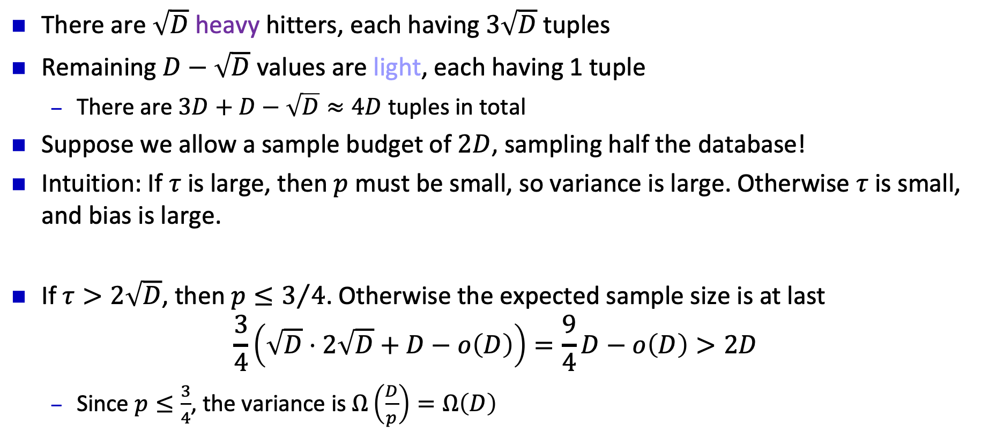
Uniform Distinct Sampling: Hard Case
$$3\sqrt{D}$$
There are $\sqrt{D}$ heavy hitters, each having $3\sqrt{D}$ tuples
Remaining $D−\sqrt{D}$ values are light, each having 1 tuple
There are $3D+D−\sqrt{D}≈4D$ tuples in total
Suppose we allow a sample budget of $2D$, sampling half the database!
Intuition: If $τ$ is large, then $p$ must be small, so variance is large. Otherwise $τ$ is small, and bias is large.
If $τ>2\sqrt{D}$, then $p≤3/4$. Otherwise the expected sample size is at last
$$\frac{3}{4}\left(\sqrt{D}⋅2\sqrt{D}+D−o\left(D\right)\right)=\frac{9}{4}D−o\left(D\right)>2D$$
Since $p≤\frac{3}{4}$, the variance is $Ω\left(\frac{D}{p}\right)=Ω\left(D\right)$
$$1$$
$$\sqrt{D}$$
$$D−\sqrt{D}$$

Slide 21
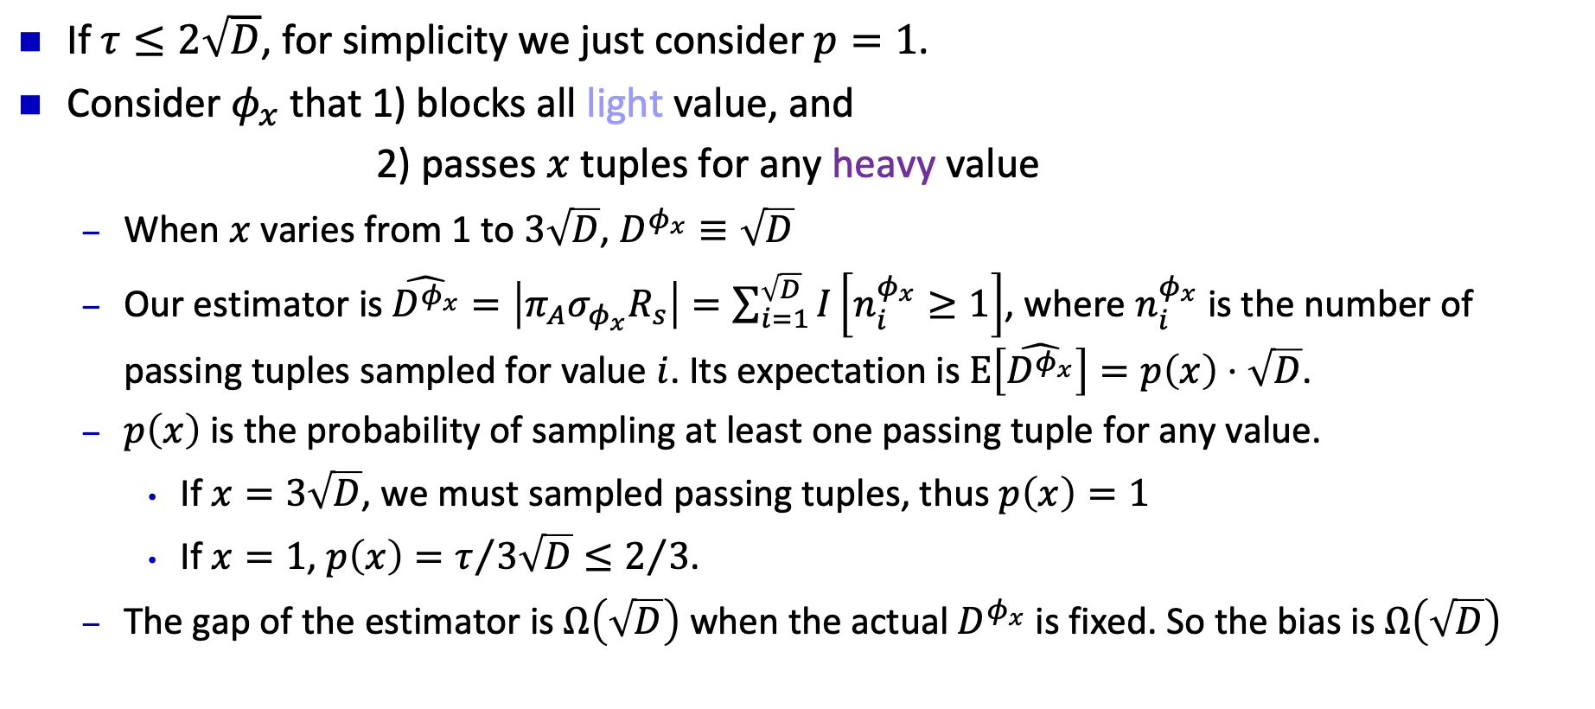
Uniform Distinct Sampling: Hard Case
$$3\sqrt{D}$$
If $τ≤2\sqrt{D}$, for simplicity we just consider $p=1$.
Consider $φ_{x}$ that 1) blocks all light value, and
2) passes $x$ tuples for any heavy value
When $x$ varies from 1 to $3\sqrt{D}$, $D^{φ_{x}}≡\sqrt{D}$
Our estimator is $\hat{D^{φ_{x}}}=\left|π_{A}σ_{φ_{x}}R_{s}\right|=\sum_{i=1}^{\sqrt{D}}{I\left[n_{i}^{φ_{x}}≥1\right]}$, where $n_{i}^{φ_{x}}$ is the number of passing tuples sampled for value $i$. Its expectation is $E\left[\hat{D^{φ_{x}}}\right]=p\left(x\right)⋅\sqrt{D}$.
$p\left(x\right)$ is the probability of sampling at least one passing tuple for any value.
If $x=3\sqrt{D}$, we must sampled passing tuples, thus $p\left(x\right)=1$
If $x=1$, $p\left(x\right)=τ/{3\sqrt{D}}≤2/3$.
The gap of the estimator is $Ω\left(\sqrt{D}\right)$ when the actual $D^{φ_{x}}$ is fixed. So the bias is $Ω\left(\sqrt{D}\right)$
$$1$$
$$\sqrt{D}$$
$$D−\sqrt{D}$$

Slide 22
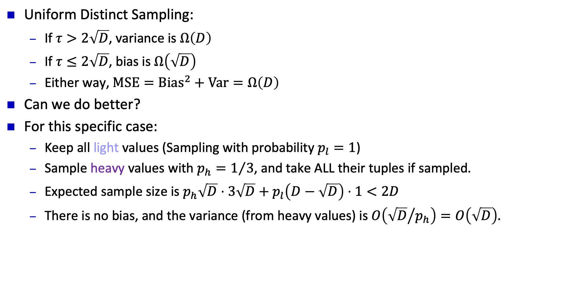
Uniform vs. Weighted Distinct Sampling
$$3\sqrt{D}$$
Uniform Distinct Sampling:
If $τ>2\sqrt{D}$, variance is $Ω\left(D\right)$
If $τ≤2\sqrt{D}$, bias is $Ω\left(\sqrt{D}\right)$
Either way, $\text{MSE}={\text{Bias}}^{2}+\text{Var}=Ω\left(D\right)$
Can we do better?
For this specific case:
Keep all light values (Sampling with probability $p_{l}=1$)
Sample heavy values with $p_{h}=1/3$, and take ALL their tuples if sampled.
Expected sample size is $p_{h}\sqrt{D}⋅3\sqrt{D}+p_{l}\left(D−\sqrt{D}\right)⋅1<2D$
There is no bias, and the variance (from heavy values) is $O\left({\sqrt{D}}/{p_{h}}\right)=O\left(\sqrt{D}\right).$
$$1$$
$$\sqrt{D}$$
$$D−\sqrt{D}$$

Slide 23
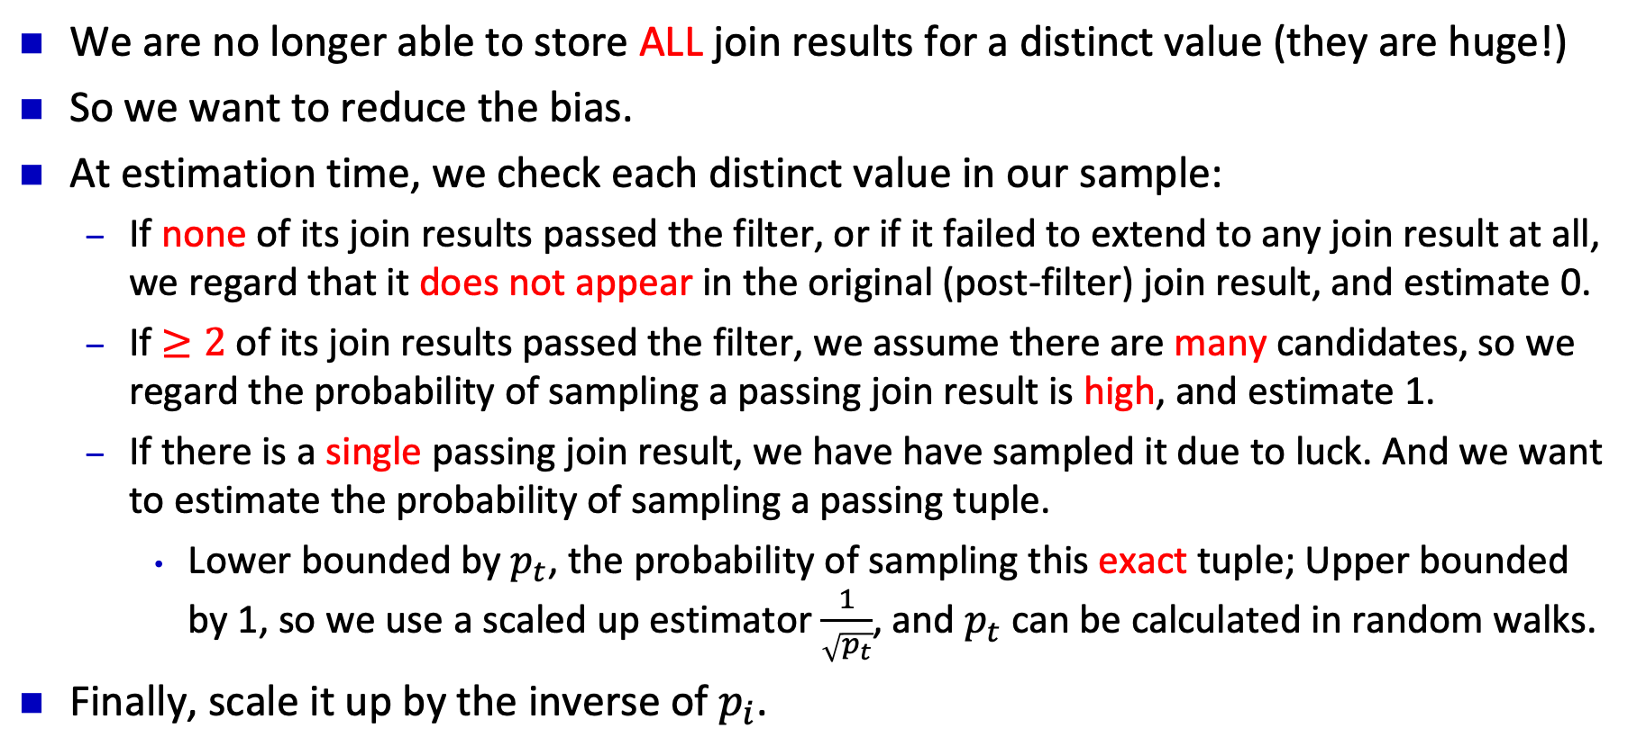
WDS for SPJ: Estimation
We are no longer able to store ALL join results for a distinct value (they are huge!)
So we want to reduce the bias.
At estimation time, we check each distinct value in our sample:
If none of its join results passed the filter, or if it failed to extend to any join result at all, we regard that it does not appear in the original (post-filter) join result, and estimate 0.
If $≥2$ of its join results passed the filter, we assume there are many candidates, so we regard the probability of sampling a passing join result is high, and estimate 1.
If there is a single passing join result, we have have sampled it due to luck. And we want to estimate the probability of sampling a passing tuple.
Lower bounded by $p_{t}$, the probability of sampling this exact tuple; Upper bounded by 1, so we use a scaled up estimator $\frac{1}{\sqrt{p_{t}}}$, and $p_{t}$ can be calculated in random walks.
Finally, scale it up by the inverse of $p_{i}$.

