Slide 1
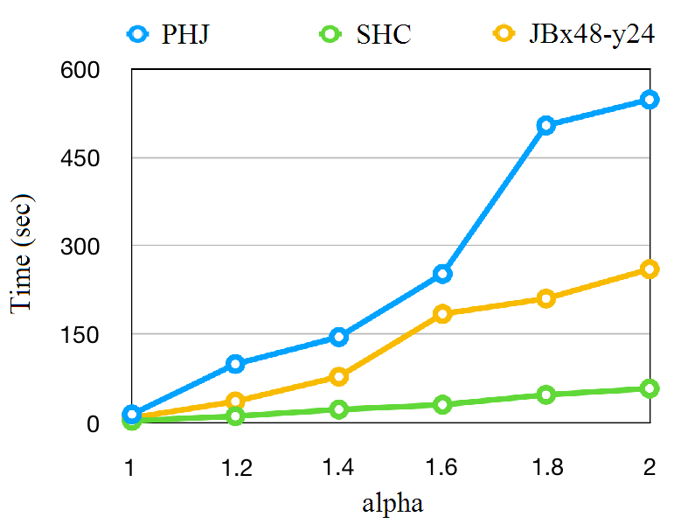
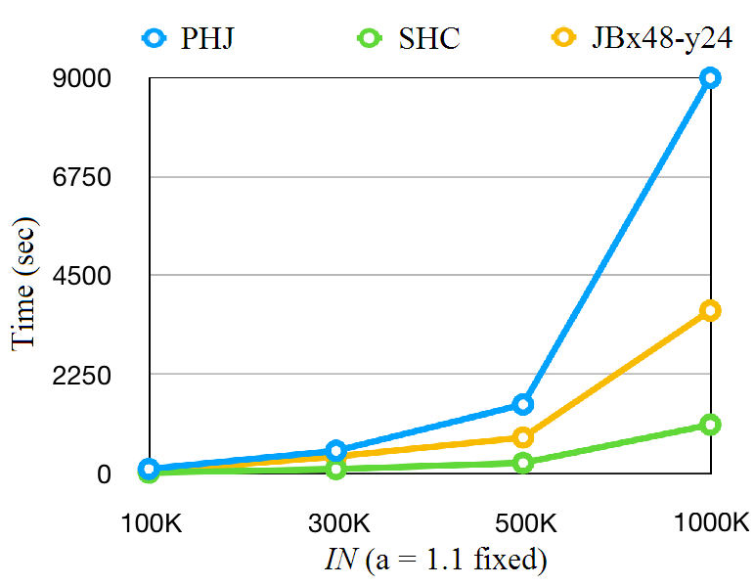
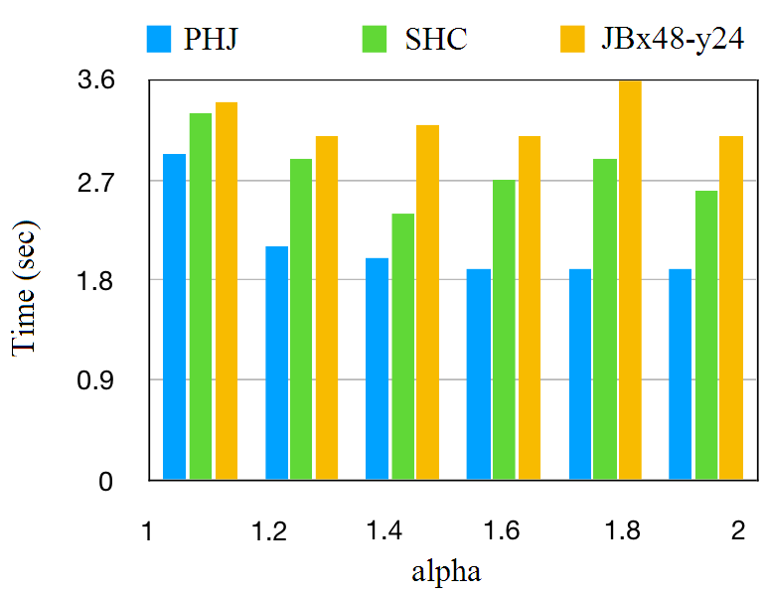
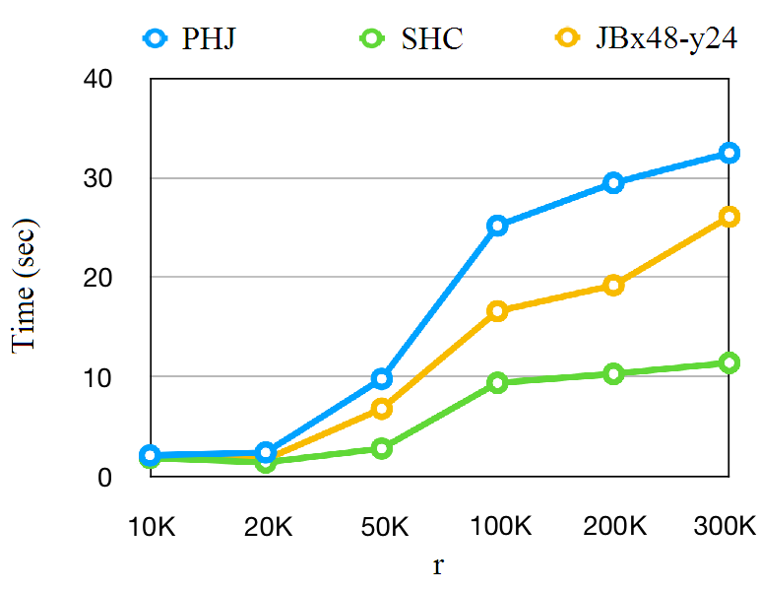
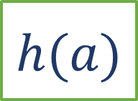
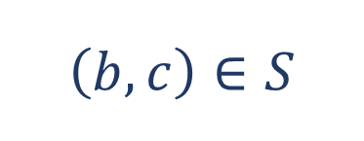
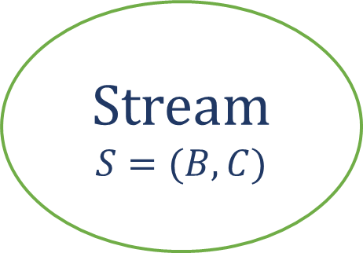



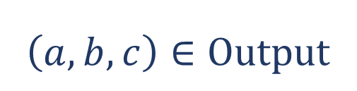

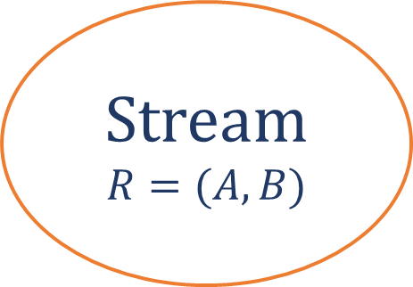

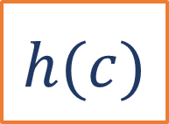
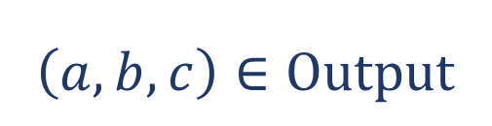
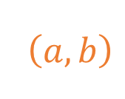


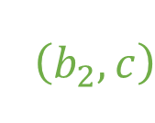


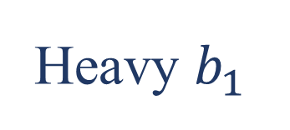
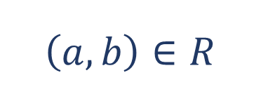

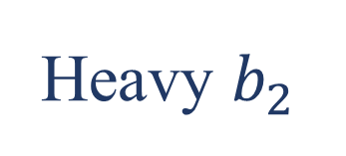

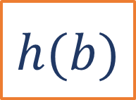

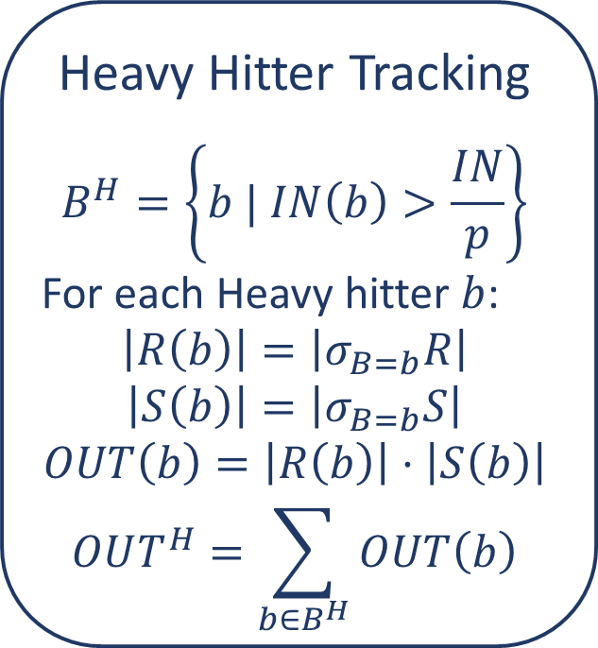
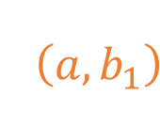
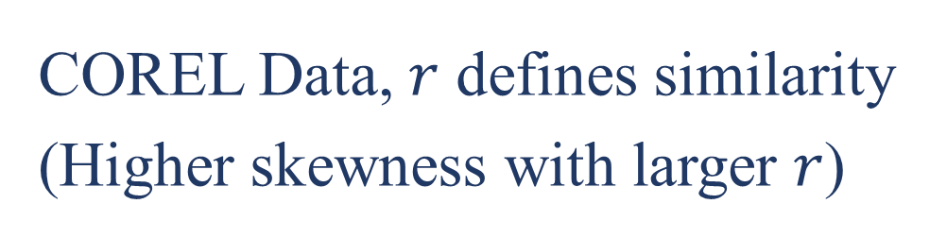

Streaming HyperCube: A Massively Parallel Stream Join Algorithm
Yuan Qiu, Serafeim Papadias, Ke Yi
HKUST
{yqiuac, spapadias, yike}@cse.ust.hk
Abstract
System Architecture
Stream join is an essential operation in many real-time applications. On static data, the HyperCube algorithm ensures a balanced load across all processors in an optimal way. We extend this algorithm to the streaming setting, which can adapt the HyperCube configuration depending on the current data distribution.
Stream
$$R=(A,B)$$
Stream
$$S=(B,C)$$
Source
Dispatcher
Heavy Hitter Tracking
$$B^{H}=\left\{b | IN\left(b\right)>\frac{IN}{p}\right\}$$
For each Heavy hitter $b$:
$$\left|R\left(b\right)\right|=\left|σ_{B=b}R\right|$$
$$\left|S\left(b\right)\right|=\left|σ_{B=b}S\right|$$
$$OUT\left(b\right)=\left|R\left(b\right)\right|⋅\left|S\left(b\right)\right|$$
$$OUT^{H}=\sum_{b∈B^{H}}{OUT\left(b\right)}$$
Stream Join
Light
$$\left(a,b_{1}\right)$$
Heavy $b_{1}$
Stream $R$
…
$$\left(a,b\right)$$
$$⋈$$
Heavy $b_{2}$
Signal a
State-Migration
- Creating
- Depreciating
- Resizing
Heavy Tasks
Stream $S$
…
$$\left(b_{2},c\right)$$
Increment
…
Task Pool
Light Tasks
Heavy Tasks
HyperCube
Create
When the current allocation is suboptimal by a constant factor!
Input tuple $\left(a,b\right)∈R$:
Light Hitter: Parallel Hash Join
Heavy Hitter: Cartesian Product
Depreciate
Resize(+)
$$\left(a,b\right)∈R$$
$$\left(b,c\right)∈S$$
Resize(-)
$$1$$
$$h(b)$$
$$p$$
… Workers …
$$\left(a,b,c\right)∈Output$$
Output
$$\left(b,c\right)∈S$$
Evaluation
$$1$$
$$h(c)$$
$$p_{S}$$
Parallel Hash Join
Streaming HyperCube
Join-Biclique
$$\left(a,b\right)∈R$$
$$h(a)$$
$$p_{R}$$
$$\left(a,b,c\right)∈Output$$
Zipf Data, Varying Skewness $α$
Zipf Data, Varying Input Size
Challenge
All heavy hitter information is needed to decide the configuration of each cube.
The heavy hitter set may change throughout the stream processing.
TPC-H Data, Varying Skewness $α$
COREL Data, $r$ defines similarity
(Higher skewness with larger $r$)

