Slide 1


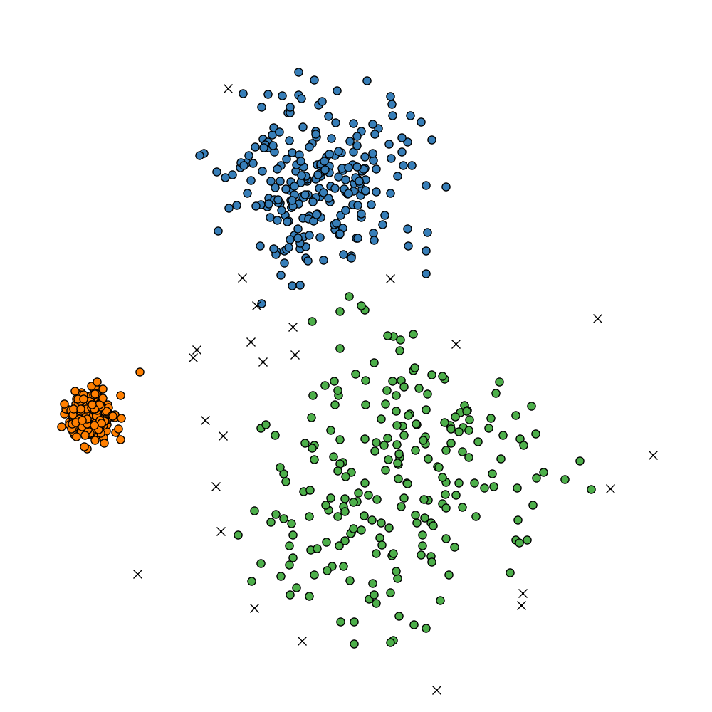
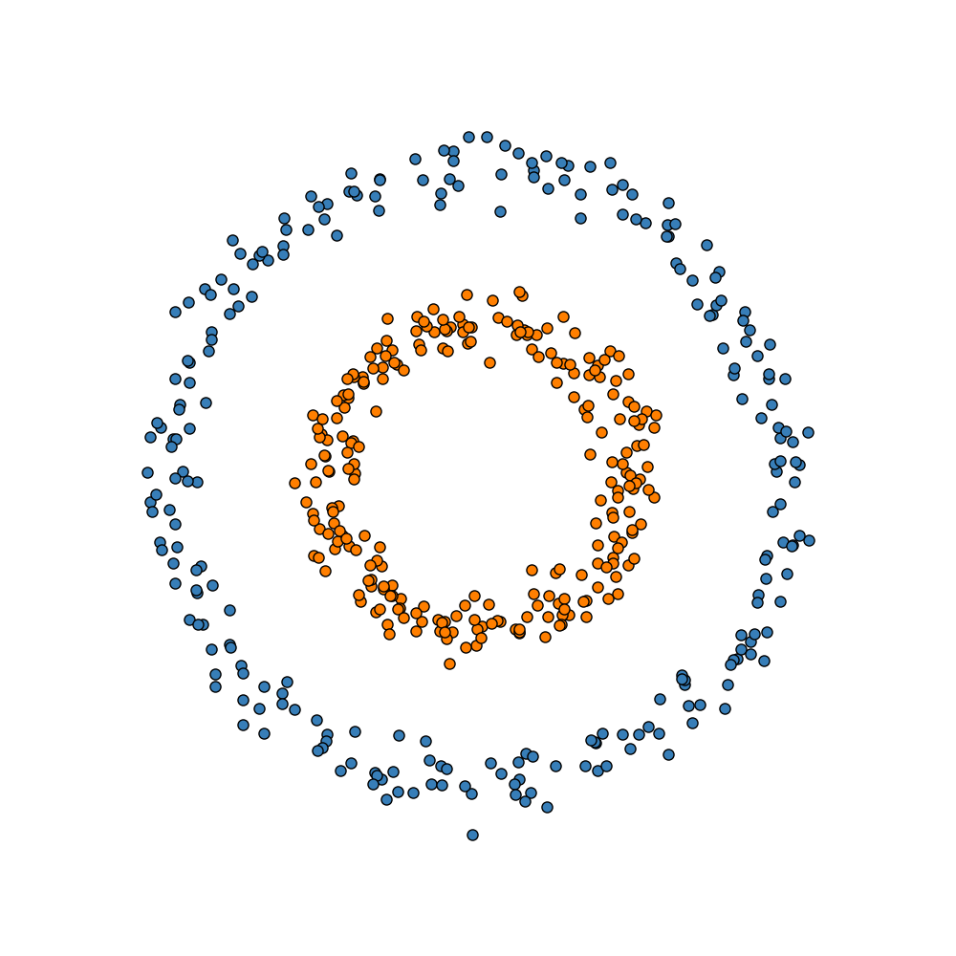
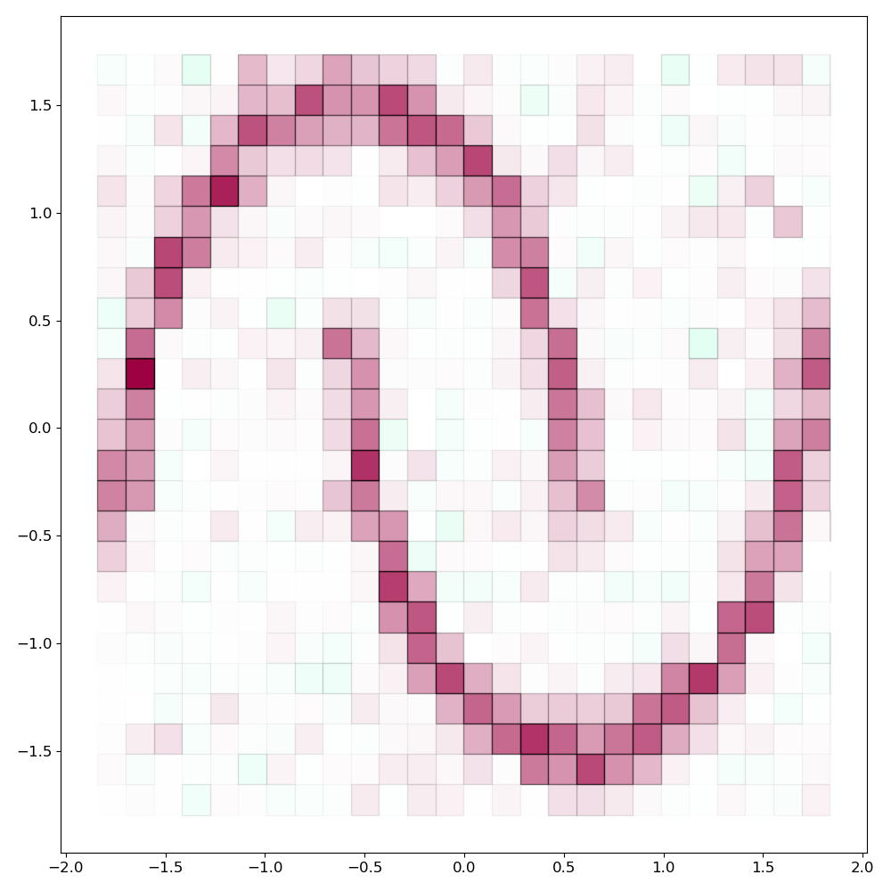
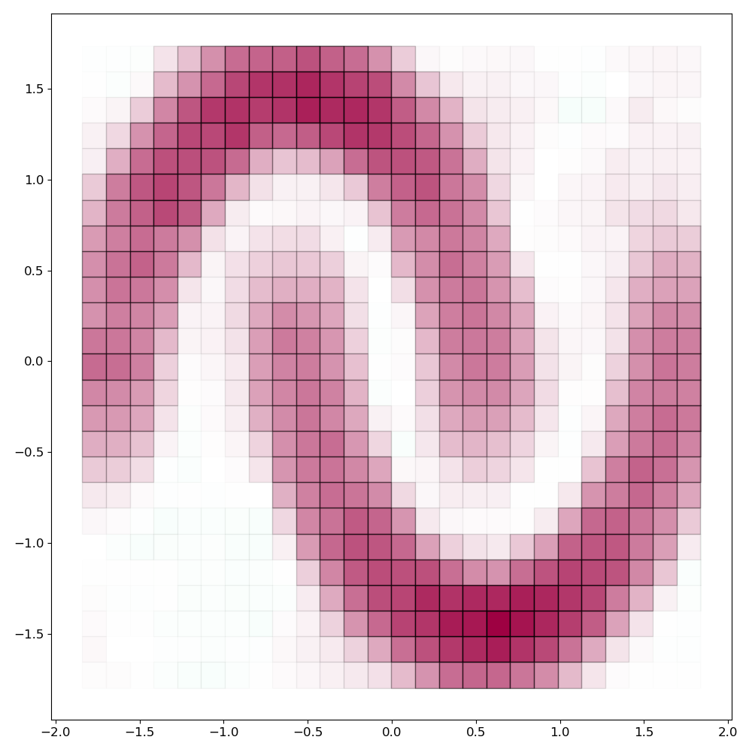
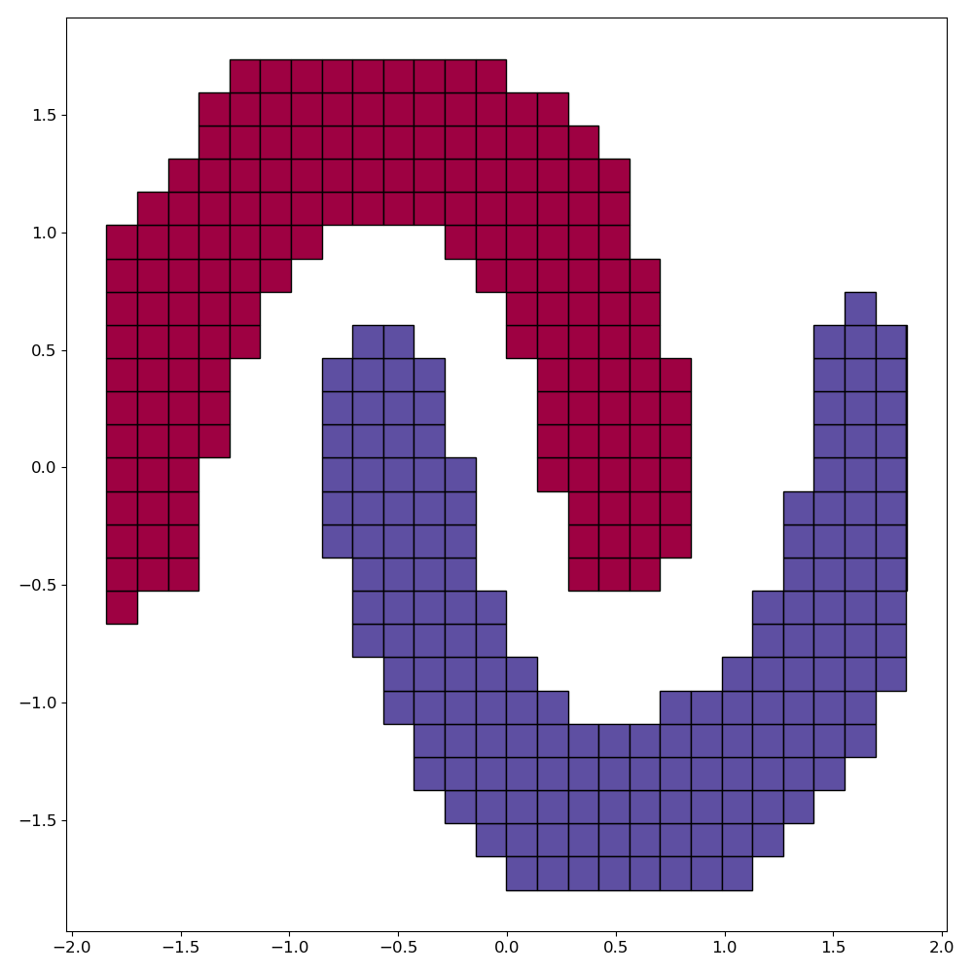
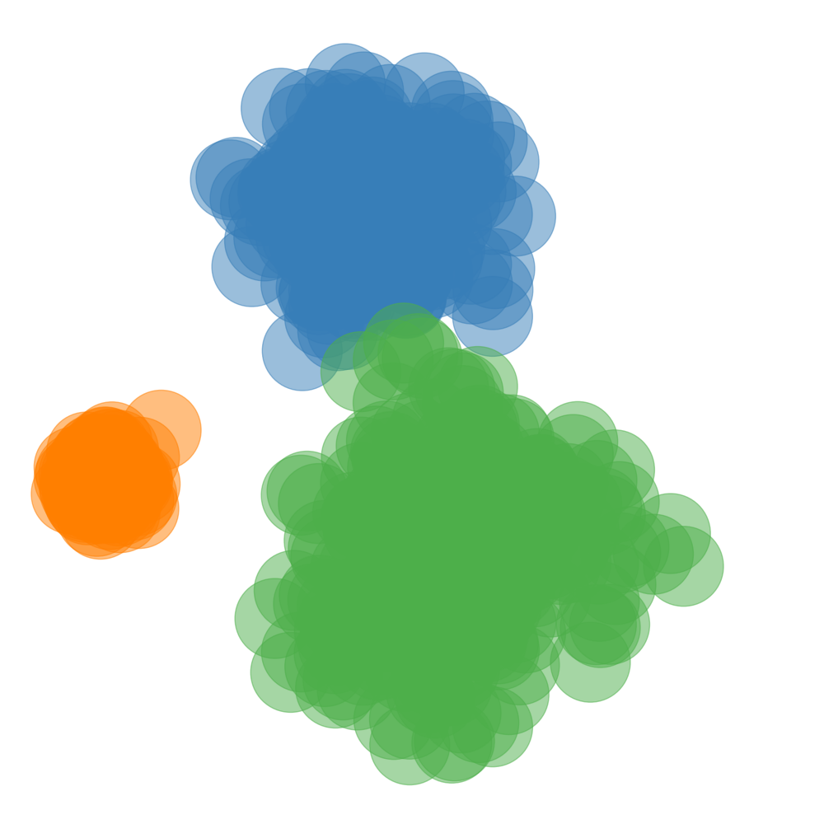
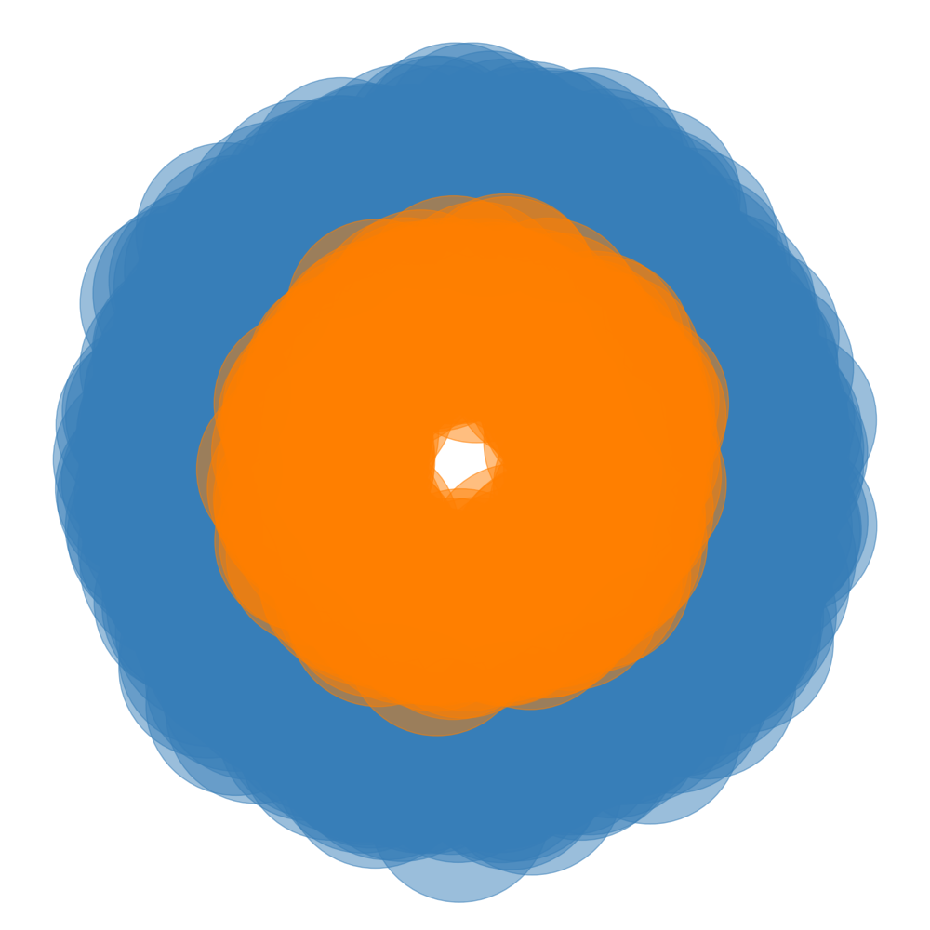
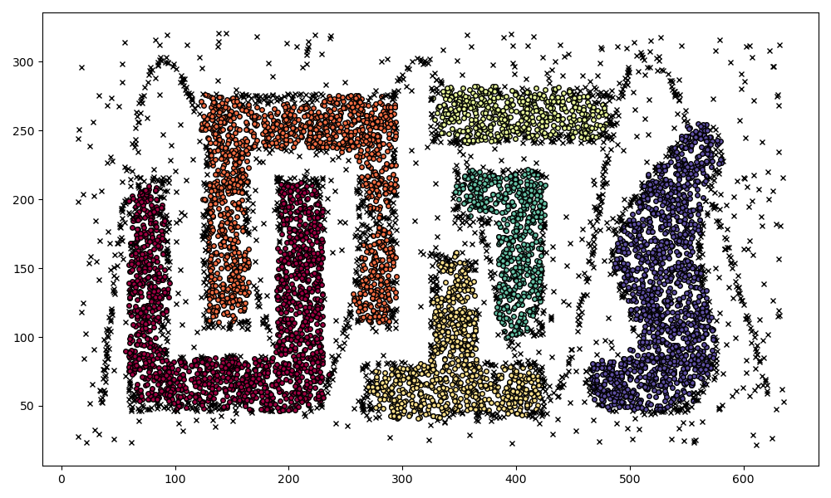
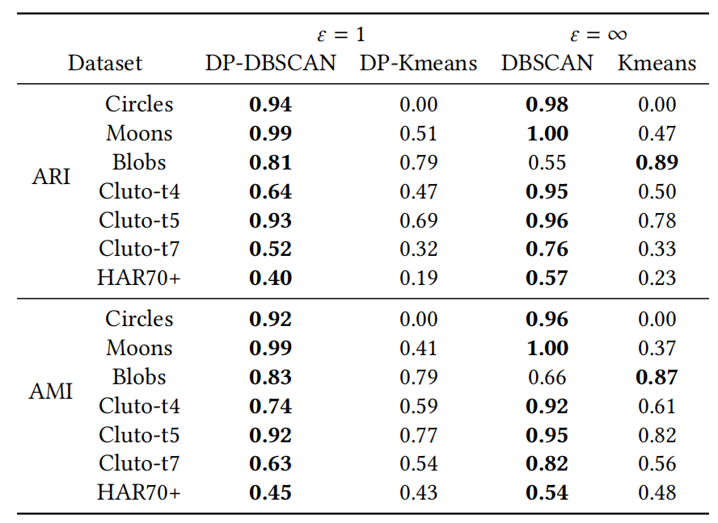
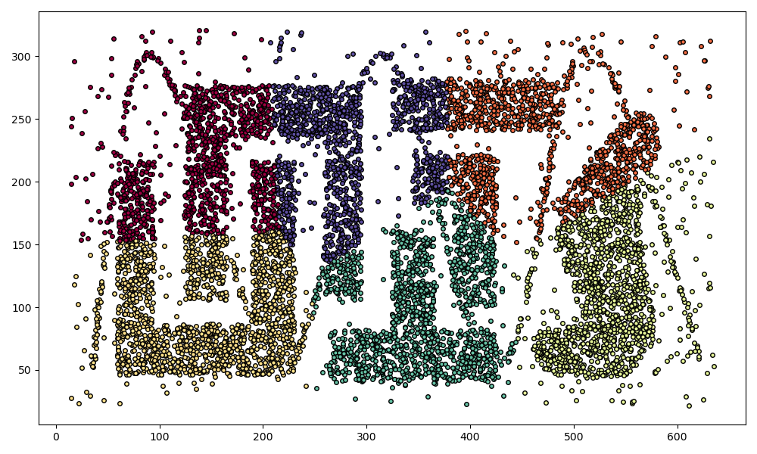



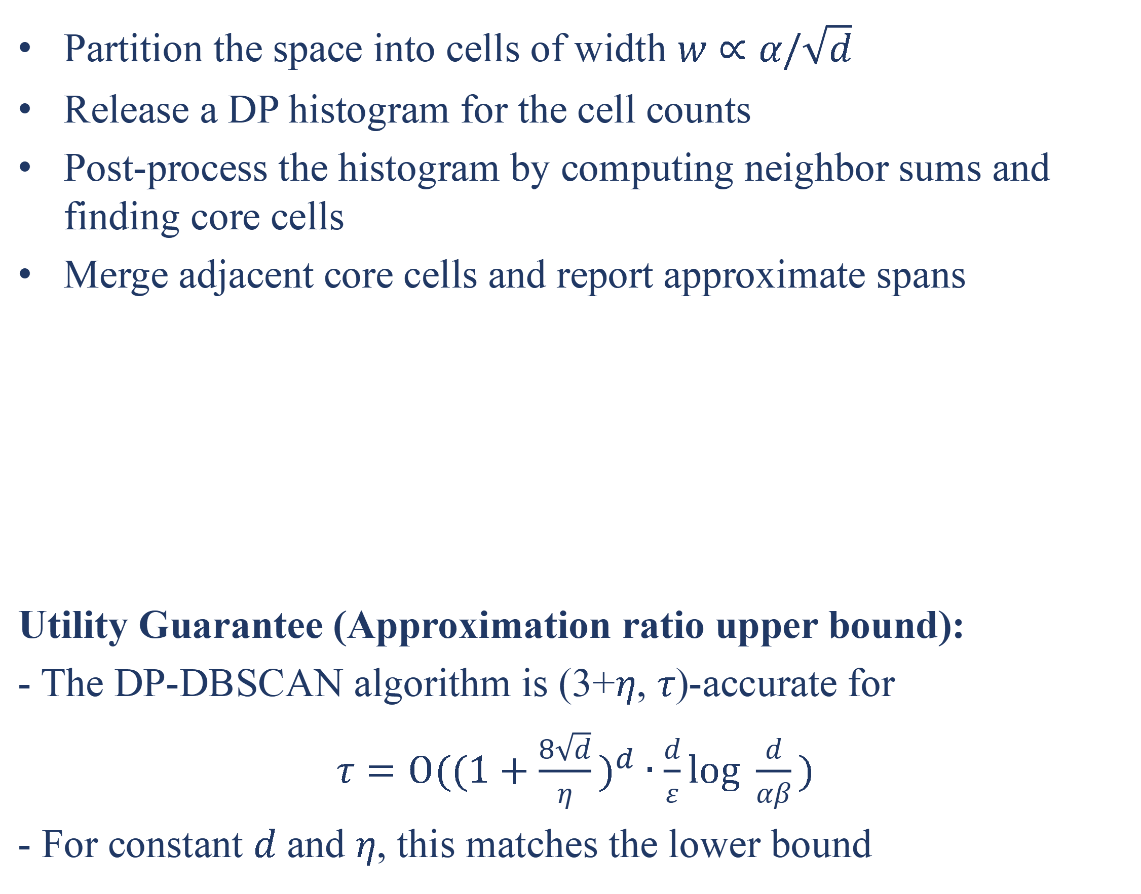
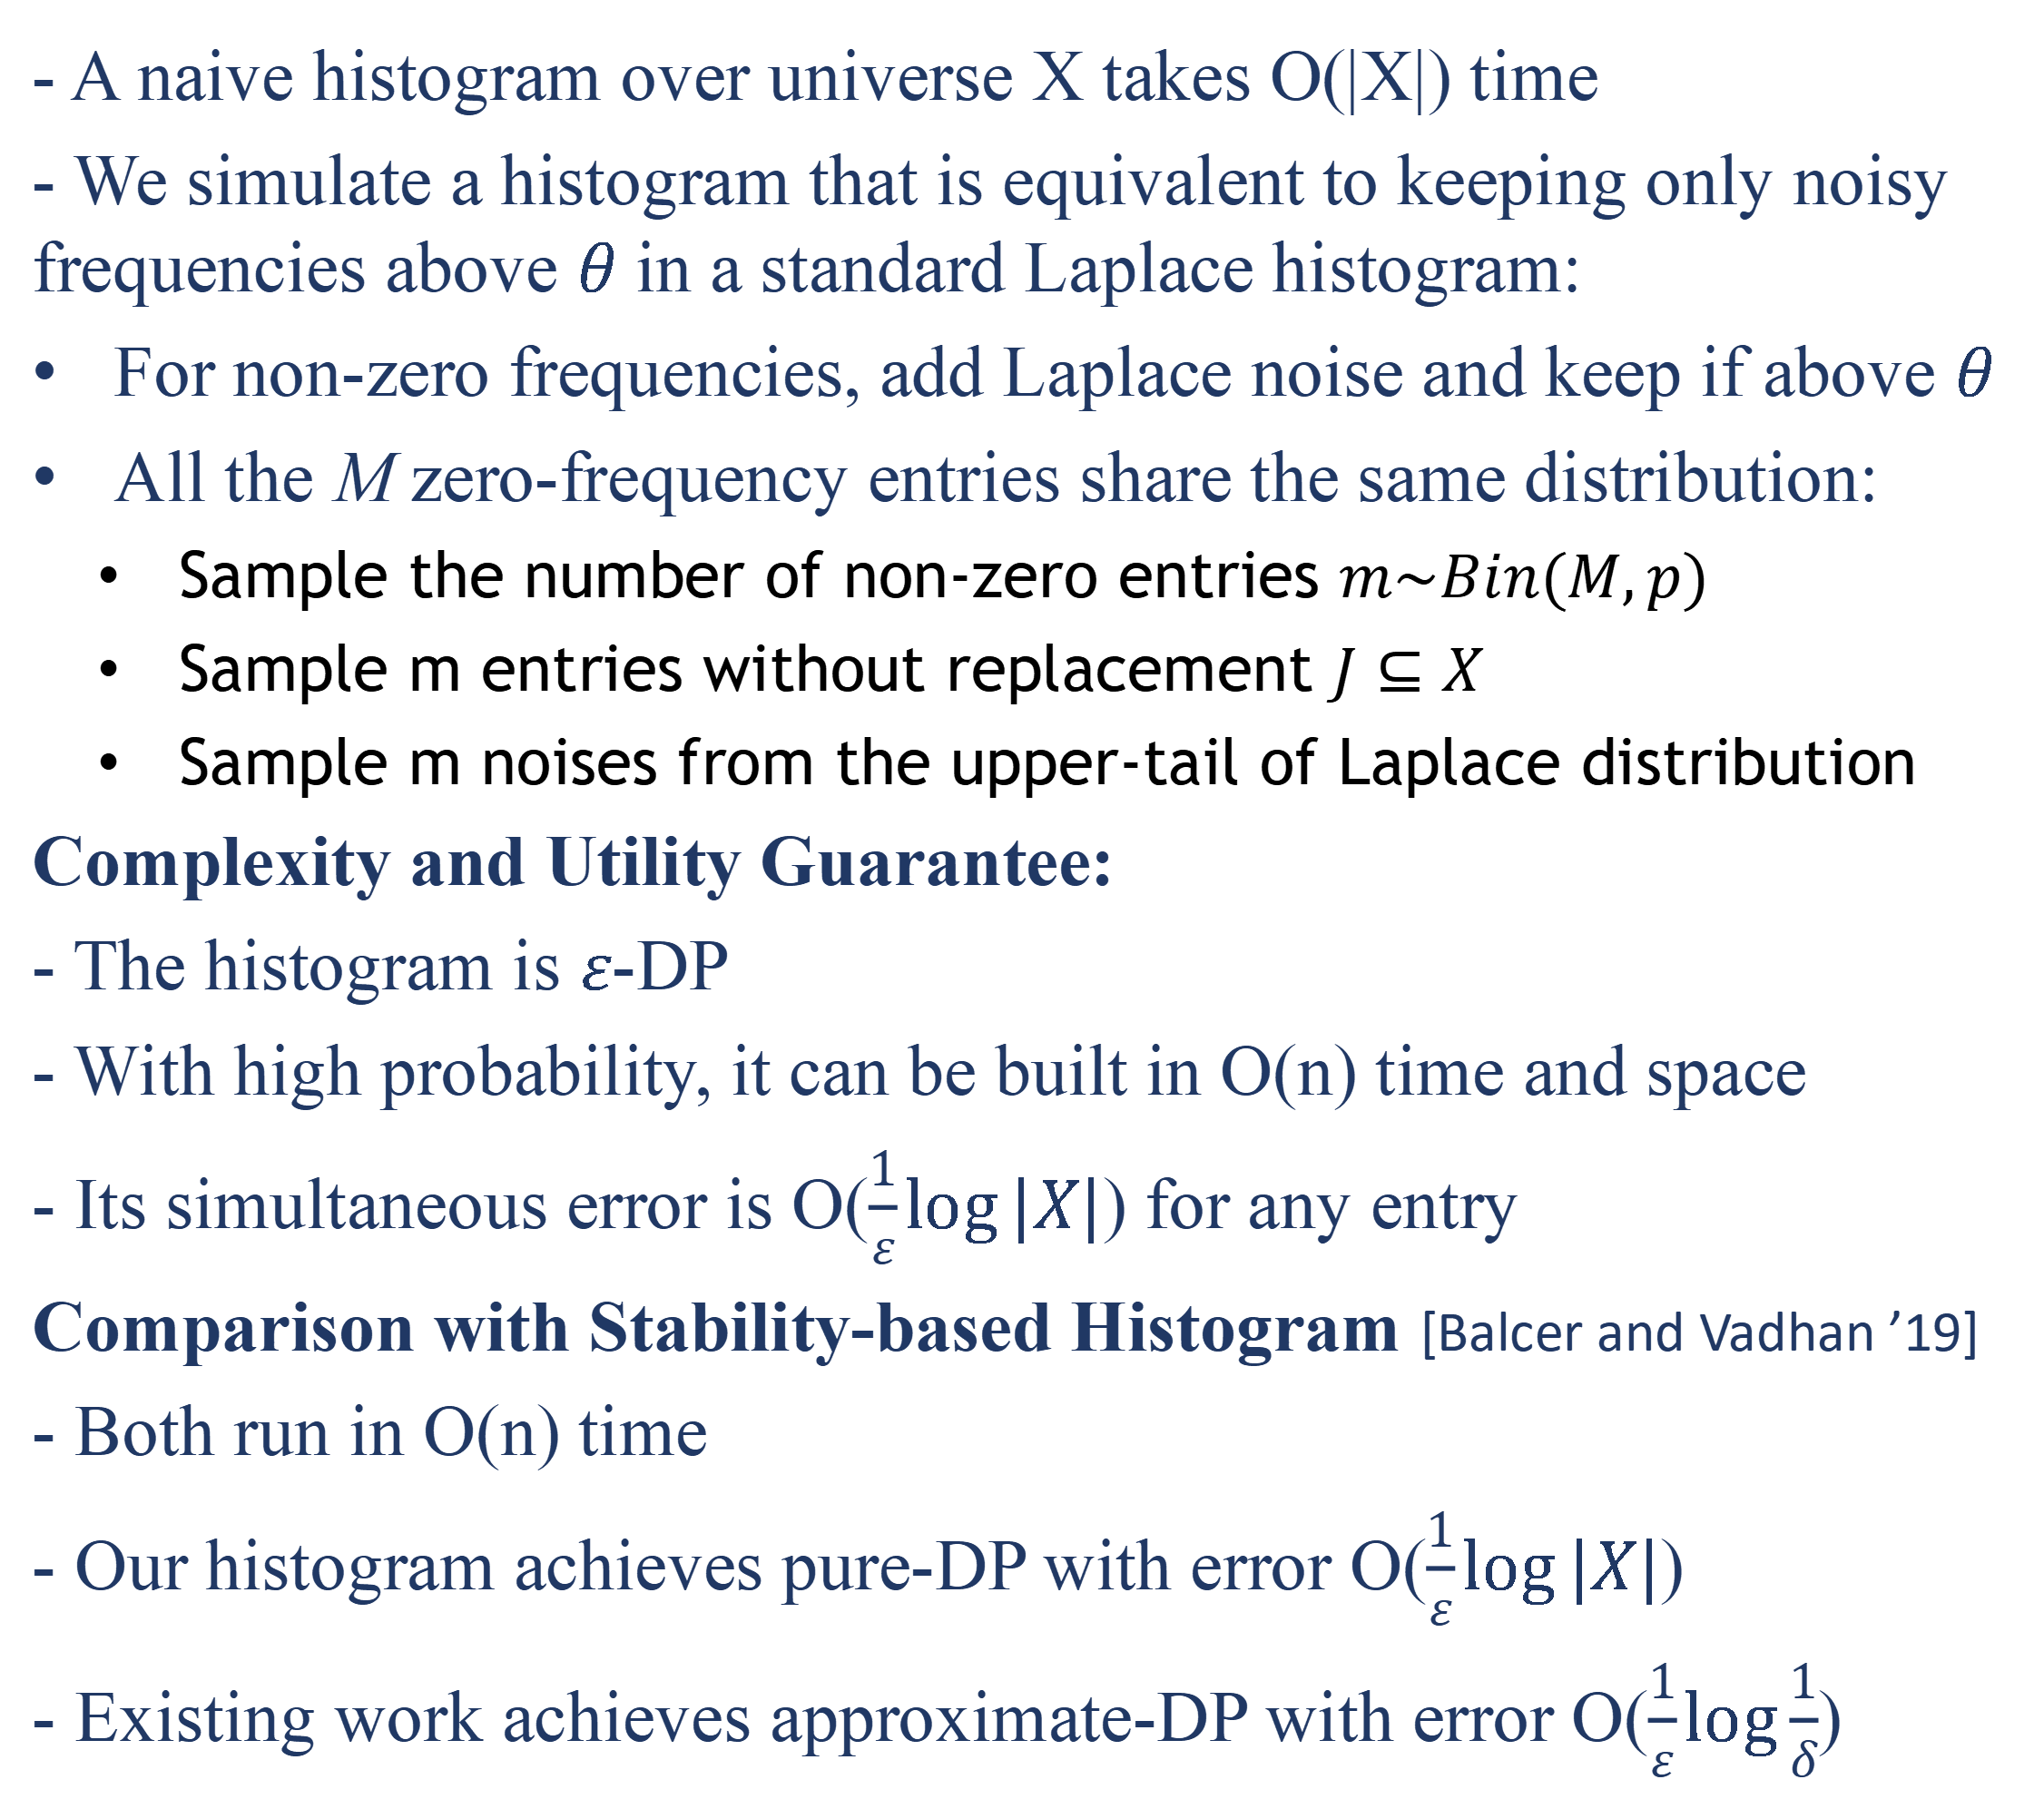
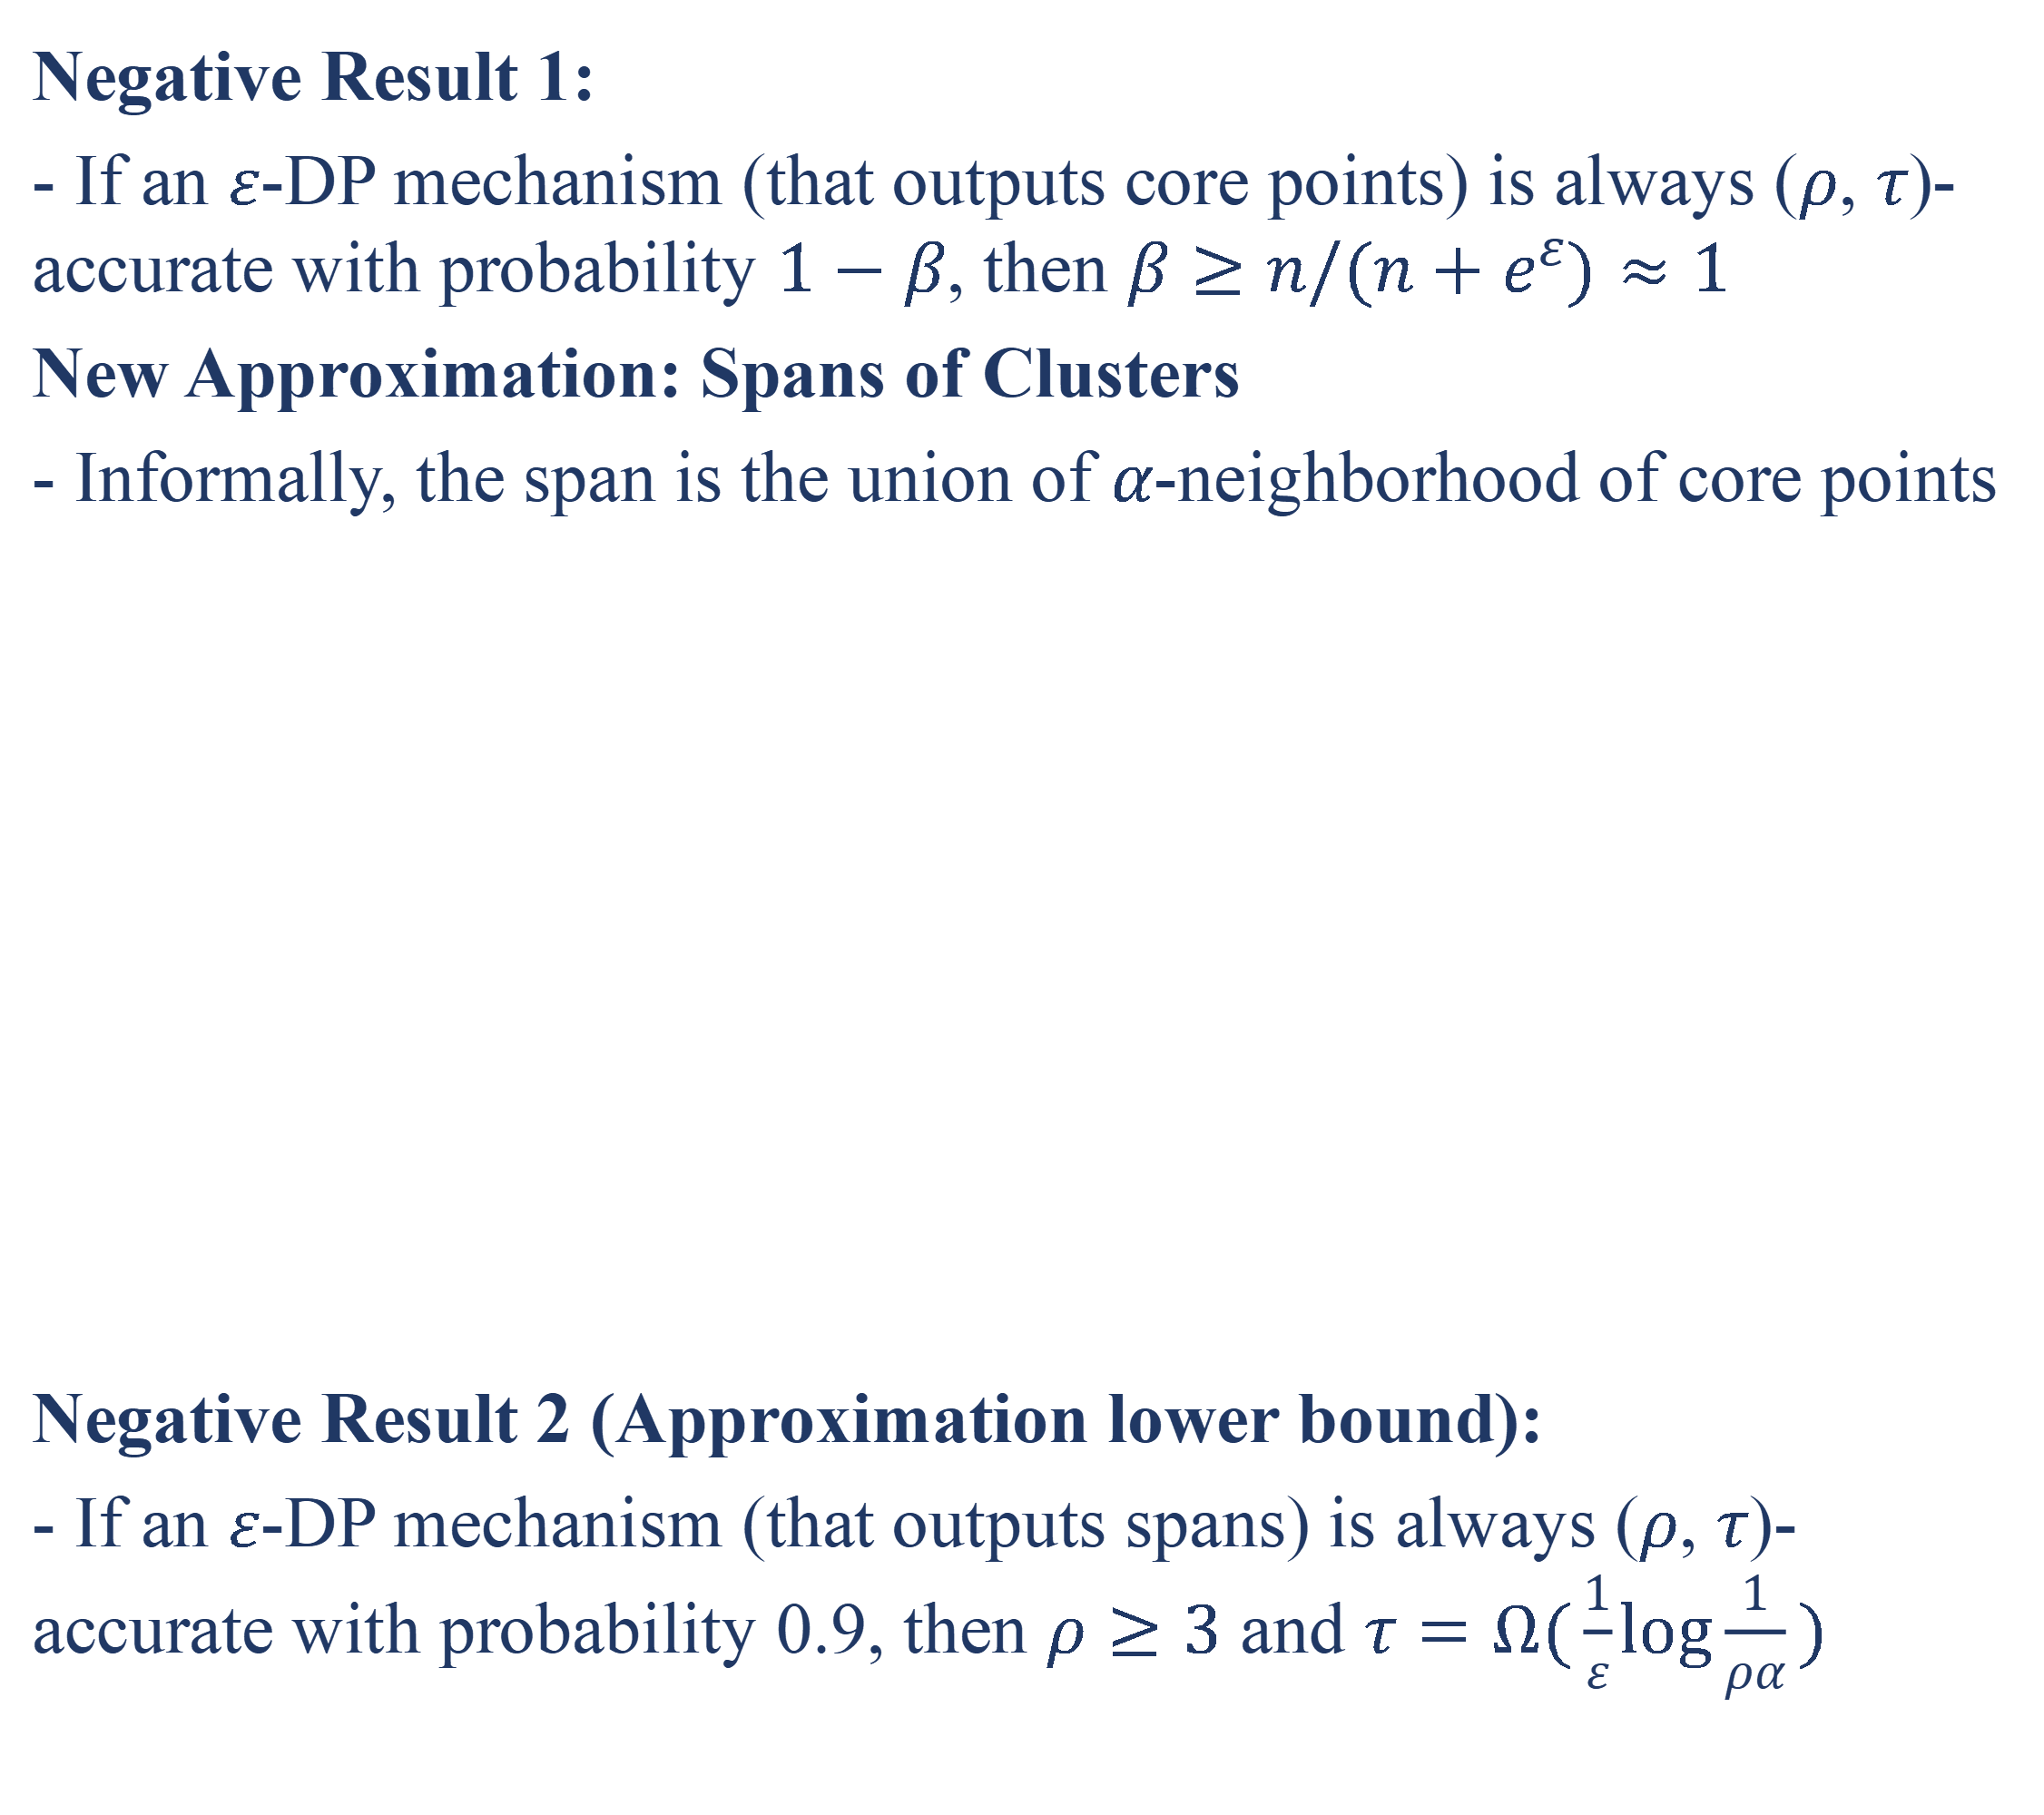



Approximate DBSCAN under Differential Privacy
Yuan Qiu and Ke Yi
yuan.qiu@cnrsatcreate.sg, yike@cse.ust.hk
Problem Definition
DP Approximate DBSCAN
DBSCAN($α$, MinPts):
- $p$ is a core point if $B(p,α)$ contains at leasat MinPts points
- $p$ and $q$ are reachable if dist($p$, $q$) < $α$
- $p$ and $q$ are connected if they are directly or transitively reachable
- A cluster is a maximal set of mutually connected core points
Differential Privacy($ε$, $δ$):
- For any pair of neighboring datasets $P\sim P’$ and any subset of outputs $O⊆𝒪$, we should have
$$Pr[ℳ(P)∈O]≤e^{ε}∙Pr[ℳ(P)∈O]+δ$$
Partition the space into cells of width $w∝α/\sqrt{d}$
Release a DP histogram for the cell counts
Post-process the histogram by computing neighbor sums and finding core cells
Merge adjacent core cells and report approximate spans
Utility Guarantee (Approximation ratio upper bound):
- The DP-DBSCAN algorithm is (3+$η$, $τ$)-accurate for
$τ=O({(1+\frac{8\sqrt{d}}{η})}^{d}∙\frac{d}{ε}log \frac{d}{αβ})$
- For constant $d$ and $η$, this matches the lower bound
Linear-Time Pure-DP Histsogram
Approximate DBSCAN [Gan and Tao ’15]
- A naive histogram over universe X takes O(|X|) time
- We simulate a histogram that is equivalent to keeping only noisy frequencies above $θ$ in a standard Laplace histogram:
For non-zero frequencies, add Laplace noise and keep if above $θ$
All the M zero-frequency entries share the same distribution:
Sample the number of non-zero entries $m\sim Bin(M,p)$
Sample m entries without replacement $J⊆X$
Sample m noises from the upper-tail of Laplace distribution
Complexity and Utility Guarantee:
- The histogram is $ε$-DP
- With high probability, it can be built in O(n) time and space
- Its simultaneous error is O($\frac{1}{ε}\log{|X|}$) for any entry
Comparison with Stability-based Histogram [Balcer and Vadhan ’19]
- Both run in O(n) time
- Our histogram achieves pure-DP with error O($\frac{1}{ε}\log{|X|}$)
- Existing work achieves approximate-DP with error O($\frac{1}{ε}\log{\frac{1}{δ}}$)
($α$, MinPts)-Cluster
$$α$$
$$ρα$$
Reported Cluster
($ρ$, $τ$)
($ρα$, MinPts-$τ$)-Cluster
Approximate Cluster Spans
Negative Result 1:
- If an $ε$-DP mechanism (that outputs core points) is always ($ρ$, $τ$)-accurate with probability $1−β$, then $β≥n/(n+e^{ε})≈1$
New Approximation: Spans of Clusters
- Informally, the span is the union of $α$-neighborhood of core points
Negative Result 2 (Approximation lower bound):
- If an $ε$-DP mechanism (that outputs spans) is always ($ρ$, $τ$)-accurate with probability 0.9, then $ρ≥3$ and $τ=Ω(\frac{1}{ε}\log{\frac{1}{ρα}})$
Experiments
DP-DBSCAN
DP-KMeans

