Slide 1

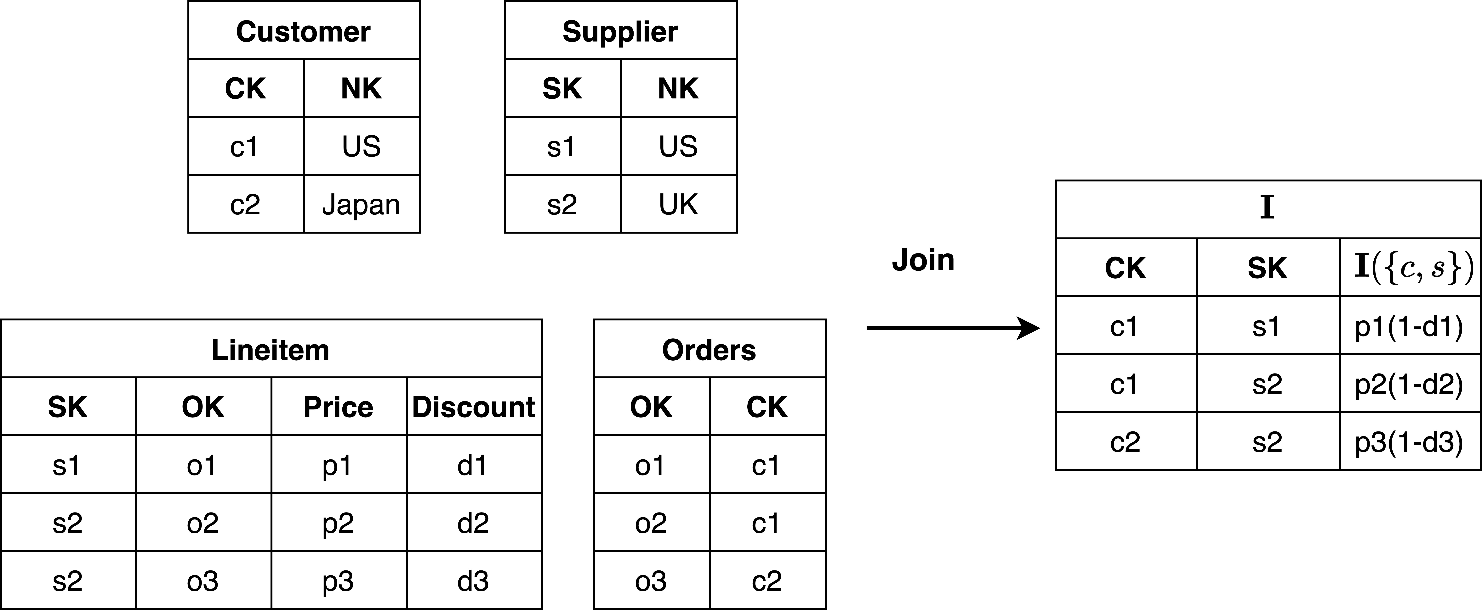
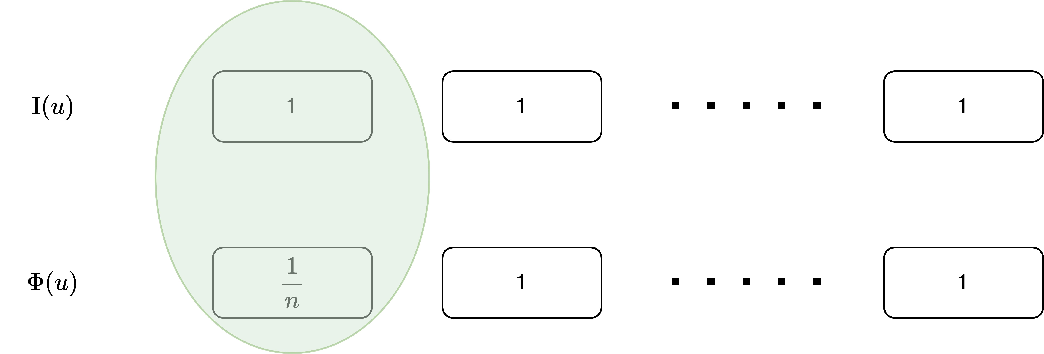
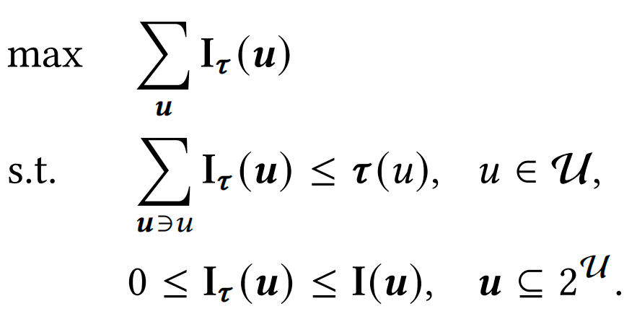
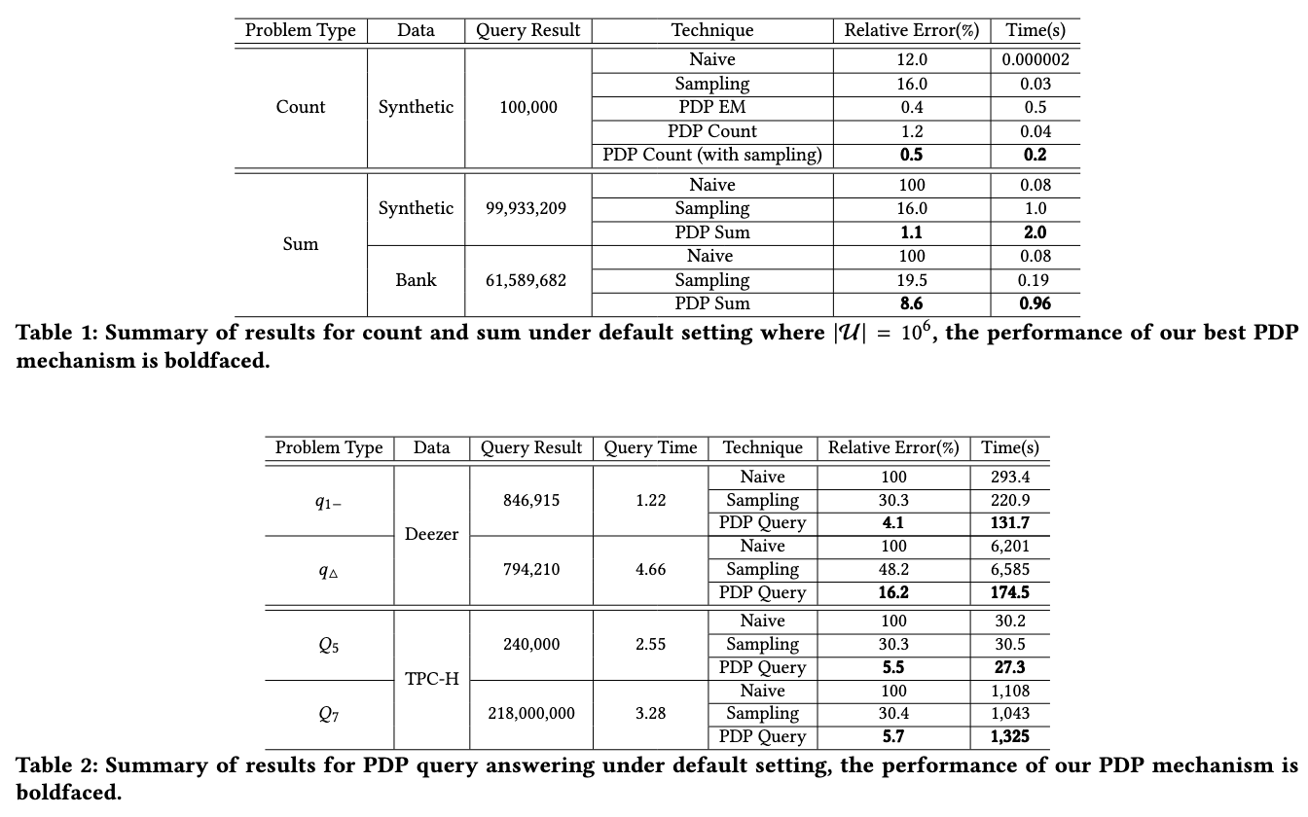
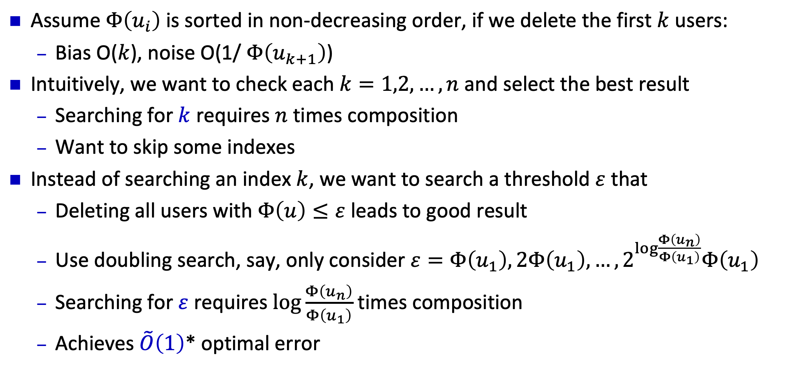

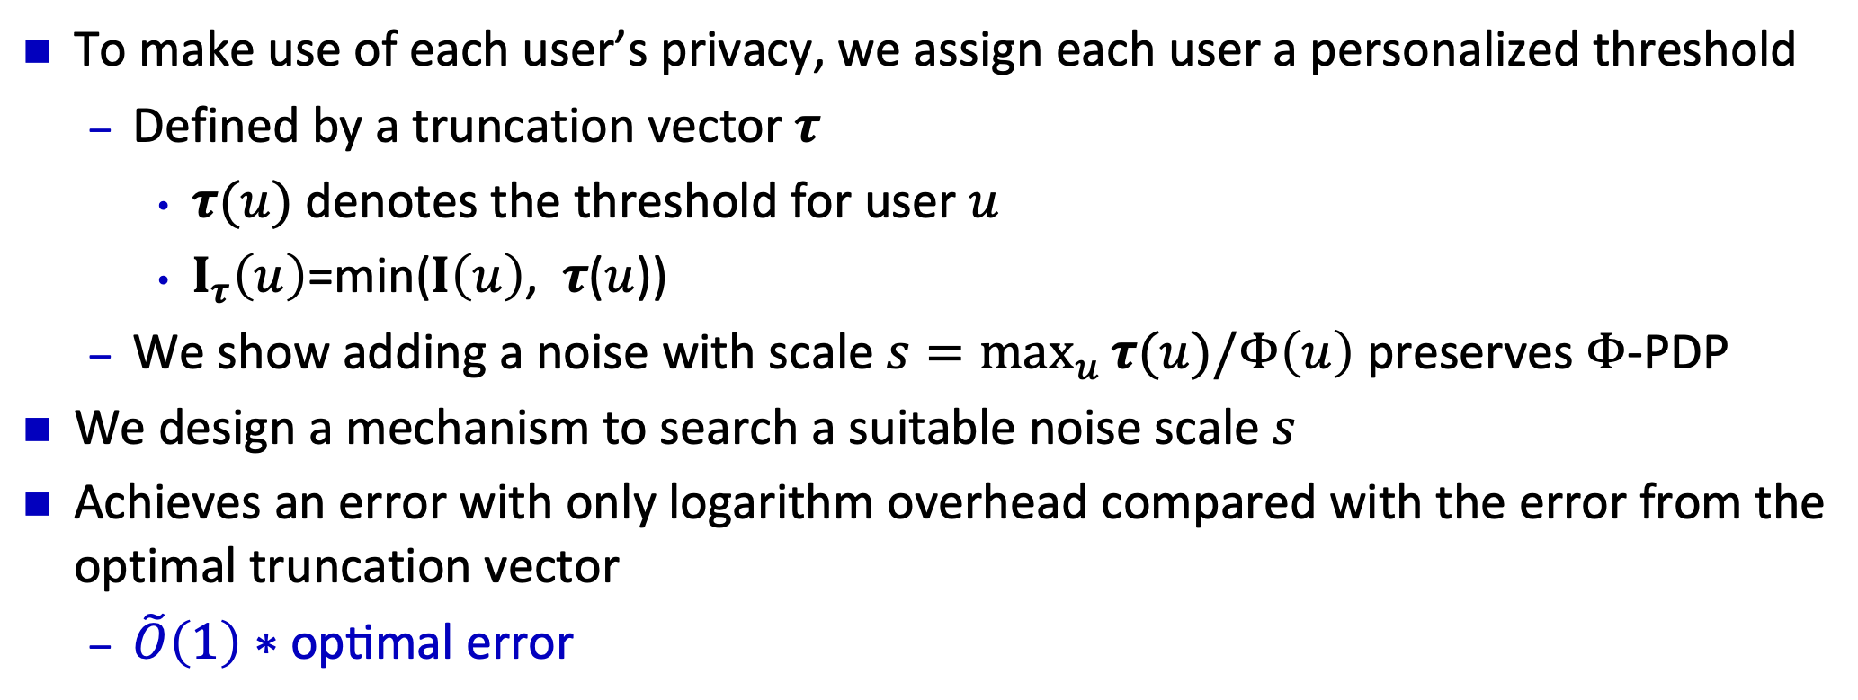
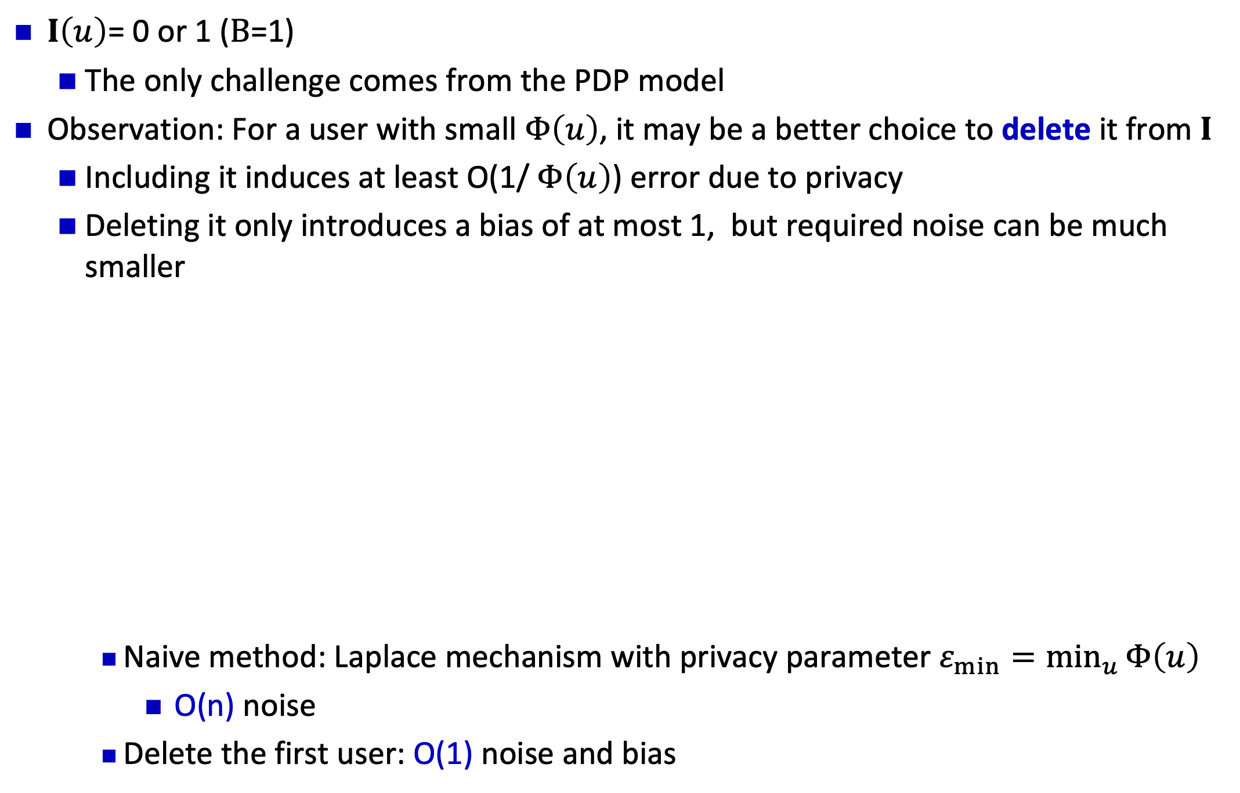

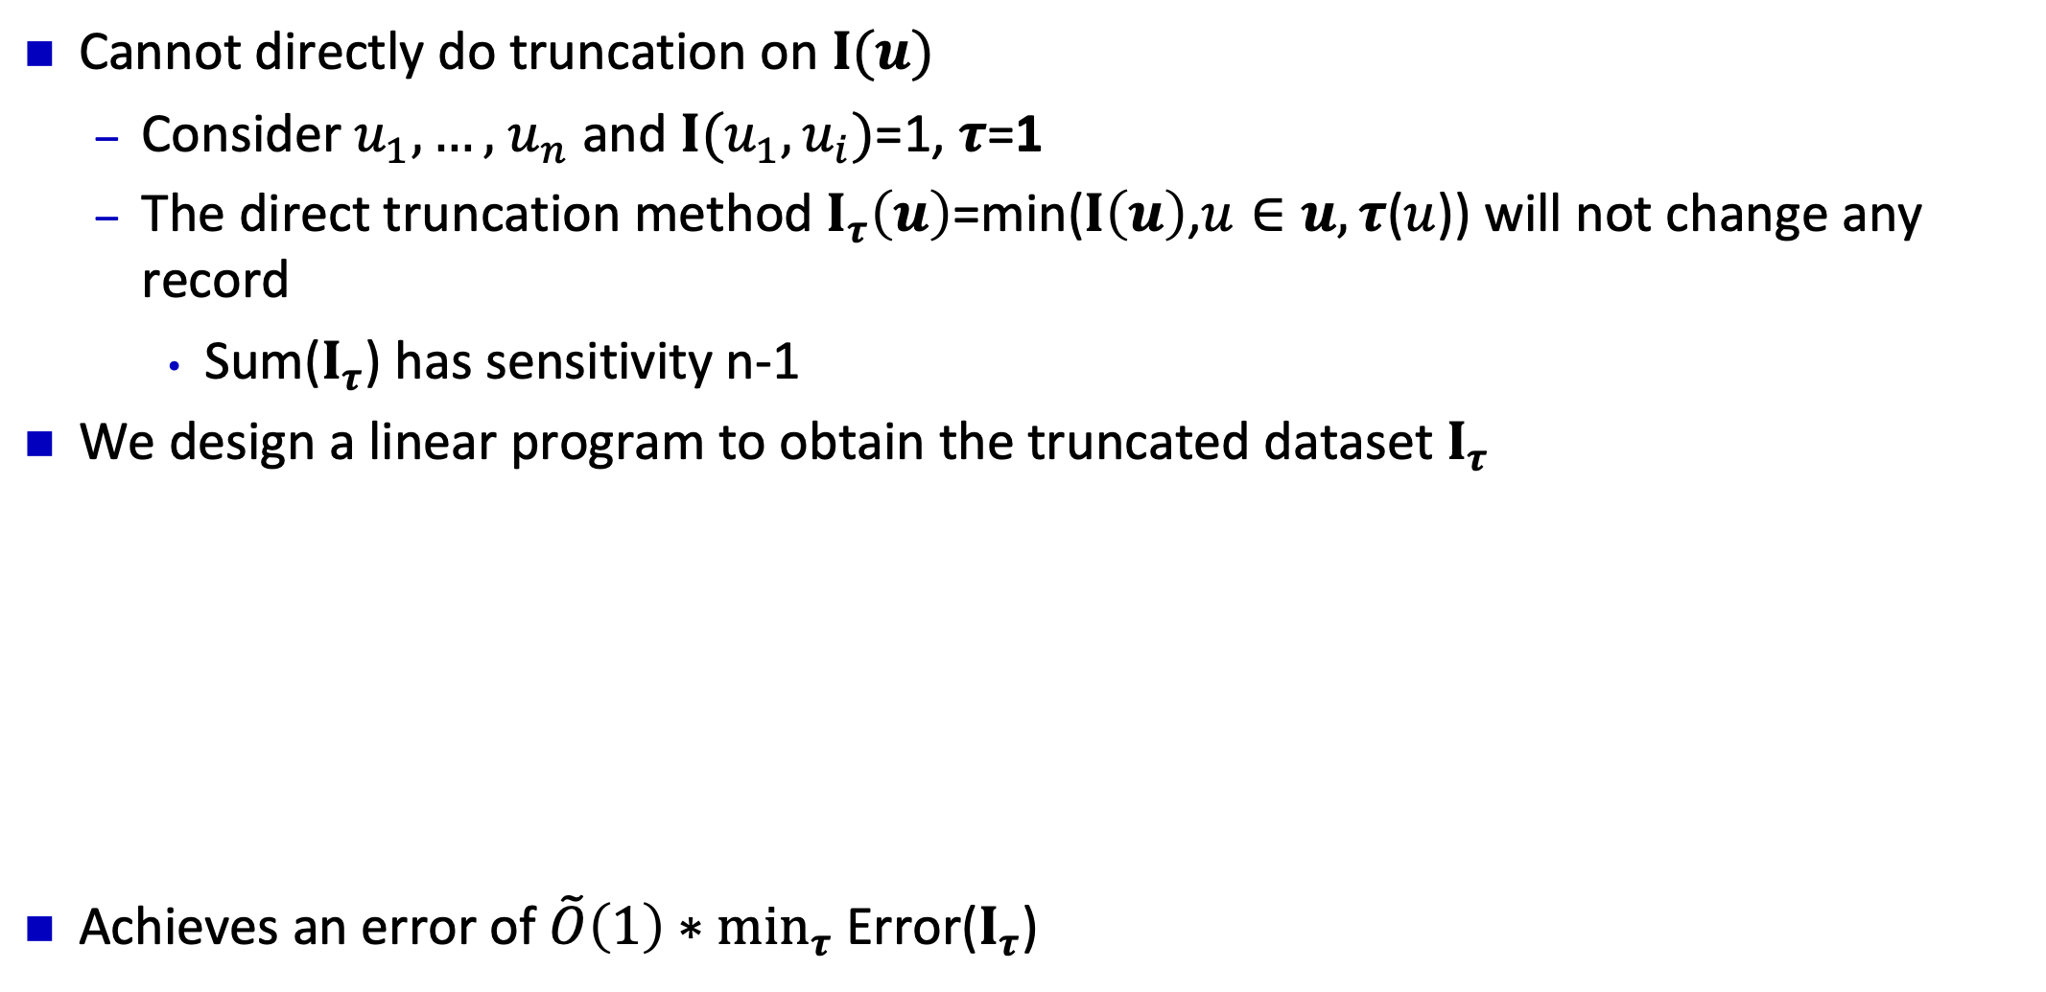


Personalized Truncation for Personalized Privacy
Dajun Sun, Wei Dong, Yuan Qiu, Ke Yi
Hong Kong University of Science and Technology
Personalized Differential Privacy(PDP) Basics
General PDP Sum Problem
Personalized Differential Privacy (PDP)_{[Jorgensen et al. 2015]}
For any pair of database instances $I, I′$, they are neighbors on $u$ ($I∼_{u}I^{′}$) if they differ by user $u$’s information
Each user $u$specifies his own privacy parameter $Φ\left(u\right)$
PDP Definition: A mechanism $M$ is $Φ$-PDP if for any $I∼_{u}I^{′}$and any subset of outputs $Y :$
$$\operatorname{Pr}\left[M\left(I\right)∈Y\right]≤e^{Φ(u)}⋅Pr\left[M\left(I^{′}\right)∈Y\right]$$
Adopt the idea of PDP count? Say,…
Find a threshold $ε$ and discard all users with $Φ\left(u\right)≤ε$
Apply $ε$-(standard) DP sum algorithm on the remaining data
This is no longer optimal
Problem Definition
We study the sum estimation problem under PDP
Assume $n$ users, each user $u$ holds:
An integer value $I\left(u\right)∈\left\{0,1,…,B\right\}$
His privacy parameter $Φ\left(u\right)$
Want to produce a privatized estimation for Sum($I$)=$\sum_{u}{I\left(u\right)}$
Naïve approach: Add a Laplace noise with scale $\frac{B}{ε_{min}}$
$B$ is the global sensitivity
${ε_{min}=min}_{u }Φ\left(u\right)$ is the strongest privacy requirement
Privacy budgets that are greater than $ε$ are wasted
To make use of each user’s privacy, we assign each user a personalized threshold
Defined by a truncation vector $τ$
$τ(u)$ denotes the threshold for user $u$
$I_{τ}\left(u\right)$=min($I\left(u\right)$, $τ$($u$))
We show adding a noise with scale $s=\max_{u }τ(u)/Φ\left(u\right)$ preserves $Φ$-PDP
We design a mechanism to search a suitable noise scale $s$
Achieves an error with only logarithm overhead compared with the error from the optimal truncation vector
$\tilde{O}\left(1\right)∗\text{optimal} \text{error}$
Challenges
Large global sensitivity B
Personalized privacy parameters
Personalized Sum under User DP
Previous solution
Consider these two challenges together
Previous solution
It is not always the case that input data can be expressed as $I\left(u\right)$
In relational database, the results after executing SQL queries are more complicated
Each user may own multiple values
Each value may be contributed by multiple users
The user-level PDP model:
Each value is denoted as $I(u)∈\left\{0,1,…,B\right\}$
$u$ is a subset of users
Each user has a privacy parameter $Φ\left(u\right)$
Truncation based mechanisms
PDP Sampling (No error guarantee)
Our Proposal: Personalized Truncation
Warm-up: PDP Bit Counting
$I\left(u\right)$= 0 or 1 ($B$=1)
The only challenge comes from the PDP model
Observation: For a user with small $Φ\left(u\right)$, it may be a better choice to delete it from $I$
Including it induces at least O(1/ $Φ\left(u\right)$) error due to privacy
Deleting it only introduces a bias of at most 1, but required noise can be much smaller
Naive method: Laplace mechanism with privacy parameter ${ε_{min}=min}_{u }Φ\left(u\right)$
O(n) noise
Delete the first user: O(1) noise and bias
Challenge: How to do truncation on 𝐈(𝒖)
Cannot directly do truncation on $I(u)$
Consider $u_{1},…,$ $u_{n}$ and $I(u_{1},u_{i})$=1, $τ$=1
The direct truncation method $I_{τ}\left(u\right)$=min($I\left(u\right)$,$u∈u, τ$($u$)) will not change any record
Sum($I_{τ}$) has sensitivity n-1
We design a linear program to obtain the truncated dataset $I_{τ}$
Achieves an error of $\tilde{O}\left(1\right)∗\min_{τ}$ Error($I_{τ}$)
Question: How to determine which user should be deleted?
Experiments
Assume $Φ\left(u_{i}\right)$ is sorted in non-decreasing order, if we delete the first $k$ users:
Bias O($k$), noise O(1/ $Φ\left(u_{k+1}\right)$)
Intuitively, we want to check each $k=1,2,…,n$ and select the best result
Searching for $k$ requires $n$ times composition
Want to skip some indexes
Instead of searching an index $k$, we want to search a threshold $ε$ that
Deleting all users with $Φ\left(u\right)≤ε$ leads to good result
Use doubling search, say, only consider $ε=Φ\left(u_{1}\right),2Φ\left(u_{1}\right),…,2^{\log{\frac{Φ\left(u_{n}\right)}{Φ\left(u_{1}\right)}}}Φ\left(u_{1}\right)$
Searching for $ε$ requires $\log{\frac{Φ\left(u_{n}\right)}{Φ\left(u_{1}\right)}}$ times composition
Achieves $\tilde{O}\left(1\right)$* optimal error

