Slide 1
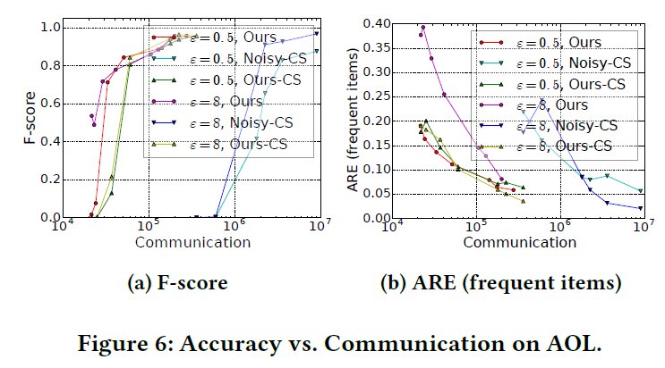
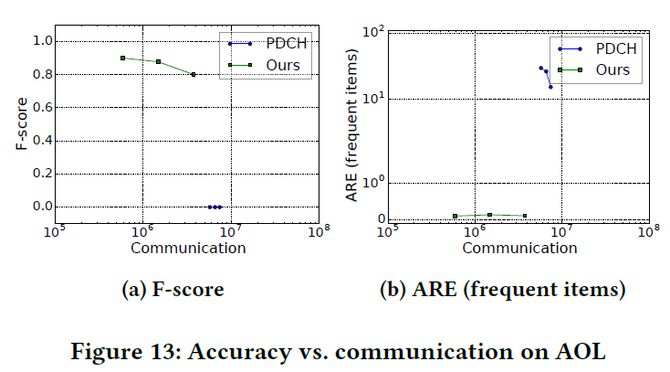


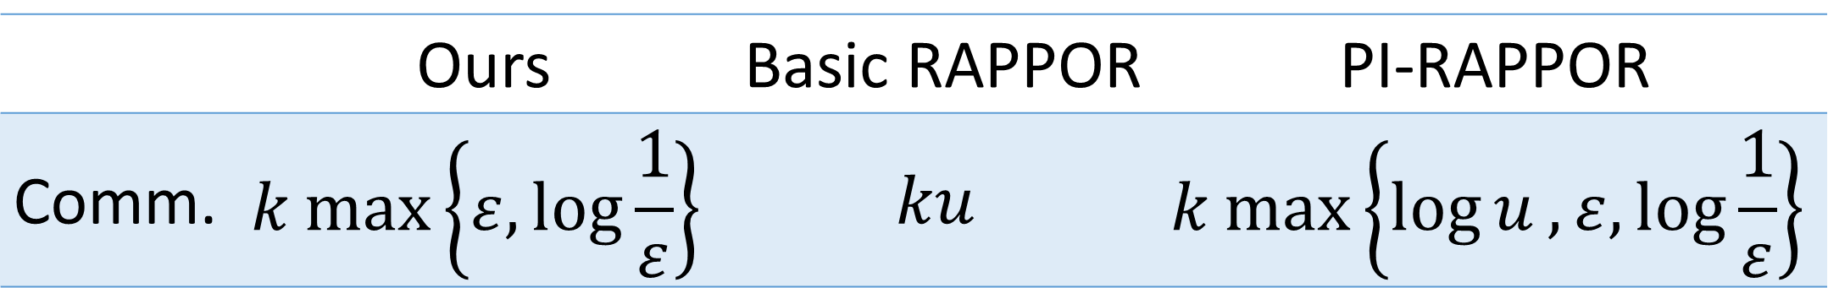
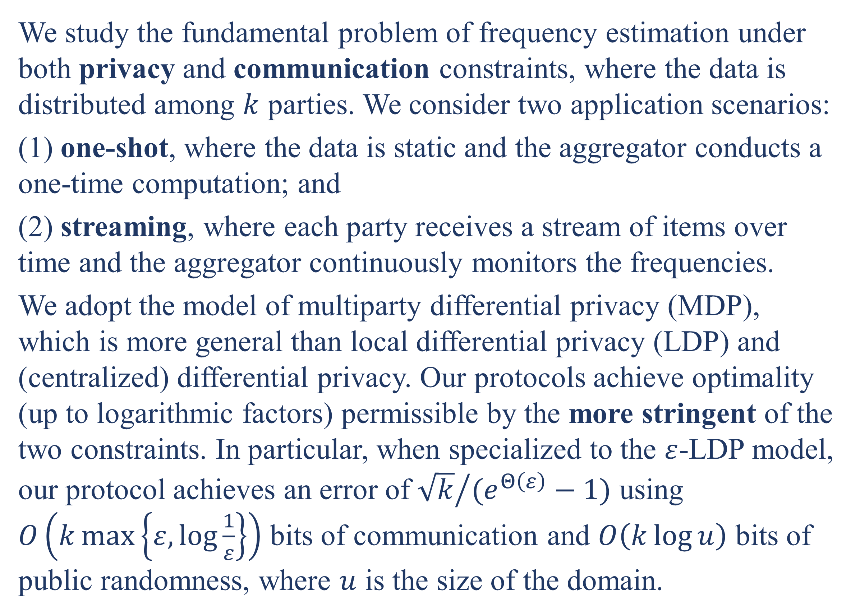
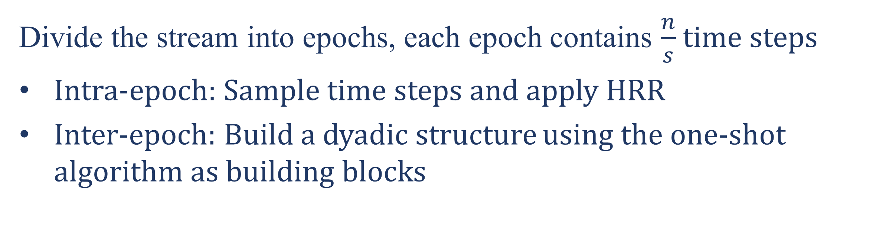
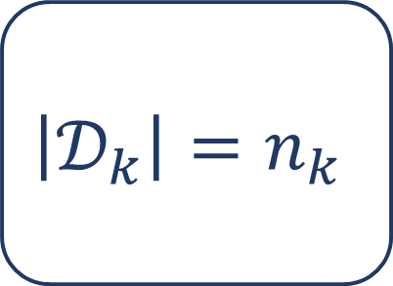



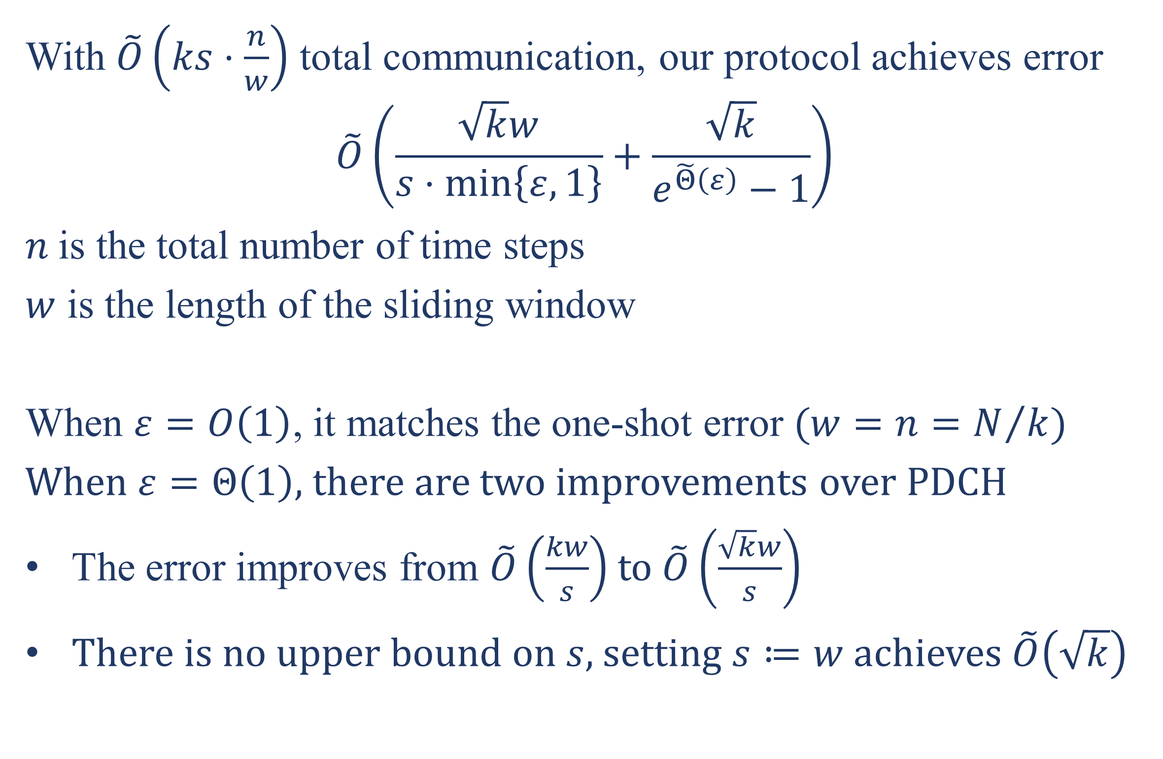

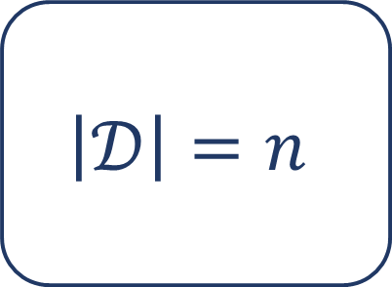
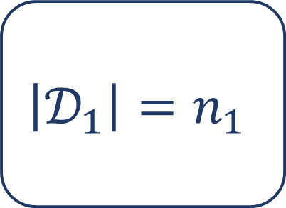


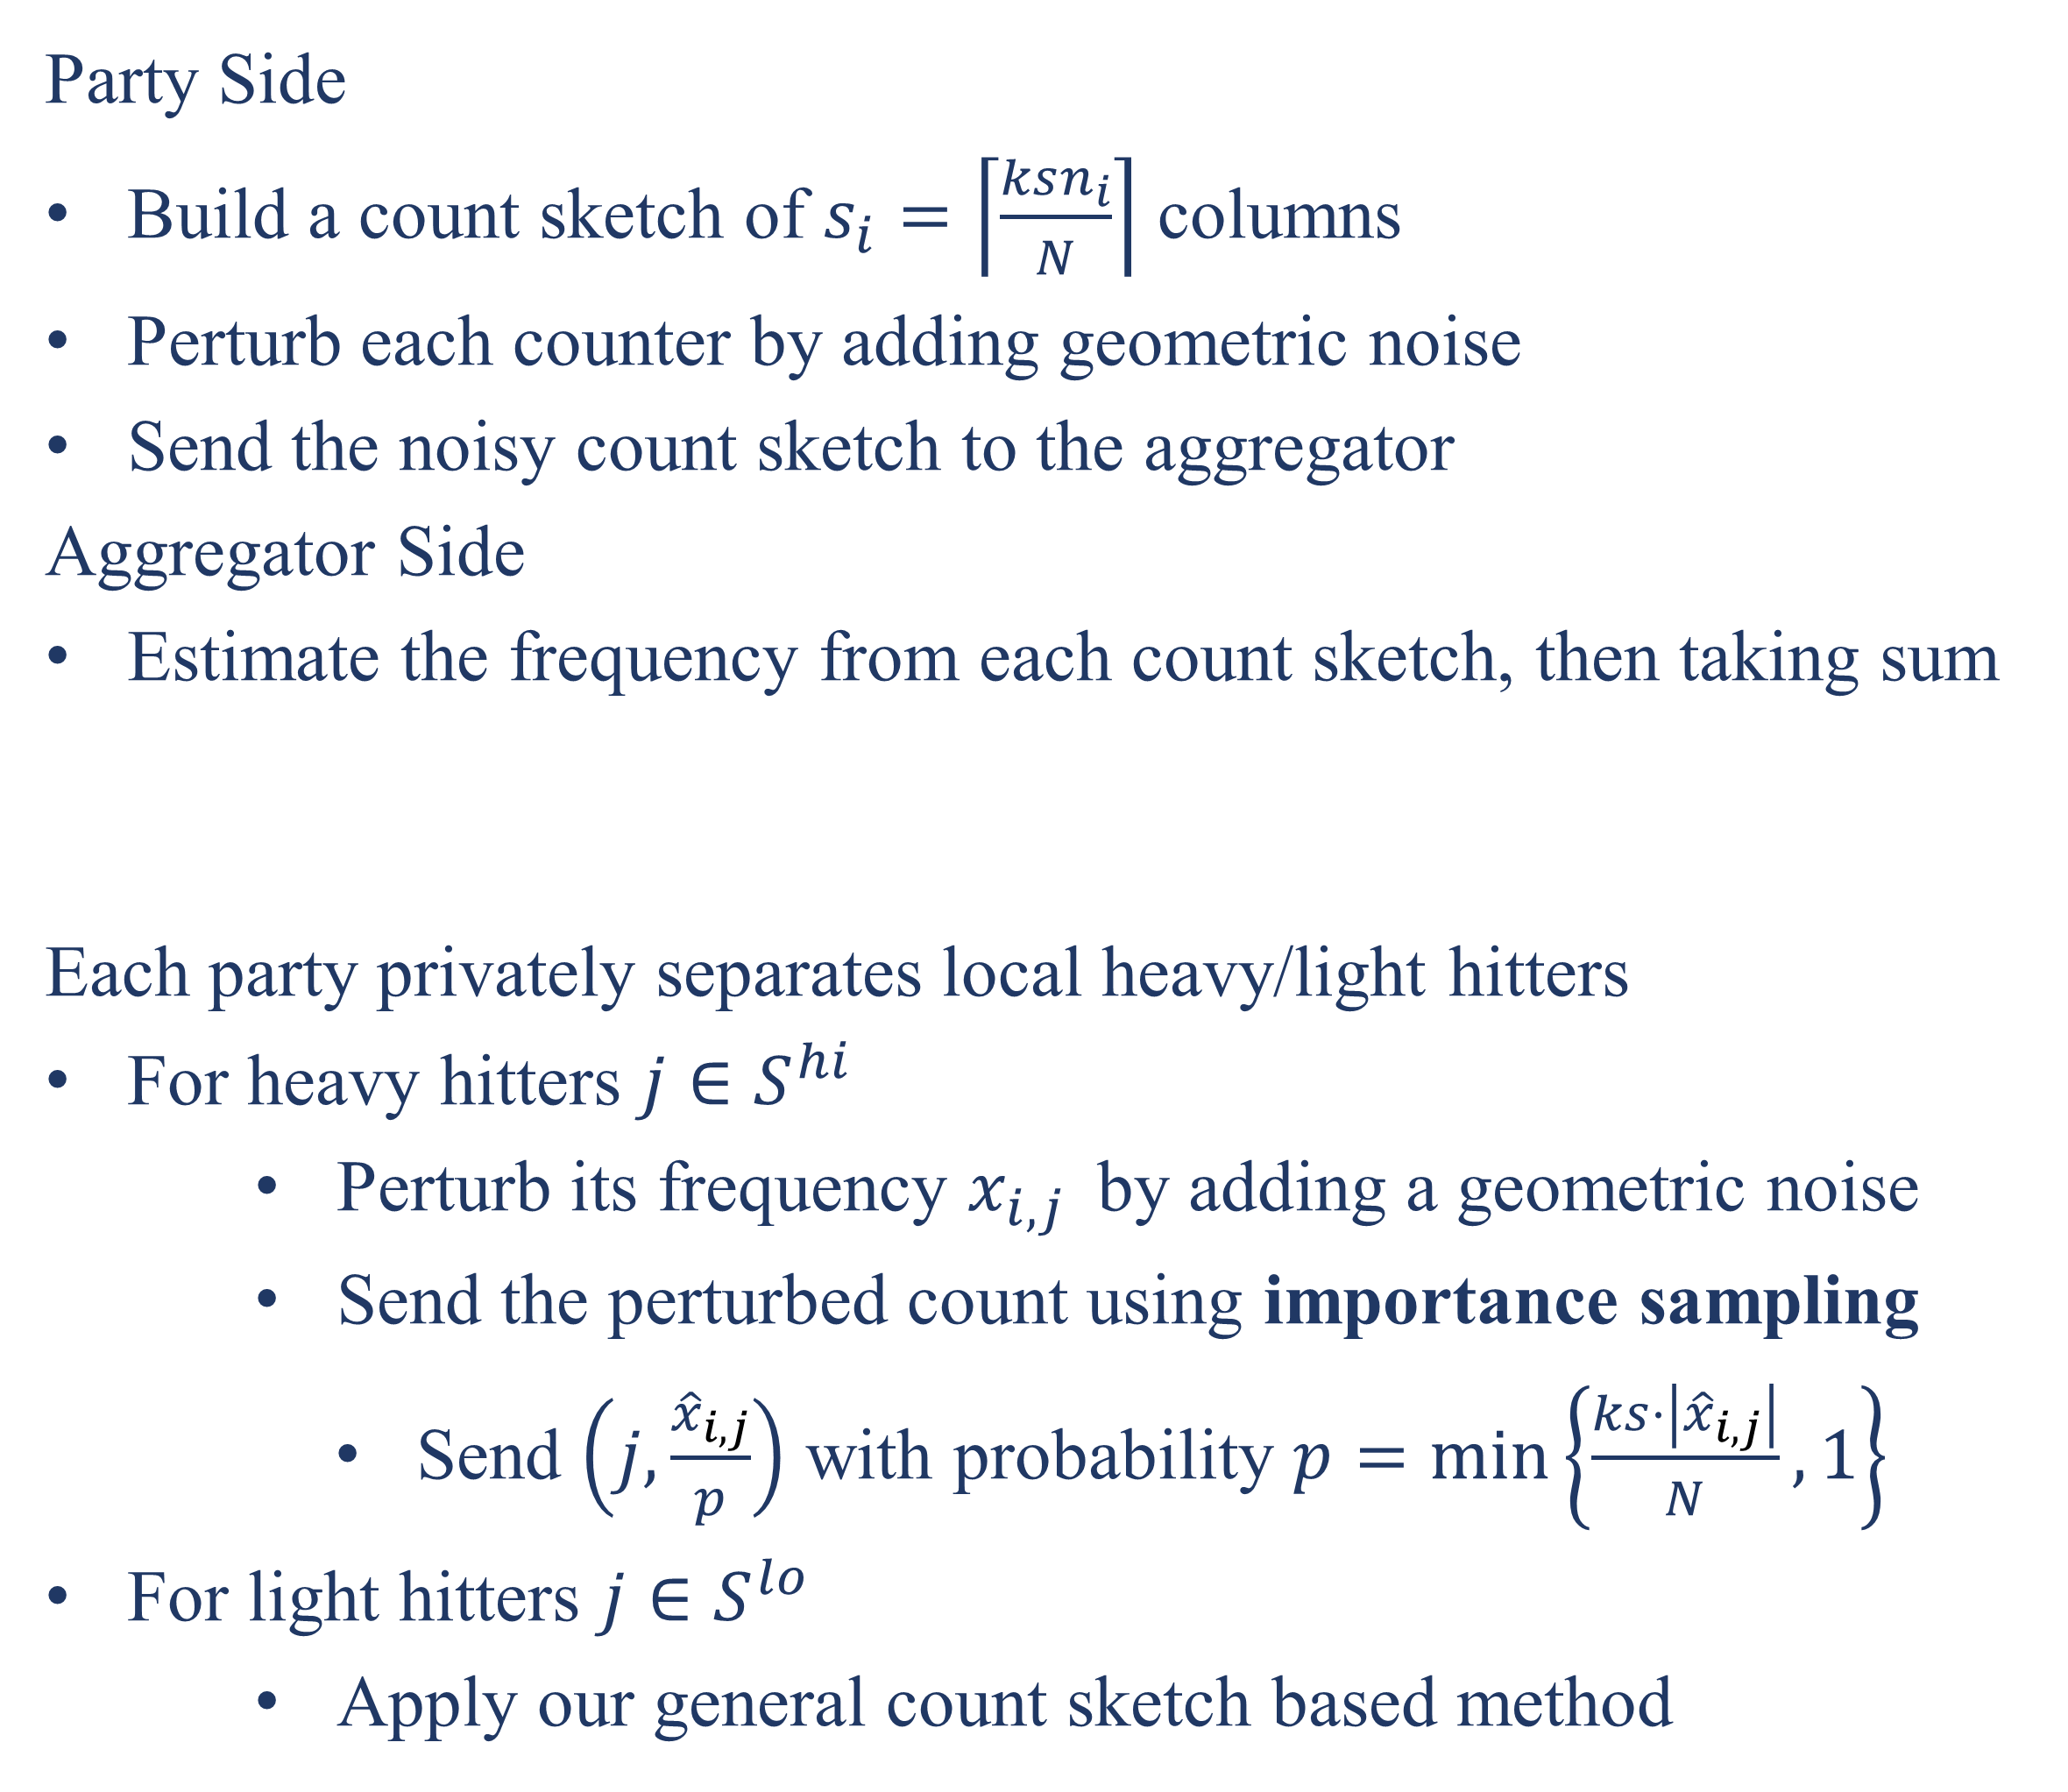
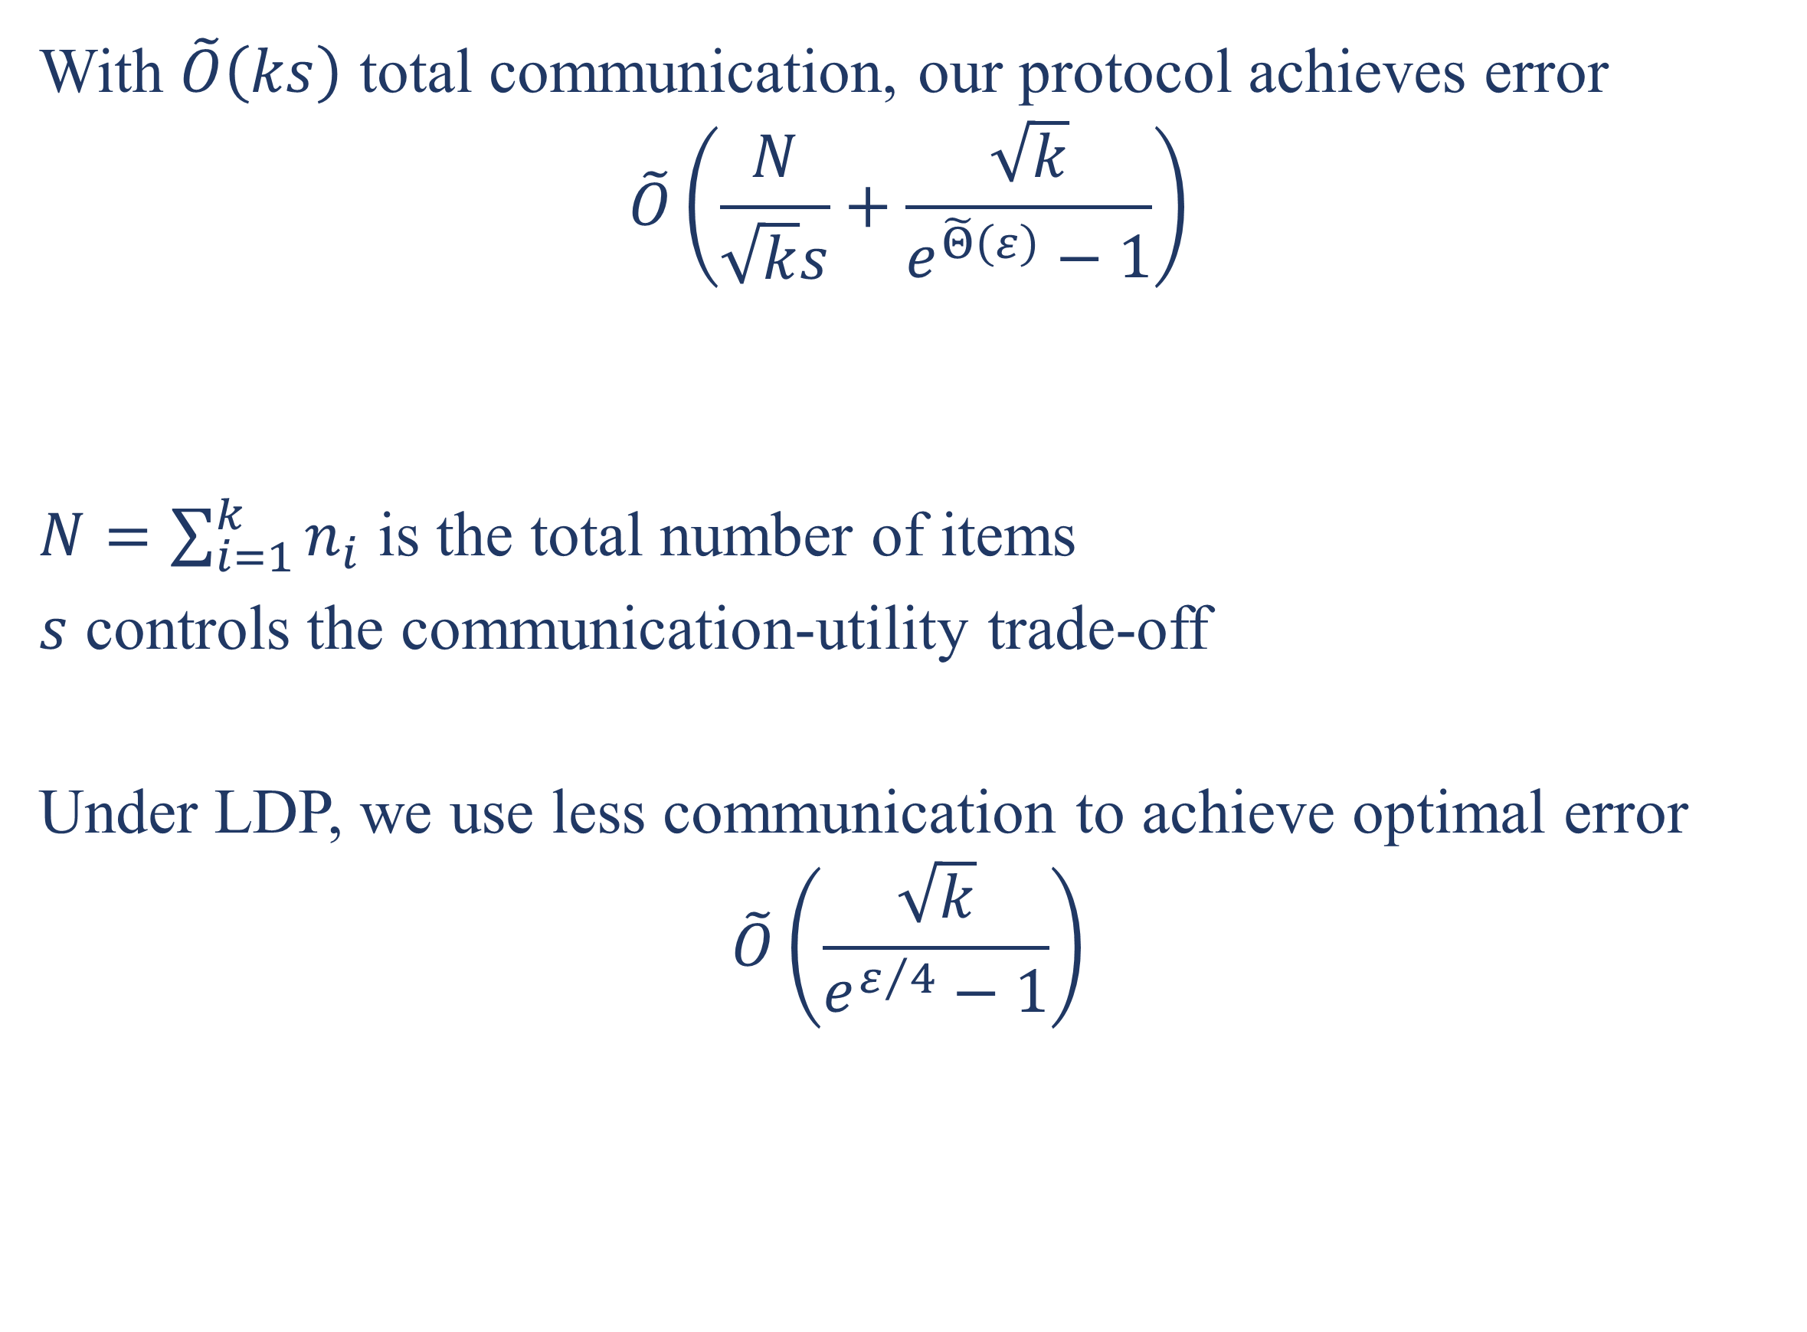


Frequency Estimation Under Multiparty Differential Privacy:
One-shot and Streaming
Ziyue Huang, Yuan Qiu, Ke Yi, Graham Cormode
{zhuangbq, yqiuac, yike}@cse.ust.hk, g.cormode@warwick.ac.uk
Abstract
General One-Shot Protocol
We study the fundamental problem of frequency estimation under both privacy and communication constraints, where the data is distributed among $k$ parties. We consider two application scenarios:
(1) one-shot, where the data is static and the aggregator conducts a one-time computation; and
(2) streaming, where each party receives a stream of items over time and the aggregator continuously monitors the frequencies.
We adopt the model of multiparty differential privacy (MDP), which is more general than local differential privacy (LDP) and (centralized) differential privacy. Our protocols achieve optimality (up to logarithmic factors) permissible by the more stringent of the two constraints. In particular, when specialized to the $ε$-LDP model, our protocol achieves an error of ${\sqrt{k}}/{(e^{Θ\left(ε\right)}−1)}$ using $O\left(k\max\left\{ε,\log{\frac{1}{ε}}\right\}\right)$ bits of communication and $O\left(k\log{u}\right)$ bits of public randomness, where $u$ is the size of the domain.
Party Side
Build a count sketch of $s_{i}=\left\lceil \frac{ksn_{i}}{N}\right\rceil$ columns
Perturb each counter by adding geometric noise
Send the noisy count sketch to the aggregator
Aggregator Side
Estimate the frequency from each count sketch, then taking sum
Each party privately separates local heavy/light hitters
For heavy hitters $j∈S^{hi}$
Perturb its frequency $x_{i,j }$ by adding a geometric noise
Send the perturbed count using importance sampling
Send $\left(j,\frac{{\hat{x}}_{i,j}}{p}\right)$ with probability $p=\min\left\{\frac{ks⋅\left|{\hat{x}}_{i,j}\right|}{N},1\right\}$
For light hitters $j∈S^{lo}$
Apply our general count sketch based method
Improvements by Frequency Separation
Multiparty Differential Privacy
Party 1
Party 2
Party $k$
Results for Streaming Estimation
$$\left|𝒟_{1}\right|=n_{1}$$
$$\left|𝒟_{2}\right|=n_{2}$$
$$…$$
$$\left|𝒟_{k}\right|=n_{k}$$
With $\tilde{O}\left(ks⋅\frac{n}{w}\right)$ total communication, our protocol achieves error
$$\tilde{O}\left(\frac{\sqrt{k}w}{s⋅\min\left\{ε,1\right\}}+\frac{\sqrt{k}}{e^{\tilde{Θ}\left(ε\right)}−1}\right)$$
$n$ is the total number of time steps
$w$ is the length of the sliding window
When $ε=O\left(1\right)$, it matches the one-shot error ($w=n=N/k$)
When $ε=Θ\left(1\right)$, there are two improvements over PDCH
The error improves from $\tilde{O}\left(\frac{kw}{s}\right)$ to $\tilde{O}\left(\frac{\sqrt{k}w}{s}\right)$
There is no upper bound on $s$, setting $s≔w$ achieves $\tilde{O}\left(\sqrt{k}\right)$
$$k=1$$
$$n_{i}=1$$
Centralized DP
Local DP
$$\left|𝒟\right|=n$$
Party 1
Party 2
Party $k$
$$\left\{x_{1}\right\}$$
$$\left\{x_{2}\right\}$$
$$…$$
$$\left\{x_{k}\right\}$$
Results for One-shot Estimation
Full-Stream Protocol
With $\tilde{O}\left(ks\right)$ total communication, our protocol achieves error
$$\tilde{O}\left(\frac{N}{\sqrt{k}s}+\frac{\sqrt{k}}{e^{\tilde{Θ}\left(ε\right)}−1}\right)$$
$N=\sum_{i=1}^{k}{n_{i}}$ is the total number of items
$s$ controls the communication-utility trade-off
Under LDP, we use less communication to achieve optimal error
$$\tilde{O}\left(\frac{\sqrt{k}}{e^{ε/4}−1}\right)$$
Divide the stream into epochs, each epoch contains $\frac{n}{s}$ time steps
Intra-epoch: Sample time steps and apply HRR
Inter-epoch: Build a dyadic structure using the one-shot algorithm as building blocks
Communication-dependent
Privacy bound
Experiments
 | Ours | Basic RAPPOR | PI-RAPPOR
Comm. | $$k\max\left\{ε,\log{\frac{1}{ε}}\right\}$$ | $$ku$$ | $$k\max\left\{\log{u}, ε,\log{\frac{1}{ε}}\right\}$$
One-shot
Streaming

