Slide 1



Differential Privacy on Fully Dynamic Streams
Yuan Qiu¹ and Ke Yi²
¹Southeast University
²Hong Kong University of Science and Technology
Notes:
This is the presentation for our paper differential privacy on fully dynamic streams, a joint work by southeast university and the hong kong university of science and technology.

Slide 2


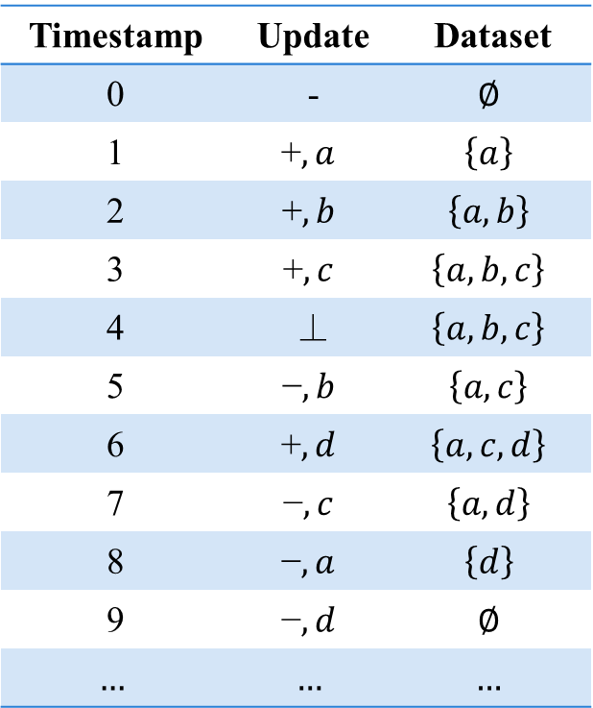
Backgrounds – Fully Dynamic Streams
A data stream is a sequence of pairs $(s_{t},x_{t})$
Insertion ($s_{t}=\text{+}$) $⟹$ $D_{t}=D_{t−1}∪\{x_{t}\}$
Deletion ($s_{t}=\text{−}$) $⟹$ $D_{t}=D_{t−1}−\{x_{t}\}$
No-op ($s_{t}=$ ⊥) $⟹$ $D_{t}=D_{t−1}$
Notation
$N_{t}$: number of updates up to time $t$
$n_{t}$: data size at time $t$
Timestamp | Update | Dataset
0 | - | $$∅$$
1 | $$\text{+},a$$ | $$\left\{a\right\}$$
2 | $$\text{+},b$$ | $$\left\{a,b\right\}$$
3 | $$\text{+},c$$ | $$\left\{a,b,c\right\}$$
4 | ⊥ | $$\left\{a,b,c\right\}$$
5 | $$\text{−},b$$ | $$\left\{a,c\right\}$$
6 | $$\text{+},d$$ | $$\left\{a,c,d\right\}$$
7 | $$\text{−},c$$ | $$\left\{a,d\right\}$$
8 | $$\text{−},a$$ | $$\left\{d\right\}$$
9 | $$\text{−},d$$ | $$∅$$
$$…$$ | $$…$$ | $$…$$
$$N_{t}^{\text{+}}+N_{t}^{\text{−}}=N_{t}≫n_{t}=N_{t}^{\text{+}}−N_{t}^{\text{−}}$$
Increases over time
Fluctuates and even hits zero
Notes:
In this work, we consider a data stream modeled as a sequence of pairs.
In a fully dynamic stream, there can be three possible operations.
An element may be inserted into or deleted from the underlying dataset, or there can be no change.
The table on the right presents a typical update sequence and the corresponding dataset at each timestamp.
We use capital N_t to denote the number of updates, and little n_t to denote the data size at time t.
A key observation is that in a fully dynamic stream, the number of updates is much larger than the data size.
In particular, the number of nontrivial updates is the number of insertions plus the deletions, which always increases over time.
On the other hand, the data size is the difference between these two, which fluctuates and may even hit zero.

Slide 3

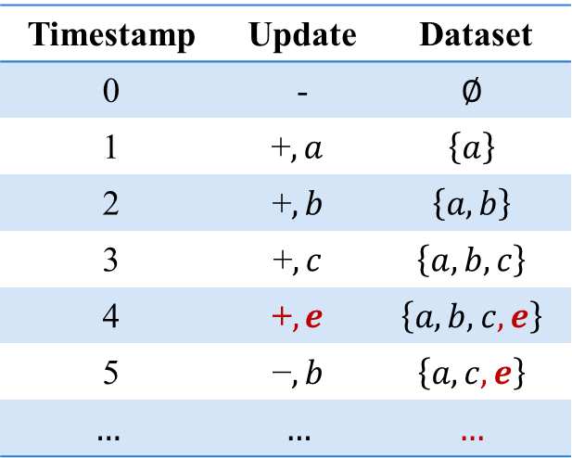
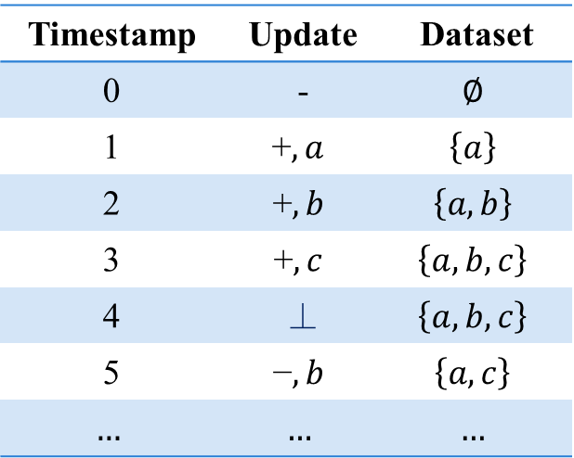
Backgrounds – Differential Privacy
DP: for any neighboring instances $D∼D^{′}$ and any subset of outputs $Y$,
$$\operatorname{Pr}\left[ℳ\left(D\right)∈Y\right]≤e^{ε}⋅\operatorname{Pr}\left[ℳ\left(D^{′}\right)∈Y\right]+δ.$$
For streams, neighboring instances differ by one update.
Timestamp | Update | Dataset
0 | - | $$∅$$
1 | $$\text{+},a$$ | $$\left\{a\right\}$$
2 | $$\text{+},b$$ | $$\left\{a,b\right\}$$
3 | $$\text{+},c$$ | $$\left\{a,b,c\right\}$$
4 | ⊥ | $$\left\{a,b,c\right\}$$
5 | $$\text{−},b$$ | $$\left\{a,c\right\}$$
$$…$$ | $$…$$ | $$…$$
Timestamp | Update | Dataset
0 | - | $$∅$$
1 | $$\text{+},a$$ | $$\left\{a\right\}$$
2 | $$\text{+},b$$ | $$\left\{a,b\right\}$$
3 | $$\text{+},c$$ | $$\left\{a,b,c\right\}$$
4 | $$\text{+},e$$ | $$\left\{a,b,c,e\right\}$$
5 | $$\text{−},b$$ | $$\left\{a,c,e\right\}$$
$$…$$ | $$…$$ | $$…$$
Notes:
Our target is to release query results under differential privacy.
DP requires the output to be indistinguishable on neighboring datasets.
For streaming data, two streams are neighbors if they differ by one update at a single timestamp.
Note that there can be subsequent influences to the underlying dataset.

Slide 4
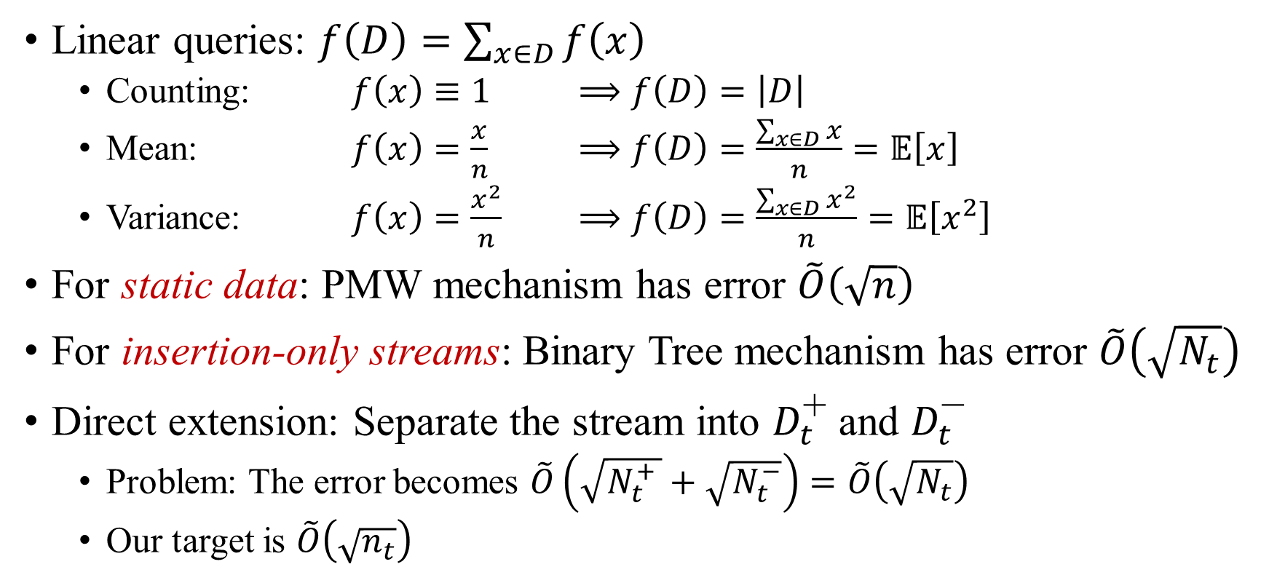
Backgrounds – DP Linear Queries
Linear queries: $f\left(D\right)=\sum_{x∈D}{f\left(x\right)}$
Counting: $f\left(x\right)≡1$ $⟹f\left(D\right)=\left|D\right|$
Mean: $f\left(x\right)=\frac{x}{n}$ $⟹f\left(D\right)=\frac{\sum_{x∈D}{x}}{n}=𝔼\left[x\right]$
Variance: $f\left(x\right)=\frac{x^{2}}{n}$ $⟹f\left(D\right)=\frac{\sum_{x∈D}{x^{2}}}{n}=𝔼\left[x^{2}\right]$
For static data: PMW mechanism has error $\tilde{O}\left(\sqrt{n}\right)$
For insertion-only streams: Binary Tree mechanism has error $\tilde{O}\left(\sqrt{N_{t}}\right)$
Direct extension: Separate the stream into $D_{t}^{\text{+}}$ and $D_{t}^{\text{−}}$
Problem: The error becomes $\tilde{O}\left(\sqrt{N_{t}^{+ }}+\sqrt{N_{t}^{−}}\right)=\tilde{O}\left(\sqrt{N_{t}}\right)$
Our target is $\tilde{O}\left(\sqrt{n_{t}}\right)$
Notes:
Our target queries are linear queries that assign weights to elements in the dataset. This is a general class. By assigning different weights, we can obtain many interesting statistics such as count, mean or variance.
For static data, the state-of-the-art mechanism private multiplicative weights has error sqrt of the data size when answering multiple queries.
This can be generalized through the binary tree mechanism for insertion-only streams with matching error.
Note that the number of updates and the data size are equivalent under the insertion-only setting.
For our fully-dynamic streams, a straightforward extension is to separate the deletions from insertions.
However, doing so will cause the error to scale with the number of updates, which can be much larger than the data size.

Slide 5






Interval Tree for Stabbing Queries
Each (insertion, deletion) of an item can be considered an interval.
$$\{d\}$$
8
$$\{a,b,c\}$$
4
2
6
1
3
5
7
$$a$$
$$b$$
$$d$$
$$c$$
Notes:
To solve this problem, let’s first set privacy aside, and simply consider how to report items from a dynamic dataset at any time instance.
We can view each insertion-deletion pair of an item as an interval, then the query becomes an interval stabbing query in the computational geometry literature.
A well-known data structure for this is the interval tree, where each node is a timestamp, and an interval is stored at the highest node that stabs it.

Slide 6



Interval Tree for Stabbing Queries
Querying: visit nodes on the root-to-node path.
$$q=6$$
$$\{d\}$$
8
$$\{a,b,c\}$$
4
2
6
1
3
5
7
$$a$$
$$b$$
$$d$$
$$c$$
Notes:
To query an interval tree, we visit the root to node path and report valid items marked in red.
There are two issues in applying this structure to our problem. First, when an item is inserted, we do not have its deletion time, yet we need to immediately release information for the item. Second, while we receive more items, the tree can grow infinitely. If an item is never deleted, then the highest node is undefined.

Slide 7





Contribution 1: Online Interval Tree
Duplicate each node $O\left(\log{t}\right)$ times.
$$\{d\}$$
8
$$\{a,b,c\}$$
4
$$\{a,b\}$$
$$\{d\}$$
2
6
$$\{a\}$$
$$\{c\}$$
1
3
5
7
$$a$$
$$b$$
$$d$$
$$c$$
Notes:
Our first contribution is a novel online interval tree that solves the previous problems.
It duplicates an item at each node that can potentially be the highest node in the offline interval tree.
Here, items in green are the duplicated ones. For example, we duplicate interval a to node 1 and 2 in addition to node 4.
Since each item appears no more than once at each level, there can be log t duplicates at most.
This is important since when we allocate privacy budgets to each node, it will only cause a polylog overhead.

Slide 8




Contribution 1: Online Interval Tree
Querying: only consider “left” nodes.
$$q=6$$
$$\{d\}$$
8
$$\{a,b,c\}$$
4
$$\{a,b\}$$
$$\{d\}$$
2
6
$$\{a\}$$
$$\{c\}$$
1
3
5
7
$$a$$
$$b$$
$$d$$
$$c$$
Notes:
Since there are duplicates, we also modify the querying process. Now we only query nodes whose id is less than or equal to the query time.
We show that such a querying strategy avoids producing duplicated items.

Slide 9
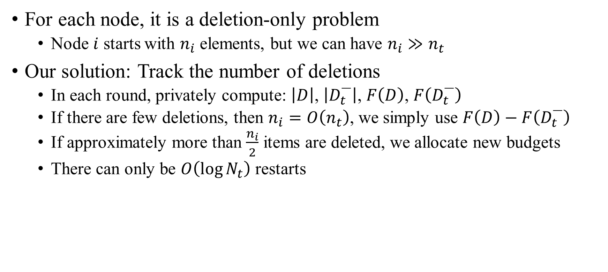
Contribution 2: Deletion-only Mechanism
For each node, it is a deletion-only problem
Node $i$ starts with $n_{i}$ elements, but we can have $n_{i}≫n_{t}$
Our solution: Track the number of deletions
In each round, privately compute: $\left|D\right|$, $\left|D_{t}^{\text{−}}\right|$, $F\left(D\right)$, $F\left(D_{t}^{\text{−}}\right)$
If there are few deletions, then $n_{i}=O\left(n_{t}\right)$, we simply use $F\left(D\right)−F\left(D_{t}^{\text{−}}\right)$
If approximately more than $\frac{n_{i}}{2}$ items are deleted, we allocate new budgets
There can only be $O\left(\log{N_{t}}\right)$ restarts
4
$\{a,b,c\}$ $⟹$ $\{a,c\}$ $⟹$ $\{a\}$ $⟹$ $∅$
init $…$ ($\text{−},b$) $…$ ($\text{−},c$) $…$ ($\text{−},a$)
$t=4$ $…$ $5$ $…$ $7$ $…$ $8$
Notes:
Back to privacy, for each node, we want to release its query result.
This is now a deletion-only problem.
When a node is initialized, it stores all intervals assigned to it. Then the intervals are deleted one-by-one when we observe their right endpoints.
We can also subtract the query result on deleted items from the initial ones, but the problem is still that the size of the node when initialized can also be much larger than the data size at query time.
To handle this, our solution is to also track the number of deletions privately.
When approximately more than half the elements are deleted, we allocate fresh privacy budgets to the remaining elements.

Slide 10

Conclusion
There is an $\left(ε,δ\right)$-DP mechanism for arbitrary linear queries on fully dynamic streams with error $\tilde{O}\left(\sqrt{n_{t}}\right)$.
$\tilde{O}$ hides $\frac{1}{ε}$ and polylog factors in $\frac{1}{δ}$, $\frac{1}{β}$, $t$, and $N_{t}$
This improves over separating $D_{t}^{\text{+}}$ and $D_{t}^{\text{−}}$, whose error was $\tilde{O}\left(\sqrt{N_{t}}\right)$
Notes:
In conclusion, we show a black-box conversion from any static DP mechanism to a fully dynamic DP mechanism.
Its error is only polynomial in the data size at each timestamp, instead of the number of historical updates. Thank you.

