Slide 1
Final Project – LCD & AC motor

Slide 2
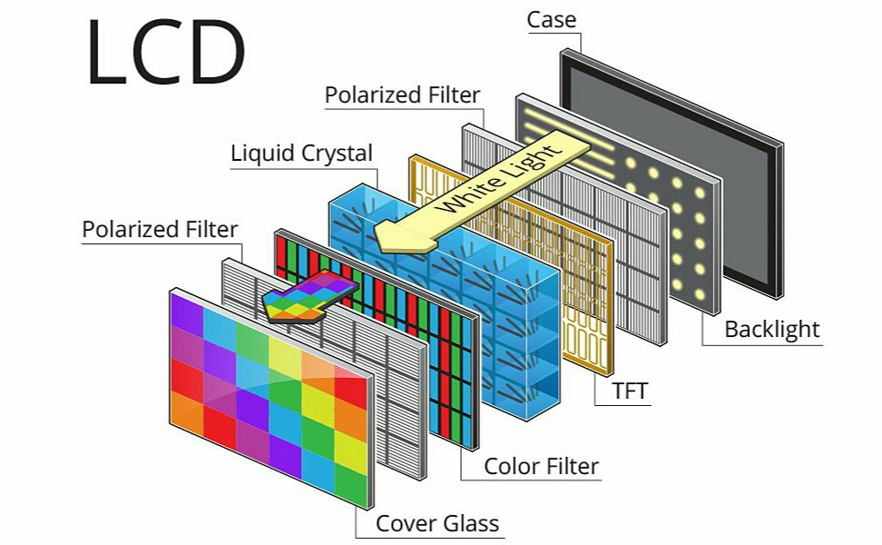
Liquid Crystal Display

Slide 3
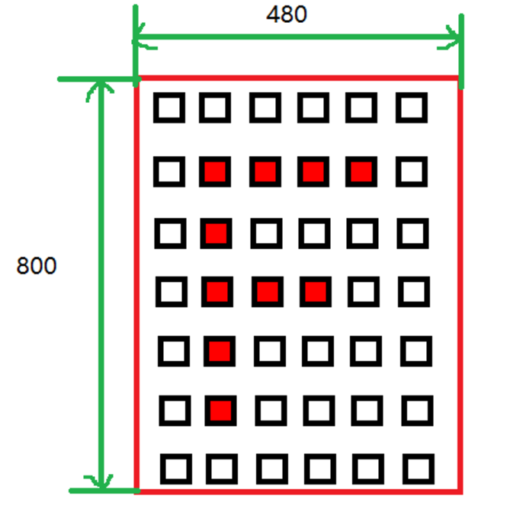
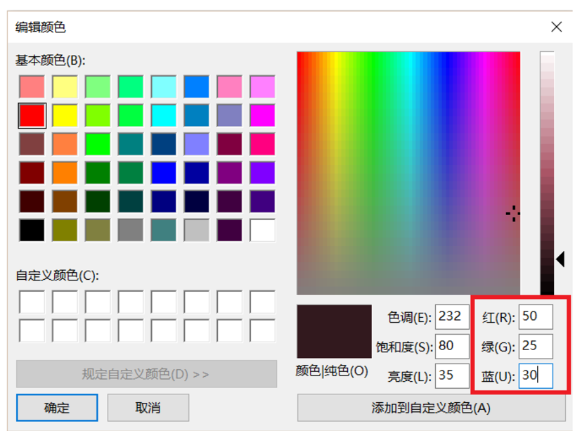
Basic parameters
Pixel
Resolution
Size
Color depth

Slide 4
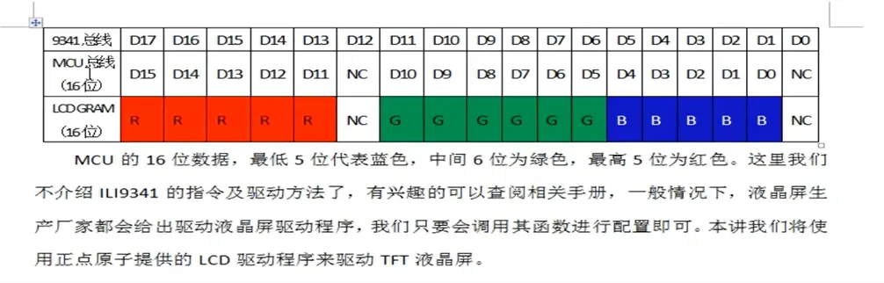
Memory:
Each pixel in the LCD screen is data, in practical applications need to cache the data of each pixel, and then transmitted to the LCD screen, generally use SRAM or SDRAM nature of the memory, and these are specifically used to store the display data memory, is known as the video memory.
Memory should generally be able to store at least one frame of the LCD screen (one page, that is, 480 * 800 pixels) display data, such as resolution of 800x480 LCD screen, using the RGB565 format display, the size of a frame of the display data is: 2x800x480 = 768000 bytes.
Generally speaking, external LCD controllers come with their own memory, while chips with integrated LCD controllers such as the STM32F429 can use internal SRAM or external SDRAM for the memory space.

Slide 5
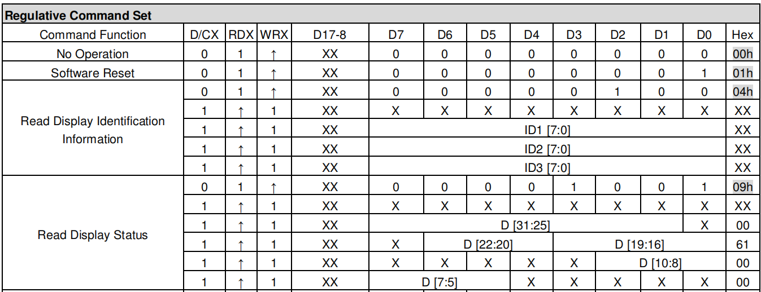
Command of SSD1963
Only accept 8-bit command
0xD3, 0x36, 0x2A, 0x2B, 0x2C, 0x2E

Slide 6
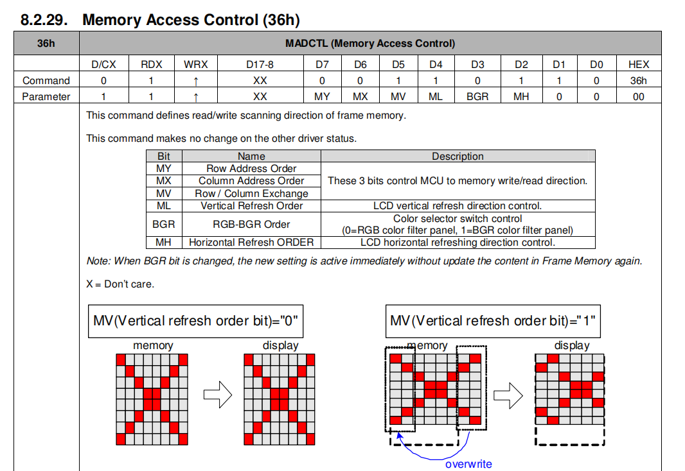
Command of SSD1963
0xD3: read LCD ID
0x36: scanning direction
0x2A, 0x2B: set the area of accessible frame memory in x and y direction
0x2C: write GRAM
0x2E: read GRAM
0x29, 0x28: display on/off

Slide 7
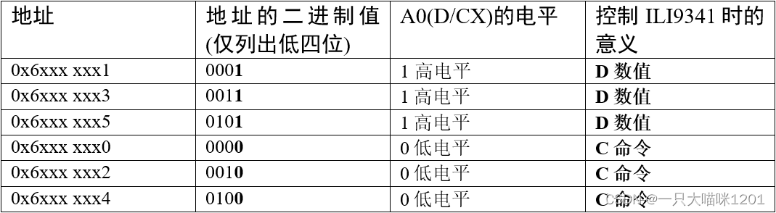
Flexible static memory controller (FSMC)

Slide 8
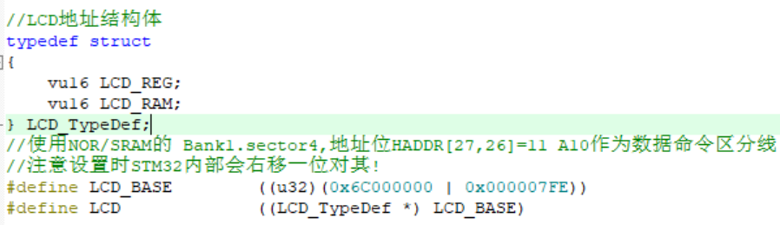
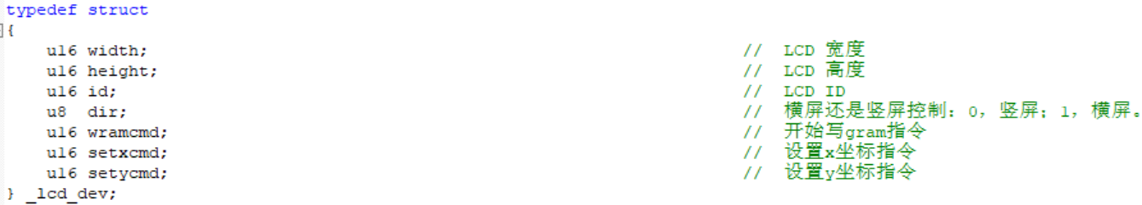
LCD Address
A10=0, Register (Command)
A10=1, Data
LCD Parameters

Slide 9
Basic functions
void LCD_WR_REG(u16 regval); # write register, i.e. command
void LCD_WR_DATA(u16 data); # write data
u16 LCD_RD_DATA(void); # read data
void LCD_WriteReg(u16 LCD_Reg, u16 LCD_RegValue); # write register and the value
u16 LCD_ReadReg(u16 LCD_Reg); # read the value of register
void LCD_WriteRAM_Prepare(void); # configure to prepare to write GRAM (graphic RAM)
void LCD_WriteRAM(u16 RGB_Code); # write GRAM

Slide 10
Initialization
Enable Clock
Initialize GPIO
Initialize FSMC
Read LCD ID
Initialize LCD based on its ID
Set parameters //display_dir(0)
LCD_LED=1 //light the background
Clear LCD

Slide 11
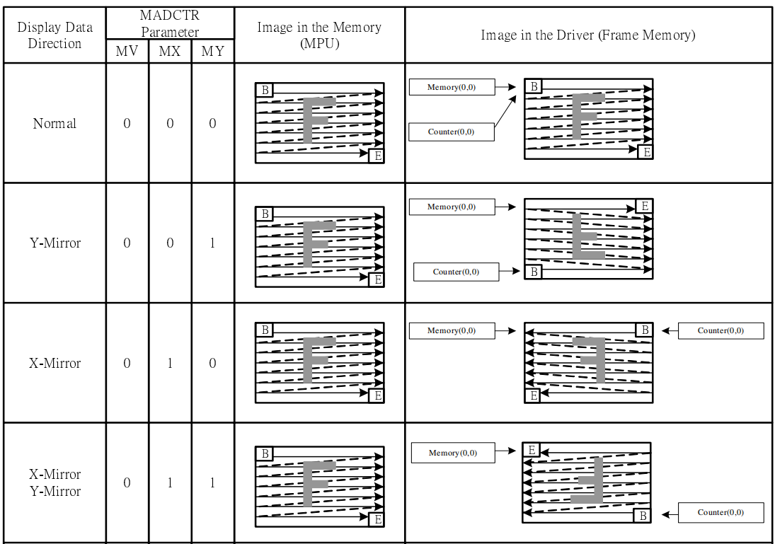
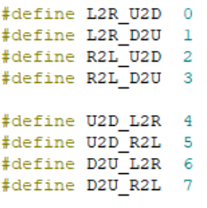

Slide 12
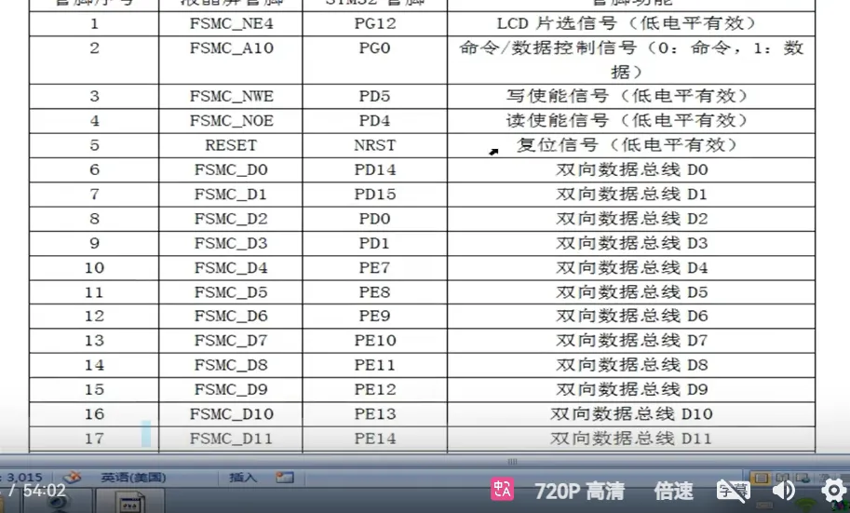
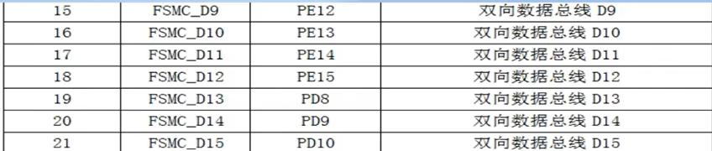

Slide 13
How to draw a point?
Setcursor
Write GRAM command
Write color data
LCD->LCD_RAM

Slide 14

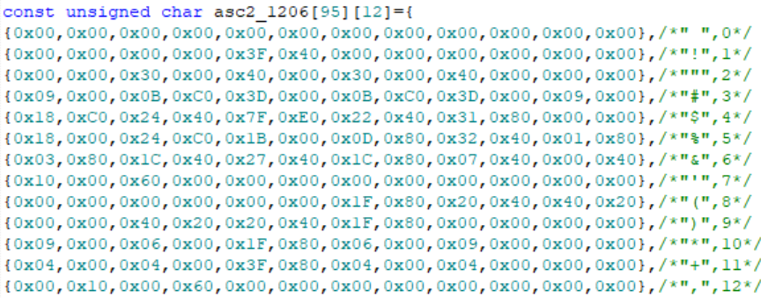
How to draw a character?
By the size of the characters to be displayed, the number of bytes occupied by a single character model is calculated using the formula.
Call the corresponding size (font size) of the font, here made three sizes of font, 12*12, 16*16, and 24 * 24
Through the loop to determine the font in a single byte in each bit of the font, if ==1, then fill the pixel
asc2_1206
1
asc2_1608
asc2_2412
2

Slide 15
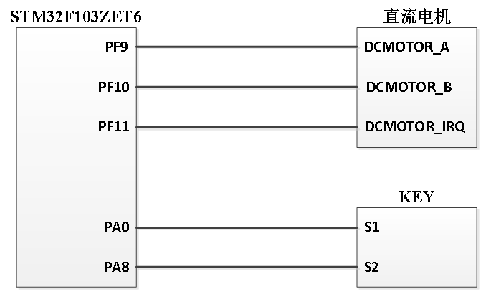
Experiment 1: Use LCD to draw
Experiment 2: Use LCD to display
1.
The names of the group members
Timer, count from 00:00 to 59:59
Use AD to control the rotation speed of the DC motor, and display it on the LCD screen
2.
or
isosceles triangle
right triangle
3.
forward
arbitrary triangle
reverse
4.
speed
And their corresponding filled patterns

