Slide 1

3 – RegEx Implementation
KU | Fall 2018 | Drew Davidson

Slide 2
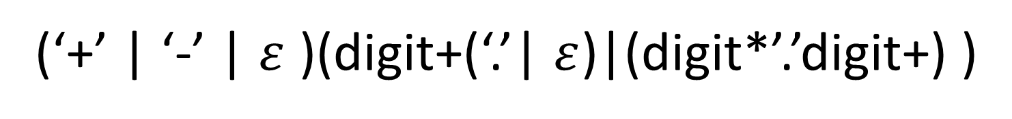
Pre-Class Warm Up
Draw the RegEx for Fortran real literals
An optional sign (‘+’ or ‘-’)
An integer or
one or more digits followed by a ‘.’ followed by 0 or more digits or
a ‘.’ followed by one or more digits
(‘+’ | ‘-’ | $ε$ )(digit+(‘.’| $ε$)|(digit*’.’digit+) )

Slide 3
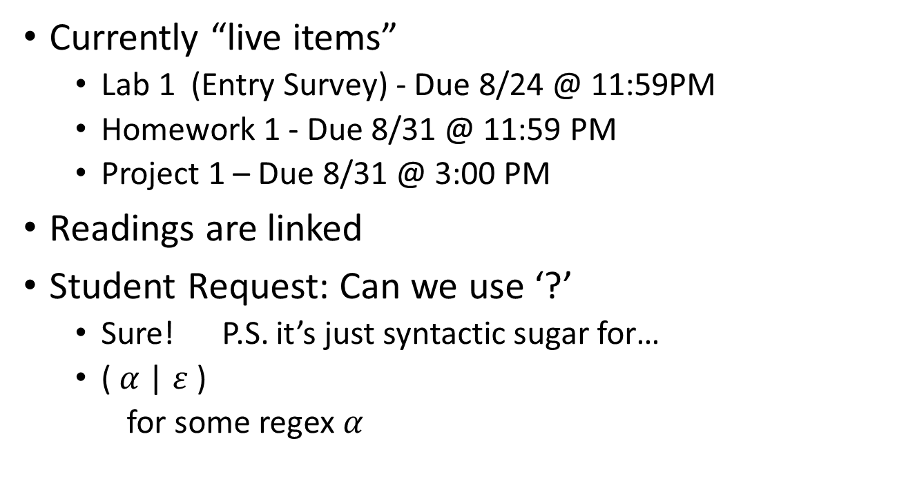
Housekeeping
Currently “live items”
Lab 1 (Entry Survey) - Due 8/24 @ 11:59PM
Homework 1 - Due 8/31 @ 11:59 PM
Project 1 – Due 8/31 @ 3:00 PM
Readings are linked
Student Request: Can we use ‘?’
Sure! P.S. it’s just syntactic sugar for…
( $α$ | $ε$ )
for some regex $α$
“Zero or one”
operator

Slide 4
Group Activity: Regex Review
The following RegExs for C identifiers are subpar. Why?
(letter | ‘_’)+(letter | digit | ‘_’)*
This + is unnecessary
(letter | ‘_’)(letter* | digit* | ‘_’* )
Disallowed the legal case of a1b2

Slide 5
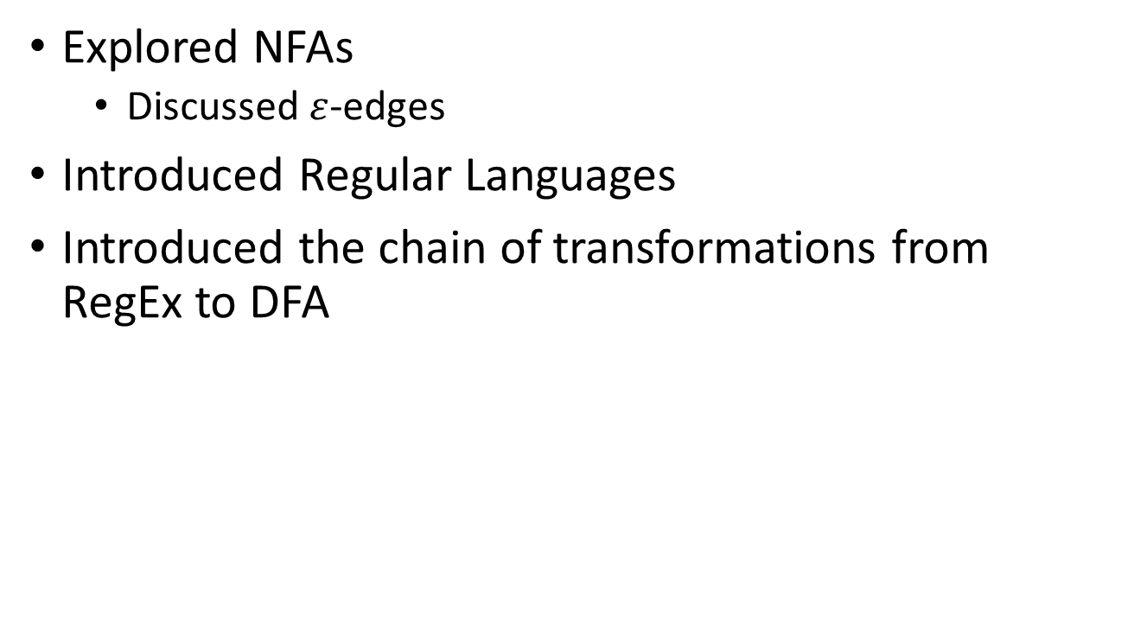
Last Time
Explored NFAs
Discussed $ε$-edges
Introduced Regular Languages
Introduced the chain of transformations from RegEx to DFA
Rabin-Scott
Powerset
Construction
RegEx
NFA
DFA
NFA
DFA

Slide 6
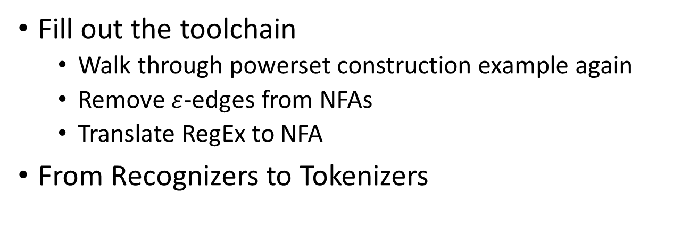
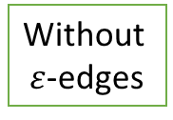
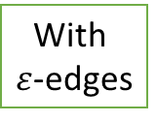
This Time
Fill out the toolchain
Walk through powerset construction example again
Remove $ε$-edges from NFAs
Translate RegEx to NFA
From Recognizers to Tokenizers
If you want
Rabin-Scott
Powerset
Construction
RegEx
RegEx
NFA
DFA
With
$ε$-edges
Without
$ε$-edges

Slide 7
Powerset DFA
S,x = {S,A}
A,x = {R}
R,x = {D}
D,x = {}
S,y = {S}
A,y = {R}
R,y = {D}
D,y = {}
y
x
{S}
x
{S,A}
x
{S,AR}
x
D
{S,AR,D}
x
y
y
y
x
x
y
{S,D}
{S,R}
{S,A,D}
x
D
{S,D}
{S,A,D}
{S,R,D}
y
y
y

Slide 8
This Time
Fill out the toolchain
Walk through powerset construction example again
Remove $ε$-edges from NFAs
Translate RegEx to NFA
From Recognizers to Tokenizers
Rabin-Scott
Powerset
Construction
RegEx
NFA
DFA
With
$ε$-edges
Without
$ε$-edges

Slide 9

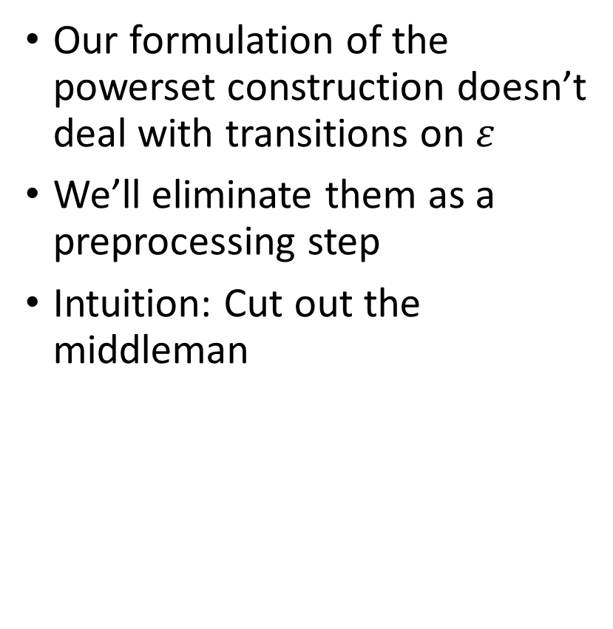

$ε$-transition Elimination
Our formulation of the powerset construction doesn’t deal with transitions on $ε$
We’ll eliminate them as a preprocessing step
Intuition: Cut out the middleman

Slide 10

$ε$-transition Elimination
Our formulation of the powerset construction doesn’t deal with transitions on $ε$
We’ll eliminate them as a preprocessing step
Intuition: Cut out the middleman
S
S
$$ε$$
1
1
a
a
a
a
a
2
2

Slide 11

$ε$-transition Elimination
Let $ε$-close(s) be the set of states reachable via 0 or more $ε$s
Let N’ be the $ε$-free version of N
Add all non-$ε$ edges from N to N’
Put s in F’ if $ε$-close(s) contains a state in F
Put s,c $→$ t in $δ$’ if there is a c-edge to t in $ε$-close(s)

Slide 12
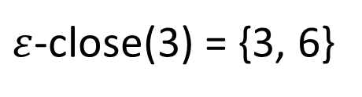
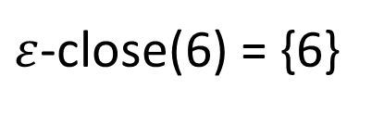
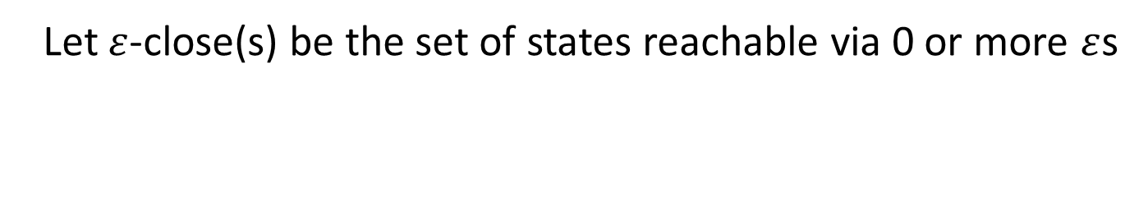
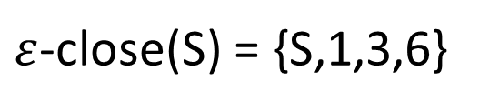
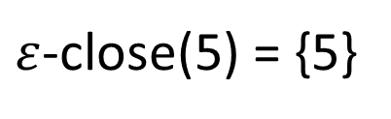

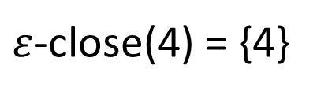

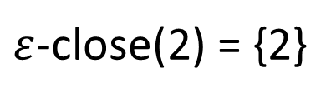

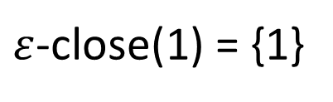

$ε$-transition Example, I
Let $ε$-close(s) be the set of states reachable via 0 or more $ε$s
6
$ε$-close(S) = {S,1,3,6}
$ε$-close(3) = {3, 6}
S
$$ε$$
$$ε$$
$ε$-close(1) = {1}
C
3
$ε$-close(2) = {2}
$$ε$$
x
$ε$-close(4) = {4}
1
4
x
$ε$-close(5) = {5}
x
x
$ε$-close(6) = {6}
2
x
5

Slide 13

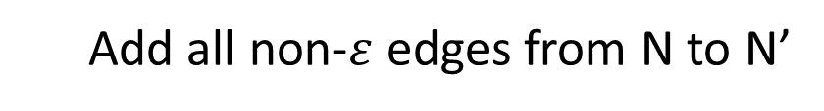
$ε$-transition Example, II
Add all non-$ε$ edges from N to N’
6
6
S
S
$$ε$$
$$ε$$
C
C
3
3
$$ε$$
x
x
1
4
1
4
x
x
x
x
x
x
x
5
2
x
5
2

Slide 14
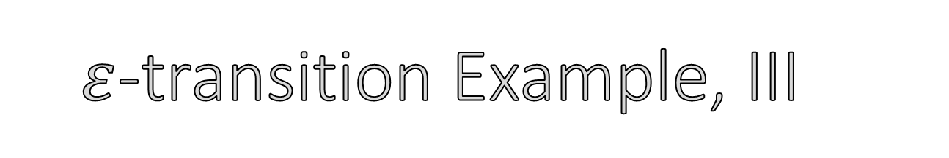

$ε$-transition Example, III
Put s in F’ if $ε$-close(s) contains a state in F
6
6
S
S
$$ε$$
$$ε$$
S
C
C
3
3
$$ε$$
x
x
1
4
1
4
x
x
x
x
x
x
x
5
2
x
5
2

Slide 15

$ε$-transition Example, IV
Put s,c $→$ t in $δ$’ if there is a c-edge to t in $ε$-close(s)
6
6
S
S
$$ε$$
$$ε$$
S
C
C
x
3
3
$$ε$$
x
x
1
4
x
1
4
x
x
x
x
x
x
x
5
2
x
5
2

Slide 16
$ε$-transition Example, IV
Put s,c $→$ t in $δ$’ if there is a c-edge to t in $ε$-close(s)
6
6
S
S
$$ε$$
$$ε$$
S
C
C
x
3
3
$$ε$$
x
x
1
4
x
1
4
x
x
x
x
x
x
x
5
2
x
5
2

Slide 17
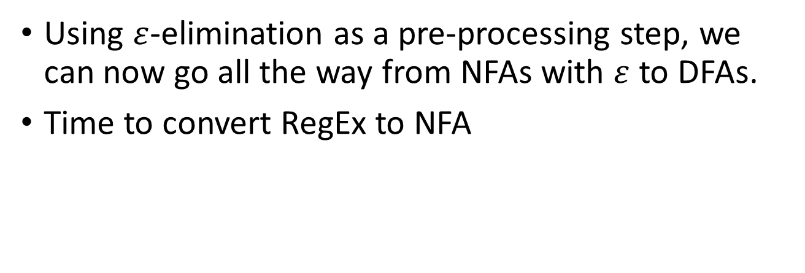
Building the Toolchain…
Using $ε$-elimination as a pre-processing step, we can now go all the way from NFAs with $ε$ to DFAs.
Time to convert RegEx to NFA
Rabin-Scott
Powerset
Construction
RegEx
NFA
DFA
With
$ε$-edges
Without
$ε$-edges

Slide 18
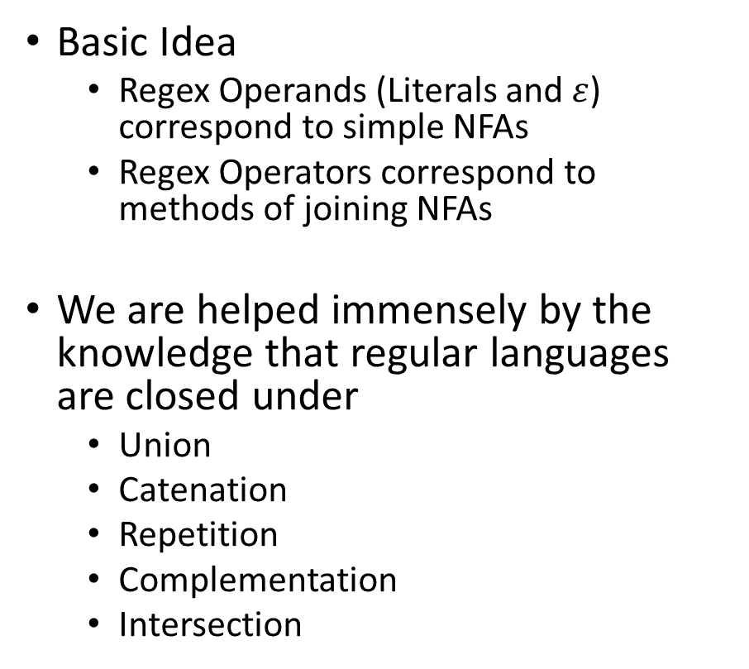
RegEx to NFAs
Basic Idea
Regex Operands (Literals and $ε$) correspond to simple NFAs
Regex Operators correspond to methods of joining NFAs
We are helped immensely by the knowledge that regular languages are closed under
Union
Catenation
Repetition
Complementation
Intersection

Slide 19


4 RegEx to NFA Conversion Rules
1. Rule for operands
S
‘a’
Literal ‘a’
S
$$ε$$
$$ε$$

Slide 20









4 RegEx to NFA Conversion Rules
2. Rule for alteration $α$|$β$
$$α$$
$$α$$
S
$α$_{S}
…
Y
…
Y
$$ε$$
S
$$β$$
$$β$$
S
$$ε$$
$β$_{S}
…
Z
…
Z

Slide 21









4 RegEx to NFA Conversion Rules
3. Rule for catenation $α. β$
$$α$$
S
…
X
$$α$$
$$α$$
S
$α$_{S}
…
X
$α$_{S}
…
Y
$$β$$
S
…
Y
$$ε$$
$$ε$$

Slide 22






4 RegEx to NFA Conversion Rules
4. Rule for iteration $α$*
$$ε$$
$$α$$
S
…
X
S
$$ε$$
$α$_{S}
…
X
$$ε$$
F

Slide 23
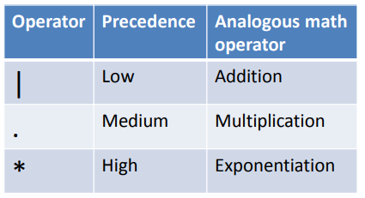
RegEx Operator Precedence

Slide 24
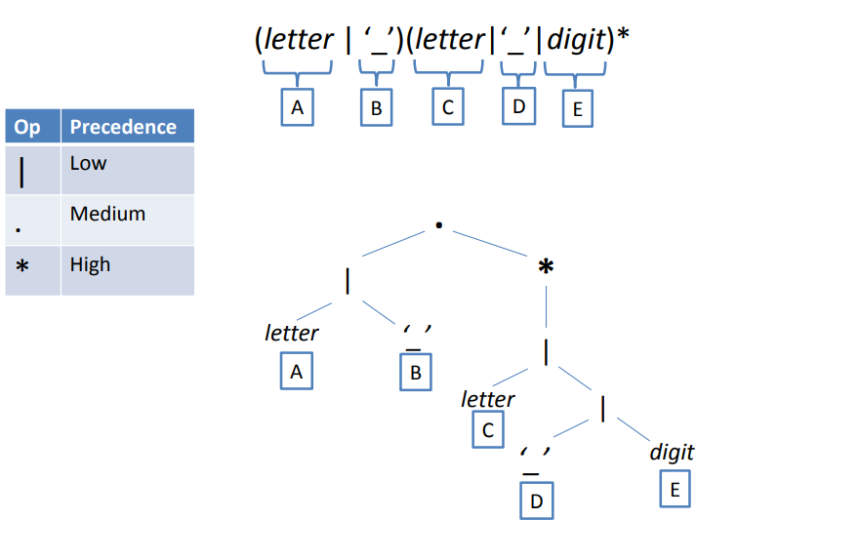
Tree Representation of a RegEx

Slide 25
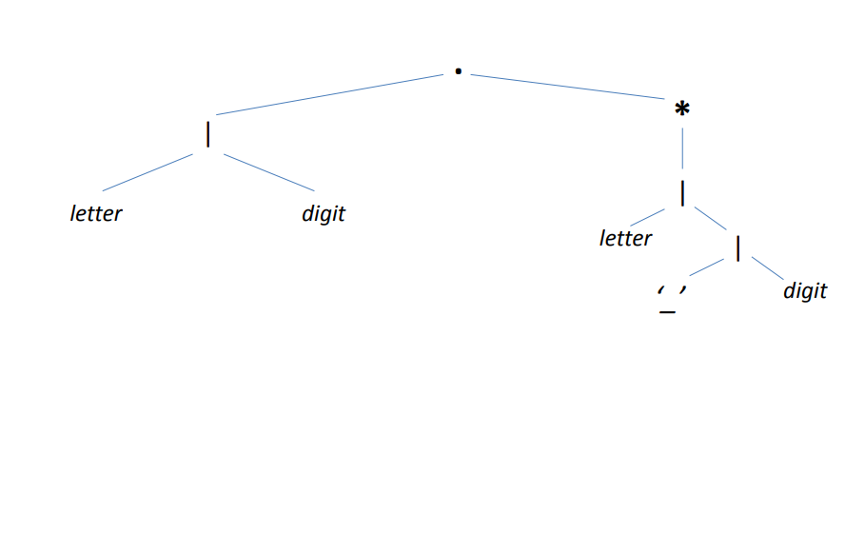
Replace RegEx Bottom-Up

Slide 26
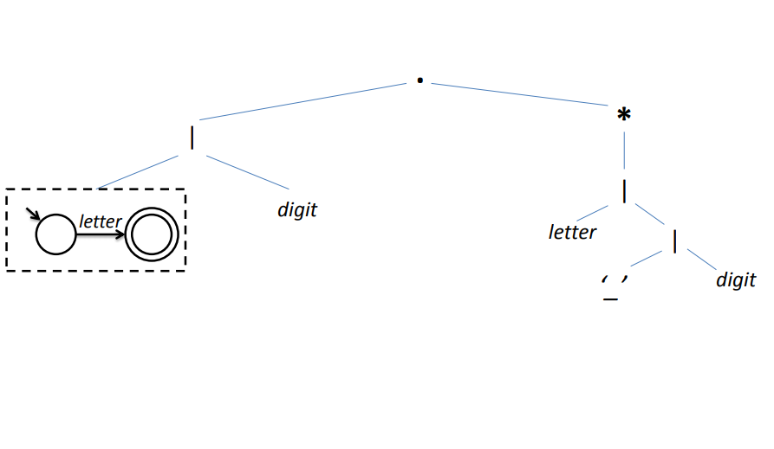
Replace RegEx Bottom-Up

Slide 27
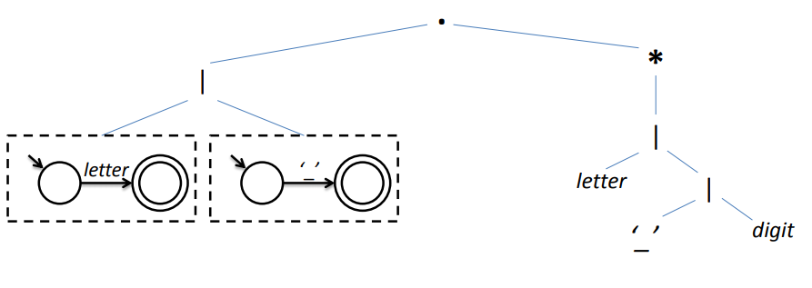
Replace RegEx Bottom-Up

Slide 28
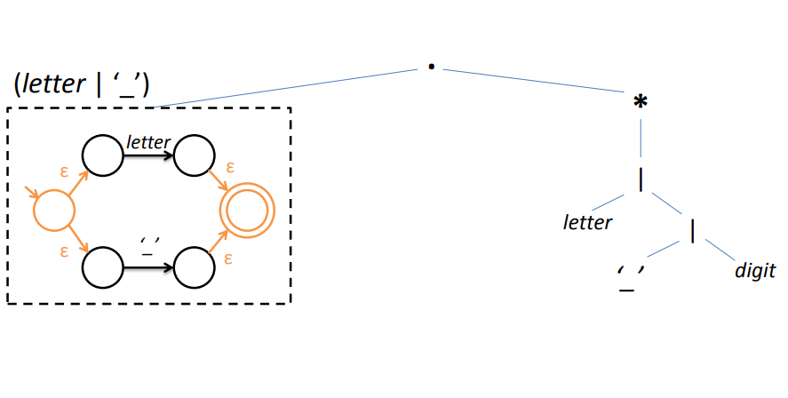
Replace RegEx Bottom-Up

Slide 29
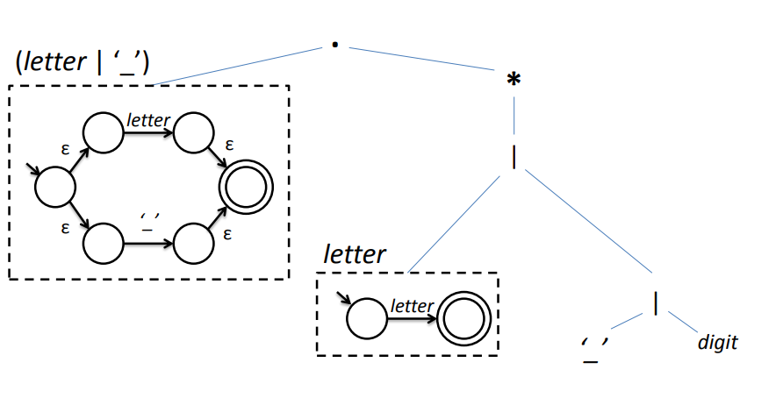
Replace RegEx Bottom-Up

Slide 30
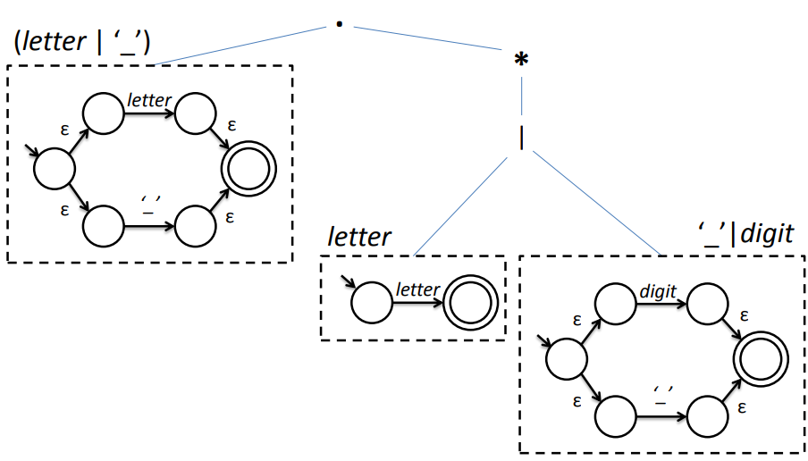
Replace RegEx Bottom-Up

Slide 31
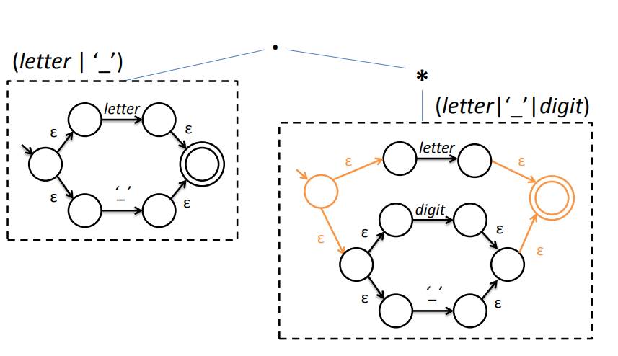
Replace RegEx Bottom-Up

Slide 32
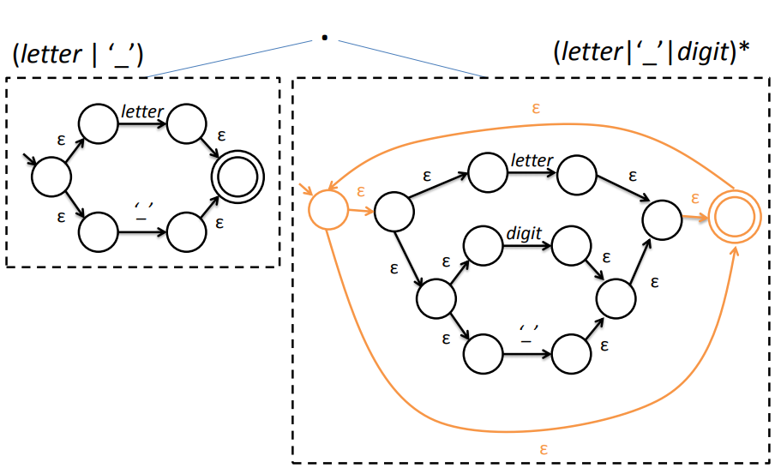
Replace RegEx Bottom-Up

Slide 33
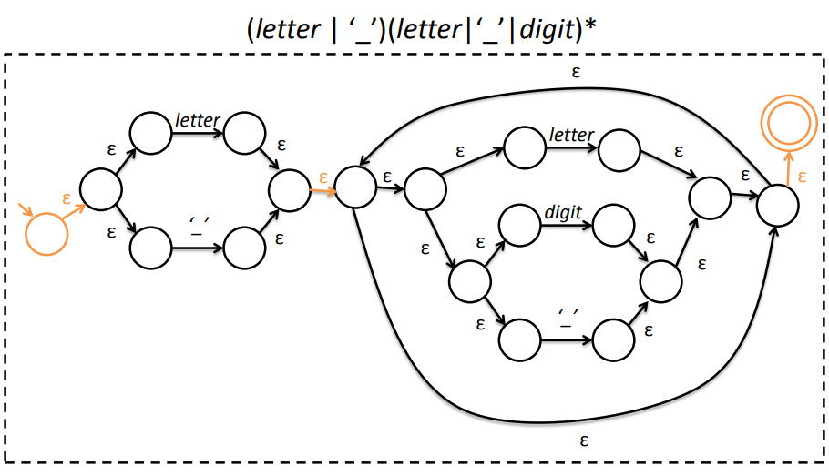
Replace RegEx Bottom-Up

Slide 34
Keep Building the Toolchain
We can now use a state transition table-based DFA engine to recognize regular languages
There are practical uses for such systems straight up
Signature detection
Policy Automata
RegEx
NFA
DFA
With
$ε$-edges
Without
$ε$-edges

Slide 35

Signature Based NIDS*
Loaded with a library of signatures
Matches network traffic, flags on acceptance
*Snort actually uses Aho-Corasick due to the size of the combined signatures,
but that’s largely an implementation detail

Slide 36
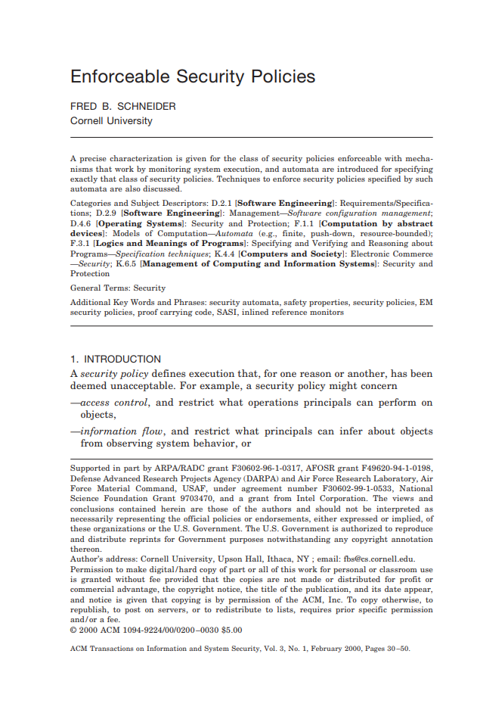
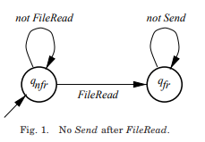
Policy Automata
Express allowable behavior as transitions
System state is forwarded to the automaton
Kills the process if a violation is encountered

Slide 37

From FSMs to Tokenization
It’s not enough for us to recognize the language
FSMs only check for language membership of a string
The Scanner needs to
Tokenize the stream of many different tokens and find the longest match
Know what characters comprise the token
For that we need to go beyond recognition

Slide 38
Actions on State Transition Tables
Key idea: fire an action when you enter the accepting state

Slide 39
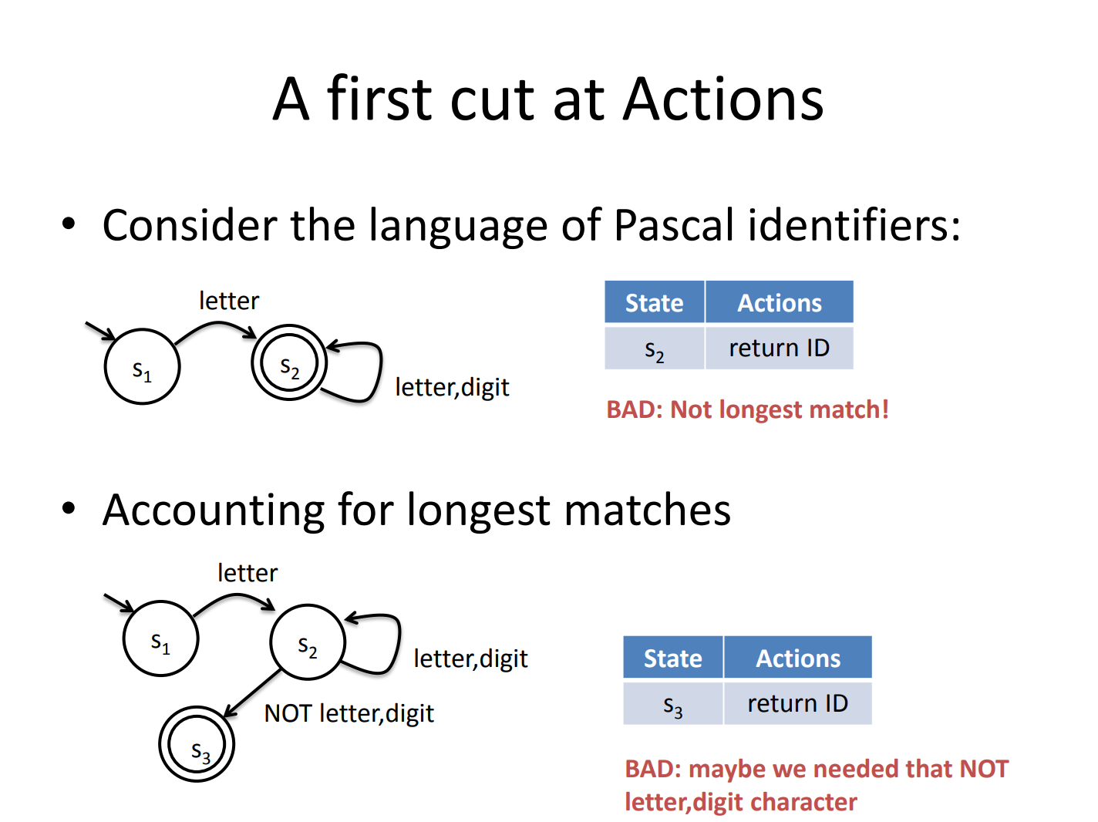

Slide 40
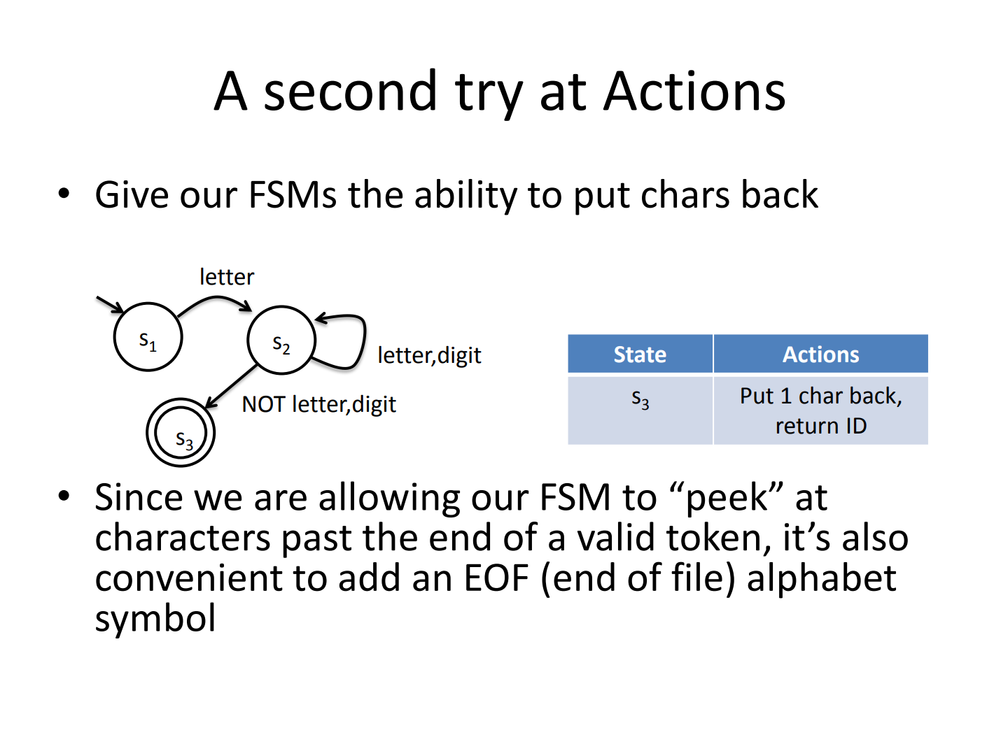

Slide 41
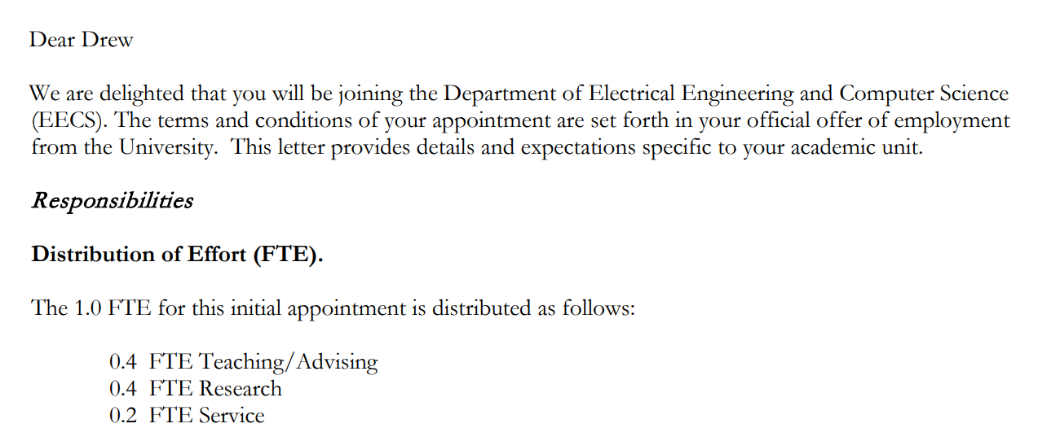

Bye until next time!

Slide 42
Extra Example: NFA Acceptance
1
S
1
S2
0
Example String
1
1
1

