Slide 1

4 – Formal Tokenization
KU | Fall 2018 | Drew Davidson

Slide 2
Review: Draw the 4 rules for RegEx -> NFA transformation

Slide 3

Administrivia
Live Assignments
P1
H1
Lil’ C wins the source language poll!
Will be denoted lilc when necessary
Entry Survey Closed
I’ll address common themes on Piazza
Doc Cam vs Powerpoint
Pretty even results!
I’ll try to split the difference?

Slide 4
Administrivia II
Live Assignments
P1
H1
New Office Hours Schedule
Drew
Monday: 9:00 – 10:30
Wednesday:
9:00 - 12:00
4:00 – 5:00
Friday: 9:00 – 10:30
Brad
Thursdays 12:00 – 2:00 (tentative)
Ruturaj
Mondays 11:00 – 1:00

Slide 5
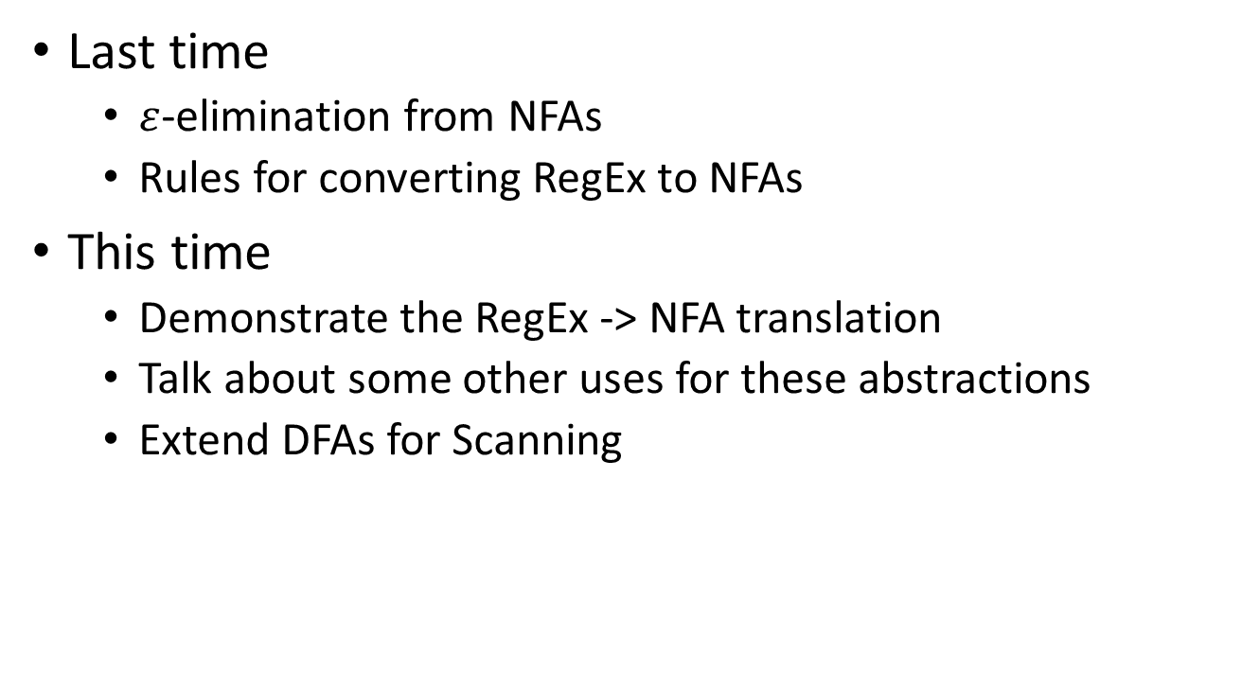
Roadmap
Last time
$ε$-elimination from NFAs
Rules for converting RegEx to NFAs
This time
Demonstrate the RegEx -> NFA translation
Talk about some other uses for these abstractions
Extend DFAs for Scanning

Slide 6
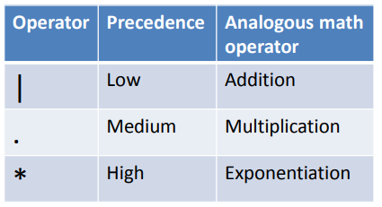
RegEx Operator Precedence

Slide 7
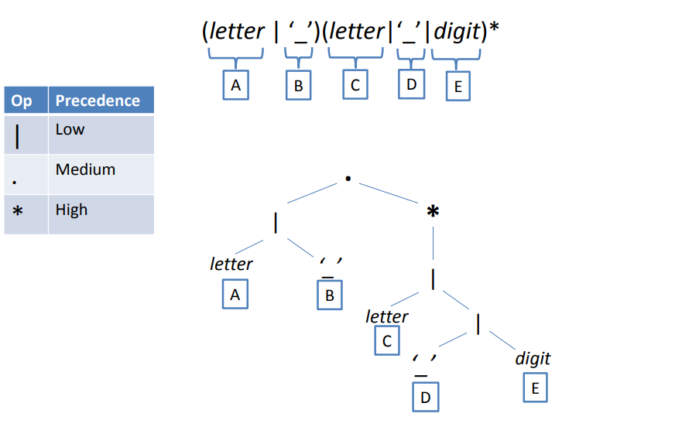
Tree Representation of a RegEx
Op | Precedence
| | Low
. | Mid
* | High
( letter | ‘_’ )(letter | ‘_’ | digit)*
A
B
C
D
E
Draw the Regex Tree

Slide 8
Tree Representation of a RegEx
Op | Precedence
| | Low
. | Mid
* | High
( letter | ‘_’ )(letter | ‘_’ | digit)*
A
B
C
D
E
.
A|B
(C|D|E)*
(A|B).(C|D|E)*
*
|
C|D|E
|
letter
‘_’
D|E
A
B
letter
|
C
‘_’
digit
D
E

Slide 9
Replace RegEx Bottom-Up

Slide 10
.
A|B
(C|D|E)*
(A|B).(C|D|E)*
*
|
C|D|E
|
letter
‘_’
D|E
A
B
letter
|
C
Draw the letter
“operand NFA”
Draw the digit
“operand NFA”
‘_’
digit
D
E

Slide 11
.
A|B
(C|D|E)*
(A|B).(C|D|E)*
*
|
C|D|E
|
letter
‘_’
S
A
S
AG
A
B
D|E
letter
|
A
B
Draw the A|B “operator NFA”
C
‘_’
digit
D
E

Slide 12


.
A|B
(C|D|E)*
(A|B).(C|D|E)*
*
letter
AS
A
$$ε$$
A
C|D|E
|
S
‘_’
D|E
$$ε$$
BS
A
B
letter
|
C
‘_’
digit
D
E

Slide 13
.
A|B
(C|D|E)*
(A|B).(C|D|E)*
*
letter
AS
A
$$ε$$
A
C|D|E
|
S
‘_’
D|E
$$ε$$
BS
A
B
letter
|
Draw the D|E “operator NFA”
C
‘_’
digit
D
E

Slide 14


.
A|B
(C|D|E)*
(A|B).(C|D|E)*
*
letter
AS
A
$$ε$$
A
C|D|E
|
S
‘_’
$$ε$$
BS
A
B
D|E
letter
‘_’
DS
A
$$ε$$
D
C
S
digit
$$ε$$
ES
A
E

Slide 15
.
A|B
(C|D|E)*
(A|B).(C|D|E)*
*
letter
AS
A
$$ε$$
A
C|D|E
|
S
‘_’
$$ε$$
BS
A
B
D|E
letter
‘_’
DS
A
$$ε$$
D
Draw the C |D|E “operator NFA”
C
S
digit
$$ε$$
ES
A
E

Slide 16




.
A|B
(C|D|E)*
(A|B).(C|D|E)*
*
letter
AS
A
$$ε$$
A
C|D|E
letter
S
CS
A
$$ε$$
C
‘_’
$$ε$$
BS
A
B
S
‘_’
DS
A
$$ε$$
D
$$ε$$
Draw the (C |D|E)* “operator NFA”
DES
digit
$$ε$$
ES
A
E

Slide 17


Gee Whiz that C|D|E
NFA is getting messy!
Let’s clean it up
with the $ε$-closure

Slide 18
.
A|B
(C|D|E)*
(A|B).(C|D|E)*
*
letter
AS
A
$$ε$$
A
C|D|E
letter
S
CS
A
$$ε$$
C
‘_’
$$ε$$
BS
A
B
S
‘_’
DS
A
$$ε$$
D
$$ε$$
Simplify the (C|D|E) NFA
DES
digit
$$ε$$
ES
A
E

Slide 19
.
A|B
(C|D|E)*
(A|B).(C|D|E)*
*
letter
AS
A
$$ε$$
A
C|D|E
S
A
‘_’
C
$$ε$$
letter
BS
A
B
‘_’
S
A
D
A
digit
E

Slide 20
.
A|B
(C|D|E)*
(A|B).(C|D|E)*
*
letter
AS
A
$$ε$$
A
C|D|E
S
A
‘_’
C
$$ε$$
letter
BS
A
B
‘_’
S
A
D
Draw the (C |D|E)* “operator NFA”
A
digit
E

Slide 21






.
A|B
(C|D|E)*
(A|B).(C|D|E)*
letter
AS
A
$$ε$$
$$ε$$
A
C
letter
$$ε$$
S
$$ε$$
‘_’
S
SCDE
‘_’
D
$$ε$$
A
$$ε$$
BS
A
F
B
digit
$$ε$$
E
$$ε$$

Slide 22
.
A|B
(C|D|E)*
(A|B).(C|D|E)*
letter
AS
A
$$ε$$
$$ε$$
A
C
letter
$$ε$$
S
$$ε$$
‘_’
S
SCDE
‘_’
D
$$ε$$
A
$$ε$$
BS
A
F
B
digit
$$ε$$
E
Draw the (A|B).(C |D|E)* “operator NFA”
$$ε$$

Slide 23










(A|B).(C|D|E)*
$$ε$$
letter
letter
C
AS
A
$$ε$$
$$ε$$
$$ε$$
$$ε$$
SCDE
‘_’
D
$$ε$$
A
S
F
‘_’
digit
$$ε$$
BS
B
$$ε$$
E
$$ε$$
$$ε$$

Slide 24
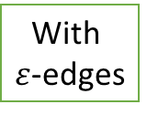
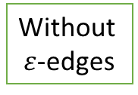
Keep Building the Toolchain
We can now use a state transition table-based DFA engine to recognize regular languages
There are practical uses for such systems straight up
Signature detection
Policy Automata
RegEx
NFA
DFA
With
$ε$-edges
Without
$ε$-edges

Slide 25

Signature Based NIDS*
Loaded with a library of signatures
Matches network traffic, flags on acceptance
*Snort actually uses Aho-Corasick due to the size of the combined signatures,
but that’s largely an implementation detail

Slide 26
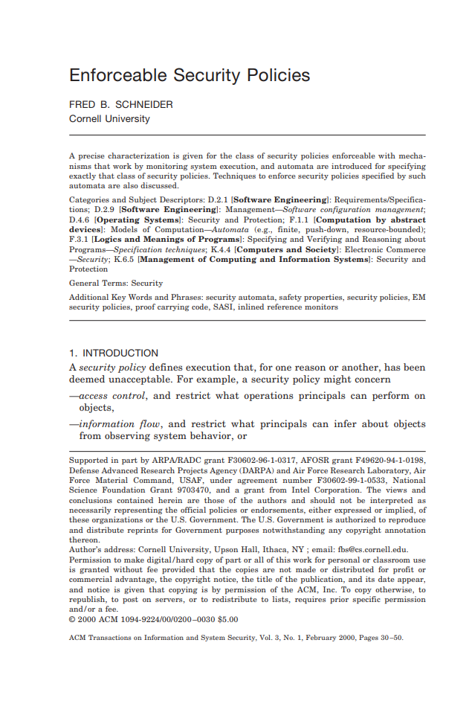
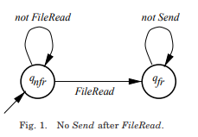
Policy Automata
Express allowable behavior as transitions
System state is forwarded to the automaton
Kills the process if a violation is encountered

Slide 27

From FSMs to Tokenization
It’s not enough for us to recognize the language
FSMs only check for language membership of a string
The Scanner needs to
Tokenize the stream of many different tokens and find the longest match
Know what characters comprise the token
For that we need to go beyond recognition

Slide 28
Actions on State Transition Tables
Key idea: fire an action when you enter the accepting state

Slide 29

A First Try at Actions
Consider the language of Pascal identifiers
letter
State | Actions
S₂ | Return ID
S
A
letter,
digit
S₂
Not Longest Match!
Accounting for longest matches
letter
$¬$ (letter, digit)
S
S₂
A
S₃
State | Actions
S₃ | Return ID
letter,
digit
We might need that next token!

Slide 30

A Second Try at Actions
Give our FSMs the ability to put chars back
letter
$¬$ (letter, digit)
S
S₂
A
S₃
State | Actions
S₃ | 1,ID
letter,
digit
Since we are allowing our FSM to “peek” at characters past the end of a valid token, it’s also convenient to add an EOF (end of file) alphabet symbol

Slide 31
Our First Scanner
Consider a language with 2 statement types
Assignment: ID = expr
Increment: ID += expr
Where expr is of the form
ID + ID
ID < ID
ID <= ID
Identifiers follow C conventions
Draw the Token to Regex table

Slide 32
Our First Scanner
Consider a language with 2 statement types
Assignment: ID = expr
Increment: ID += expr
Where expr is of the form
ID + ID
ID < ID
ID <= ID
Identifiers follow C conventions
Token Name | RegEx
ASSIGN | “=“
INC | “+=“
PLUS | “+”
LT | “<“
LEQ | “<=“
ID | (letter|_) . (letter|digit|_)*

Slide 33



Draw the Combined NFA
A
G
A
H
A
A
I
F
Token Name | RegEx
ASSIGN | “=“
INC | “+=“
PLUS | “+”
LT | “<“
LEQ | “<=“
ID | (letter|_) . (letter|digit|_)*
$¬$(‘=‘)
‘=‘
‘=‘
$¬$(‘=‘)
B
C
‘<‘
‘+‘
A
A
S
‘=‘
‘_’ |letter|digit
D
$¬$(‘=‘|letter|digit)
A
E

Slide 34

A
G
A
A
H
A
F
I
Token Name | RegEx
ASSIGN | “=“
INC | “+=“
PLUS | “+”
LT | “<“
LEQ | “<=“
ID | (letter|_) . (letter|digit|_)*
$¬$(‘=‘)
‘=‘
‘=‘
$¬$(‘=‘)
B
C
‘<‘
‘+‘
A
A
S
‘=‘
‘_’ |letter
‘_‘|letter|digit
D
$¬$(‘_‘|letter|digit)
A
E

Slide 35

Draw the State
Action table
A
G
A
A
H
A
F
I
Token Name | RegEx
ASSIGN | “=“
INC | “+=“
PLUS | “+”
LT | “<“
LEQ | “<=“
ID | (letter|_) . (letter|digit|_)*
$¬$(‘=‘)
‘=‘
‘=‘
$¬$(‘=‘)
B
C
‘<‘
‘+‘
A
A
S
‘=‘
‘_’ |letter
‘_‘|letter|digit
D
$¬$(‘_‘|letter|digit)
($¬$: any other character)
A
E

Slide 36
A
G
A
A
H
A
F
I
Token Name | RegEx
ASSIGN | “=“
INC | “+=“
PLUS | “+”
LT | “<“
LEQ | “<=“
ID | (letter|_) . (letter|digit|_)*
 | Action
A | 0,ASSIGN
F | 0,INC
G | 1,PLUS
H | 0,LEQ
I | 1,LT
E | 1, ID
$¬$(‘=‘)
‘=‘
‘=‘
$¬$(‘=‘)
B
C
‘<‘
‘+‘
A
A
S
‘=‘
‘_’ |letter
‘_‘|letter|digit
D
$¬$(‘_‘|letter|digit)
($¬$: any other character)
A
E

Slide 37
 | = | + | < | _ | letter | digit | EOF | OTHER
S
B
C
D
Fill in the Transition Action table
A
G
A
A
H
A
F
I
Token Name | RegEx
ASSIGN | “=“
INC | “+=“
PLUS | “+”
LT | “<“
LEQ | “<=“
ID | (letter|_) . (letter|digit|_)*
 | Action
A | 0,ASSIGN
F | 0,INC
G | 1,PLUS
H | 0,LEQ
I | 1,LT
E | 1, ID
$¬$(‘=‘)
‘=‘
‘=‘
$¬$(‘=‘)
B
C
‘<‘
‘+‘
A
A
S
‘=‘
‘_’ |letter
‘_‘|letter|digit
D
$¬$(‘_‘|letter|digit)
($¬$: any other character)
A
E

Slide 38
 | = | + | < | _ | letter | digit | EOF | OTHER
S | 0,ASSIGN | B | C | D | D |  | 0,EOF
B | 0,INC | 1,PLUS | 1,PLUS | 1,PLUS | 1/PLUS | 1/PLUS | 1,PLUS | 1,PLUS
C | 0,LEQ | 1,LT | 1,LT | 1,LT | 1,LT | 1,LT | 1,LT | 1,LT
D | 1,ID | 1,ID | 1,ID | C | C | C | 1,ID | 1,ID
A
G
A
A
H
A
F
I
Token Name | RegEx
ASSIGN | “=“
INC | “+=“
PLUS | “+”
LT | “<“
LEQ | “<=“
ID | (letter|_) . (letter|digit|_)*
$¬$(‘=‘)
‘=‘
‘=‘
$¬$(‘=‘)
B
C
‘<‘
‘+‘
A
A
S
‘=‘
‘_’ |letter
‘_‘|letter|digit
D
$¬$(‘_‘|letter|digit)
($¬$: any other character)
A
E

