Slide 1

6 – Flex Outro
KU | Fall 2018 | Drew Davidson

Slide 2
Pre-class Activities
Live Assignments
P1
H2
Turn in HW1!!
Write the Flex definitions for…
Digits
Hexadecimal characters
C Identifiers

Slide 3
Administrivia
Live Assignments
P1
H1
Homework 2 is due next Friday 9/7
Quiz 1 on 9/7
1 page of notes allowed – WILL BE COLLECTED
Topics:
DFAs
NFAs
Regular Expressions
Flex
CFGs
P2 will be out by midnight, I’ll also post about it
Review Session
Availability matrix on Doodle

Slide 4

Roadmap
Last time
Merged actions into transition table
Introduced Flex
This time
Go over HW 1
Wrap up Flex
Talk about P2

Slide 5
HW1 Solutions Go Here
Live Assignments
P1
H2
((‘-’|’-’.’-’)?.letter)+(‘-’|’-’.’-’)?

Slide 6
HW1 Solutions Go Here
Live Assignments
P1
H2
letter, digit, ’_’
letter, digit, ’_’
letter
dot
S
letter,digit
letter,digit
‘_’
dot
‘_’
‘_’

Slide 7
Flex Demo…

Slide 8
P2 Discussion

Slide 9
Regexs are Great!
Perfect for tokenizing a language
They do have some limitations

Slide 10
Regexs are Great!
Perfect for tokenizing a language
They do have some limitations
Limited class of language that cannot specify all programming constructs we need
No notion of structure
Let’s explore both of these issues

Slide 11
Limitations of Regexs!
Cannot handle “matching”
Eg: language of balanced parentheses
L = { (^{x})^{x} where x > 1}
cannot be matched
Intuition:
An FSM can only handle a finite depth of
parentheses that we can handle
let’s see a diagram…

Slide 12
Balanced Parens Problem
Assume F is an FSM that recognized L. Let N be the number of states in F’.
Feed N+1 left parens into N
By the pidgeonhole principle, we must have revisited some state s on two input characters i and j.
By the definition of F, there must be a path from s to a final state. But this means that it accepts some suffix of closed parens at input i and j, but both cannot be correct
S
(
(
(
(
…

Slide 13

Limitations of Regex Structure
Our Enhanced-RegEx scanner can emit a stream of tokens:
We need more power than
RegExs can provide
X
Y
=
Z
+
… but doesn’t enforce structure

Slide 14
The Chomsky Heirarchy
LANGUAGE CLASS:
power
efficiency
Recursively enumerable
Context-Sensitive
Context-Free
Regular

Slide 15
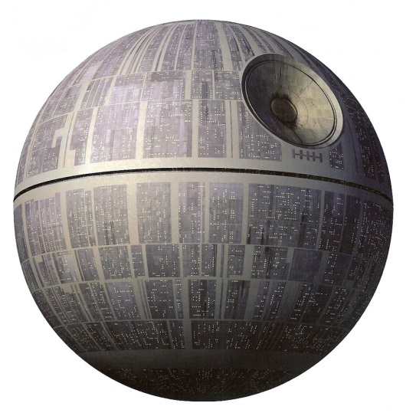
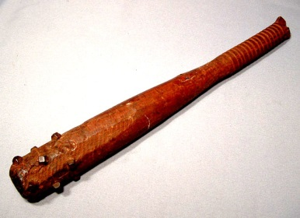
The Chomsky Heirarchy
Turing machine
LANGUAGE CLASS:
power
efficiency
Recursively enumerable
Context-Sensitive
Context-Free
Happy medium?
Regular
FSM

