Slide 1

7 – CFGs
KU | Fall 2018 | Drew Davidson

Slide 2
Warmup
Which of these Flex Rules fires on the input string “123a” ?
[0-9]+ {std::cout << “FIRST”; }
[0-9]a+ {std::cout << “SECOND”; }
[0-9]+a {std::cout << “THIRD”; }
[0-9]+a+ {std::cout << “FOURTH”; }

Slide 3
Roadmap
Last Time
Outro to Flex
Limitations of RegEx
Balanced Parens problem
Order of tokens
This Time
Explore CFGs

Slide 4

Context Free Grammars (CFGs)
A set of (recursive) rewriting rules to generate patterns of strings
Can envision a “parse tree” that keeps structure

Slide 5
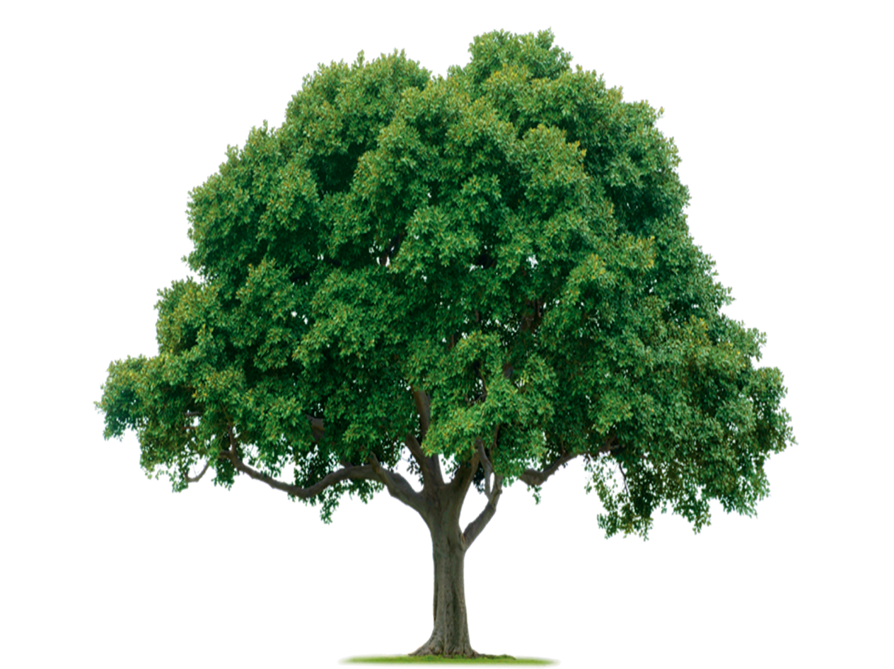
Parse Tree Intuition

Slide 6
Parse Tree Intuition
Apply rules until no rules no longer apply
If the tree is “complete” it defines some element in the language

Slide 7
CFG: Rules
Example Rule
Before applying rule
After applying rule
Draw the rule
Show the transformation

Slide 8
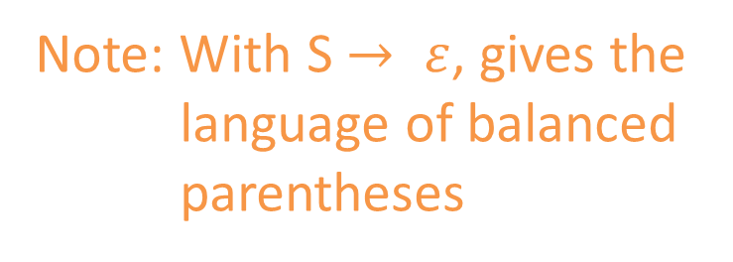
CFG: Rules
Example Rule
Before applying rule
After applying rule
S → ( S )
S
S
Rewrite S to be
an S surrounded by
a single set of parens
(
S
)
Note: With S $→ ε$, gives the
language of balanced
parentheses

Slide 9

Context Free Grammars (CFGs)
Formally, a 4-tuple (N,$Σ$,P,S) where:
Write the definitions

Slide 10
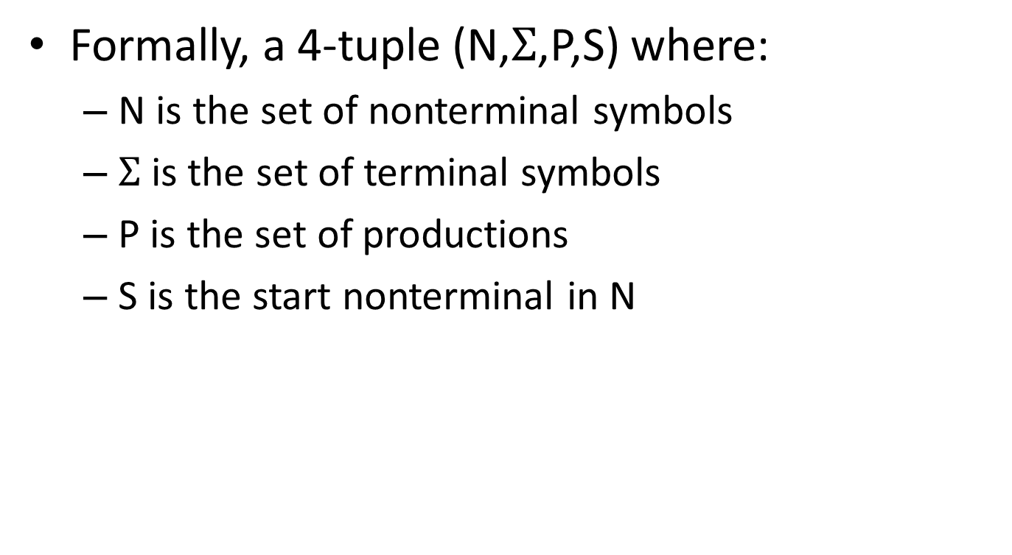
Context Free Grammars (CFGs)
Formally, a 4-tuple (N,$Σ$,P,S) where:
N is the set of nonterminal symbols
$Σ$is the set of terminal symbols
P is the set of productions
S is the start nonterminal in N
Annotate with meaning

Slide 11
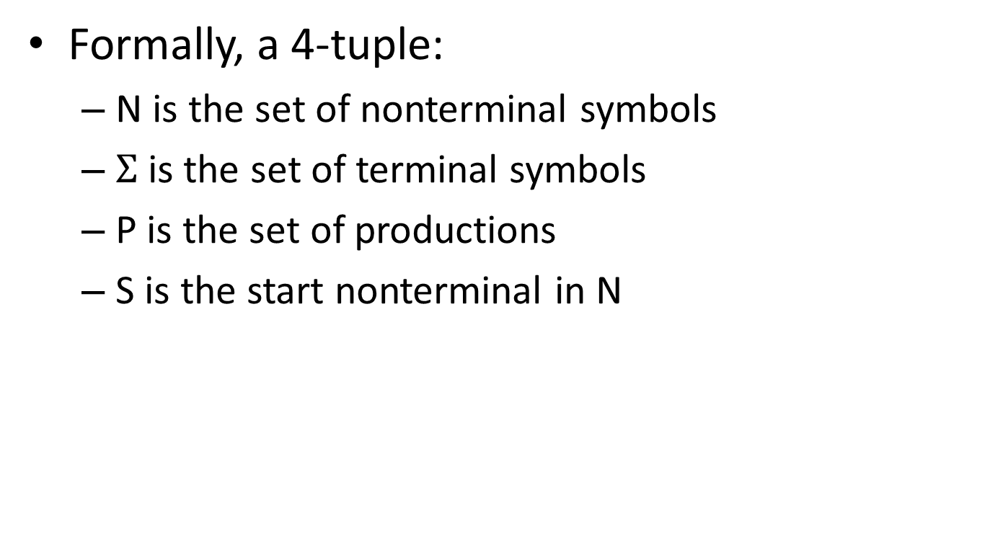
Context Free Grammars (CFGs)
Placeholder / interior nodes
in the parse tree
Formally, a 4-tuple:
N is the set of nonterminal symbols
$Σ$is the set of terminal symbols
P is the set of productions
S is the start nonterminal in N
Tokens from
scanner
Rules for deriving strings
If not otherwise specified, start at the
nonterminal that appears on the LHS
of the first production is the start

Slide 12
Production Syntax
LHS → RHS
LHS Intuition
RHS Intuition

Slide 13
Production Syntax
LHS → RHS
Expression: Sequence of
terminals and nonterminals
Single nonterminal symbol

Slide 14
Production Shorthand
Nonterm → Expression
Nonterm→ ε
equivalently:
equivalently:
| multi-line Notation
| one-line notation

Slide 15
Production Shorthand
Sequence of terms and nonterms
Nonterm → Expression
Nonterm→ ε
equivalently:
Nonterm → expression
| ε
equivalently:
Nonterm → expression | ε

Slide 16
Derivations
To derive a string:
Start by setting “Current Sequence” to the start symbol
Repeat:
Find a Nonterminal X in the Current Sequence
Find a production of the form X→α
“Apply” the production: create a new “current sequence” in which α replaces X
Stop when there are no more nonterminals

Slide 17
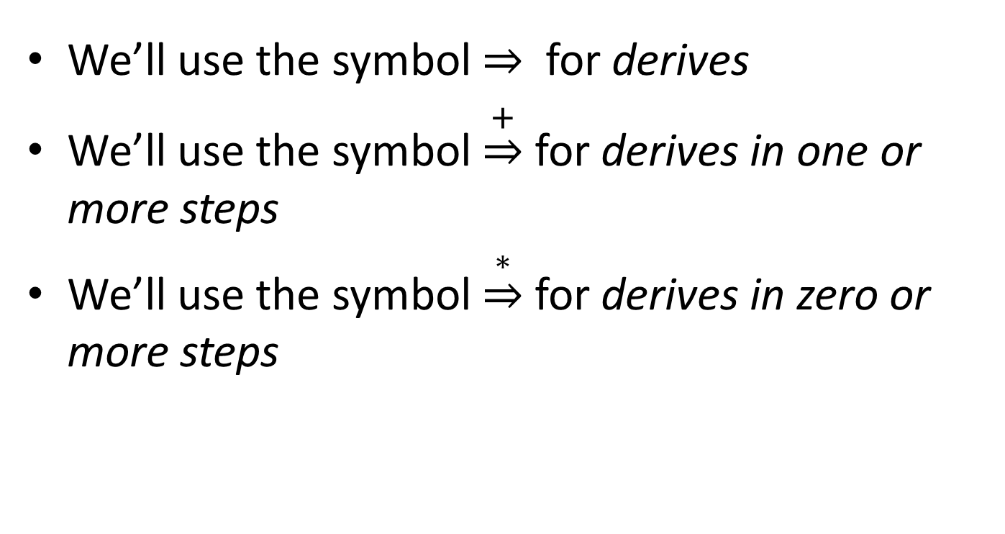
Derivation Syntax
We’ll use the symbol for derives
We’ll use the symbol $\underset{⇒}{+}$ for derives in one or more steps
We’ll use the symbol $\underset{⇒}{∗}$ for derives in zero or more steps

Slide 18
An Example Grammar

Slide 19
An Example Grammar
Terminals
begin
end
semicolon
assign
id
plus

Slide 20
An Example Grammar
For readability, bold and lowercase
Terminals
begin
end
semicolon
assign
id
plus
Program
boundary
Represents “;”
Separates statements
Represents “=“ statement
Identifier / variable name
Represents “+“ expression

Slide 21
An Example Grammar
For readability, bold and lowercase
Terminals
begin
end
semicolon
assign
id
plus
Nonterminals
Prog
Stmts
Stmt
Expr

Slide 22
An Example Grammar
For readability, bold and lowercase
Terminals
begin
end
semicolon
assign
id
plus
Defines the syntax of legal programs
Productions
Prog → begin Stmts end
Stmts → Stmts semicolon Stmt
| Stmt
Stmt → id assign Expr
Expr → id
| Expr plus id
For readability, Italics and UpperCamelCase
Nonterminals
Prog
Stmts
Stmt
Expr

Slide 23
An Example Grammar
For readability, bold and lowercase
Terminals
begin
end
semicolon
assign
id
plus
Program
boundary
Defines the syntax of legal programs
Represents “;”
Separates statements
Productions
Prog → begin Stmts end
Stmts → Stmts semicolon Stmt
| Stmt
Stmt → id assign Expr
Expr → id
| Expr plus id
Represents “=“ statement
Identifier / variable name
Represents “+“ expression
For readability, Italics and UpperCamelCase
Nonterminals
Prog
Stmts
Stmt
Expr
Root of the parse tree
List of statements
A single statement
A mathematical expression

Slide 24
Productions
Prog → begin Stmts end
Stmts → Stmts semicolon Stmt
| Stmt
Stmt → id assign Expr
Expr → id
| Expr plus id

Slide 25
Productions
Prog → begin Stmts end
Stmts → Stmts semicolon Stmt
| Stmt
Stmt → id assign Expr
Expr → id
| Expr plus id
Derivation Sequence

Slide 26
Productions
Prog → begin Stmts end
Stmts → Stmts semicolon Stmt
| Stmt
Stmt → id assign Expr
Expr → id
| Expr plus id
Parse Tree
Derivation Sequence

Slide 27
Productions
Prog → begin Stmts end
Stmts → Stmts semicolon Stmt
| Stmt
Stmt → id assign Expr
Expr → id
| Expr plus id
Parse Tree
Derivation Sequence
Key
terminal
Nonterminal
Rule used

Slide 28
Productions
Prog → begin Stmts end
Stmts → Stmts semicolon Stmt
| Stmt
Stmt → id assign Expr
Expr → id
| Expr plus id
Parse Tree
Prog
Derivation Sequence
Prog
Key
terminal
Nonterminal
Rule used

Slide 29

Productions
Prog → begin Stmts end
Stmts → Stmts semicolon Stmt
| Stmt
Stmt → id assign Expr
Expr → id
| Expr plus id
Parse Tree
Prog
Derivation Sequence
Prog begin Stmts end
1
Key
terminal
Nonterminal
Rule used

Slide 30
Productions
Prog → begin Stmts end
Stmts → Stmts semicolon Stmt
| Stmt
Stmt → id assign Expr
Expr → id
| Expr plus id
Parse Tree
Prog
begin
Stmts
end
Derivation Sequence
Prog begin Stmts end
1
Key
terminal
Nonterminal
Rule used

Slide 31
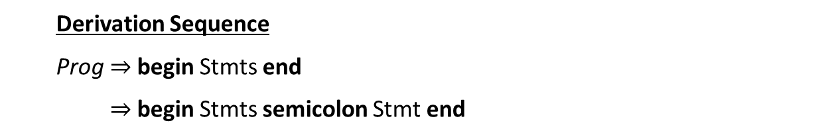
Productions
Prog → begin Stmts end
Stmts → Stmts semicolon Stmt
| Stmt
Stmt → id assign Expr
Expr → id
| Expr plus id
Parse Tree
Prog
begin
Stmts
end
Stmts
semicolon
Stmt
Derivation Sequence
Prog begin Stmts end
begin Stmts semicolon Stmt end
1
2
Key
terminal
Nonterminal
Rule used

Slide 32
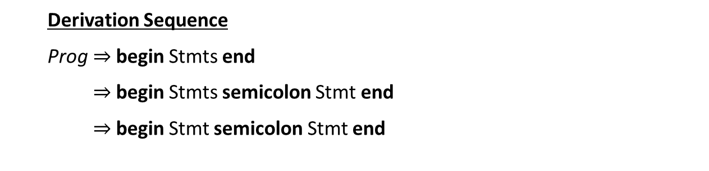
Productions
Prog → begin Stmts end
Stmts → Stmts semicolon Stmt
| Stmt
Stmt → id assign Expr
Expr → id
| Expr plus id
Parse Tree
Prog
begin
Stmts
end
Stmts
semicolon
Stmt
Stmt
Derivation Sequence
Prog begin Stmts end
begin Stmts semicolon Stmt end
begin Stmt semicolon Stmt end
1
2
Key
3
terminal
Nonterminal
Rule used

Slide 33
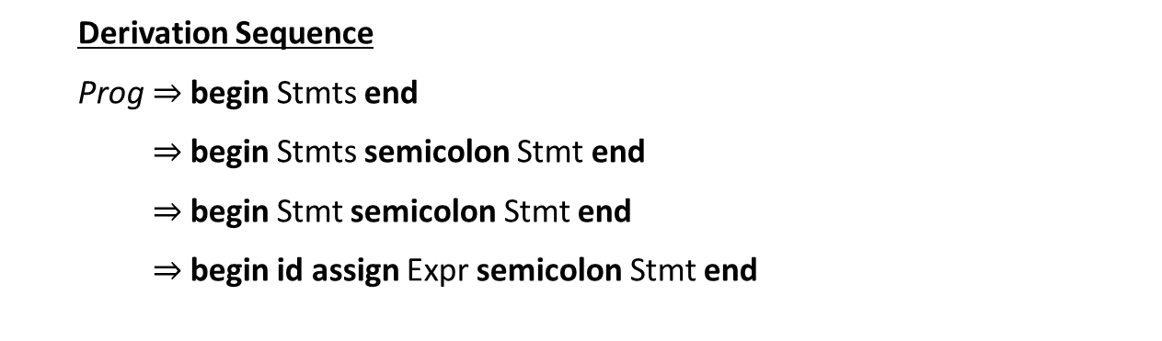
Productions
Prog → begin Stmts end
Stmts → Stmts semicolon Stmt
| Stmt
Stmt → id assign Expr
Expr → id
| Expr plus id
Parse Tree
Prog
begin
Stmts
end
Stmts
semicolon
Stmt
Stmt
Derivation Sequence
Prog begin Stmts end
begin Stmts semicolon Stmt end
begin Stmt semicolon Stmt end
begin id assign Expr semicolon Stmt end
id
assign
Expr
1
2
Key
3
4
terminal
Nonterminal
Rule used

Slide 34
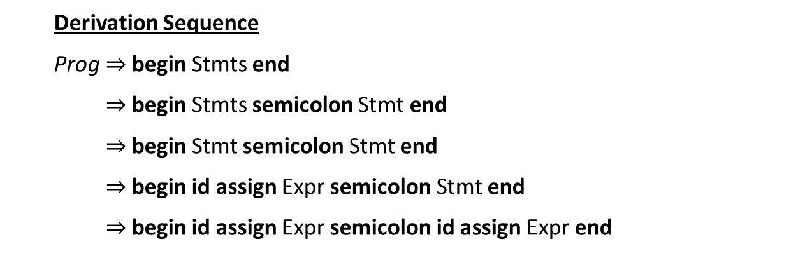
Productions
Prog → begin Stmts end
Stmts → Stmts semicolon Stmt
| Stmt
Stmt → id assign Expr
Expr → id
| Expr plus id
Parse Tree
Prog
begin
Stmts
end
Stmts
semicolon
Stmt
Stmt
id
assign
Expr
Derivation Sequence
Prog begin Stmts end
begin Stmts semicolon Stmt end
begin Stmt semicolon Stmt end
begin id assign Expr semicolon Stmt end
begin id assign Expr semicolon id assign Expr end
id
assign
Expr
1
2
Key
3
4
terminal
4
Nonterminal
Rule used

Slide 35
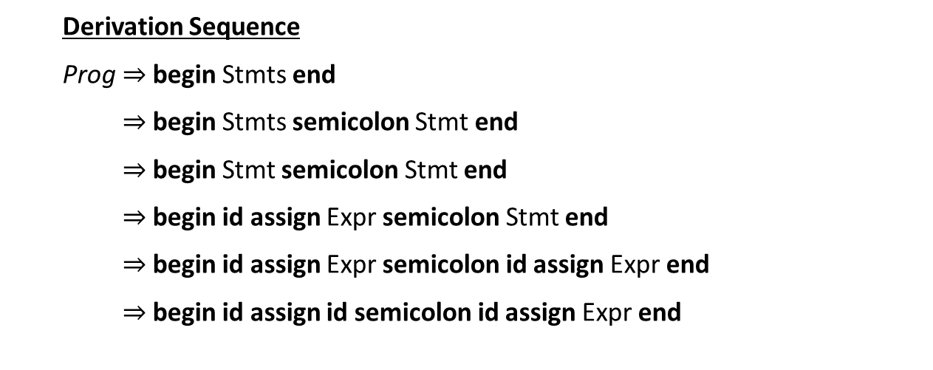
Productions
Prog → begin Stmts end
Stmts → Stmts semicolon Stmt
| Stmt
Stmt → id assign Expr
Expr → id
| Expr plus id
Parse Tree
Prog
begin
Stmts
end
Stmts
semicolon
Stmt
Stmt
id
assign
Expr
Derivation Sequence
Prog begin Stmts end
begin Stmts semicolon Stmt end
begin Stmt semicolon Stmt end
begin id assign Expr semicolon Stmt end
begin id assign Expr semicolon id assign Expr end
begin id assign id semicolon id assign Expr end
id
assign
Expr
1
2
id
Key
3
4
terminal
4
Nonterminal
5
Rule used

Slide 36
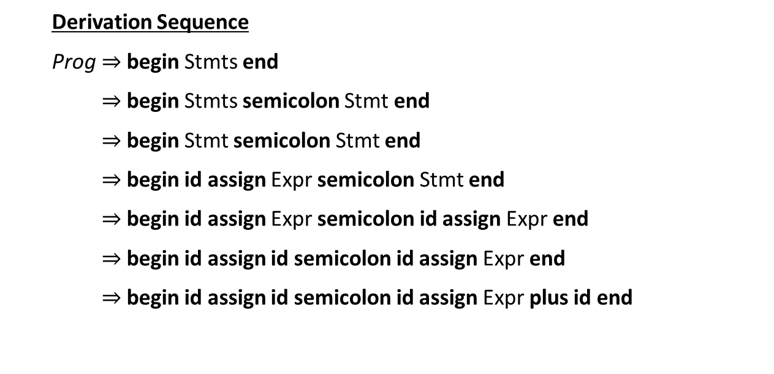
Productions
Prog → begin Stmts end
Stmts → Stmts semicolon Stmt
| Stmt
Stmt → id assign Expr
Expr → id
| Expr plus id
Parse Tree
Prog
begin
Stmts
end
Stmts
semicolon
Stmt
Stmt
id
assign
Expr
Derivation Sequence
Prog begin Stmts end
begin Stmts semicolon Stmt end
begin Stmt semicolon Stmt end
begin id assign Expr semicolon Stmt end
begin id assign Expr semicolon id assign Expr end
begin id assign id semicolon id assign Expr end
begin id assign id semicolon id assign Expr plus id end
id
assign
Expr
Expr
plus
id
1
2
id
Key
3
4
terminal
4
Nonterminal
5
Rule used
6

Slide 37
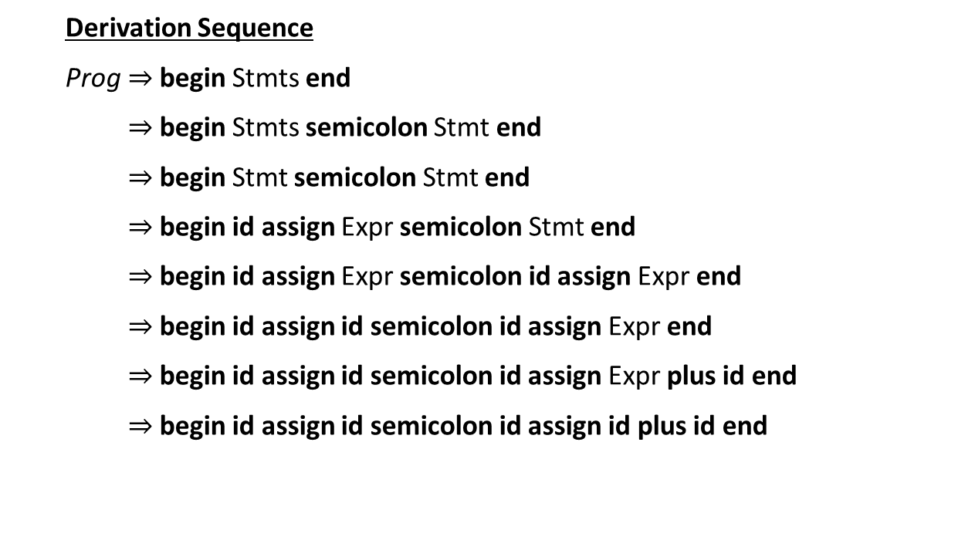
Productions
Prog → begin Stmts end
Stmts → Stmts semicolon Stmt
| Stmt
Stmt → id assign Expr
Expr → id
| Expr plus id
Parse Tree
Prog
begin
Stmts
end
Stmts
semicolon
Stmt
Stmt
id
assign
Expr
Derivation Sequence
Prog begin Stmts end
begin Stmts semicolon Stmt end
begin Stmt semicolon Stmt end
begin id assign Expr semicolon Stmt end
begin id assign Expr semicolon id assign Expr end
begin id assign id semicolon id assign Expr end
begin id assign id semicolon id assign Expr plus id end
begin id assign id semicolon id assign id plus id end
id
assign
Expr
Expr
plus
id
1
2
id
id
Key
3
4
terminal
4
Nonterminal
5
Rule used
6
5

Slide 38
P2 Walkthrough

