Slide 1

8 – CFG Recognition
KU | Fall 2018 | Drew Davidson

Slide 2
Warmup Exercise
Define CFG productions for the language a^{n}b^{n} for some finite number n (i.e., the language of as followed by that many bs)

Slide 3
Administrivia
Live Assignments
P2
New: H3
Homework 3 now assigned
Covers CFGs for Regular expressions
Today is the drop date
Everything turned in is graded
Please check BlackBoard for issues

Slide 4
Quiz 1
Live Assignments
P2
New: H3
Probably too easy
Average Score: 90.1%
That’s higher than I would like
Allotted more time than likely necessary
Future quizzes will probably be…
A bit less generous with partial credit
A bit more difficult
A bit longer
Note all quizzes are anonymous grading

Slide 5
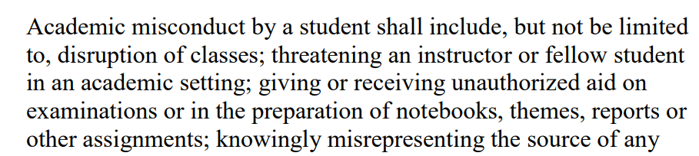
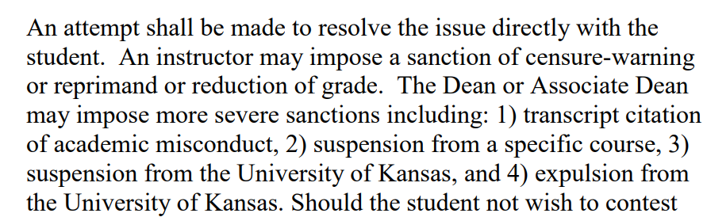
Academic Misconduct
Live Assignments
P2
New: H3
Reminder: Do not…
Share answers
Check answers
Discuss homework problems
Share project code
Do…
Ask me a question if you’re unsure
Report instances of cheating
…

Slide 6

Roadmap
Last Time
Intuitive Language Definition using CFGs
Demonstrated how parse trees can use internal structure
This Time
Formal Language Definition using CFGs
Ambiguity
Language Recognition using CFGs

Slide 7

Let’s check in on our Compiler…
Our lexer
Recognizes a valid character stream
Produces a corresponding token stream
Our parser must
Define a language to token groupings
Recognize valid groups
Produce Parse Trees

Slide 8
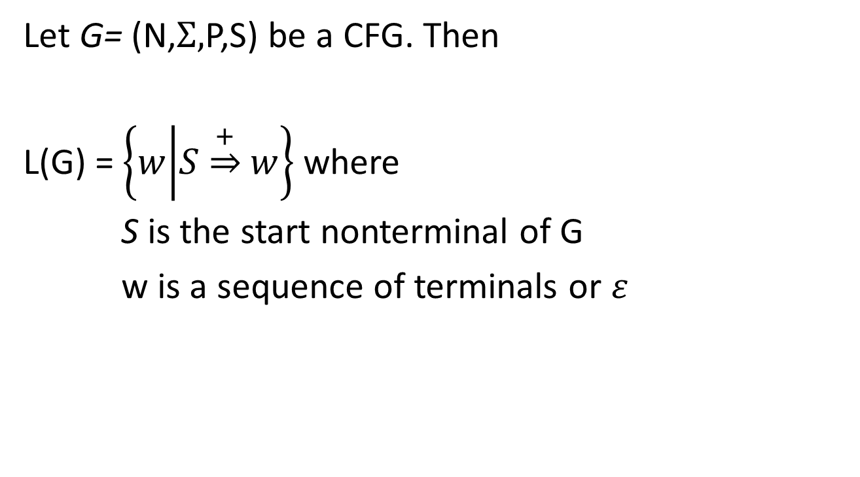
Formal Language Definition
Let G= (N,$Σ,$P,S) be a CFG. Then
L(G) = $\left\{w | S\underset{⇒}{+}w\right\}$ where
S is the start nonterminal of G
w is a sequence of terminals or $ε$

Slide 9
BNF
CFG productions define the syntax of a language
We call this notation “BNF” or “enhanced BNF”
HTML Grammar using BNF
http://bioinfo2.ugr.es/OReillyReferenceLibrary/web/html/appa_02.html
Prog → begin Stmts end
Stmts → Stmts semicolon Stmt
| Stmt
Stmt → id assign Expr
Expr → id
| Expr plus id

Slide 10
List Grammars
Useful to repeat a structure arbitrarily often
Stmts → Stmts semicolon Stmt | Stmt

Slide 11
List Grammars
Useful to repeat a structure arbitrarily often
Stmts → Stmts semicolon Stmt | Stmt
Stmts
Stmts
;
Stmt
List skews left
Stmts
;
Stmt
Stmts
Stmts
;
Stmt
Stmts
Stmts
;
Stmt
…

Slide 12
List Grammars
Useful to repeat a structure arbitrarily often
Stmts → Stmt semicolon Stmts | Stmt

Slide 13
List Grammars
Useful to repeat a structure arbitrarily often
Stmts → Stmt semicolon Stmts | Stmt
Stmts
Stmts
;
Stmt
List skews right
Stmts
;
Stmt
Stmts
Stmts
;
Stmt
Stmts
Stmts
;
Stmt

Slide 14
List Grammars
What if we allowed both “skews”?
Stmts → Stmts semicolon Stmts | Stmt

Slide 15
List Grammars
What if we allowed both “skews”?
Stmts → Stmts semicolon Stmts | Stmt
Stmts
Stmts
;
Stmts
Stmts
;
Stmts
Stmts
;
Stmts
Stmt
Stmts
;
Stmts

Slide 16
Derivation Order
Leftmost Derivation
Rightmost Derivation
Prog → begin Stmts end
Stmts → Stmts semicolon Stmt
| Stmt
Stmt → id assign Expr
Expr → id
| Expr plus id
Prog
begin
Stmts
end
Stmts
semicolon
Stmt

Slide 17
Derivation Order
Leftmost Derivation
Rightmost Derivation
Expand the leftmost terminal
Expand the rightmost terminal
Prog → begin Stmts end
Stmts → Stmts semicolon Stmt
| Stmt
Stmt → id assign Expr
Expr → id
| Expr plus id
Prog
begin
Stmts
end
Stmts
semicolon
Stmt
Leftmost expands
this nonterminal
Rightmost expands
this nonterminal

Slide 18
Ambiguity
Even with a fixed derivation order, it is possible to derive the same string in multiple ways
For Grammar G and string w
G is ambiguous if
>1 leftmost derivation of w
>1 rightmost derivation of w
> 1 parse tree for w

Slide 19
Ambiguous Grammar Example
Expr → intlit
| Expr minus Expr
| Expr times Expr
| lparen Expr rparen
Derive the string 4 - 7 * 3
(assume tokenization)
Parse Tree 1
Parse Tree 2
Expr
Expr
Expr
minus
Expr
Expr
times
Expr
intlit
Expr
times
Expr
Expr
minus
Expr
intlit
4
3
intlit
intlit
intlit
intlit
7
3
4
7

Slide 20
Why is Ambiguity Bad?
Eventually, we’ll be using CFGs as the basis for our parser
Parsing is much easier when there is no ambiguity in the grammar
The parse tree may mismatch user understanding!
Operator precedence
4 - 7 * 3
Expr
Expr
Expr
minus
Expr
Expr
times
Expr
intlit
Expr
times
Expr
Expr
minus
Expr
intlit
4
3
intlit
intlit
intlit
intlit
7
3
4
7

Slide 21
Resolving Ambiguity: Precedence
Intuitive problem
“Context-freeness”
Nonterminals are the same for both operators
To fix precedence
1 nonterminal per precedence level
Parse lowest level first
Expr → intlit
| Expr minus Expr
| Expr times Expr
| lparen Expr rparen

Slide 22
Resolving Ambiguity: Precedence
lowest precedence level first
1 nonterm per precedence level
Expr → intlit
| Expr minus Expr
| Expr times Expr
| lparen Expr rparen
Derive the string 4 - 7 * 3
Expr
Expr
minus
Expr
Expr → Expr minus Expr
| Term
Term → Term times Term
| Factor
Factor → intlit
| lparen Expr rparen
Term
Term
Factor
Term
times
Term
intlit
Factor
Factor
4
intlit
intlit
7
3

Slide 23
Resolving Ambiguity: Precedence
Fixed Grammar
Expr → expr minus expr
| Term
Term → Term times Term
| Factor
Factor → intlit
| lparen Expr rparen
Derive the string 4 - 7 * 3
Let’s try to re-build the wrong parse tree
Expr
Term
Expr
Term
times
Term
Factor
Expr
minus
Expr
We’ll never be able to derive minus
without parens
intlit
3
Term
Term
Term
times
Term
Factor
Factor
Factor
intlit
4
intlit
7
intlit
3

Slide 24

Did we fix all ambiguity?
Fixed Grammar
Expr → Expr minus Expr
| Term
Term → Term times Term
| Factor
Factor → intlit
| lparen Expr rparen
NO!

Slide 25
Did we fix all ambiguity?
Fixed Grammar
Expr → Expr minus Expr
| Term
Term → Term times Term
| Factor
Factor → intlit
| lparen Expr rparen
Derive the string 4 - 7 - 3
Expr
Expr
minus
Expr
Term
Expr
minus
Expr
Factor
Term
Term
NO!
intlit
Factor
Factor
intlit
intlit
These subtrees could have
been swapped!

Slide 26
Where we are so far
Precedence
We want correct behavior on 4 – 7 * 9
A new nonterminal for each precedence level
Associativity
We want correct behavior on 4 – 7 – 9
Minus should be left associative: a – b – c = (a – b) – c
Problem: the recursion in a rule like
Expr → Expr minus Expr

Slide 27
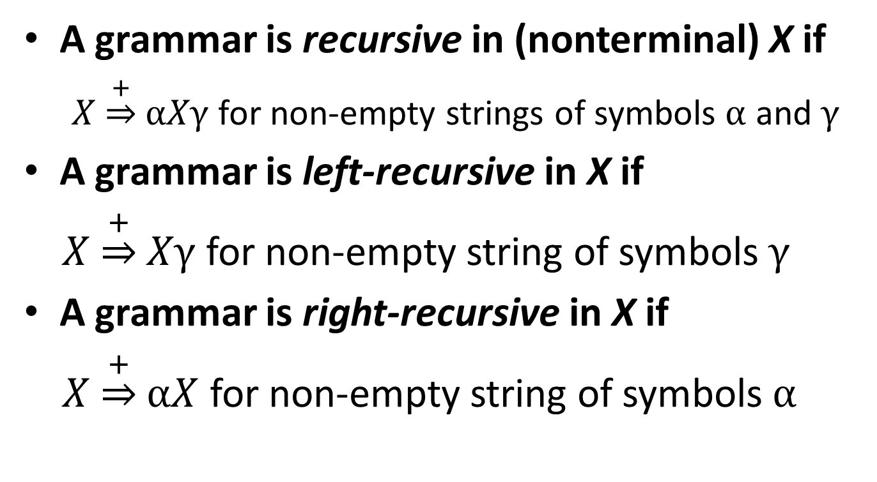
Definition: Recursion in Grammars
A grammar is recursive in (nonterminal) X if
$X\underset{⇒}{+}αXγ$ for non-empty strings of symbols $α$ and $γ$
A grammar is left-recursive in X if
$X\underset{⇒}{+}Xγ$ for non-empty string of symbols $γ$
A grammar is right-recursive in X if
$X\underset{⇒}{+}αX$ for non-empty string of symbols $α$

Slide 28
Resolving Grammar Ambiguity: Associativity
We’ll recognize left-associative operators with left-associative productions
We’ll recognize right-associative operators with right-associative productions
Term
Example: 4 – 7 – 9
Expr → Expr minus Expr
| Term
Term → Term times Term
| Factor
Factor → intlit | lparen Expr rparen
E
E
-
T
Factor
T
F
E
-
T
F
intlit
F
intlit
9
7
intlit
4

Slide 29
Resolving Grammar Ambiguity: Associativity
Expr → Expr minus Term
| Term
Term → Term times Factor
| Factor
Factor → intlit | lparen Expr rparen
Example: 4 – 7 – 9
Let’s try to re-build the wrong parse tree again
E
E
-
T
T
We’ll never be able to derive minus
without parens
F
intlit
4

Slide 30
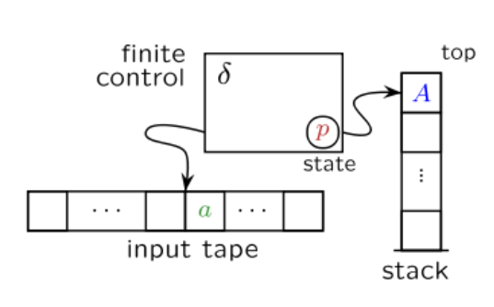
Pushdown Automata (PDA)s
Can be used to recognize Context-Free Grammars
Looks at
Current state p
Current input token a
Current stack symbol s
Moves to
Next state p’
Pop stack symbol A
Push stack symbol A’

Slide 31
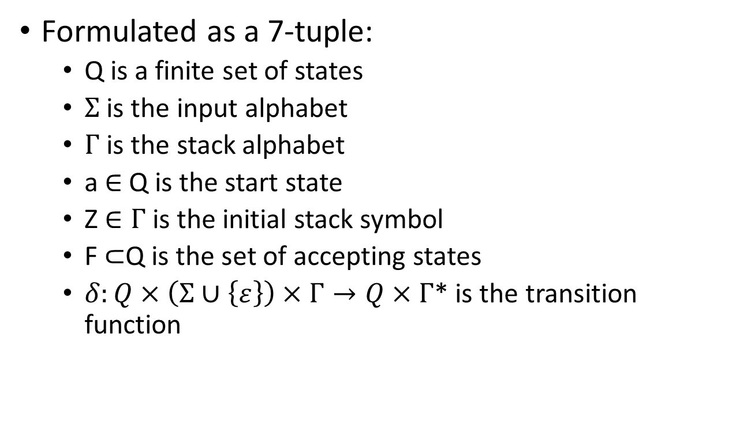
CFG Recognition
Formulated as a 7-tuple:
Q is a finite set of states
$Σ$ is the input alphabet
$Γ$ is the stack alphabet
a $∈$ Q is the start state
Z $∈Γ$ is the initial stack symbol
F $⊂$Q is the set of accepting states
$δ:Q×\left(Σ∪\left\{ε\right\}\right)×Γ→Q×Γ$* is the transition function

Slide 32
Nondeterminism in PDAs?
NPDAs and DPDAs both exist
Do NOT recognize the same class of languages:
NPDAs are strictly weaker!
Implies that (unlike FSMs), not every non-deterministic machine can be simulated by a deterministic one!
What this means for the compiler:
Language definition may be constrained by expressive power of the abstraction

Slide 33
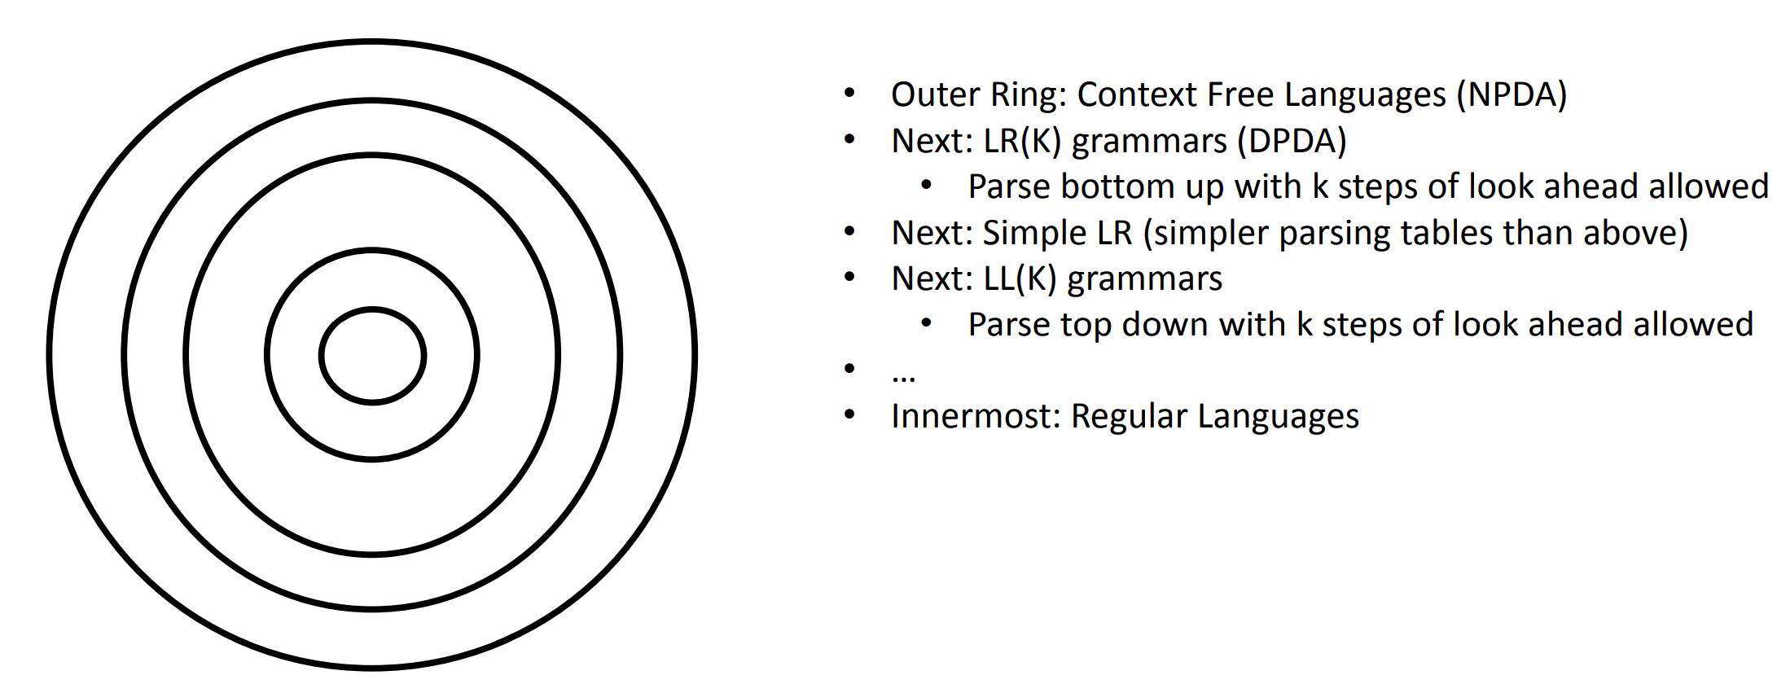
Relationship between CFGs Recognizers

Slide 34

Next Time…
Produce ASTs from Parse Trees

