Slide 1
Intro. to Data Mining
Chapter 1. Introduction

Slide 2

教师简介
王悦，博士
中央财经大学信息学院
计算机科学与技术系，副教授
研究方向：
数据库与知识工程
近期兴趣点：
自动化知识库搭建，强化学习/深度学习模型，信息抽取，图数据挖掘, 空间数据挖掘

Slide 3

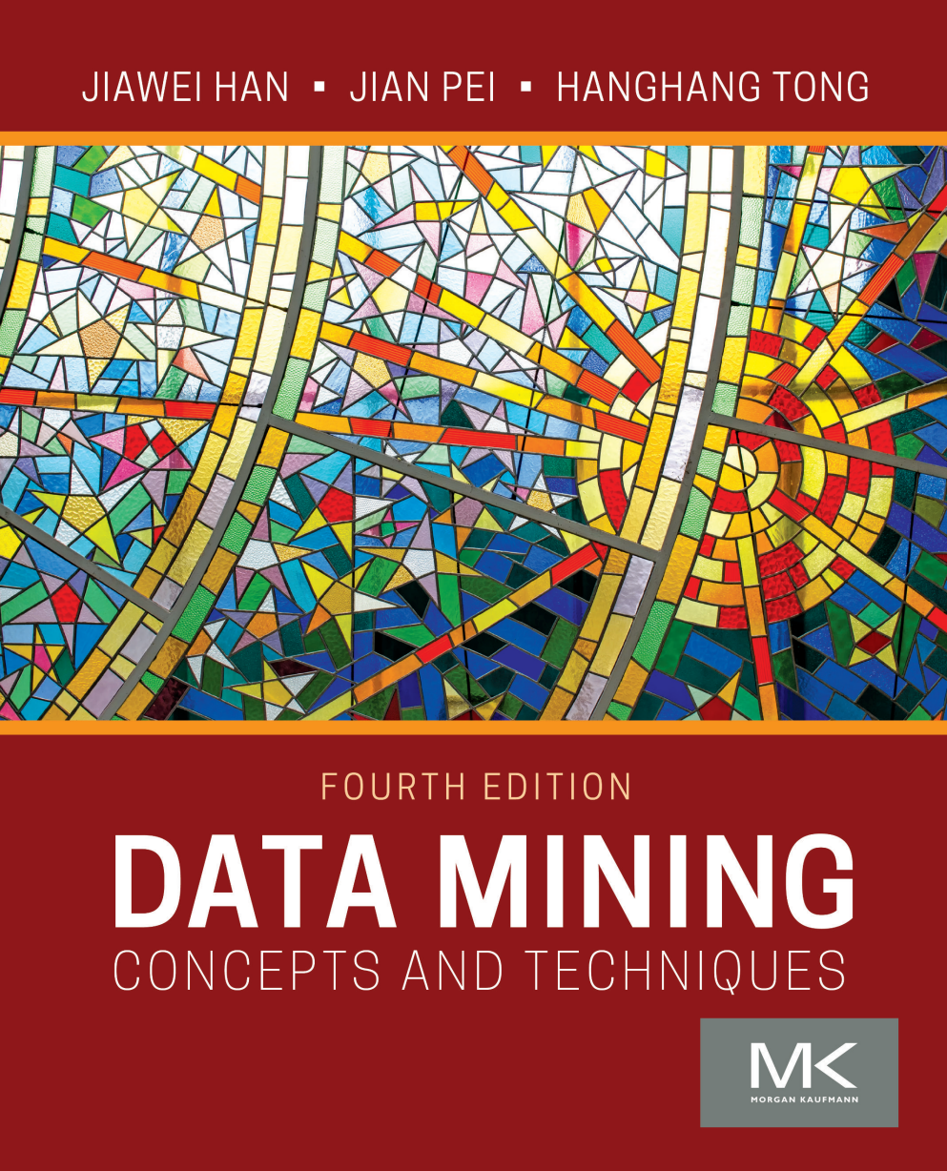


参考教材作者韩家炜老师
ICDM 2019
Beijing
本学期：Data Mining: Concepts and Techniques 4th edition
(22年7月底发行)
APWEB WAIM 2014
Macau

Slide 4
Chapter 1. Introduction
What Is Data Mining?
Data Mining: An Essential Step in Knowledge Discovery
Diversity of Data Types for Data Mining
Mining Various Kinds of Knowledge
Data Mining: Confluence of Multiple Disciplines
Data Mining and Applications
Data Mining and Society
Major Issues in Data Mining
A Brief History of Data Mining and Data Mining Society
Summary

Slide 5
What Is Data Mining?
We live in a world where vast amounts of data are generated constantly and rapidly
Data mining is the process of discovering interesting patterns, models and other kinds of knowledge in large data sets
  “Data mining”: a misnomer? It should be “knowledge mining from data”
  Other terms: Knowledge mining from data, KDD (Knowledge Discovery from Data), pattern discovery, knowledge extraction, data analytics, information harvesting
Data mining is a young, dynamic, and promising field
Example: Data mining turns a large collection of data into knowledge
  Google’s Flu Trends found a close relationship between the number of people who search for flu-related info. and the number of people who have flu symptoms
    It can estimate flu activity up to two weeks faster than traditional systems

Slide 6
Data Mining: An Essential Step in Knowledge Discovery
Knowledge Discovery Process
  Data preparation
    Data cleaning
    Data integration
    Data transformation
    Data selection
  Data mining
  Pattern/model evaluation
  Knowledge presentation

Slide 7
Diversity of Data Types for Data Mining (I)
Structured vs. unstructured data
  Structured: uniform, record- or table-like structures, defined by data dictionaries, with a fixed set of attributes, each with a fixed set of value ranges and semantic meaning
    Ex. Data stored in relational databases, data cubes, data matrices, and many data warehouses
  Semi-structured: allow a data object to contain a set value, a small set of heterogeneous typed values, or nested structures, or to allow the structure of objects or sub-objects to be defined flexibly and dynamically
  Data having certain structures with clearly defined semantic meaning, such as transactional data set, sequence data set (e.g., time-series data, gene or protein data, or Weblog data)
  Graph or network data: A more sophisticated type of semi-structured data set
  Unstructured data: text data and multimedia (e.g., audio, image, video) data
The real-world data can often be a mixture of structured, semi-structured data and unstructured data

Slide 8
Diversity of Data Types for Data Mining (II)
Data associated with different applications
  Different applications: different data sets and require different data analysis methods
    Sequence data: Biological sequences vs. shopping transaction sequences
    Time-series: ordered set of numerical values with equal time interval
    Spatial, temporal and spatiotemporal data
    Graph and network data: Social networks, computer communication networks, biological networks, and information networks may carry rather different semantics
  On the same data set, finding different kinds of patterns: require different mining methods
    Ex. software programs: finding plagiarized modules vs. finding copy-and-paste bugs
Stored vs. streaming data
  Stored data: Finite, stored in various kinds of large data repositories
  Streaming data (e.g., video surveillance or remote sensing): Dynamic, constantly coming, infinite, real-time response―posing challenges on effective data mining

Slide 9
Mining Various Kinds of Knowledge
Multidimensional Data Summarization
Mining Frequent Patterns, Associations, and Correlations
Classification and Regression for Predictive Analysis
Cluster Analysis
Deep Learning
Outlier Analysis
Are All Mining Results Interesting?

Slide 10
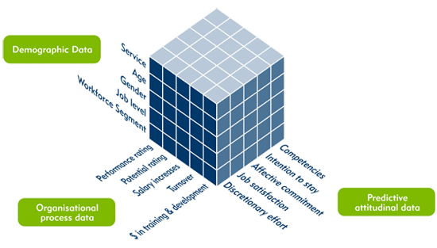
Multidimensional Data Summarization
Information integration and data warehouse construction
  Data cleaning, transformation, integration, and multidimensional data model
Data cube technology
  Scalable methods for computing (i.e., materializing) multidimensional aggregates
  OLAP (online analytical processing)
Multidimensional concept description: Characterization and discrimination
  Generalize, summarize, and contrast data characteristics, e.g., dry vs. wet region

Slide 11
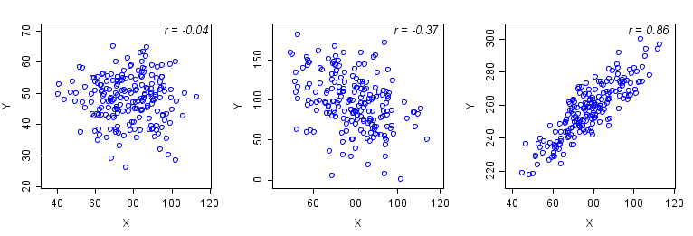
Pattern Discovery: Mining Frequent Patterns, Associations, and Correlations
Frequent patterns (or frequent itemsets)
  What items are frequently purchased together in your Walmart?
Association and Correlation Analysis
A typical association rule
    Diaper → Beer [0.5%, 75%] (support, confidence)
  Are strongly associated items also strongly correlated?
How to mine such patterns and rules efficiently in large datasets?
How to use such patterns for classification, clustering, and other applications?

Slide 12
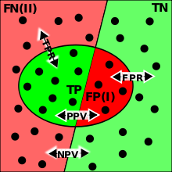
Classification and Regression for Predictive Analysis
Classification and label prediction
  Construct models (functions) based on some training examples
  Describe and distinguish classes or concepts for future prediction
    Ex. 1. Classify countries based on (climate)
    Ex. 2. Classify cars based on (gas mileage)
  Predict some unknown class labels
Typical methods
  Decision trees, naïve Bayesian classification, support vector machines, neural networks, rule-based classification, pattern-based classification, logistic regression, …
Typical applications:
  Credit card fraud detection, direct marketing, classifying stars, diseases, web-pages, …

Slide 13
Cluster Analysis
Unsupervised learning (i.e., Class label is unknown)
Group data to form new categories (i.e., clusters), e.g., cluster houses to find distribution patterns
Principle: Maximizing intra-class similarity & minimizing interclass similarity
Many methods and applications

Slide 14
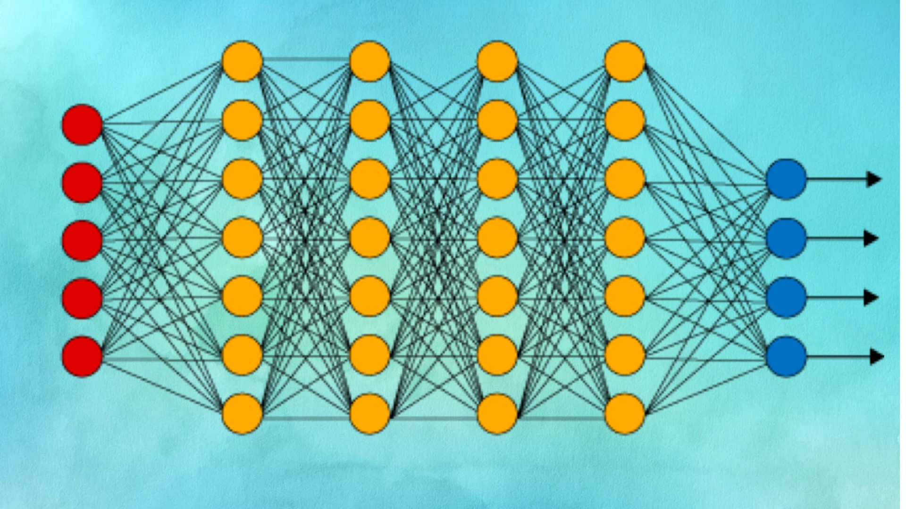
Deep Learning
Deep learning: A fast expanding dynamic frontier in machine learning
Deep learning has developed various neural network architectures
  Feed-forward neural networks
  Convolutional neural networks
  Recurrent neural networks
  Graph neural networks
  Transformer
Deep learning has broad applications in computer vision, natural language processing, machine translation, social network analysis, and so on
Deep learning has been reshaping a variety of data mining tasks
  Ex. classification, clustering, outlier detection, and reinforcement learning

Slide 15
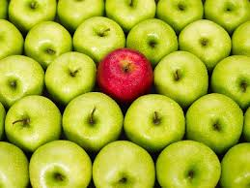
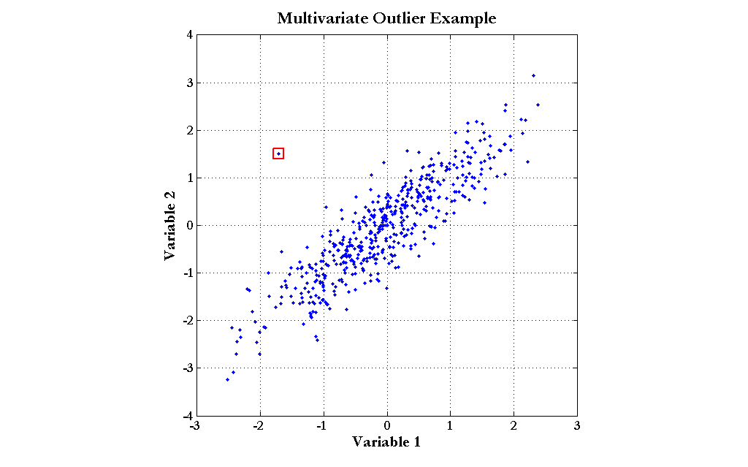
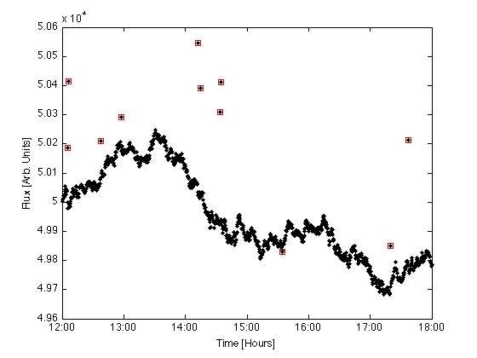
Outlier Analysis
Outlier analysis
  Outlier: A data object that does not comply with the general behavior of the data
  Noise or exception?―One person’s garbage could be another person’s treasure
  Methods: by product of clustering or regression analysis, …
  Useful in fraud detection, rare events analysis

Slide 16

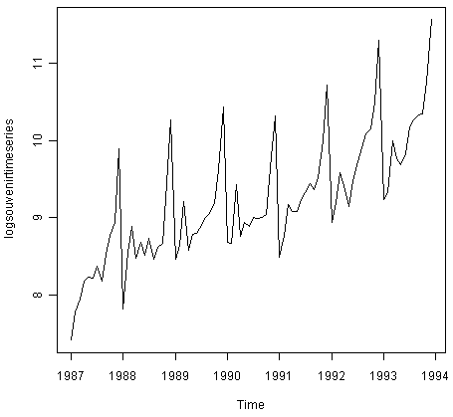
Other Data Mining Functions: Time and Ordering: Sequential Pattern, Trend and Evolution Analysis
Sequence, trend and evolution analysis
  Trend, time-series, and deviation analysis
    e.g., regression and value prediction
  Sequential pattern mining
    e.g., buy digital camera, then buy large memory cards
  Periodicity analysis
  Motifs and biological sequence analysis
    Approximate and consecutive motifs
  Similarity-based analysis
Mining data streams
  Ordered, time-varying, potentially infinite, data streams

Slide 17
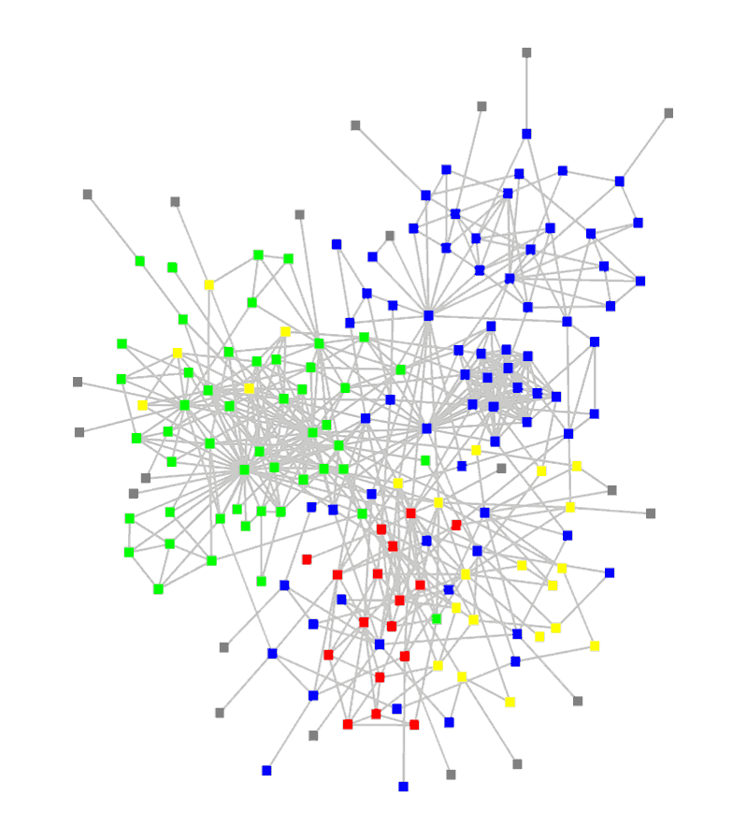
Other Data Mining Functions: Structure and Network Analysis
Graph mining
  Finding frequent subgraphs (e.g., chemical compounds), trees (XML), substructures (web fragments)
Information network analysis
  Social networks: actors (objects, nodes) and relationships (edges)
    e.g., author networks in CS, terrorist networks
  Multiple heterogeneous networks
    A person could be multiple information networks: friends, family, classmates, …
  Links carry a lot of semantic information: Link mining
Web mining
  Web is a big information network: from PageRank to Google
  Analysis of Web information networks
    Web community discovery, opinion mining, usage mining, …

Slide 18

Evaluation of Knowledge
Are all mined knowledge interesting?
  One can mine tremendous amount of “patterns”
  Some may fit only certain dimension space (time, location, …)
  Some may not be representative, may be transient, …
Evaluation of mined knowledge → directly mining only interesting knowledge?
  Descriptive vs. predictive
  Coverage
  Typicality vs. novelty
  Accuracy
  Timeliness
  …

Slide 19
Data Mining: Confluence of Multiple Disciplines

Slide 20
Why Confluence of Multiple Disciplines?
Tremendous amount of data
  Algorithms must be scalable to handle big data
High-dimensionality of data
  Micro-array may have tens of thousands of dimensions
High complexity of data
  Data streams and sensor data
  Time-series data, temporal data, sequence data
  Structure data, graphs, social and information networks
  Spatial, spatiotemporal, multimedia, text and Web data
  Software programs, scientific simulations
New and sophisticated applications
Notes:
Add a definition/description of “traditional data analysis”.

Slide 21

Data Mining and Applications
Web page analysis: classification, clustering, ranking
Collaborative analysis & recommender systems
Basket data analysis to targeted marketing如投资组合推荐
Biological and medical data analysis
Data mining and software engineering
Data mining and text analysis
Data mining and social and information network analysis
Built-in (invisible data mining) functions in Google, Microsoft, LinkedIn, Meta, …
Major dedicated data mining systems/tools
  SAS, MS SQL-Server Analysis Manager, Oracle Data Mining Tools)

Slide 22
Data Mining and Society
Data mining technology may benefit society KKD里面有一个专门的financial trunk
  Ex.: Help scientific discovery, business management, economy recovery, and security protection (e.g., the real-time discovery of intruders and cyberattacks)
Need to guard against the misuse of data mining 保护隐私
  Data mining also poses the risk of unintentionally disclosing some confidential business or government information and disclosing an individual’s personal information
Studies on data security in data mining and privacy-preserving data publishing and data mining are important, ongoing research theme
  The philosophy is to observe data sensitivity and preserve data security and people’s privacy while performing successful data mining
These and other related issues will be discussed throughout the book

Slide 23
Chapter 1. Introduction
Why Data Mining?
What Is Data Mining?
A Multi-Dimensional View of Data Mining
What Kinds of Data Can Be Mined?
What Kinds of Patterns Can Be Mined?
What Kinds of Technologies Are Used?
What Kinds of Applications Are Targeted?
Major Issues in Data Mining
A Brief History of Data Mining and Data Mining Society
Summary

Slide 24
Major Issues in Data Mining (1)
Mining Methodology
  Mining various and new kinds of knowledge
  Mining knowledge in multi-dimensional space
  Data mining: An interdisciplinary effort
  Boosting the power of discovery in a networked environment
  Handling noise, uncertainty, and incompleteness of data第二章讲
  Pattern evaluation and pattern- or constraint-guided mining
User Interaction
  Interactive mining
  Incorporation of background knowledge
  Presentation and visualization of data mining results

Slide 25
Major Issues in Data Mining (2)
Efficiency and Scalability
  Efficiency and scalability of data mining algorithms
  Parallel, distributed, stream, and incremental mining methods
Diversity of data types
  Handling complex types of data
  Mining dynamic, networked, and global data repositories
Data mining and society
  Social impacts of data mining
  Privacy-preserving data mining
  Invisible data mining

Slide 26
Chapter 1. Introduction
Why Data Mining?
What Is Data Mining?
A Multi-Dimensional View of Data Mining
What Kinds of Data Can Be Mined?
What Kinds of Patterns Can Be Mined?
What Kinds of Technologies Are Used?
What Kinds of Applications Are Targeted?
Major Issues in Data Mining
A Brief History of Data Mining and Data Mining Society
Summary

Slide 27
A Brief History of Data Mining Society
1989 IJCAI Workshop on Knowledge Discovery in Databases
  Knowledge Discovery in Databases (G. Piatetsky-Shapiro and W. Frawley, 1991)
1991-1994 Workshops on Knowledge Discovery in Databases
  Advances in Knowledge Discovery and Data Mining (U. Fayyad, G. Piatetsky-Shapiro, P. Smyth, and R. Uthurusamy, 1996)
1995-1998 International Conferences on Knowledge Discovery in Databases and Data Mining (KDD’95-98)
  Journal of Data Mining and Knowledge Discovery (1997)
ACM SIGKDD conferences since 1998 and SIGKDD Explorations
More conferences on data mining
  PAKDD (1997), PKDD (1997), SIAM-Data Mining (2001), (IEEE) ICDM (2001), WSDM (2008), etc.
ACM Transactions on KDD (2007)

Slide 28
Conferences and Journals on Data Mining
KDD Conferences
  ACM SIGKDD Int. Conf. on Knowledge Discovery in Databases and Data Mining (KDD)
  SIAM Data Mining Conf. (SDM)
  (IEEE) Int. Conf. on Data Mining (ICDM)
  European Conf. on Machine Learning and Principles and practices of Knowledge Discovery and Data Mining (ECML-PKDD)
  Pacific-Asia Conf. on Knowledge Discovery and Data Mining (PAKDD)
  Int. Conf. on Web Search and Data Mining (WSDM)
Other related conferences
  DB conferences: ACM SIGMOD, VLDB, ICDE, EDBT, ICDT, …
  Web and IR conferences: WWW, SIGIR, WSDM
  Big data field: IEEE Big Data
  ML conferences: ICML, NIPS
  PR conferences: CVPR, ICPR
Journals
  IEEE Trans. On Knowledge and Data Eng. (TKDE)
  ACM Trans. on KDD (TKDD)
  Data Mining and Knowledge Discovery (DAMI or DMKD)
  KDD Explorations

Slide 29
Where to Find References? DBLP, CiteSeer, Google
Data mining and KDD (SIGKDD)
  Conferences: ACM-SIGKDD, IEEE-ICDM, SIAM-DM, PKDD, PAKDD, etc.
  Journal: Data Mining and Knowledge Discovery, KDD Explorations, ACM TKDD
Database systems (SIGMOD)
  Conferences: ACM-SIGMOD, ACM-PODS, VLDB, IEEE-ICDE, EDBT, ICDT, DASFAA
  Journals: IEEE-TKDE, ACM-TODS/TOIS, JIIS, J. ACM, VLDB J., Info. Sys., etc.
AI & Machine Learning
  Conferences: Machine learning (ML), AAAI, IJCAI, COLT (Learning Theory), CVPR, NIPS, etc.
  Journals: Machine Learning, Artificial Intelligence, Knowledge and Information Systems, IEEE-PAMI, etc.
Web and IR
  Conferences: SIGIR, WWW, CIKM, etc.
  Journals: WWW: Internet and Web Information Systems,
Statistics
  Conferences: Joint Stat. Meeting, etc.
  Journals: Annals of statistics, etc.
Visualization
  Conference proceedings: CHI, ACM-SIGGraph, etc.
  Journals: IEEE Trans. visualization and computer graphics, etc.

Slide 30
Chapter 1. Introduction
Why Data Mining?
What Is Data Mining?
A Multi-Dimensional View of Data Mining
What Kinds of Data Can Be Mined?
What Kinds of Patterns Can Be Mined?
What Kinds of Technologies Are Used?
What Kinds of Applications Are Targeted?
Major Issues in Data Mining
A Brief History of Data Mining and Data Mining Society
Summary

Slide 31
Summary
Data mining: Discovering interesting patterns and knowledge from massive amount of data
A natural evolution of science and information technology, in great demand, with wide applications
A KDD process includes data cleaning, data integration, data selection, transformation, data mining, pattern evaluation, and knowledge presentation
Mining can be performed in a variety of data
Data mining functionalities: characterization, discrimination, association, classification, clustering, trend and outlier analysis, etc.
Data mining technologies and applications
Major issues in data mining

Slide 32
Recommended Reference Books
Charu C. Aggarwal, Data Mining: The Textbook, Springer, 2015
E. Alpaydin. Introduction to Machine Learning, 2nd ed., MIT Press, 2011
R. O. Duda, P. E. Hart, and D. G. Stork, Pattern Classification, 2ed., Wiley-Interscience, 2000
U. Fayyad, G. Grinstein, and A. Wierse, Information Visualization in Data Mining and Knowledge Discovery, Morgan Kaufmann, 2001
J. Han, M. Kamber, and J. Pei, Data Mining: Concepts and Techniques. Morgan Kaufmann, 3rd ed. , 2011
T. Hastie, R. Tibshirani, and J. Friedman, The Elements of Statistical Learning: Data Mining, Inference, and Prediction, 2nd ed., Springer, 2009
T. M. Mitchell, Machine Learning, McGraw Hill, 1997
P.-N. Tan, M. Steinbach and V. Kumar, Introduction to Data Mining, Wiley, 2005 (2nd ed. 2016)
I. H. Witten and E. Frank, Data Mining: Practical Machine Learning Tools and Techniques with Java Implementations, Morgan Kaufmann, 2nd ed. 2005
Mohammed J. Zaki and Wagner Meira Jr., Data Mining and Analysis: Fundamental Concepts and Algorithms 2014

Slide 33


