Slide 1
Which Mutual-Information Representation Learning Objectives are Sufficient for Control?
https://arxiv.org/pdf/2106.07278.pdf
tl;dr: I(Zt+1;Zt,At) is sufficient, but
I(Zt+k; Zt) or I(At; Zt+k|Zt) is not

Slide 2
Figure 1

Slide 3
Important Points
1. “Forward information” contains max info and is sufficient
Lemma 1: You can predict the reward function using forward information
Lemma 2: Z contains as much information as S, hence sufficiency
2. Tuning the temperature parameter in InfoNCE helps
3. Implicit feature modification removes “easy” features during training by maximizing the InfoNCE loss

Slide 4
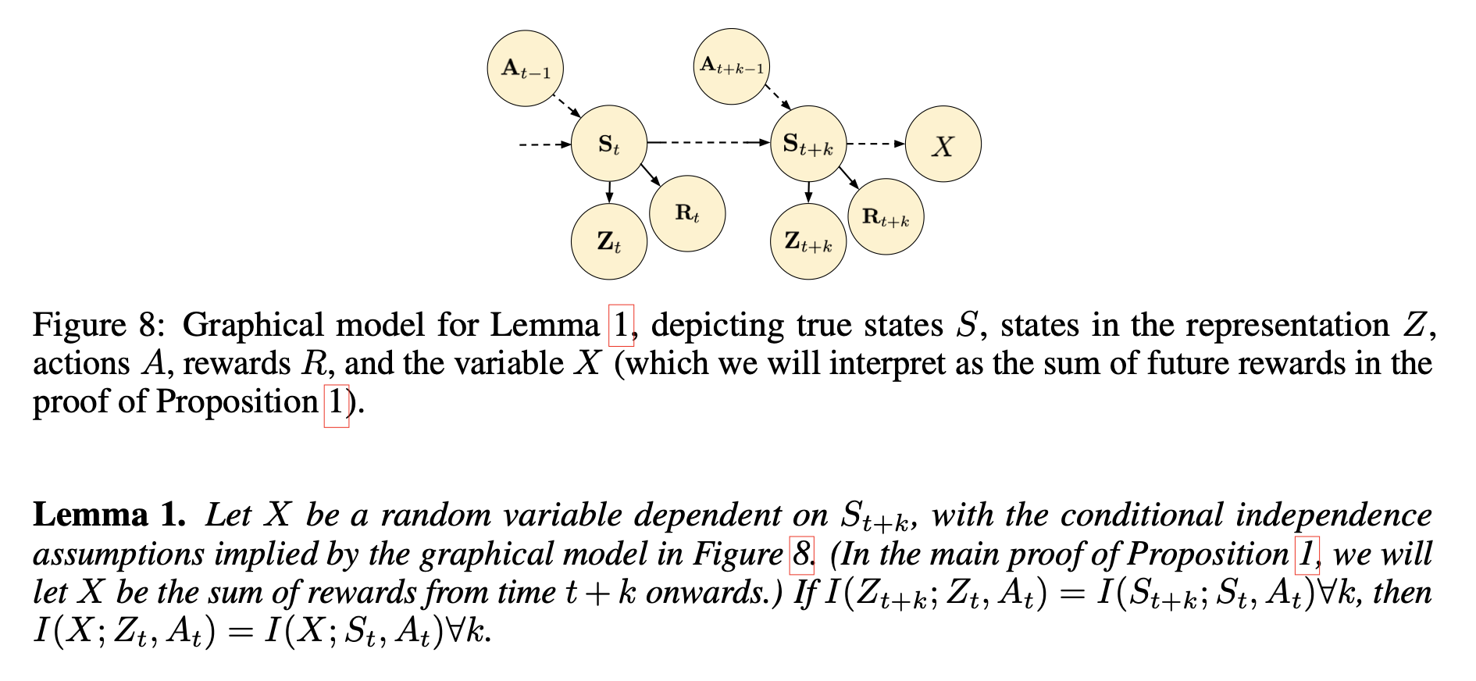
Proof of Lemma 1 cause the proof is graphical and easy to present

Slide 5
Figure 2

