Slide 1
Epidemic Control with Reinforcement Learning
Qiyao Wei
Romina Abachi
Ehsan Mehralian
Notes:
版权声明：300套精品模板商业授权，请联系【锐旗设计】:https://9ppt.taobao.com，专业PPT老师为你解决所有PPT问题！

Slide 2
CONTENTS
01
02
03
04
SIR Model
Single node
Network
Further
Notes:
版权声明：300套精品模板商业授权，请联系【锐旗设计】:https://9ppt.taobao.com，专业PPT老师为你解决所有PPT问题！

Slide 3
01
SIR Model

Slide 4
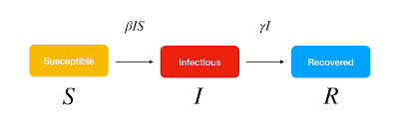
SIR Model Diagram
Source: https://www.google.com/imgres?imgurl=https%3A%2F%2Fwww.lewuathe.com%2Fassets%2Fimg%2Fposts%2F2020-03-11-covid-19-dynamics-with-sir-model%2Fsir.png&imgrefurl=https%3A%2F%2Fwww.lewuathe.com%2Fcovid-19-dynamics-with-sir-model.html&tbnid=MGGvj3NpXEuxzM&vet=12ahUKEwiGtanUu-HsAhW5hEsFHRhZDDQQMygCegUIARClAQ..i&docid=Kzhci_GewKdHiM&w=2628&h=808&q=sir%20model%20diagram&ved=2ahUKEwiGtanUu-HsAhW5hEsFHRhZDDQQMygCegUIARClAQ

Slide 5
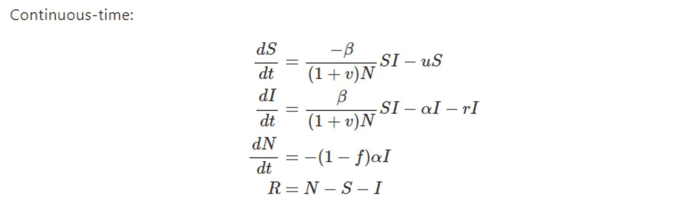
Parameter Reference
Beta: transmission coefficient (susceptible becoming infectious)
Alpha: rate of infectives leaving the infected class
f: proportion of infectives recovering, with the remainder dying of infection (think of this as a “subset” of alpha)
u, v, r: control variables/actions
Moment of caution: I will use the term “return” to represent the returns in training, and I will use the term “reward” and “penalty” interchangeably to represent the returns in evaluation.
Source: https://www.maa.org/press/periodicals/loci/joma/the-sir-model-for-spread-of-disease-the-differential-equation-model

Slide 6
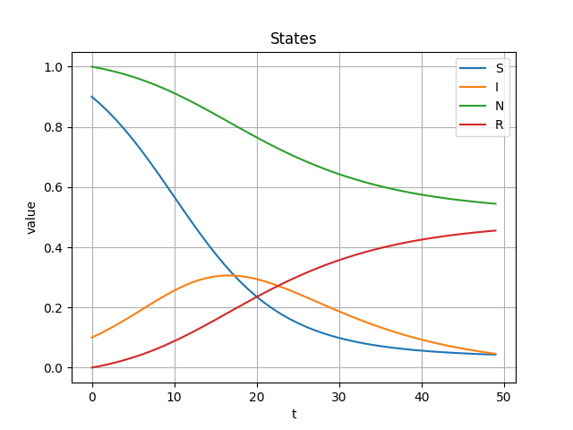
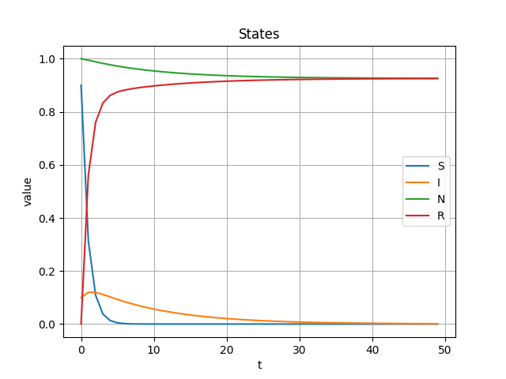
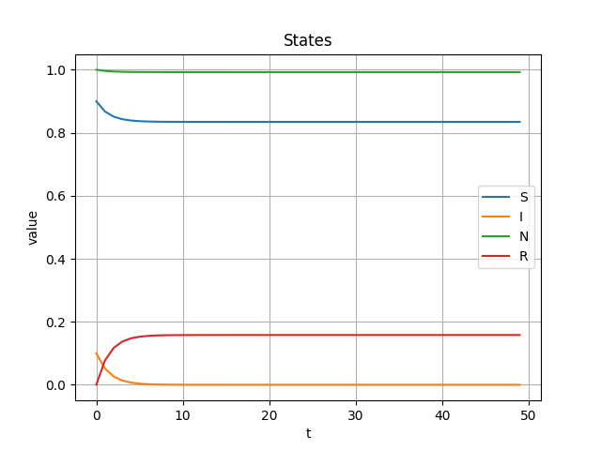
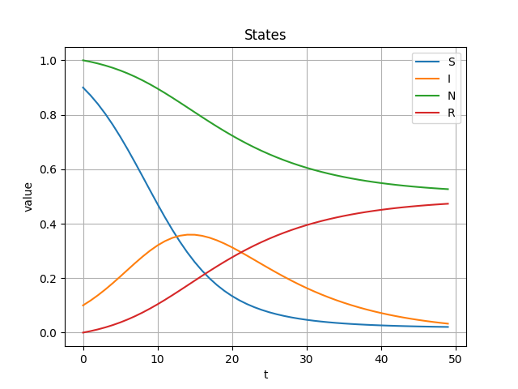

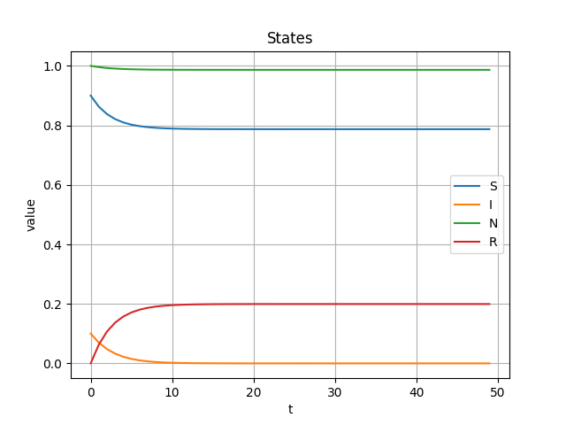
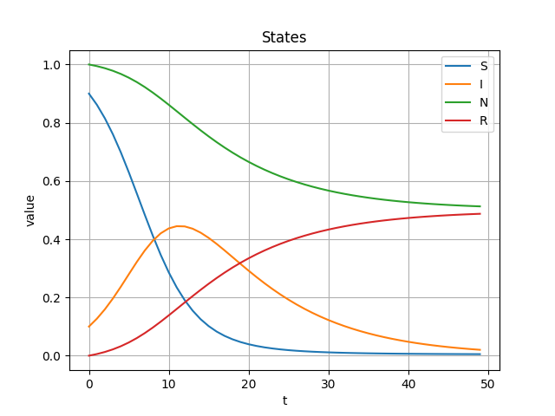
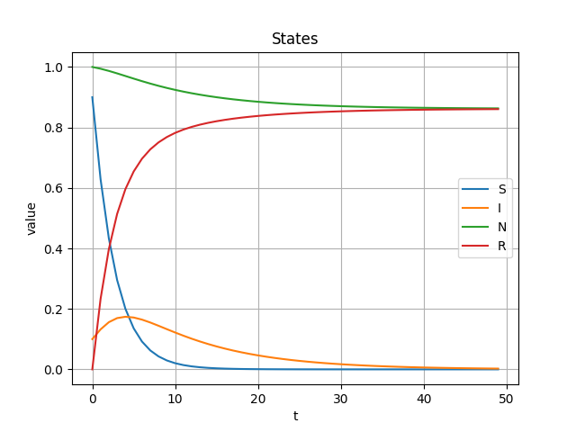
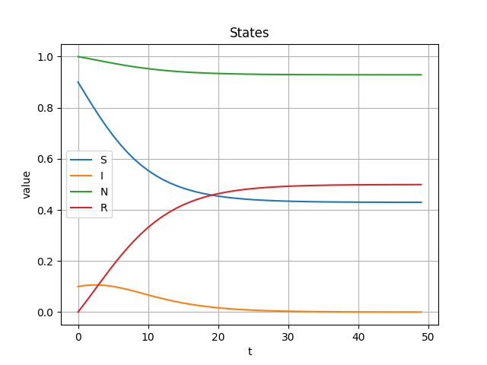
SIR Evolution
v (inform public)
u (vaccination)
r (quarantine)
action = 1
action = 0.7
action = 0.3

Slide 7
02
Single node

Slide 8
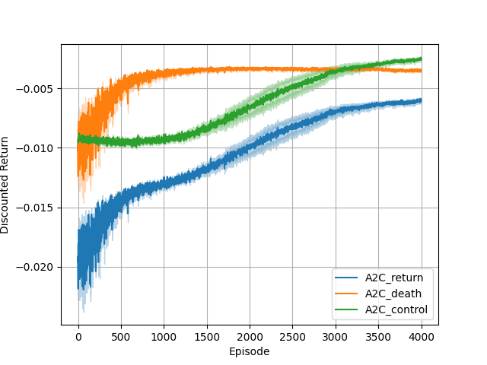
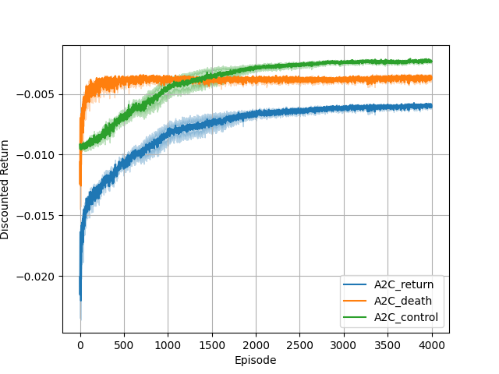
Training Returns
Beta A2C
Beta PPO
Notes:
版权声明：300套精品模板商业授权，请联系【锐旗设计】:https://9ppt.taobao.com，专业PPT老师为你解决所有PPT问题！

Slide 9
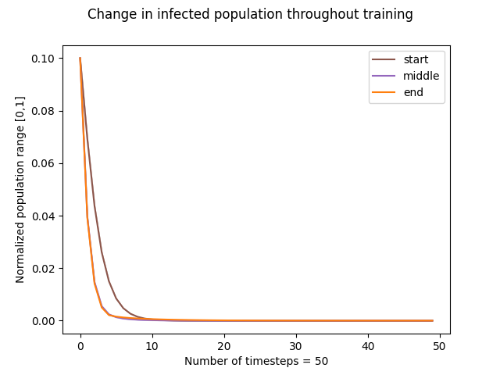
Change in infected
Beta A2C
Evaluated at
timestep 0 (start),
100e3 (middle),
and 200e3 (end)
Notes:
版权声明：300套精品模板商业授权，请联系【锐旗设计】:https://9ppt.taobao.com，专业PPT老师为你解决所有PPT问题！

Slide 10
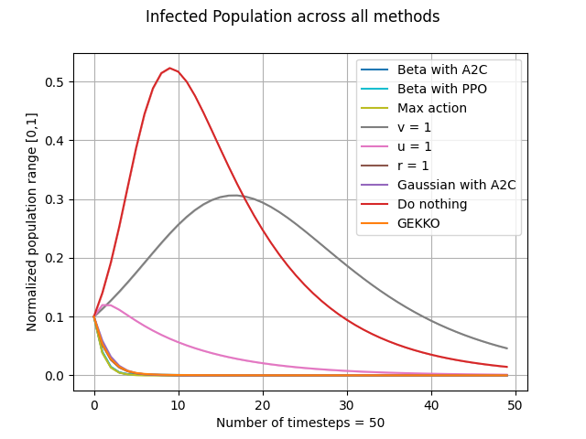
Infected Population
Sampled over 50 timesteps
Most ”good” control curves
overlap, since they control the
infected population right away
Notes:
版权声明：300套精品模板商业授权，请联系【锐旗设计】:https://9ppt.taobao.com，专业PPT老师为你解决所有PPT问题！

Slide 11
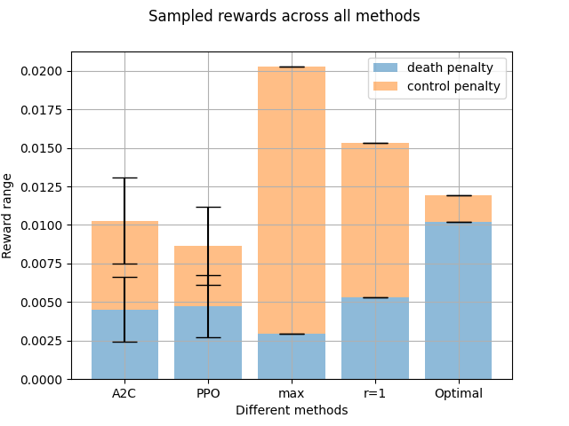
Sampled Rewards
Our agent can outperform
optimal control policy (GEKKO)
We did not include Gaussian
because it has a high variance.
We did not include v = 1 and
u = 1 heuristics because their
penalties are too high
Notes:
版权声明：300套精品模板商业授权，请联系【锐旗设计】:https://9ppt.taobao.com，专业PPT老师为你解决所有PPT问题！

Slide 12
03
Network

Slide 13
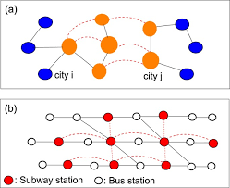
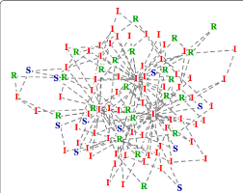
SIR Network Diagram
Source: https://www.google.com/imgres?imgurl=https%3A%2F%2Fwww.researchgate.net%2Fpublication%2F317711741%2Ffigure%2Ffig3%2FAS%3A614016938422276%401523404454318%2FExample-of-an-epidemic-situation-by-applying-SIR-model-to-scale-free-network-Snapshot-of.png&imgrefurl=https%3A%2F%2Fwww.researchgate.net%2Ffigure%2FExample-of-an-epidemic-situation-by-applying-SIR-model-to-scale-free-network-Snapshot-of_fig3_317711741&tbnid=RNO3vUDdvzsNiM&vet=12ahUKEwjjmeiMk-PsAhVMYpQKHYN5DnEQMygDegUIARCnAQ..i&docid=DRHVxLrflez25M&w=689&h=546&q=sir%20model%20network%20diagram&ved=2ahUKEwjjmeiMk-PsAhVMYpQKHYN5DnEQMygDegUIARCnAQ
Source: https://www.google.com/imgres?imgurl=https%3A%2F%2Fmedia.springernature.com%2Fm685%2Fspringer-static%2Fimage%2Fart%253A10.1038%252Fsrep11401%2FMediaObjects%2F41598_2015_Article_BFsrep11401_Fig1_HTML.jpg&imgrefurl=https%3A%2F%2Fwww.nature.com%2Farticles%2Fsrep11401&tbnid=QFFperaFoY4_IM&vet=12ahUKEwjjmeiMk-PsAhVMYpQKHYN5DnEQMygXegUIARDQAQ..i&docid=3minOJOdq7xAcM&w=685&h=559&q=sir%20model%20network%20diagram&ved=2ahUKEwjjmeiMk-PsAhVMYpQKHYN5DnEQMygXegUIARDQAQ

Slide 14
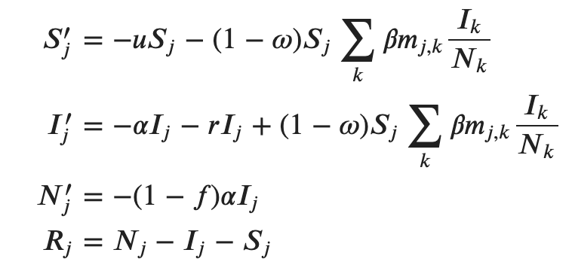
SIR Network Equations

Slide 15
Sanity Check (1)
1.0 | 0.0 | 0.0 | 0.0 | 0.0 | 0.0 | 0.0 | 0.0 | 0.0 | 0.0
0.0 | 0.5 | 0.5 | 0.0 | 0.0 | 0.0 | 0.0 | 0.0 | 0.0 | 0.0
0.0 | 0.5 | 0.4 | 0.1 | 0.0 | 0.0 | 0.0 | 0.0 | 0.0 | 0.0
0.0 | 0.0 | 0.1 | 0.7 | 0.2 | 0.0 | 0.0 | 0.0 | 0.0 | 0.0
0.0 | 0.0 | 0.0 | 0.2 | 0.0 | 0.8 | 0.0 | 0.0 | 0.0 | 0.0
0.0 | 0.0 | 0.0 | 0.0 | 0.8 | 0.2 | 0.0 | 0.0 | 0.0 | 0.0
0.0 | 0.0 | 0.0 | 0.0 | 0.0 | 0.0 | 0.0 | 1.0 | 0.0 | 0.0
0.0 | 0.0 | 0.0 | 0.0 | 0.0 | 0.0 | 1.0 | 0.0 | 0.0 | 0.0
0.0 | 0.0 | 0.0 | 0.0 | 0.0 | 0.0 | 0.0 | 0.0 | 0.9 | 0.1
0.0 | 0.0 | 0.0 | 0.0 | 0.0 | 0.0 | 0.0 | 0.0 | 0.1 | 0.9
S_0
5000 | 4500 | 4500 | 4000 | 4000 | 3000 | 2000 | 1000 | 500 | 500
I_0
0 | 500 | 500 | 1000 | 1000 | 2000 | 3000 | 4000 | 4500 | 4500
Notes:
版权声明：300套精品模板商业授权，请联系【锐旗设计】:https://9ppt.taobao.com，专业PPT老师为你解决所有PPT问题！

Slide 16
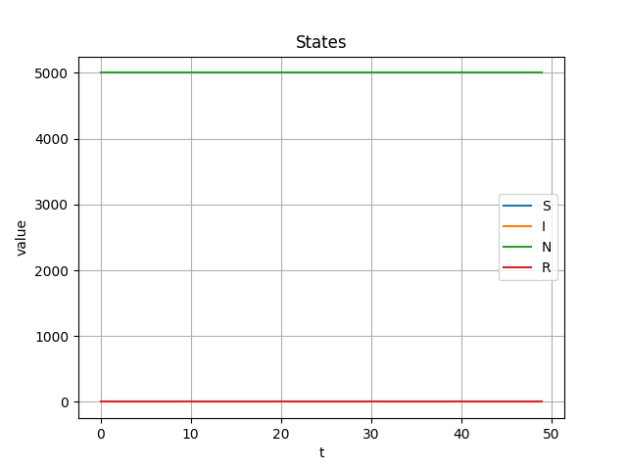
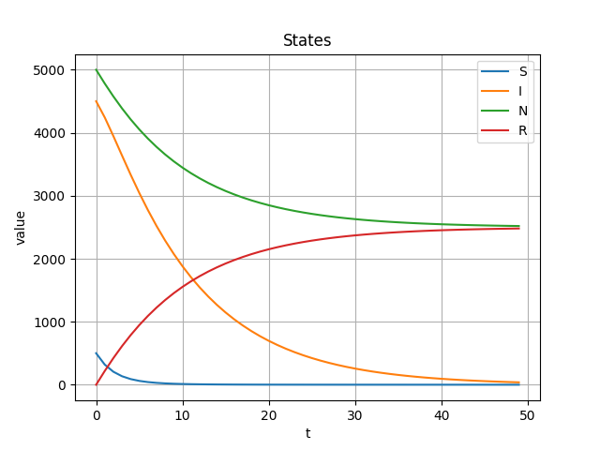
Sanity Check (2)
node0
node8
node9
Node 0 does not experience the epidemic, which is expected
Node 8 and 9 are the most affected, since they start off with a high infected population
Node 8 and 9 have identical SIR curves, which is expected
Notes:
版权声明：300套精品模板商业授权，请联系【锐旗设计】:https://9ppt.taobao.com，专业PPT老师为你解决所有PPT问题！

Slide 17
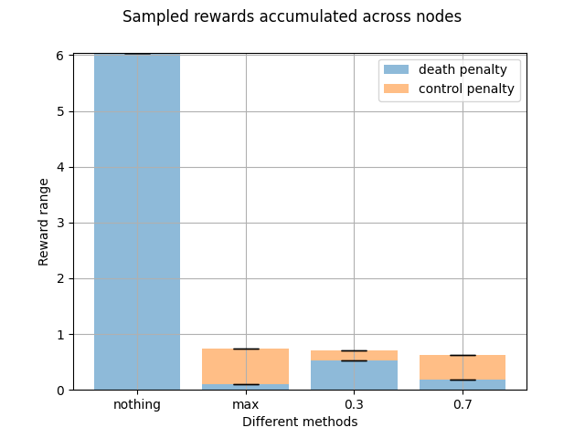
Sampled Rewards
Notes:
版权声明：300套精品模板商业授权，请联系【锐旗设计】:https://9ppt.taobao.com，专业PPT老师为你解决所有PPT问题！

Slide 18
04
Future Directions

Slide 19
Future Directions
1. Design heuristic tests on the network formulation, and make sure they work with our expectations.
2. Test the network on real data

