Slide 1
Replacing Rewards with Examples: Example-Based Policy Search via Recursive Classification
arxiv.org/pdf/2103.12656.pdf
tl;dr: transform example-based learning into
actor-critic style value-based learning

Slide 2
Disclaimer
I have decided not to use any formulas in this presentation, otherwise it would get too involved. I ask you to trust my language ability when I summarize the paper
But feel free to ask me further theoretical questions, since I think their “recursive classification” idea is novel

Slide 3
Background
Q. Has this been attempted before?
A. Yes! Behavioral cloning. Except BC still tries to learn a reward
Q. What about goal-conditioned learning?
A. More general, but based on C-Learning (Eysenbach et al 2021)
Q. ValueDICE (Kostrikov et al 2019) and SQIL (Reddy et al 2020)
A. Probabilistic formulation that does not rely on BC theory

Slide 4
Important Points
1. Only give success examples (i.e. states) and not trajectories (i.e. state-action pairs)
2. The algorithm learns a classifier that differentiates between “good” s-a pairs and s-a pairs from any “bad” random policy
3. Very similar to actor-critic methods, except the neural net learns to output probabilities rather than values
Specifically, I believe they directly modified the loss function of SAC
4. As a result, RCE satisfies (basically) the same Bellman Equations as reward-based updates

Slide 5
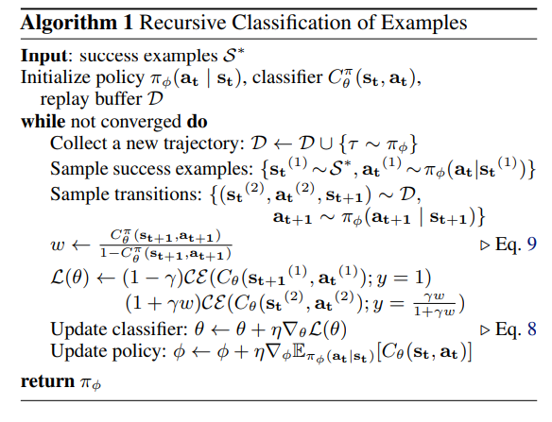
Algorithm

Slide 6
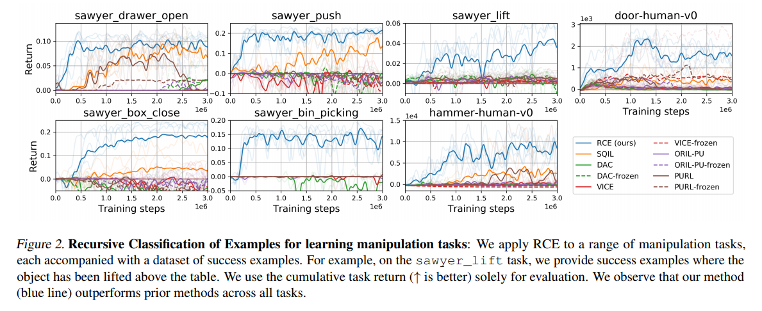
Experiments (1)

Slide 7
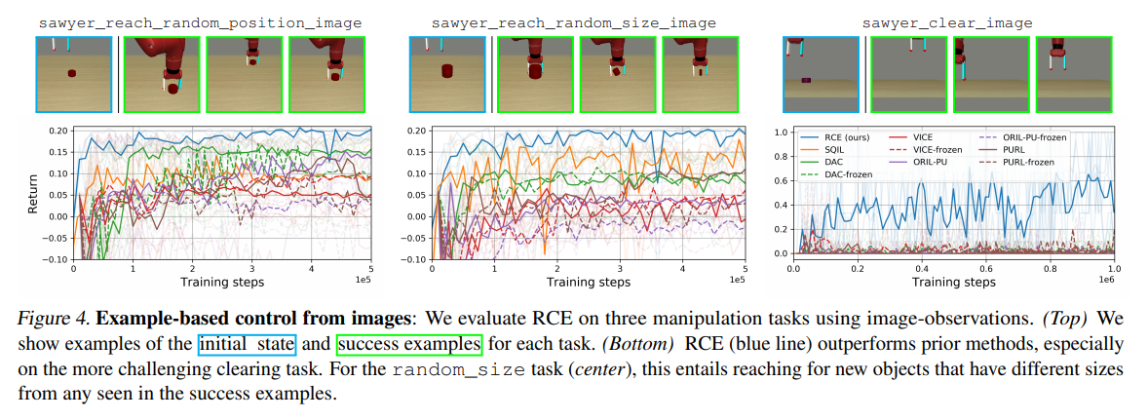
Experiments (2)

Slide 8
Future Directions
1. The authors observed phenomenons very similar to Q-function overestimation in their experiments. Since the classifier shares certain commonality with value-based update, this is a promising future direction of research on improving RCE
2. Even though this paper talks about a very interesting assumption about how the success examples are collected, I feel like they did not exploit the theoretical properties enough.

Slide 9
I really like this paragraph
This paper will also address a challenge in the formulation of example-based control: the probability that a particular state solves the task depends not only on whether the state was labeled as a success example, but also on the distribution used to select these success examples. Intuitively, some states might always solve the task while other states might rarely solve the task; without knowing how often the user visited each state, we cannot determine the likelihood that each state solves the task. Thus, an agent can only estimate the probability of success if they make an additional assumption about how the success examples were generated. This paper will discuss two choices of assumptions. The first choice of assumption is convenient from an algorithmic perspective, but sometimes violated in practice. A second choice is to resolve this ambiguity by taking a worst-case approach, a problem setting that we call robust example-based control. Our analysis shows that the robust example-based control objective is equivalent to minimizing the squared Hellinger distance (an f-divergence).

