Slide 1
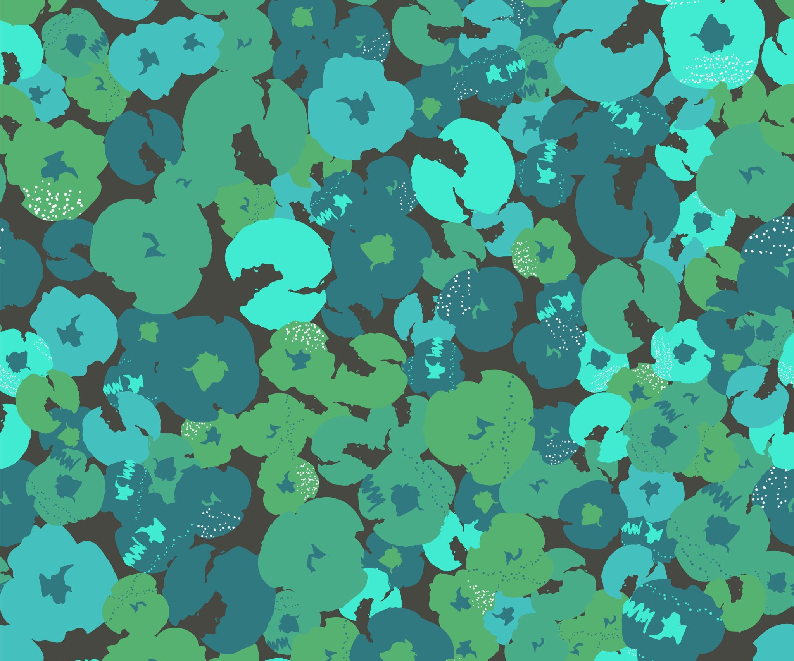
Face Mask Detection
9444
Group: A Group
Members: Jingyu Zhou, Jinzhe Li, Qiyao Zhou, Xiang Ji, Zihao Jiang

Slide 2
Introduction
Name:
Zid:

Slide 3
1
Introduction
Application scenario:
Widely used as a reminder or supervisor in places of life, transport and entertainment
Task:
Face Mask Detection
Neural Network method:
Vgg,Resnet18, Resnet34 and SelfNet
Optimization method:
Parameter optimization
（SGD and Adam)
UNSW

Slide 4
Datasets & DataLoaders
Name:
Zid:

Slide 5
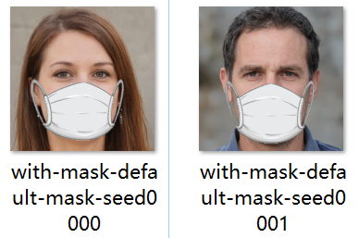
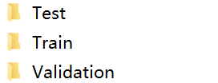
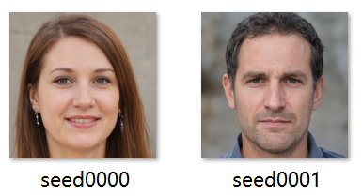

2
Datasets & DataLoaders
Total (color) images:4008
Data source and composition analysis:
Divided into:
-Two genres(with_mask and without_mask)
-Three datasets(train,test and validation)
UNSW

Slide 6
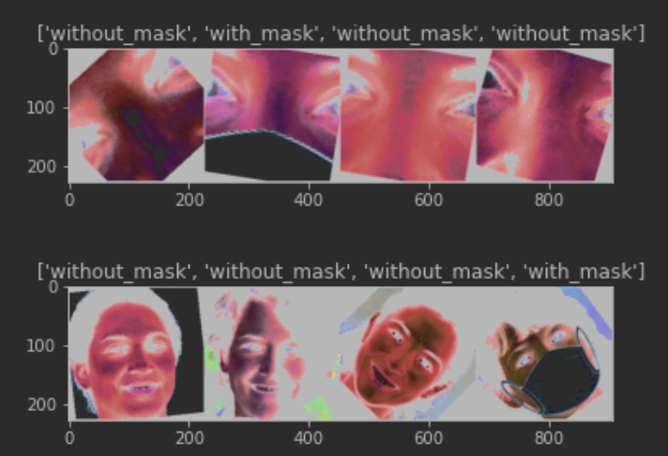
2
Datasets & DataLoaders
Methods we used for data enhancement:
Dataloader:
-cropping
-flipping
-rotation
-color changing
-normalization
-call data_transforms
-put the image data in the dataloader
-the bath size is set to 256
Why we choose a large batch size?
UNSW

Slide 7
Methods & Models
Name:
Zid:

Slide 8
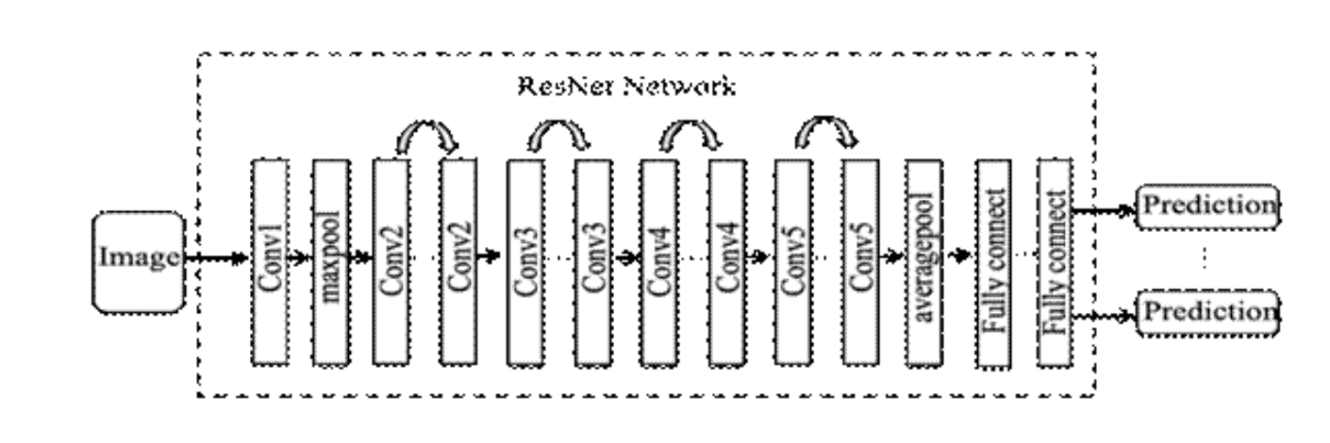
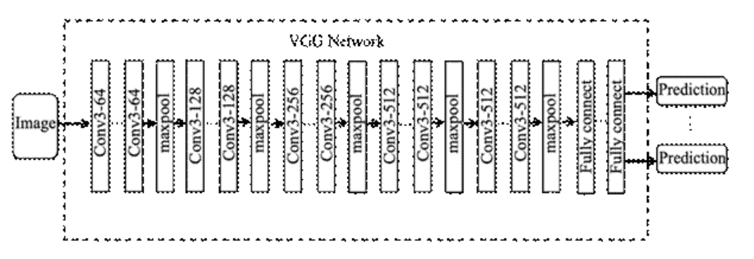
3
Methods & Models
ResNet
VGG
UNSW

Slide 9
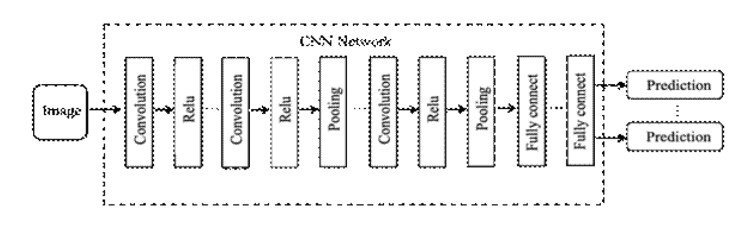
3
Methods & Models
-based on the vgg model
-keep the first two convolutional layers and the pooling layer
-relu activation function
SelfNet
UNSW

Slide 10
Result
Name: Qiyao Zhou
Zid: z5379852

Slide 11
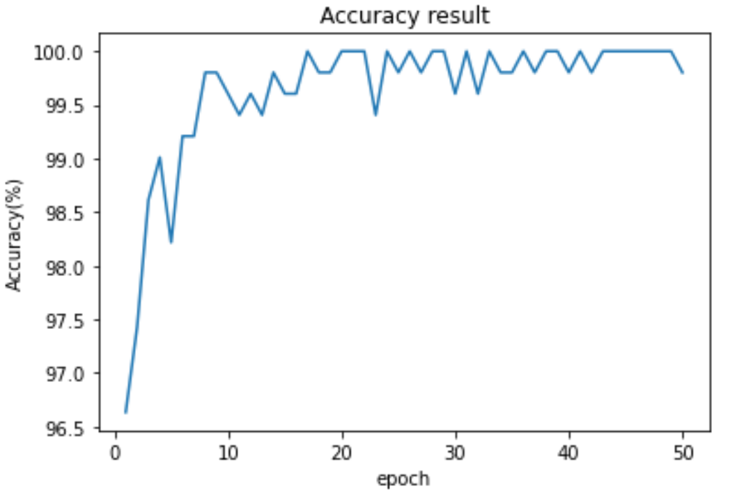
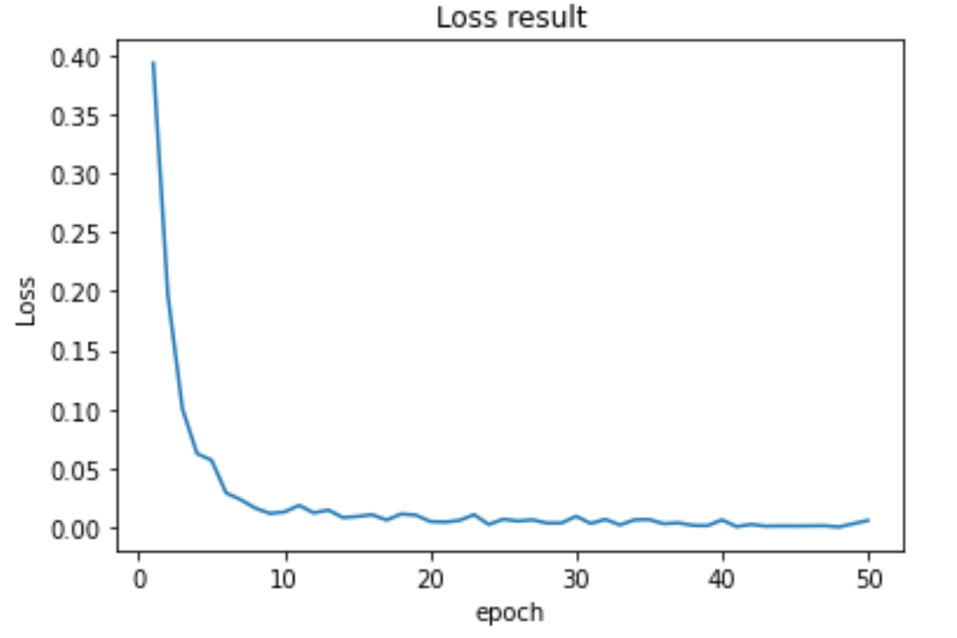
4
Result
-
UNSW

Slide 12
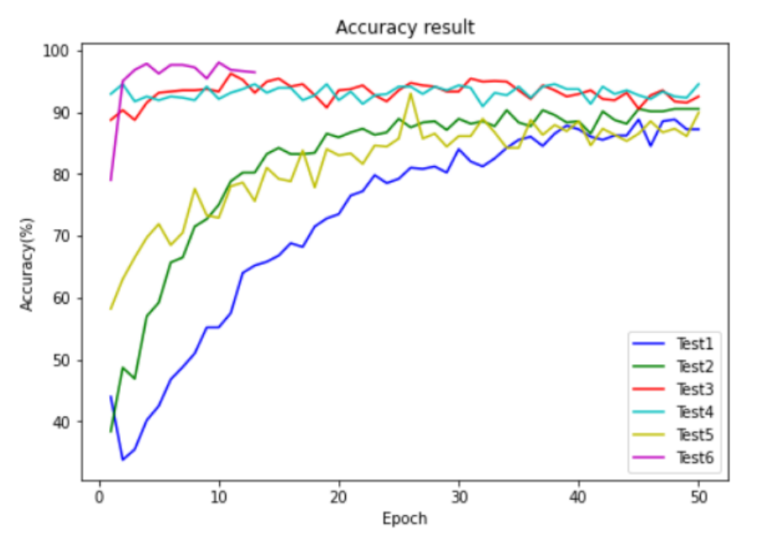
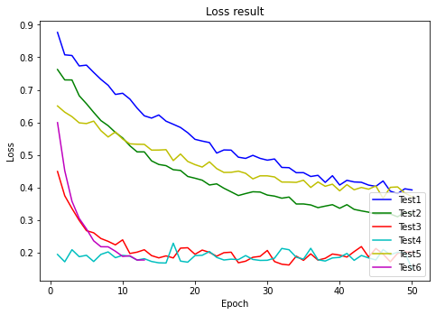
4
Result
-
UNSW

Slide 13
Result Analysis
Name:
Zid:

Slide 14

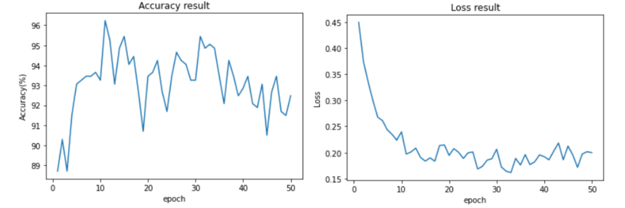
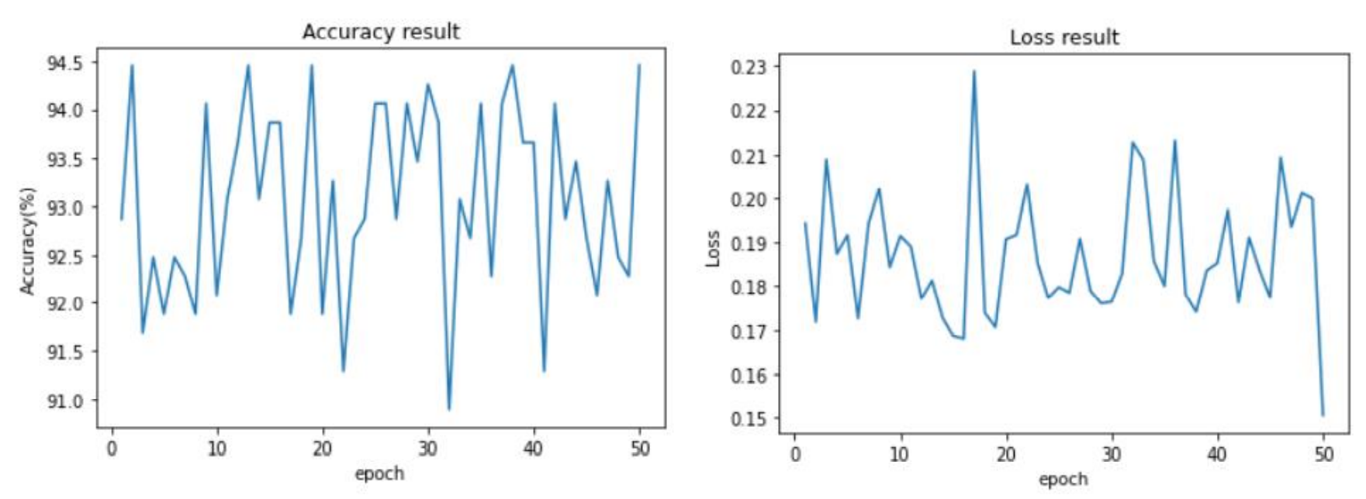
5
Result Analysis
High learning rate
(resnet18)
optimizer=SGD
(resmet18)
Unsuitable learning rates and optimizers can produce over-fitting
UNSW

Slide 15
5
Result Analysis
Improvements:
Expand the test scope
Add test training module for inappropriate mask-wearing
Add the CascadeClassifier module
-for real-time testing
Different sides of faces, mask types, etc.
Idealized dataset
UNSW

Slide 16
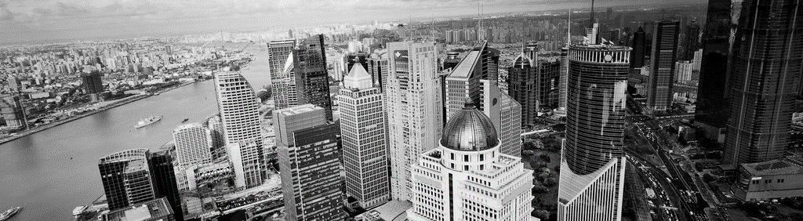

Thanks
Jingyu Zhou
Jinzhe Li
Qiyao Zhou
Xiang Ji
Zihao Jiang
UNSW

