Slide 1





Cross-Layer Optimisation for 4G Broadband Wireless Communication Networks
Supervisor: Dr Xu Zhu
Assessor: Prof Yi Huang
Presenter: Yang Zhao
sgyzha90@Liverpool.ac.uk
Cross-layer design
Maximum weighted sum capacity
OFDM system / downlink

Slide 2

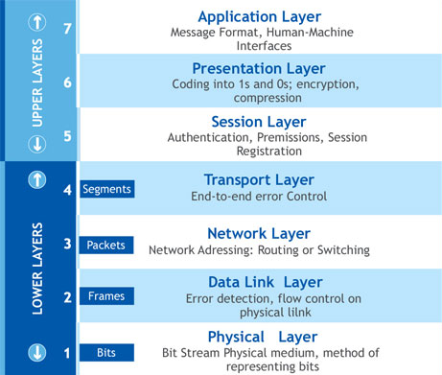


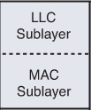

OSI Model -> Theory
Conventional OSI Model:
Layer
Service
Interface
Object-oriented design:
Clear structure, easy to maintain & modify
Low info exchange efficiency
Cross-layer optimisation!
Certiology, Inc, (2017). OSI Layer Model. [image] Available at: http://www.certiology.com/computing/computer-networking/osi-layer-model.html [Accessed 8 Dec. 2017].
Reference, sublayers, functions, general network structure
Upper->advanced
PHY and MAC: fundamental, commonly applied

Slide 3

Cross-layer Design -> Application
Remove the boundaries between layers
Access ‘private’ data of other layer
Dynamic feedback and compensation
Resource allocation (power + subcarrier)
Data scheduling
Why
Where
To utilise the spectrum and power efficiently
To exchange information and enable interaction
To meet requirements of different services
OFDM system with heterogeneous downlink traffic
PHY Layer
MAC Layer
What
How
In terms of Etas;
E.g. Voice -> low delay + high QoS priority / error
Data -> high delay + low QoS priority / error
Video -> medium delay + medium QoS priority / error
‘Friend’ class in programming;

Slide 4

Previous Research
1
Adaptive subcarrier bit and power allocation [1]
2
Joint subcarrier and power allocation algorithm [2]
Minimise the total transmit power with fixed data rate
Maximise the system capacity with fixed data rate
3
Serial scheduling: packets sequence decision scheme[3]
4
Modified largest weighted delay first scheduling [4]
Decrease the delay of voice packets and maximise total data throughput
Assign a higher priority to the queues with larger delay / higher data rate / more requirement for outage
5
Fairness criterion based on QoS satisfaction[5]
Maximise a utility function based on CSI, QoS, random packet arrivals and queue states

Slide 5

Resource Allocation at the PHY Layer: Subcarriers
Weighted Maximum Capacity
Weight -> important index
Weighted sum of all users’ capacity is to be maximised
Proportional Fairness
RA depends on QoS requirements
No data rate limitation for users
Balance the tradeoff between capacity and fairness by coefficients
Maximum Capacity
Users select subcarriers with high CNR
RA does not depend on QoS requirements
Subcarriers are allocated to users with the best channel gain
C maximized only with enough data
RA does not depend on QoS requirements
PF (download threads)
1. allocate the best subcarrier for users
2. update the data rate of users
3. if there are unassigned subcarrier, find user with the minimum data rate
4. assign that user with the best subcarrier among the rests

Slide 6
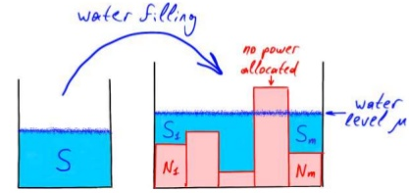

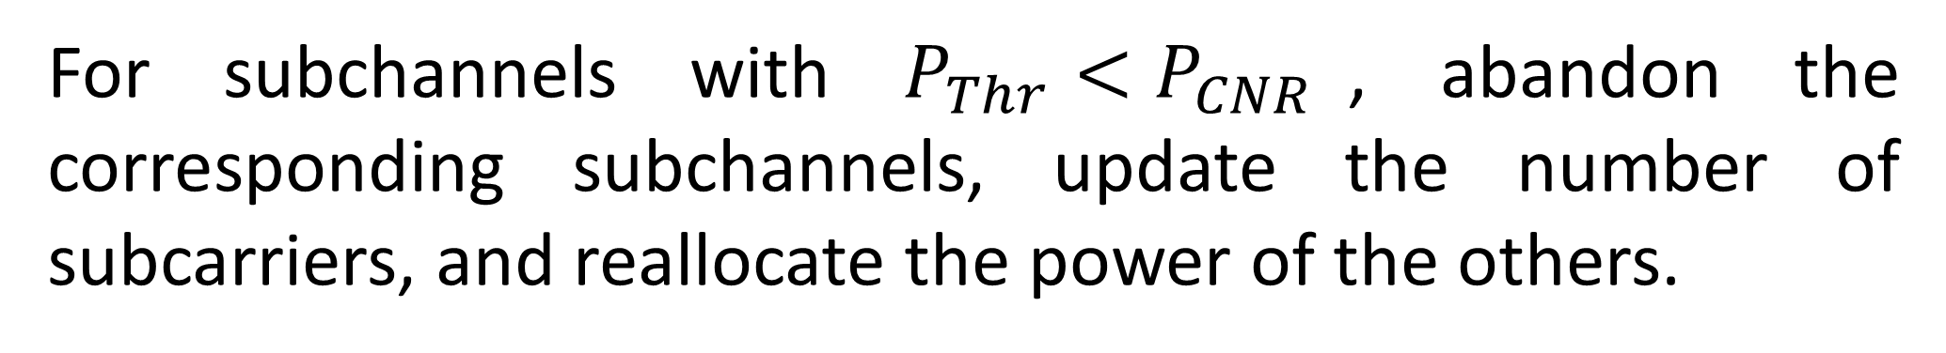
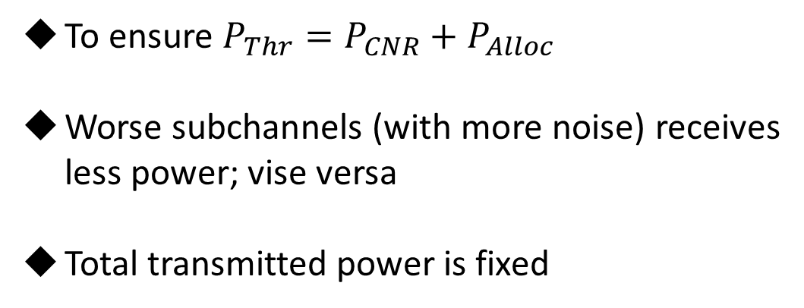
Resource Allocation at the PHY Layer: Power
Water-filling algorithm
To ensure $P_{Thr}=P_{CNR}+P_{Alloc}$
Worse subchannels (with more noise) receives less power; vise versa
Total transmitted power is fixed
Water level: a threshold value determined by the environment (fading or SNR)
Base: the state of subchannels (CNR)
Filled water: the power allocated to corresponding subcarriers
Weighted water-filling algorithm
Introduce weights to water-filling algorithm.
Power efficient: allocate power based on the subchannel state!
Sukhinov, A, (2015). Computational Linear Algebra in Wireless Communications. [image] Available at: https://www.slideshare.net/soukhinov/computational-linear-algebra-in-wireless-communications [Accessed 8 Dec. 2017].
For subchannels with $P_{Thr}<P_{CNR}$, abandon the corresponding subchannels, update the number of subcarriers, and reallocate the power of the others.

Slide 7
Data Scheduling at the MAC Layer
Queue-based modified largest weighted delay first
Packet dependent scheduling
Serve the packets on service nature, delay and queue length, combining with queue-based MWS scheme
Data is sent packet by packet with different weights: depends on QoS, delay and size of packet
Give priority to the queue with high data rate, delay, or outage probability
Suitable for multiuser system with different QoS requirements
More flexible based on packets rather than queues or channels
Better performance for urgent packets / diverse applications

Slide 8
Story So Far…
Background
Model design
Maximum capacity based subcarrier allocation
Water-filling algorithm based power allocation
More relevant articles
Further algorithm improvement
Introducing weights to existing outcomes
Proportional fairness scheme
Data scheduling (LWDF + PD)
Result analysis and explanation

Slide 9
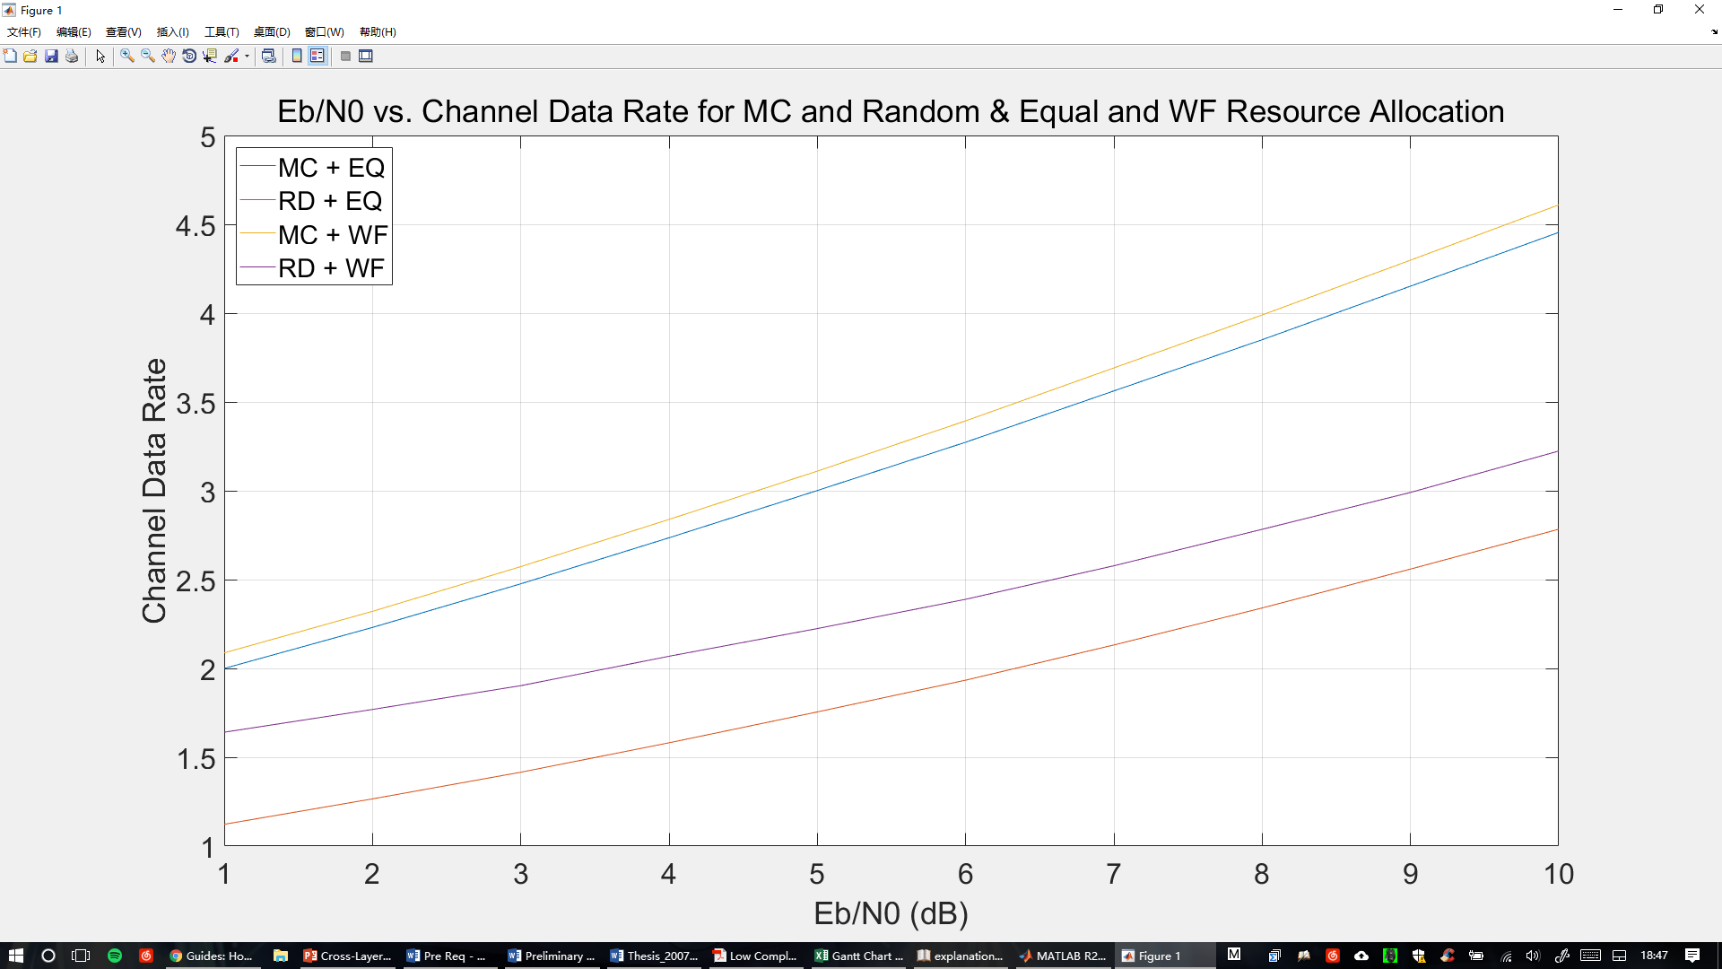
Sweet Results!
- Power Diff.
- Subcarrier Diff.
Maximum Capacity + Water-filling
Random Allocation + Water-filling
Maximum Capacity + Equal Power
Random Allocation + Equal Power

Slide 10

Reference
[1] C. Y. Wong, R. S. Cheng, K. B. Letaief, and R. D. Murch, “Multiuser OFDM with adaptive subcarrier, bit and power allocation,” IEEE JSAC, vol. 17, pp. 1747–1758, Oct. 1999.
[2] D. S. W. Hui, V. K. N. Lau, and W. H. Lam, “Cross-layer design for OFDMA wireless systems with heterogeneous delay requirements,” IEEE Trans. Wireless Commun., vol. 6, pp. 2872–2880, Aug. 2007.
[3] E. K. Bowdon, "Priority assignment in a network of computers," IEEETrans. Computers, vol. C-18, pp. 1021-1026, Nov. 1969.
[4] M. Andrews, K. Kumaran, K. Ramanan, A. Stolyar, P. Whiting, and R. Vijayakumar, “Providing quality of service over a shared wireless link,” IEEE Commun. Mag., vol. 2, pp. 150–154, Feb. 2001.
[5] Shen, Z., Andrews, J.G. & Evans, B.L. 2005, "Adaptive resource allocation in multiuser OFDM systems with proportional rate constraints", IEEE Transactions on Wireless Communications, vol. 4, no. 6, pp. 2726-2736.
Thank you!

