Slide 1
CSI3105 – Software Testing
Jarryd Wimbridge, QJ Stout-Spykers, Carl Wagner

Slide 2
Approach
Bottom up OO approach
Created CFGs and Intraclass diagrams
Used to identify DU-pairs within classes (unit testing) & between classes (integration testing)
Identified base classes and tiers
Identified Meeting as the base class

Slide 3
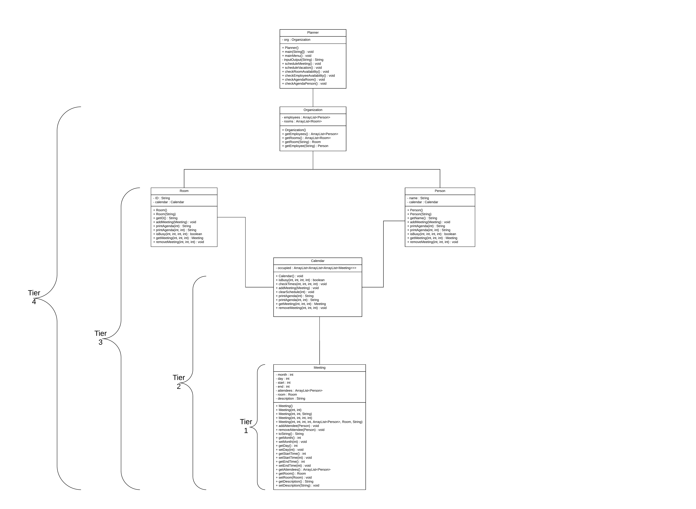

Slide 4
Results
Unit testing
StackOverFlowErrors in Planner.class
Multitude of triggers, recursive calls, mainMenu is primary culprit
Logic errors in Calendar.checkTimes
December innacessible
Logic errors in Calendar constructor
Blocks 30th of November
Leaves some invalid dates available

Slide 5
Results
Integration testing
Meeting default constructor
Attempting to add an attendee causes a NullPointerException
Duplicate attendees can be added to a single Meeting
Meeting.setDay()
Allows changing state of Rooms from valid to invalid

Slide 6
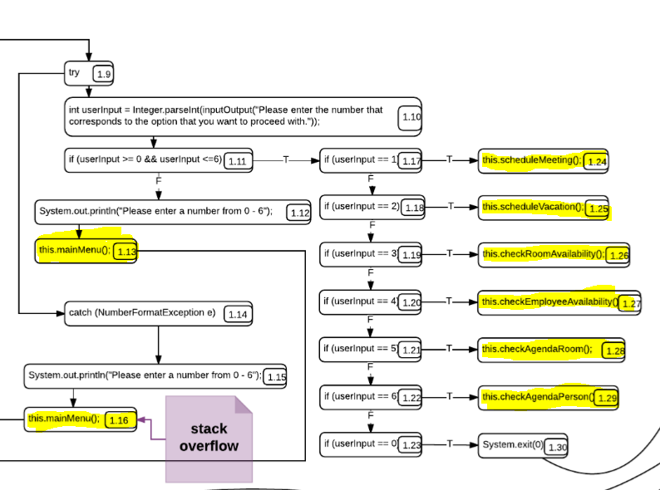
StackOverFlowErrors - mainMenu
Each this.mainMenu() adds a new instance to the stack
Each highlighted menu option adds an instance to the stack & adds an additional instance of mainMenu()

Slide 7
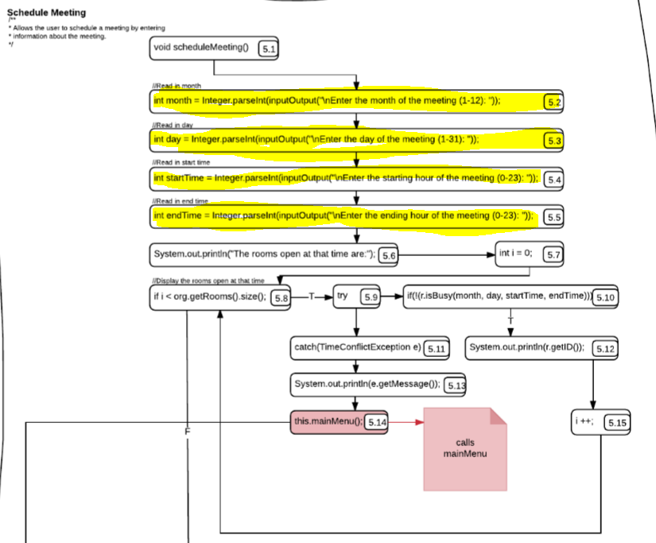
StackOverFlowErrors – Exception paths
Each highlighted menu option adds an instance to the stack & adds an additional instance of mainMenu()
Some paths throwing exceptions can remove the top 1-2 stackframes

Slide 8
Reflection – What went wrong
We began the assignment with a mindset of testing the entire system using blackbox techniques from top to bottom. WRONG
When we began to test from bottom up, we were essentially “method testing”. We still looked to apply BVA, EP to every method for the most part. WRONG
We believe we misidentified the base class.
Should be Organization
We realised we were taking the wrong approach too late to implement the correct approach in entirety.

Slide 9
What the test plan should have looked like.
Identify the base class: Organization.
Identify the instance variables of the class: The ArrayLists of Room and Person objects.
Identify the uses of these instance variables in the methods of the class.
Form DU-pairs. These will form the basis of the test cases and should represent the modifying and inspecting of the state of these instance variables.
Derive test cases based on the DU-pairs in a way that each transition has been carried out in a sequence of method calls.
Identify any methods that derive their parameters from a source outside the class and if they require blackbox testing techniques, apply them.

Slide 10
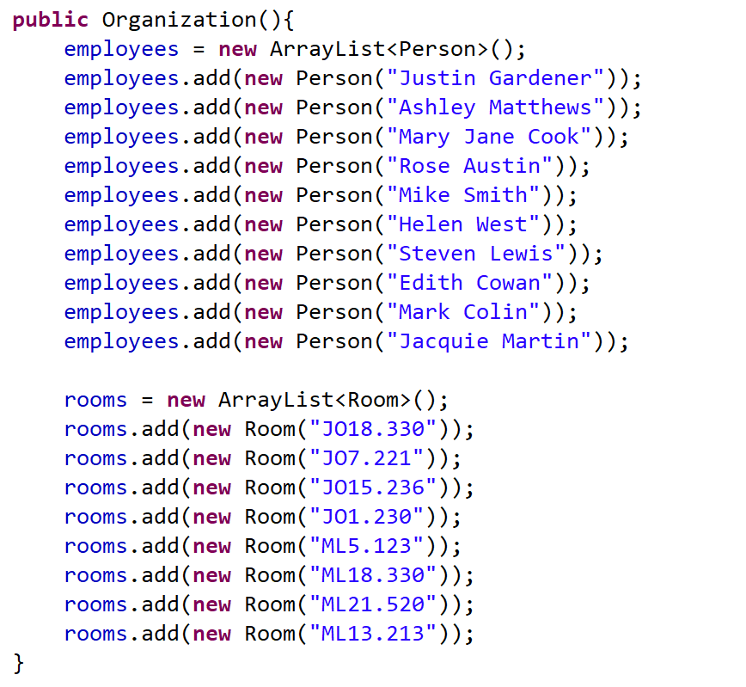
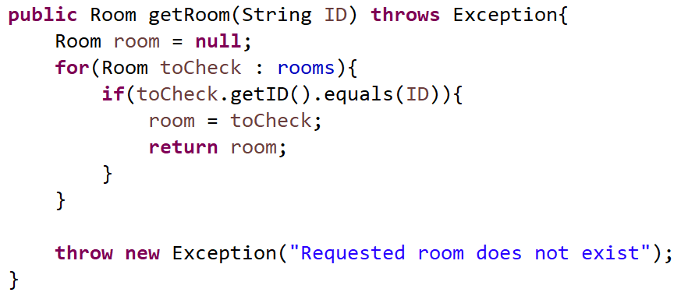
The intraclass CFG would be used to find DU-pairs of instance variables but can be shown on code below.
The Organization class has four DU-pairs for the instance variables:
Two uses of ArrayList<Room> def: ArrayList<Room> getRooms() & Room getRoom()
Two uses of ArrayList<Person> def: ArrayList<Person> getEmployees() & Person getEmployee()
Example:
DU-pair

Slide 11
Example of where to apply blackbox
The addMeeting(Meeting) method is a method of Calendar, contained by Room or Person.
It gets its values for validation from an external class (Meeting).
This is the kind of method where blackbox testing methods are highly applicable.
Most other test cases will revolve around sequences of methods to change state of the object via its instance variables and determining the resultant behaviours.

Slide 12
After Unit tests, Integrate..
Start from the two lower-most classes in the hierarchy
Determine where the instantiations of the objects occur for the classes and then where the uses of THAT object occur in any and all methods within the sub-system under test.
Defined | Use | Call chain
Meeting[1]: Meeting() | Room[4]: addMeeting(meeting) | Calendar.addMeeting(meeting),
 | Room[5]: printAgenda(m) | Calendar.printAgenda(m), Meeting.toString()
 | Room[6]: printAgenda(m, d) | Calendar.printAgenda(m, d), Meeting.toString()
 | Room[8]: getMeeting(m, d, i) | Calendar.getMeeting(m, d, i)
 | Room[9]: removeMeeting(m, d, I) | Calendar.removeMeeting(m, d, i)

Slide 13
Expand the sub-system
Gradually add classes to your subsystem, working up the hierarchy.
E.g
1) Organization & Room & Person
2) Organization & Room & Person & Calendar…
And so on…

