Slide 1
计算机系统安全
从 RADIUS 到 Diameter
2022.4
Notes:
安全协议与标准
linfb@sdu.edu.cn
2008-11 init
2014-03 update
2019, 2022 revised

Slide 2
从RADIUS到Diameter
0. 引言
1. AAA ↓ p10
2. RADIUS实验 ↓ p29
3. RADIUS标准 ↓ p38
4. Diameter介绍 ↓ p53
5. Diameter协议解析 ↓ p63
6. Diameter实现:Opendiameter ↓ p82
7. 附一个用iptable实现的NAS ↓

Slide 3

计算机系统安全
操作系统安全
RADIUS
看不见
不让看
看得见
看不懂
PKCS#11
访问控制(认证)
密码技术(加密)
认证源
Token
Notes:
RADIUS：Remote Authentication Dial In User Service

Slide 4
术语：Network Access Server
终端服务器、远程访问服务器
In some cases also known as a Terminal Server or Remote Access Server (RAS).
网关
The NAS is meant to act as a gateway to guard access to a protected resource.
互联网等
This can be anything from a telephone network, to printers, to the Internet.
Notes:
http://wiki.freeradius.org/glossary/NAS

Slide 5
NAS：允许 or 拒绝
客户连接NAS。
The client connects to the NAS.
NAS问某。
The NAS then connects to another resource asking whether the client's supplied credentials are valid.
根据回答决定开关。
Based on that answer the NAS then allows or disallows access to the protected resource.

Slide 6
谁说了算：AAA
The NAS contains no information about what clients can connect or what credentials are valid.
All the NAS does is send the credentials the client supplied to a resource which does know how to process the credentials.

Slide 7
示意图：NAS/AAA
终端
AAA
手机
互联网
NAS
PC

Slide 8
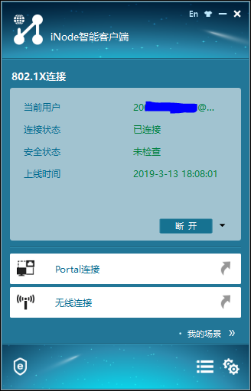
展示：802.1x

Slide 9
相关协议和AAA
Although not required, NAS are almost exclusively used with AAA servers.
Of the AAA protocols available, RADIUS tends to be the most widely used.
DIAMETER is a new protocol which extends on RADIUS by providing error handling and inter-domain communications which is starting to be implemented in some high end NAS.
RFC 2881/2882
Notes:
RFC 2881 (Network Access Server Requirements Next Generation NAS Model, July 2000)
RFC 2882 (Network Access Servers Requirements: Extended RADIUS Practices, July 2000)

Slide 10
AAA
Authentication 认证
Authorization 授权
Accounting 记帐
AAA是网络服务基础。
网络运营商关心AAA服务。
Notes:
[ ɔ:,θenti'keiʃən ] [ ,ɔ:θərai'zeiʃən ] [ ə'kauntiŋ ]
http://www.ietf.org/dyn/wg/charter/history/ /* find aaa */

Slide 11
AAA
鉴别（Authentication）指用户在使用网络系统中的资源时对用户身份的确认，通过与用户的交互获得用户身份信息（如帐号/口令组合、生物特征等），然后提交给认证服务器，由认证服务器对该信息与存储在数据库里的用户信息进行核对，以确认用户身份是否正确。
Examples of types of credentials are passwords, one-time tokens, digital certificates, digital signatures and phone numbers (calling/called).
Notes:
account、authentication、authorization、audit (AAAA)

Slide 12
AAA
授权（Authorization）是网络系统授权用户以特定的方式使用资源，包括用户在接入网络后能够使用的业务和拥有的权限等。
Typical authorization in everyday computer life is, for example, granting read access to a specific file for a specific authenticated user.
Authorization may be determined based on a range of restrictions;
  for example, time-of-day restrictions, or physical location restrictions, or restrictions against multiple access by the same entity or user.
Notes:
account、authentication、authorization、audit (AAAA)

Slide 13
AAA
计帐（Accounting）是网络系统收集、记录用户对网络资源的使用，以便向用户收取资源使用费用或用于安全审计等目的。
Real-time accounting vs. Batch accounting
Notes:
account、authentication、authorization、audit (AAAA)

Slide 14
AAA协议发展: 5个协议
TACACS (Terminal Access Controller Access Control System)
  →XTACACS
    Cisco ，RFC 927，RFC1492
TACACS+, a complete new
RADIUS (Remote Authentication Dial In User Service)
DIAMETER

Slide 15
TACACS，XTACACS
Terminal Access Controller Access-Control System (TACACS) is a remote authentication protocol that is used to communicate with an authentication server commonly used in UNIX networks.
  TACACS allows a remote access server to communicate with an authentication server in order to determine if the user has access to the network.
A later version of TACACS introduced by Cisco in 1990 was called XTACACS (extended TACACS).

Slide 16
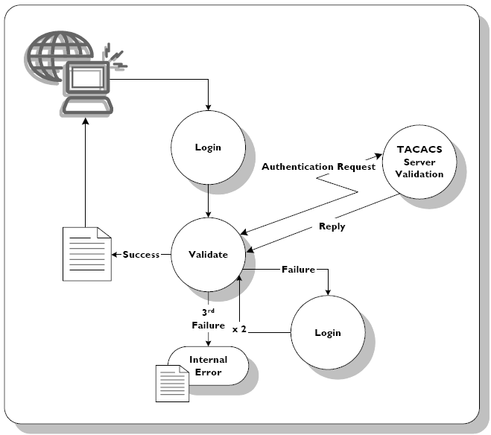
TACACS Authentication Flow
Notes:
TACACS allows a client to accept a username and password and send a query to a TACACS authentication server, sometimes called a TACACS daemon or simply TACACSD. This server was normally a program running on a host. The host would determine whether to accept or deny the request and send a response back. The TIP (routing node accepting dial-up line connections, which the user would normally want to log in into) would then allow access or not, based upon the response. In this way, the process of making the decision is "opened up" and the algorithms and data used to make the decision are under the complete control of whoever is running the TACACS daemon.

Slide 17
TACACS+
TACACS+ and RADIUS have generally replaced TACACS and XTACACS in more recently built or updated networks.
TACACS+ is a completely new protocol and is therefore not compatible with TACACS or XTACACS.
RFC 8907

Slide 18
TACACS+ vs. RADIUS
TACACS+ encrypts all the information mentioned above and therefore does not have the vulnerabilities present in the RADIUS protocol.
RADIUS encrypts only the users' password as it travels from the RADIUS client to RADIUS server. All other information such as the username, authorization, accounting are transmitted in clear text. Therefore it is vulnerable to different types of attacks.
Notes:
（扩展阅读）TACACS+ 和 RADIUS 的比较
https://www.cisco.com/c/zh_cn/support/docs/security-vpn/remote-authentication-dial-user-service-radius/13838-10.html

Slide 19
相关标准： Related RFCs
TACACS is defined in RFC 1492, and uses (either TCP or UDP) port 49 by default.
  RFC 1492 - An Access Control Protocol, sometimes called TACACS
RFC 927 - TACACS user identification Telnet option

Slide 20
Software implementations
TACACS.net
  http://www.tacacs.net/download.asp
TACACS+
  http://www.shrubbery.net/tac_plus/
tac_plus
  http://www.networkforums.net/
DialWays 3.0 // TACACS
TacacsPlus

Slide 21
MS Forefront supports tacacs
Microsoft Forefront通过一套整合式的保护、访问，以及身份管理产品，帮助您提供端到端的安全保护和信息访问。
  Unified Access Gateway: Protects network assets by encrypting all inbound access request from authorized users. Supports Virtual Private Networks (VPN) and DirectAccess.
      Formerly called Intelligent Application Gateway.
  Identity Manager
to configure a TACACS authentication server on Forefront Unified Access Gateway (UAG).
  …

Slide 22
AAA Framework
# RFC 2881 Network Access Server Requirements Next Generation (NASREQNG) NAS Model
# RFC 2903 Generic AAA Architecture
# RFC 2904 AAA Authorization Framework
# RFC 2905 AAA Authorization Application Examples
# RFC 2906 AAA Authorization Requirements
Notes:
http://en.wikipedia.org/wiki/AAA_protocol
http://www.ietf.org/html.charters/OLD/aaa-charter.html
http://tools.ietf.org/wg/aaa/

Slide 23
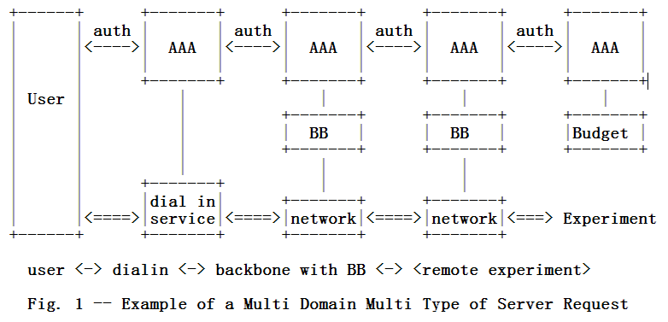

Rfc 2903
Generic AAA Architecture

Slide 24
在线课堂：浏览RFC 2904
RFC 2904 AAA Authorization Framework
https://datatracker.ietf.org/doc/html/rfc2904
注意看几个字符画的框图

Slide 25
RFC 2881: NASREQNG
This document describes the terminology and gives a model of typical Network Access Server (NAS).
The purpose of this effort is to set the reference space for describing and evaluating NAS service protocols, such as RADIUS (RFCs 2865, 2866) , and follow-on efforts like AAA Working Group, and the Diameter protocol.
These are protocols for carrying user service information for authentication, authorization, accounting, and auditing, between a Network Access Server which desires to authenticate its incoming calls and a shared authentication server.
不是用户和NAS之间，而是NAS和AAA之间的。
Notes:
NASREQNG

Slide 26
NAS：Network access server
A Network Access Server (NAS) is a single point of access to a remote resource.
The NAS is meant to act as a gateway to guard access to a protected resource. This can be anything from a telephone network, to printers, to the Internet.
The client connects to the NAS. The NAS then connects to another resource asking whether the client's supplied credentials are valid. Based on that answer the NAS then allows or disallows access to the protected resource.
The NAS contains no information about what clients can connect or what credentials are valid. All the NAS does is send the credentials the client supplied to a resource which does know how to process the credentials.

Slide 27
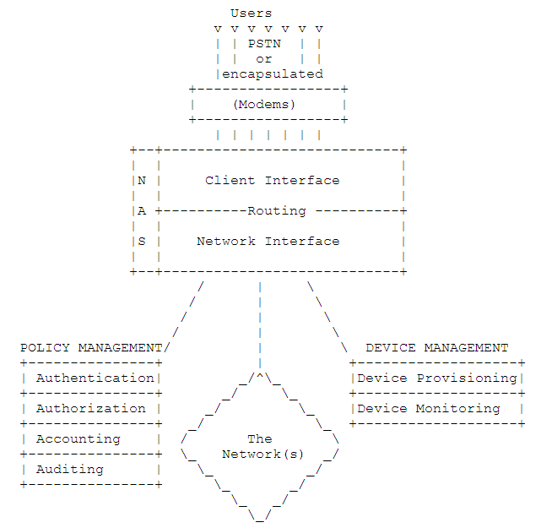

Slide 28
引出：RADIUS
(Remote Authentication Dial In User Service)
RADIUS协议
  由Livingston公司提出的
  起先的目的是为拨号用户进行认证和计费
  后经过多次改进成为了通用的认证计费协议

Slide 29
2. RADIUS实验
IAS in Windows
FreeRADIUS in Linux

Slide 30
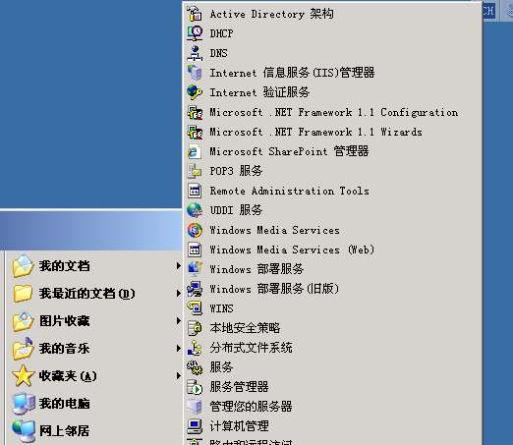
RADIUS in Windows Server
Windows中的”Internet验证服务”器(IAS)，主要实现和支持RADIUS协议。

Slide 31
Radius: IAS实验环境
R：Windows Server，开启IAS/即RADIUS服务，有用户u2
V：Windows Server，开启VPN服务，有用户u1
C：Windows客户端
u1/u2都给予拨入权限

Slide 32
IAS实验示意图
u1
u2
XP
V
R

Slide 33
实验过程演示
不用RADIUS
使用RADIUS

Slide 34
FreeRADIUS
一个Radius的Open/Free实现，Linux可用
RPM包名字是freeradius。
服务主进程名字radiusd。主配置文件/etc/raddb/radiusd.conf。
允许使用该Radius服务的Radius客户端用户信息配置在/etc/raddb/clients.conf，需要把每个用户的IP、秘密和短名等信息写进去。
允许验证通过的用户信息配置在/etc/raddb/users。
Notes:
http://www.freeradius.org/

Slide 35
Windows + FreeRADIUS（失败中）
尝试使用FreeRadius。
修改clients.conf加入Win2k3为radius客户，以调试模式开启radius服务进程#radiusd -X，在Win2k3中开启VPN服务，并让VPN服务使用radius验证。
从xp中拨入到VPN，可以看到radius服务进程接收到了radius请求，但是验证返回失败。
什么原因导致不行？
  已经注意了让用户名/口令和Linux上的一致

Slide 36
实验分析和结论
Windows中的IAS服务是RADIUS的实现。RADIUS客户端可以利用IAS提供的认证功能。
本例中，VPN服务器是RADIUS客户端用户。VPN客户端提交账号和口令给VPN服务器，VPN服务器作为RADIUS客户端，把账号口令转给RADIUS服务器，即Windows的IAS，IAS会从本地Windows用户数据库中(或者某域中)提取信息以考察该账号口令是否合法有效，并把结果原路反馈。（注：具体协议中未必传输明文口令）
RADIUS可以取本机帐号（如Windows的SAM，或linux的/etc/passwd），也可以用LDAP协议从目录服务中取认证信息，也可以从SQL数据库中取，或者使用自己的数据表。
RADIUS服务应该可以位于另一台Linux机器上。
不管启用RADIUS与否，VPN客户端其实是没有感觉的。

Slide 37
设计实验
Windows in VMware
内容
  使用VPN拨号到2003(RRAS)
  启用2003的IAS，让RRAS使用IAS
操作员
  3

Slide 38
3. Radius协议标准和规范文档
RFC 2865 - Remote Authentication Dial In User Service (RADIUS)
  http://tools.ietf.org/html/rfc2865
RFC 2866 - RADIUS Accounting
  http://tools.ietf.org/html/rfc2866
RFC 2867 - RADIUS Accounting Modifications for Tunnel Protocol Support
  http://tools.ietf.org/html/rfc2867
RFC 2868 - RADIUS Attributes for Tunnel Protocol Support
  http://tools.ietf.org/html/rfc2868
RFC 2869 - RADIUS Extensions
  http://tools.ietf.org/html/rfc2869
RFC 3162 RADIUS and IPv6
Notes:
* RFC 2548 Microsoft Vendor-specific RADIUS Attributes
* RFC 2607 Proxy Chaining and Policy Implementation in Roaming
* RFC 2618 RADIUS Authentication Client MIB
* RFC 4668 RADIUS Authentication Client MIB for IPv6 (Obsoletes: RFC 2618)
* RFC 2619 RADIUS Authentication Server MIB
* RFC 4669 RADIUS Authentication Server MIB for IPv6 (Obsoletes: RFC 2619)
* RFC 2620 RADIUS Accounting Client MIB
* RFC 4670 RADIUS Accounting Client MIB for IPv6 (Obsoletes: RFC 2620)
* RFC 2621 RADIUS Accounting Server MIB
* RFC 4671 RADIUS Accounting Server MIB for IPv6 (Obsoletes: RFC 2621)
* RFC 2809 Implementation of L2TP Compulsory Tunneling via RADIUS
* RFC 2867 RADIUS Accounting Modifications for Tunnel Protocol Support
* RFC 2868 RADIUS Attributes for Tunnel Protocol Support
* RFC 2869 RADIUS Extensions
* RFC 2882 Network Access Servers Requirements: Extended RADIUS Practices
* RFC 3162 RADIUS and IPv6
* RFC 3575 IANA Considerations for RADIUS
* RFC 3576 Dynamic Authorization Extensions to RADIUS
* RFC 3579 RADIUS Support for EAP (Updates: RFC 2869)
* RFC 3580 IEEE 802.1X RADIUS Usage Guidelines
* RFC 4014 RADIUS Attributes Suboption for the DHCP Relay Agent Information Option
* RFC 4372 Chargeable User Identity
* RFC 4590 RADIUS Extension for Digest Authentication (new revision pending)
* RFC 4675 RADIUS Attributes for Virtual LAN and Priority Support
* RFC 4679 DSL Forum Vendor-Specific RADIUS Attributes
* RFC 4818 RADIUS Delegated-IPv6-Prefix Attribute
* RFC 4849 RADIUS Filter Rule Attribute

Slide 39
RADIUS 消息
RADIUS 消息由一个 RADIUS 头和多个 RADIUS 属性组成。
RADIUS属性用于表达客户端、代理和服务器之间的信息。
每个 RADIUS 属性指定一则有关连接尝试的信息。
  例如，有用于用户名称、用户密码、用户请求的服务类型和访问服务器的 IP 地址的 RADIUS 属性。
  例如，“访问 - 请求”消息中的属性列表包含有关用户凭据和连接尝试的参数的信息。
  相反，“访问 - 接受”消息包含有关可创建的连接类型、连接限制和特定供应商属性 (VSA) 的信息。

Slide 40
RADIUS
RADIUS是基于挑战/应答(Challenge/ Response)的C/S结构的协议。
RADIUS是一种可扩展的协议，它进行的全部工作都是基于ALV(Attribute-Length-Value)的向量进行的。
RADIUS协议认证机制灵活，可以采用PAP、CHAP或者Unix登录认证等多种方式。

Slide 41
RADIUS UDP/Port
RADIUS服务器使用UDP协议进行通信。
  采用UDP的基本考虑是因为NAS和RADIUS服务器大多在同一个局域网中，使用UDP更加方便快捷。
RADIUS服务器的1645(1812)端口负责认证，1646(1813)端口负责计费工作。

Slide 42
Packet Format
A summary of the RADIUS data format is shown below. The fields are
transmitted from left to right.
0 1 2 3
0 1 2 3 4 5 6 7 8 9 0 1 2 3 4 5 6 7 8 9 0 1 2 3 4 5 6 7 8 9 0 1
+-+-+-+-+-+-+-+-+-+-+-+-+-+-+-+-+-+-+-+-+-+-+-+-+-+-+-+-+-+-+-+-+
| Code | Identifier | Length |
+-+-+-+-+-+-+-+-+-+-+-+-+-+-+-+-+-+-+-+-+-+-+-+-+-+-+-+-+-+-+-+-+
| |
| Authenticator |
| |
| |
+-+-+-+-+-+-+-+-+-+-+-+-+-+-+-+-+-+-+-+-+-+-+-+-+-+-+-+-+-+-+-+-+
| Attributes ...
+-+-+-+-+-+-+-+-+-+-+-+-+-
Notes:
http://tools.ietf.org/html/rfc2865
http://tools.ietf.org/html/rfc2865#page-13
Code
The Code field is one octet, and identifies the type of RADIUS
packet. When a packet is received with an invalid Code field, it
is silently discarded.
RADIUS Codes (decimal) are assigned as follows:
1 Access-Request
2 Access-Accept
3 Access-Reject
4 Accounting-Request
5 Accounting-Response
11 Access-Challenge
12 Status-Server (experimental)
13 Status-Client (experimental)
255 Reserved

Slide 43
RFC2865定义的RADIUS 消息类型
Access-Request 访问 - 请求
  由 RADIUS 客户端发送请求对连接尝试进行身份验证和授权。
Access-Accept 访问 - 接收
  由 RADIUS 服务器发送，响应“访问 - 请求”消息。此消息通知 客户端已对连接尝试进行身份验证和授权。
Access-Reject 访问 - 拒绝
  由 RADIUS 服务器发送，响应“访问 - 请求”消息。此消息通知 RADIUS 客户端连接尝试被拒绝。如果凭据未被验证或连接尝试未被授权，服务器将发送此消息。
Access-Challenge 访问 - 质询
  由 RADIUS 服务器发送，响应“访问 - 请求”消息。此消息是对需要响应的 RADIUS 客户端的质询。

Slide 44
RFC2866定义的RADIUS 消息类型
//contin…
Accounting-Request 记帐 - 请求
  由 RADIUS 客户端发送，为接收的连接指定记帐信息。
Accounting-Response 记帐 - 响应
  由 RADIUS 服务器发送，响应“记帐 - 请求”消息。此消息识别对记帐请求消息的成功接收和处理。

Slide 45
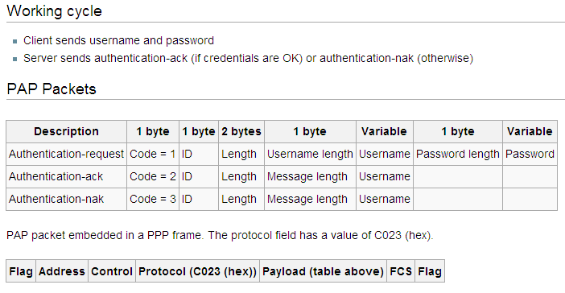
PAP: Password Authentication Protocol
PPP, PAP
  http://www.faqs.org/rfcs/rfc1334.html
Notes:
http://www.faqs.org/rfcs/rfc1334.html
PPP Authentication Protocols
PAP transmits unencrypted ASCII passwords over the network and is therefore considered insecure.

Slide 46
Radius: PAP
PAP验证
  用户以明文的形式把用户名和口令传递给NAS。
  NAS把用户名和加密过的口令放到包的相应属性中传递给RADIUS服务器。
  RADIUS服务器返回结果。
  NAS来决定是否允许用户上网。
把口令加密方法
  passwd XOR md5(S||RA)
  S是共享秘密，RA是一次性随机值

Slide 47
PAP：an Access-Request UDP packet
The Request Authenticator is a 16 octet random number generated by the NAS. The User-Password is 16 octets of password padded at end with nulls,XORed with MD5(shared secret|Request Authenticator).
01 00 00 38 0f 40 3f 94 73 97 80 57 bd 83 d5 cb
98 f4 22 7a 01 06 6e 65 6d 6f 02 12 0d be 70 8d
93 d4 13 ce 31 96 e4 3f 78 2a 0a ee 04 06 c0 a8
01 10 05 06 00 00 00 03
  1 Code = Access-Request (1)
  1 ID = 0
  2 Length = 56
  16 Request Authenticator
Attributes:
  6 User-Name = "nemo"
  18 User-Password
  6 NAS-IP-Address = 192.168.1.16
  6 NAS-Port = 3

Slide 48
PAP：an Access-Accept UDP packet
The Response Authenticator is a 16-octet MD5 checksum of the code(2), id (0), Length (38), the Request Authenticator from above, the attributes in this reply, and the shared secret.
02 00 00 26 86 fe 22 0e 76 24 ba 2a 10 05 f6 bf
9b 55 e0 b2 06 06 00 00 00 01 0f 06 00 00 00 00
0e 06 c0 a8 01 03
  1 Code = Access-Accept (2)
  1 ID = 0 (same as in Access-Request)
  2 Length = 38
  16 Response Authenticator
Attributes:
  6 Service-Type (6) = Login (1)
  6 Login-Service (15) = Telnet (0)
  6 Login-IP-Host (14) = 192.168.1.3

Slide 49
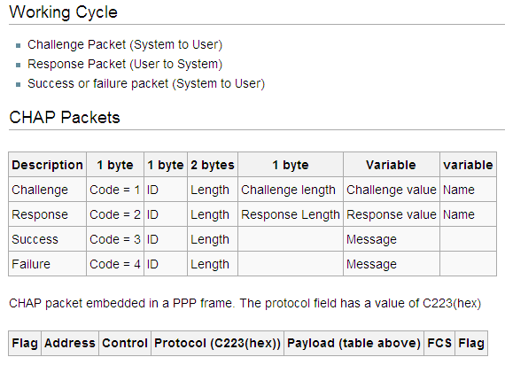
CHAP: Challenge/Handshake Authentication Protocol
PPP, CHAP
  http://www.faqs.org/rfcs/rfc1994.html

Slide 50
CHAP: Challenge and Response
The Response Value is the one-way hash calculated over a stream of octets consisting of the Identifier, followed by (concatenated with) the "secret", followed by (concatenated with) the Challenge Value. The length of the Response Value depends upon the hash algorithm used (16 octets for MD5).
||
Notes:
http://tools.ietf.org/html/rfc1994#section-4.1
The Identifier field is one octet. The Identifier field MUST be changed each time a Challenge is sent.

Slide 51
Radius: CHAP
当用户请求上网时，NAS产生一个16字节的随机码给用户。
用户端得到这个包后使用MD5生成一个response传给NAS（还有ID/username等信息）。
NAS把传回来的username和ID/Response作为用户名和口令，并把原来的16字节随机码传给RADIUS服务器。
RADIUS根据用户名在服务器端查找数据库，得到和用户端进行加密所用的一样的密码，然后根据传来的16字节的随机码进行加密，将其结果与传来的Password作比较，如果相同表明验证通过，如果不相同表明验证失败。
另外如果验证成功，RADIUS服务器同样可以生成一个16字节的随机码对用户进行询问（Challenge）。
Notes:
For CHAP, the NAS generates a random challenge (preferably 16 octets) and sends it to the user, who returns a CHAP response along with a CHAP ID and CHAP username. The NAS then sends an Access-Request packet to the RADIUS server with the CHAP username as the User-Name and with the CHAP ID and CHAP response as the CHAP-Password (Attribute 3). The random challenge can either be included in the CHAP-Challenge attribute or, if it is 16 octets long, it can be placed in the Request Authenticator field of the Access-Request packet. The NAS MAY include the Attributes Service-Type = Framed- User and Framed-Protocol = PPP as a hint to the RADIUS server that PPP service is expected.

Slide 52
练习 rfc2865
CHAP：an Access-Request UDP packet
CHAP：an Access-Accept UDP packet
Notes:
7.2. Framed User Authenticating with CHAP
The NAS at 192.168.1.16 sends an Access-Request UDP packet to the
RADIUS Server for a user named flopsy logging in on port 20 with PPP,
authenticating using CHAP. The NAS sends along the Service-Type and
Framed-Protocol attributes as a hint to the RADIUS server that this
user is looking for PPP, although the NAS is not required to do so.
The Request Authenticator is a 16 octet random number generated by
the NAS, and is also used as the CHAP Challenge.
The CHAP-Password consists of a 1 octet CHAP ID, in this case 22,
followed by the 16 octet CHAP response.
01 01 00 47 2a ee 86 f0 8d 0d 55 96 9c a5 97 8e
0d 33 67 a2 01 08 66 6c 6f 70 73 79 03 13 16 e9
75 57 c3 16 18 58 95 f2 93 ff 63 44 07 72 75 04
06 c0 a8 01 10 05 06 00 00 00 14 06 06 00 00 00
02 07 06 00 00 00 01
1 Code = 1 (Access-Request)
1 ID = 1
2 Length = 71
16 Request Authenticator
Attributes:
8 User-Name (1) = "flopsy"
19 CHAP-Password (3)
6 NAS-IP-Address (4) = 192.168.1.16
6 NAS-Port (5) = 20
6 Service-Type (6) = Framed (2)
6 Framed-Protocol (7) = PPP (1)
The RADIUS server authenticates flopsy, and sends an Access-Accept
UDP packet to the NAS telling it to start PPP service and assign an
address for the user out of its dynamic address pool.
The Response Authenticator is a 16-octet MD5 checksum of the code
(2), id (1), Length (56), the Request Authenticator from above, the
attributes in this reply, and the shared secret.
02 01 00 38 15 ef bc 7d ab 26 cf a3 dc 34 d9 c0
3c 86 01 a4 06 06 00 00 00 02 07 06 00 00 00 01
08 06 ff ff ff fe 0a 06 00 00 00 02 0d 06 00 00
00 01 0c 06 00 00 05 dc
1 Code = Access-Accept (2)
1 ID = 1 (same as in Access-Request)
2 Length = 56
16 Response Authenticator
Attributes:
6 Service-Type (6) = Framed (2)
6 Framed-Protocol (7) = PPP (1)
6 Framed-IP-Address (8) = 255.255.255.254
6 Framed-Routing (10) = None (0)
6 Framed-Compression (13) = VJ TCP/IP Header Compression (1)
6 Framed-MTU (12) = 1500

Slide 53
4. 新一代AAA的目标
兼容RADIUS
传输层无关性
明确的代理支持
轻量级的对象安全模型
IPv6支持
支持IPv4/6的MIBs
协议文档内容明确
定义错误消息和错误处理
针对每一种网络应用的记账
协议间的逻辑独立性和丰富的数据类型

Slide 54
Diameter
Radius是C/S模式，Diameter是P2P模式
R是基于UDP的，D是基于TCP/SCTP的。
R使用共享秘密保护C/S间安全，D必须使用IPSec(SSL/TLS可选)保护。
D中认证和授权是分开的。
D增强了对错误和异常的处理能力。

Slide 55
Diameter诸文档包括
BASE，RFC 3588
  specifies the message format, transport, error reporting, accounting and security services to be used by all Diameter applications
AAATRANS，RFC 3539
  discusses transport issues that arise within protocols for AAA
DIAMMIP，RFC 4004
NASREQ，RFC 4005
…
Notes:
In RFC3539
Issues that arise in AAA transport usage include:
Application-driven versus network-driven
Slow failover
Use of Nagle Algorithm
Multiple connections
Duplicate detection
Invalidation of transport parameter estimates
Inability to use fast re-transmit
Congestion avoidance
Delayed acknowledgments
Premature Failover
Head of line blocking
Connection load balancing
We discuss each of these issues in turn.

Slide 56
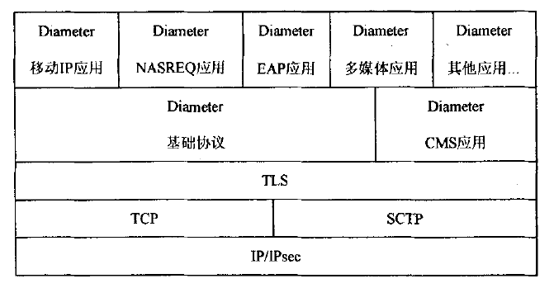
Diameter协议层次结构

Slide 57
Diameter Base Protocol
为移动IP(Mobile IP)、网络接入服务(NAS)等应用提供基本的AAA服务，如用户会话、计费等，具有能力协商、差错通知等功能。
定义了所有Diameter应用所需的消息的格式、传输、错误报告、计费和安全服务。其协议命令代码、AVP值和种类都可以按应用需要和规则进行扩展。
可以在客户机、代理、服务器之间传递鉴别、授权和计费信息。不管客户机、代理还是服务器，都可以主动发出会话请求，对方给予应答，所以也是对等实体之间的协议。

Slide 58
Diameter的CMS协议
Cryptographic Message Syntax 密码消息语法
  实现了协议数据的Peer-to-Peer（端到端）加密。
  由于Diameter网络中存在不可信的Relay（中继）和Proxy（代理），而IPSec和TLS又只能实现跳到跳的安全，所以IETF定义了Diameter CMS应用协议来保证（端到端）数据安全。

Slide 59
Diameter的EAP协议
Extensible Authentication Protocol 可扩展鉴别协议
  协议提供了一个支持各种鉴别方法的标准机制，一种框架，一种帧格式，可以容纳各种鉴别信息。EAP所提供的多回合鉴别是PAP和CHAP所不具备的。
  EAP协议描述用户、NAS(AAA客户机)和AAA服务器之间有关EAP鉴别消息的请求和应答的关系，完成一次对鉴别请求的应答，中间可能需要多次消息交换过程。
  在移动终端MN移动的环境下，MN与FA之间的鉴别扩展采用EAP，即把FA看做是一个NAS，它作为Diameter AAA的客户机，Diameter AAA服务器作为EAP的后端服务器，两者之间载送EAP分组。端到端的EAP鉴别发生在用户和它的H-AAA之间。

Slide 60
Diameter的NAS协议
Network Access Service（网络接入服务）协议
  由NAS客户机处理用户MN的接入请求（RegReq），将收到的客户认证信息转送给NAS(AAA)服务器；AAA服务器对客户进行鉴别，将结果（Success/Fail）发给客户机；客户机通过RegReply将结果发回给MN，并根据结果对MN进行相应处理。
  NAS作为网络接入服务器，在其用户端口接收到呼叫或服务请求时便开始与AAA服务器之间进行消息交换，有关呼叫的信息、用户身份和用户鉴别信息被打包成一种AAA消息发给AAA服务器。
  实际上，移动IP中的FA可以看成是通过空中的MPPP链路接收移动终端MN的服务连接请求的NAS服务器，它作为AAA服务器的客户机，在两者之间交换NAS消息请求和应答。

Slide 61
Diameter的MIP协议
Diameter Mobile IPv4 Application
  未来移动通信网络正逐步向全IP网络演进，这就不可避免碰到用户移动到外部域的问题。
  当用户移动到外部域的时候，需要进行一系列的消息交换才能安全地接入外部网络，接受其提供的服务。MIP协议的实现环境中MN和HA都可以在家乡域或在外地域，其中比较典型的一种情况是MN在外地域而HA在家乡域。
  Diameter MIP应用协议允许用户漫游到外部域，并在经过鉴权后接受外部域Server（服务器）和Agent（代理）提供的服务。在未来移动通信中，这种情况将十分常见，因此MIP协议对于移动通信系统来说至关重要。

Slide 62
Diameter Application
Diameter Mobile IPv4 Application (MobileIP, RFC 4004)
Diameter Network Access Server Application (NASREQ, RFC 4005)
Diameter Extensible Authentication Protocol Application (EAP, RFC 4072)
Diameter (real-time) Credit-Control Application (DCCA, RFC 4006)
Diameter Session Initiation Protocol Application (SIP, RFC 4740)
various applications in the 3GPP IP Multimedia Subsystem (//3GPP IMS)
3GPP GBA (Generic Bootstrapping Architecture): Bootstrapping Server Function
Notes:
3GPP的目标是在ITU的IMT-2000计划范围内制订和实现全球性的(第三代) 移动电话系统规范。它致力于GSM到UMTS（W-CDMA)的演化，虽然GSM到W-CDMA空中接口差别很大，但是其核心网采用了GPRS的框架，因此仍然保持一定的延续性。
http://www.3gpp.org/

Slide 63
5. Diameter协议解析
消息分组格式 //message packet format
AVP格式
解析：NASREQ

Slide 64
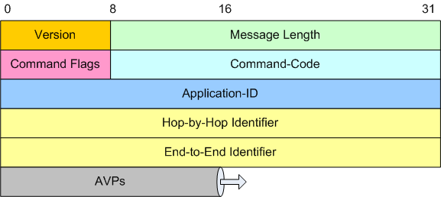
Packet Format
Notes:
Command Flags (类似类型或操作模式) || id 就是序列号，去除重复用途
The Command Flags field is eight bits. The following bits are assigned:
0 1 2 3 4 5 6 7
+-+-+-+-+-+-+-+-+
|R P E T r r r r|
+-+-+-+-+-+-+-+-+
R(equest) - If set, the message is a request. If cleared, the message is an answer.
P(roxiable) - If set, the message MAY be proxied, relayed or redirected. If cleared, the message MUST be
locally processed.
E(rror) - If set, the message contains a protocol error, and the message will not conform to the ABNF
described for this command. Messages with the 'E' bit set are commonly referred to as error
messages. This bit MUST NOT be set in request
messages. See Section 7.2.
T(Potentially re-transmitted message)
- This flag is set after a link failover procedure, to aid the removal of duplicate requests....This flag
MUST NOT be set in answer messages.
r(eserved) - these flag bits are reserved for future use, and MUST be set to zero, and ignored by the receiver.

Slide 65
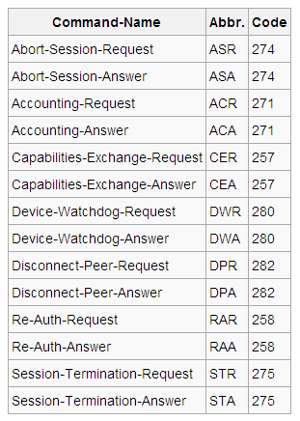
Commands
Each command is assigned a command code, which is used for both requests and answers.
Notes:
256以下的留做RADIUS兼容用途

Slide 66
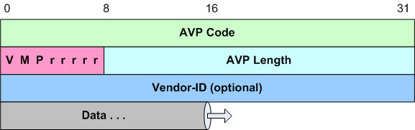
Attribute-Value Pairs (AVP)
The 'V' bit, known as the Vendor-Specific bit,
The ‘M’ Bit, known as the Mandatory bit,
The 'P' bit indicates the need for encryption for end-to-end security.
The 'r' (reserved) bits …
Notes:
AVP Flags
The AVP Flags field informs the receiver how each attribute must
be handled. The 'r' (reserved) bits are unused and SHOULD be set
to 0. Note that subsequent Diameter applications MAY define
additional bits within the AVP Header, and an unrecognized bit
SHOULD be considered an error. The 'P' bit indicates the need for
encryption for end-to-end security.
The 'M' Bit, known as the Mandatory bit, indicates whether support
of the AVP is required. If an AVP with the 'M' bit set is
received by a Diameter client, server, proxy, or translation agent
and either the AVP or its value is unrecognized, the message MUST
be rejected. Diameter Relay and redirect agents MUST NOT reject
messages with unrecognized AVPs.
The 'M' bit MUST be set according to the rules defined for the AVP
containing it. In order to preserve interoperability, a Diameter
implementation MUST be able to exclude from a Diameter message any
Mandatory AVP which is neither defined in the base Diameter
protocol nor in any of the Diameter Application specifications
governing the message in which it appears. It MAY do this in one
of the following ways:
1) If a message is rejected because it contains a Mandatory AVP
which is neither defined in the base Diameter standard nor in
any of the Diameter Application specifications governing the
message in which it appears, the implementation may resend the
message without the AVP, possibly inserting additional standard
AVPs instead.
2) A configuration option may be provided on a system wide, per
peer, or per realm basis that would allow/prevent particular
Mandatory AVPs to be sent. Thus an administrator could change
the configuration to avoid interoperability problems.
Diameter implementations are required to support all Mandatory
AVPs which are allowed by the message's formal syntax and defined
either in the base Diameter standard or in one of the Diameter
Application specifications governing the message.
AVPs with the 'M' bit cleared are informational only and a
receiver that receives a message with such an AVP that is not
supported, or whose value is not supported, MAY simply ignore the
AVP.
The 'V' bit, known as the Vendor-Specific bit, indicates whether
the optional Vendor-ID field is present in the AVP header. When
set the AVP Code belongs to the specific vendor code address
space.
Unless otherwise noted, AVPs will have the following default AVP
Flags field settings:
The 'M' bit MUST be set. The 'V' bit MUST NOT be set.

Slide 67
AVP: Name-code-type
Attribute-Name Code Data Type
=========================================
Acct-Interim-Interval 85 Unsigned32
Accounting-Realtime-Required 483 Enumerated
Acct-Multi-Session-Id 50 UTF8String
Accounting-Record-Number 485 Unsigned32
Accounting-Record-Type 480 Enumerated
Accounting-Session-Id 44 OctetString
Accounting-Sub-Session-Id 287 Unsigned64
Acct-Application-Id 259 Unsigned32
Auth-Application-Id 258 Unsigned32
…
Notes:
Attribute-Name Code Data Type
==========================
Acct-Interim-Interval 85 Unsigned32
Accounting-Realtime-Required 483 Enumerated
Acct-Multi-Session-Id 50 UTF8String
Accounting-Record-Number 485 Unsigned32
Accounting-Record-Type 480 Enumerated
Accounting-Session-Id 44 OctetString
Accounting-Sub-Session-Id 287 Unsigned64
Acct-Application-Id 259 Unsigned32
Auth-Application-Id 258 Unsigned32
Auth-Request-Type 274 Enumerated
Authorization-Lifetime 291 Unsigned32
Auth-Grace-Period 276 Unsigned32
Auth-Session-State 277 Enumerated
Re-Auth-Request-Type 285 Enumerated
Class 25 OctetString
Destination-Host 293 DiamIdent
Destination-Realm 283 DiamIdent
Disconnect-Cause 273 Enumerated
E2E-Sequence 300 Grouped
Error-Message 281 UTF8String
Error-Reporting-Host 294 DiamIdent
Event-Timestamp 55 Time
Experimental-Result 297 Grouped
Experimental-Result-Code 298 Unsigned32
Failed-AVP 279 Grouped
Firmware-Revision 267 Unsigned32
Host-IP-Address 257 Address
Inband-Security-Id 299 Unsigned32
Multi-Round-Time-Out 272 Unsigned32
Origin-Host 264 DiamIdent
Origin-Realm 296 DiamIdent
Origin-State-Id 278 Unsigned32
Product-Name 269 UTF8String
Proxy-Host 280 DiamIdent
Proxy-Info 284 Grouped
Proxy-State 33 OctetString
Redirect-Host 292 DiamURI
Redirect-Host-Usage 261 Enumerated
Redirect-Max-Cache-Time 262 Unsigned32
Result-Code 268 Unsigned32
Route-Record 282 DiamIdent
Session-Id 263 UTF8String
Session-Timeout 27 Unsigned32
Session-Binding 270 Unsigned32
Session-Server-Failover 271 Enumerated
Supported-Vendor-Id 265 Unsigned32
Termination-Cause 295 Enumerated
User-Name 1 UTF8String
Vendor-Id 266 Unsigned32
Vendor-Specific-Application-Id 260 Grouped

Slide 68
EAP
EAP - Extensible Authentication Protocol
  an authentication framework which supports multiple authentication methods
  EAP typically runs directly over data link layers such as Point-to-Point Protocol (PPP) or IEEE 802, without requiring IP
The EAP conversation
  between the authenticating peer and the access device begins with the initiation of EAP within a link layer, such as PPP or IEEE 802.11i.
  Once EAP has been initiated, the access device will typically send a Diameter-EAP-Request message with an empty EAP-Payload AVP to the Diameter server, signifying an EAP-Start.
Notes:
http://www.ietf.org/html.charters/eap-charter.html

Slide 69
EAP Multiplexing Model
+-+-+-+-+-+-+-+-+-+-+-+-+ +-+-+-+-+-+-+-+-+-+-+-+-+
| | | | | |
| EAP method| EAP method| | EAP method| EAP method|
| Type = X | Type = Y | | Type = X | Type = Y |
| V | | | ^ | |
+-+-+-+-!-+-+-+-+-+-+-+-+ +-+-+-+-!-+-+-+-+-+-+-+-+
| ! | | ! |
| EAP ! Peer layer | | EAP ! Auth. layer |
| ! | | ! |
+-+-+-+-!-+-+-+-+-+-+-+-+ +-+-+-+-!-+-+-+-+-+-+-+-+
| ! | | ! |
| EAP ! layer | | EAP ! layer |
| ! | | ! |
+-+-+-+-!-+-+-+-+-+-+-+-+ +-+-+-+-!-+-+-+-+-+-+-+-+
| ! | | ! |
| Lower ! layer | | Lower ! layer |
| ! | | ! |
+-+-+-+-!-+-+-+-+-+-+-+-+ +-+-+-+-!-+-+-+-+-+-+-+-+
! !
! Peer ! Authenticator
+------------>-------------+
Notes:
RFC 3748

Slide 70
EAP Packet Format
A summary of the EAP packet format is shown below. The fields are transmitted from left to right.
0 1 2 3
0 1 2 3 4 5 6 7 8 9 0 1 2 3 4 5 6 7 8 9 0 1 2 3 4 5 6 7 8 9 0 1
+-+-+-+-+-+-+-+-+-+-+-+-+-+-+-+-+-+-+-+-+-+-+-+-+-+-+-+-+-+-+-+-+
| Code | Identifier | Length |
+-+-+-+-+-+-+-+-+-+-+-+-+-+-+-+-+-+-+-+-+-+-+-+-+-+-+-+-+-+-+-+-+
| Data ...
+-+-+-+-+
Code 1 Request
2 Response
3 Success
4 Failure
Identifier: The Identifier field is one octet and aids in matching Responses with Requests.

Slide 71
EAP authentication methods
Initial EAP Request/Response Types
  All EAP implementations MUST support Types 1-4, which are defined in this document, and SHOULD support Type 254. Implementations MAY support other Types defined here or in future RFCs.
1 Identity
2 Notification
3 Nak (Response only)
4 MD5-Challenge
5 One Time Password (OTP)
6 Generic Token Card (GTC)
254 Expanded Types
255 Experimental use
Notes:
RFC 3748

Slide 72
EAP Overview
User NAS Server
| | |
| (initiate EAP) | |
|<------------------------------>| |
| | Diameter-EAP-Request |
| | EAP-Payload(EAP Start) |
| |------------------------------->|
| | |
| | Diameter-EAP-Answer |
| Result-Code=DIAMETER_MULTI_ROUND_AUTH |
| | EAP-Payload(EAP Request #1) |
| |<-------------------------------|
| EAP Request #1 | |
|<-------------------------------| |
: : :
: ...continues... :
Notes:
RFC 4072

Slide 73
Basic sequence: 4-way handshake
Client
NAS
Server
(initiate EAP)
Diameter-EAP-Request
EAP-Payload(EAP start)
Diameter-EAP-Answer
Result-Code=MULTI_ROUND_AUTH
EAP-Payload(Request(…))
EAPOL(Request(…))
EAPOL(Response (…))
Diameter-EAP-Request
EAP-Payload(Response(…))
Diameter-EAP-Answer
Result-Code=SUCCESS
EAP-Master-Session-Key EAP-Payload(Success)
EAPOL(Success)
(4-way handshake)

Slide 74
EAP: New AVPs
EAP-Payload AVP // AVP Code 462
EAP-Reissued-Payload AVP // 463
EAP-Master-Session-Key AVP // 464
Accounting-EAP-Auth-Method AVP // 465
EAP-Key-Name AVP //102
Notes:
RFC 4072

Slide 75
PANA
Protocol for Carrying Authentication for Network Access
  mechanisms for providing client (IP devices) information to the network for authentication and authorization purposes
  allows a host and a network to authenticate each other for network access
  run between a client's device and an agent in the network where the agent might be a client of the AAA infrastructure
  In EAP terms, PANA is a UDP-based EAP lower layer that runs between the EAP peer and the EAP authenticator
Notes:
Protocol for carrying Authentication for Network Access (pana)
http://www.ietf.org/html.charters/pana-charter.html
http://tools.ietf.org/wg/pana/

Slide 76
Figure 1: PANA Functional Model
RADIUS,
Diameter,
+-----+ PANA +-----+ LDAP, API, etc. +-----+
| PaC |<----------------->| PAA |<------------------->| AS |
+-----+ +-----+ +-----+
^ ^
| |
| +-----+ |
IKE, +-------->| EP |<--------+ ANCP, API, etc.
4-way handshake, +-----+
etc. .
.
.
v
Data traffic
Notes:
draft-ietf-pana-framework-10:
PANA Client (PaC)
PANA Authentication Agent (PAA)
Enforcement Point (EP)
Authentication Server (AS)

Slide 77
Figure 2: PANA Signaling Flow
PaC EP PAA AS
| | | |
IP address ->| | | |
config. | PANA | | AAA |
|<------------------------------>|<-------------->|
| | Provisioning | |
(Optional) | |<-------------->| |
IP address ->| | | |
reconfig. | Sec.Assoc. | | |
|<------------->| | |
| | | |
| Data traffic | | |
|<-----------------> | |
| | | |

Slide 78
PANA session
Authentication and authorization phase
  The main task of the authentication and authorization phase is to establish a PANA session and carry EAP messages between the PaC and the PAA
  PaC-initiated Session vs. PAA-initiated Session
Access phase
Re-authentication phase
Termination phase
Notes:
A PANA session consists of distinct phases:
o Authentication and authorization phase: This is the phase that
initiates a new PANA session and executes EAP between the PAA and
PaC. The PANA session can be initiated by both the PaC and the
PAA. The EAP payload (which carry an EAP method inside) is what
is used for authentication. The PAA conveys the result of
authentication and authorization to the PaC at the end of this
phase.
o Access phase: After a successful authentication and authorization
the access device gains access to the network and can send and
receive IP traffic through the EP(s). At any time during this
phase, the PaC and PAA may optionally send PANA notification
messages to test liveness of the PANA session on the peer.
o Re-authentication phase: During the access phase, the PAA may, and
the PaC should, initiate re-authentication if they want to update
the PANA session lifetime before the PANA session lifetime
expires. EAP is carried by PANA to perform re-authentication.
This phase may be optionally triggered by both the PaC and the PAA
without any respect to the session lifetime. The re-
authentication phase is a sub-phase of the access phase. The
session moves to this sub-phase from the access phase when re-
authentication starts, and returns back there upon successful re-
authentication.
o Termination phase: The PaC or PAA may choose to discontinue the
access service at any time. An explicit disconnect message can be
sent by either end. If either the PaC or the PAA disconnects
without engaging in termination messaging, it is expected that
either the expiration of a finite session lifetime or failed
liveness tests would clean up the session at the other end.

Slide 79
a PaC-initiated session: an example sequence
PaC PAA Message(sequence number)[AVPs]
--------------------------------------------------------------------
-----> PANA-Client-Initiation(0)
<----- PANA-Auth-Request(x)[PRF-Algorithm, Integrity-Algorithm]
// The 'S' (Start) bit set
-----> PANA-Auth-Answer(x)[PRF-Algorithm, Integrity-Algorithm]
// The 'S' (Start) bit set
<----- PANA-Auth-Request(x+1)[Nonce, EAP-Payload]
-----> PANA-Auth-Answer(x+1)[Nonce] // No piggybacking EAP
-----> PANA-Auth-Request(y)[EAP-Payload]
<----- PANA-Auth-Answer(y)
<----- PANA-Auth-Request(x+2)[EAP-Payload]
-----> PANA-Auth-Answer(x+2)[EAP-Payload]
// Piggybacking EAP
<----- PANA-Auth-Request(x+3)[Result-Code, EAP-Payload,
Key-Id, Session-Lifetime, AUTH]
// The 'C' (Complete) bit set
-----> PANA-Auth-Answer(x+3)[Key-Id, AUTH]
// The 'C' (Complete) bit set
Notes:
PaC PAA Message(sequence number)[AVPs]
------------------------------------------------------
-----> PANA-Notification-Request(q)[AUTH]
// The 'A' (re-Authentication) bit set
<----- PANA-Notification-Answer(q)[AUTH]
// The 'A' (re-Authentication) bit set
<----- PANA-Auth-Request(p)[EAP-Payload, Nonce, AUTH]
-----> PANA-Auth-Answer(p)[AUTH, Nonce]
-----> PANA-Auth-Request(q+1)[EAP-Payload, AUTH]
<----- PANA-Auth-Answer(q+1)[AUTH]
<----- PANA-Auth-Request(p+1)[EAP-Payload, AUTH]
-----> PANA-Auth-Answer(p+1)[EAP-Payload, AUTH]
<----- PANA-Auth-Request(p+2)[Result-Code, EAP-Payload,
Key-Id, Session-Lifetime, AUTH]
// The 'C' (Complete) bit set
-----> PANA-Auth-Answer(p+2)[Key-Id, AUTH]
// The 'C' (Complete) bit set
Figure 2: Example sequence for the re-authentication phase initiated
by PaC

Slide 80
PANA Message Header
0 1 2 3
0 1 2 3 4 5 6 7 8 9 0 1 2 3 4 5 6 7 8 9 0 1 2 3 4 5 6 7 8 9 0 1
+-+-+-+-+-+-+-+-+-+-+-+-+-+-+-+-+-+-+-+-+-+-+-+-+-+-+-+-+-+-+-+-+
| Reserved | Message Length |
+-+-+-+-+-+-+-+-+-+-+-+-+-+-+-+-+-+-+-+-+-+-+-+-+-+-+-+-+-+-+-+-+
| Flags | Message Type |
+-+-+-+-+-+-+-+-+-+-+-+-+-+-+-+-+-+-+-+-+-+-+-+-+-+-+-+-+-+-+-+-+
| Session Identifier |
+-+-+-+-+-+-+-+-+-+-+-+-+-+-+-+-+-+-+-+-+-+-+-+-+-+-+-+-+-+-+-+-+
| Sequence Number |
+-+-+-+-+-+-+-+-+-+-+-+-+-+-+-+-+-+-+-+-+-+-+-+-+-+-+-+-+-+-+-+-+
| AVPs ...
+-+-+-+-+-+-+-+-+-+-+-+-+-
The Flags field is two octets. The following bits are assigned:
0 1 2 3 4 5 6 7 8 9 0 1 2 3 4 5
+-+-+-+-+-+-+-+-+-+-+-+-+-+-+-+-+
|R S C A P I r r r r r r r r r r|
+-+-+-+-+-+-+-+-+-+-+-+-+-+-+-+-+
Notes:
PANA port number (to be assigned by IANA)
…
R (Request)
If set, the message is a request. If cleared, the message is
an answer.
S (Start)
If set, the message is the first PANA-Auth-Request or PANA-
Auth-Answer in authentication and authorization phase. For
other messages, this bit MUST be cleared.
C (Complete)
If set, the message is the last PANA-Auth-Request or PANA-Auth-
Answer in authentication and authorization phase. For other
messages this bit MUST be cleared.
A (re-Authentication)
If set, the message is a PANA-Notification-Request or PANA-
Notification-Answer to initiate re-authentication. For other
messages this bit MUST be cleared.
P (Ping)
If set, the message is a PANA-Notification-Request or PANA-
Notification-Answer for liveness test. For other messages this
bit MUST be cleared.
I (IP Reconfiguration)
If set, it indicates that the PaC is required to perform IP
address reconfiguration after successful authentication and
authorization phase to configure an IP address that is usable
for exchanging data traffic across EP. This bit is set by the
PAA and only for PANA-Auth-Request messages in the
authentication and authorization phase. For other messages,
this bit MUST be cleared .
r (reserved)
These flag bits are reserved for future use, and MUST be set to
zero, and ignored by the receiver.

Slide 81
PANA AVP
0 1 2 3
0 1 2 3 4 5 6 7 8 9 0 1 2 3 4 5 6 7 8 9 0 1 2 3 4 5 6 7 8 9 0 1
+-+-+-+-+-+-+-+-+-+-+-+-+-+-+-+-+-+-+-+-+-+-+-+-+-+-+-+-+-+-+-+-+
| AVP Code | AVP Flags |
+-+-+-+-+-+-+-+-+-+-+-+-+-+-+-+-+-+-+-+-+-+-+-+-+-+-+-+-+-+-+-+-+
| AVP Length | Reserved |
+-+-+-+-+-+-+-+-+-+-+-+-+-+-+-+-+-+-+-+-+-+-+-+-+-+-+-+-+-+-+-+-+
| Vendor-Id (opt) |
+-+-+-+-+-+-+-+-+-+-+-+-+-+-+-+-+-+-+-+-+-+-+-+-+-+-+-+-+-+-+-+-+
| Value ...
+-+-+-+-+-+-+-+-+
V (Vendor) The 'V' (Vendor) bit
0 1
0 1 2 3 4 5 6 7 8 9 0 1 2 3 4 5
+-+-+-+-+-+-+-+-+-+-+-+-+-+-+-+-+
|V r r r r r r r r r r r r r r r|
+-+-+-+-+-+-+-+-+-+-+-+-+-+-+-+-+
Notes:
V (Vendor)
The 'V' (Vendor) bit indicates whether the optional Vendor-Id
field is present in the AVP header. When set the AVP Code
belongs to the specific vendor code address space. All AVPs
defined in this document MUST have the 'V' (Vendor) bit

Slide 82
6. Opendiameter
Diameter的Open/Free实现。
    Open source Diameter and Diameter related protocols
  http://www.opendiameter.org/
  http://sourceforge.net/projects/diameter/

Slide 83
OpenDiameter：编译、试用
参看 “CNGI工作笔记-OpenDiameter安装试用+od107i.doc”
od:~# du -sm *
11 ACE-5.5.tar.gz
203 ACE_wrappers
1 apts-01
1 dbootstrap_settings
1 install-report.template
100 opendiameter-1.0.7-i
5 opendiameter-1.0.7-i.tar.gz
0 rc
od:~#
Notes:
AT I:\CNGI\_工作笔记.lin
aptitude -y install autoconf automake openssl libssl-dev libxerces26 libxerces26-dev libboost-dev
ACE 需手动：
tar zxf ACE-5.5.tar.gz
cd ACE_wrappers
mkdir build
cd build
../configure --disable-debug --enable-ipv4-ipv6 --enable-ssl --with-openssl=/usr/local/ssl CFLAGS=-O2 CXXFLAGS=-O2
make
make install
OD 手工

Slide 84
Opendiameter分析
参见“CNGI工作笔记-OpenDiameter解析.doc”
例子

Slide 85
7. A mini NAS based on IPTable
win
互联网
NAS
(linux)
Notes:
Office 2003 word 格式 ok

Slide 86

A mini NAS based on IPTable
如下zip附件
Notes:
Office 2003 word 格式 ok

Slide 87
习题
名词概念解释
AAA
RADIUS
Diameter
PAP
CHAP
EAP
PANA
Opendiameter

Slide 88
Q & A

