Slide 2
This table shows the number of time-series columns per variable prefix, each recorded every 5 minutes over a 6-hour period.
Prefix | Number of Columns
bg | 72
insulin | 72
carbs | 72
hr | 72
steps | 72
cals | 72
activity | 72
Variable Type | Data Type
bg | float64
insulin | float64
carbs | float64
hr | float64
steps | float64
cals | float64
activity | object (string or mixed)

Slide 3
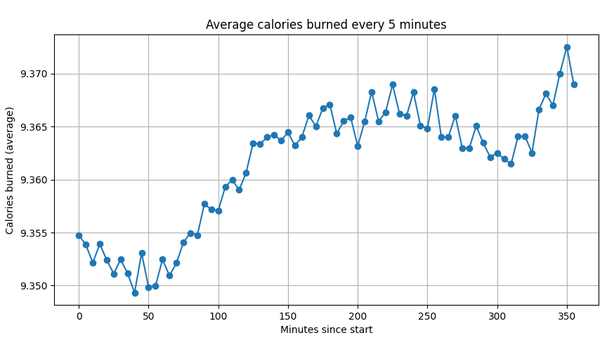
Averaged the calorie-burning variables across all participants and aligned them with time intervals of 5 minutes to analyze overall trends.
Approach of using calories burned as a guiding variable to segment and organize the raw, uncleaned train dataset, with the purpose of structuring the data before performing cleaning or exploratory analysis.

Slide 4
Averaged the calorie-burning variables across all participants and aligned them with time intervals of 5 minutes to analyze overall trends.
Time Range (minutes) | Time Interval (HH:MM) | Description
0–50 | 00:00–00:50 | Initial period
51–150 | 00:51–02:30 | Early metabolic activity
151–250 | 02:31–04:10 | Mid-phase activity
251–300 | 04:11–05:00 | Late-phase activity
301–355 | 05:01–05:55 | Final observation period

Slide 5
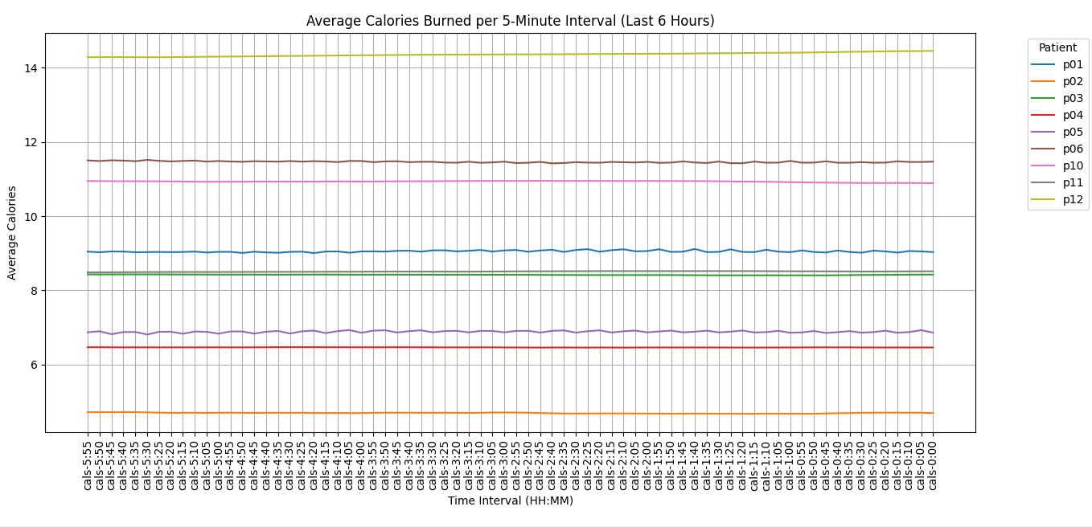

Slide 6
This table shows the total number of missing values (total_nulls) for each patient (p_num). It helps identify which patients have more incomplete data.
p_num | total_nulls
p02 | 8,066,184
p11 | 6,013,667
p04 | 5,721,123
p10 | 5,036,418
p03 | 4,816,878
p12 | 4,687,347
p05 | 2,169,868
p06 | 1,964,051
p01 | 1,819,258

Slide 7
This table summarizes the number of missing values for each patient (p_num) across different variable categories: blood glucose (bg), insulin, carbohydrates (carbs), heart rate (hr), steps, calories (cals), and declared activities. It highlights the extent and distribution of missing data per variable and per individual.
p_num | bg | insulin | carbs | hr | steps | cals | activity
p01 | 409686 | 0 | 599148 | 32689 | 186405 | 6252 | 585078
p02 | 22640 | 0 | 1839242 | 1464176 | 1566168 | 1328607 | 1845351
p03 | 18863 | 0 | 1851652 | 196203 | 782364 | 101844 | 1865952
p04 | 19507 | 0 | 1744331 | 879067 | 1117523 | 203292 | 1757403
p05 | 407515 | 0 | 587155 | 99260 | 347281 | 139284 | 589373
p06 | 407807 | 0 | 598281 | 118862 | 221574 | 29580 | 587947
p10 | 21642 | 0 | 1807092 | 136835 | 855589 | 448524 | 1766736
p11 | 28524 | 677556 | 1754561 | 668213 | 1047533 | 102636 | 1734644
p12 | 35500 | 0 | 1780392 | 113789 | 742497 | 199188 | 1815981
Due to the absence of
null values on insulin,
patient p11 is
removed from the dataset.

Slide 8
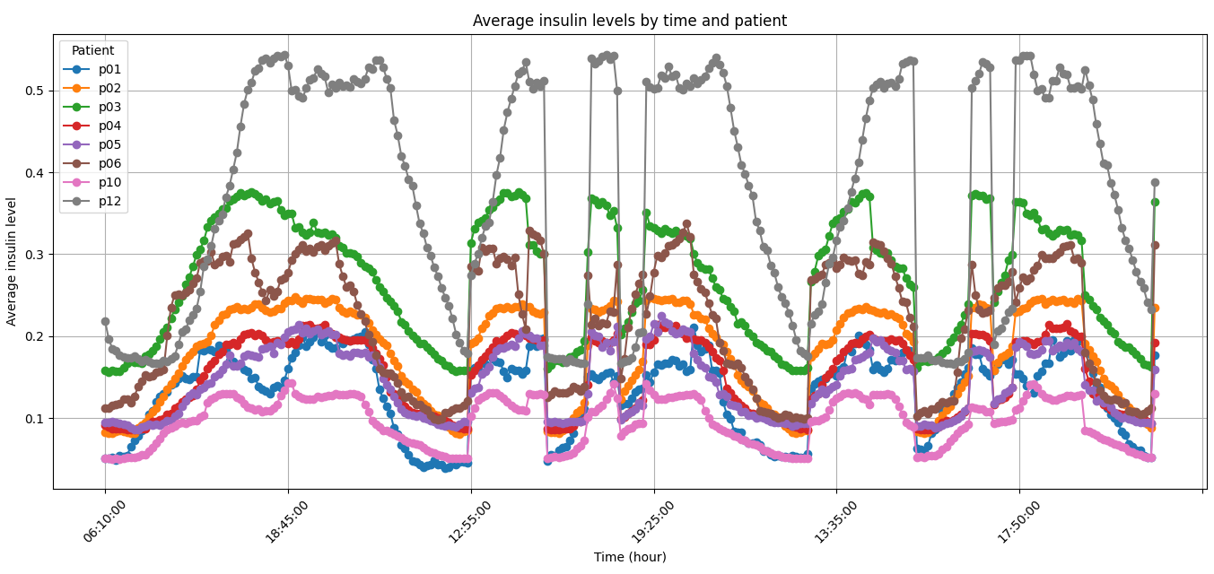
Since insulin is the only variable without missing data across patients, it is plotted to observe its behavior, revealing that patient 12 appears to receive insulin at a higher average level.
Insulin pumps
automatically deliver
personalized doses
of insulin throughout
the day,
which may explain the
variation in average insulin
levels between patients.

Slide 9
Insights
Inter-Patient Variability: There’s notable variation among patients.
Patient p06 (dark gray) shows the highest average insulin and sharpest peaks.
Patients p01 and p02 display the lowest insulin levels.
Others fall in between with their own patterns.

Slide 10
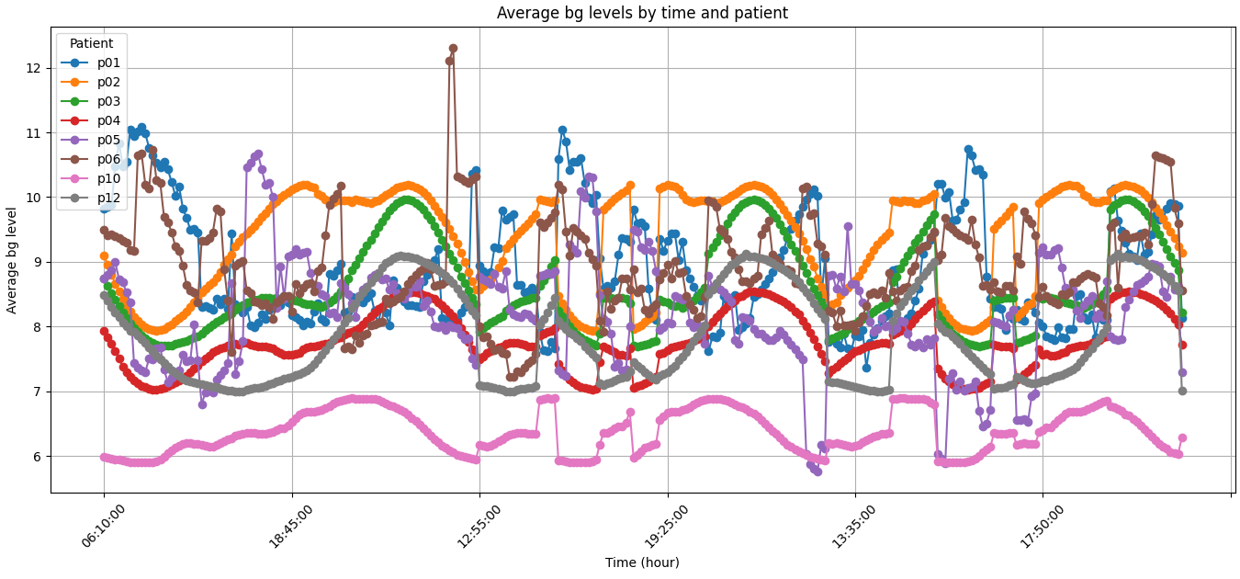

Slide 11
Insights
Patients p06 (dark gray) and p05 (purple) show the highest glucose levels, often exceeding 12, indicating maybe hyperglycemia (high level of glucose on blood)
Patients p01, p02, and p03 also show post-meal spikes but maintain baseline levels generally below 10.
Patient p12 (pink) has the lowest and most stable glucose, rarely exceeding 7, suggesting excellent control.

Slide 12
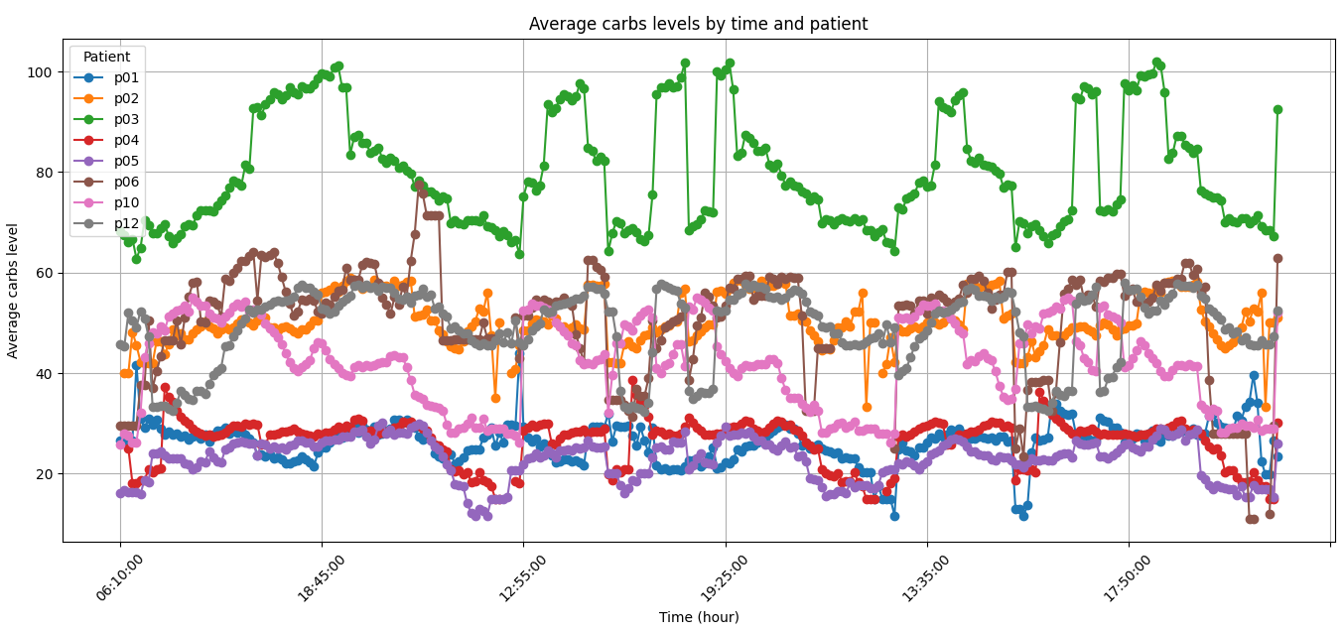

Slide 13
Insights
Meal-Time Peaks: A clear daily pattern of carbohydrate intake aligns with main meals — around 06:10 (breakfast), 12:55 (lunch), and 18:45 (dinner).
Most patients show distinct peaks at these times. This confirms that the insulin and glucose spikes observed earlier are directly linked to meal-related carb intake.
Patient p03 (green) consistently consumes the most carbs, with peaks above 100 and high baseline levels (~60–70).
Patients p04, p05, p06, and p10 have intermediate intake, often peaking above 50–60 grams.
Patients p01, p02, and p12 consume the least carbs.

Slide 14
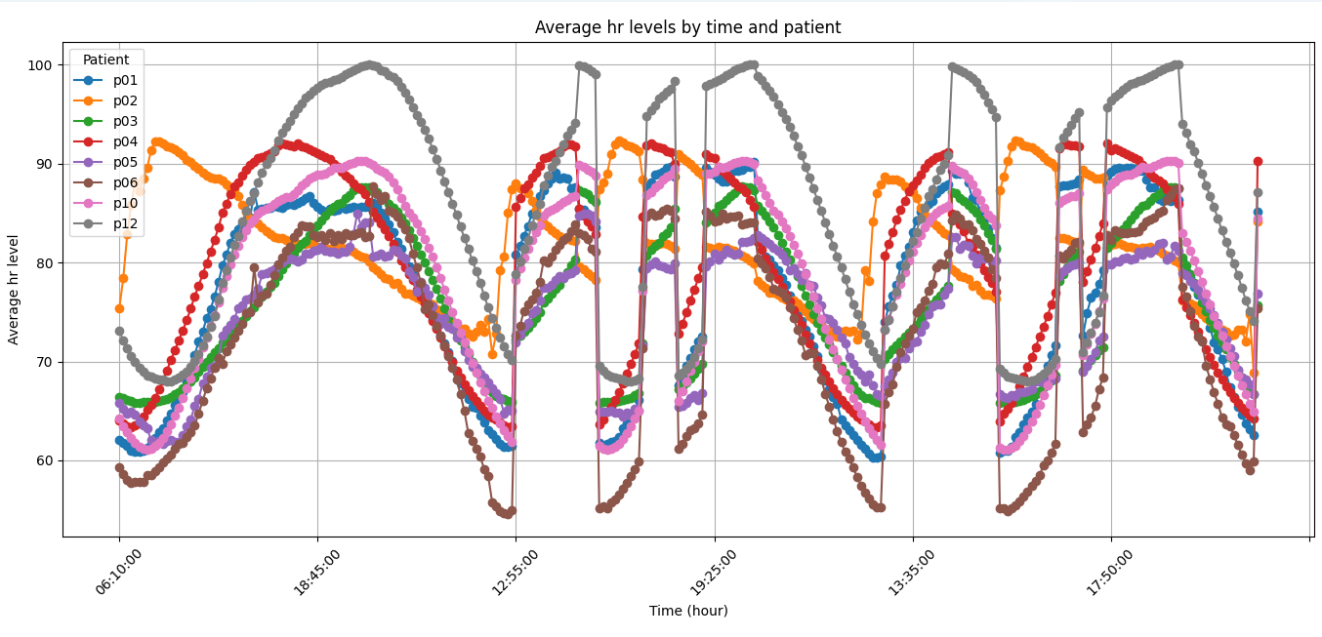

Slide 15
Insights
A clear and consistent daily pattern in heart rate is observed across most patients, closely linked to their activity-rest cycle.
Patient p06 (dark gray):Shows the highest heart rates throughout the day, with peaks around 100 bpm and relatively elevated resting levels.
Patients p01 (blue), p03 (green), and p04 (dark purple):Also display elevated peaks (85–95 bpm) during active periods.
Patient p12 (pink):Has the lowest overall heart rate, with rare peaks above 80–85 bpm and very low resting levels (~60 bpm).

Slide 16
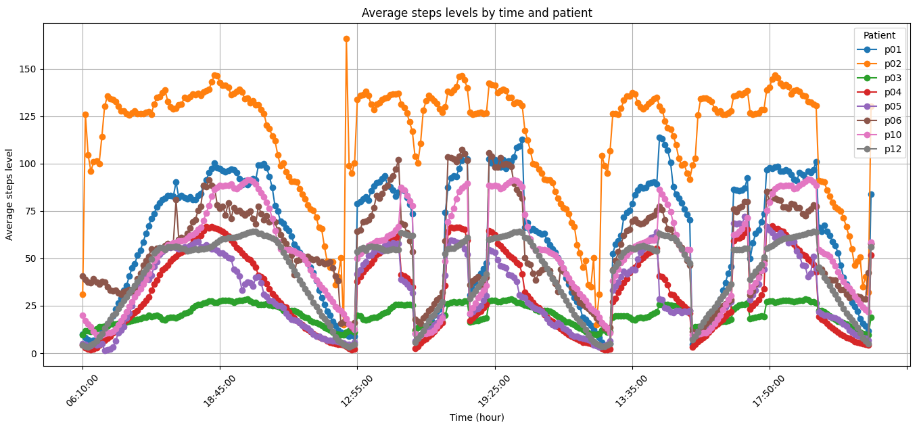

Slide 17
Insights
Low activity is observed during early morning hours (before 06:10), reflecting periods of sleep or rest.
Step counts increase significantly throughout the day, with activity peaks typically around morning, midday (≈12:55), and early evening (≈18:45)
Patient p02 (orange line) is by far the most active, consistently recording the highest step counts.
Patient p01 (blue line) also shows considerable activity, with peaks frequently above 75–100 steps.On the opposite end, patient p03 (green line) is notably sedentary.
Other patients (p04, p05, p06, p10, p12) fall within an intermediate range, each displaying distinct activity patterns.

Slide 18
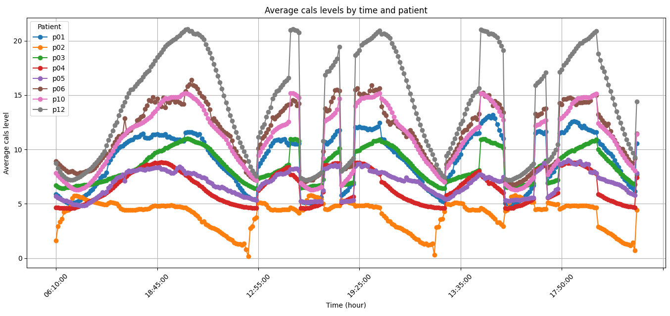

Slide 19
Insights
Patient p06 (dark gray) consistently burns the most calories, with peaks exceeding 20.
Patient p02 (orange), despite being the most active in terms of steps, has a surprisingly low average calorie burn, with peaks barely above 5.
Patients p04 (dark purple), p05 (light blue), and p10 (brown) show intermediate calorie burn, with peaks around 15–16.
Patients p01 (blue) and p03 (green) exhibit lower calorie expenditure.
Patient p12 (pink) has relatively low calorie burn, consistent with their minimal step count.

