Slide 1
What is Data Science?
- A Colaberry Data Science Module

Slide 2
Agenda
Industry landscape
What tools to use and when?
Careers in Data Sciences

Slide 3

Industry Landscape

Slide 4





Data is Omnipresent!
400 Million
Number of tweets per day on Twitter
3 Billion
Number of ‘Likes’ each day on Facebook
90%
Data
OF THE WORLD’S DATA WAS GENERATED IN THE
LAST TWO YEARS
10 TB
Data generated in one flight from NY to London
7 Billion
Shares traded on US Stock Markets each day

Slide 5
Types of Analysis
Descriptive Analysis
Diagnostic Analysis
1
2
Mining data to provide
business insights
What happened?
Understanding the root cause
of a certain trend
Why did it happen?
Analysis
Prescriptive Analysis
4
3
Predictive Analysis
Enabling smart decisions
based on data
How to respond to future events?
Predicting the future based on historical patterns
What could happen?

Slide 6






Types of Analysis – Examples
How does Netflix frequently recommend just the right movie?
Why did Samsung’s stock perform badly in the year 2016?
How do grocery cashiers know to hand you coupons you might actually use?
Why do airline prices change every hour?
Descriptive
Analysis
insight into the past
Diagnostic
Analysis
Identify the root cause
Predictive
Analysis
understanding the future
Prescriptive Analysis
advice on possible outcomes

Slide 7
Types of Analysis - Python
Descriptive
Analysis
insight into the past
Methods:
Exploratory Data Analysis
Data Visualization
Data Aggregations
Libraries:
Numpy
Pandas
Matplotlib
Seaborn
Plotly
Stats Models
Diagnostic
Analysis
Identify the root cause
Methods:
Bayesian Models
Bayesian Networks
Graphical Models
Libraries:
PyMC3
PgmPy
Scikit Learn
Stats Models
Numpy
Methods:
Regression
Classification
Unsupervised Learning Models
Libraries:
Scikit Learn
Scipy
Stats Models
NLTK
Tensorflow
Predictive
Analysis
understanding the future
Methods:
Recommendation Engines
Neural Networks
Multiclass Classifiers
Reinforcement Learning
Libraries:
Scikit Learn
Scipy
Tensorflow
Theano
Keras
Prescriptive Analysis
advice on possible outcomes

Slide 8
What tools to use and when?

Slide 9





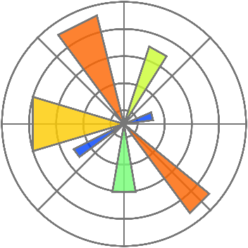

Tools used in this program
The program is developed keeping in mind the needs of an evolving Analytics industry that requires individuals to be “job-ready” from Day 1.

Slide 10



Data Science tool usage survey
Python
is the most
popular
language
Jupyter
Notebooks
is the widely
used IDE
TensorFlow
is the most
popular
framework
*Source : Kaggle 2017 the state of Data Science Survey https://www.kaggle.com/surveys/2017

Slide 11
Why Python?
Python offers extensive analytics capabilities for Text & Predictive Analytics.
Python is a powerful, flexible, open-source language that is easy to learn, easy to use, and has powerful libraries for data manipulation and analysis
iPython & Spyder IDEs are widely used for data mining.
What are the reasons for its sudden popularity?
Big Data Analytics made possible by PyDoop and Scipy
Cost of Ownership
Python is an open source software that is free to download.
A Data Scientists’ Dream
Python is particularly useful in data analytics because it has a rich library for reading and writing data, running calculations on the information and creating graphical representations of data sets.
We can write map reduce programs in python using PyDoop. Here is where Python scores over R. While R uses in-memory processing, Python using PyDoop can process Peta Bytes of data
Integration
Versatility
Multi-purpose language that can be used to build an entire application
In industry, the data science trend shows increasing popularity of Python. A Python-based application stack can more easily integrate a data scientist who writes Python code, since that eliminates a key hurdle in deploying a data scientist's work to production server.
Big data compatibility
Python has become one of the big go-to languages for big data processing due to its wide selection of libraries

Slide 12


Python Vs R
General purpose programming language
Longer code blocks with easy debugging features
A wide variety of packages are available
Production Ready
R is built specifically for statistical data analysis
Statistical Models can be built in few lines of code
Superior number of statistical packages available
Can be made production ready

Slide 13
Careers in Data Science

Slide 14















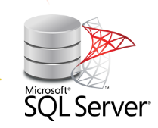







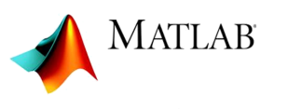

Comparison of various Data jobs
Data Analyst
Data Scientist
Data Engineer
ML Engineer

Slide 15

Career options
FIELDS IN ANALYTICS
MIS
REPORTING
NON-PREDICTIVE ANALYTICS
PREDICTIVE ANALYTICS
MACHINE LEARNING
Data management
Data Exploration
MIS and report creation
Automation of reports
Segmentation
Customer profiling
Portfolio Analysis
Trend Analysis
Forecasting
Probability models
Classification and regression trees
Time series models
Neural networks
Multi-layer Perceptron
Geospatial models
Associative rule learning
Inductive logic programming
KEY FEATURES
No matter what your educational background or aspirations, you have a fulfilling career in one of the many fields of Business Analytics.
Undergrads (Science and other fields)
Undergrads (Science and other)
Masters (Science and ither
Undergrad (Statistics)
Masters (Science or Statistics)
PhD (Statistics)
Undergrad (Computers)
Masters (Computers)
PhD
TARGET AUDIENCE
MIS Analyst
Data Analyst
Strategy Analyst
Cost Analyst
Pricing Analyst
Data Scientist
Statistician
Machine Learning Engineer
Research Scientist
Artificial Intelligence Developer
INDICATIVE JOB ROLES

Slide 16
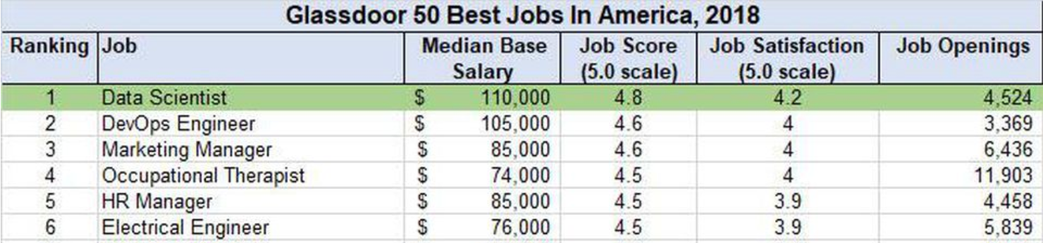
Best Job of 2018
Data Scientist
The top jobs in terms of median base salary, job satisfaction and available opportunities are Data Scientist and DevOps Engineer. Software Engineer has the highest number of available opportunities, but scores low on job satisfaction and pay scale.
The
Best
Job
2018
Of
Glassdoor Jobs Review, 2018

