Slide 1

Industry Landscape

Slide 2

Data Everywhere!
Shares traded on US Stock Markets each day:
Data generated in one flight from NY to London:
DATA
7 Billion
10 Terabytes
Number of tweets per day on Twitter:
Number of ‘Likes’ each day on Facebook:
400 Million
3 Billion
90
%
OF THE WORLD’S DATA WAS GENERATED IN THE
LAST TWO YEARS
2

Slide 3

What is Analytics?
Data on its own is useless unless you can make sense of it!
WHAT IS ANALYTICS?
The scientific process of transforming data into insight for making better decisions, offering new opportunities for a competitive advantage
3
Notes:
Business Analytics refers to the practice of investigation of past business
performance, using data and statistical models in order to develop new insights and
understanding of future business performance. It makes extensive use of statistical
and quantitative analysis, explanatory and predictive modeling and fact-based
management to drive decision-making.

Slide 4
The Case for Business Analytics
BUSINESS NEED
The Business environment today is more complex than ever before.
Businesses are expected to be diligently responsive to the increasing demands of customers, various stakeholders and even regulators.
SOLUTION
Organizations have been turning to the use of analytics.
More than 83% of Global CIOs surveyed by IBM in 2010 singled out Business Intelligence and Analytics as one of their visionary plans for enhancing competitiveness.
GOAL
In most cases the primary objective of an organization that seeks to turn to analytics is:
Revenue/Profit growth
Optimize expenditure
4
Notes:
Some of the key business challenges that organizations face in this regard are elicited in the next slide.

Slide 5
Types of Analytics
1
Prescriptive Analytics
Enabling smart decisions
based on data
What should we do?
Analytics
2
3
Predictive analytics
Descriptive analytics
Predicting the future based on historical patterns
What could happen?
Mining data to provide
business insights
What has happened?
5

Slide 6


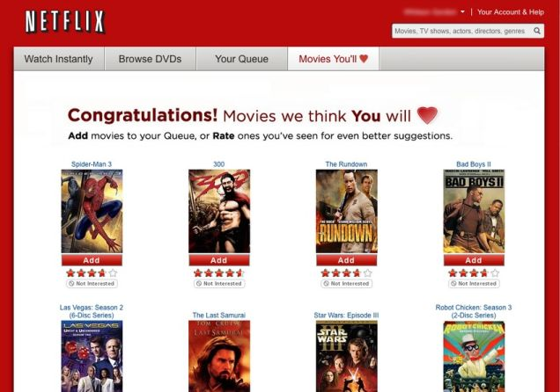
Types of Analytics
Why do airline prices change every hour?
Prescriptive Analytics
advice on possible outcomes
How do grocery cashiers know to hand you coupons you might actually use?
Predictive
Analytics
understanding the future
How does Netflix frequently recommend just the right movie?
Descriptive
Analytics
insight into the past
6
Notes:
There are typically four functions in analytics domain for an individual to choose from.
Decision Science Management:
Responsibility: This function is involved in developing statistical models to address a particular business problem. The models so developed is evaluated after regular intervals and enhanced to suit the changing environment encompassing the business problem. Historically 70% of work involves tracking and monitoring model performance and 30% of work building models.
Significance: The resulting models are used for decision making in various industries such as
Financial Industry: Credit card approvalwith pre-assigned credit limits, identifying credit defaulters in advance, mitigating credit cards fraud through risk scores etc.
Retail Industry: Cross Selling strategy, identifying customer’s propensity to buy certain products etc.
Pharmaceutical Industry: Predicting false claims, Building Sales effectiveness plan
Manufacturing : The reliability of expensive components
Why this function: If candidate is interested in statistics and complex data processing for meaningful insights then this would be apt function. Though, this function demands command on statistics after a while the work becomes monotonous in terms of monitoring and evaluations.
Business Analysis / Business Consulting:
Responsibility: This function is involved in understanding day to day business problems on a regular basis by analyzing data. The output is generally Dashboard, ppt with meaningful insights for business to take actions for the key problems at stake. The role would be more like a front end consulting profile which should have the required business knowledge and fair understanding of extensive data research.
Significance: The scope of this function is quite large. This function is quite important for any business to understand and manage the existing and future business challenges. Though there are numerous data based solutions and strategies come from this function, here are few example of the typical outputs
i. Financial Industry:
Marketing strategy
in terms of whom target, what to offer, when to offer
ii. Retail Industry: Brand positioning, marketing strategy, product mix for cross sell
Why this function: If candidate is interested in being a domain expert and has an affinity towards consulting then this is the ideal function. Being a front end role, this requires good amount of domain knowledge along with sound interpersonal skills.
Customer Information Management
Responsibility: This team is involved in setting and managing the data warehouse used for any type of data analysis. This function is the backbone of analytics as managing data in most efficient manner for access and re-use is of primary importance. The knowledge on basic ETL and Business Intelligence tools are essential for choosing this function.
Significance: Typically all major/minor organizations require data management solution and hence this function is not limited to any particular industry but cater a broad spectrum of industries starting from energy, manufacturing, technology, finance, retail, pharmaceutical and many more.
Why this function: If candidate has inclination towards coding and has capability to debug day to day data problems then this is an apt function. This would also expose the candidate to various types of database management like Oracle, Mainframe, Big Data etc. which needs patience and willingness to learn new concepts.
Management Information System
Responsibility: This function is very critical to run smooth business in ever changing environments to take corrective actions. The team is involved in management dashboard building, providing critical information to management on a regular basis.
Significance: Without this function, management is helpless to assess what’s going in and around the business. The requirement for this role can be seen across all industries and hence is always in demand in the job market.
Why this function: If candidate is interested in coding along with an intention to develop business skills, this role will be suitable for such candidates. Thought work will be routine but the requirement in this function is always in demand.

Slide 7

Growing Need for Analytics
Generation of Large Amount of Data from Business Transactions
DATA HARNESSING
Companies store each piece of information generated during the business operations and customer interactions.
DATA VOLUMES
Data is generated.
Data is analyzed.
2010
1.2
2012
2.4
Learning from the data is used in the decision making and process optimization.
2015
7.9
Volumes in Trillion GB
DID
?
Number of transactions every year
Number of Stores
Number of SKUs
YOU
4 Billion
10000
-1 lakh
900
KNOW

Slide 8
Enter Data Scientists
Data Scientist:
A Business analyst is not able to discover insights from huge sets of data of different domains.
Data scientists can work in co-ordination with different verticals of an organization and find useful patterns/insights for a company to make tangible business decisions.
The
Best
Job
21
ST
Of The
century
15,000%
INCREASE IN JOB POSTINGS FOR DATA SCIENTISTS IN THE US BETWEEN 2011-12
Harvard Business Review, Oct 2012
www.imarticus.org
8
Notes:
A Business analyst is not able to discover insights from huge sets of data of different domains.
That’s where data scientists are hired.
Data scientists can work in co-ordination with different verticals of an organization and find useful patterns/insights for a company to make tangible business decisions. A business analyst never knew that data would become highly unstructured and difficult to analyze with the 3 v’s.

Slide 9
Demand for Analytics Professionals in India
Domestic Market
Analytics Market
Job Openings
$ 250 Million
Jan, 2016
$ 1.7 Billion
Jan, 2016
100,000
Jan, 2016
$ 375 Million
Projected for 2018
$ 2.3 Billion
Projected for 2018
2,50,000
Projected for 2018
Source: NASSCOM
Salary Report
Experience
0-2 Years
2-5 Years
5-10 Years
10+ Years
Salary in INR
4.5 Lakhs
9 Lakhs
16 Lakhs
25 Lakhs
9
Notes:
http://www.business-standard.com/article/technology/nasscom-boost-to-big-data-analytics-114062700723_1.html

Slide 10

New Analytics Jobs By Industry
Analytics Services and Pharma lead the pack in the highest percentage
of Analytics jobs being created in developing nations.
US
INDIA
CHINA
UK
BRAZIL
JAPAN
SINGAPORE
ANALYTICS SERVICES
11%
54%
25%
9%
14%
6%
9%
PHARMA
14%
24%
32%
19%
30%
44%
26%
INSURANCE
39%
7%
8%
32%
11%
27%
24%
BANKING
20%
11%
22%
25%
19%
14%
25%
OIL & GAS
14%
3%
10%
13%
23%
8%
9%
COMMUNICATIONS TECHNOLOGIES
2%
1%
3%
2%
3%
1%
7%
TOTAL NUMBER OF JOBS
38,700
31,500
30,500
7,000
6,200
2,400
1,300
10
Notes:
http://www.business-standard.com/article/technology/nasscom-boost-to-big-data-analytics-114062700723_1.html

Slide 11
Know Your Tools & Why Learn About Them?

Slide 12



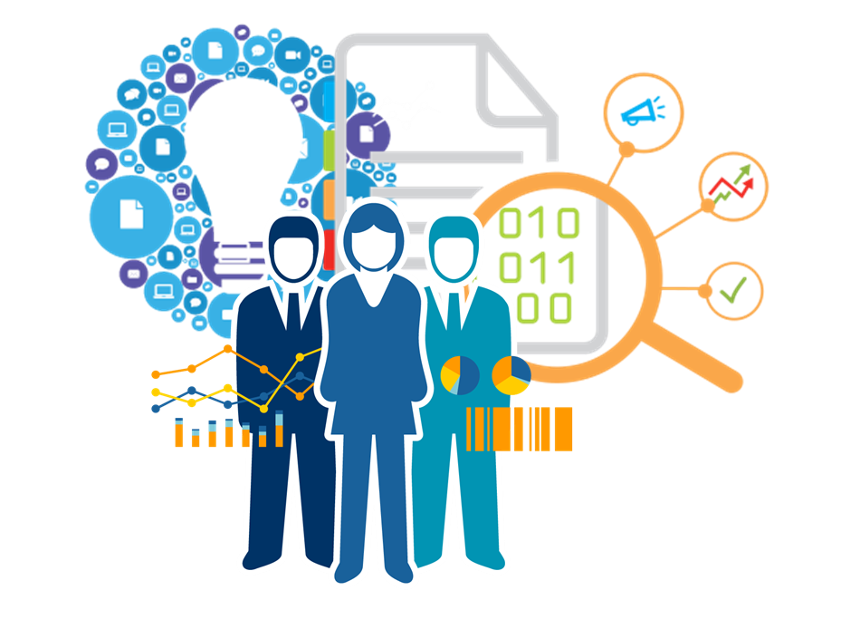


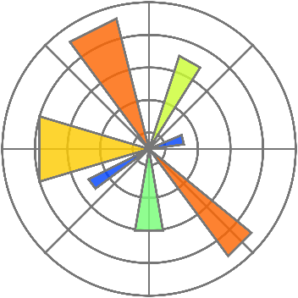
Tools used in this Program
The program is developed keeping in mind the needs of an evolving Analytics industry that requires individuals to be “job-ready” from Day 1.
12

Slide 13
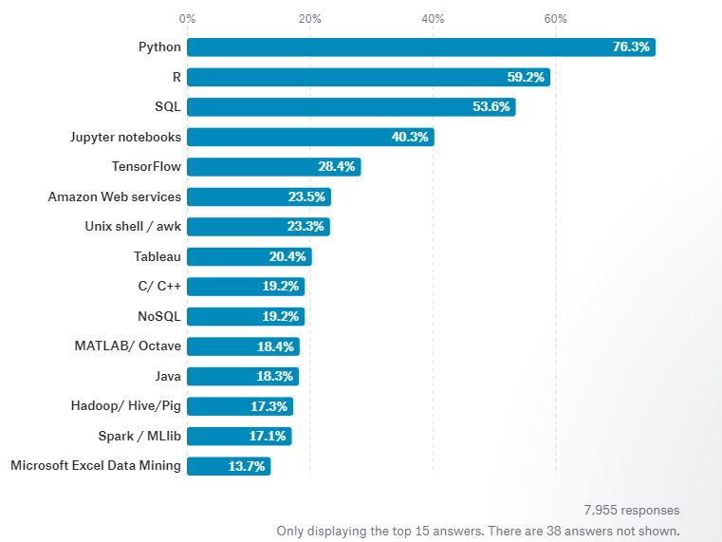
Data Science Tool Usage Survey
13

Slide 14
Why Python?
Python is a powerful, flexible, open-source language that is easy to learn, easy to use, and has powerful libraries for data manipulation and analysis
What are the reasons for its sudden popularity?
Cost of Ownership
Python is an open source software that is free to download.
Versatility
Multi-purpose language that can be used to build an entire application
Big data compatibility
Python has become one of the big go-to languages for big data processing due to its wide selection of libraries
Python offers extensive analytics capabilities for Text & Predictive Analytics.
A Data Scientists’ Dream
Integration
Python is particularly useful in data analytics because it has a rich library for reading and writing data, running calculations on the information and creating graphical representations of data sets.
We can write map reduce programs in python using PyDoop. Here is where Python scores over R. While R uses in-memory processing, Python using PyDoop can process PetaBytes of data
In industry, the data science trend shows increasing popularity of Python. A Python-based application stack can more easily integrate a data scientist who writes Python code, since that eliminates a key hurdle in productionizing a data scientist's work.
IDLE & Spyder IDE is widely used for data mining.
Big Data Analytics made possible by PyDoop and Scipy
www.imarticus.org
14

Slide 15
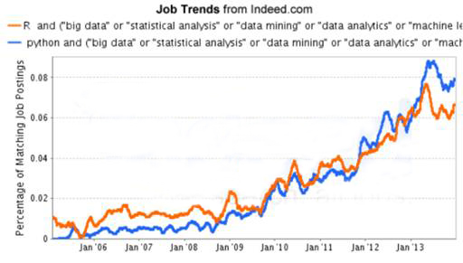
Why Python?
46% of job ads mention Python
(after SQL)
2nd most
popular data science language
Official language of Google
Among top
in-demand data science skills
KDNuggets
Dec 2014
Ranked #1 of
all programming languages
KDNuggets 2013
KDNuggets,
Dec2014
Codeeval rankings, Feb 2015
Companies Already
Onboard Python
IBM
National Weather Service
& Many More…
Google
Yahoo
Quora
Nokia
ABN
AMRO Bank
www.imarticus.org
15

Slide 16
Why R?
Highest Paid IT Skill
75% of data professionals use R
Supports close to 10,000 free packages
Linkedin Skills and O'Reilly Survey, 2016
Rexer Survey,
Oct 2015
Second best programming languages for data science
CRAN Figure as on December 2016
Most-used data science language after SQL
O’Reilly Survey,
Jan 2014
O'Reilly Survey, 2016
Companies Already Onboard R
R is the #1 Google Search for Advanced Analytics software Google Trends, April 2016
Facebook
Google
Twitter
McKinsey
ANZ Bank
BCG
Uber
Lloyds of London
& Many More…
R is #13 of all Programming Languages
Redmonk Language Ratings, June 2015
Demand for R language skills is on the rise.
www.imarticus.org
16
Notes:
http://www.listendata.com/2016/12/companies-using-r.html
http://www.slideshare.net/GilJGH/r-as-supporting-tool-for-analytics-and-simulation

Slide 17

What is Data Visualization?
Data visualization is the presentation of data in a pictorial or graphical format. For centuries, people have depended on visual representations such as charts and maps to understand information more easily and quickly.
17

Slide 18
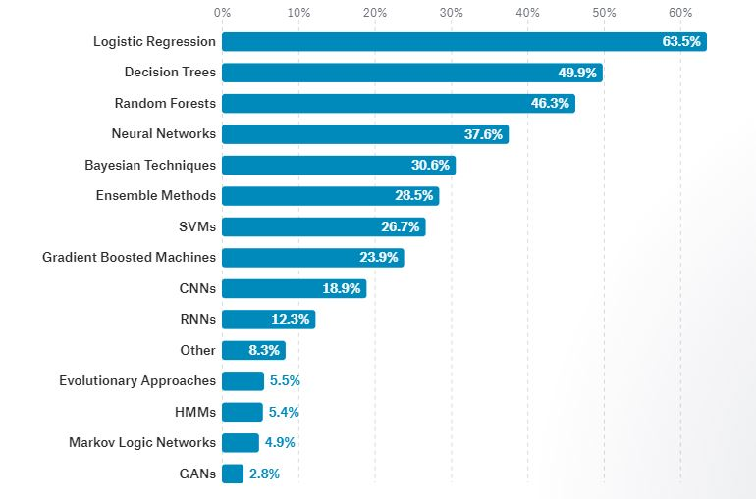
Algorithms used in Industry:

Slide 19
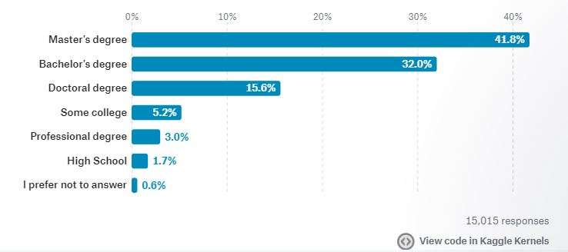
Education of Data Science professionals

Slide 20
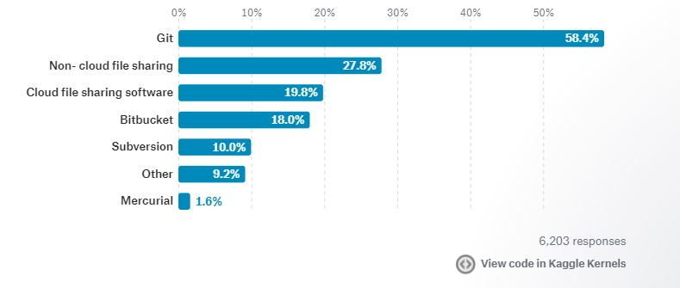
Code sharing at workplace

Slide 21
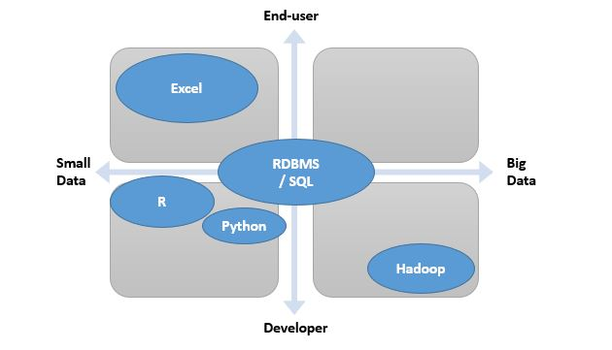
Choosing tools based on data

Slide 22
Careers in Analytics

Slide 23
Career Options in Analytics
No matter what your educational background or aspirations,
you have a fulfilling career in one of the many fields of Business Analytics.
FIELDS IN ANALYTICS
MIS
REPORTING
NON-PREDICTIVE ANALYTICS
PREDICTIVE ANALYTICS
MACHINE LEARNING
Data management
Data Exploration
MIS and report creation
Automation of reports
Segmentation
Customer profiling
Portfolio Analysis
Trend Analysis
Forecasting
Probability models
Classification and regression trees
Time series models
Neural networks
Multi-layer Perceptron
Geospatial models
Associative rule learning
Inductive logic programming
KEY FEATURES
BCom
B.E
BTech
BCom
B.E
BTech
MBAs
B.E
BTech
MSc (Statistics)
MBAs
MCA
B.E
BTech
MSc (Statistics)
MBAs
MCA
TARGET AUDIENCE
MIS Analyst
Data Analyst
Strategy Analyst
Cost Analyst
Data Scientist
Statistician
Advanced Analytics – Team Manager
Market / Global Research Analyst
Analytics Manager
INDICATIVE JOB ROLES
www.imarticus.org
23

Slide 24
Career Path and Indicative Salaries (CTC)
CAREER TRAJECTORY
Skills require to succeed in the Industry
Strong analytical and critical thinking skills
Statistics
Predictive Analytics
SQL Knowledge
Understanding complex data & tools for Analytics
Soft Skills & Communication
Business Understanding
15+ Yrs
Director
10-15 Yrs
Average Salaries
VP
6-10 Yrs
AVP
Director
Rs. 35-40 Lakhs
4-6Yrs
AVP
Rs. 22-27 Lakhs
Manager
Manager
Rs. 15-19 Lakhs
2-4 Yrs
Senior Analyst
Senior Analyst
Rs. 9-11 Lakhs
0-2 Yrs
Analyst
Analyst
Rs 4-6 Lakhs
www.imarticus.org
24

Slide 25












Careers
Top Companies Hiring for
Analytics
Rs. 15-20 Lakhs
Rs. 9-15 Lakhs
www.imarticus.org
25

Slide 26
RefactorED.ai is an advanced browser based platform for learning and practicing data science and machine learning techniques.
All key concepts, execution engine to learn by doing various exercises and industry workshops offered completely within a browser for a great head-start.

Slide 27
By Data Scientists. For Data Scientists
Courses on Refactored have been created by data science experts and practitioners that offer a practical and industry driven context for understanding key concepts of data science.
Each course feature real world context for key concepts, practicing lab exercises, data visualization tools and a project to connect all together to gain in-depth knowledge and an opportunity to provide practical solutions to real life problems.

Slide 28
Current Partnerships of Refactored.ai
University at Buffalo, SUNY
University of Texas at Dallas
Boston College
Narsee Monjee Hyderabad
JNTU Hyderabad
IIIT Hyderabad

