Slide 1


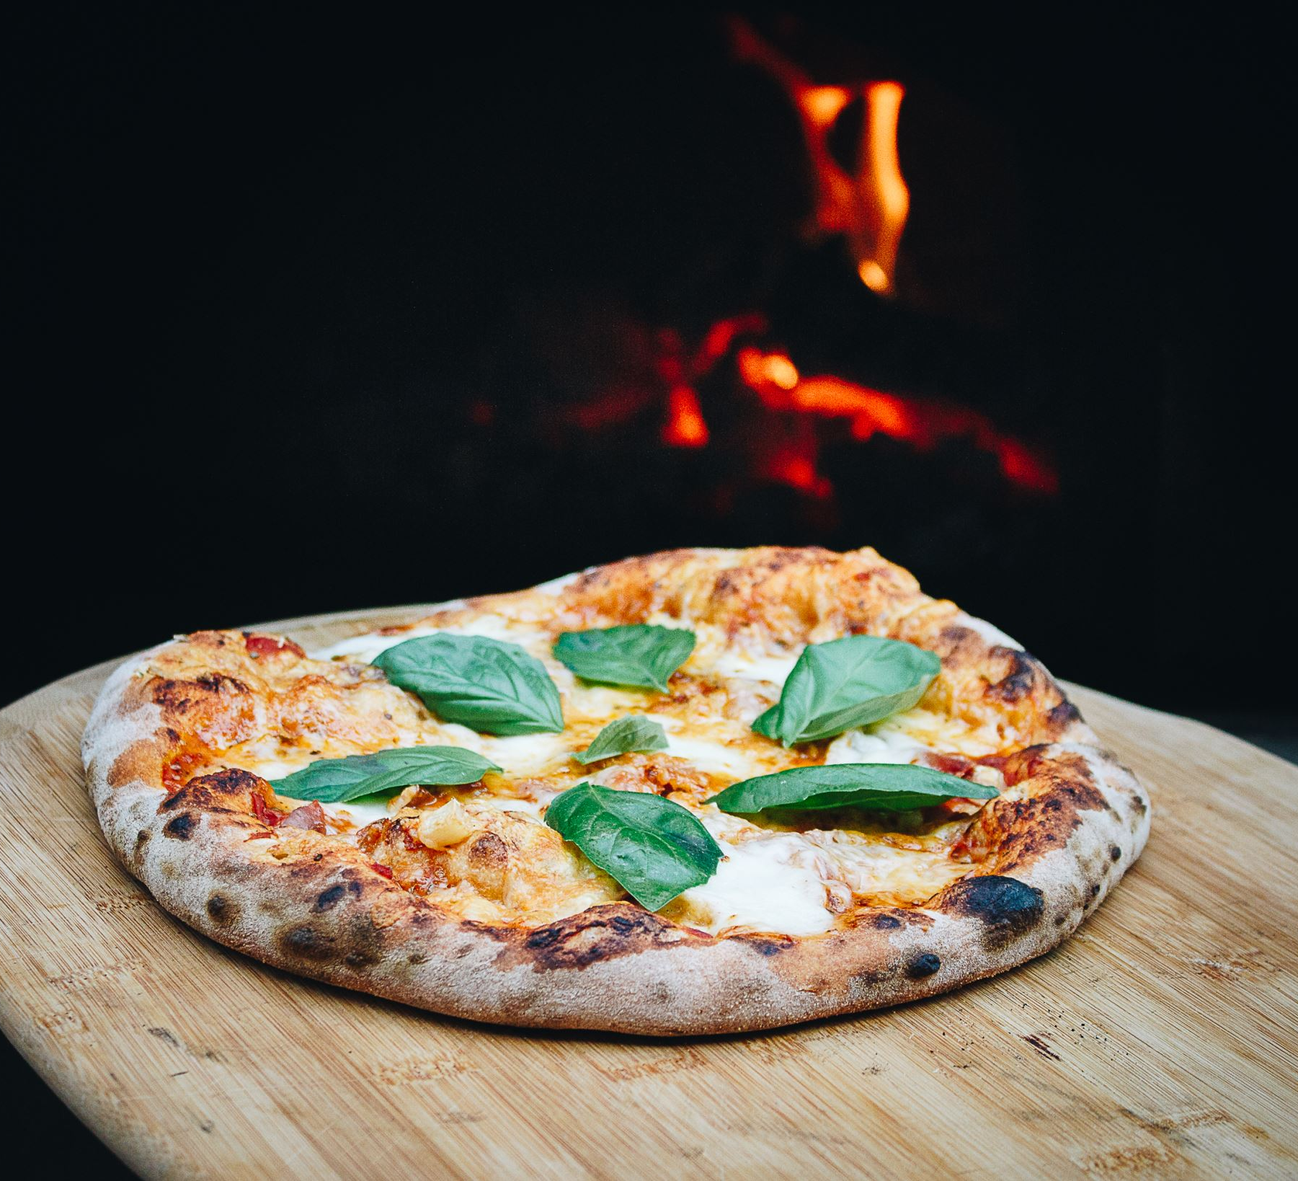
Pizza Clicker
By: Quentin Loree

Slide 2
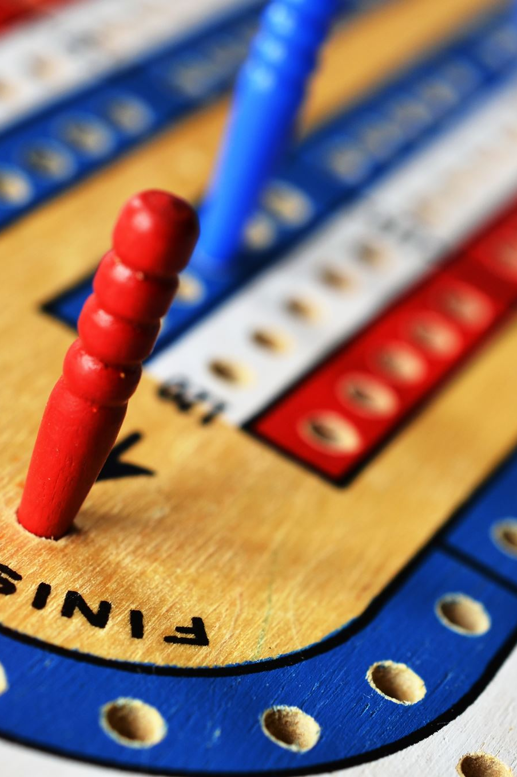
Purpose
Pizza Clicker is an incremental game based off the popular game ‘Cookie Clicker’.
It’s meant for anyone who wants to have a stress-free game they can run in the background as they go about their day that they can quickly tab in and out of with ease.
My goal with this is to create a short and fun experience for people to play.

Slide 3
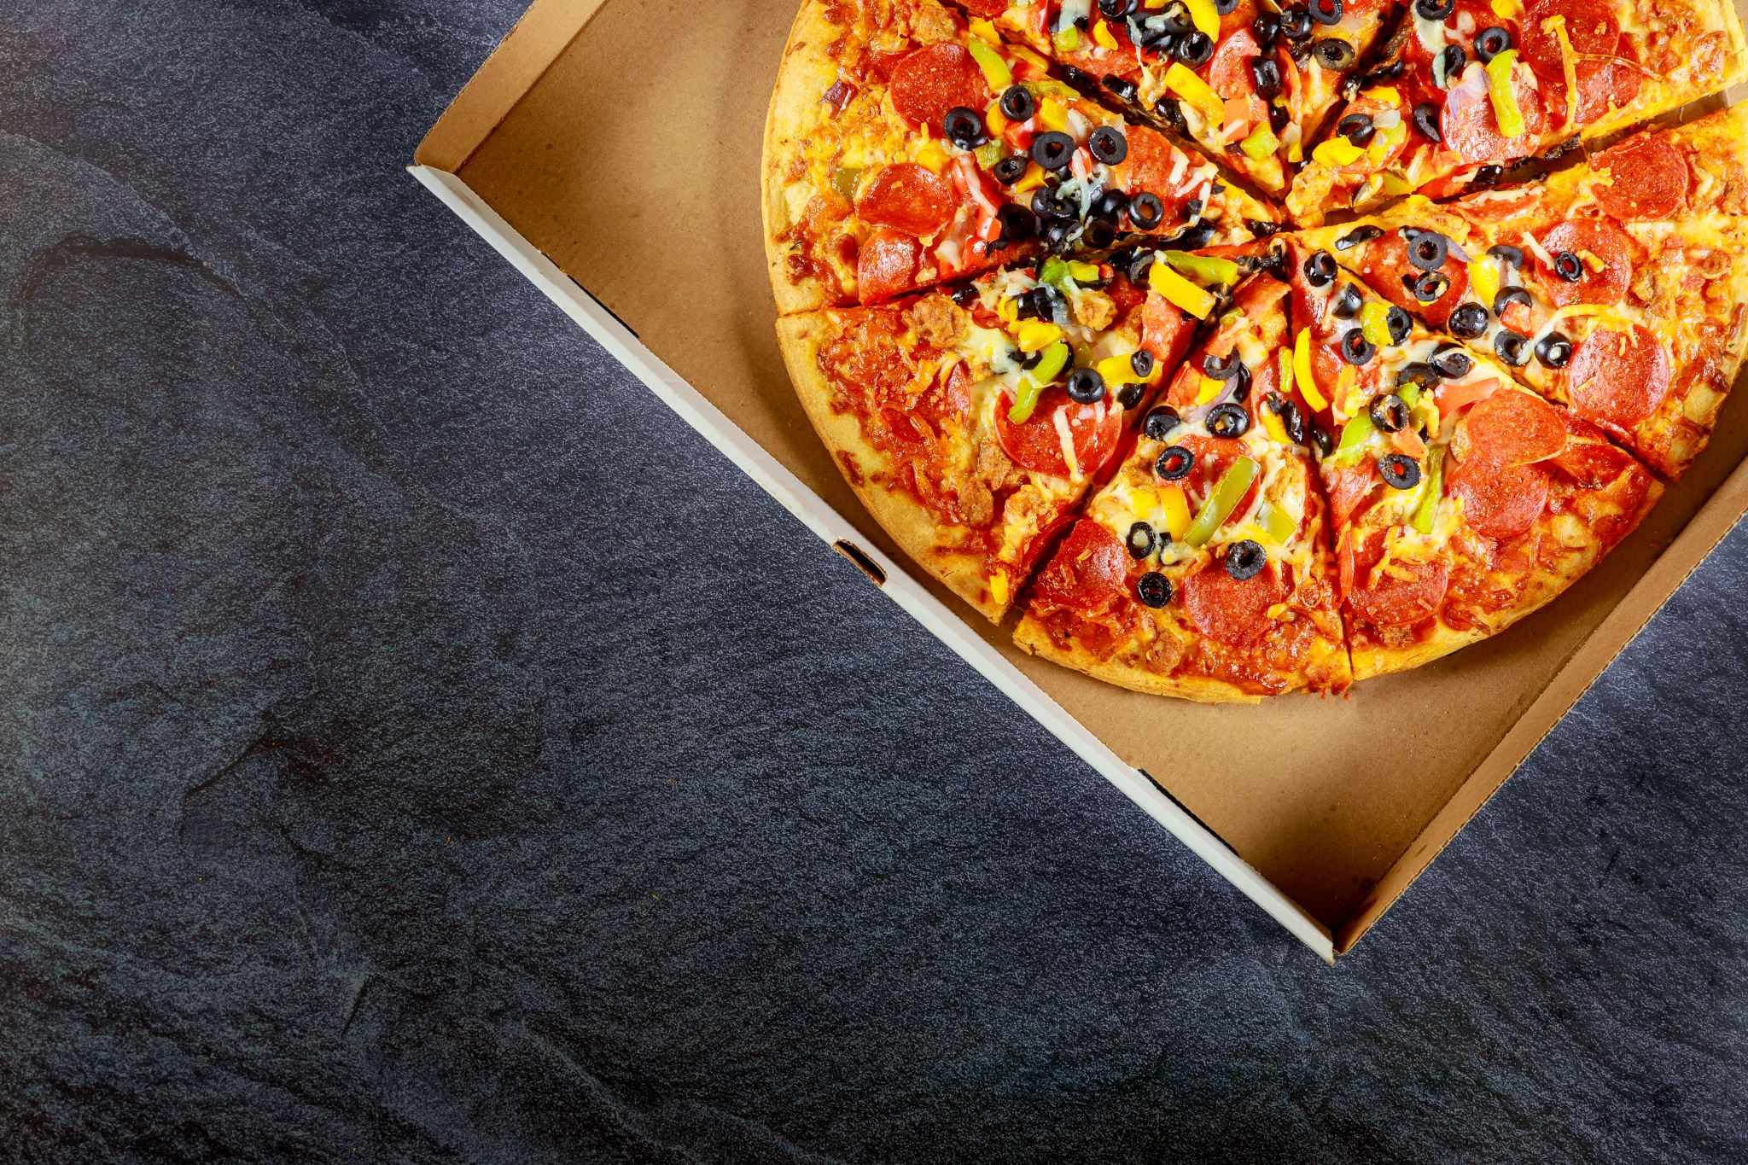
What is this game about?
As mentioned before Pizza Clicker is an incremental video game.
An incremental game is a game where players repeatedly perform the same action (in this case clicking on a pizza) to earn a currency (pizzas) that they can use to purchase automation items. These items will ‘click’ the pizza for you, helping you gain more currency to buy more automation items.

Slide 4
Pizza Clicker Features
My program features the following:
A pizza counter displaying how many pizzas you have
A passive pizzas counter displaying how many automated pizza clicks per second you have.
9 upgrade items helping you grow your automation quickly.
Save and Load feature to keep track of your progress
Jazzy background music

Slide 5

UML Class Diagram Summary (Oversimplified)
PizzaClickerApp
This is my main application class which handles the UI and user interactions like displaying the pizza counter at the top, the upgrades box, and passive pizza label.
PizzaGame
This handles the game logic of the prior’s elements, as well as listing the available upgrades.
musicStuff
This handles the looping background music and is separate from the main file.

Slide 6
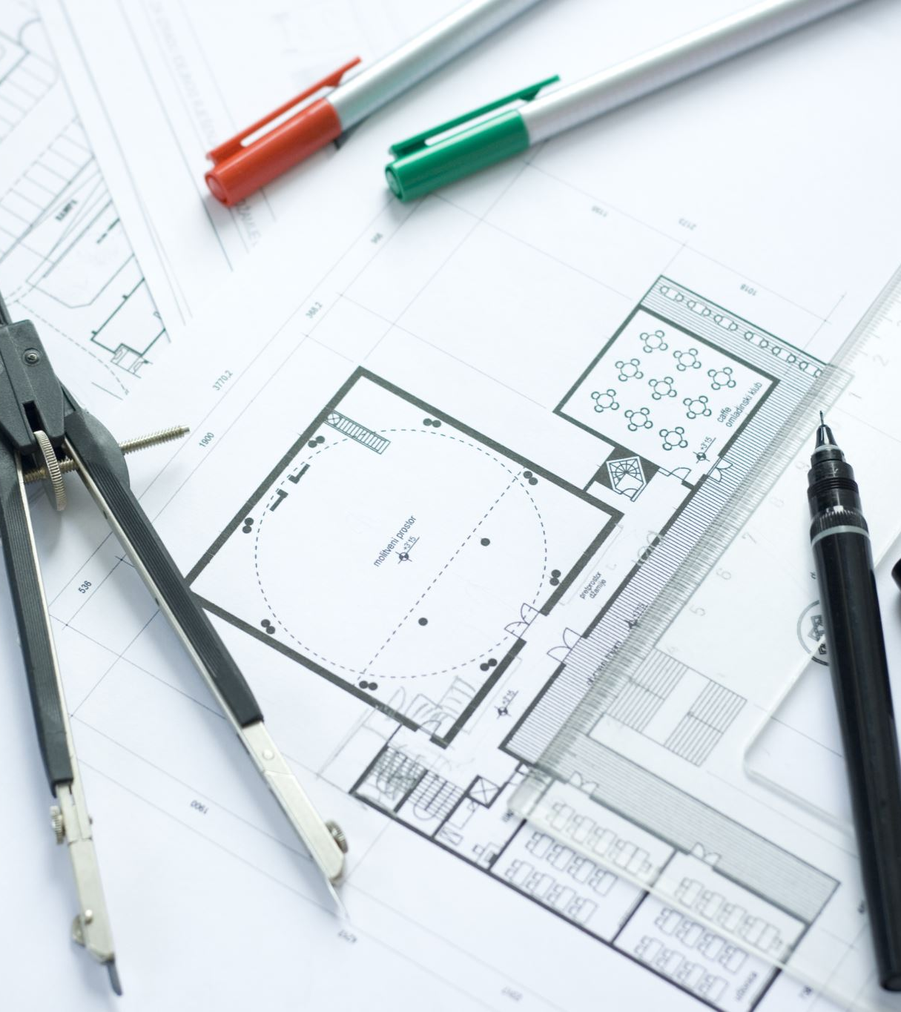
What did I learn?
It’s important to have a plan before starting work on a project.
Lack of initial plan
Added features as I went
Obviously, a lot about java
Images
Buttons
Music
Things are usually simpler in your mind than in reality.

Slide 7
Wishlist
More sounds
Every time an upgrade it purchased, play an audio file
Icons for all the upgrades
A volume slider for the music
More robust saving system
Autosave
More visual flair
Have a cluster of tiny pizza’s fly onto the screen when you buy your first of each upgrade

