Slide 1
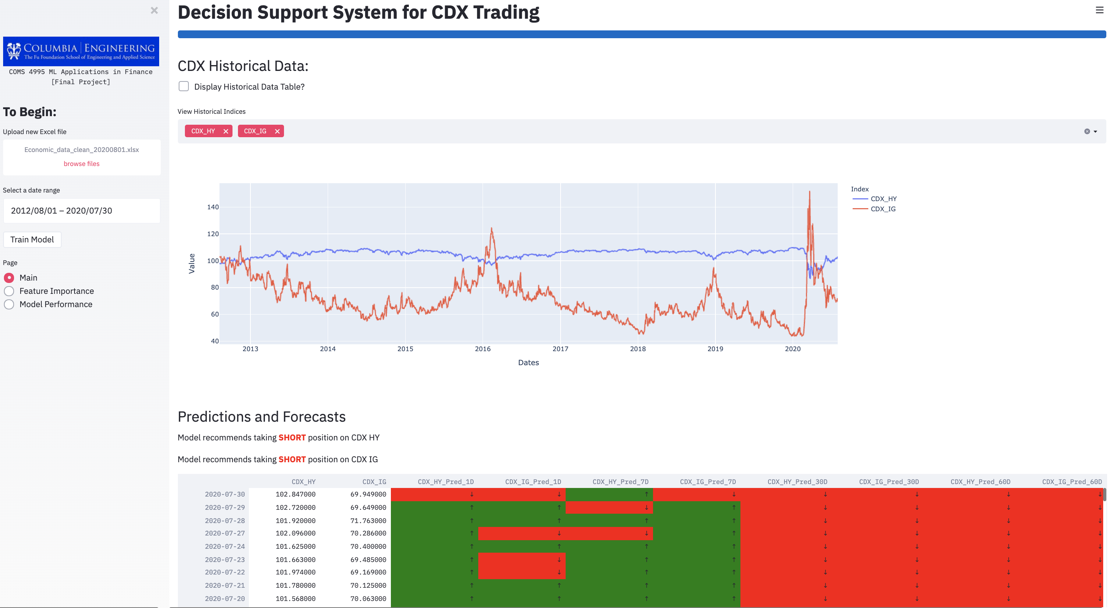
Trading Price Forecasting for the CDX Market Adrian Adduci, Clement Chin, Adam Kravitz, Yuhao Zhang
Introduction: Problem
For investment professionals focused on fixed income instruments within the U.S. corporate credit market, there is a dearth of machine learning applied strategies currently available for investment professionals.
Many current forecasting models are provided by research analysts utilzing sproadic macroeconomic indicators to predict valuations for fixed income instruments. This is partially a result of lagging technological infrastructure in the credit markets, lower relative trading volumes when compared to more liquid asset classes such as equities, and slower release of primary and secondary market trading information.
As such, we will look to emply ML techniques to forecast trading probabilities for 2 credit instruments.
Results & Evaluation
For evaluation, multiple predictions were created, predicting 1 days, 7 days, 30 days, and 60 days ahead.
The results for the 1-day prediction results in an accuracy anywhere from 51% to 52%, as well as also getting an AUC score of 0.6. The ROC curve that is created also matches what a good predictive classifier's ROC curves graph should look like.
The results for the 7-day prediction results in an accuracy anywhere from 55% to 57%, getting an AUC score of 0.55.
The results for the 30-day prediction results in an accuracy anywhere from 67% to 70%, getting an AUC score of 0.74.
The results for the 60-day prediction results in an accuracy anywhere from 62% to 65%, getting an AUC score of 0.76.
Using this model , we can use our predictions to recommend longing or shorting. Ideally, it would be best to predict on a day to day basis. However, since the accuracy is low compared to later predictions, we can predict safety to long and short based on different the predictions across different length projections. From this change we can get and calculate our ROI by running our predictions and predicting if we recommend too short or long. The specific returns gained will then tell us how well our algorithm did.
Data Understanding
Our target securities are two different inidices which comprise a basket of Credit Default Swaps, the CDX.IG and the CDX.HY. Each securitiy is defined by an underlying correlation to the most liquid CDS traded for companies with credit ratings which are investment grade (CDX.IG) or high yield (CDX.HY)
We will incorporate a number of fundamental, technical, relative value and socio- and macroeconomic features to help our forecast, including the underlying rate enviroment, comparable credit indicies, analyst forecasts, and commodity prices.
We used real trading data supplied by Bloomberg Terminal for analysis
Conclusion
We find that our predictions are decently accurate, which means there is potential of applying this algorithm to trade CDX.
Some of the reasons we thought why this could be the case is the CDX market is quite niche with lower volume traded, that retail investors tend to shy away from, this offers a unique opportunity to develop ML models in a less competitive environment, hence a greater return.
For now, the model we built is just predicting if it expects an increase or decrease in value, which suggest a long or short position, providing greater confidence and safer investment. As an extension in future, we could enhance the model to predict a real value, i.e. “regression” instead of “classification”, this will further increase the value and potential of this system in supporting CDX trading decisions.
Deployment
Figure 1: Prototype System developed
The prediction ML model which is developed, will be deployed into a decision support system which allows the Trading Analyst to receive trade recommendations, and look at the predictive results to assist in his decision making.
To simulate how the system will function, we have developed a web application prototype (as seen in the image above), loading in data extracted from Bloomberg system.
For the actual production environment, we can deploy the system as a cloud application running on AWS with API function call to Bloomberg API for daily data loading. This will allow for continuous update to the model, making it a ‘live’ system.
Data Preparation
We preprocess our data, by eliminating rows containing no information (NA). We convert dates to be a pandas datetime type. From this point any NA information we still is removed by filling in the NA values using a forward fill method. Lastly, the data is sorted and Dates is set to be the new index.
From cleaned data, new indicators are made using the existing data that was sourced. Calculating simple moving averages, and momentum, of different columns that were thought to be strong indicators.
Modeling
We collect and separate our target variables from the rest of the data, and create train and test sets.We train on data from September of 2012 to August of 2018, and we test on data from August of 2018 to July of 2020.
Feature importance graph are generated using an Adaboost classifier to fit to the training data. Two feature importance graphs are made for the two target variables, investment grade (CDX.IG) or high yield (CDX.HY). The two feature importance graphs are then added together, and the top 20 features are kept for the next model. The filter to only keeping the top 20 features are used for the purpose to speed up predictions.
Random Forest with parameters of n_estimators equal to 100 and a criterion equal to ‘gini’ was tested, since the Random Forest algorithm is less likely to be influenced by outliers, and can also handle non-linear relationships.
Adaboost was picked as the final ML algorithm to reduce both bias and variance in the data, where Random Forest only reduced variance. We used the parameters of n_estimators equal to 30 and learning rate equal to 0.5, parameters which were acquired using cross validation. The prediction created by these models are binary outputs predicting if we predict and increase in price or a decrease. A simpler binary prediction was chosen over regression to try to increase prediction accuracy.

