Slide 1
Predicting the stock market
Dillon Farber
Christian Davis
Quinn Templeton

Slide 2
Table of contents
Overview
Data
Exploratory Data Analysis
Data Processing
Models
Outcome/Conclusion

Slide 3
Dataset Information
Data
The data was taken from the Kaggle datasets catalog.
The dataset was comprised of multiple years of past stock information. 2014-2018.
The intent of the dataset is to determine if the user should buy or sell the current stock they may be looking at.
The dataset has over 20k rows with 225 columns

Slide 4
Summary of experiment/question
Data
The objective of this notebook is to take the stock information about a single stock and its information to find out whether the stock should be sold or bought. We take the information and use binary classification techniques to determine what the stock might be classified as to better determine the decision of someone to buy or sell that stock in its current state. We are using collected stock information from the years 2014-2018 years to train and test our models. The data has 20 thousand rows and 225 columns, giving us around 4 billion float and integer datapoints of data for us to use in creating models and feature selection.

Slide 5
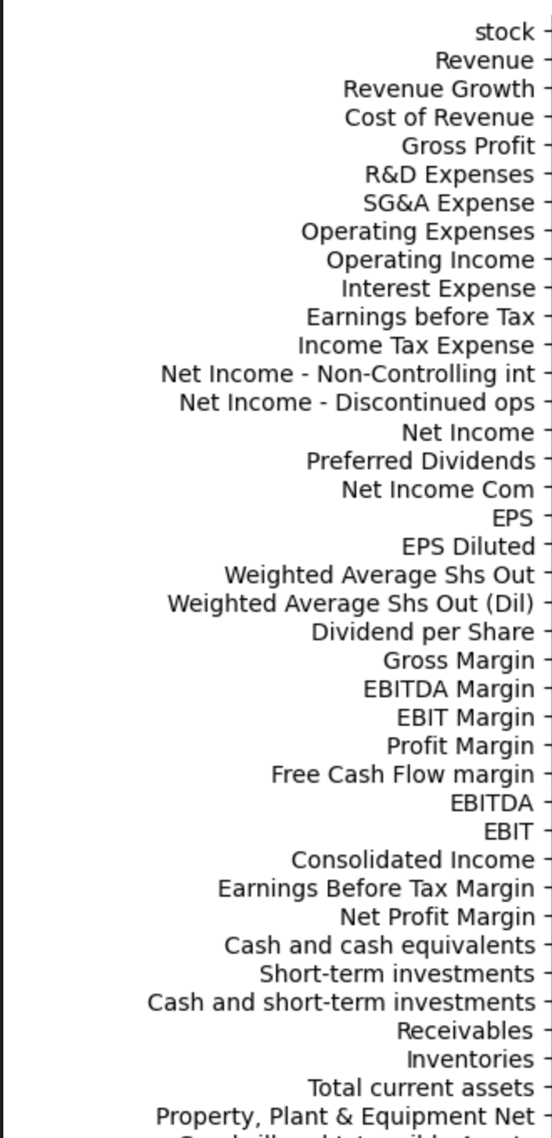
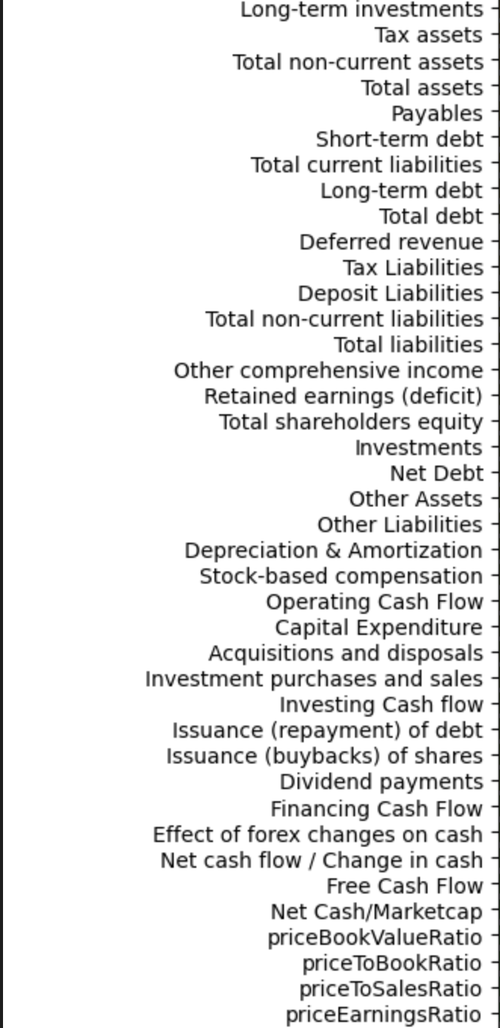
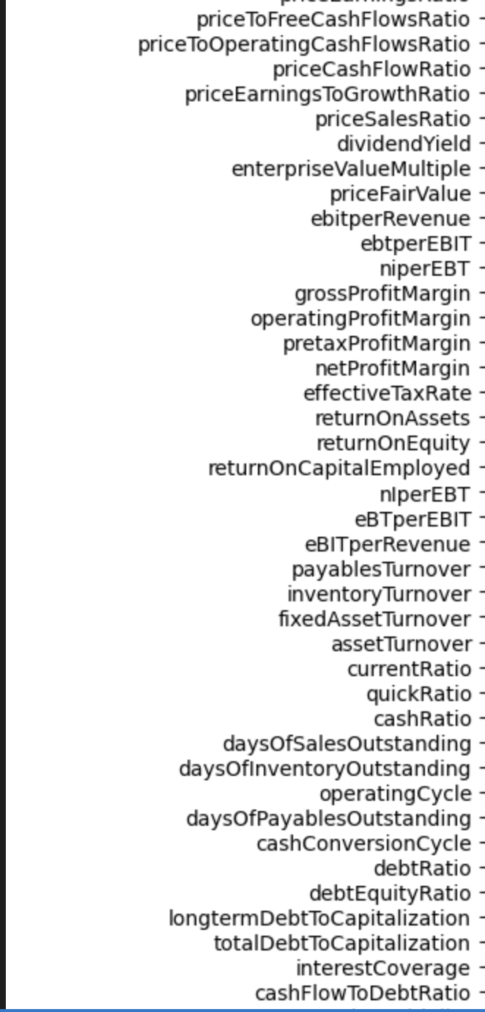
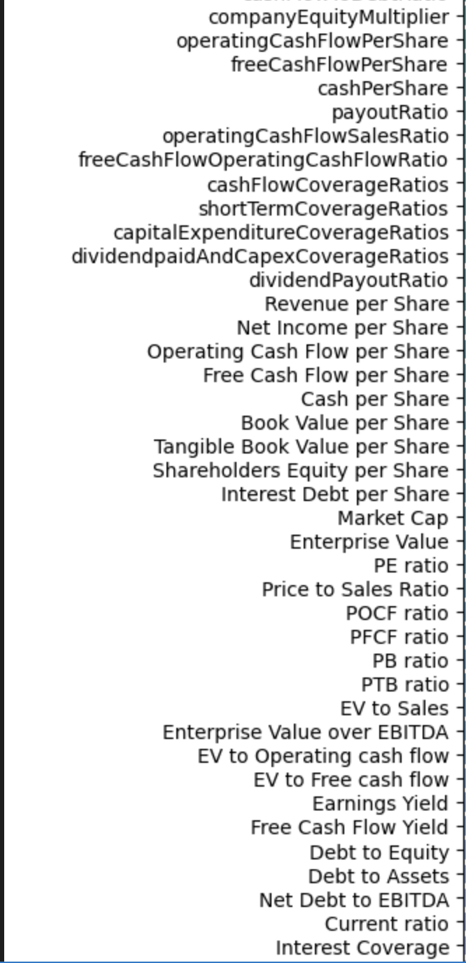
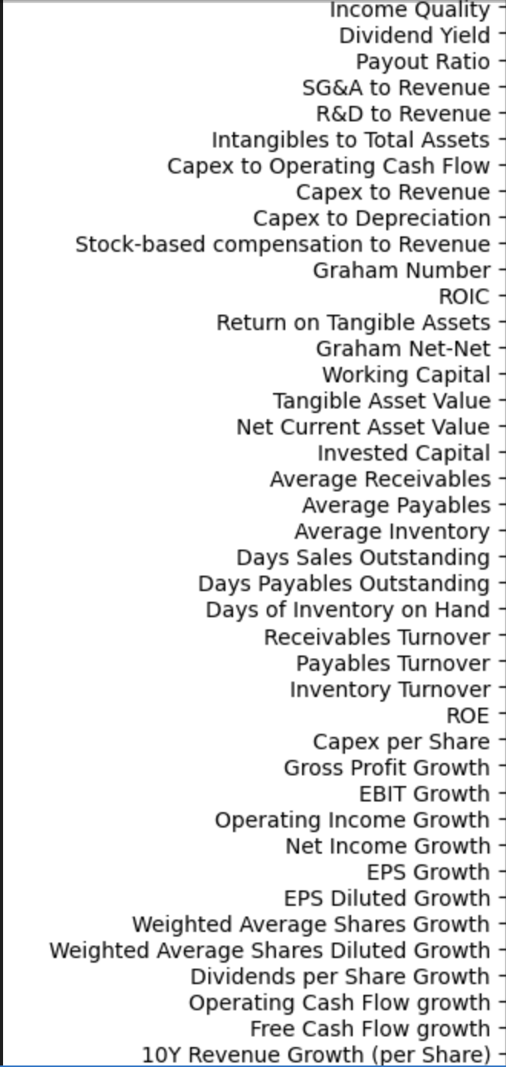
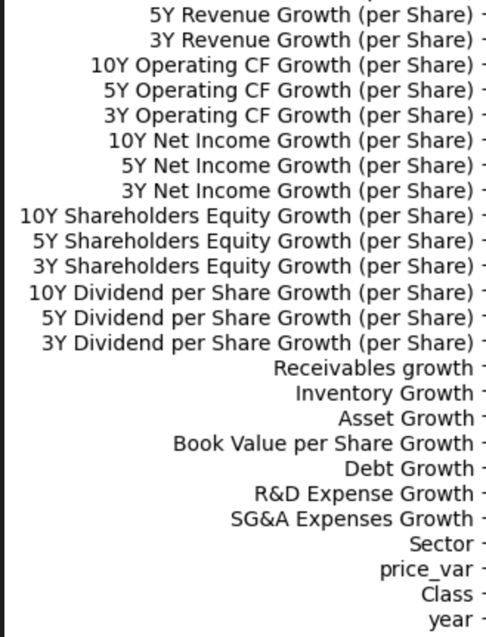
Columns
Text

Slide 6
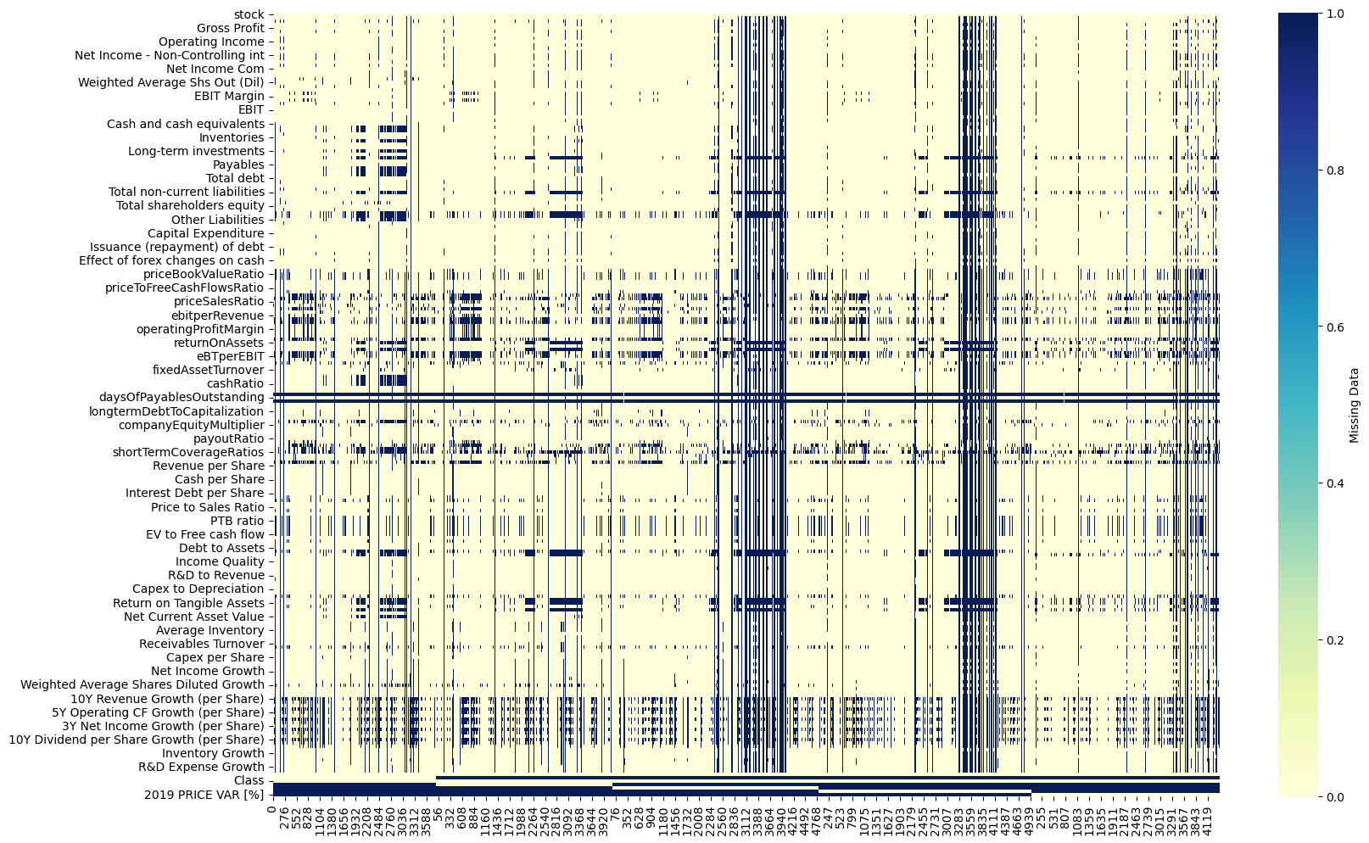
Zero Heat Map
Exploratory Data Analysis
We displayed visually to see what our data looked like and how it might affect the data by placing a zero in the columns.
We did this because of the large number of missing values in the dataset.

Slide 7
Transforming The data
Exploratory Data Analysis
Changed column names from text to integer values based on unique id.
Filled missing data with 0’s to keep the majority of data, doing so left us with more information to use, doing a drop column left us with barely any data.
Correlation map between columns and the column for our prediction class and looking for to highly correlated columns leading to duplicate columns.
Bar chart for visual representation of the stability of our prediction column.

Slide 8
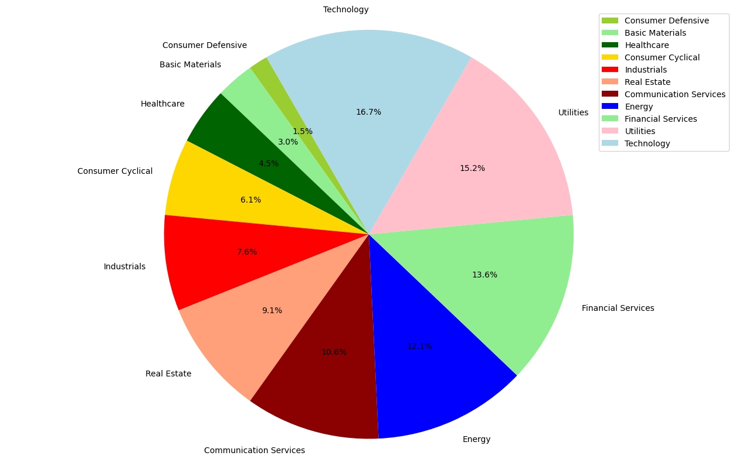
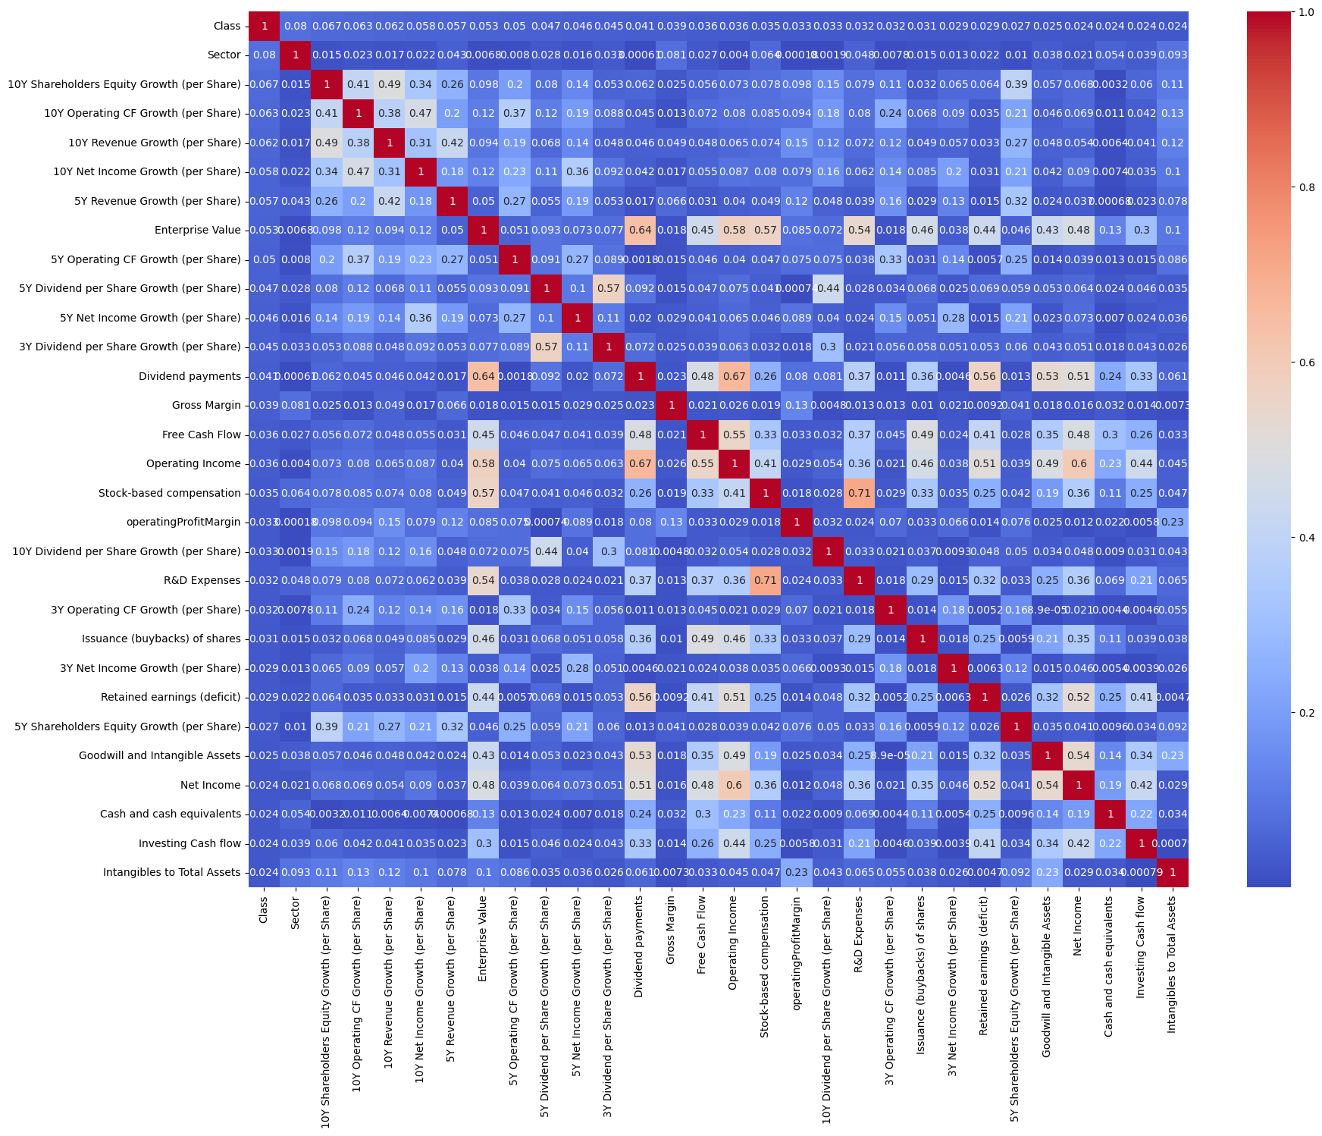
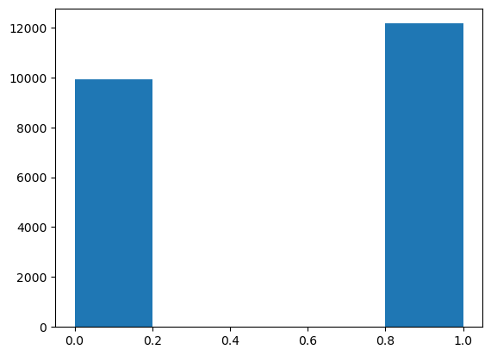
Correlation Map/Pie Chart
Exploratory Data Analysis

Slide 9
Scaling Technique
Data Processing
Used Both Standard scaler and and the MaxAbsScaler().
The Data had huge min and max differences, with minimum being in the negatives, and the max values in the 10’s of billions. With a mix in between the two.
The Standard Scalar gave us better results, so we used this technique throughout the rest of the experiment.

Slide 10
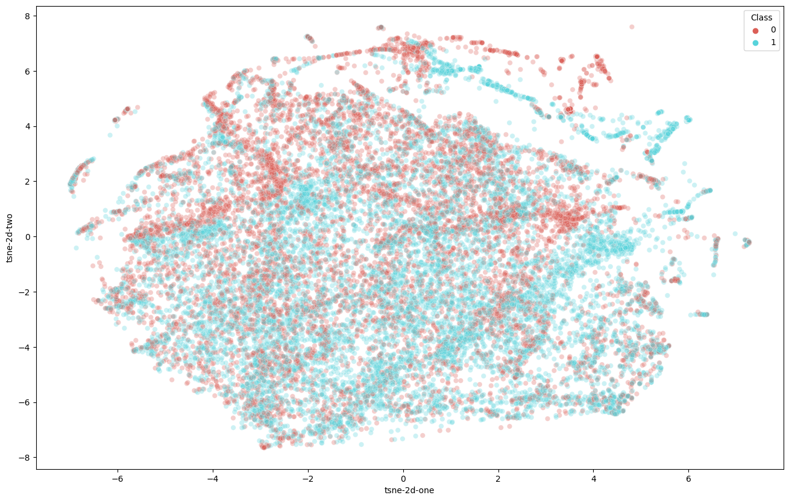
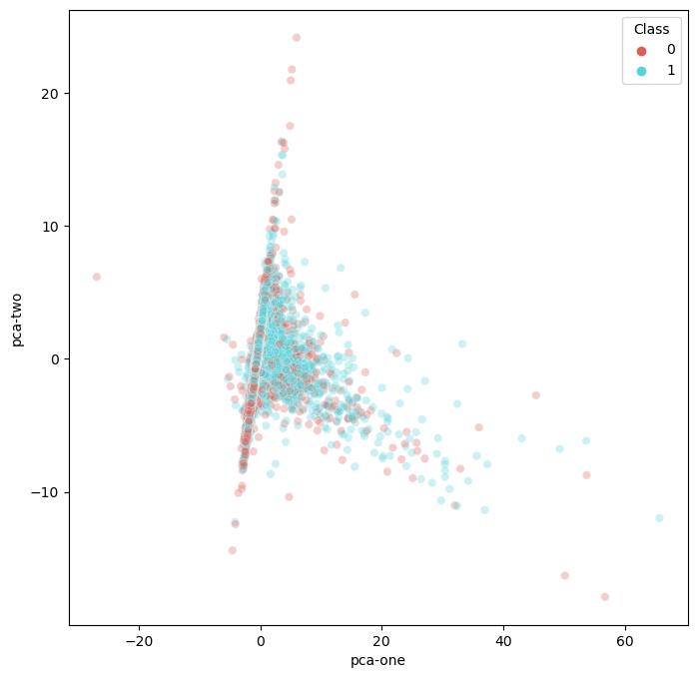
TSNE-PCA
Data Processing
We chose to use a dimensionality reduction tool and used both the TSNE and PCA to try and give our results the best chance.
TSNE- used for high dimensionality in data, we received the best results from the set of data points. This reduction used gaussian when trying to reduce the distance between two points.
PCA- used for high dimensionality, not has good as TSNE and used for linear dimensionality.

Slide 11
Feature Selection
Data Processing
Several methods were used for feature selection.
Highest correlated columns
Took the 15 highest correlated features and used them as our data points.
Select K Best
Takes the best K value and then determines which column has the best score and then picks between them and returns those columns back as our x.
Select Percentile
This takes in a function for scoring each column, Mutual info classifier, then it selects the top percentile that you chose.

Slide 12
Gradient Boosting
Models
Takes a data set and puts it through training on a tree.
Then it takes the predictions and uses the residual errors and then trains the dataset.
The model keeps doing this till it each tree is trained.
The model is then ready for prediction testing.

Slide 13
K Nearest Neighbor
Models
Supervised learning technique.
The model is trained by taking the n-nearest neighbors and predicts what the outcome might be.
The model groups data and then uses these groups to determine the nearest neighbors to the dataset to be predicted.
The algorithm returns the classification of the group of n-nearest neighbors.

Slide 14
Logistic Regression
Models
Takes multiple labels in and the predictor is a binary operation
The model makes a threshold based on one or multiple labels give as x.
Once the threshold is in place, it takes that and predicts the outcome.
If below its 0 and if above it is 1.

Slide 15
SVM
Models
Using the SVM in sklearn with the SVC(Support Vector Clustering) model.
It makes a line that then gives a support vectors to the nearest x to the decision line.
If above and below the line and outside the margin of error we classify as one or the other, but in side the the margins or support vectors the model uses the decision line to make the determination.

Slide 16
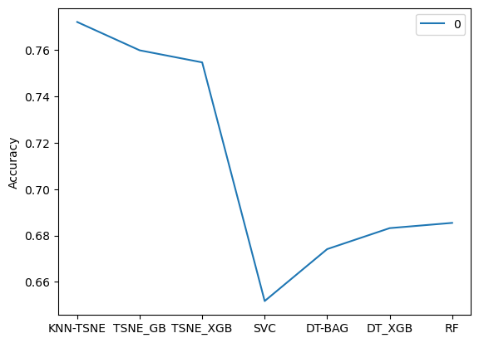
Conclusion/Results
Outcome/Conclusion
The outcome, we see that KNN was our best model, closely followed by Gradient boosting. The SVC model was our worst model for our data . We were able to get a 78% accuracy rate on our data with KNN with the TSNE technique. This is a pretty good score for predicting the buy or sell of a stock.

