Slide 1

Innolux Paper Explaination
with ChatGPT
NYCU MLLAB
app
Nycu MLlab
Version: 3.8

Slide 2
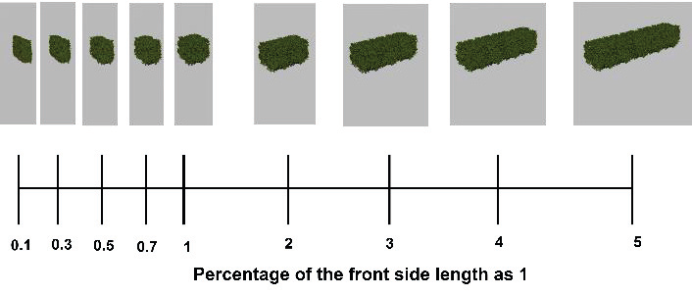
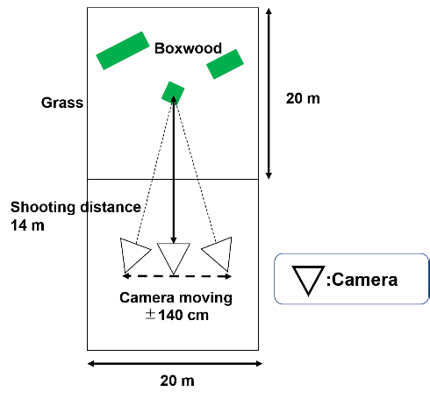
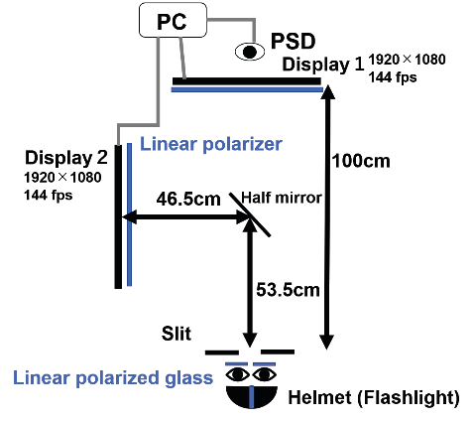
Effects of Motion Parallax Smoothness and Head Moving Range on Reduction of The Cardboard Effect
Kosuke Takahashi,Haruki Mizushina,Shiro Suyama,Kenji Yamamoto Dept. of Optical Science and Technology, Tokushima University, Japan,Center for Optical Research and Education, Utsunomiya University, Japan
Keywords : 3D,cardboard effect,motion parallax,binocular disparity,multiple cameras,Kosuke Takahashi,Dept. of Optical Science and Technology, Tokushima University, Japan Organization: Dept. of Optical Science and Technology, Tokushima University, Japan,Center for Optical Research and Education, Utsunomiya University, Japan
Keypoints : - Motion parallax smoothness and head moving range impact reduction of the cardboard effect - Adding motion parallax can alleviate the cardboard effect in stereoscopic displays - Experiment evaluated impact of motion parallax smoothness and head moving range using hedges as stimuli - Results showed smoother motion parallax and wider head moving range reduce the cardboard effect - Significant effects observed among different conditions for reducing the cardboard effect
Nycu MLlab

Slide 3
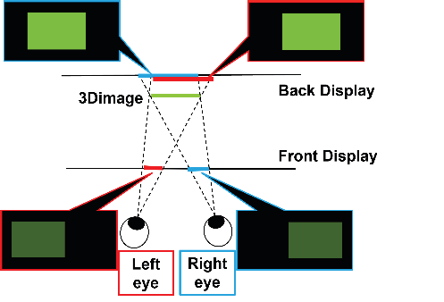
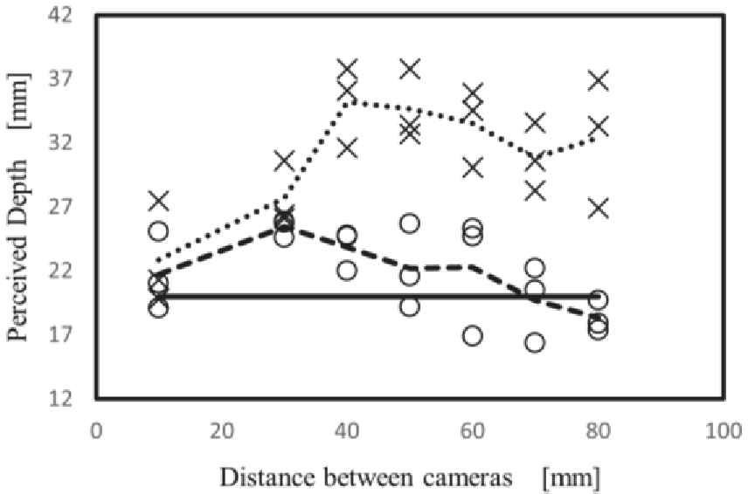
Multi-view DFD (Depth-fused 3D) Rendering with Linear Blending
Yuto Morishita,Munekazu Date,Haruki Mizushina,Shiro Suyama,Kenji Yamamoto Dept. of Optical Science and Technology, Tokushima University, 2-1 Minamijousanjima, Tokushima 770-8506, Japan,Faculty of Science and Engineering, Tokushima Bunri University, 1314-1 Shido, Sanuki-shi, Kagawa 769-2193, Japan
Keywords : micro-LED,stretchable displays,stretchable technology,Yuto Morishita,Dept. of Optical Science and Technology, Tokushima University, 2-1 Minamijousanjima, Tokushima 770-8506, Japan Organization: Dept. of Optical Science and Technology, Tokushima University, 2-1 Minamijousanjima, Tokushima 770-8506, Japan,Faculty of Science and Engineering, Tokushima Bunri University, 1314-1 Shido, Sanuki-shi, Kagawa 769-2193, Japan
Keypoints : - Development of 12-inch 100 PPI active-matrix micro-LED stretchable displays - Achievement of up to 20% stretchability in the displays - Integration of key technologies such as stretchable interconnect - stretchable film - and micro-LED
Nycu MLlab

Slide 4
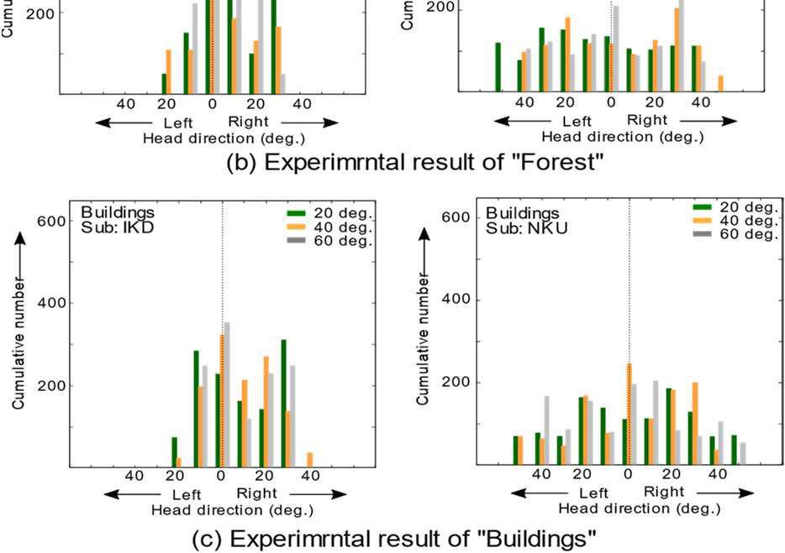
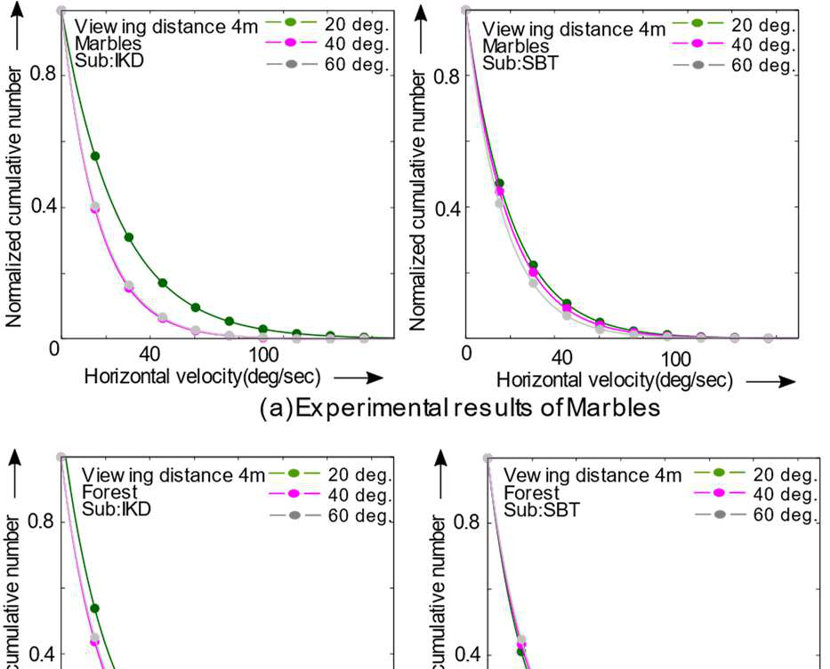
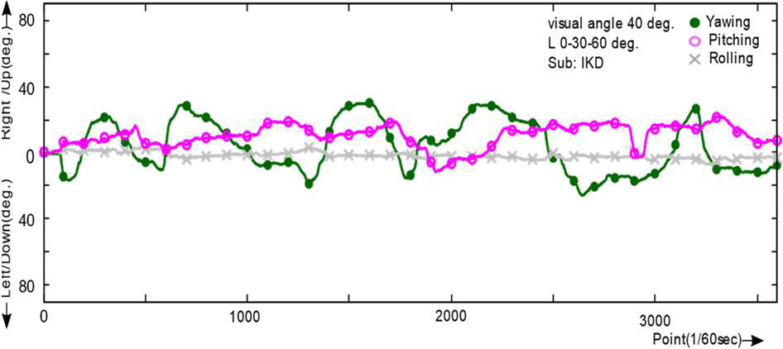
Relationship between Field of View Size and Head Motion in Eyepiece Displays
Sumio YANO,Shuichi OJIMA 1. Shimane University, Japan,2. RITECS Inc, Japan,3. Sojo University, Japan
Keywords : Eyepiece display,Field of view,Head motion,Yawing,Saliency map,Sumio YANO,1. Shimane University, Japan Organization: 1. Shimane University, Japan,2. RITECS Inc, Japan,3. Sojo University, Japan
Keypoints : - Head movements are narrower in a wide field of view - Head movement speed may depend on the frequency component of the image - Results analyzed mainly in terms of yawing - Saliency maps were calculated for still images - Head motion range and velocity become narrower with larger field of view
the keypoint is the average of the three plots
the keypoint is the number of times the same number of times the same number of times the same number of times the same number of times the same number of times the same number of times the same number of times the same number of times the same number of times the same number of times the same number of times the same number of times the same number of times the same number of times the same number of times the same number
the arctic sea ice extent is decreasing
Nycu MLlab

Slide 5
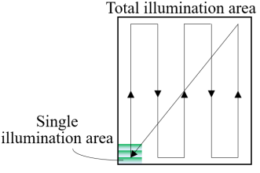
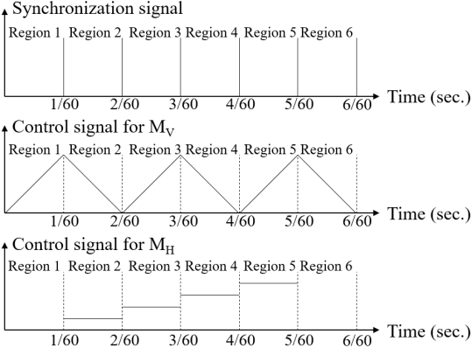
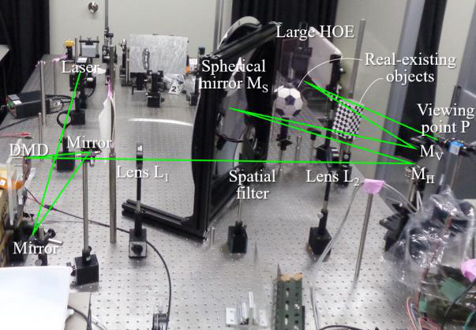
Very Wide FOV in Holographic AR Display Using a Large HOE Fabricated by Area Segmentation and Multiple Exposures
Yusuke Sando,Daisuke Barada,Toyohiko Yatagai Osaka Research Institute of Industrial Science and Technology, Japan,Center for Optical Research & Education, Utsunomiya University, Japan,Graduate School of Engineering, Utsunomiya University, Japan
Keywords : holographic 3D display,holographic optical element,very wide FOV,time division method,digital micromirror device (DMD),Yusuke Sando,Osaka Research Institute of Industrial Science and Technology, Japan Organization: Osaka Research Institute of Industrial Science and Technology, Japan,Center for Optical Research & Education, Utsunomiya University, Japan,Graduate School of Engineering, Utsunomiya University, Japan
Keypoints : - Development of a large holographic optical element (HOE) using area segmentation and multiple exposures - Successful demonstration of an augmented reality (AR) 3D display with a very wide FOV of 34° and 25° - Introduction of the time division method to overcome pixel limitations in holographic displays - Exploration of the trade-off relationship between viewing zone and FOV in holographic displays - Utilization of a digital micromirror device (DMD) in the optical system for the time division method
Nycu MLlab

Slide 6
Digitally Printed Holograms for Efficient Generation of Structured Light
Boaz Jessie Jackin,Kenji Kinashi,Naoto Tsutsumi,Wataru Sakai Materials Innovation Laboratory, Kyoto Institute of Technology, Kyoto, Japan,Faculty of Material Science and Engineering, Kyoto Institute of Technology, Kyoto, Japan
Keywords : Computer Generated Holography,Structured Light,Digital Hologram Printing,Optical Communication,Diffraction Efficiency,Boaz Jessie Jackin,Materials Innovation Laboratory, Kyoto Institute of Technology, Kyoto, Japan Organization: Materials Innovation Laboratory, Kyoto Institute of Technology, Kyoto, Japan,Faculty of Material Science and Engineering, Kyoto Institute of Technology, Kyoto, Japan
Keypoints : - Combination of analog hologram recording material and digital hologram printing technique - Efficient generation of structured light beams for optical communication and information processing applications - Hologram fabrication process involves sample preparation - computation - printing - and reconstruction - Optical setup for digital hologram printing includes laser source - Spatial Light Modulator (SLM) - imaging optics - and polymer film - Successful transfer of computed hologram patterns onto polymer film with high accuracy
Nycu MLlab

Slide 7
Holographic Image Reconstruction Using a Magneto-optical Spatial Light Modulator with its Pixel Pitch of 1µm and its Layout of 10k × 5k
Ken-ichi Aoshima,Nobuhiko Funabashi,Ryo Higashida,Mayumi Kawana,Yuta Yamaguchi,Kenji Machida Japan Broadcasting Corp., Science and Technology Research Laboratories, 1-10-11 Kinuta Setagaya Tokyo 157-8510, Japan
Keywords : holographic images,magneto-optical spatial light modulator,pixel pitch,current-induced domain wall motion,viewing zone angle,Ken-ichi Aoshima,Japan Broadcasting Corp., Science and Technology Research Laboratories, 1-10-11 Kinuta Setagaya Tokyo 157-8510, Japan Organization: Japan Broadcasting Corp., Science and Technology Research Laboratories, 1-10-11 Kinuta Setagaya Tokyo 157-8510, Japan
Keypoints : - Successful reconstruction of holographic images using a magneto-optical spatial light modulator (MO-SLM) with a pixel pitch of 1 micron - MO-SLM's magnetization controlled by current-induced domain wall motion - Large viewing zone angle of 30 degrees achieved - MO-SLM device structure includes two hard magnets (HMs) and a magnetic nanowire for light modulation - Optical setup enables reconstruction of holographic images with a large viewing zone angle
Nycu MLlab

Slide 8
Lateral Electric Field Driving of High-resolution Liquid Crystal Devices for Electronic Holography with Wide Viewing-Zone Angle
Hiroto Tochigi,Masakazu Nakatani,Ken-ichi Aoshima,Mayumi Kawana,Yuta Yamaguchi,Kenji Machida,Nubuhiko Funabashi,Hideo Fujikake Tohoku University, Japan,Japan Broadcasting Corporation, Science and Technology Research Laboratories, Japan
Keywords : Electronic Holographic Display,Lateral Electric Field Drive,Pixel Pitch,Liquid Crystals,High-resolution,Hiroto Tochigi,Tohoku University, Japan Organization: Tohoku University, Japan,Japan Broadcasting Corporation, Science and Technology Research Laboratories, Japan
Keypoints : - Development of lateral electric field drive system for electronic holographic displays with wide viewing-zone angles - High-resolution light modulation at 1µm pitch using lateral transparent electrodes - Demonstration of independent driving of each pixel - Possibility of 2-dimensional driving by combining driving and grounding electrodes - Simpler fabrication process compared to existing techniques
Nycu MLlab

