Slide 1

Innolux Paper Explaination
with ChatGPT
NYCU MLLAB
test
Nycu MLlab
Version: 3.8

Slide 2
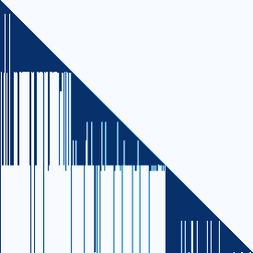
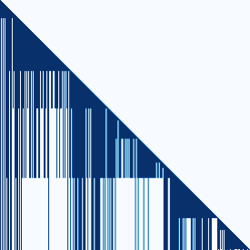
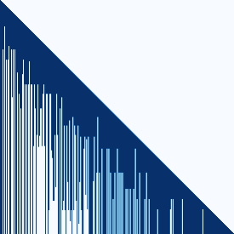
Dynamic Context Pruning for Efficient and Interpretable Autoregressive Transformers
Sotiris Anagnostidis,Dario Pavllo,Luca Biggio,Lorenzo Noci,Aurelien Lucchi,Thomas Hofmann ETH Zürich,ML, CSEM SA,University of Basel
Keywords : micro-LED,stretchable displays,stretchable technology,Sotiris Anagnostidis,ETH Zürich Organization: ETH Zürich,ML, CSEM SA,University of Basel
Keypoints : - Development of 12-inch 100 PPI active-matrix micro-LED stretchable displays - Achievement of up to 20% stretchability in the displays - Development of key technologies such as stretchable interconnect - stretchable film - and micro-LED - Exhibited various types of deformations - suggesting new applications in information display
Nycu MLlab

Slide 3



SOFT CONTRASTIVE LEARNING FOR TIME SERIES
Seunghan Lee,Taeyoung Park,Kibok Lee Department of Statistics and Data Science, Yonsei University
Keywords : SoftCLT,contrastive learning,time series data,state-of-the-art performance,GitHub repository,Seunghan Lee,Department of Statistics and Data Science Organization: Department of Statistics and Data Science, Yonsei University
Keypoints : - SoftCLT introduces soft contrastive learning for time series data - SoftCLT enhances traditional contrastive learning methods with instance-wise and temporal contrastive losses - Experimental results show improved quality of learned representations with SoftCLT - SoftCLT achieves state-of-the-art performance in various downstream tasks - SoftCLT code repository is available on GitHub
Nycu MLlab

