Slide 1

Innolux Paper Explaination
with ChatGPT
NYCU MLLAB
test2
Nycu MLlab
Version: 3.8

Slide 2
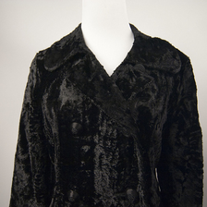
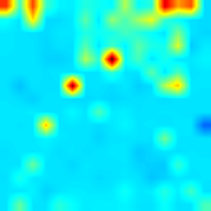
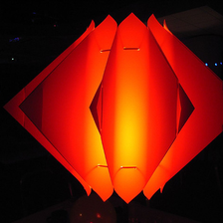
INTERPRETING CLIP’S IMAGE REPRESENTATION VIA TEXT-BASED DECOMPOSITION
Yossi Gandelsman,Alexei A. Efros,Jacob Steinhardt UC Berkeley
Keywords : micro-LED,stretchable displays,stretchable technology,Yossi Gandelsman,UC Berkeley Organization: UC Berkeley
Keypoints : - Development of 12-inch 100 PPI active-matrix micro-LED stretchable displays - Achievement of up to 20% stretchability in the displays - Exploration of potential new applications in information display
Nycu MLlab

