Slide 1
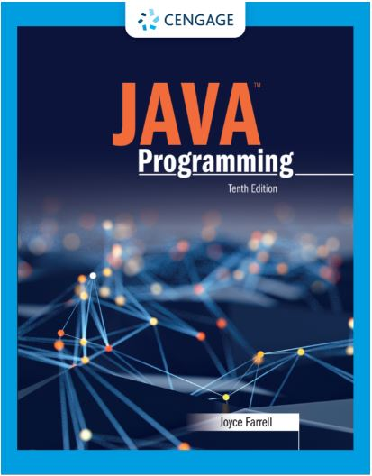
Java Programming, 10e
Chapter 02: Using Data
Joyce Farrell, Java Programming, 10th Edition. © 2023 Cengage. All Rights Reserved. May not be scanned, copied or duplicated, or posted to a publicly accessible website, in whole or in part.

Slide 2
Chapter Objectives
By the end of this chapter, you should be able to:
02.01 Declare and use constants and variables
02.02 Use integer data types
02.03 Use the boolean data type
02.04 Use floating-point data types
02.05 Use the char data type
02.06 Use the Scanner class to accept keyboard input
02.07 Use the JOptionPane class to accept GUI input
02.08 Perform arithmetic using variables and constants
02.09 Describe type conversion
Notes:
Instructions:
Briefly review with students the major concepts you will be covering during this class. There is one objective for every major A-Head section of the chapter.

Slide 3
2.1 Declaring and Using Constants and Variables (1 of 8)
Constant
Cannot be changed while program is running
Literal constant
Value taken literally at each use
Numeric constant
As opposed to a literal constant
Unnamed constant
No identifier is associated with it

Slide 4
2.1 Declaring and Using Constants and Variables (2 of 8)
Variable
A named memory location
Used to store a value
Can hold only one value at a time
Its value can change
Data type
A type of data that can be stored
How much memory an item occupies
What types of operations can be performed on data

Slide 5
2.1 Declaring and Using Constants and Variables (3 of 8)
Primitive type
A simple data type
Examples: byte, short, int, long, float, double, char, boolean
Reference types
More complex data types
Examples: System, Scanner

Slide 6
2.1 Declaring and Using Constants and Variables (4 of 8)
Variable declaration
Statement that reserves a memory location
Includes:
Data type of variable
Identifier (variable’s name)
Optional assignment operator and value
Ending semicolon
Java is a strongly typed language
Camel casing example: lastName

Slide 7
2.1 Declaring and Using Constants and Variables (5 of 8)
Assignment operator
The equal sign (=)
The value to the right is assigned to the variable on the left
Initialization
An assignment made when declaring a variable
Assignment
An assignment made after a variable is declared
Associativity
The order in which operands are used with operators
lvalue (left) and rvalue (right)

Slide 8
2.1 Declaring and Using Constants and Variables (6 of 8)
Uninitialized variable
Declared within a method but no value assigned
Garbage value is unknown value
Named constant
Also known as symbolic constant
Has data type, name value
Preceded by keyword final
Can only be assigned a value once
Identifiers are uppercase and use underscores

Slide 9
2.1 Declaring and Using Constants and Variables (7 of 8)
Scope
The area in which a data item is visible to a program, and in which you can refer to it using its simple identifier
A variable or constant is in scope from the point it is declared
Until the end of the block of code where the declaration lies

Slide 10
2.1 Declaring and Using Constants and Variables (8 of 8)
Concatenated
A numeric variable is concatenated to a String using the plus sign
The entire expression becomes a String
Use a dialog box to display values

Slide 11
2.2 Learning About Integer Data Types (1 of 1)
Integer
Whole number without decimal places
int, byte, short and long
If you attempt to assign a value too large for the data type of variable, the compiler issues an error message
If you choose a data type larger than you need, you waste memory.

