Slide 1
JavaScript operators and Tsikillar (for, while, do)
Tsikillar (for, while, do)

Slide 2
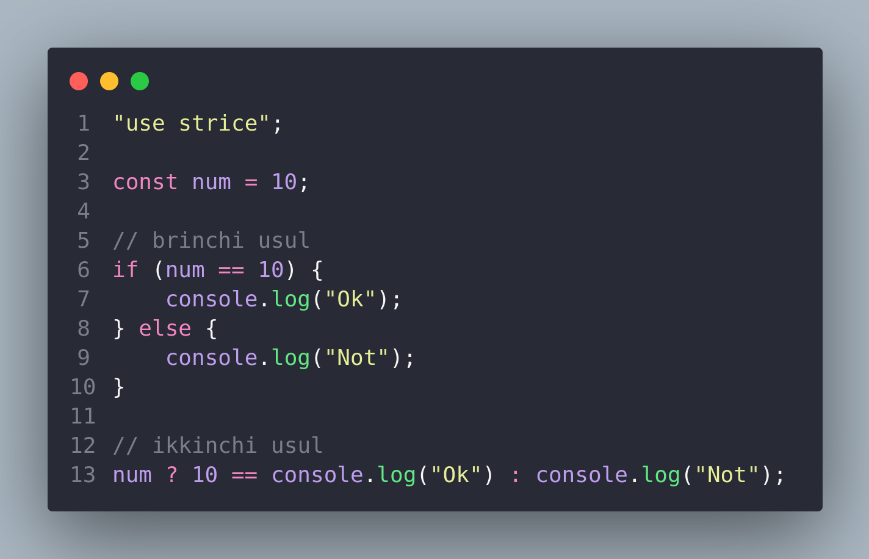

Slide 3
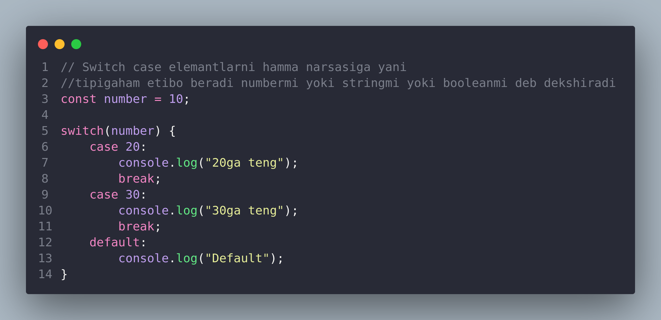

Slide 4
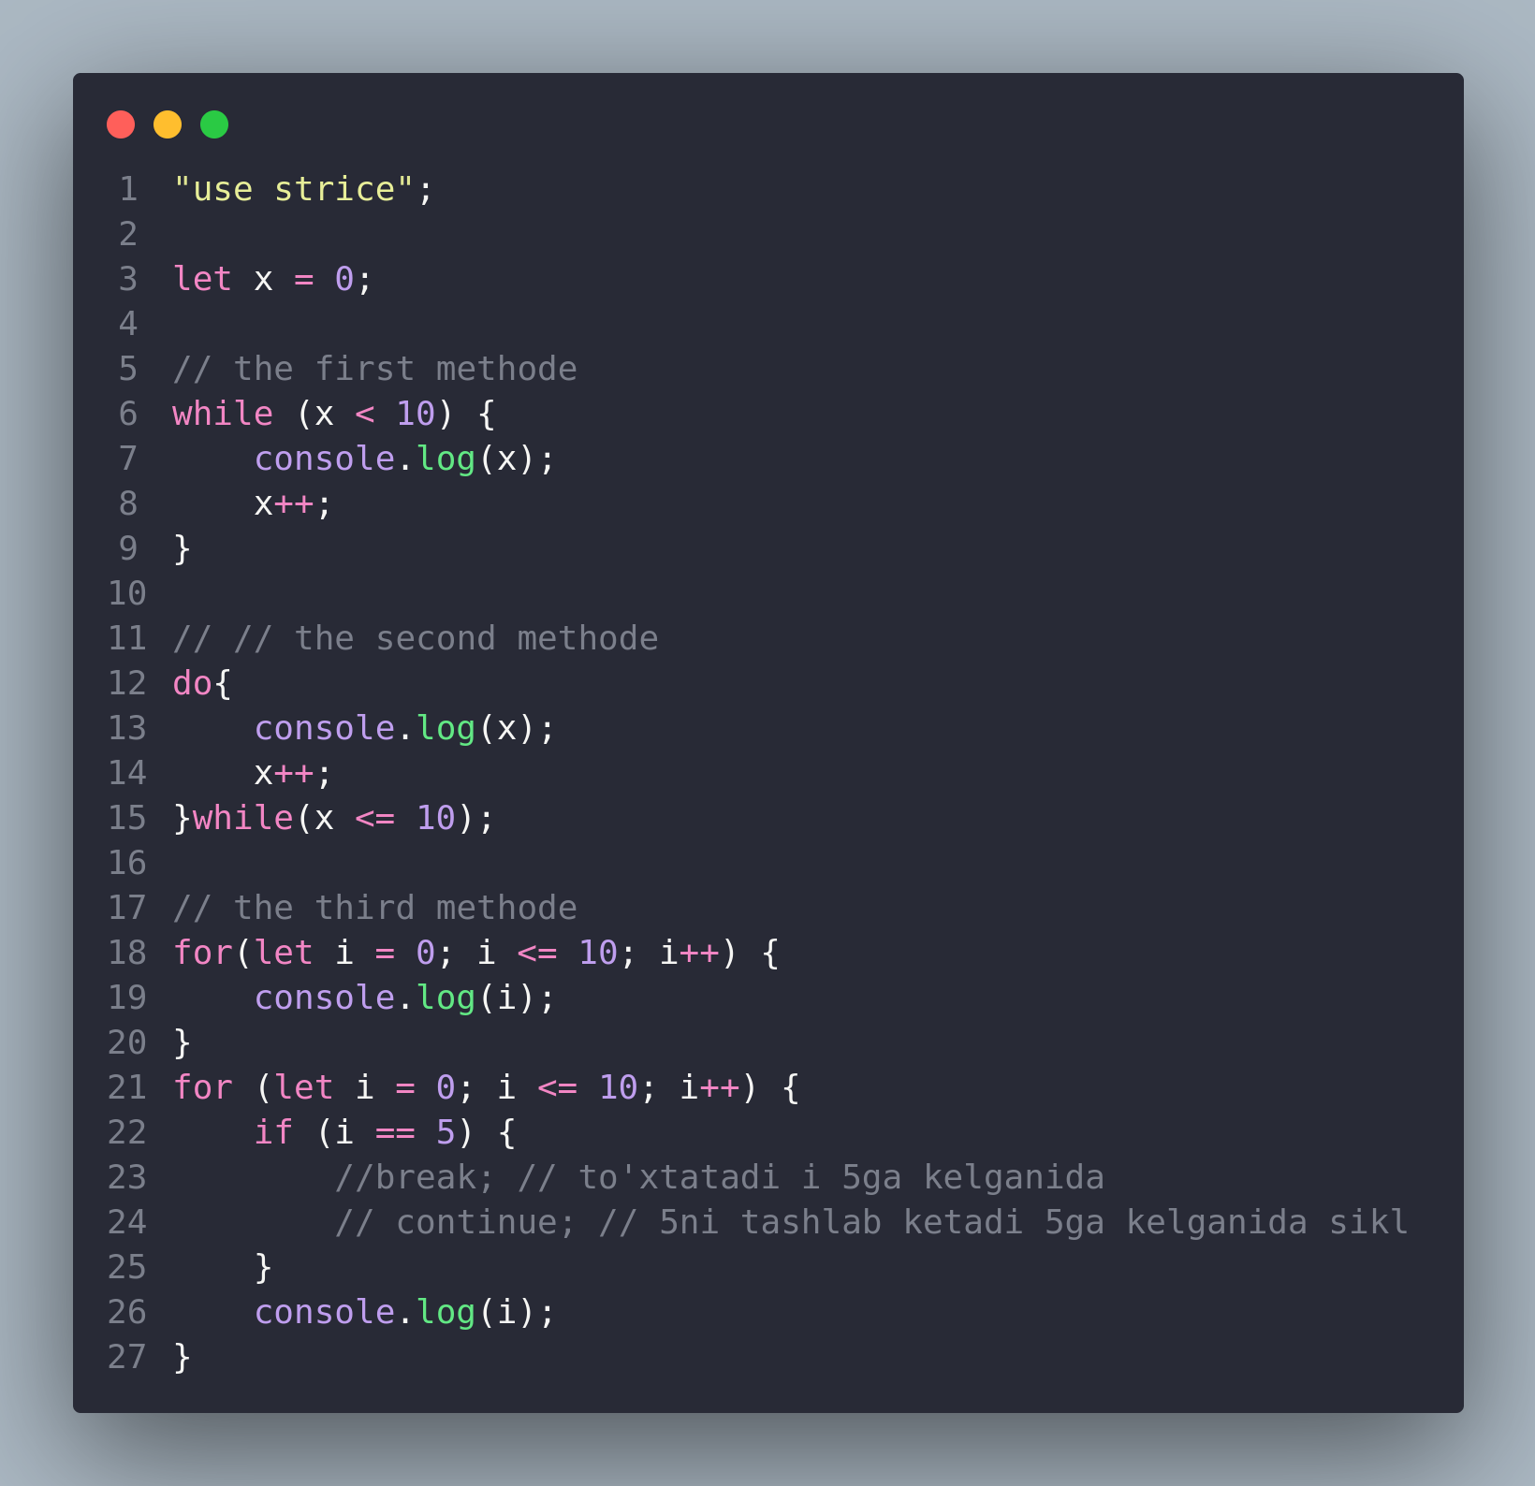
Tsikillar (for, while, do)

