Slide 1
JavaScript operators
Operators

Slide 2
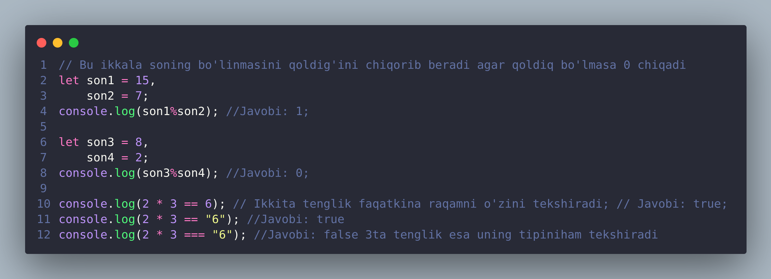
JavaScript operators

