Slide 1
Satrlar va sonlarning usullari va xususiyatlari

Slide 2
Length, toLoweCase, indeOf...
Length –> bu bizga numberlarni va stringlarni sanab beradi uzuligi nechtaligini
ToLowerCase() → bu bizga hamma hariflarni kichkina qilib beradi
ToUpperCase() → bu bizga hamma hariflarni katta qilib beradi
Let text = “Hello world”
console.log(text.indexOf(“world”))
IndexOf() → bu bizga textni nechanchi indexdaligini aniqlab beradi

Slide 3
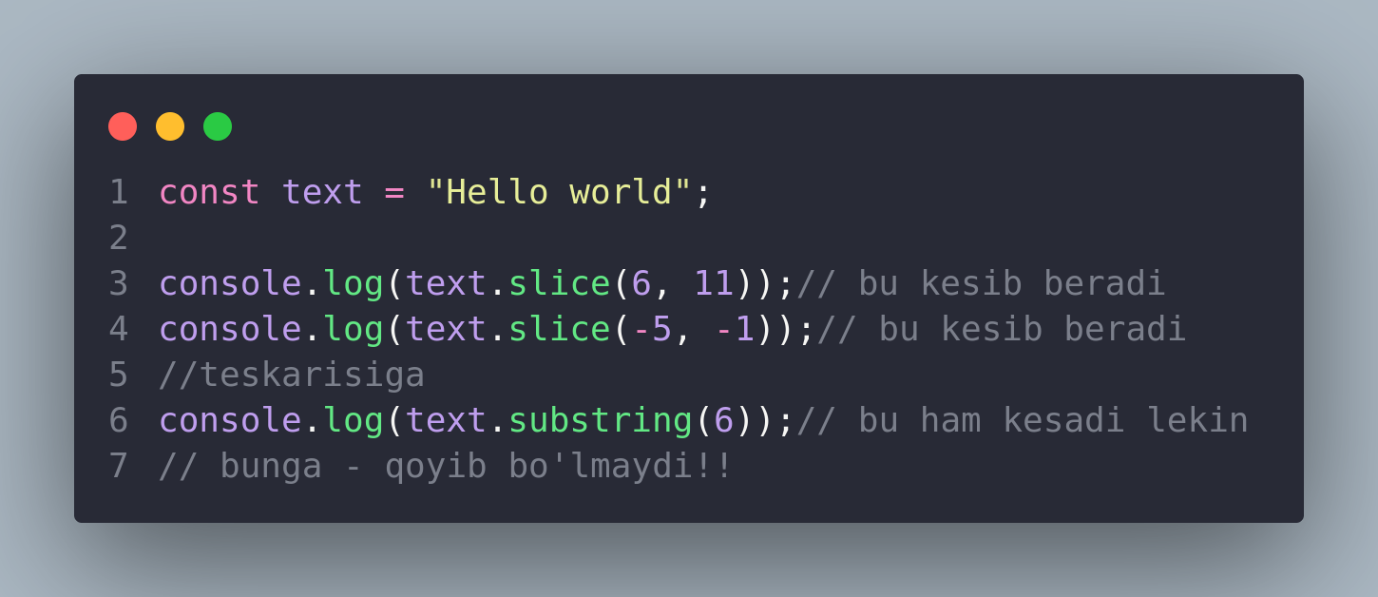
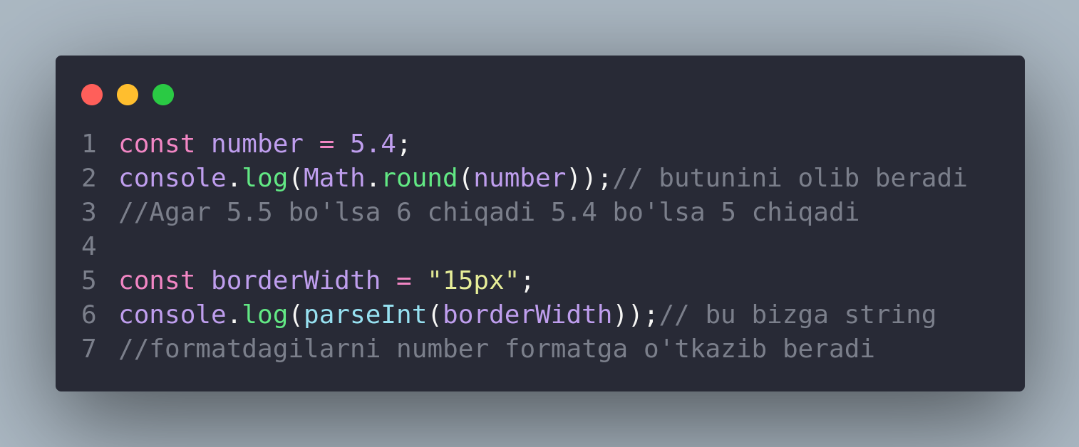

Slide 5
This work is licensed under a Creative Commons Attribution-ShareAlike 3.0 Unported License.
It makes use of the works of
Kelly Loves Whales and Nick Merritt.

